Slide 1
The Bone and The Marrow: Some Suggestions for the Future of Climate Prediction
Francisco Doblas-Reyes
R. Bernardello, R. Bilbao, A. Carreric, J. Cos, C. Delgado, M. Donat, N. Milders, B. Solaraju Murali, V. Torralba, E. Tourigny
28 March 2023

Slide 2
Outline: a collection of thoughts
Understanding the title:
the bone and the marrow as a set of key elements for life
chill to the marrow/to the bone
What we can do:
with what we have
with what climate change colleagues are doing
with what other domains are doing

Slide 3
Some of what else we can do with what we have:
Transparency, standards, guidance, user engagement

Slide 4
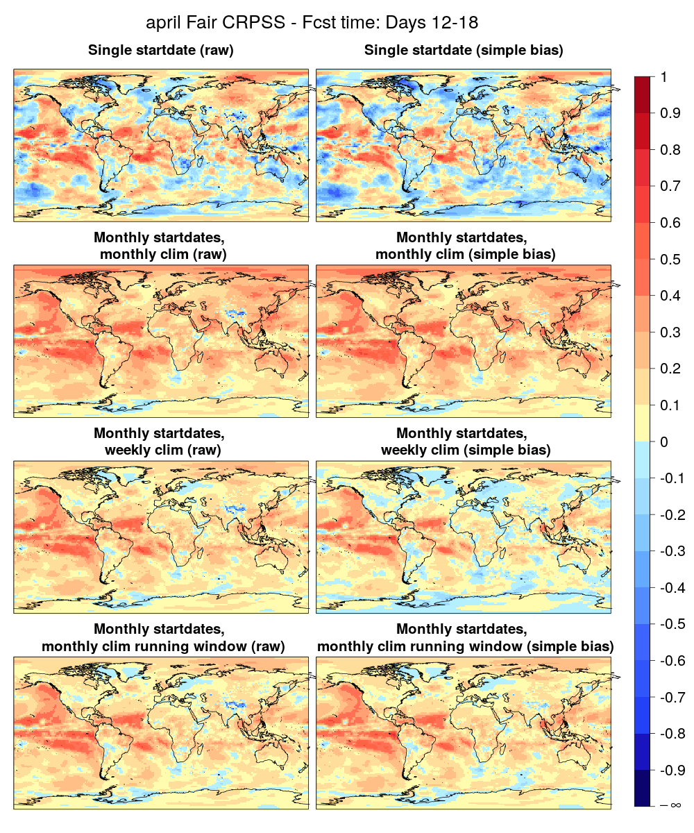
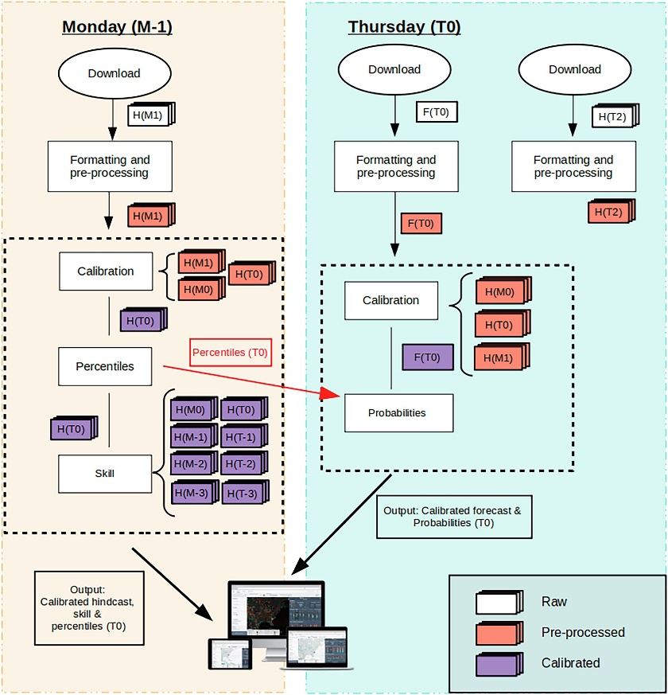
Non-trivial climatology definitions
ECMWF-Ext-Ens 2016
Period: 1996-2015 Month: April
Reference: ERA Int
Variable: 2-m temperature
Weekly: too noisy
Monthly: good skill, but suspiciously high …
Monthly running window, but weekly for the bias adjustment: lower skill , and too noisy for the adjustment
Monthly running window: more credible quality estimates
Manrique-Suñén et al. (2020, MWR; 2023, CliSer)

Slide 5
What for? Non-trivial climatology definitions
ECMWF-Ext-Ens 2016
Period: 1996-2015 Month: April
Reference: ERA Int
Variable: 2-m temperature
Relevant when we have to deal with forecast timeliness, system updates, multi-model choices, etc.
Manrique-Suñén et al. (2020, MWR)

Slide 6
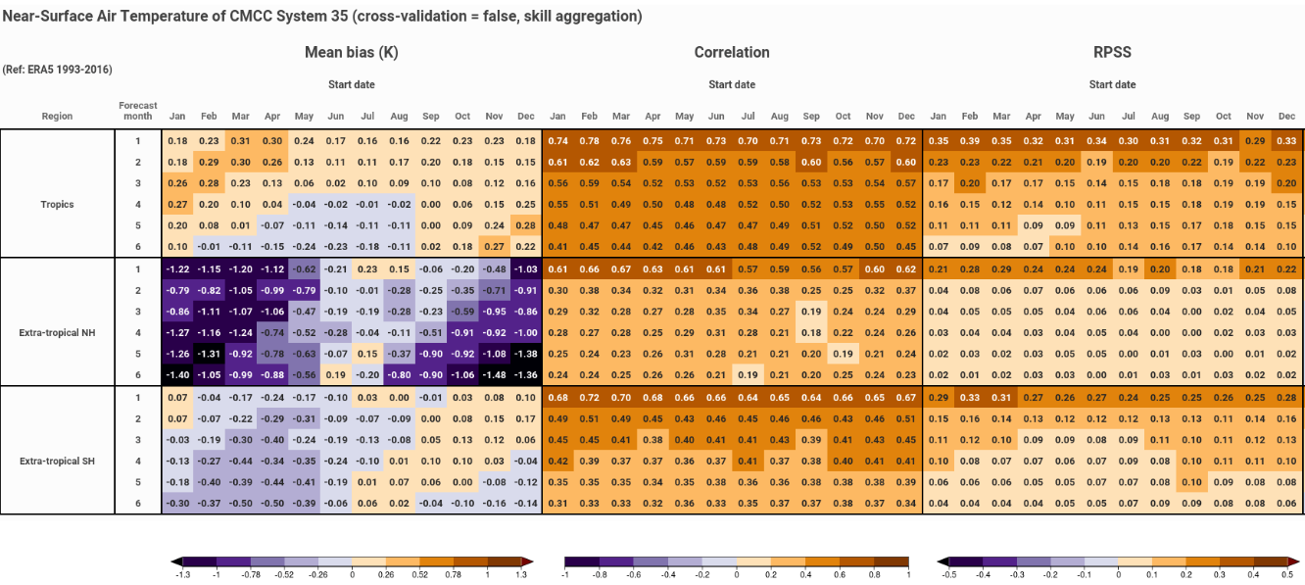
Systematic forecast quality assessment
N. Milders (BSC)

Slide 7
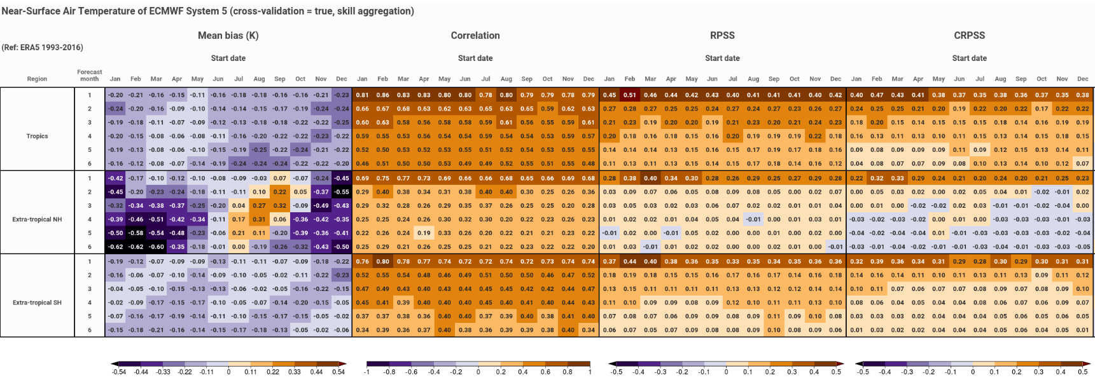
Systematic forecast quality assessment
Impact of cross-validation
N. Milders (BSC)

Slide 8
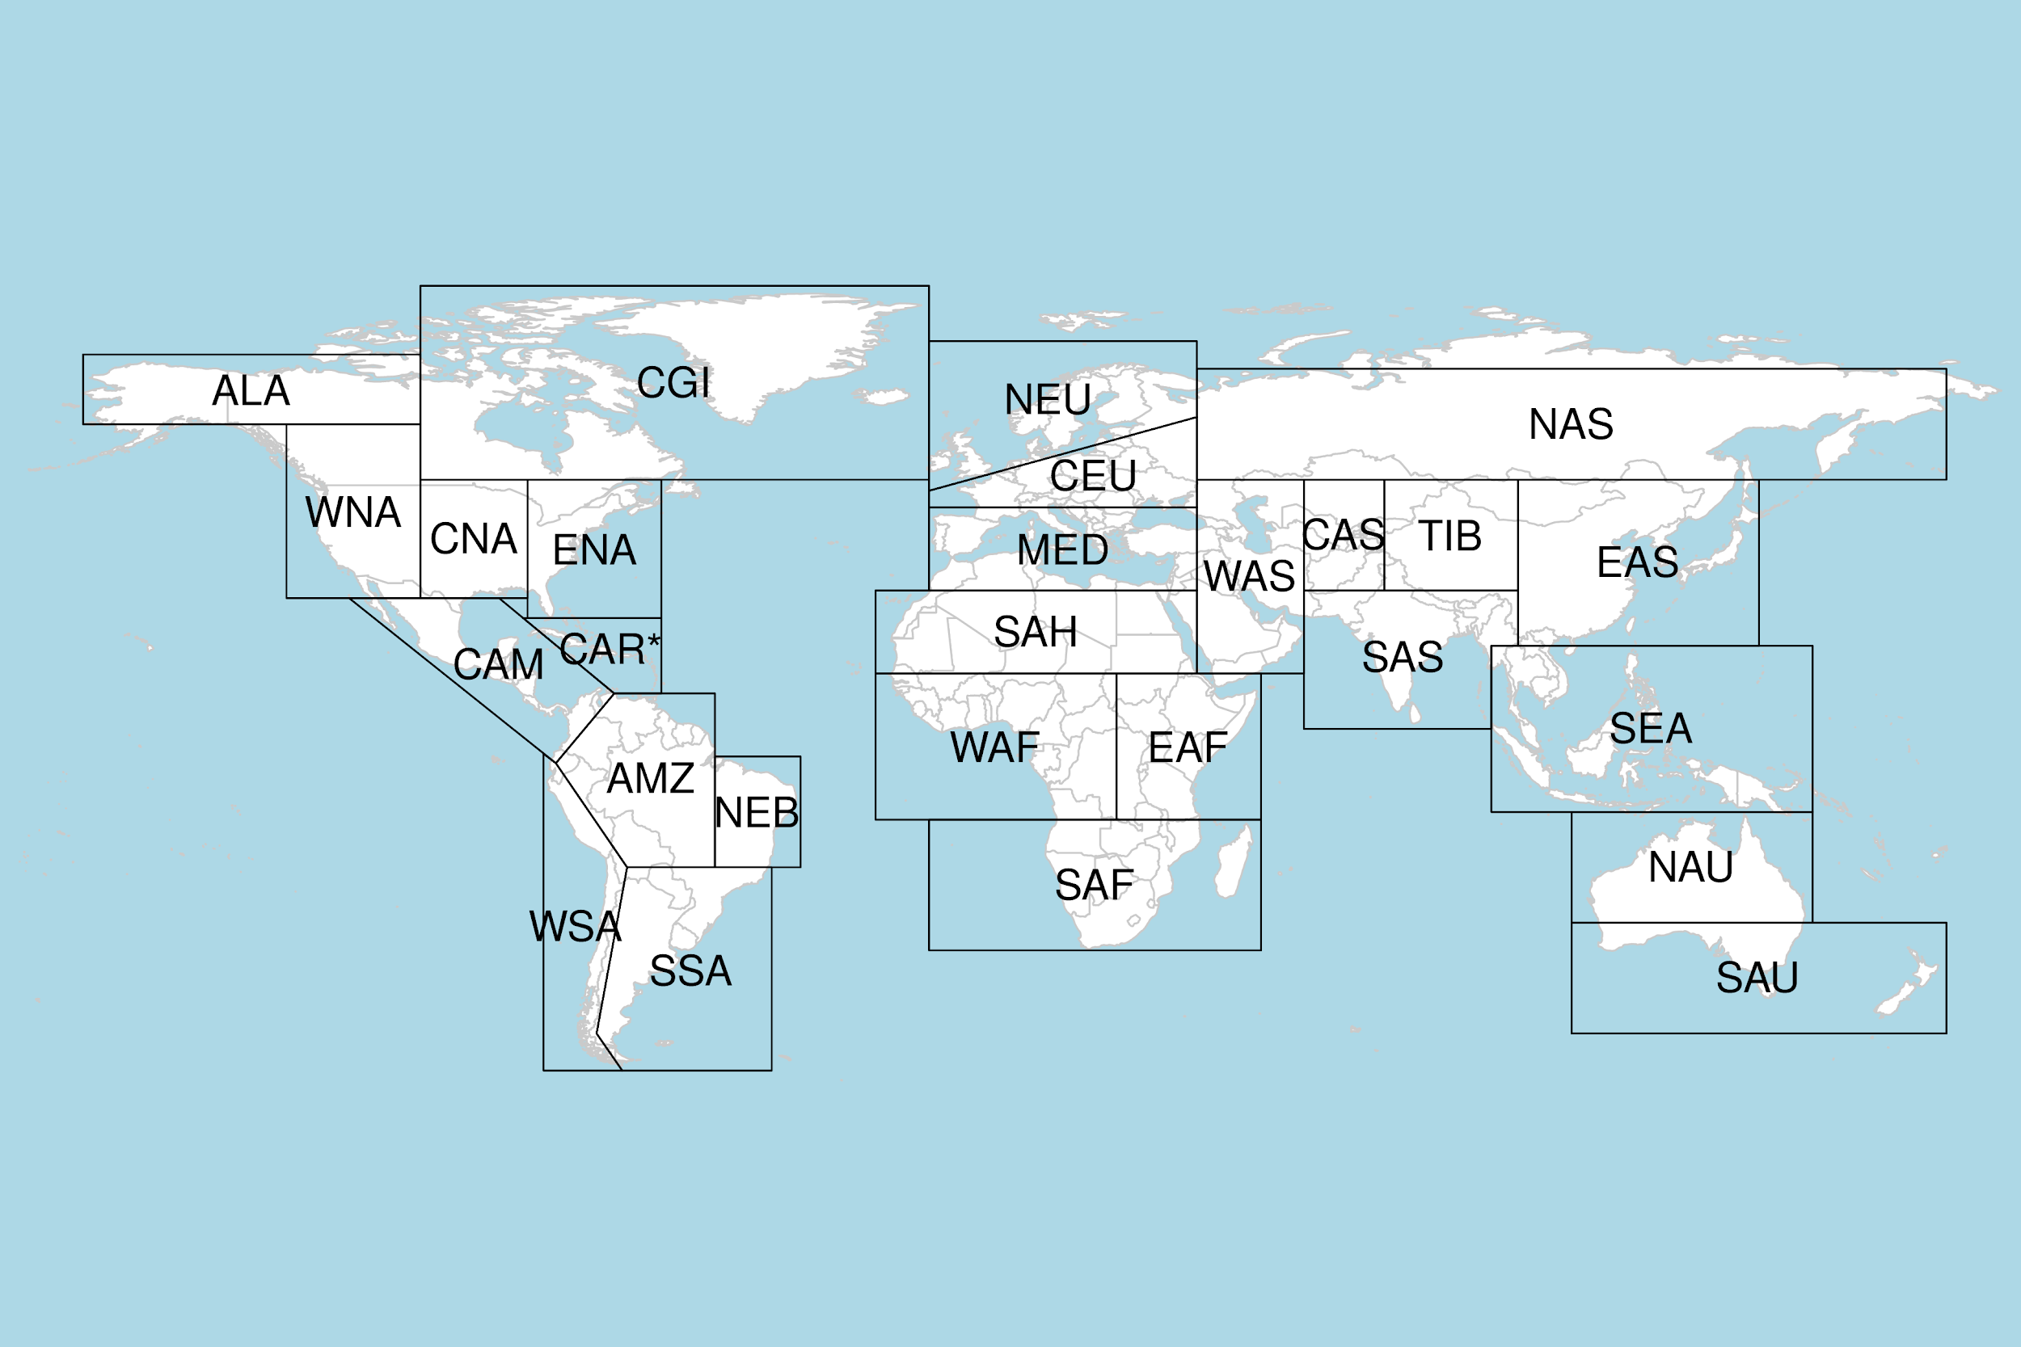
Beware of the observational uncertainty
Verification with two ground-based observational datasets and three reanalyses. The use of both types of datasets is very informative for wind energy users as they use them for the development of impact models and the long-term resource assessments.
“Failing to account for the effects of observation error when deciding between two forecasting systems could lead to the wrong choice and a high opportunity cost” (Ferro, 2017)

Slide 9
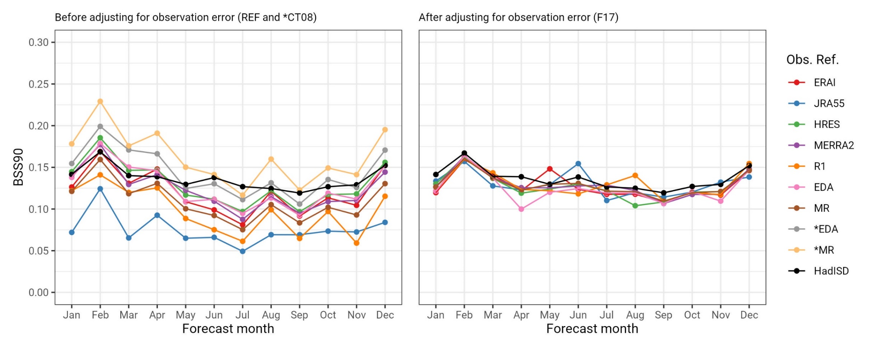
Observational uncertainty
Verification against several reanalysis-based references gives different results. Adjustment of the observational references to in-situ observations (HadISD) shows that this uncertainty can be reduced. 10 m wind speed, BSS90 for zero-month lead one-month forecasts from ECMWF S5 (1981-2017).
“Failing to account for the effects of observation error when deciding between two forecasting systems could lead to the wrong choice and a high opportunity cost” (Ferro, 2017)
Ramon et al. (in preparation)

Slide 10
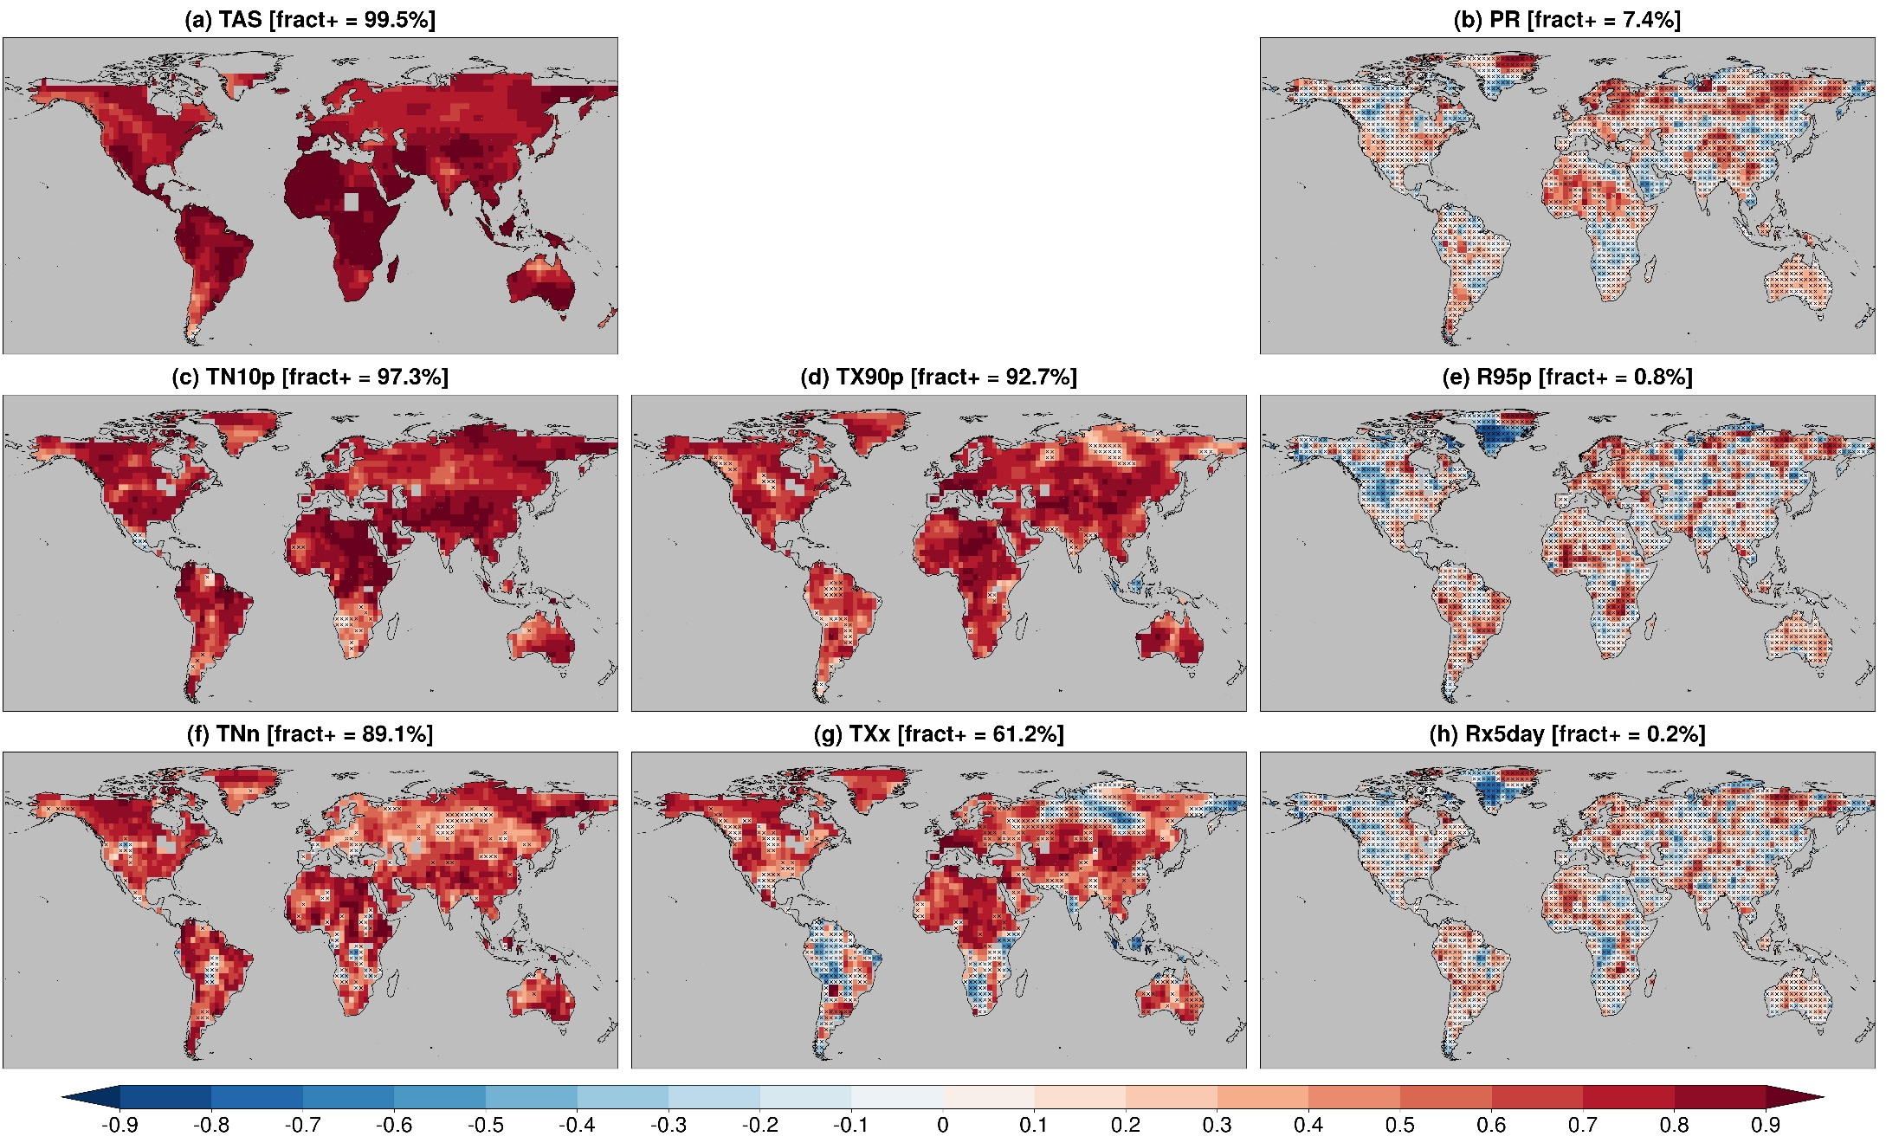
Building multi-model systems
ACC (ref. GHCNv4-GPCC)
for DCPP, 1-5 forecast years, 169 members, 13 DCPP forecast systems
(significance t-test)
Delgado-Torres et al. (2022, J. Climate)

Slide 11
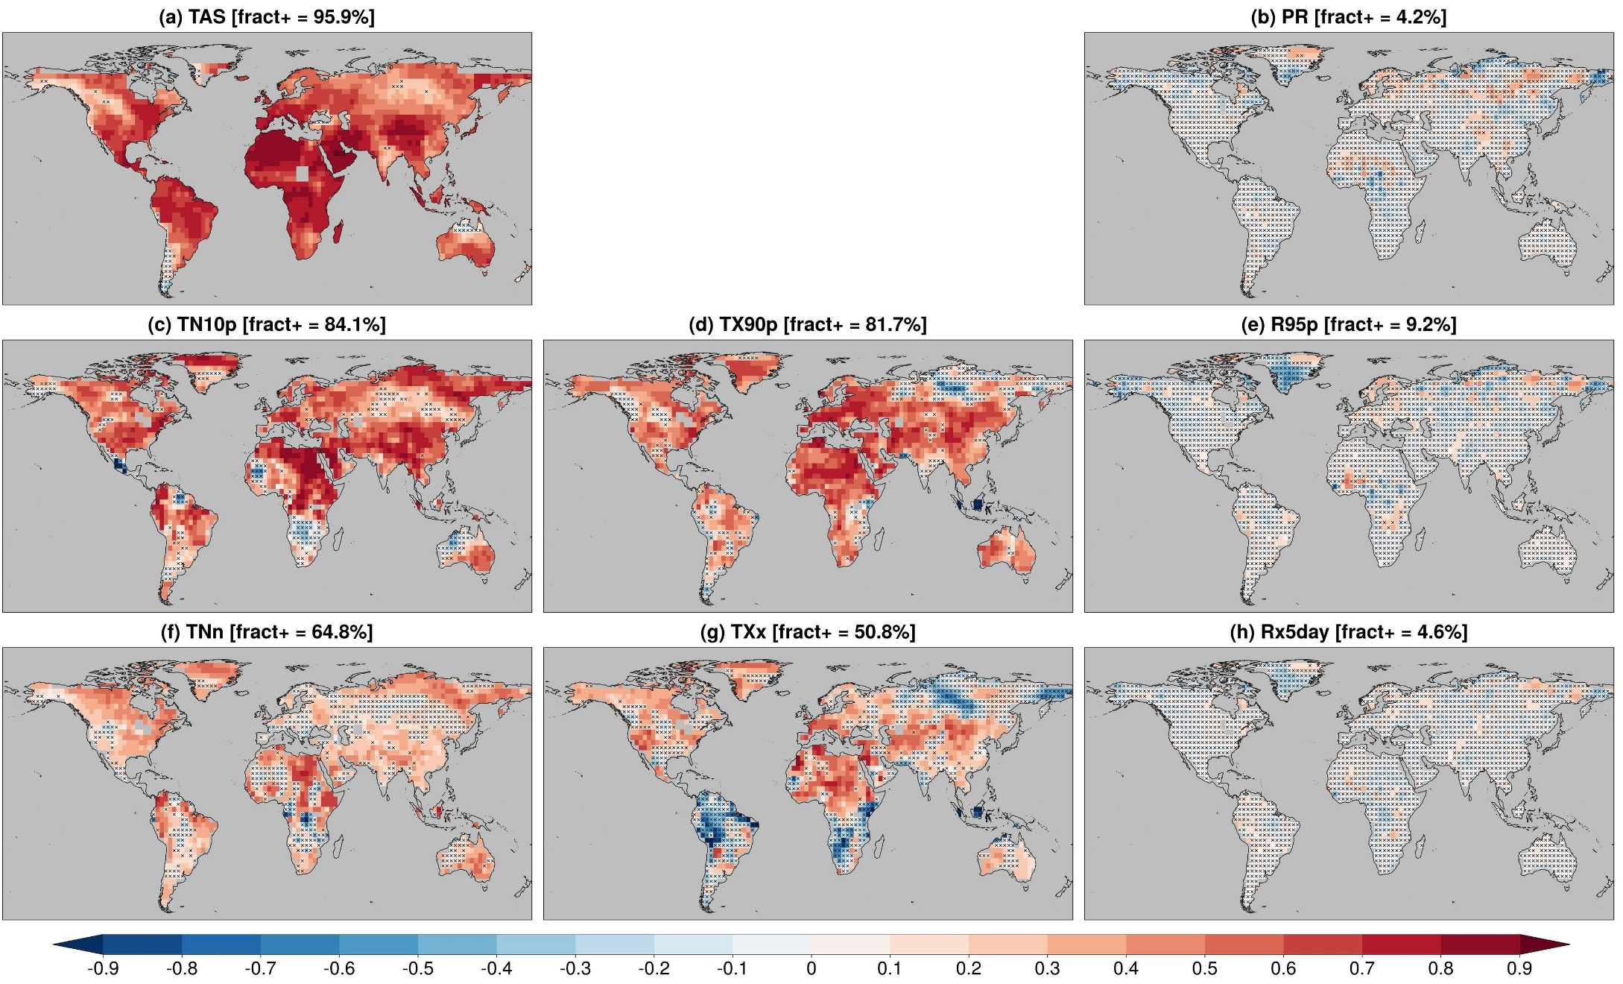
Building multi-model systems
RPSS (3 cat.; BEST-REGEN)
for DCPP, 1.5 forecast years, 169 members, 13 DCPP forecast systems
(significance random walk)
Delgado-Torres et al. (2022, J. Climate)

Slide 12
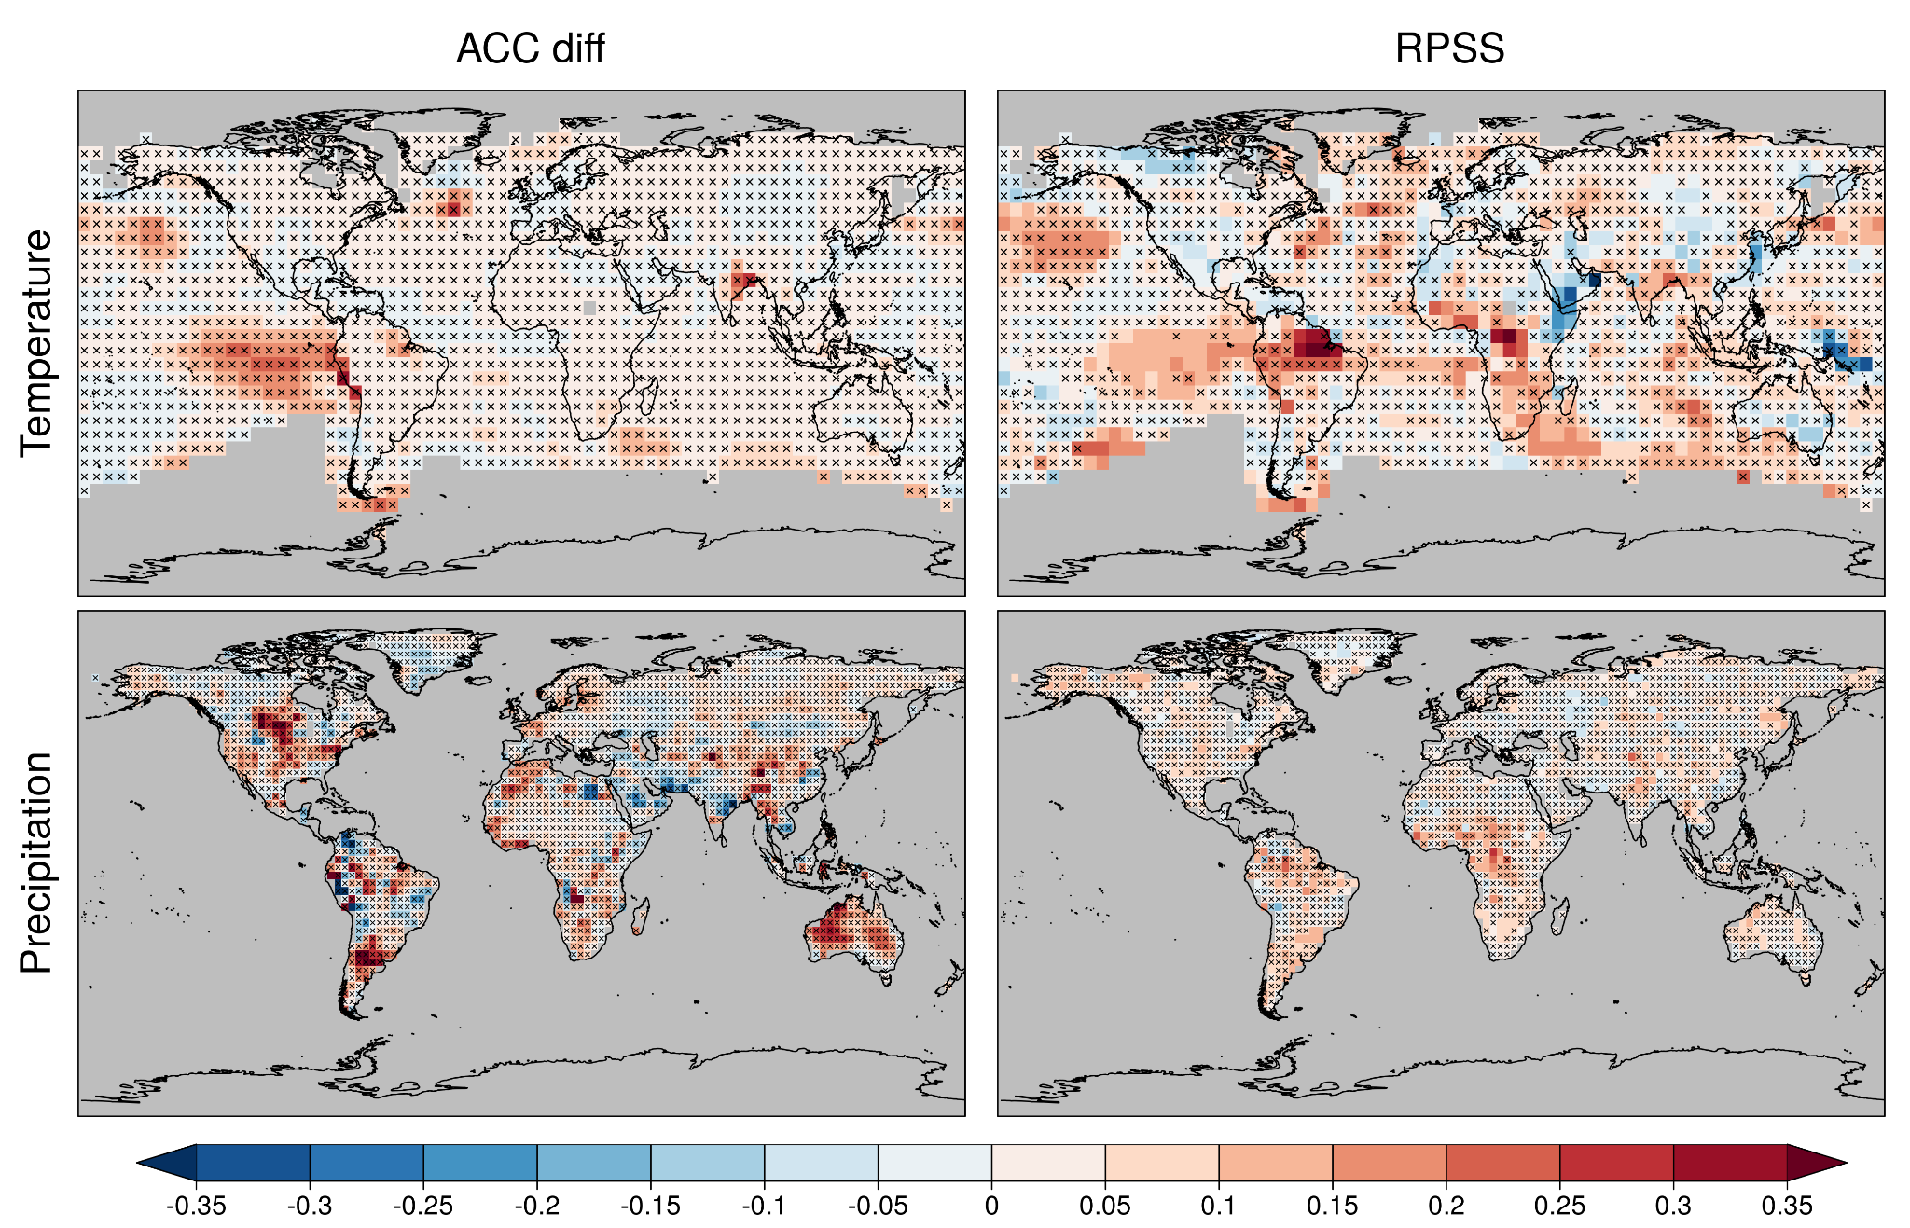
Building multi-model systems
Systematic assessment of the multi-model decadal prediction forecast quality helps illustrating, among other things, the importance of a large enough operational multi-model.
Comparison between a research (DCPP, 169 members, 13 forecast systems) and an operational (C3S_34c, 40 members, 4 forecast systems, CMCC-CM2-SR5, EC-Earth3-i1, HadGEM3-GC3.1-MM and MPI-ESM1.2-HR).
DCPP worse than C3S_34c multi-model ← | →DCPP better than C3S_34c multi-model
Delgado-Torres et al. (2022, J. Climate)

Slide 13
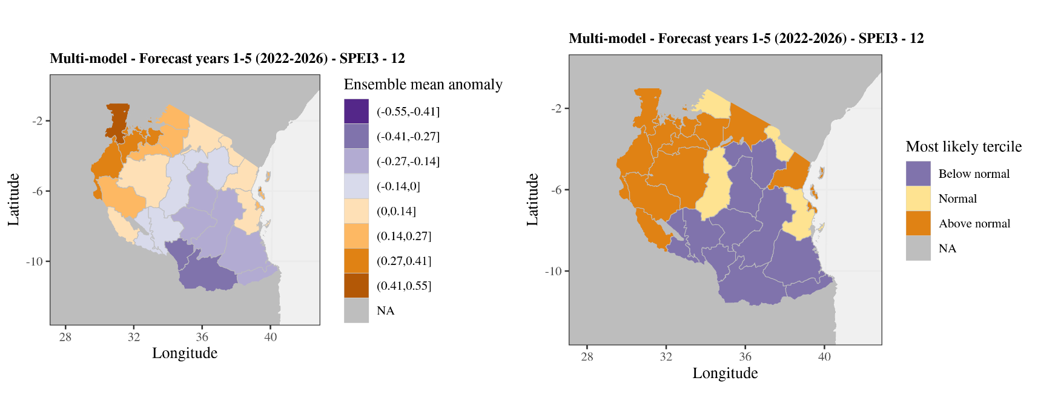
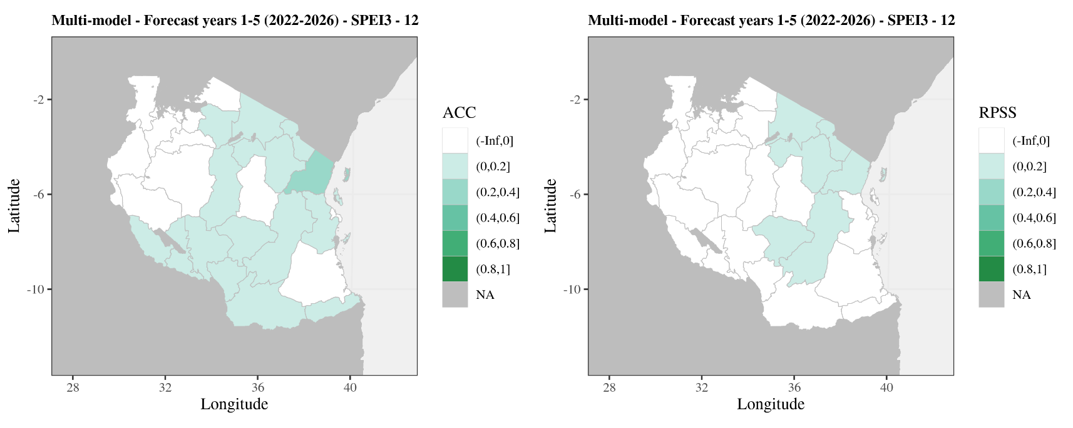
Where to from here? User requirements
Downscaled SPEI3 (October to December) multi-model (three models) predictions for 2022-2026 over Tanzania to support agricultural decisions for maize. ERA5Land used as reference.
C. Delgado-Torres (BSC)

Slide 14
Lessons from research in user engagement
Better links, collaboration and knowledge sharing among the increasing, and currently fragmented, community of practice. The current supply-driven approach is more likely to improve climate data, but not necessarily to contribute to better informed decisions. Direct interaction would allow identifying improvement areas and emerging user needs (role for climate services).
Better interaction between providers and users and more effort to build local competences.
Improving usefulness and usability of the products and moving towards demand-driven (instead of demand-relevant):
enhancing credibility with a more transparent approach to the forecast production and quality assurance of the corresponding climate services
enhancing salience by improving the skill, user interface, visualisation and communication
enhancing legitimacy by creating independent quality control and certification systems designed by including the different stakeholders involved in the value chain of climate services
Find a space for those forecast intermediaries (national and sub-national agents) that so far have been using subjective methods, consider a balanced power relation in the transition to fully objective forecasts.
Findlater et al. (2021, NCC), Bojovic et al. (2022, Clim. Change)

Slide 15
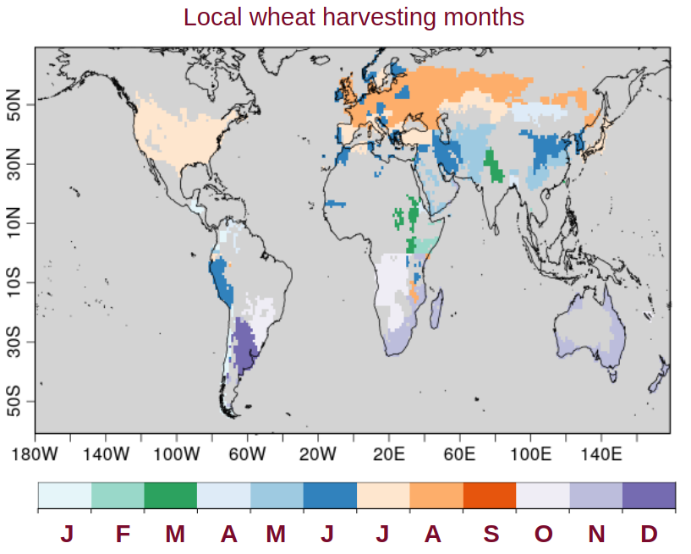
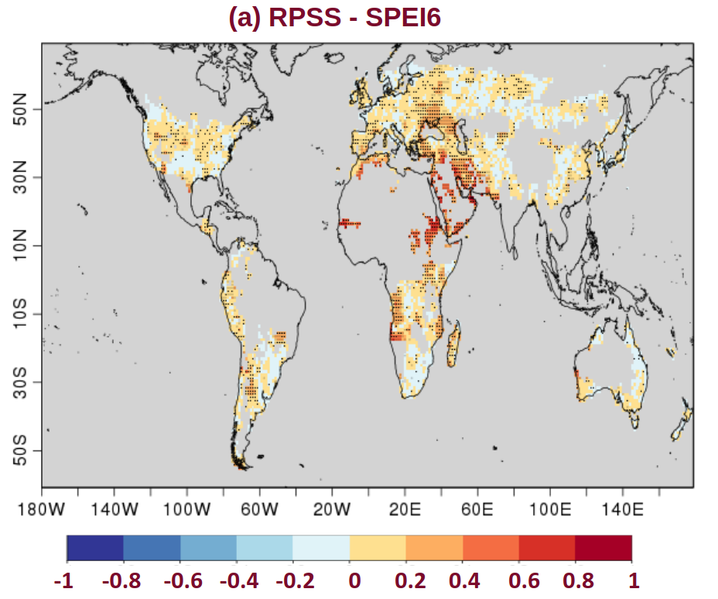
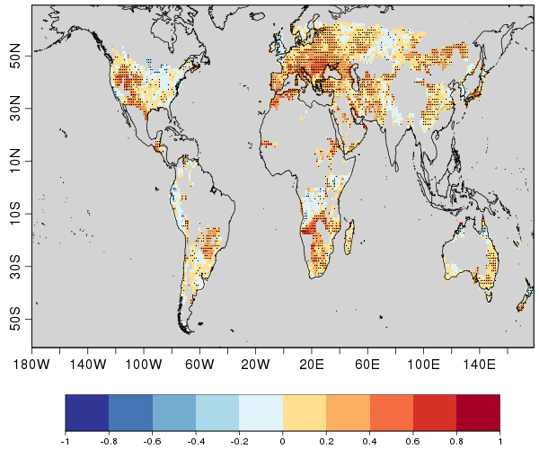
Forecasts for crop yield
WMO recognised global producing centres of decadal predictions contribute with the definition of standards for decadal predictions data and products, while C3S promotes the evaluation of the European multi-model and the illustration of the decadal prediction use in, among other sectors, the agricultural sector using indicators.
SPEI6
RPSS (3 categories)
Indicators:
Drought: Standardized Precipitation Evapotranspiration Index (SPEI6)
Heat stress: Heat Magnitude Day Index (HMDI3)
HMDI3
Solaraju-Murali et al. (2021, NPJ Climate)

Slide 16
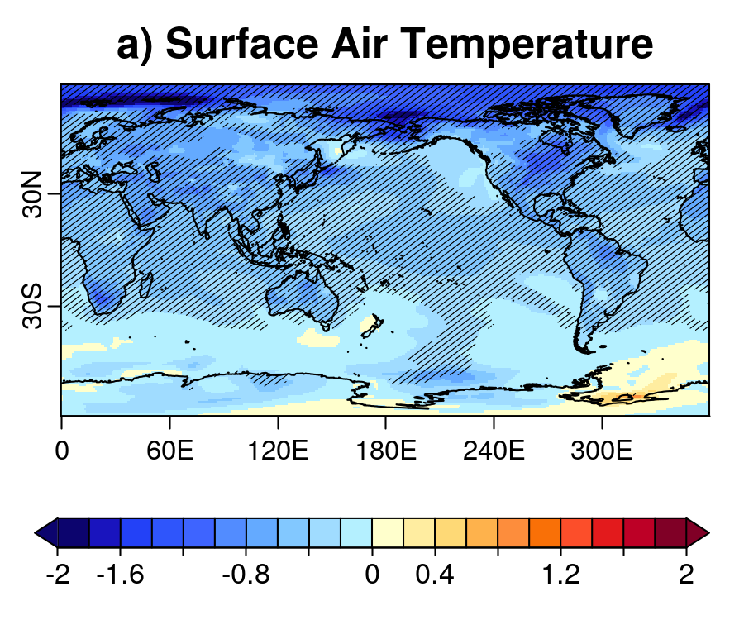
Volcanic influence
Results from the Decadal Prediction Volcanic Response Readiness Exercise (VolRes-RE).
A 2xEl Chichón eruption is set in April 2022 for the decadal forecast started in late 2021 and the difference with respect to DCPP-A made.
TAS YR2-5
ºC
R. Bilbao (BSC)

Slide 17
Some of what we can do with what happens around us:
Seamless information, more realistic models, carbon cycle

Slide 18
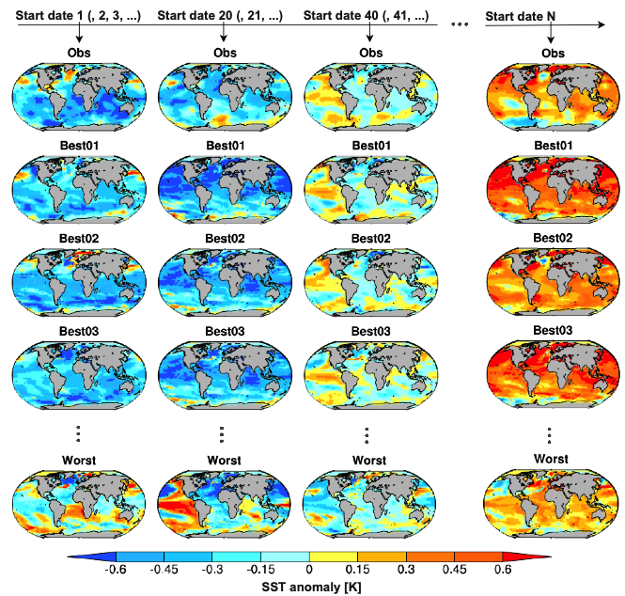
Near-term seamless climate information
Projections: 223 members from 35 models
Decadal predictions: 93 members from 9 models
Sub-selecting the 30 projections members in closest agreement with the predictions over years 1-9
There is substantial multi-decadal predictability by aligning internal variability
Skill in constrained projections can be larger than in decadal predictions used to constrain
initialized prediction
initialized prediction
initialized prediction
initialized prediction
(un-initialized) projections
Mahmood et al. (2021, GRL; 2022, ESD)

Slide 19
Near-term seamless climate information
Skill of 20-year projections using five constraining methods over the period 1970-2000
Heterogeneity between methods
It’s fundamental to evaluate the constraining methods before claiming improvements in regional climate projections
Cos et al. (in prep.)

Slide 20
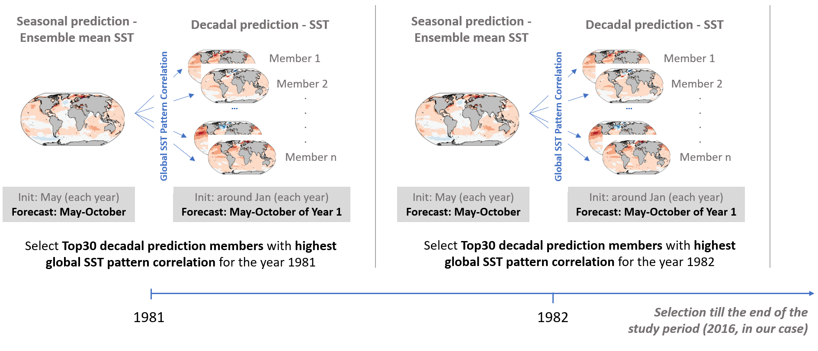
Merging seasonal and decadal predictions
Solaraju Murali (BSC)

Slide 21
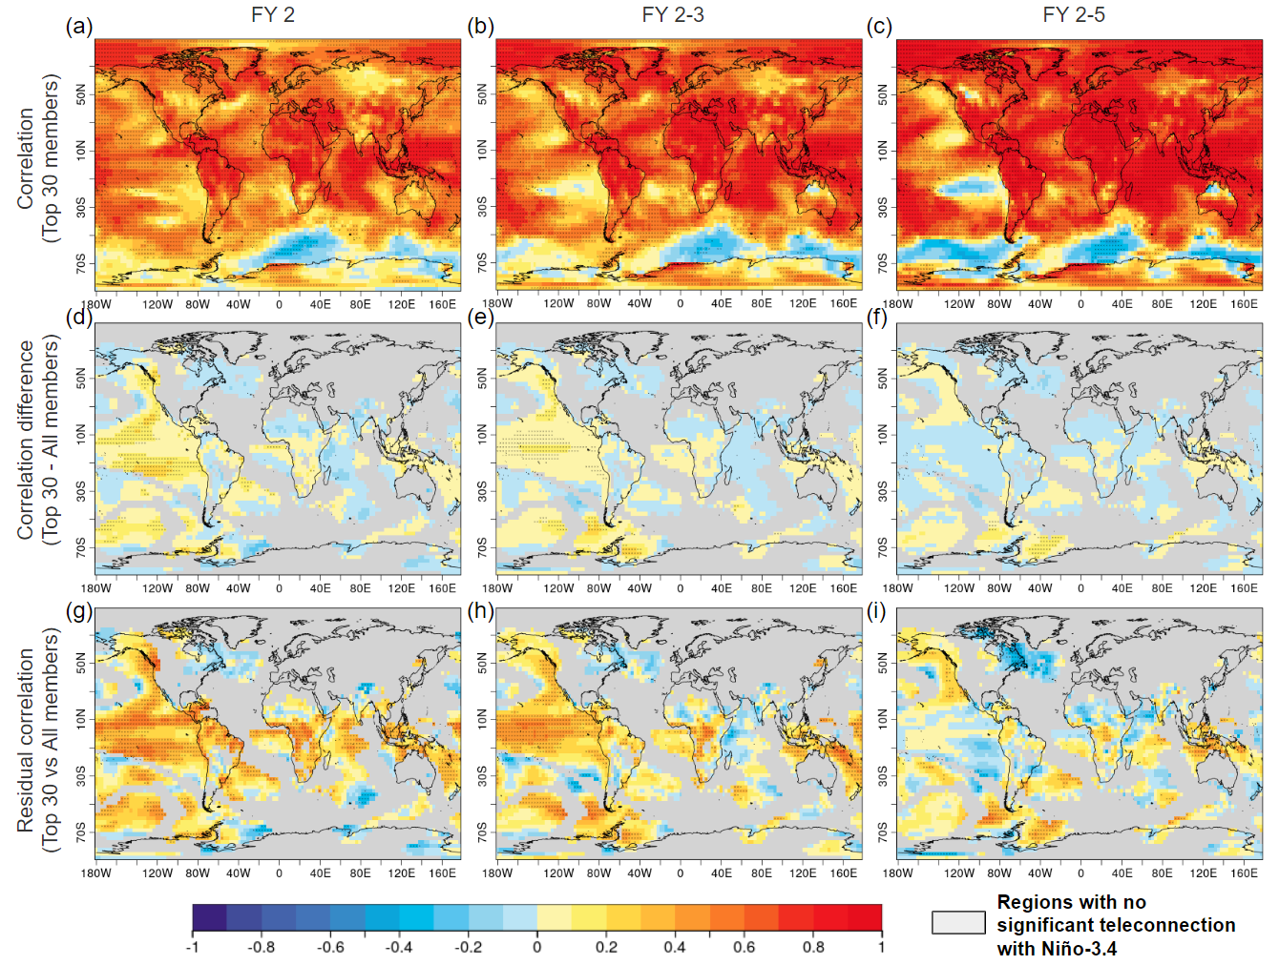
Merging seasonal and decadal predictions
Correlation of the best 30 members selected from a 135-member ensemble decadal predictions that better fit the SST pattern of the System 5 seasonal predictions over the common period of May to October.
Verification period for start dates 1982-2016.
Solaraju Murali (BSC)

Slide 22
New generation of climate models: resolution
Eddy-rich, storm-resolving models (10-km or higher resolution) simulate a decrease in SST biases over the North Atlantic (right) and a northward shift in the Gulf Stream over the XXI Century that leads to rainfall increases in Europe (left), not found with traditional low-resolution models.
Moreno-Chamarro et al. (2021, ERL)

Slide 23
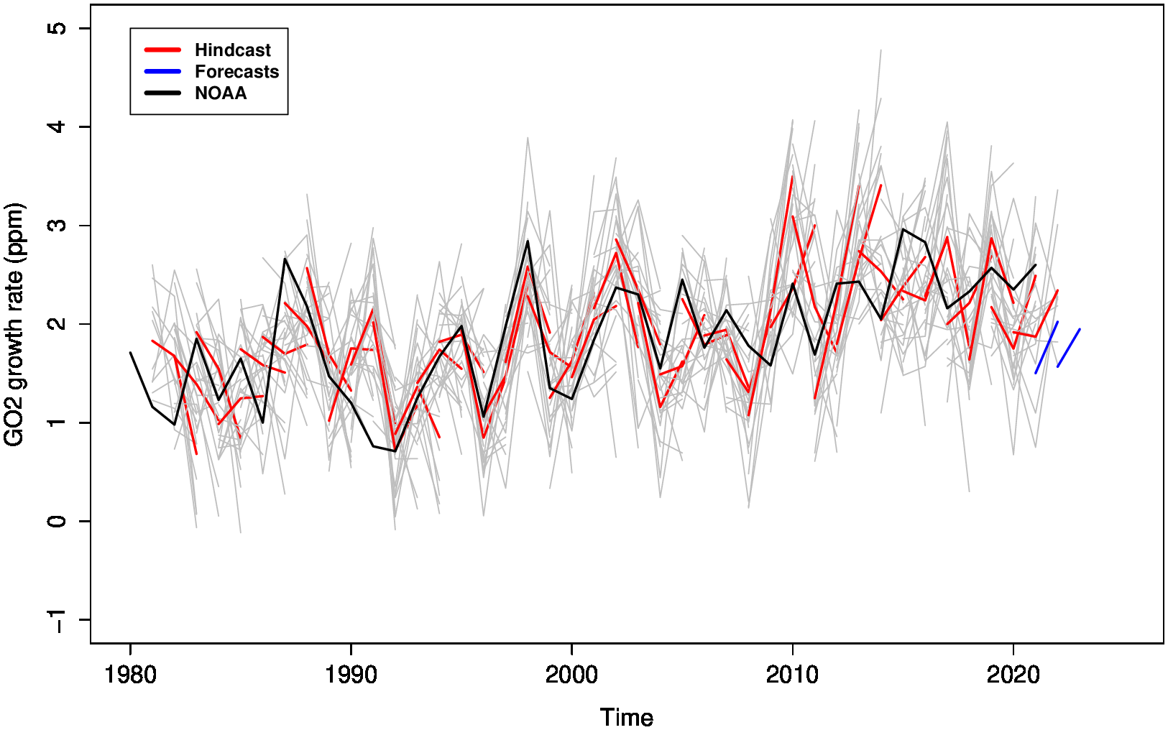
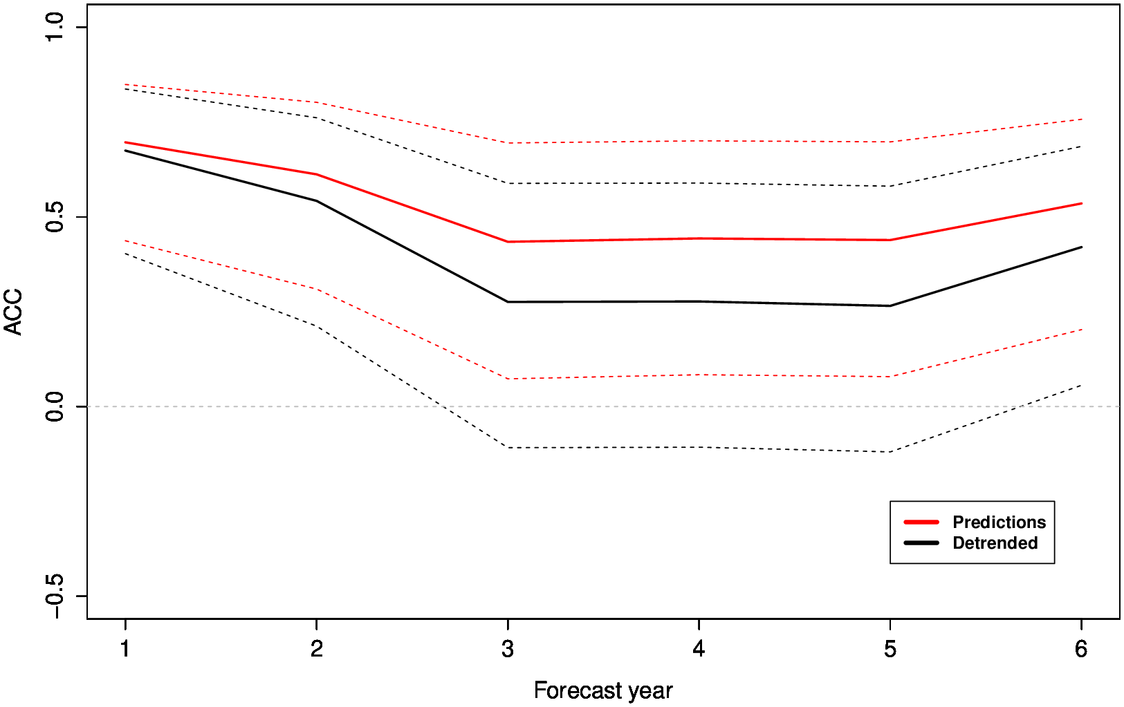
Carbon cycle predictions
Global atmospheric CO2 growth rate predictions from EC-Earth3-CC. Initial conditions are obtained from off-line simulations.
There is skill up to two years. It then decreases mainly due to the land-atmosphere flux.
Tourigny et al. (in prep.)

Slide 24
What gives the chill:
Lack of interactivity, emergence of AI-based solutions

Slide 25
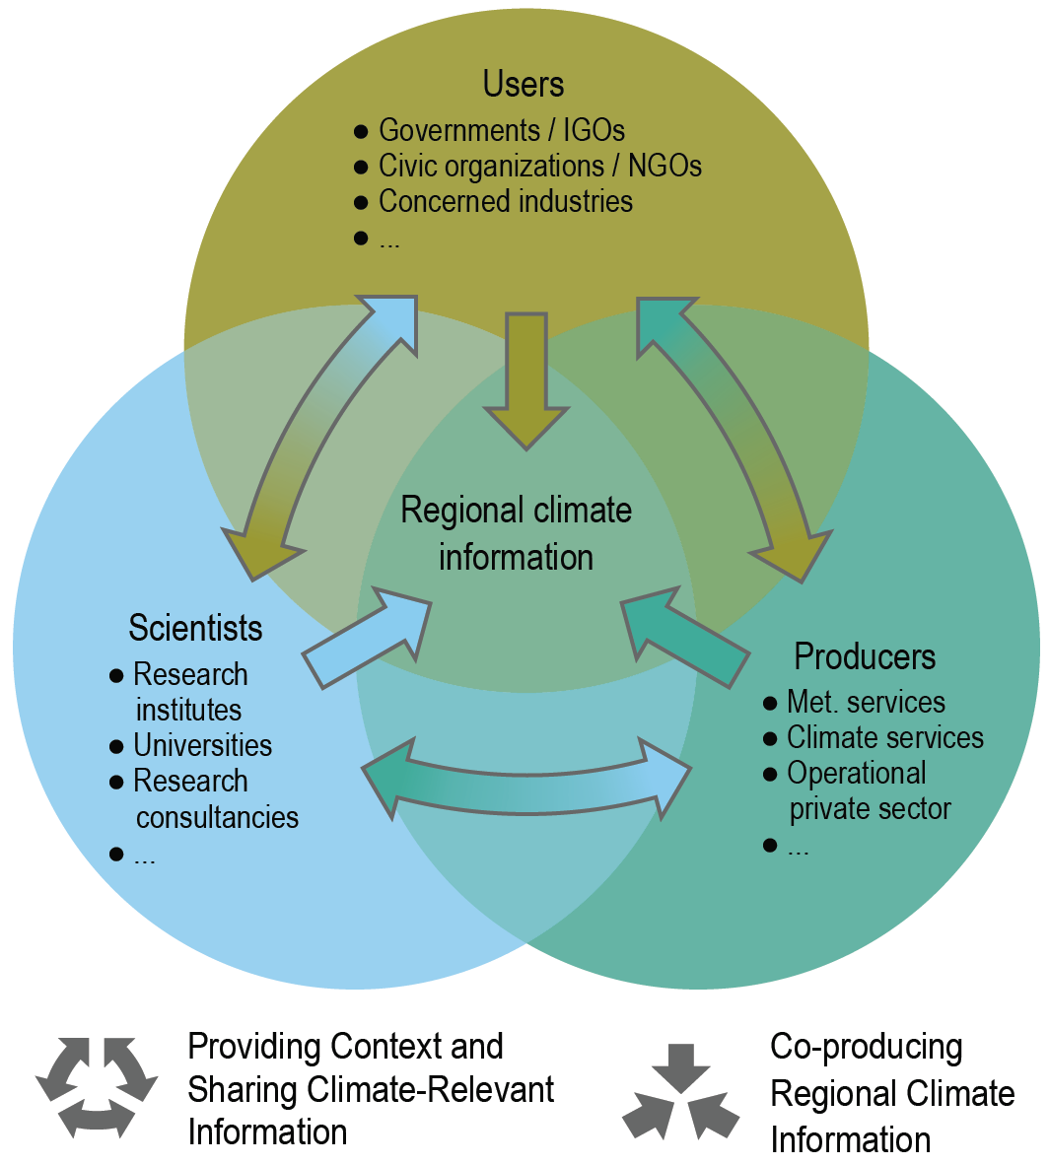
Actors and values in climate information
This can only work if the user is offered true interactivity with the data sources.
AR6 WGI Figure 10.21

Slide 26
Tethering: A necessary condition for interactivity
One of the ML-based weather forecast models (e.g,, FourCastNet) could be trained on the trajectories of a (preferably several) process-based climate model (with high-frequency output). The tethering concept allows, using the climate model restarts, to recreate almost instantly (in inference mode as an interpolation between restarts) the model output requested by any user leading for true interactivity.
2100
The ML-based model can provide downscaled (super-resolution), targeted (user indicators), and bias adjusted data with large ensembles (if uncertainty handling is trustworthy).
The physical model is a guarantee that there is a possibility to generate wildcards, i.e., unprecedented events plausible in a changing climate.
Climate trajectory of a (or many) physical model(s)
2022
Restarts every 10 or 20 days

Slide 27
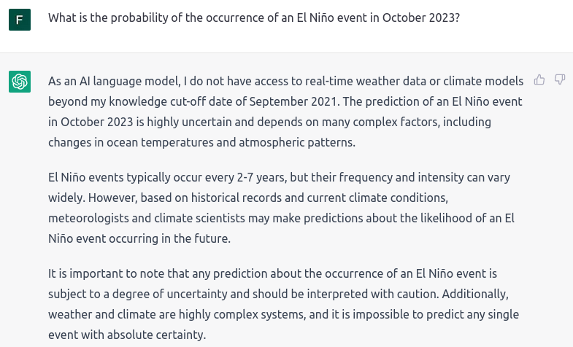
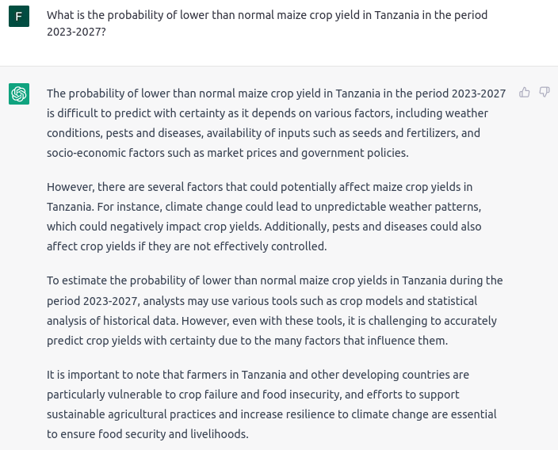
User interface to climate information
How long before a generative chatbot will be trained with the latest forecast information?

Slide 28
A collection of thoughts
Understanding the title:
the bone and the marrow as a set of key elements for life
chill to the marrow/to the bone
What we can do
with what we have
with what climate change colleagues are doing
with what other domains are doing

