Slide 1
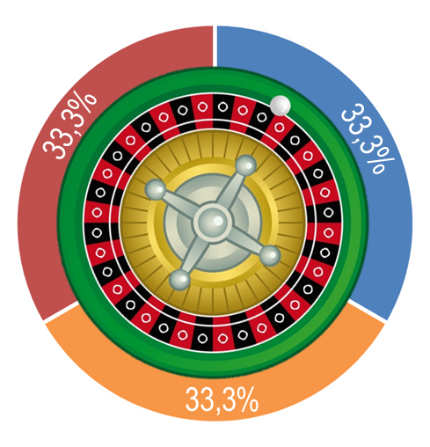
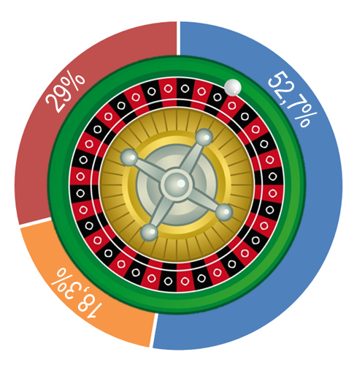
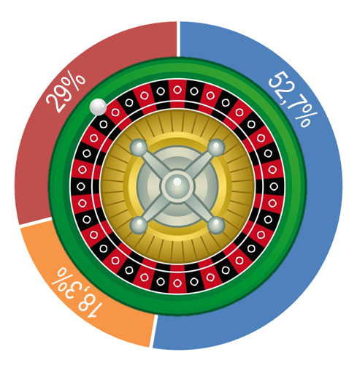
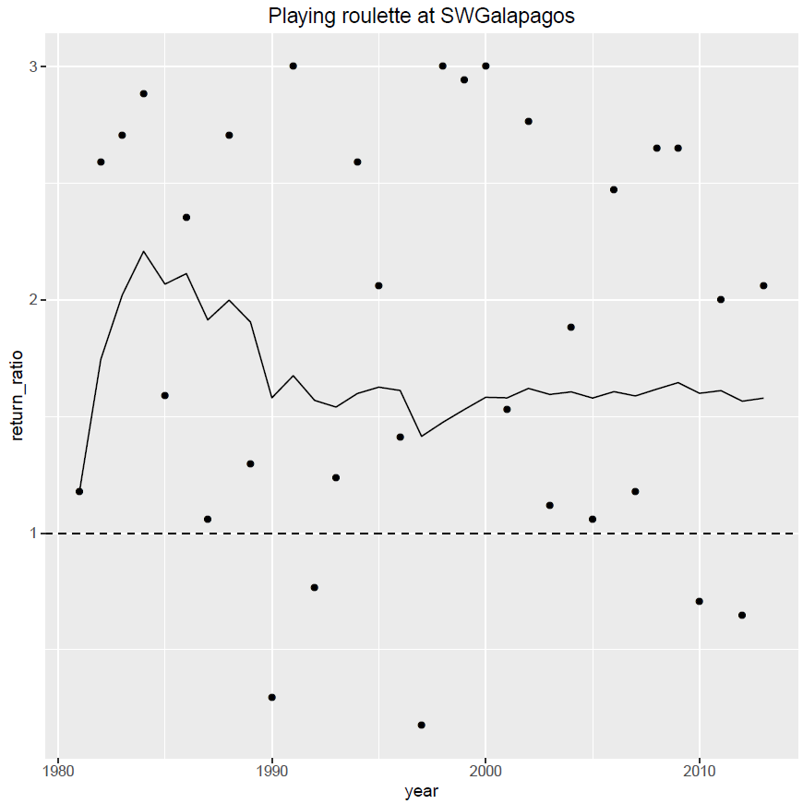
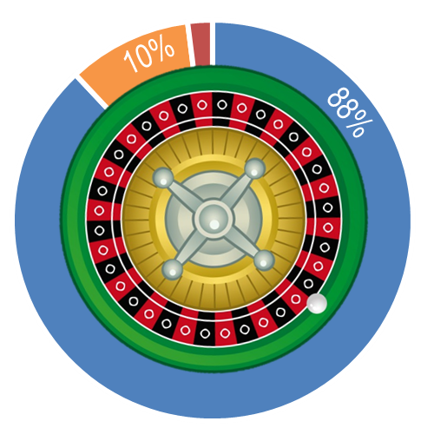
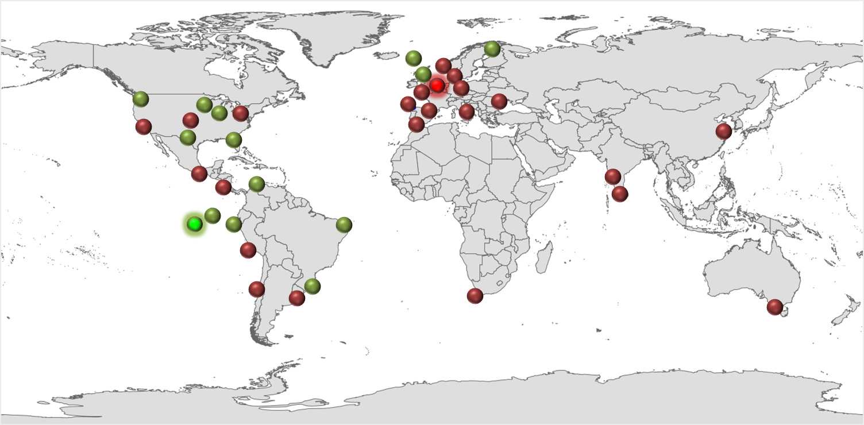
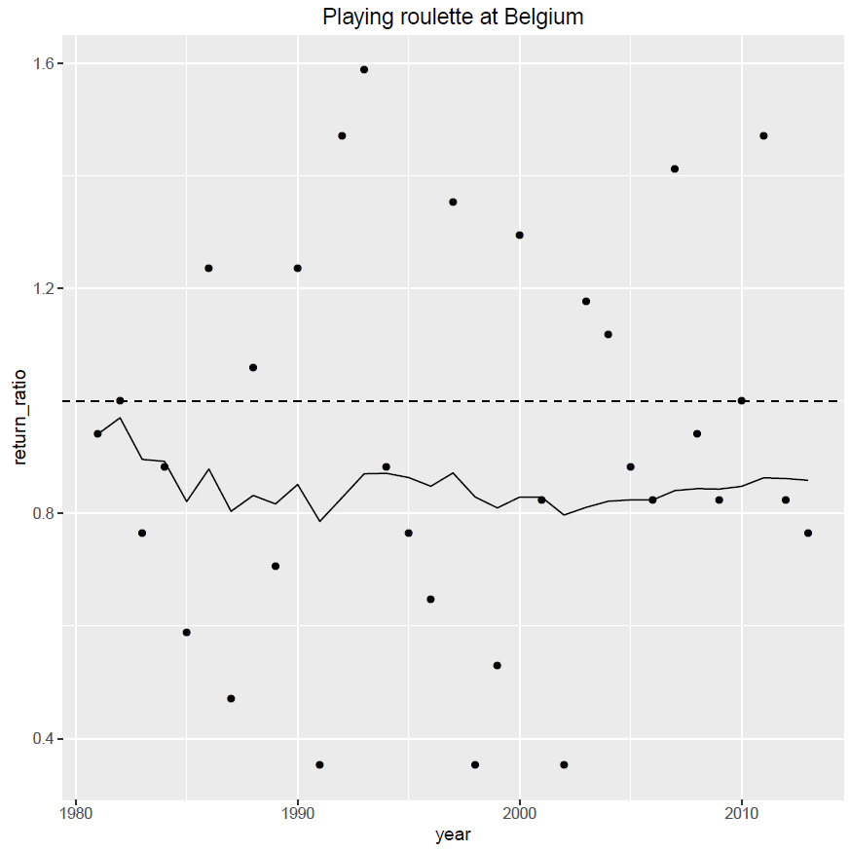
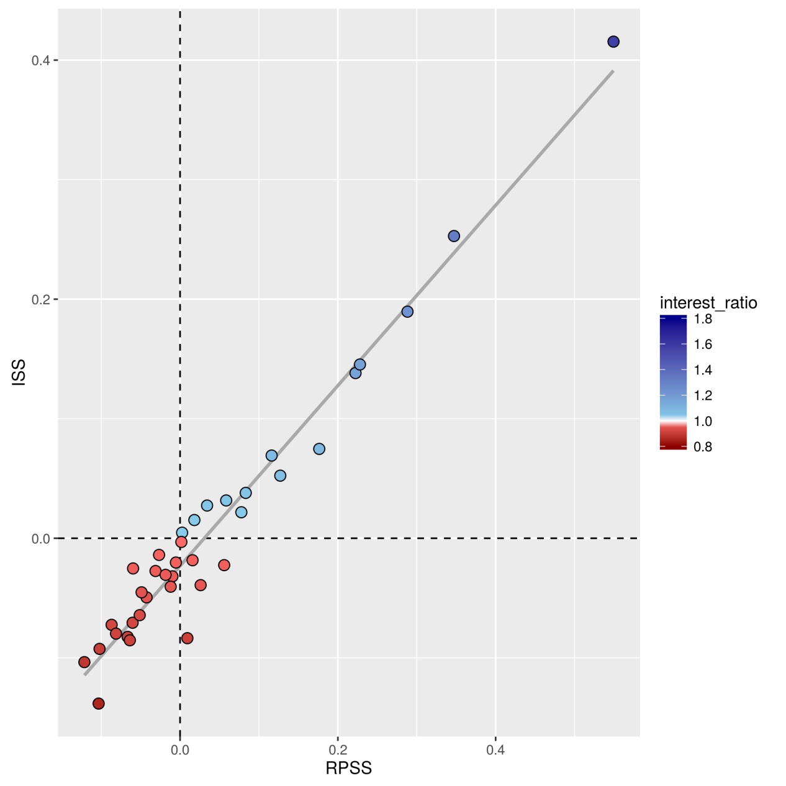
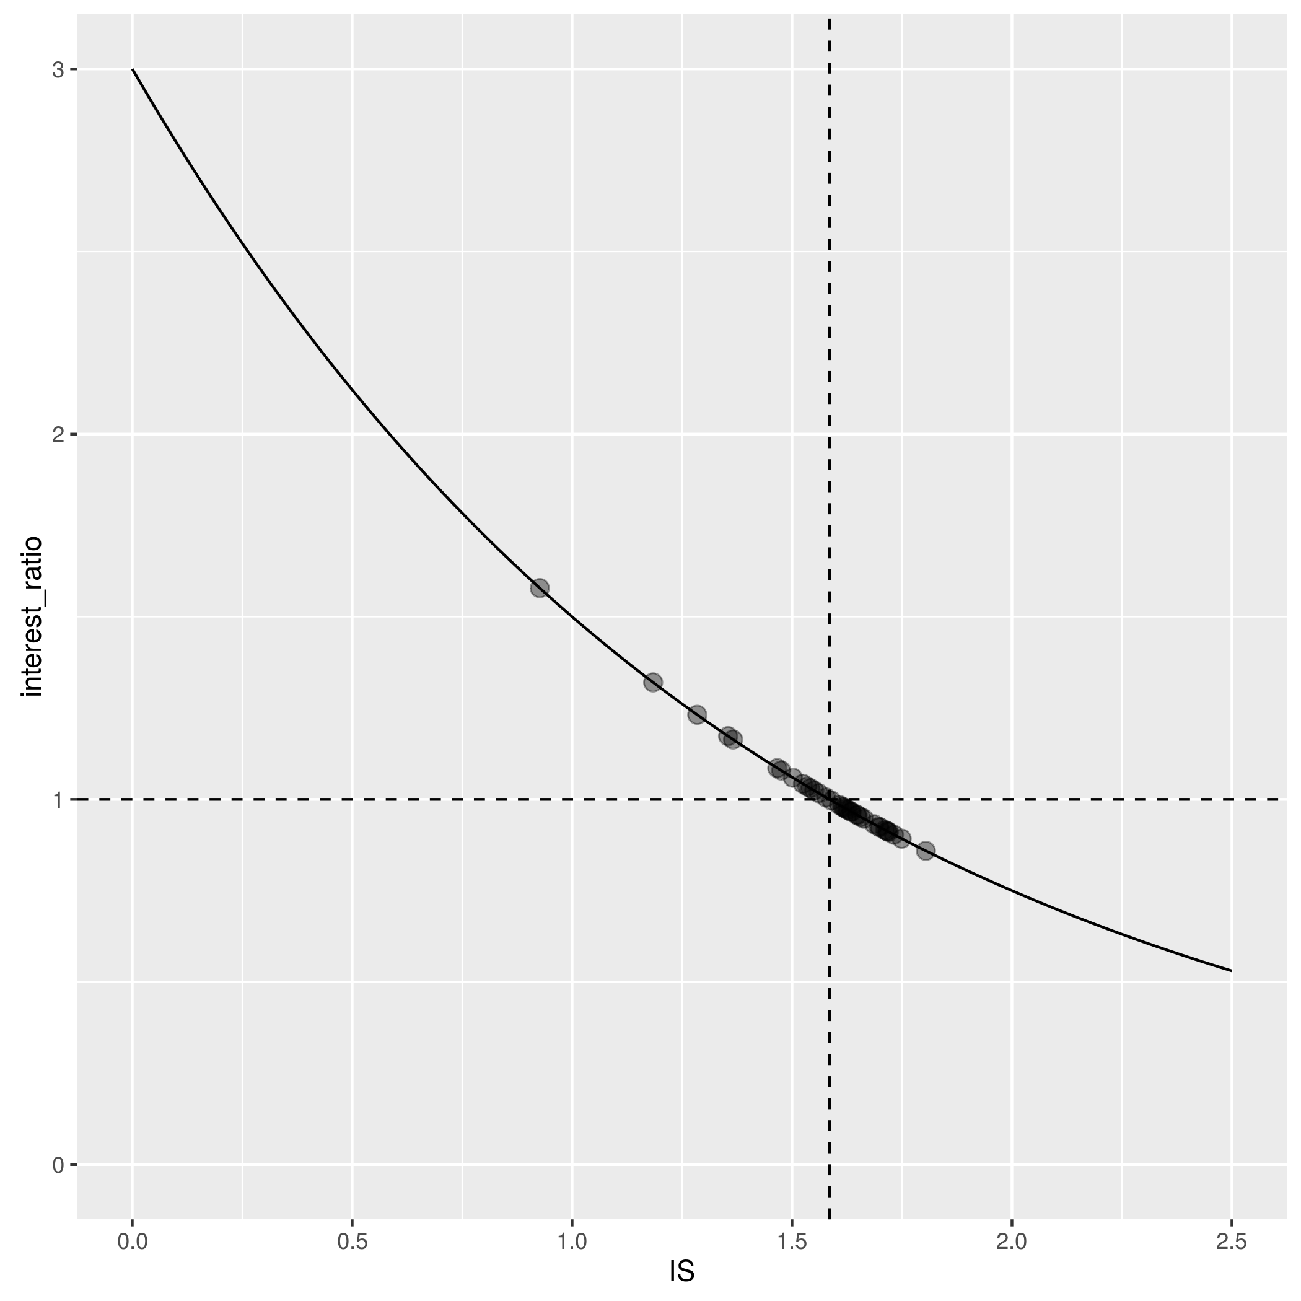
The weather roulette:
communicating probabilistic predictions for wind energy
Isadora Christel, Llorenç Lledó, Verónica Torralba, Albert Soret, Nube González-Reviriego, Francisco Doblas-Reyes Barcelona Supercomputing Center (BSC), Institució Catalana de Recerca i Estudis Avançats (ICREA)
Current use of climatology
Seasonal wind speed predictions
Predictions vs. past climatology
Climate predictions can provide new insights in the future variability of climate from sub-seasonal to decadal time scales, which can potentially benefit the wind energy sector. However, current energy practice relies on climatology to estimate what is going to happen in the future. Assuming that future conditions will be similar to the past doesn’t take into account extreme events, limited information of the past, variability in past conditions or climate change.
Based on ECMWF System 4 data, RESILIENCE provides seasonal wind speed predictions for the energy sector (more info in www.project-ukko.net)
However, to foster the adoption of new technology we have to demonstrate the added value of the predictions compared to climatology.
The performance of seasonal predictions is currently quantified with skill scores but… Is there a better way to present this to users?
How can we improve the communication of probabilistic predictions?
The Weather Roulette framework is based on Hagedorn & Smith 2009. This method translates skill scores into commonplace concepts as interest ratios or return of investment.
The Weather Roulette: Methodology
Expected wind speed:
Above average
Average
Below average
10€
The dots are the performance of the forecast in each year (i.e. interest ratio). Over the dashed line, seasonal predictions outperform climatology; below the line, climatology is better.
These dots are used to calculate the geometric average of the interest ratio (solid line)
2.9€
1.83€
5.27€
2.9€ x 3= 8.7€
Climatology
RESILIENCE
seasonal predictions
0.17€
0.87€
7.65€
Climatology assumes a fixed probability to each category while climate predictions adjust the category probabilities of the ‘climatology’ forecast.
There is an initial investment of 10€ and everything earned is reinvested in the next run.
7.65€ x 3= 22.97€
In the game, the user bets proportionally to the probabilities estimated in the seasonal forecast and the amount invested in the observed category is multiplied by 3 (i.e. the inverse of the climatology probability)
After 33 runs with historical data (one for the prediction of each year from 1981 to 2013) we calculate the average interest ratio for the wind farm that, with this value we obtain the total return of investment:
Results
The performance of seasonal predictions is assessed with skill scores. The Ignorance Score (IS) measures the average information deficit. The Ranked probability score (RPS) uses the probabilities assigned to the three categories and the outcome category to compute the verification.
For both scores we compute the skill over climatology (ISS, RPSS). Skill scores > 0 mean that the prediction system performance is better than climatology, whereas skill scores < 0 mean that it is not better than making a guess based on historical data.
All wind farms with an ISS > 0 had Interest ratios over 1
All wind farms with RPSS > 0.06 had return ratio over 1, between 0 and 0.06 there was not clear advantage between climatology and seasonal predictions
RPSS is more widely used than ISS. Although they do not measure exactly the same concepts, they share information and this yields a high correlation between them. i.e. forecasts with high RPSS will typically have high ISS and vice versa.
IS can be translated to interest ratio using a mathematical equation.
(b)
(a)
(b)
(a)
Prediction for the Winter period (Dec-Jan-Feb) from 1981 to 2013 in 37 wind farms around the world.
Green dots: wind farm in skillful areas
Red dots: wind farm in unskillful areas
Skill: 0.55 RPSS; 0.42 ISS
Interest ratio: 1.578
34 772 654€ returned
Skill: -0.10 RPSS; -0.14 ISS
Interest ratio: 0.859
10 cents returned
Interest
ratio
= 3 * 2 ^{(-IS)}
The research leading to these results has received funding from the EU Seventh Framework Programme FP7 (2007-2013) under grant agreement GA 308291 and the Ministerio de Economía y Competitividad (MINECO) under project CGL2013-41055-R

