Slide 1
9 October 2020
AI, climate data and service development at the Barcelona Supercomputing Center
Francisco J. Doblas-Reyes

Slide 2
Barcelona Supercomputing Center Centro Nacional de Supercomputación
BSC-CNS objectives
Supercomputing services
to Spanish and
EU researchers
R&D in Computer,
Life, Earth and
Engineering Sciences
PhD programme,
technology transfer,
public engagement
Spanish Government 60%
Catalonian Government 30%
Univ. Politècnica de Catalunya (UPC) 10%
BSC-CNS is
a consortium
that includes

Slide 3
BSC’s Earth Sciences Department
Environmental modelling and forecasting using process-based and artificial intelligence models, with a particular focus on weather, climate and air quality. This includes transferring solutions to support the main societal environmental challenges through data applications
Climate Prediction
Atmospheric Composition
Computational Earth Sciences
Earth System Services
~120 people
Funding from EC, Copernicus, private sector, ESA, Spanish and regional governments

Slide 4
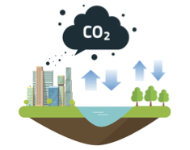
Global climate modelling
Developers of a global high-resolution Earth system model with a high-resolution configuration (10 kms).
The objective is to understand and predict global climate in time scales of one month to 100 years
...and how carbon fluxes will evolve (to inform future actions regarding the Paris Agreement)
Explore the effectiveness of natural-based climate mitigation strategies, such as reforestation.

Slide 5
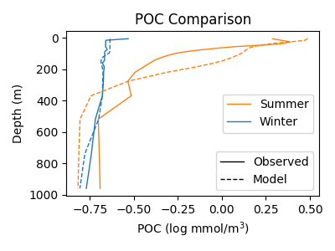
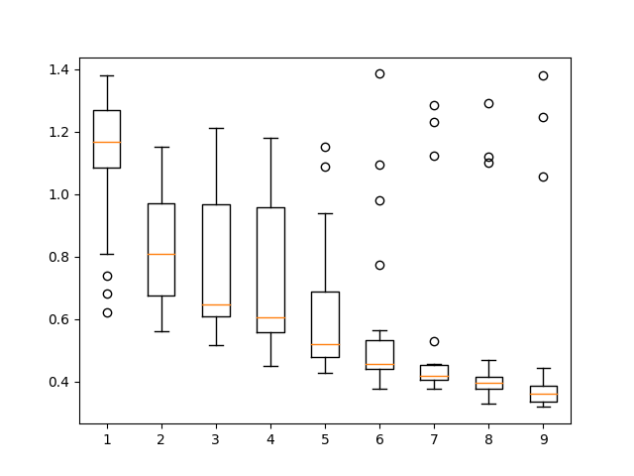
ORCAS: ORganic CArbon Sequestration in the ocean
Constraining model predictions with novel high-resolution observations using AI (genetic algorithm).
1D model
3D model
Improving estimates of organic carbon storage with the PISCES (EC-Earth ocean biogeochemistry model)
Misfit
Robotic measurements of ocean particles (with biogeochemical-Argo floats, 0-1000 m)
Iteration #
Reducing model-data misfit through parameter optimization (genetic algorithm)
Notes:
The ORCAS project uses robotic measurements of organic particles (sinking plankton, aggregates) and compares them to equivalent estimates made with PISCES, the ocean biogeochemistry component of EC-Earth. The values of key model parameters are optimized by running the model in 1D (water column) offline configuration and comparing it to observations iteratively until a good fit is obtained. The genetic algorithm is embedded in the Autosubmit workflow manager. The approach is repeated in different ocean regions with abundant measurements to obtain globally-relevant parameters that can be then used in global 3D simulations. This approach can also detect limitations in the model and lead to the development of new parameterizations.

Slide 6
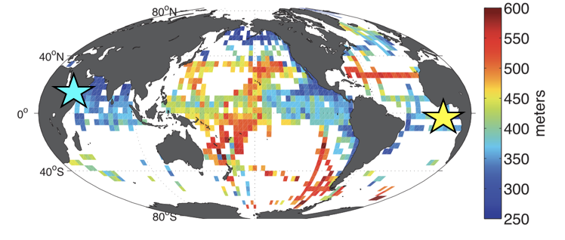
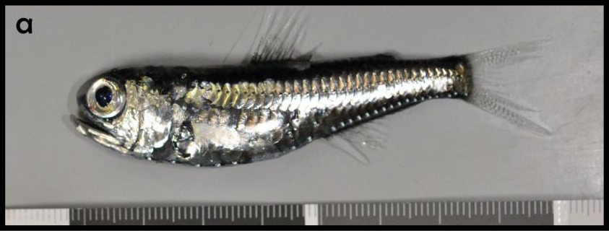
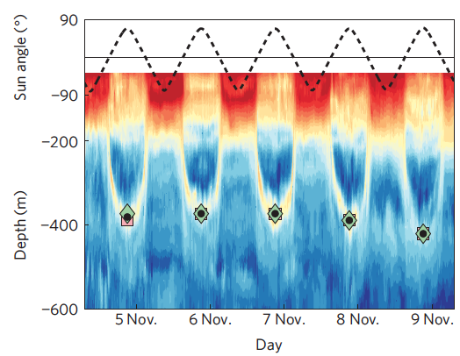
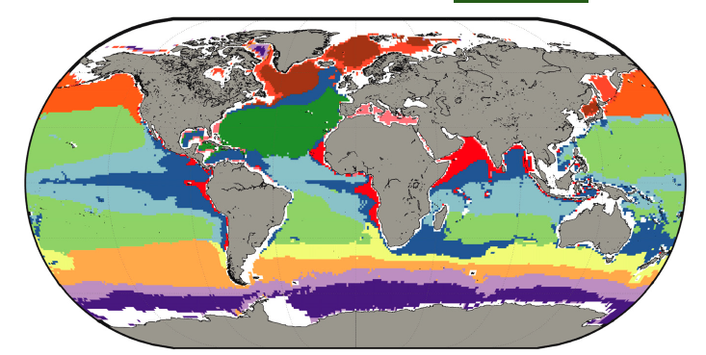
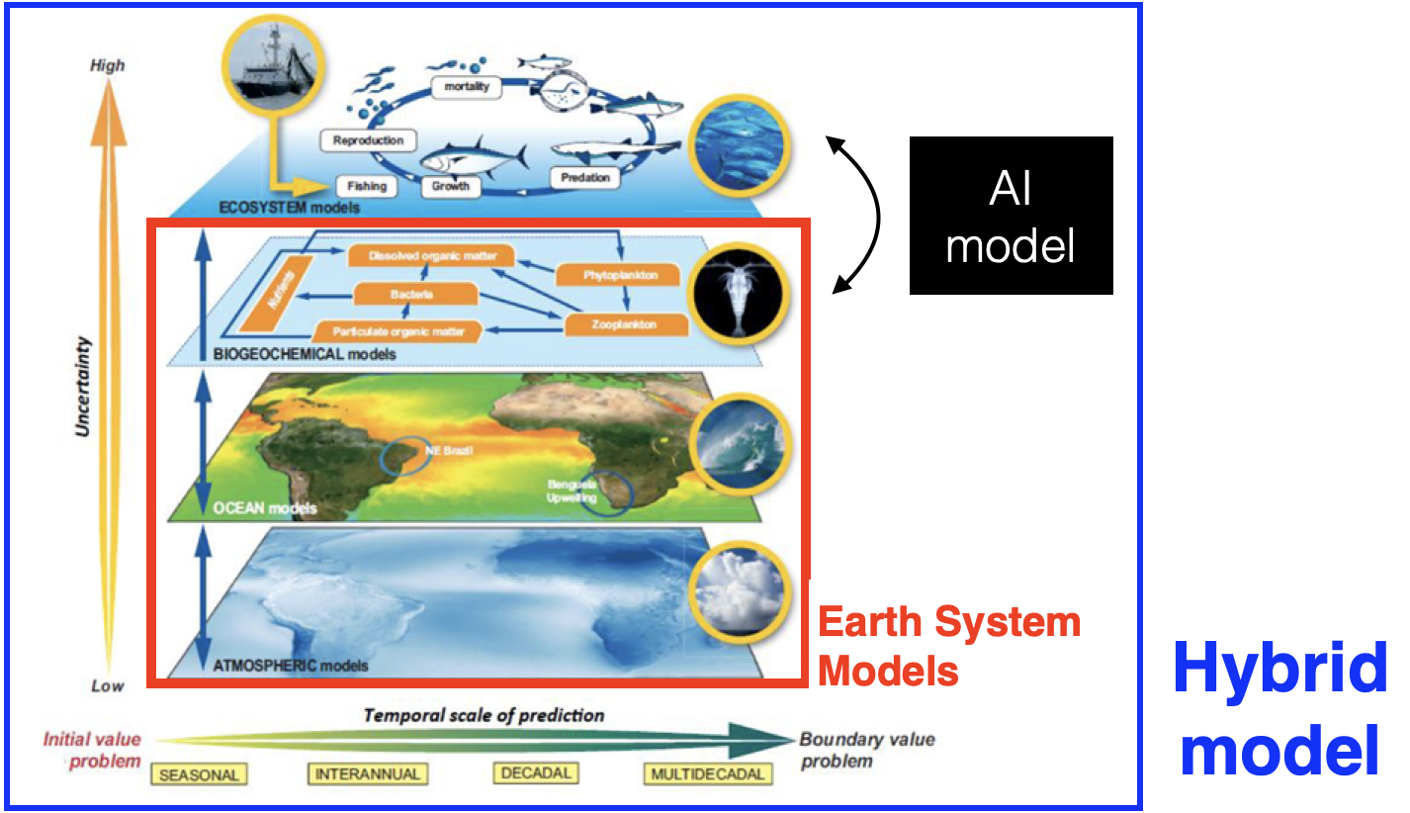
Characterising the twilight zone ecosystems
The twilight zone is:
potential source of nutrients
potential commercial exploitation
but is it sustainable?
strategic resource
Bianchi et al, 2013
Environmental
characterisation
AI-based image classification
Reygondeau et al, 2018
In collaboration with
Notes:
The ORCAS project uses robotic measurements of organic particles (sinking plankton, aggregates) and compares them to equivalent estimates made with PISCES, the ocean biogeochemistry component of EC-Earth. The values of key model parameters are optimized by running the model in 1D (water column) offline configuration and comparing it to observations iteratively until a good fit is obtained. The genetic algorithm is embedded in the Autosubmit workflow manager. The approach is repeated in different ocean regions with abundant measurements to obtain globally-relevant parameters that can be then used in global 3D simulations. This approach can also detect limitations in the model and lead to the development of new parameterizations.

Slide 7
Deep learning for processing model output
Downscaling precipitation with supervised U-NETs and ERA5 large-scale predictors.
Input: Precipitation plus predictor variables
Output:
Precipitation at higher resolution
Cross-modal transfer functions with conditional generative models (cGAN).
Input:
Predictor variables (geopotential, humidity, temperature)
Output:
Probabilistic precipitation at higher resolution
CNN (e.g. U-NET)
Notes:
The ORCAS project uses robotic measurements of organic particles (sinking plankton, aggregates) and compares them to equivalent estimates made with PISCES, the ocean biogeochemistry component of EC-Earth. The values of key model parameters are optimized by running the model in 1D (water column) offline configuration and comparing it to observations iteratively until a good fit is obtained. The genetic algorithm is embedded in the Autosubmit workflow manager. The approach is repeated in different ocean regions with abundant measurements to obtain globally-relevant parameters that can be then used in global 3D simulations. This approach can also detect limitations in the model and lead to the development of new parameterizations.

Slide 8
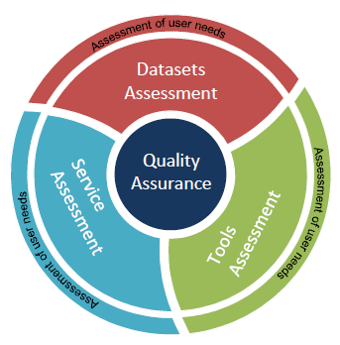
Evaluation and quality control
BSC leads the contract responsible of the development of the evaluation and quality control (EQC) function of the climate data store (CDS) of the Copernicus Climate Change Service (C3S) to:
Provide a user-led overarching EQC service for the whole CDS
Provide an independent quality assessment
CDS datasets: provide information about the technical and scientific quality and fitness-for-purpose, and an assessment of the datasets
CDS toolbox: assessment of maturity and fitness for purpose of the software provided to explore the datasets
CDS service: performance assessment of the CDS infrastructure (e.g. speed, responsiveness, system availability)
CDS users: user requirement assessment to measure users’ satisfaction with the CDS. Map evolving user needs into viable user requirements to ensure a user-oriented evolution of the CDS

Slide 9
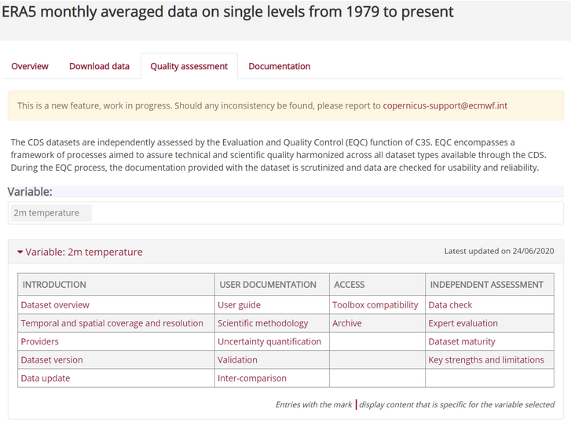
Evaluation and quality control

Slide 10
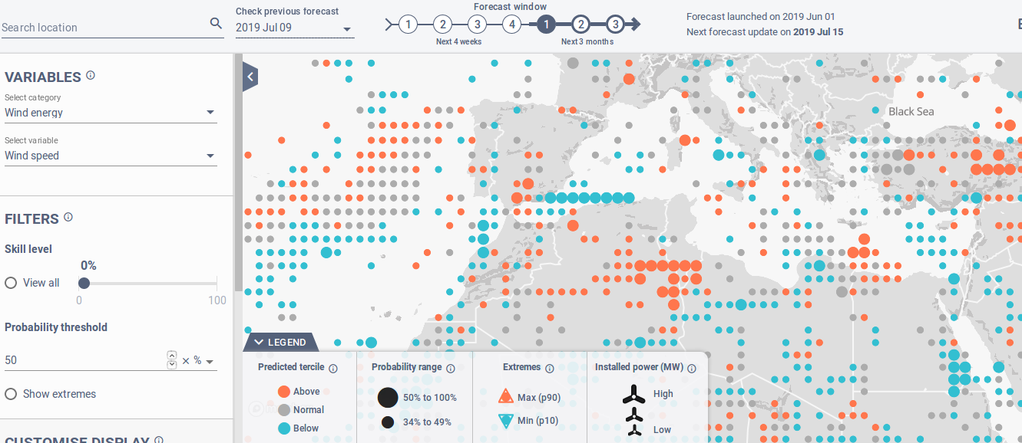
Prototypical services: energy
Climate service for the renewable energy sector based on C3S forecasts processed and displayed operationally for the industry using user engagement practices.
Publicly available (under registration) from http://s2s4e.eu/dst

Slide 11
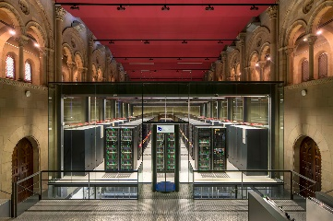
A broader sense of the service: Climate analysis cluster
BSC/RISC2
platform
Data storage
A user-friendly data analysis cluster accessed through Jupyter Notebooks as the best way to enhance the user data analysis experience based on access to open and free Earth European data to ensure the sustainability, traceability and usefulness of the action.

