Slide 1
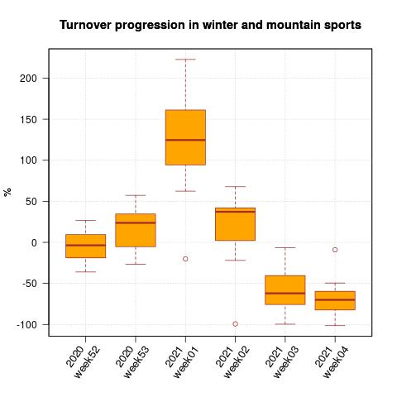
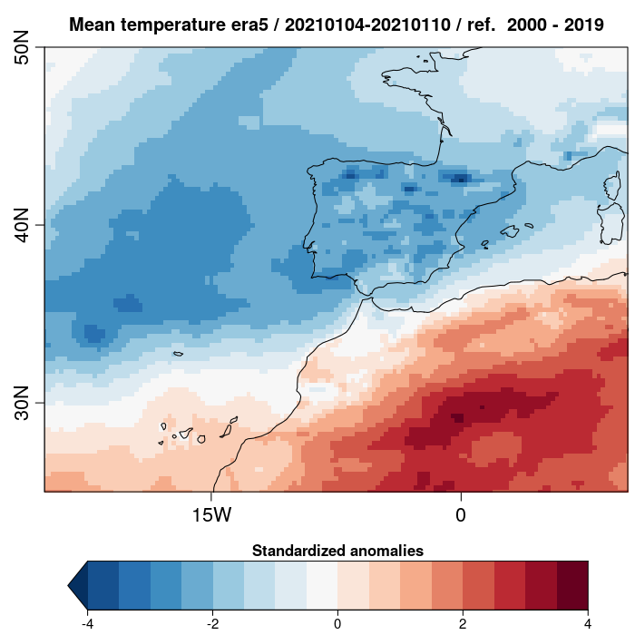
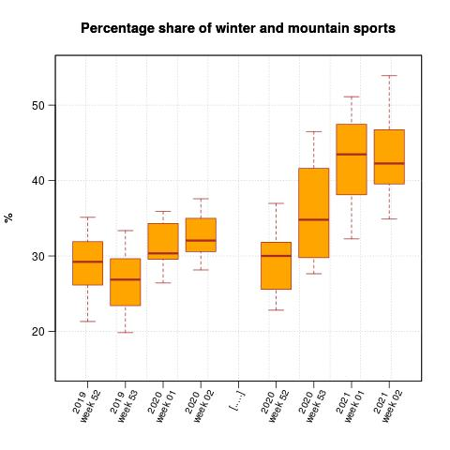
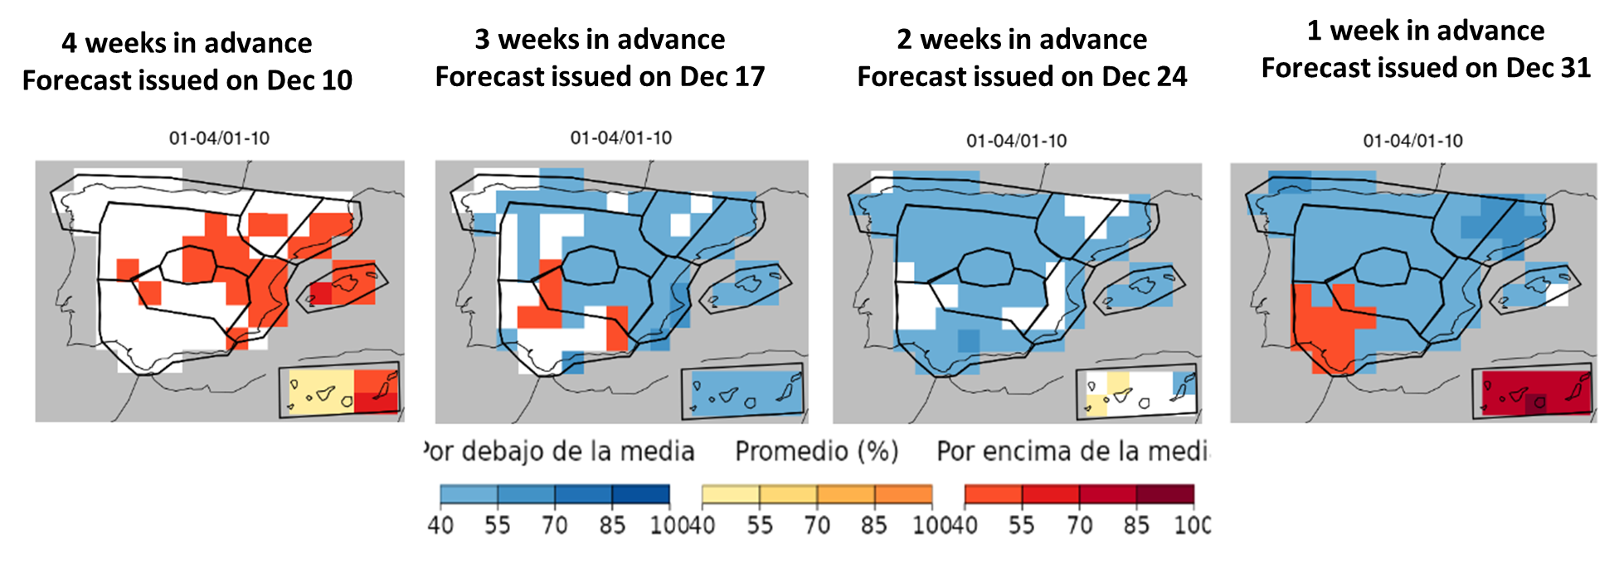
Climate services for the retail sector: Filomena’s case
A QUICK PROOF OF THE CLIMATE INFLUENCE ON RETAIL USING DECATHLON DATA
ANOMALY MAP
Around 75% of regional aggregations of Decathlon’s stores had increased winter and mountain sporting good sales in 100% or higher during Filomena’s week
OBSERVATIONS
vs
FORECAST FOR FILOMENA’S WEEK
DIFFERENT WEEKS IN ADVANCE
During Filomena’s week and the next one, the percentage of winter and mountain sales to the total experienced a remarkable increase
WELL-PREDICTED 3 WEEKS
IN ADVANCE!
A. Martinez Boti^{1,3}, Ll. Palma^{1,3}, F. Roura¹, A. Manrique-Suñén¹, N. Gonzáles-Reviriego¹, R. Marcos^{1,3}, S. González², A. López² and A. Soret¹
¹Barcelona Supercomputing Center, Earth Sciences, Barcelona, 08034, Spain
²Decathlon España, San Sebastian de los Reyes, Madrid, Spain
³Universitat de Barcelona, Barcelona, 08007, Spain

