Slide 1
Seeking value in decadal predictions
M. Donat, F. Doblas-Reyes, R. Bilbao, L.-P. Caron, C. Delgado Torres, L. Díaz, Y. Liu, P. Ortega,
Y. Ruprich-Robert, B. Solaraju-Murali, D. Verfaillie, S. Wild

Slide 2
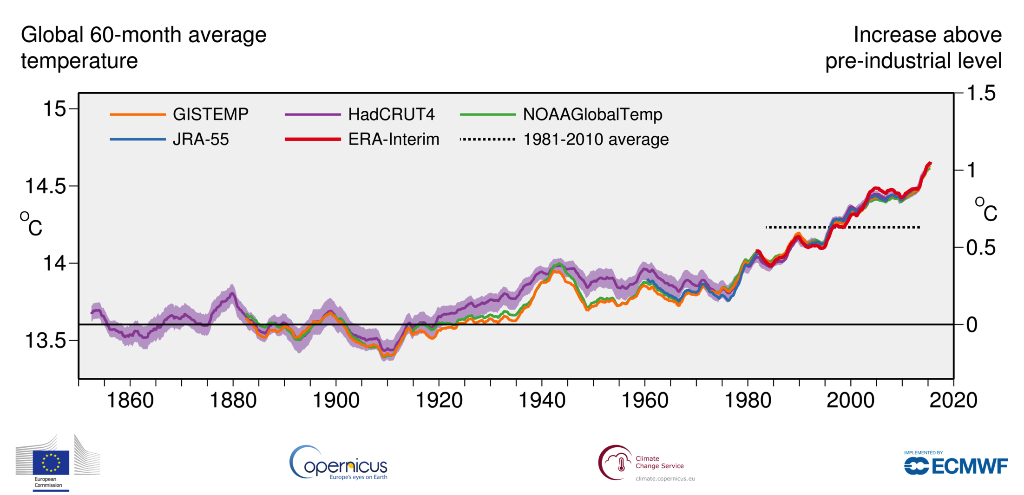
Climate is changing...
…we need to prepare for climate conditions to come
(besides mitigating the worst of course!)

Slide 3
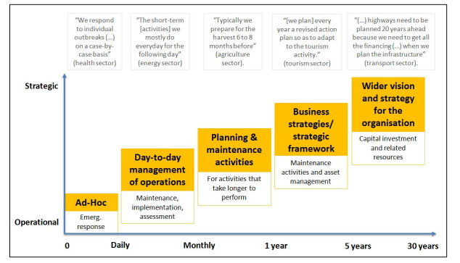
User perspectives: Planning versus climate time scales
Mid-term planning (1-5 yr): business strategies often linked to annual capital investment plans
Long-term planning (5-30 yr): wider vision and strategy, and associated resources and capital investment
Dessai and Bruno-Soares (2013)

Slide 4
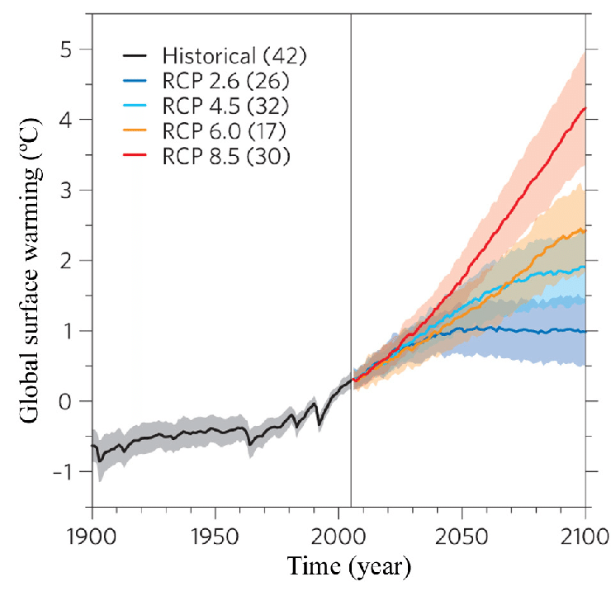
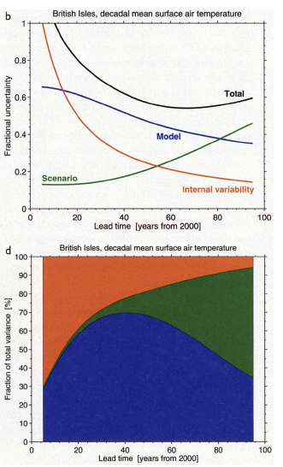
Future climate simulations
Global temperature changes (CMIP5)
Regional temperature extremes TXx (e.g. CONUS)
RCP8.5
RCP4.5
Knutti and Sedlácek (2013)
Global mean temperature anomaly relative to 1861-1880
Seneviratne, Donat et al (2016)
Sources of uncertainty include internal variability, model differences and scenario spread
Internal variability dominates during first decades
Hawkins & Sutton (2009)

Slide 5
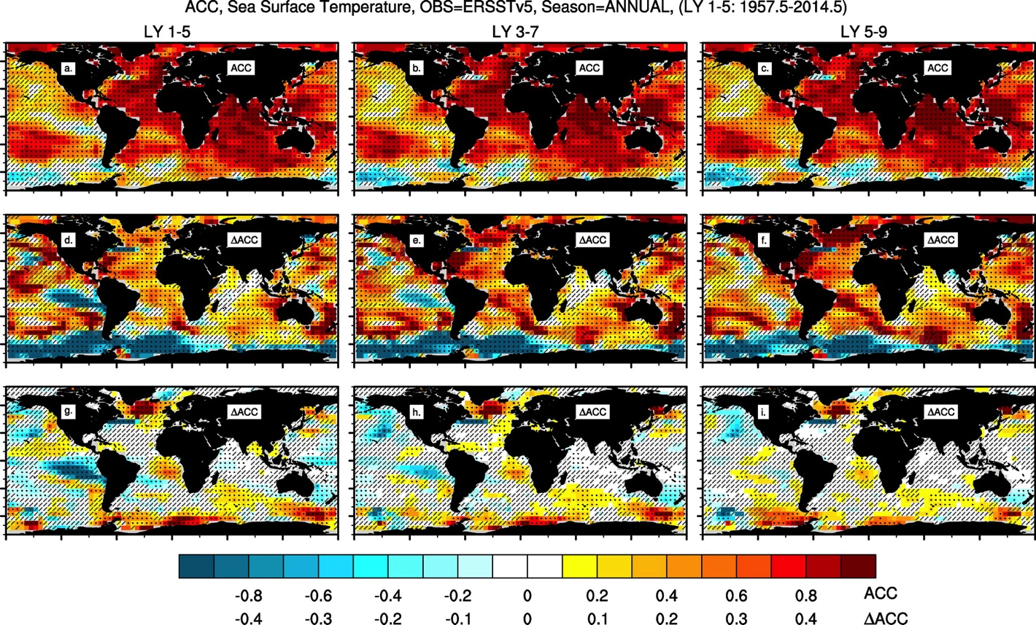
Initialized climate predictions
Skill predicting SSTs, using NCAR’s Decadal Prediction Large Ensemble
Yeager et al (2018)

Slide 6
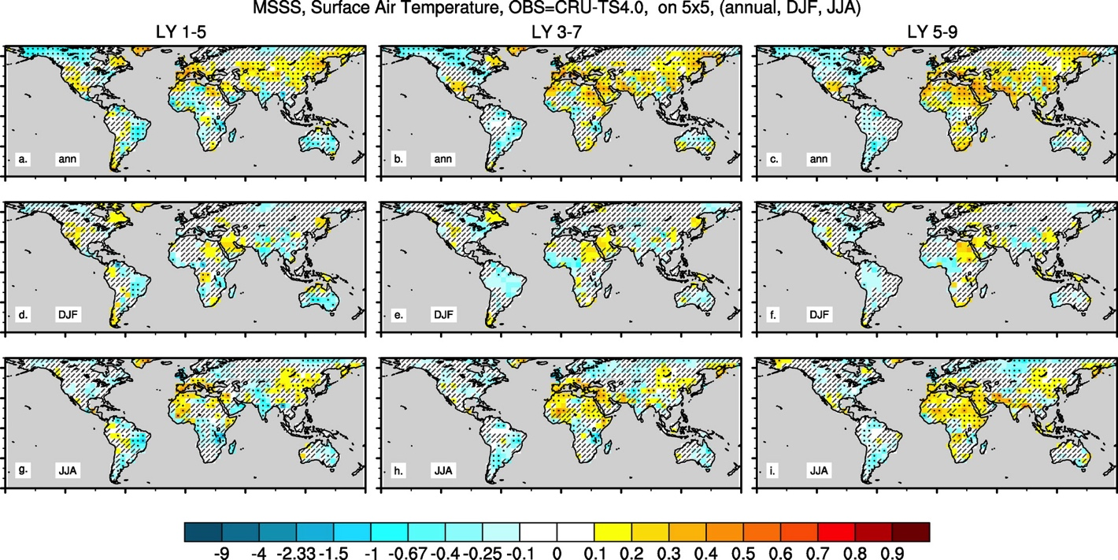
Seeking “value”...
Skill over land (and added value over non-initialized projections)?
Yeager et al (2018)
(note: also skill in predicting ocean condition can of course be of “value” e.g. to fisheries)

Slide 7
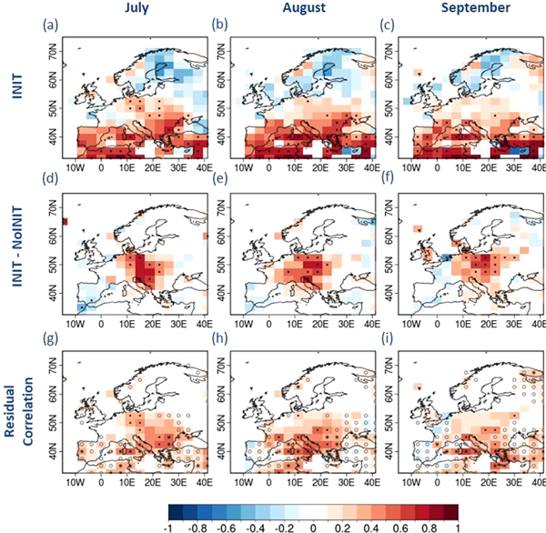
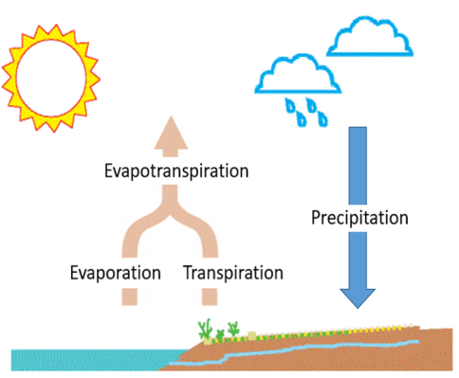
Useful for agricultural applications?
Skilful predictions of drought indicators (e.g. SPI6, SPEI6) for the boreal summer averaged over forecast years 2 to 5.
INIT: Initialized decadal prediction
NoINIT: Non initialized climate projection
Solaraju-Murali et al 2019

Slide 8
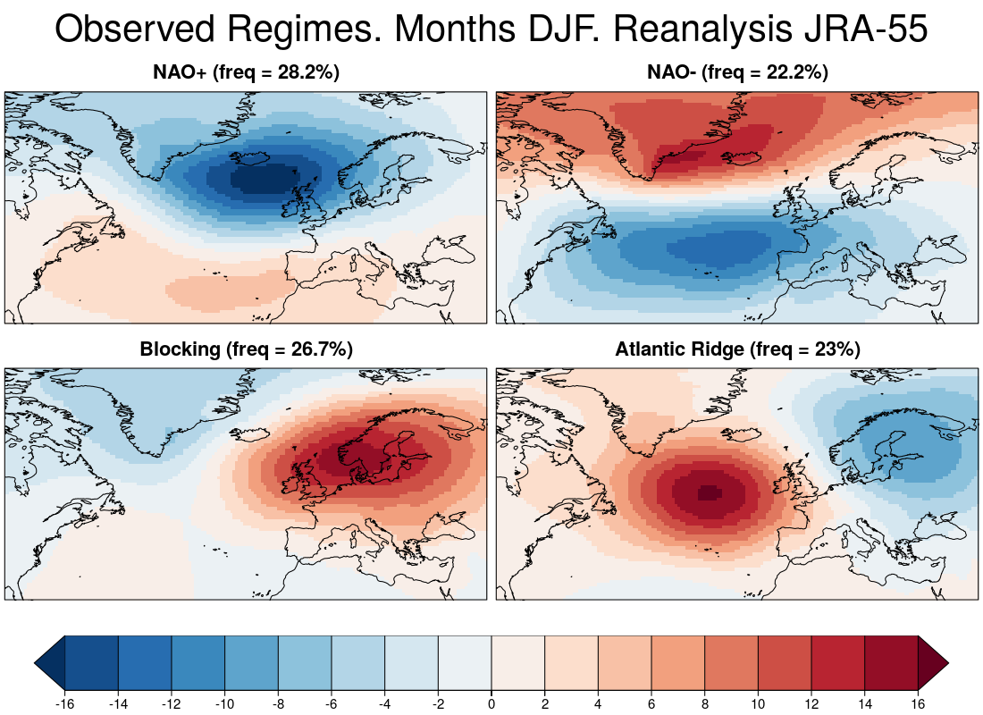
Euro-Atlantic Weather Regimes
Skill multiple years ahead (summer)
in EC-Earth 3.3, 10 ensemble members (DCPP-A),
Related to Atlantic SSTs
ACC
Delgado-Torres et al, in prep

Slide 9
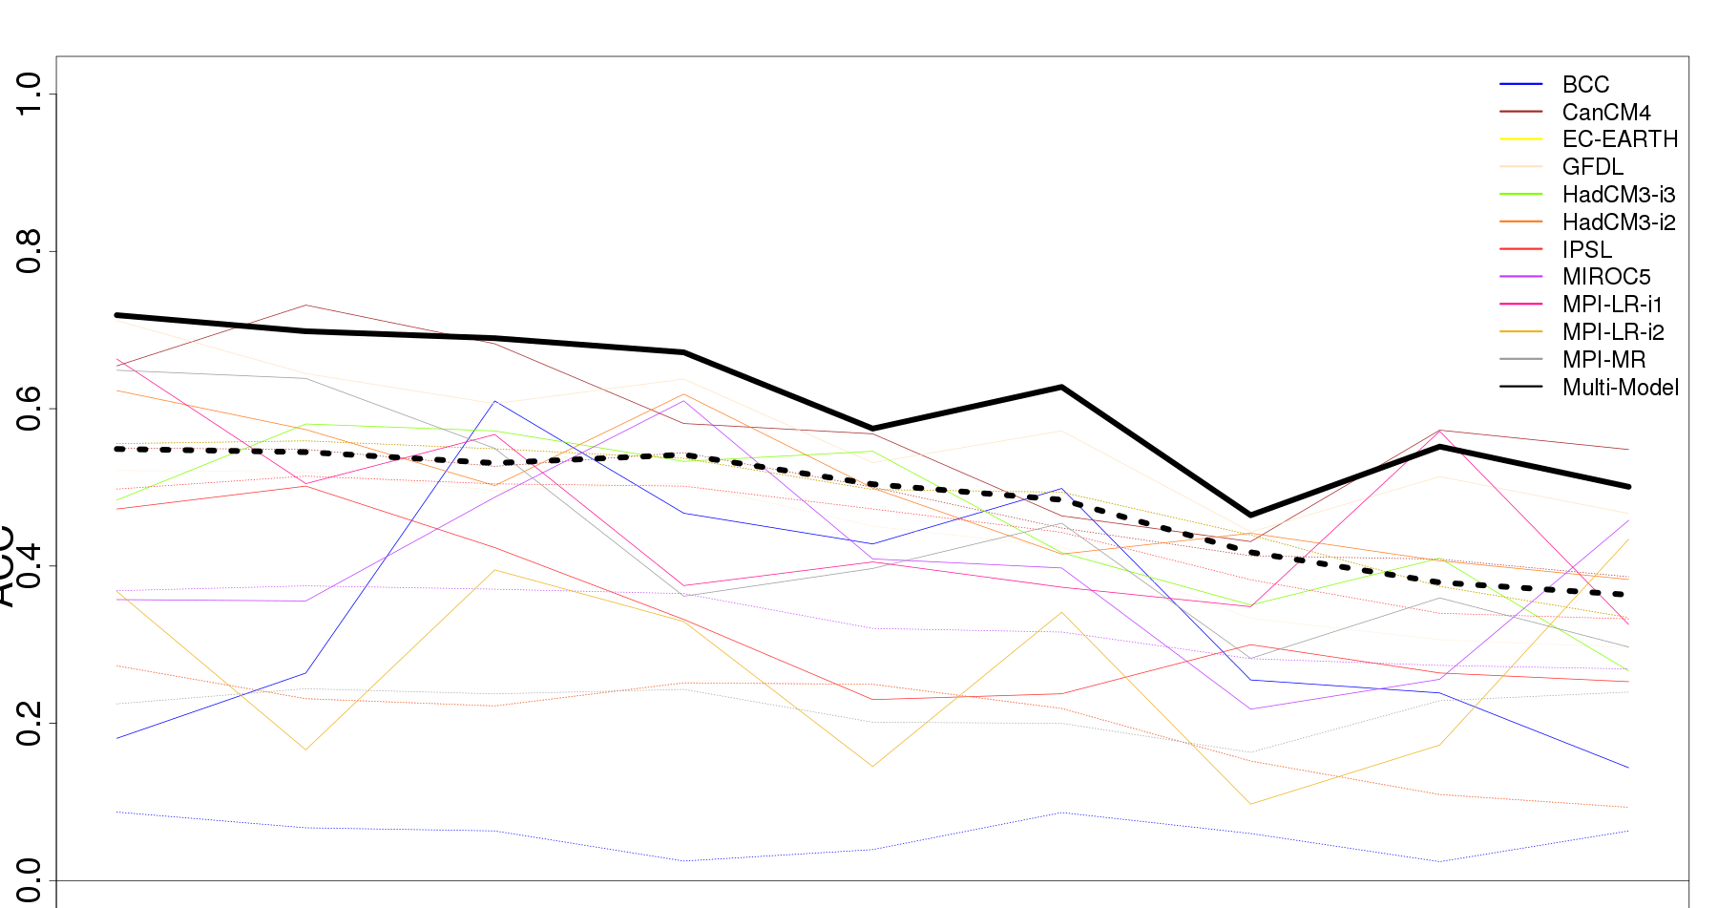
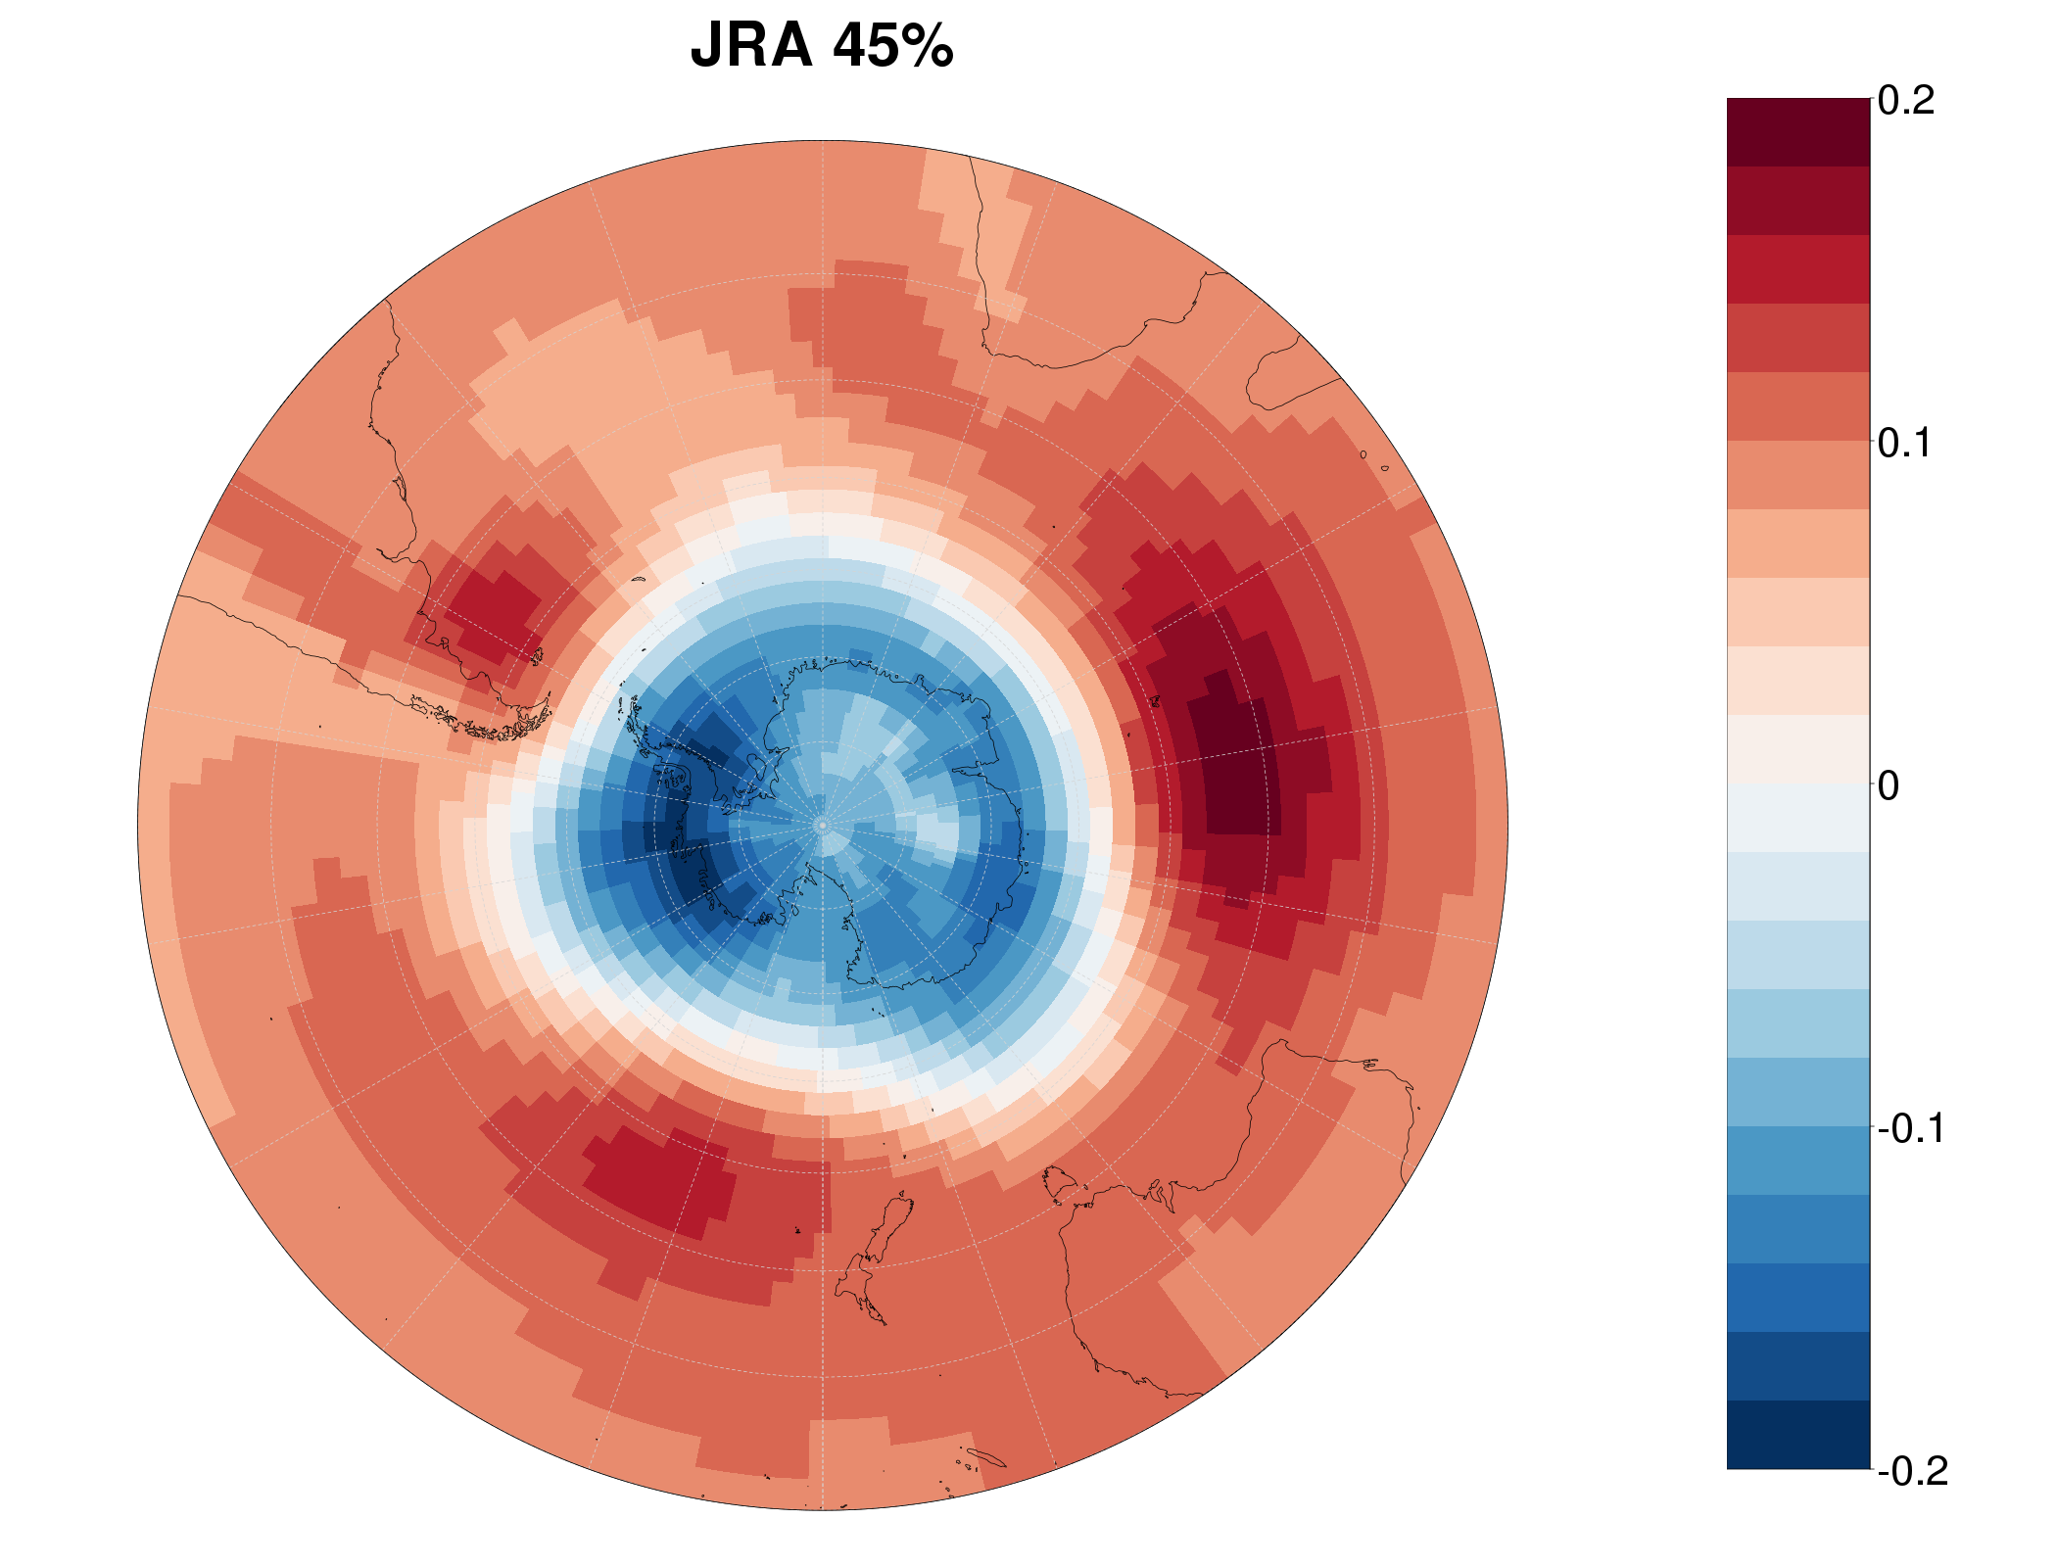
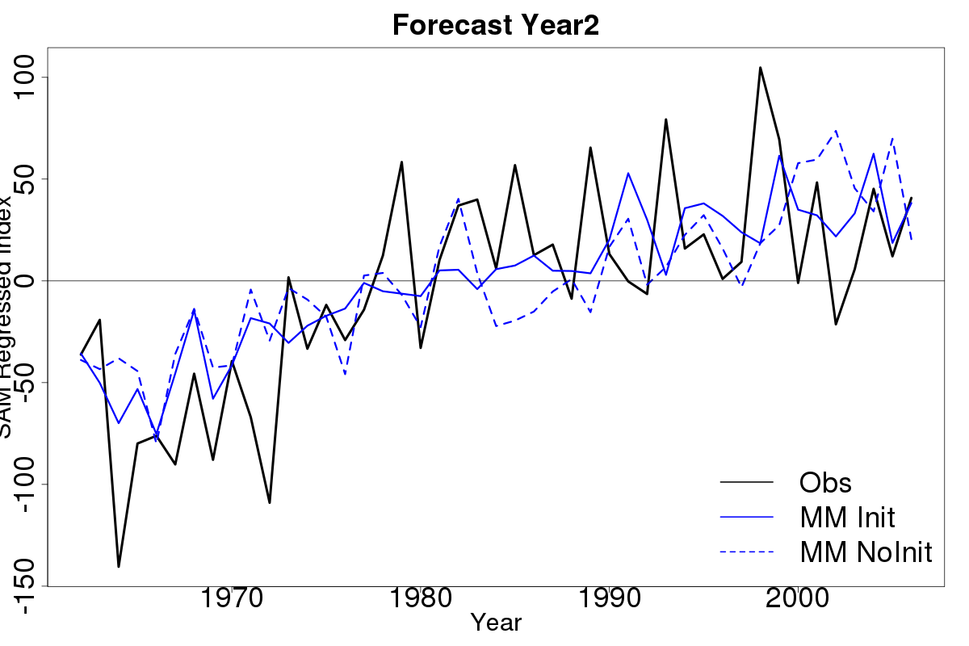
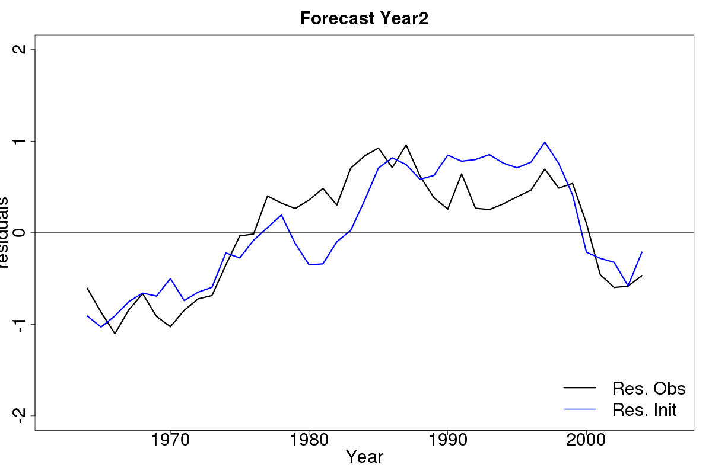
Southern Annual Mode
e.g. defined as 1st EOF of MSLP
ACC [CMIP5+SPECS, n=69 members]
Init
NoInit
0.0 0.2 0.4 0.6 0.8
Forecast Year
Diaz et al, in prep
2 4 6 8
Residuals, 5-yr averages

Slide 10
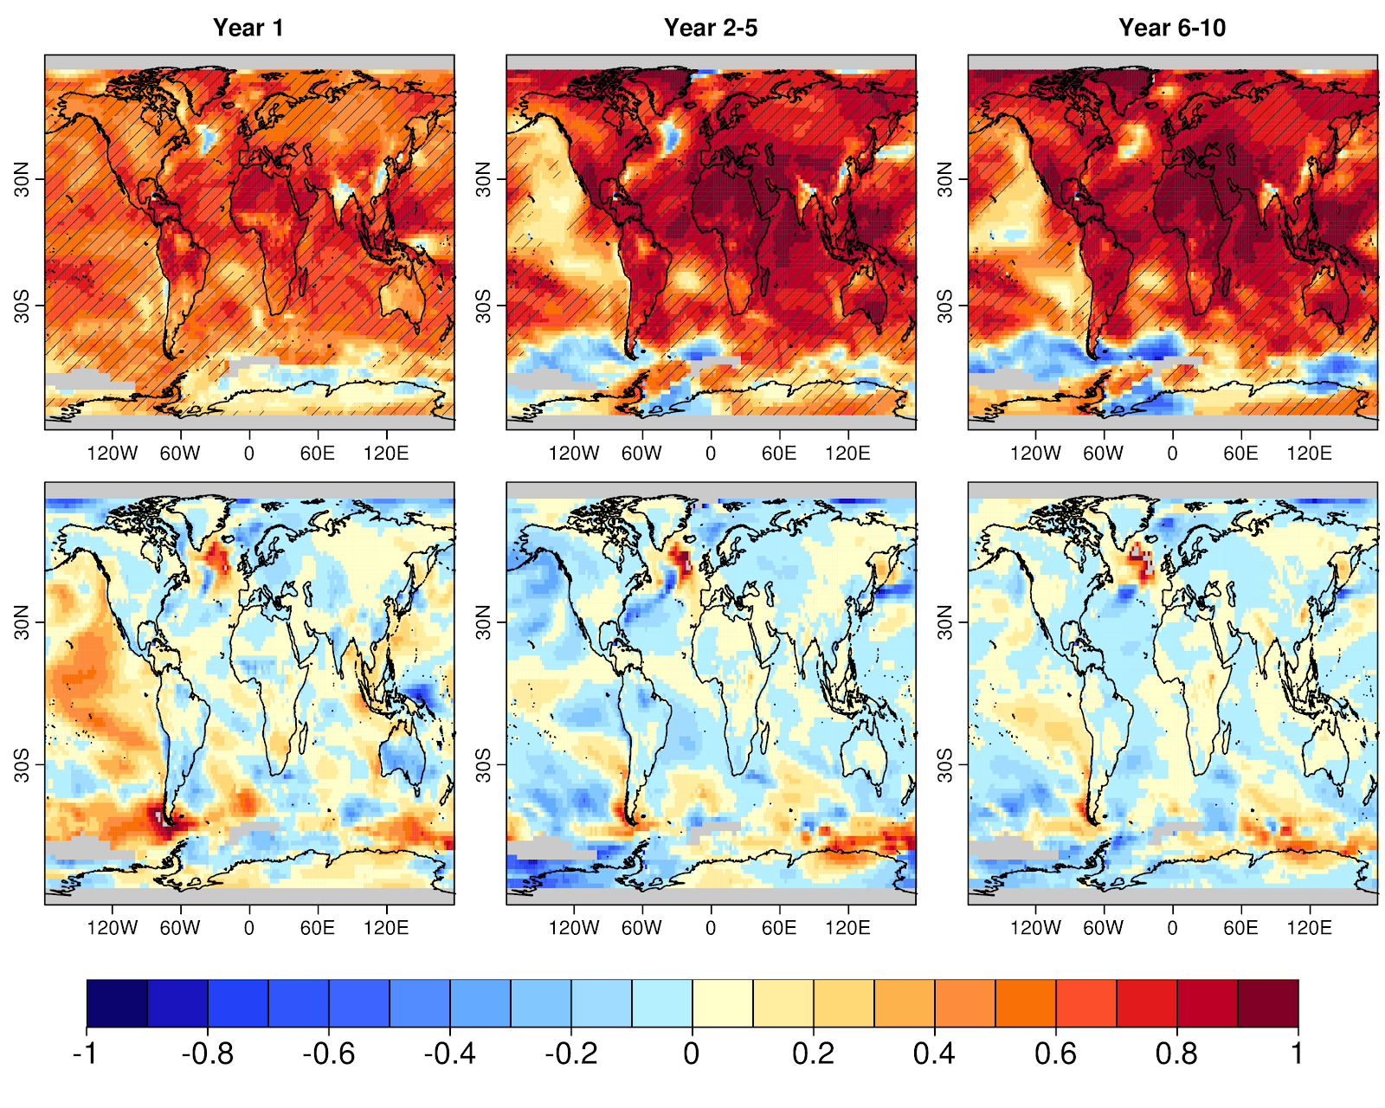
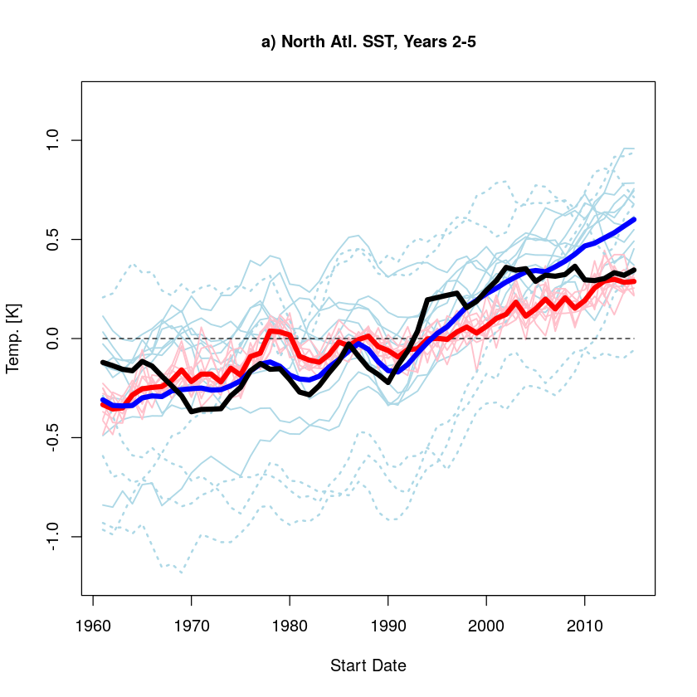
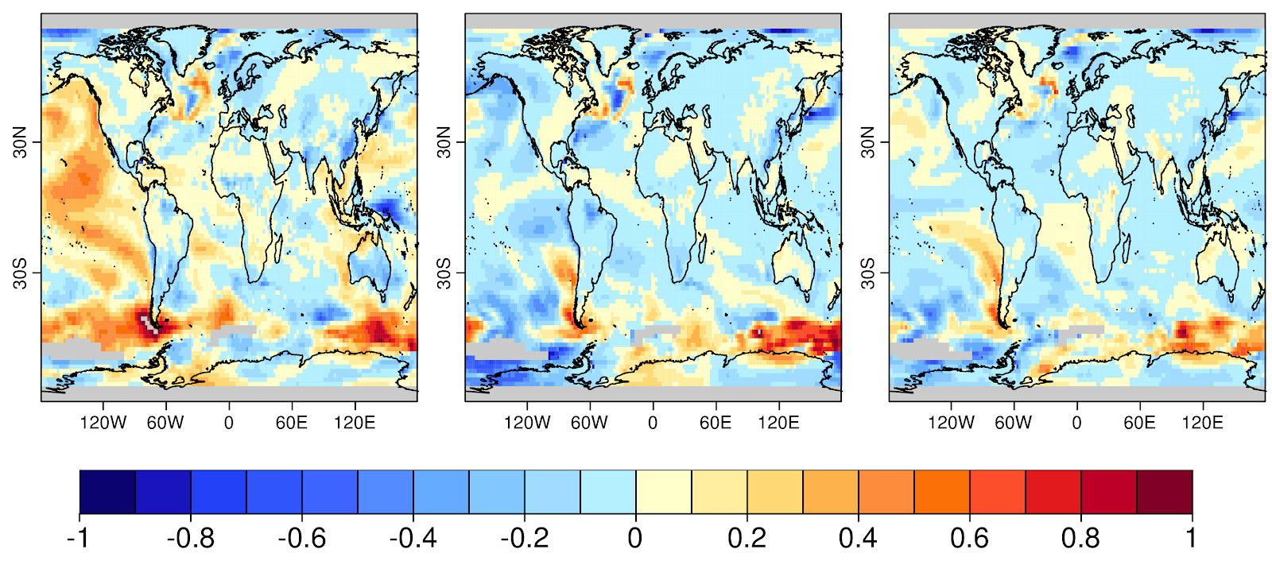
Added value of initialization depends on reference
Un-initialized runs show vide range of behavior; skill estimates depend on how the ‘ensemble of opportunity’ is constructed
Yr1
Yr2-5
Yr6-10
SST North Atlantic (yr 2-5)
Obs
Init
NoInit
ΔACC
(10 ”worst”)
Temperature Anomaly
ΔACC
(10 ”best”)
time

Slide 11
“Perfect-model” predictions - predictability from perfect initial state
5-member prediction started 1 Nov 2019
Versus “Signal-to-Noise Paradox?”
5-member prediction started 1 Nov 1962
… every year …
5-member prediction started 1 Nov 1961
5-member prediction started 1 Nov 1960
1960
2019
Observations
Smith et al (2019)
Historical climate simulation

Slide 12
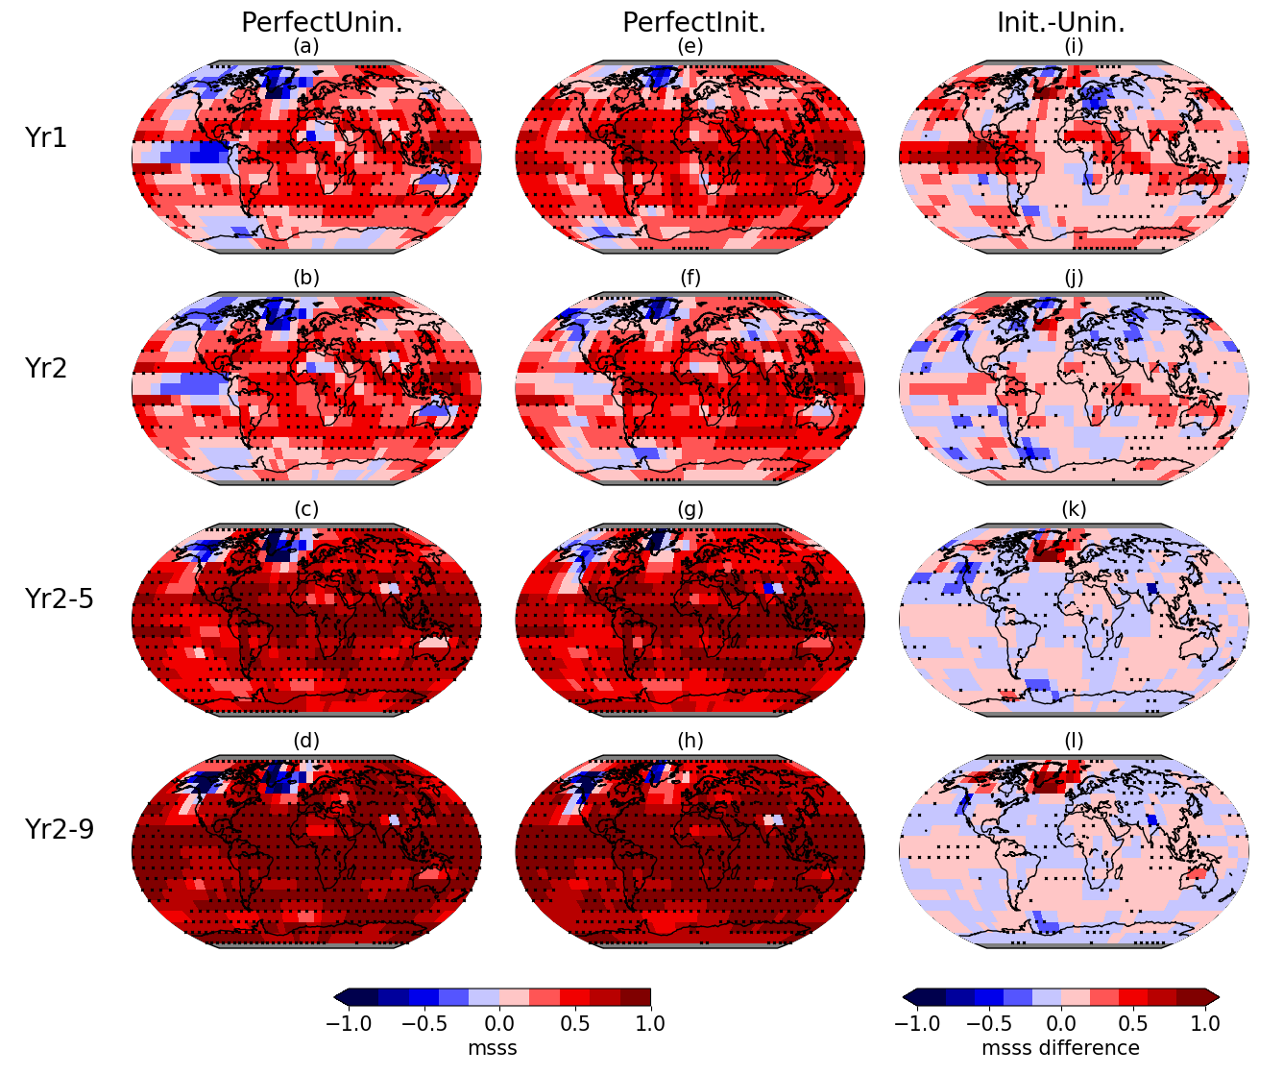
MSSS in initialized and un-initialized perfect-model predictions
CCSM4,
annual initializations from historical run, 5 ensemble members.
Compare to historical simulations (CMIP5)
Liu, Donat et al (2019, JGR-Atmosphere)
[added value from initialization?]

Slide 13
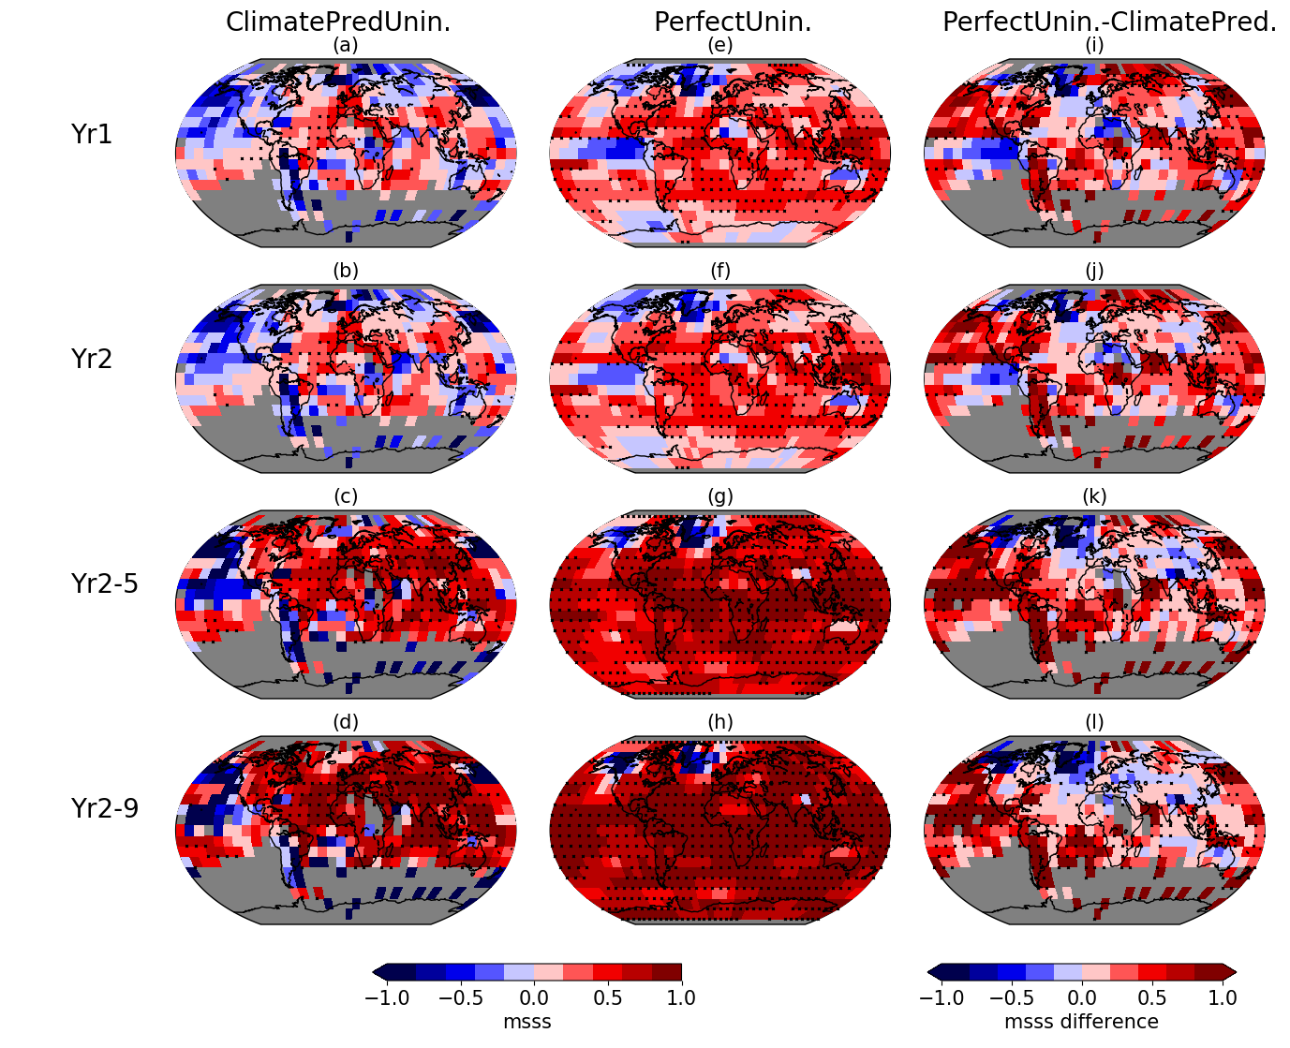
MSSS un-initialized real-world and perfect-model predictions
Liu, Donat et al (2019, JGR-Atmosphere)
[inconsistencies model vs. obs?]

Slide 14
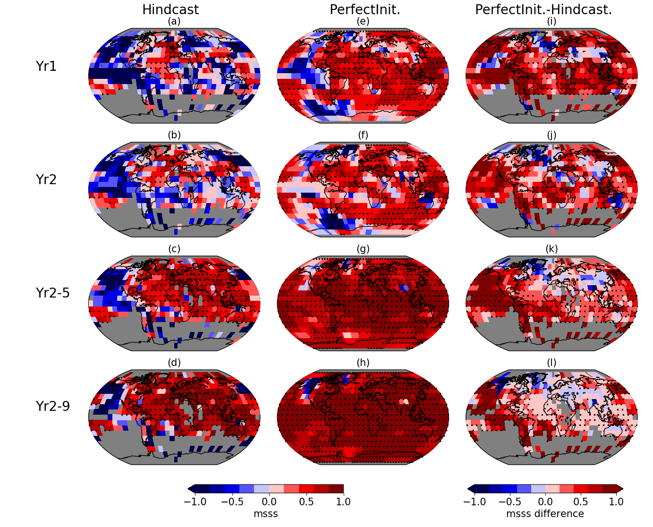
MSSS un-initialized real-world and perfect-model predictions
Versus “Signal-to-Noise Paradox?”
Smith et al (2019)
Liu, Donat et al (2019, JGR-Atmosphere)
[total margin of possible improvement?]

Slide 15
Predictability of extremes (vs mean)
Correlation skill
Tmean # of warm days warm days - Tmean
Tmean # of cold nights cold nights - Tmean
Liu, Donat et al (2019, Climate Dynamics)

Slide 16
Summary
Decadal predictions show initialization-related skill in some aspects of atmospheric circulation
this can help to predict climate conditions over continental regions (e.g. drought indicators)
Identifying added value from initialization is sensitive to the behaviour of the ensemble of non-initialized runs used for reference
Perfect-model experiments can be useful to identify the potentially achievable skill in multi-annual predictions
Indicate initialization-related added value over land for two to three forecast years (CCSM4)
Indicate increased predictability of moderate temperature extremes compared to average conditions
Need to better understand how predictability differs between models and real-world climate, and across different models

Slide 17
Thank you.
markus.donat@bsc.es
This work was supported through the European Horizon 2020 project EUCP (EUropean Climate Prediction system) under Grant agreement no. 776613 and by the Spanish Ministry for the Economy, Industry and Competitiveness Ramón y Cajal 2017 grant reference RYC-2017-22964

