Slide 1
Tall wind mast data collection
Jaume Ramon
Llorenç Lledó
13/11/2018
INDECIS 2nd GA, Dublin

Slide 2
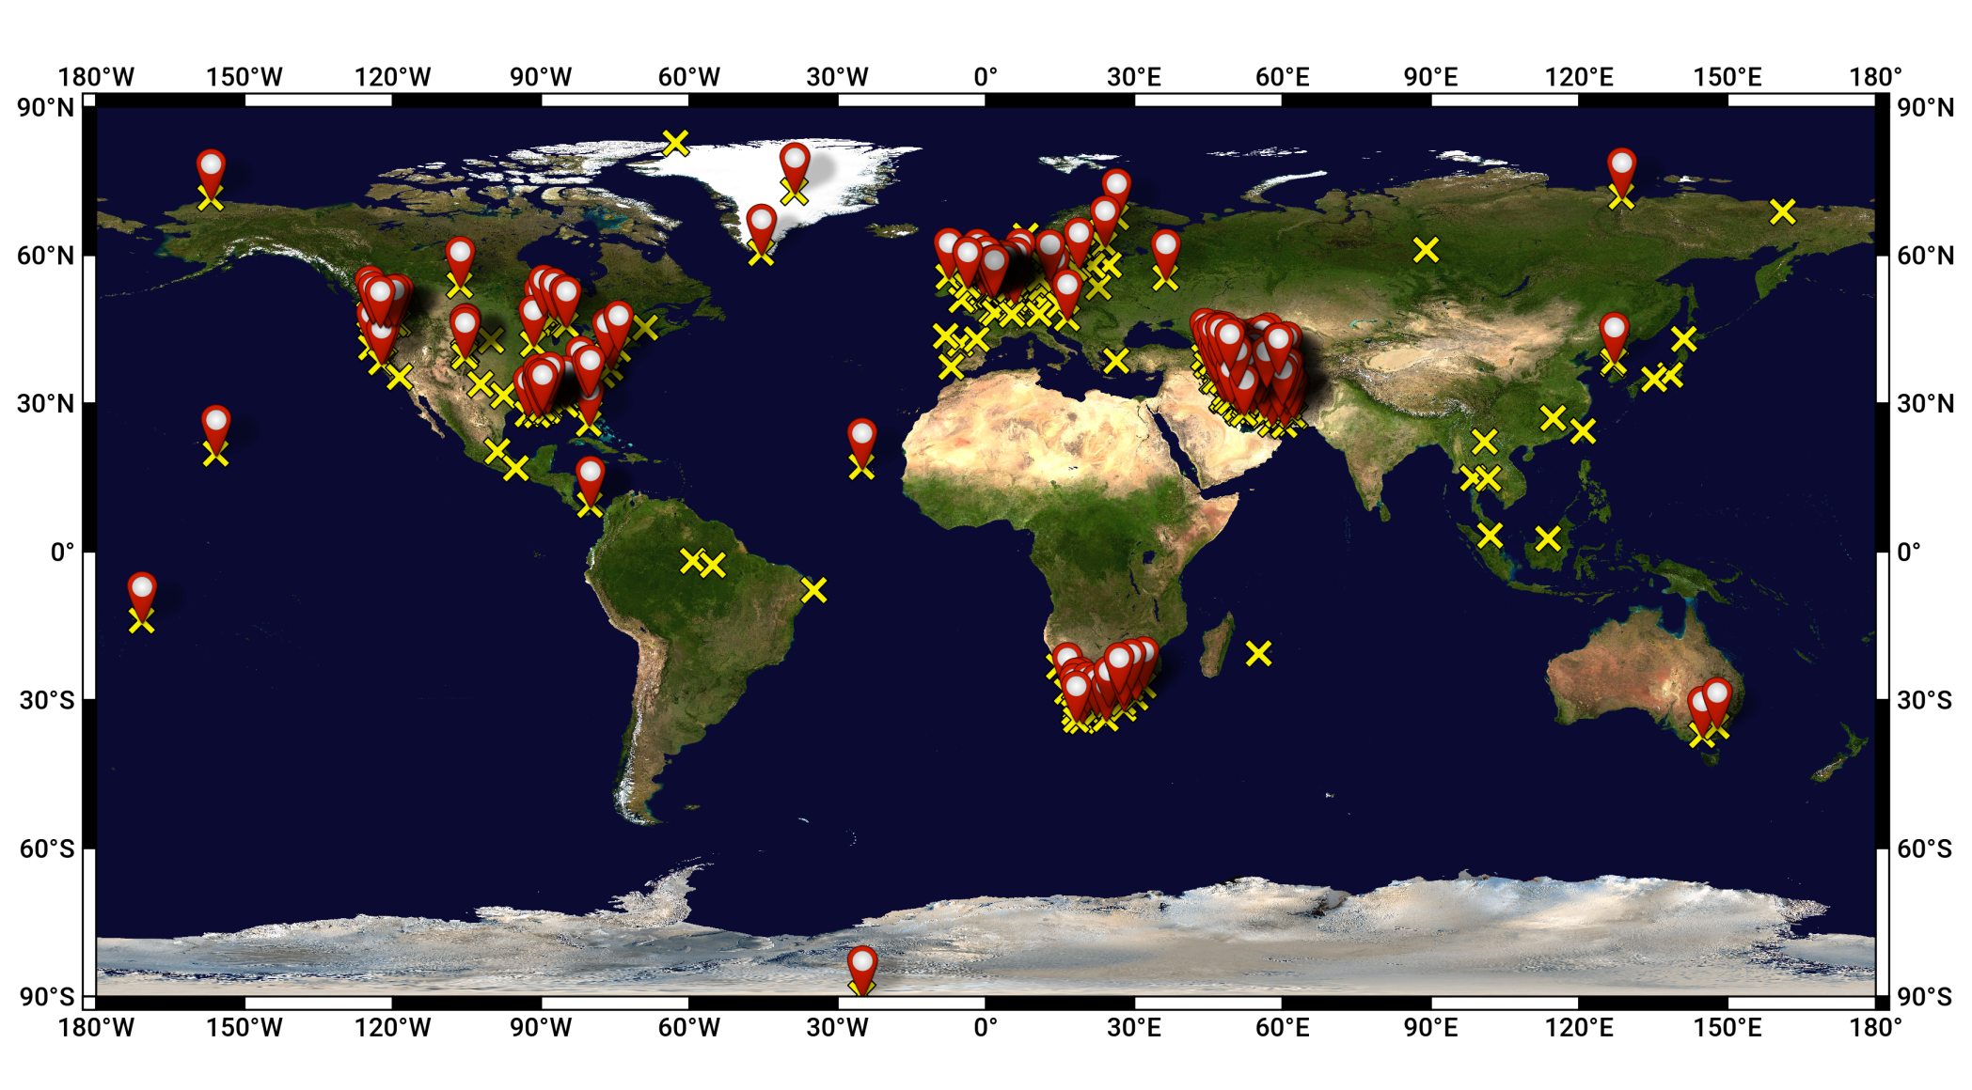
Tall tower database
Identified (311)
Processed (215)
Notes:
Bsc objectives – consortium – objectius consorci

Slide 3
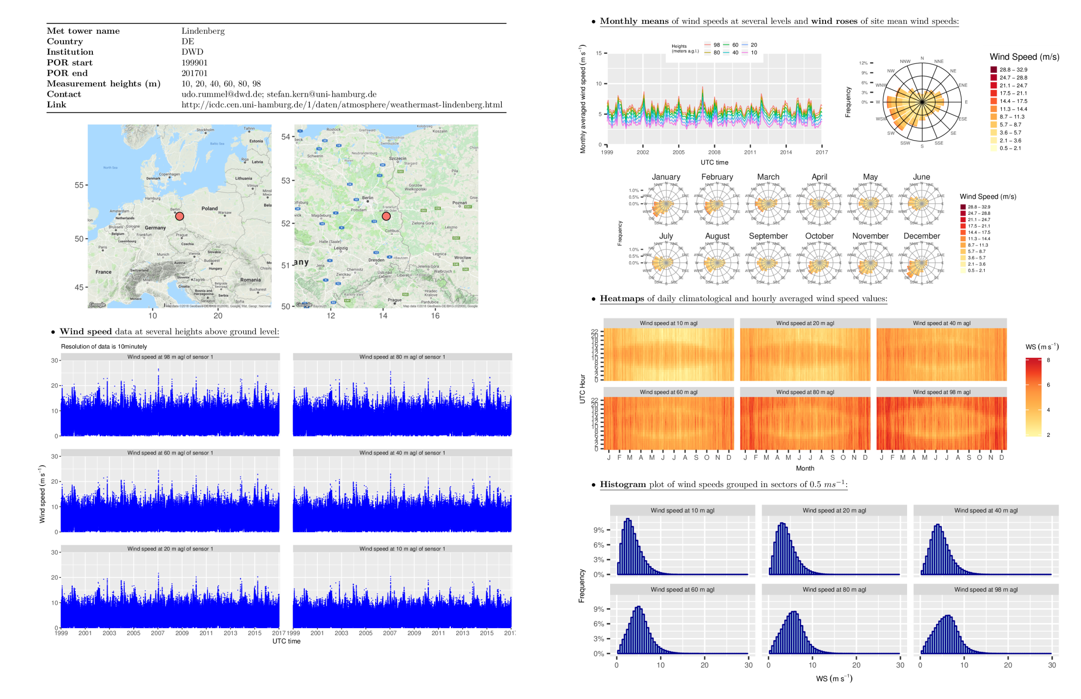
Tall tower summary sheets
Notes:
Bsc objectives – consortium – objectius consorci

Slide 4
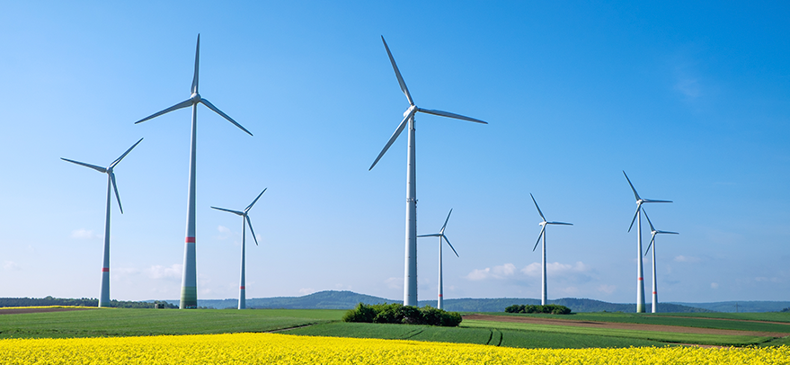
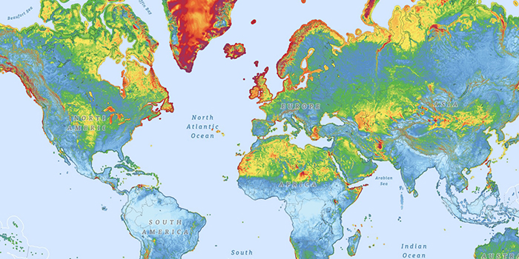
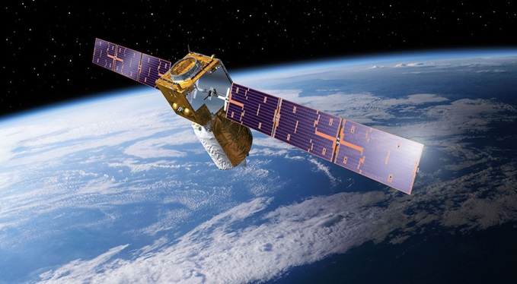
Potential users – future usage
RESEARCH
VERIFICATION
ENERGY
Climate indices calculation. Capacity Factor (CF):
$$CF=\frac{power produced}{\max{power prod.}}$$
PBL studies
From mesoscale simulations to seasonal predictions
Reanalysis datasets
Wind atlas
Satellite products
Wind resource assessment
Risk assessment for energy projects
Measure-Correlate-Predict (MCP) methods

Slide 5
Main challenges
ISSUE |  | SOLUTION
IDENTIFICATION |  | Finished or ongoing projects, initiatives (NEWA, ICOS) Existing databases (WDCGG, Marine Data Exchange) Contacts
DATA ACCESS | Via data portal, ftp, email, etc. | Downloading scripts
FORMAT | Lack of coordination: Metadata Time stamps format and sampling Sensor redundancy Units | Create scripts to process and standardise data format for each tall tower
STORAGE | Total size of original files: 146 GB | Total size of processed data using compressed NetCDF: 9.9 GB

Slide 6
Main challenges
ISSUE |  | SOLUTION
ORGANISATION OF THE INFORMATION | Several measurement heights Different time stamp samplings for the same tower Sensor redundancy | $tower_name$/ $time_resolution$/ windagl$height$S$sensor_id$/ windagl$height$S$sensor_id$_YYYYMM.nc
DATA POLICY | Restrictions when transferring data to thirds | Publish list of tall towers and their metadata
QUALITY OF DATA | Measurement errors Inhomogeneities | QC for tall tower wind data

Slide 7
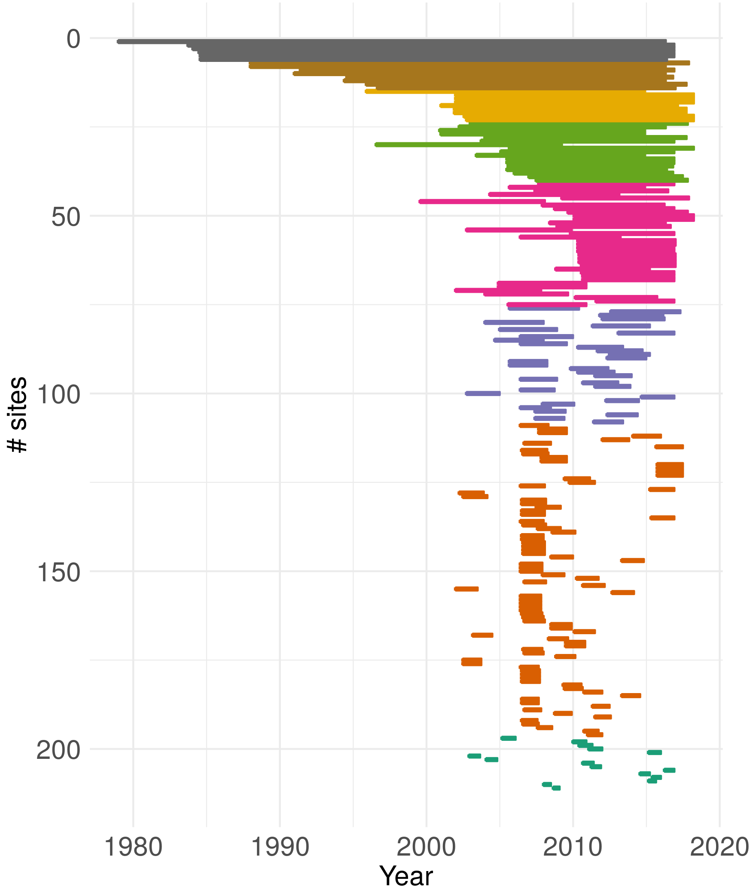
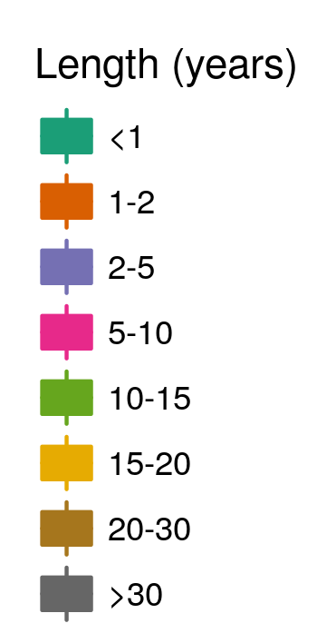
Periods of Record

Slide 8
Conclusions
Data from more than 200 tall towers have been processed
Data are in a standardised format. They will be easily transferable to the INDECIS portal
The data policy issue will affect us in some cases.
We aim to add more data to the Tall Tower Database.
We will be able to release the Tall Tower Raw Database within the INDECIS Raw Database by December 2018.

Slide 9
THANK YOU!
jaume.ramon@bsc.es
INDECIS is part of ERA4CS, an ERA-NET initiated by JPI Climate, and funded by FORMAS (SE), DLR (DE), BMWFW (AT), IFD (DK), MINECO (ES), ANR (FR) with co-funding by the European Union’s Horizon 2020 research and innovation programme under grant agreement no 690462
www.indecis.eu

