Slide 1
22 October 2020
Digital Twin: Climate information for climate change adaptation
Francisco J. Doblas-Reyes

Slide 2
Outline
Context for climate adaptation
Climate information for climate change adaptation and the user role
Sources of climate information and the user-provider interaction
Challenges in the production of climate information and Destination Earth
Linkages
Some questions

Slide 3
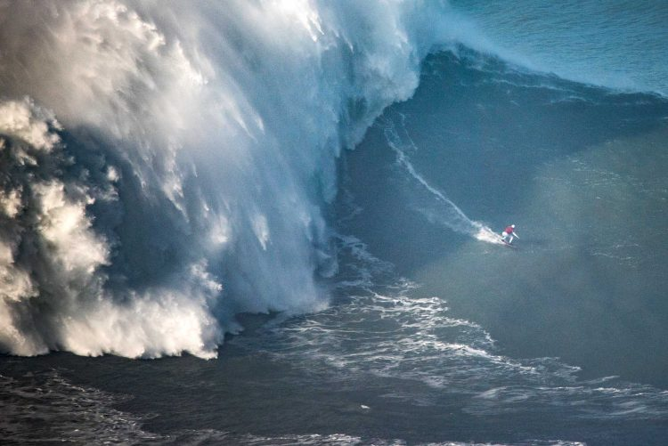
How I felt after a bit of broad search

Slide 4
The international context
Policy and programmes that drive the adaptation to climate change research and development.
Global level policies
UNFCCC Paris Agreement
Sendai Framework for Disaster Risk Reduction
Sustainable Development Goals
European level policies
EU Climate Adaptation Strategy (new one in 2021)
EU Regulation on governance of the Energy Union and Climate action and the Climate Law
EU Water Framework Directive
EU Floods Directive
EU Biodiversity strategy
EU Common Agricultural Policy
European level programmes
LIFE+, Copernicus, Horizon 2020/Europe, Green Deal, Digital Europe
B. Kurnik (EEA)

Slide 5
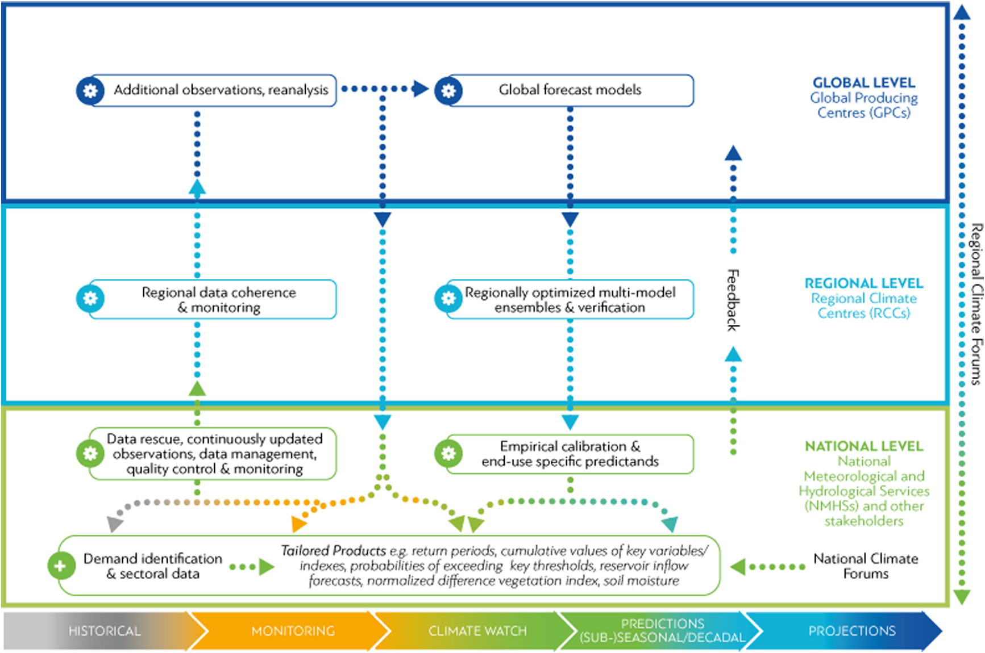
The WMO context
WMO’s Climate Services Information System, a key pillar of GFCS, illustrates the tension between local demand and coarser credibility.
Hewitt et al. (2020, BAMS)

Slide 6
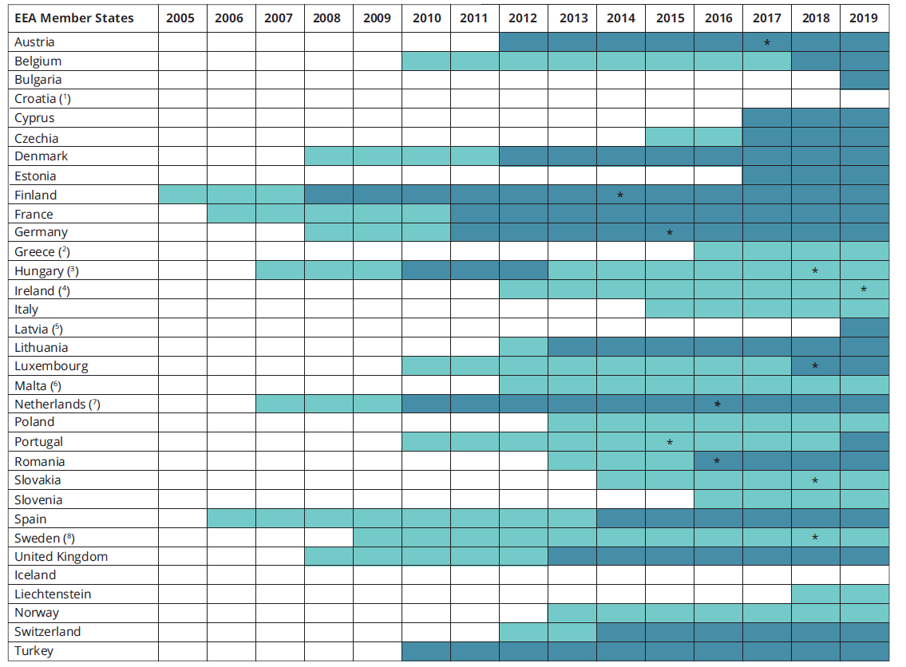
The national context
European countries are promoting adaptation, although at difference paces.
What climate information is it used for the purpose?
Overview of the adoption of national adaptation strategies and plans by EEA member countries
B. Kurnik (EEA)

Slide 7
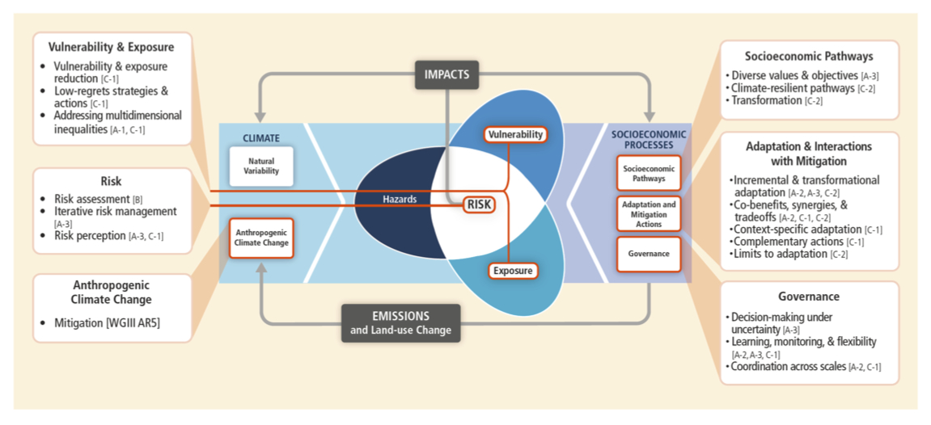
The general scientific context
WGII AR5 SPM (2013)

Slide 8
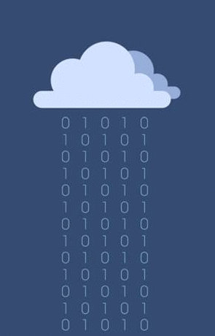
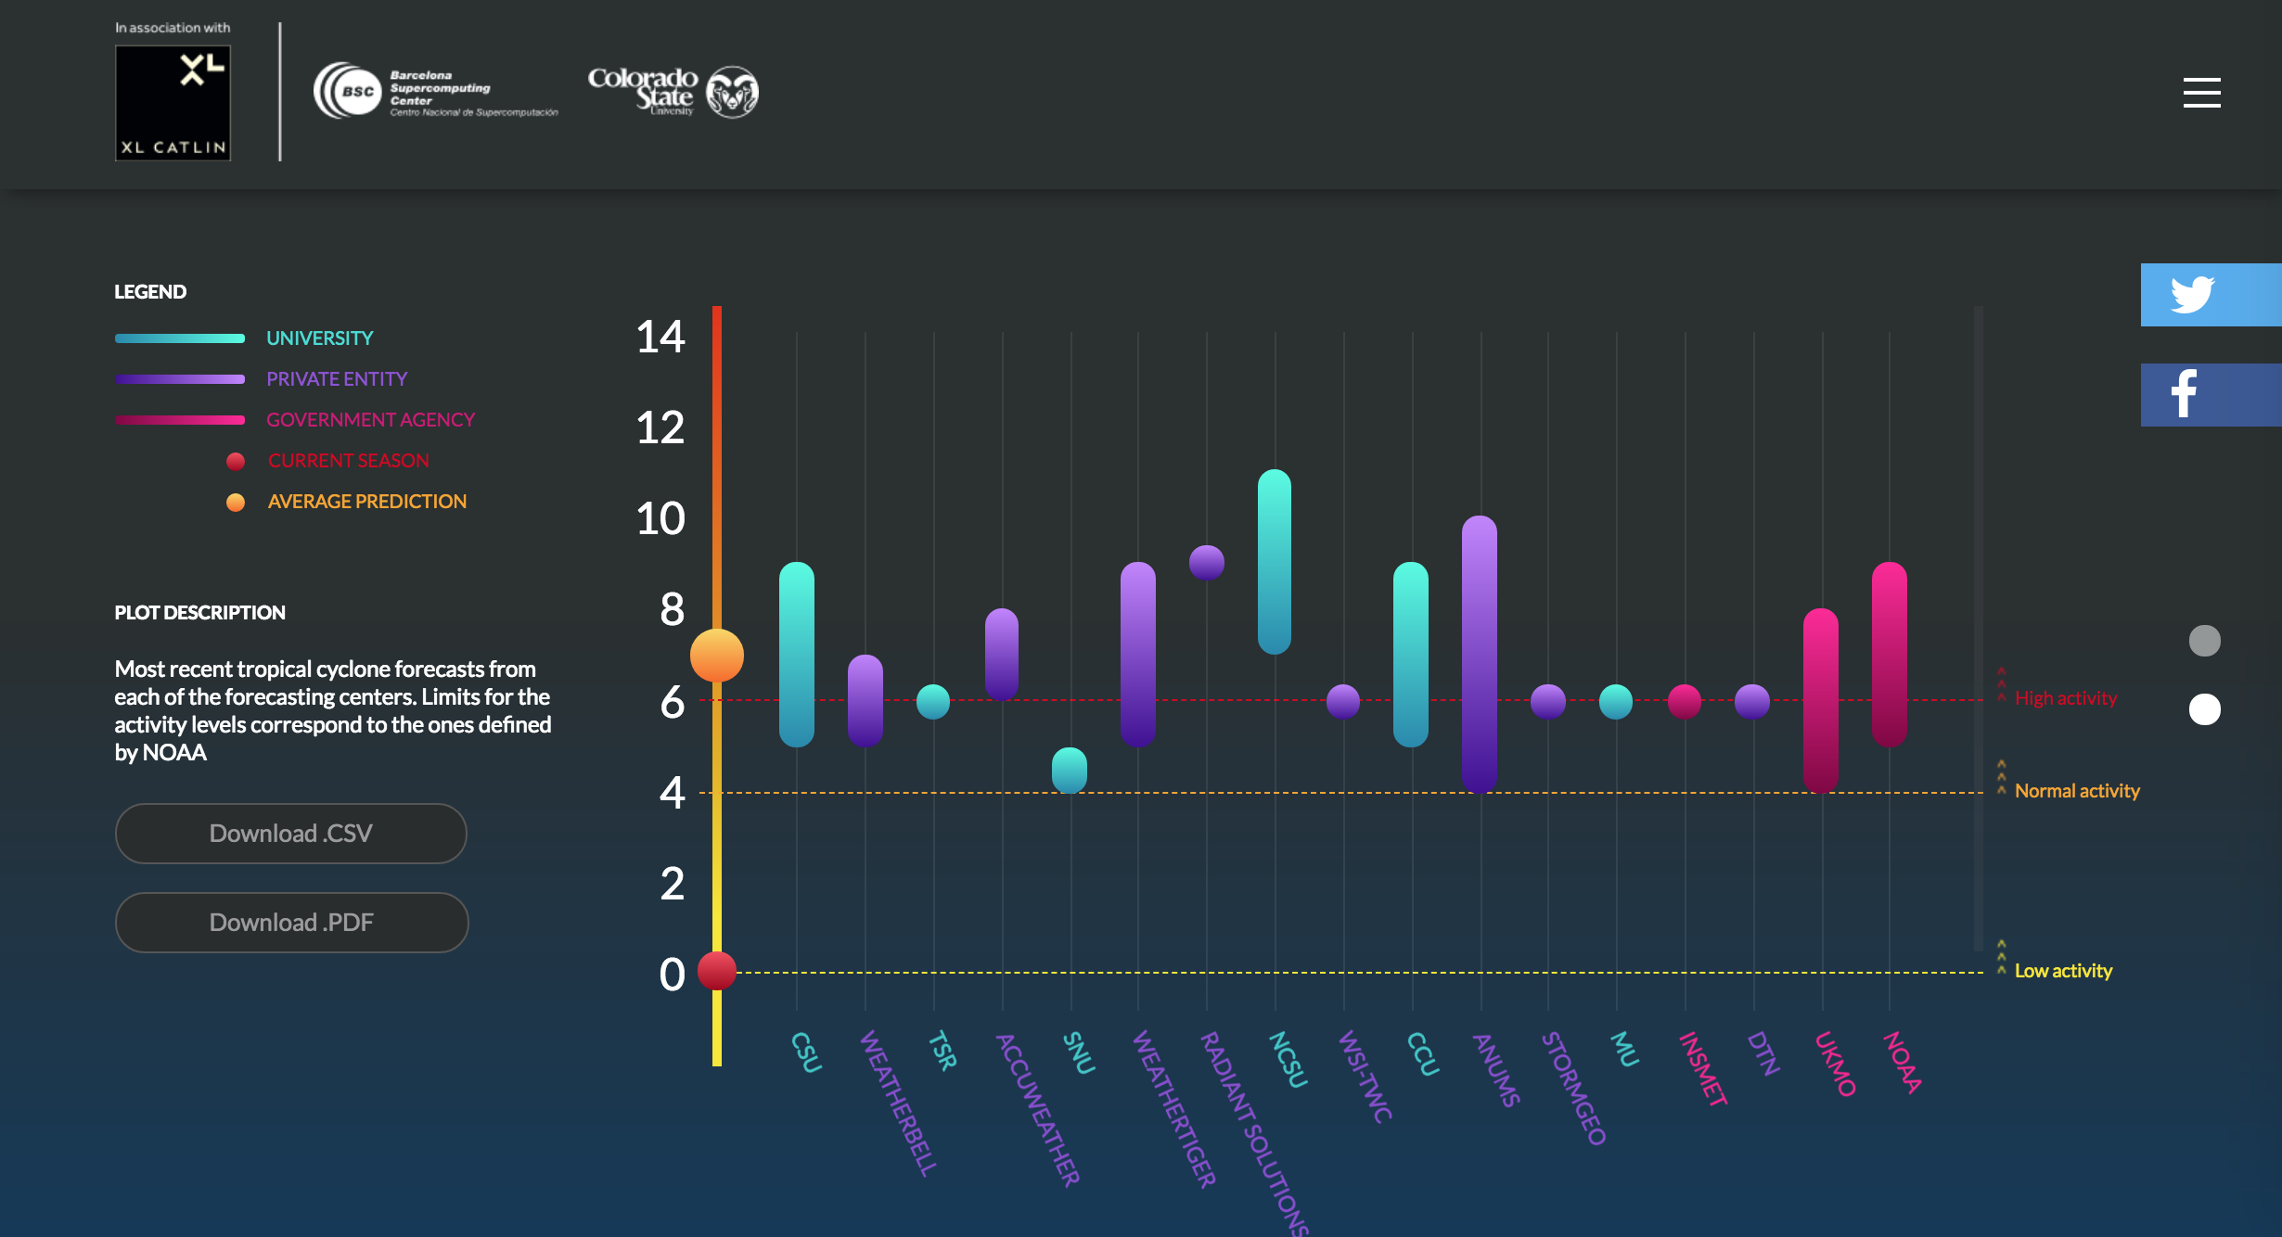
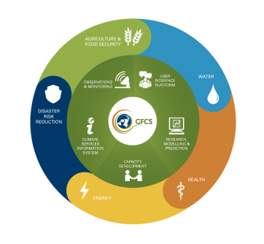
Some definitions
Climate data: numerical values representing ECVs and associated magnitudes; includes metadata and documentation
Climate information: the result of processing climate data according to the available climate knowledge
Climate knowledge: climate information put in context and generated in a co-production process
Climate service: ensemble of processes through which climate knowledge is generated
Climate change adaptation: in natural (human) systems, the process of adjustment to current (and future) climate and its effects (in order to moderate harm or exploit benefits)

Slide 9
Climate information requirements
Climate information
Salience: It refers to the relevance of information for an actor’s decision choices. Often interesting scientific questions are far from a real-world situation.
Credibility: It refers to whether an actor perceives information as meeting standards of scientific plausibility and technical adequacy. Sources must be trustworthy and/or believable.
Legitimacy: It refers to whether an actor perceives the climate information process as unbiased and meeting standards of political and procedural fairness.
Power
Reputation
Values
Transparency
Standards
Cash et al. (2003, PNAS)

Slide 10
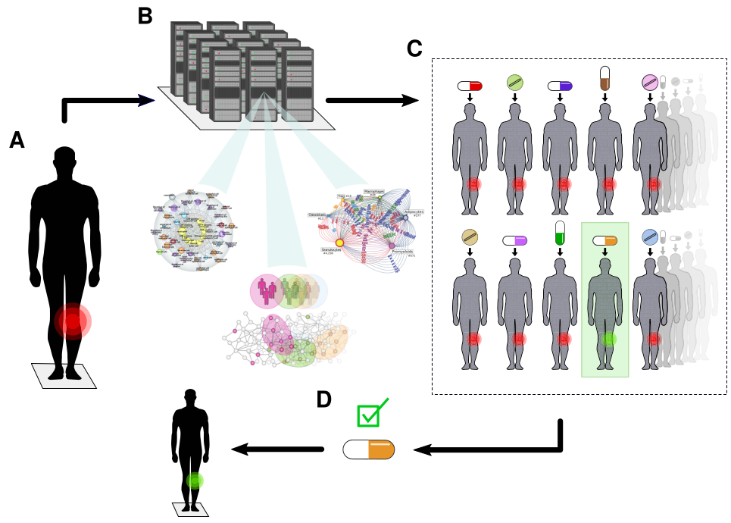
Some inspiration
The digital twin for personalised medicine starts from the identification of a local sign of disease in a patient (red circle). The user comes first.
Björnsson et al. (2020, Genome Medicine)

Slide 11
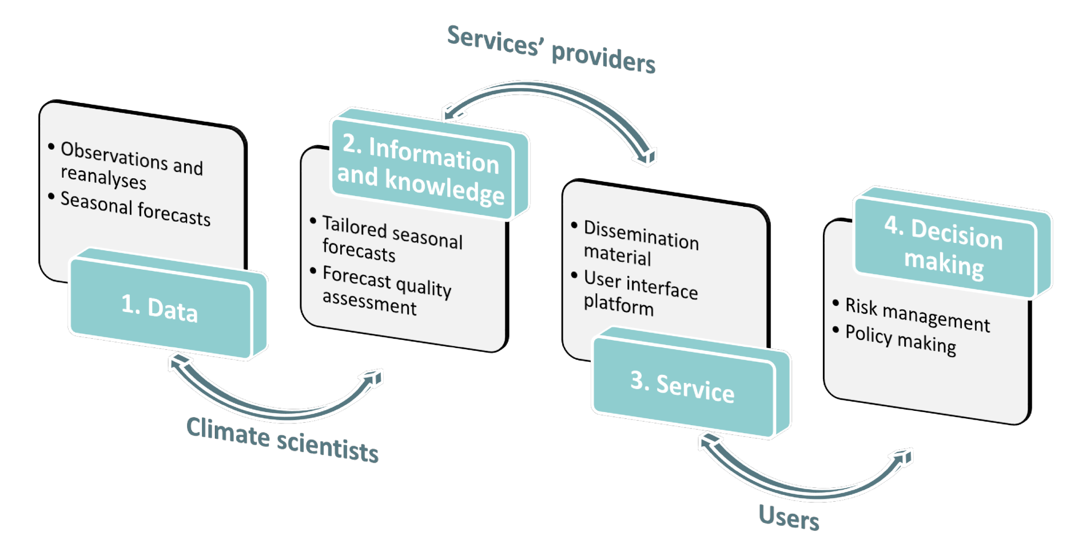
The research-provider-service paradigm
User-provider interaction
A service-oriented climate adaptation agenda requires the traditional chain “research-operations-service provision” to move both ways so that not only information quality is demonstrated, but user requirements are adequately addressed and value illustrated. This leaves a space for transdisciplinary research. This chain should not preclude basic research to take place though.
V. Torralba (CMCC)

Slide 12
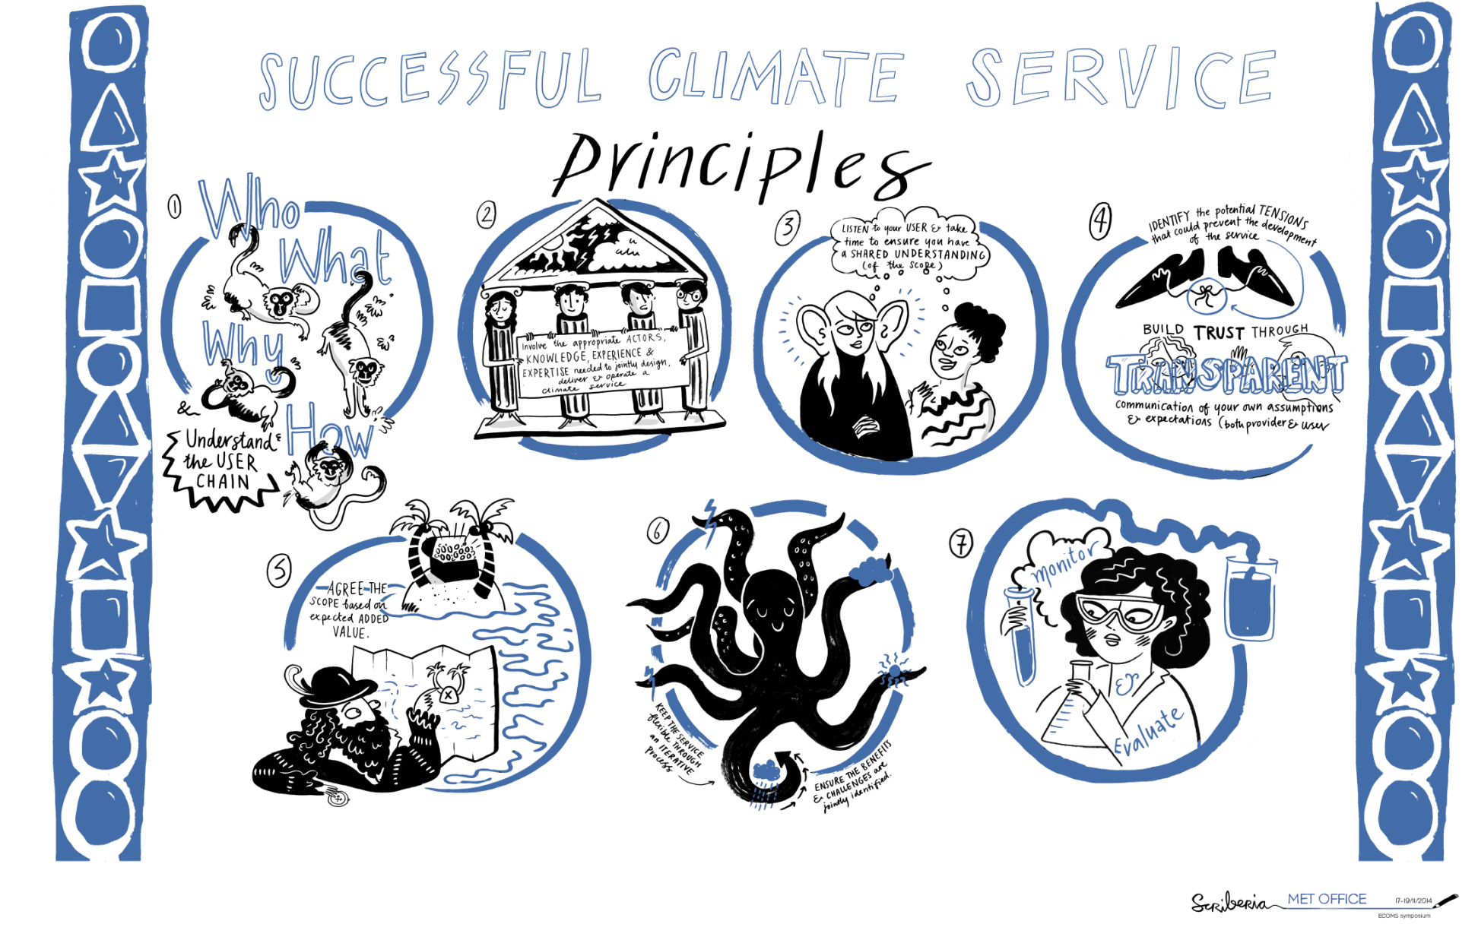
The research-provider-service paradigm
User-provider interaction
EUPORIAS lesson: Climate data is not climate information

Slide 13
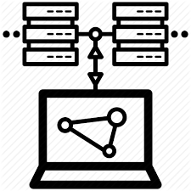
Barriers to use climate information
User-provider interaction
Some limitations for the use of climate information in different socio-economic sectors. Information quality≠impact.
Possible solution: synthesize climate data into a piece of information that can be integrated in decision-making.
Lack of awareness
Climate services
What: development and incorporation of climate information for planning, policy-making and practice at the global, regional and national scale.
Implementation: co-production.
Barriers: locality, operationalisation, evolving role of the regulator, variety in adaptation strategy types, vocabulary, etc.
Difficult interpretation
Lack of expert synthesis
Notes:
To enable better management of the climate-related risks
To improve the resilience and adaptation to climate change

Slide 14
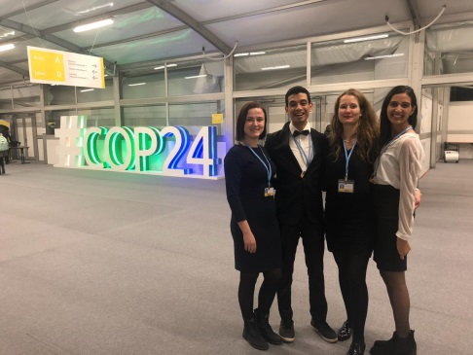
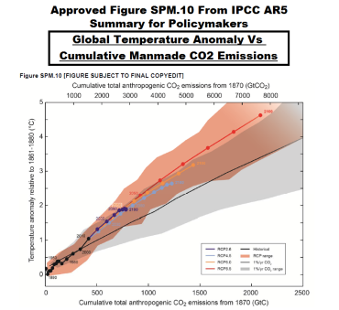
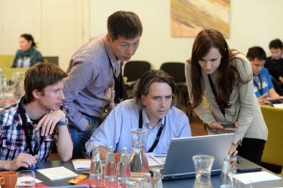
Climate time scales
Climate information
Weather forecasts
Subseasonal to seasonal forecasts (2 weeks-18 months)
Decadal forecasts (18 months-20 years)
Climate-change projections
Time
Initial-value driven
Boundary-condition driven
The user
The data provider
The assessed knowledge
The knowledge producer
e.g. IPCC SPM and SyR preparation
Adapted from Meehl et al. (2009)

Slide 15
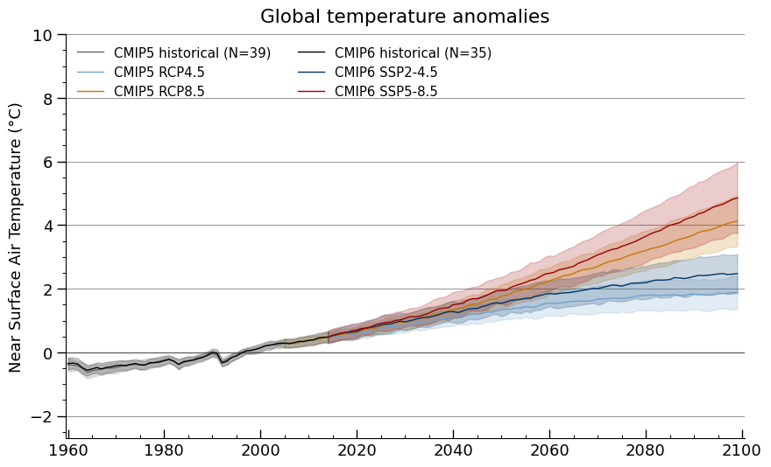
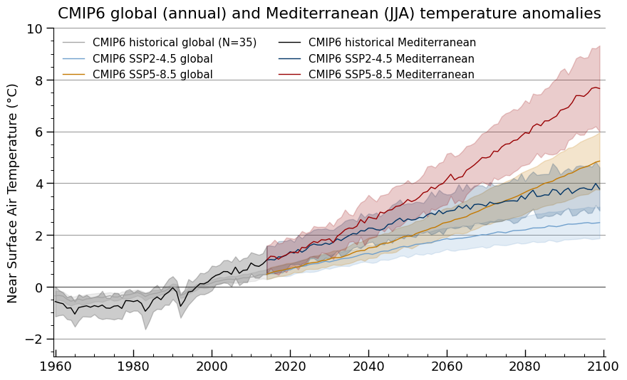
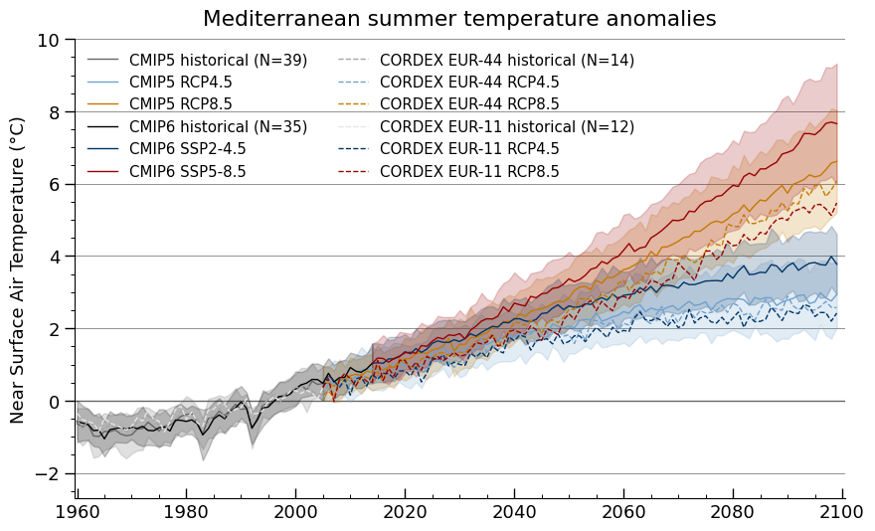
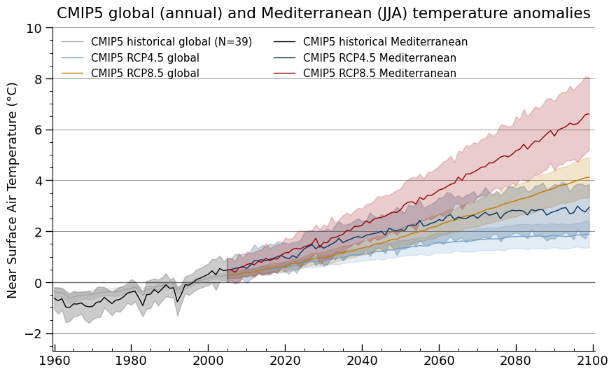
The IPCC WGI dilemma
Climate sources
Global annual mean and Mediterranean land summer temperature.
M. Jury (BSC)

Slide 16
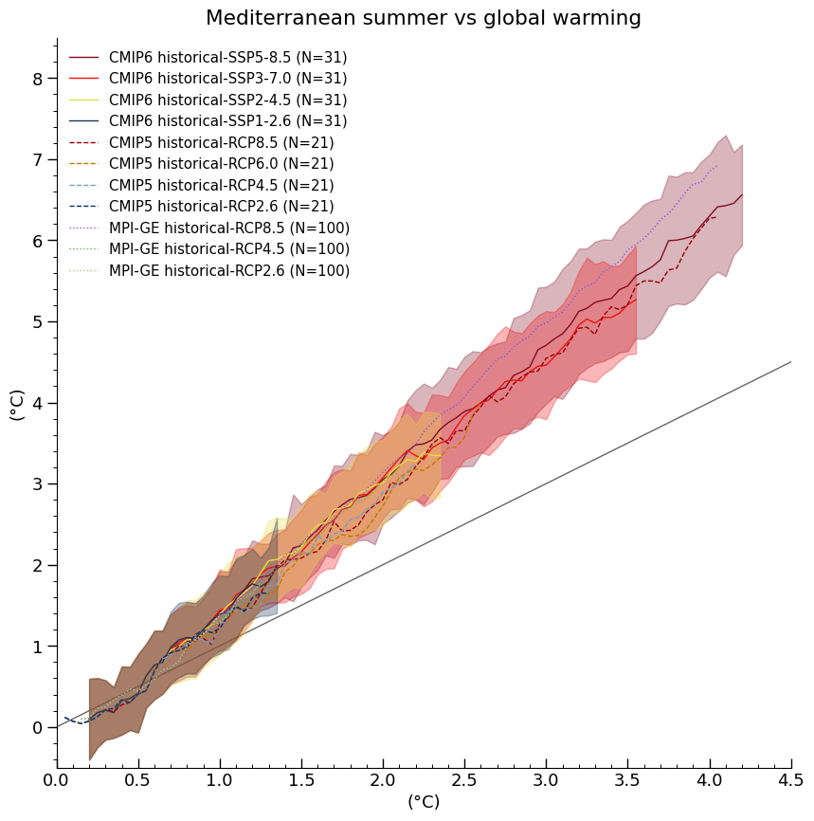
The IPCC WGI dilemma
Climate sources
At least Mediterranean summer land temperatures scale with global mean temperature in a consistent way for CMIP5 and CMIP6. However, users become extremely confused in a situation like this.
M. Jury (BSC)

Slide 17
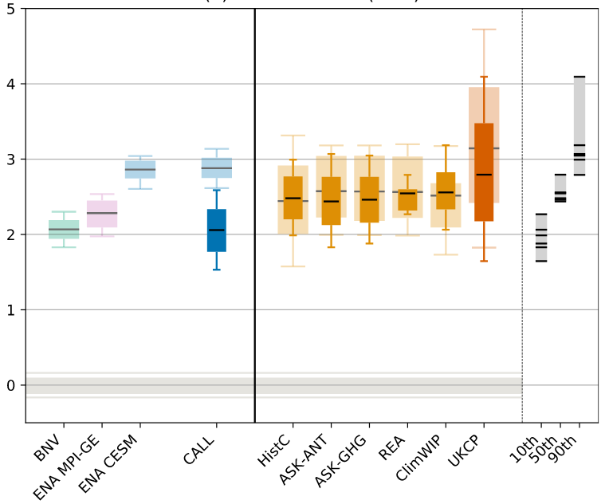
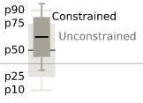
Synthesis of different lines of evidence
Climate information
Different approaches for Mediterranean land summer temperature projections. The range between methods is non-negligible. What synthesis from the lines of evidence available? Expert judgement enters the ensemble and model design and the choice of the approach.
Salient and legitimate, but credibility is compromised
Brunner et al. (2020, J. Climate)

Slide 18
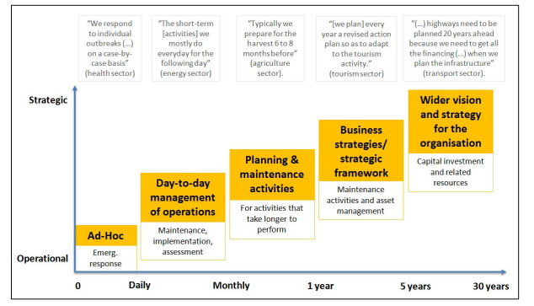
User engagement: problem boundaries
User-provider interaction
Users of climate information are involved in increasingly strategic decisions as the time horizon expands
Dessai and Bruno-Soares (2013, SRI Paper 62)

Slide 19
An example: Users in the energy sector
Long-term user engagement has allowed identifying a number of decisions that could benefit from climate predictions
Post-construction decisions
Energy producers: Resource management strategies
Energy traders: Resource effects on markets
Plant operators: Planning for maintenance works, especially offshore wind O&M
Plant investors: anticipate cash flow, optimize return on investment
Mid-term planning
Grid operators: Anticipate hotter/colder seasons to schedule power plants to reinforce supply.
Energy traders: Anticipate energy prices.

Slide 20
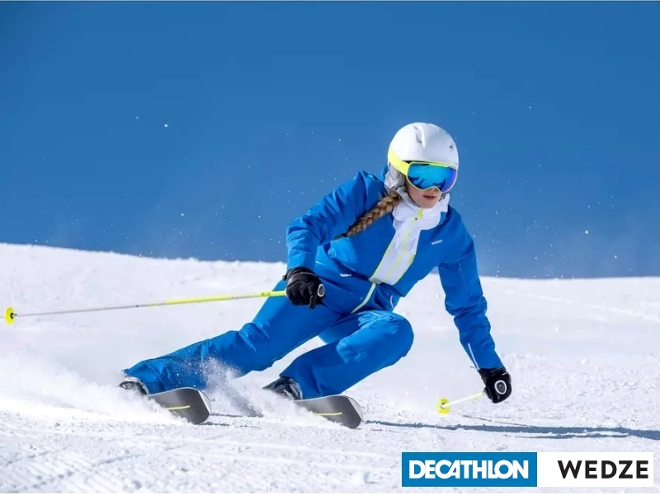
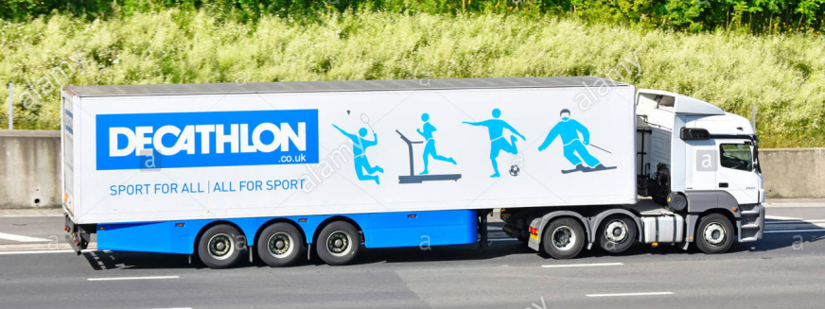
Climate information chain: logistic services
User-provider interaction
Logistics and selling of seasonal products are affected by climate. The BSC works in a research agreement to design a service with three objectives:
Work with historical data (some times the user only wants to understand) to assess how climate variability affects a range of decisions.
Translate this knowledge into a prototype of action-oriented service based on climate forecasts covering time scales up to a few years.
Walk together the path towards climate adaptation across the jungle of climate data and information to find ways to address their strategic vulnerabilities and reach a common understanding of what uncertainty means.
Seamless user engagement looking at quality assurance, standards, synthesis, interpretation, traceability, user uncertainty

Slide 21
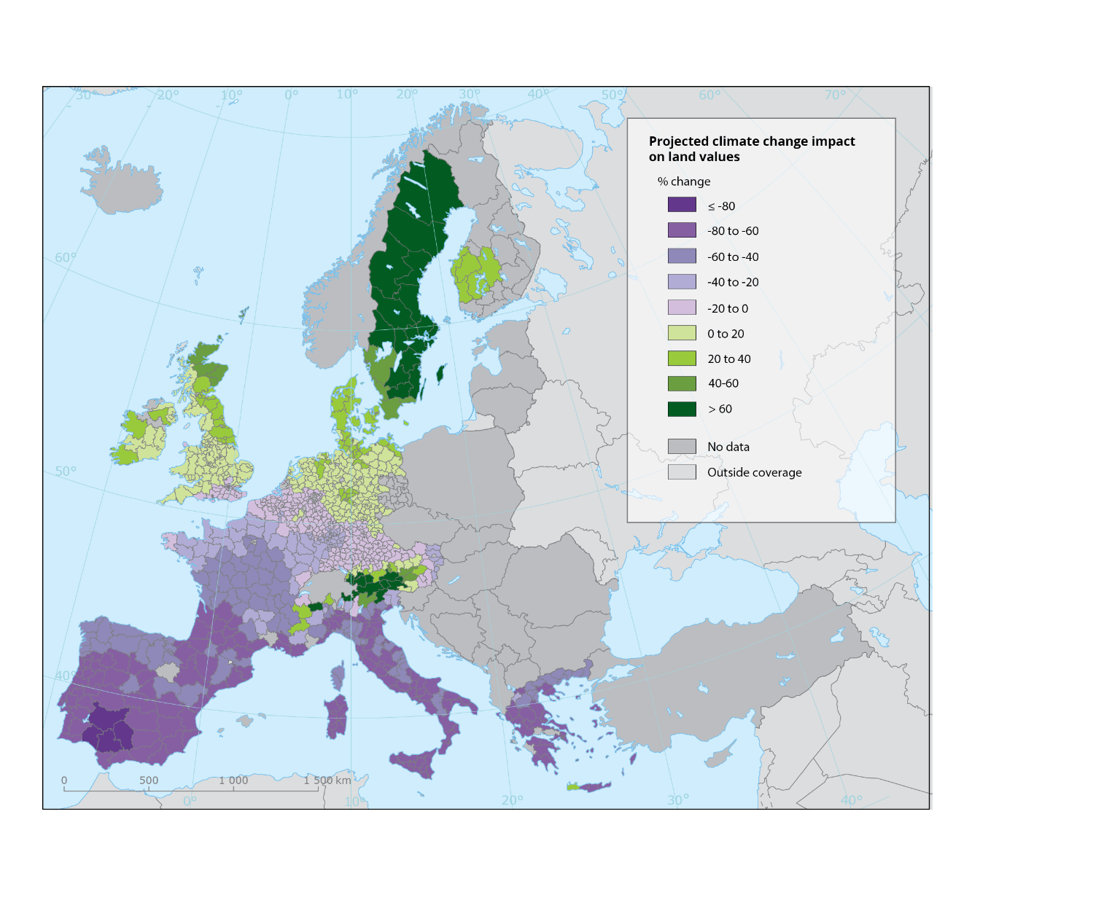
Climate change affects food production
Climate information
Agricultural income in Europe is projected to decrease by the end of Century, with farmland value suffering most in southern Europe. Some farmland risks of being abandoned due to economic conditions.
Projected change in farmland value by 2100
But food security also has more immediate concerns
van Passel et al. (2017, ERE)

Slide 22
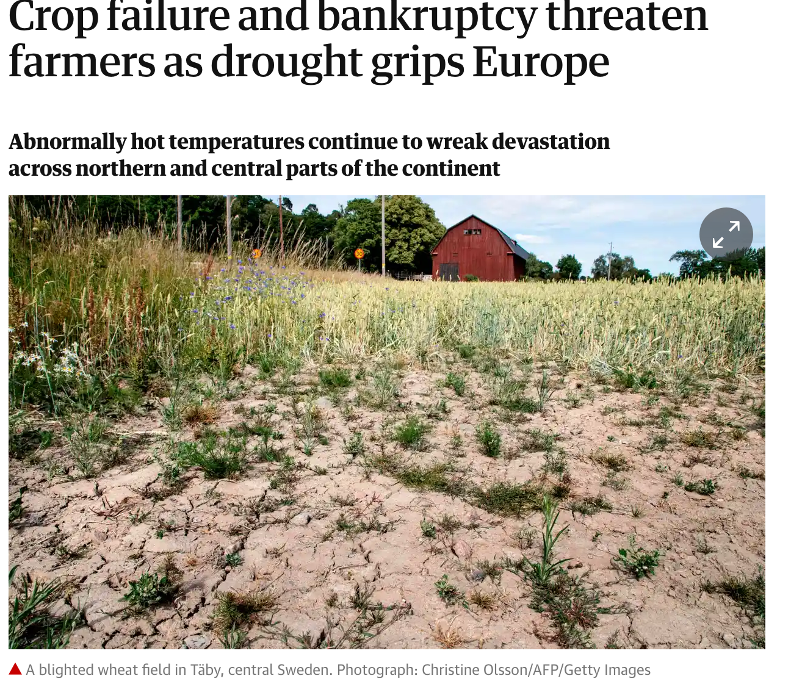
Climate change affects food production
User-provider interaction
Events such as the 2018 in Europe should serve as warning call. Concurrent climate extremes may shock the global market with decadal effects. Tailored co-designed climate services are needed as part of a dynamically evolving adaptation strategy. Innovative integrated Earth System modelling approaches with dynamic human effects as well as dynamic economic at different spatial scales.
Optimize practices &
Infrastructur
Optimize selection & development
investments
Climate
Farmers
Breeders
Food companies
Risk indicators
Actions
React & Adapt
Biophysical-Economic models
Regional to national policy makers
EU
Experts
Market stabilization, trade
Support plans, Investments
A. Toreti (JRC)

Slide 23
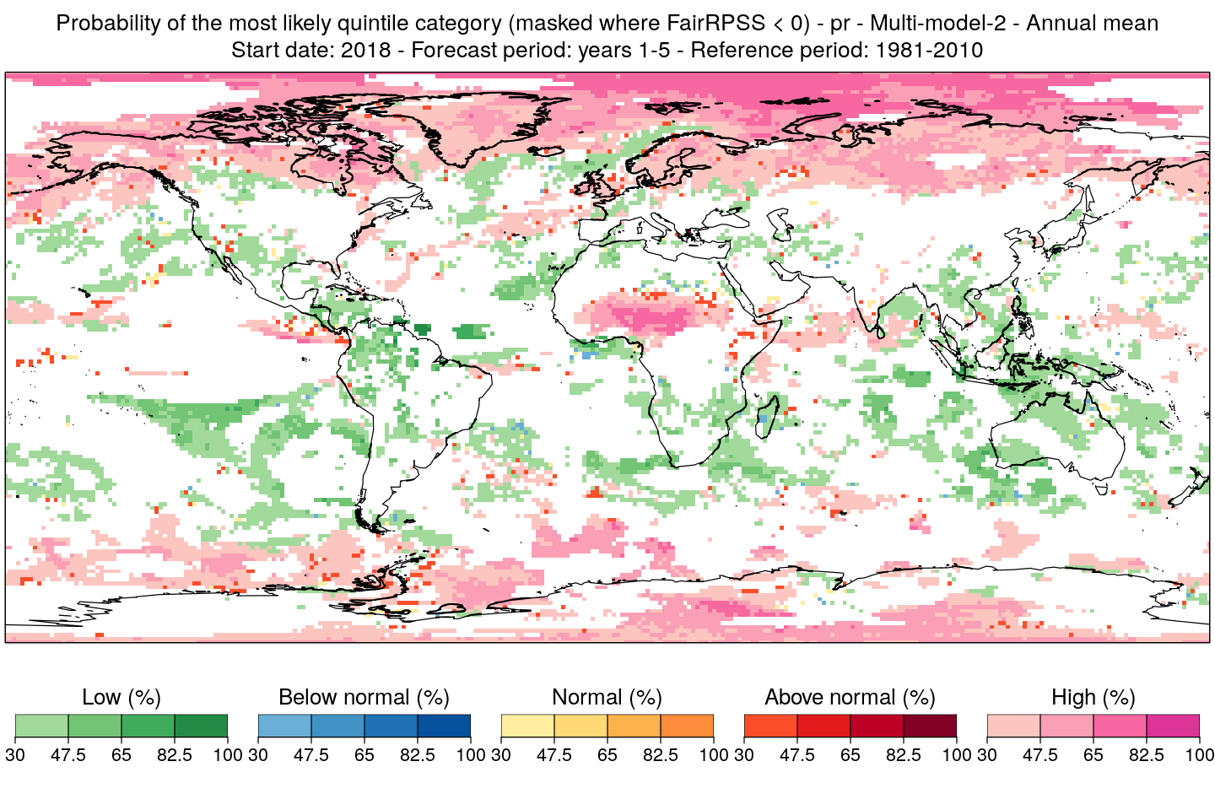
Global decadal climate predictions
Climate sources
Some of the WMO recognised global producing centres of decadal predictions contribute with the definition of standards for decadal predictions data and products, the evaluation of the European multi-model and the illustration of the decadal prediction use in the agricultural sector (in collaboration with JRC-Ispra).

Slide 24
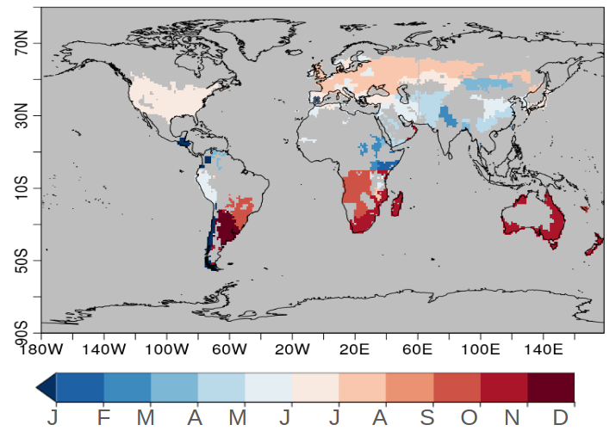
Global decadal climate predictions
User-provider interaction
Some of the WMO recognised global producing centres of decadal predictions contribute with the definition of standards for decadal predictions data and products, the evaluation of the European multi-model and the illustration of the decadal prediction use in the agricultural sector (in collaboration with JRC-Ispra).
SPEI6
HMDI3
Indicators:
Drought: Standardized Precipitation Evapotranspiration Index (SPEI6)
Heat Stress: Heat Magnitude Day Index (HMDI3)
Wheat harvesting month

Slide 25
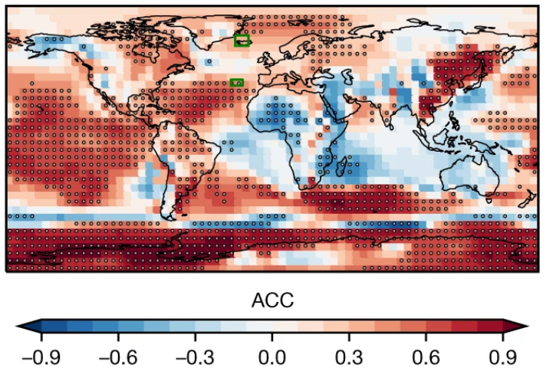
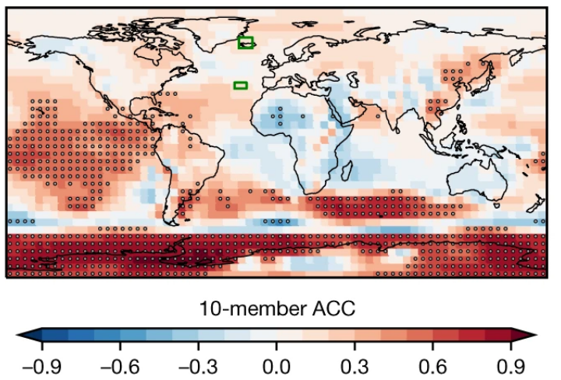
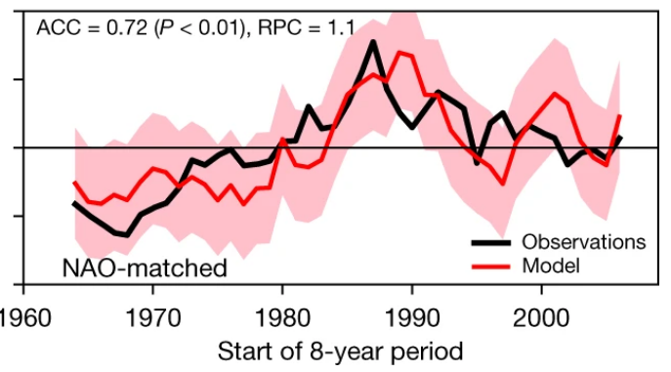
Why could we expect this to be a DT?
Climate sources
Skill of decadal predictions is highly sensitive to ensemble size due to the low signal-to-noise ratio (multi-model sea level pressure correlation with more than 100, left, and 10 members, right). Careful member selection (160 members) unveils untapped skill for northern European precipitation predictions for the next nine years (bottom).
Smith et al. (2020, Nature)

Slide 26
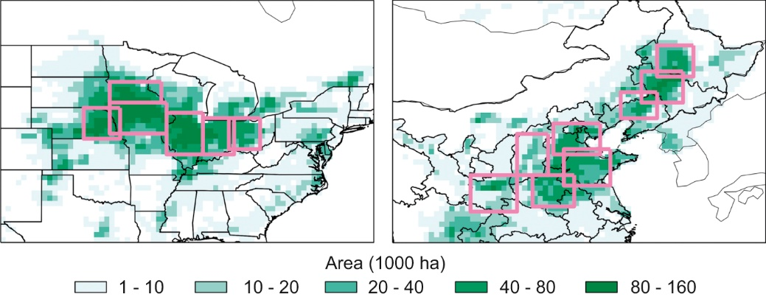
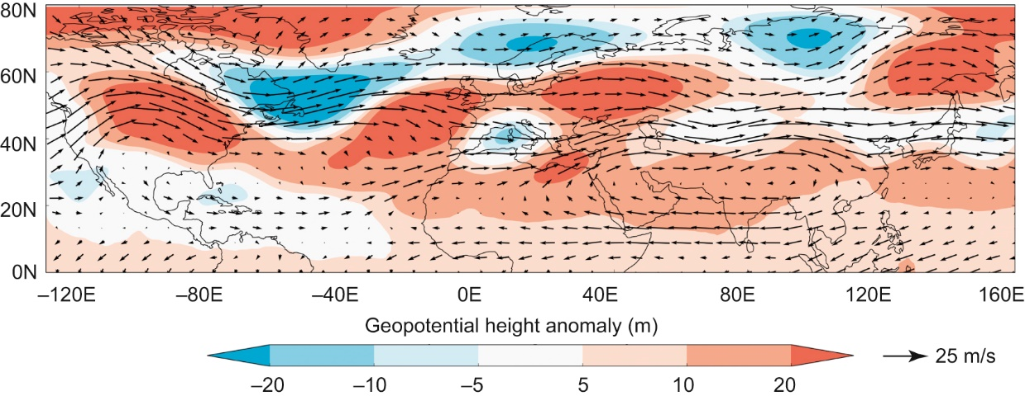
There is life beyond skill
Climate information
Decadal predictions can be used as surrogates to estimate probabilities of extreme compound events leading to multi-bread basket failures.
Total maize growing area
Somehow salient, not fully legitimate and marginally credible current decadal prediction systems not yet fit for purpose
June-to-August 200 hPa geopotential height pattern and wind speed associated with multi-breadbasket failures.
Kent et al. (2017, ERL)

Slide 27
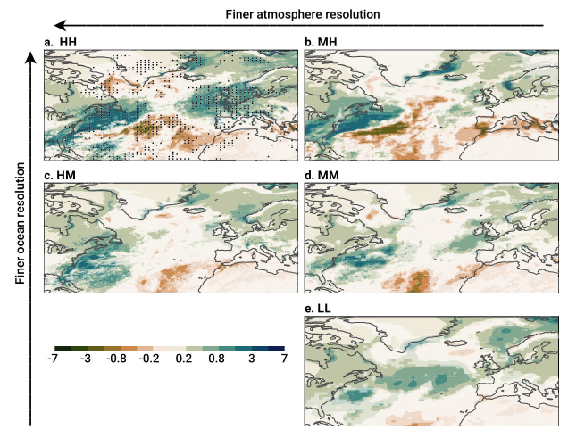
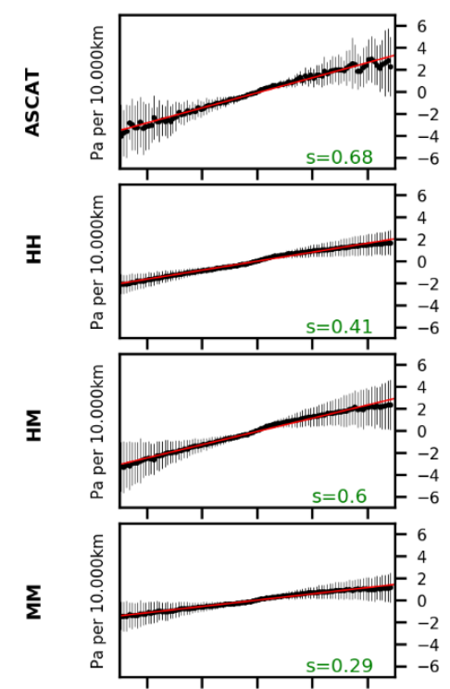
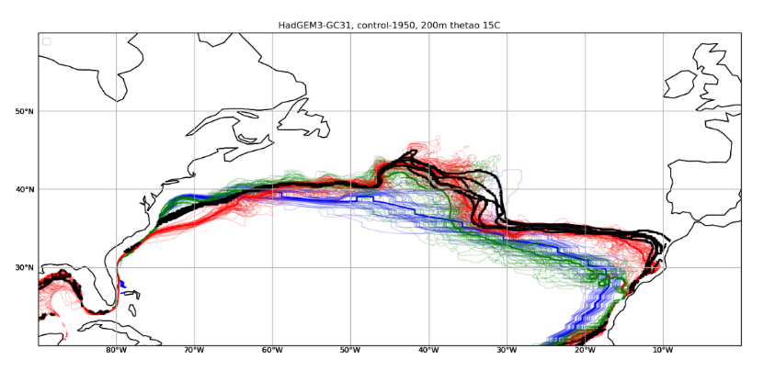
How to go beyond in decadal prediction?
Climate sources
From a user perspective (e.g. JRC) credibility and usability of decadal predictions are seriously compromised by current model quality (understood in the most general sense possible). Progress will not be possible without larger ensembles, higher resolution along with more realistic processes, better initialisation, etc.
High-pass filtered wind stress divergence versus downwind SST gradients
Winter precipitation differences 2030-2050 and 1960-1980
Moreno-Chamorro et al., Grist et al., Tsartsali et al. (submitted)

Slide 28
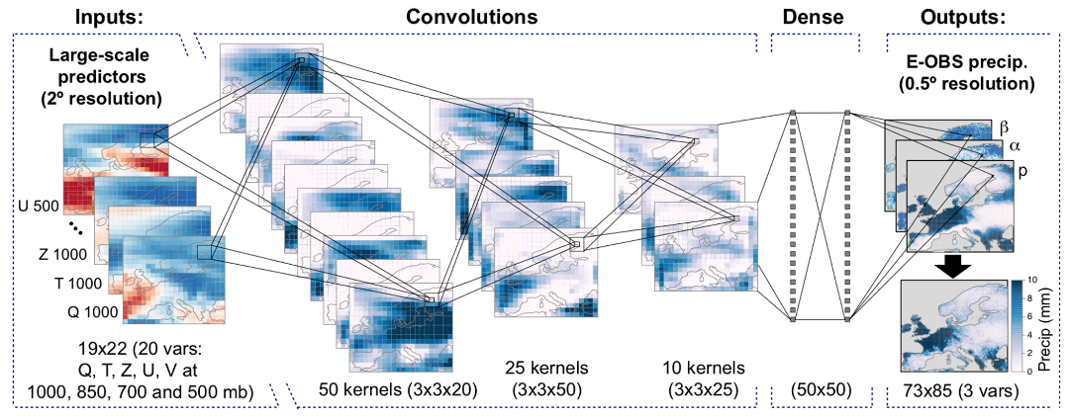
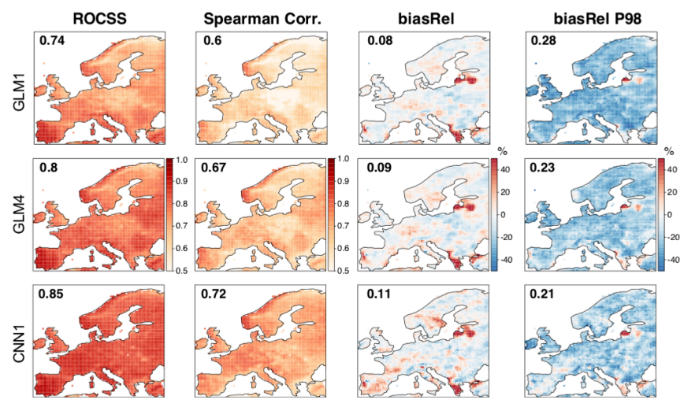
And as for locality, add innovation to the DT
Climate information
Traditional dynamical downscaling is beyond reach in a fit-for-purpose decadal prediction system (large ensembles, high resolution global models, 3,000 years of simulation at a minimum). Machine learning might come to the rescue.
Validation of downscaled historical precipitation (EOBS reference) using generalised linear methods and convolutional neural networks with ERA-Interim. Inset numbers for spatial averages of absolute values.
Baño-Meditna et al. (2020, GMD)

Slide 29
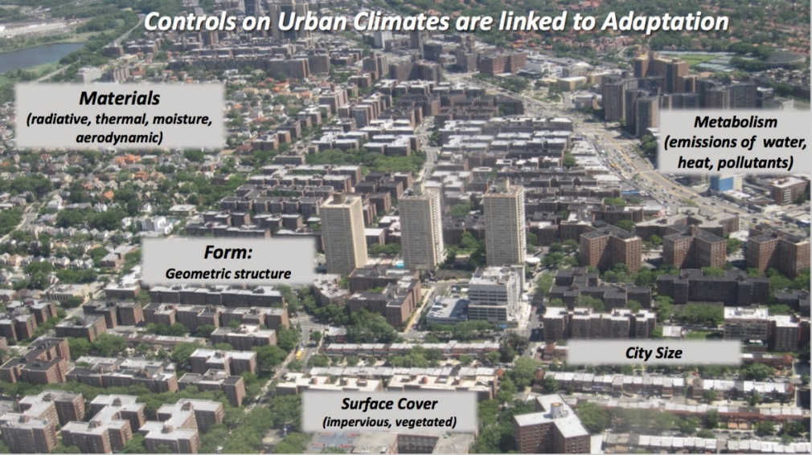
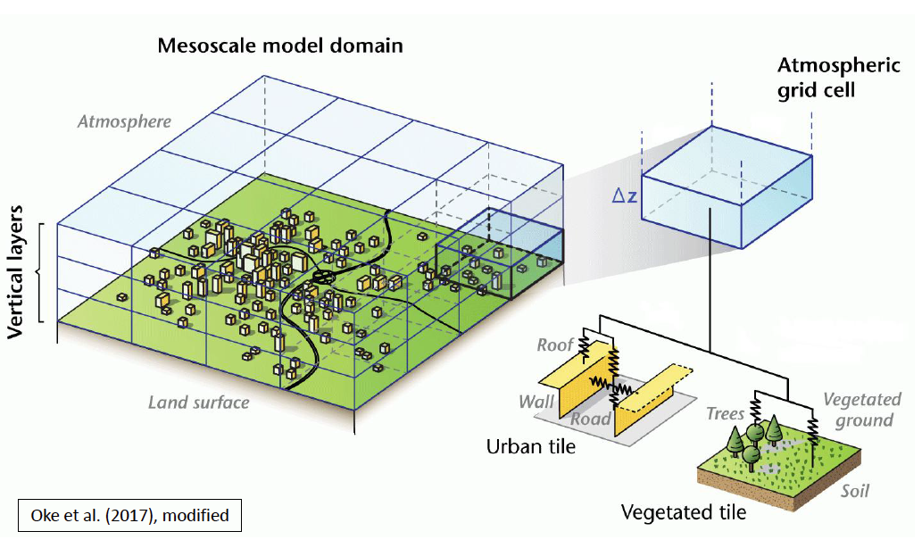
However, local is complex
Climate information
Simulations of future urban climate at fine spatial scales have strong requirements:
Integrate with urban expansion and population growth scenarios, human behaviour, city characterization (satellite based like http://www.wudapt.org/)
Include coastal hazards for coastal cities
Observations for urban climate and structure (citizen science, new sensors)
Climate change effects in the near future (i.e. coming decades)
The current modelling paradigm needs to evolve taking into account models that include urban processes (biophysics, human), targeted downscaling (with uncertainties) and impact models.
WCRP (2018)

Slide 30
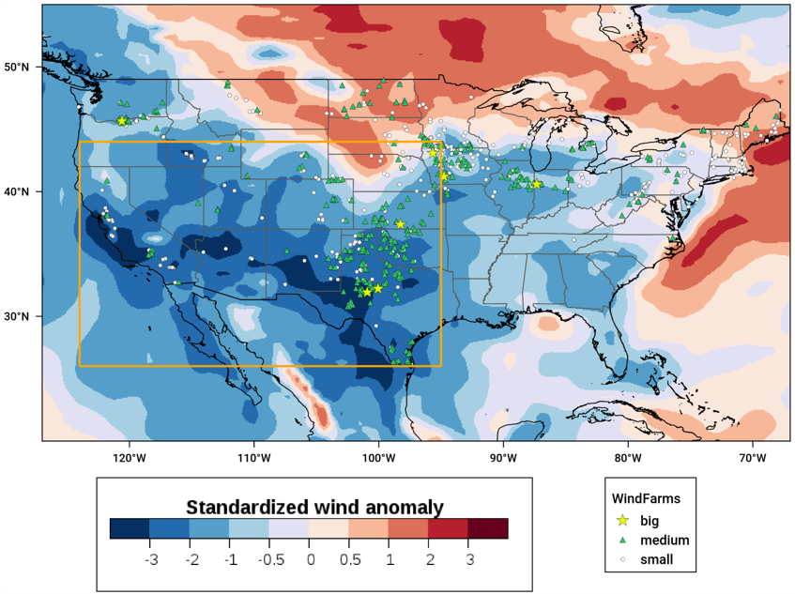
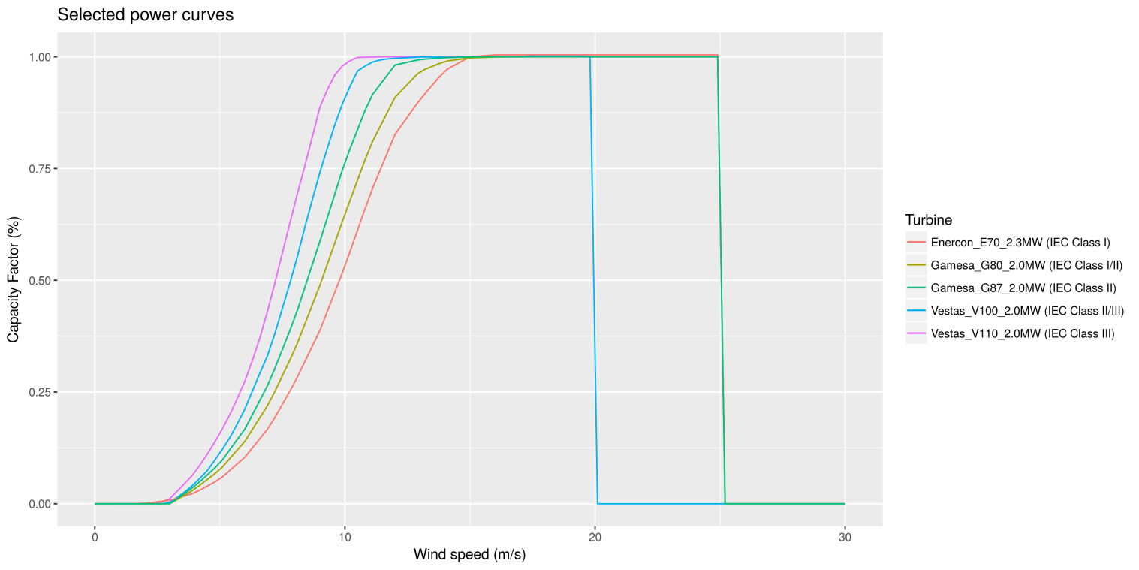
Some interactions are motivated by an event
Climate science in user engagement
During the first quarter of 2015 the United States experienced a widespread and extended episode of low surface wind speeds. Some wind farms did not generate enough cash for their steady payments, decreasing the value of wind farm assets.
Aim to predict the capacity factor
for a specific turbine type.
Wind speed anomalies reflecting the wind drought over the United States for the first trimester of 2015, where the USA wind-farm fleet is also shown (Lledó et al., JGR 2018)

Slide 31
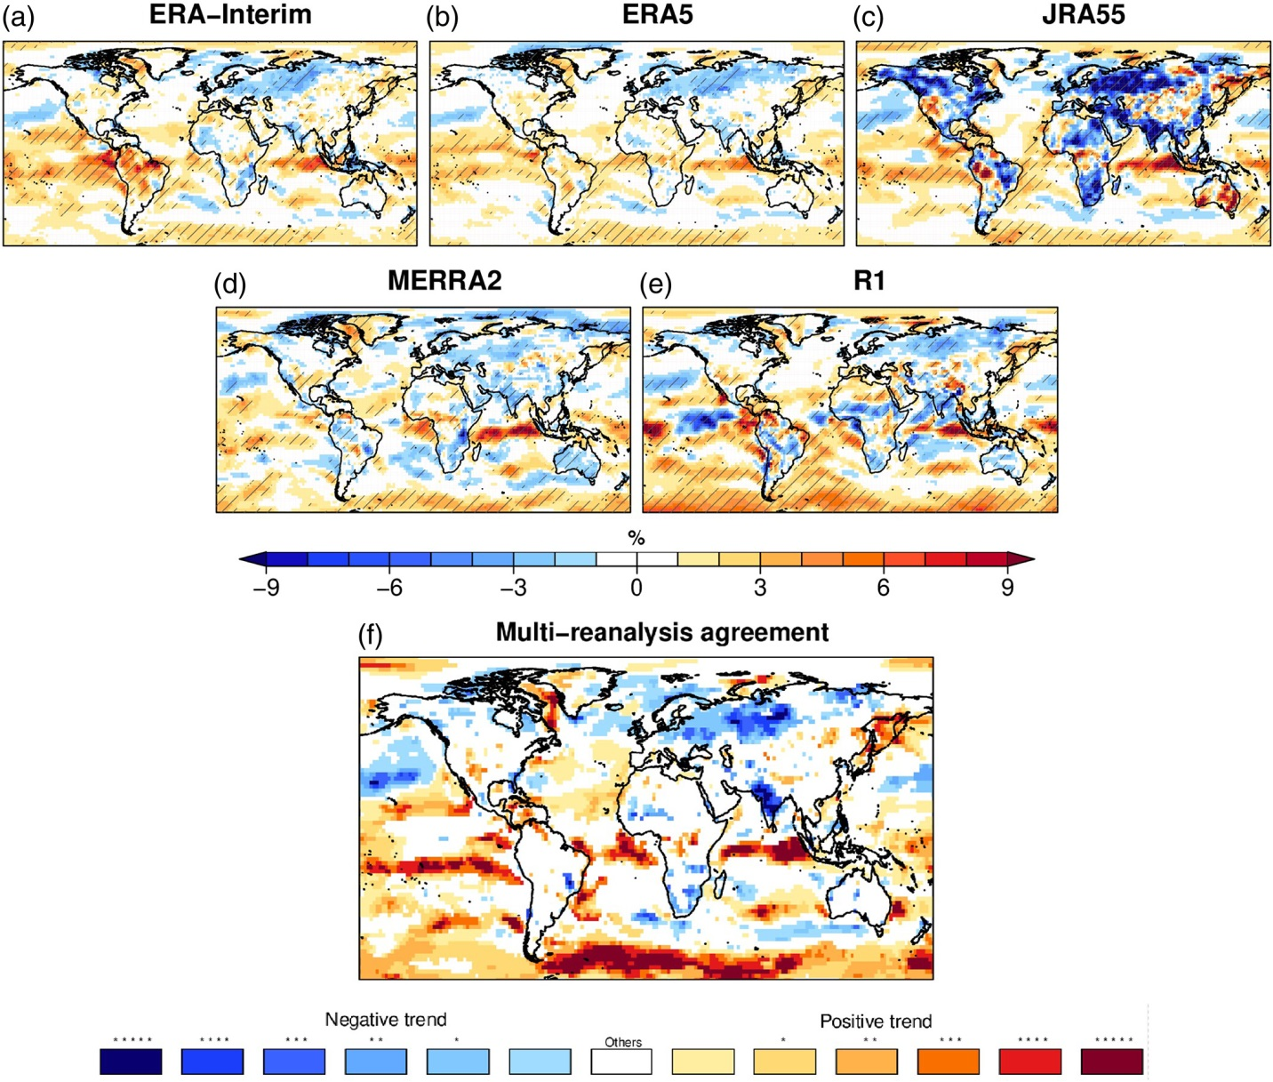
Observational uncertainty relevant to users
Climate data quality
10-m wind speed trends (in percentage of the mean wind) for the multi-reanalysis (MR) and five reanalyses in DJF over 1981-2017.
Ramon et al. (2019, QJRMS)

Slide 32
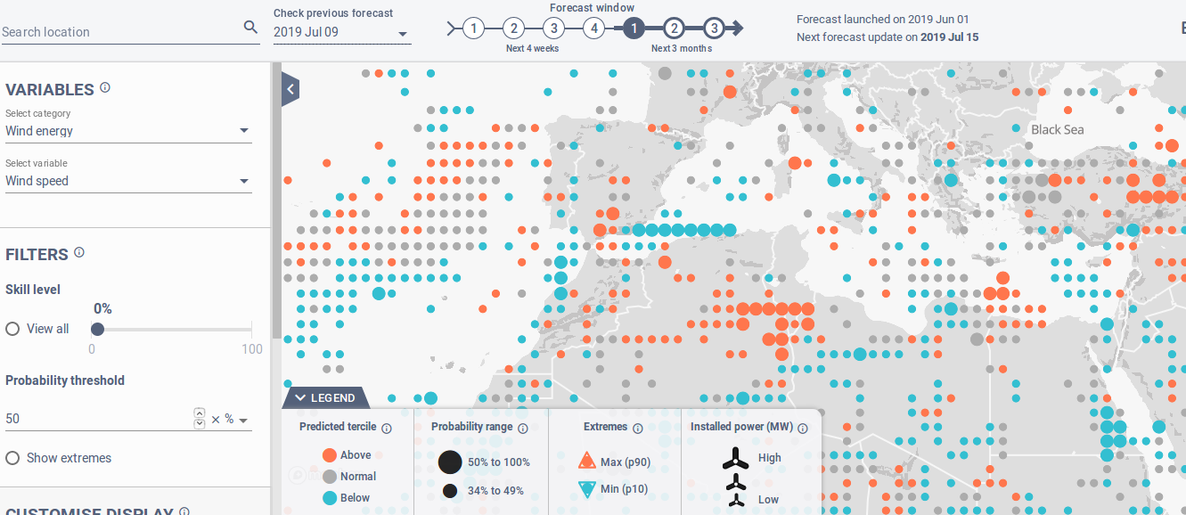
Prototypical climate services for energy
Climate service and message synthesis
S2S4E is developing a decision support tool for the renewable energy sector based on Copernicus climate forecasts and NCEP operational predictions co-designed with the industry for periodic updates on the state of relevant climate variables.

Slide 33
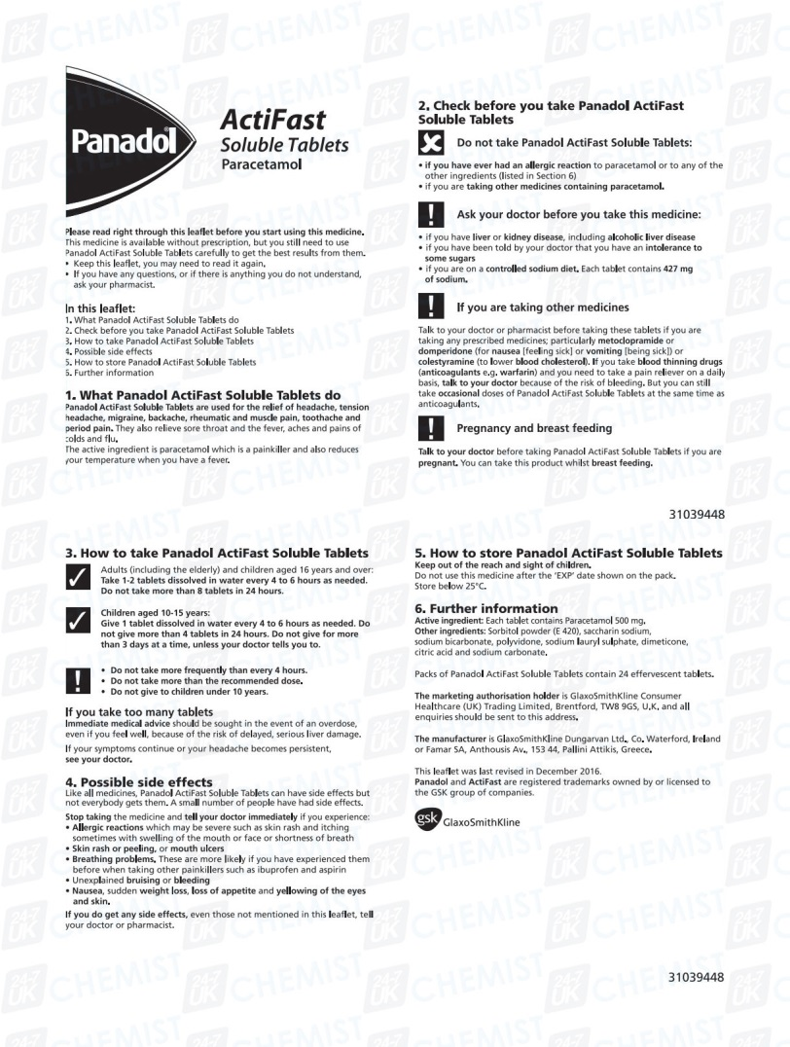
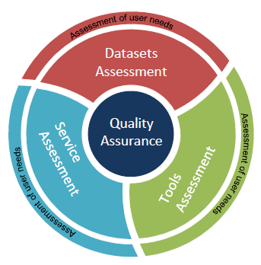
Evaluation and quality control
Quality control and traceability
BSC leads the contract responsible of the development of the evaluation and quality control (EQC) function of the climate data store (CDS) of the Copernicus Climate Change Service (C3S) to:
Provide a user-led overarching EQC service for the whole CDS
Provide an independent quality assessment
CDS datasets: provide information about the technical and scientific quality and fitness-for-purpose, and an assessment of the datasets
CDS toolbox: assessment of maturity and fitness for purpose of the software provided to explore the datasets
CDS service: performance assessment of the CDS infrastructure (e.g. speed, responsiveness, system availability)
CDS users: user requirement assessment to measure users’ satisfaction with the CDS. Map evolving user needs into viable user requirements to ensure a user-oriented evolution of the CDS

Slide 34
How traceable is the climate information?
Quality control and traceability
Generalised metadata provision and workflow provenance is required to ensure a minimum quality of the forecast-based climate information
J. Bedia (Predictia)

Slide 35
The communication challenge
Communication
Gamification is useful to illustrate the challenges of using and the value of seasonal climate predictions addressed to the wind energy sector:
Play against a reference taken from climatological frequencies.
The bets are proportional to the predicted probabilities.
The amount invested in the observed category is multiplied by 3.
▼
▼
▼
▼
play.google.com/store/apps
demo.predictia.es/roulette-app/mobile.html
Terrado et al. (2019, BAMS)

Slide 36
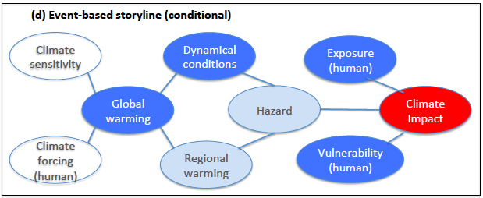
The communication challenge
Communication
Use of storylines to communicate changes in extreme events, uncertainty and attribution. Same dynamical situation with different thermodynamical conditions illustrate a tangible change. The information is more efficient when the context is recognised.
Climate-change signal for January (SST)
But this is efficient if models are much more realistic (and credible)
+4 K - today
Today - preindustrial
Climate-change signal for 25 July 2019
(T2m)
T. Jung (AWI)

Slide 37
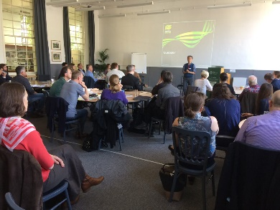
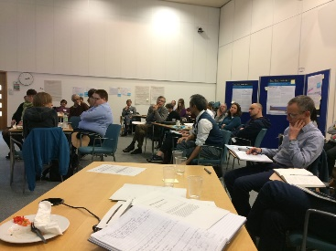
UKCP18
Related activities
The UK Climate Projections 2018 undertook an extensive programme of user requirements. Participants were selected to represent communities and not individuals. The lists below come from user group workshops in 2016-17. Satisfying all of them was beyond scope.
Model: surface variables
Climate indices
Storminess
Temperature degree days
Hydrological metrics
Evaporation
Hail
Lightning
Snowfall
Soil moisture
Weather patterns
Dry/Wet bulb temperature
Wind speed at surface
Flood risk
Future coastline
Fluvial flows and levels
Soil moisture deficit
Surface water runoff
Water quality
Water stress
Impacts metrics
Wind gusts
Air quality
Urban heat island effect
Vegetation growth
Heat Stress
Earth movements
Soil stability
Erosion risk
Groundwater recharge
Convective available potential energy
Radiation (sunshine, short/long wave)
Runoff
Model: Ocean/sea variables
Local thermal expansion
Ocean pH, saility, temperature
Sea level rise
Storm surge
Stratification
Tidal range
Wave direction/height/period
Ice sheet dynamics, sea ice melt
Cloud cover
Royal Botanical Gardens,
Edinburgh, Feb 2017
Met Office
Exeter, October 2017
J. Lowe (Met Office)

Slide 38
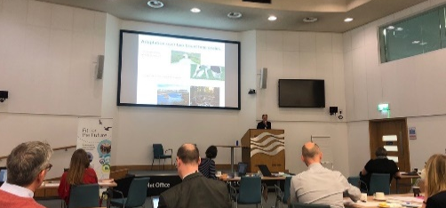
UKCP18
Related activities
The UK Climate Projections 2018 undertook an extensive programme of user requirements. Participants were selected to represent communities and not individuals. The lists below come from user group workshops in 2016-17. Satisfying all of them was beyond scope.
Updating existing reports & guidance
Catchment flows update
Catalyst for climate risk assessment
Fit for the Future Network
Exploiting new information
CCRA research projects
Water resources management planning
Climate scenarios for local government
Developing CC assessment guidance for MOD assets
CCRA climate change evidence
Strategic Priority Fund on Climate Resilience projects
Rail infrastructure climate risk assessment
Climate change in commonwealth countries project
Assessment of existing school building stock and care homes
J. Lowe (Met Office)

Slide 39
Horizon Europe Mission
Programmatic linkages
The Mission on Adaptation to Climate Change, Including Societal Transformation: “A Climate Resilient Europe” to prepare for climate disruptions and accelerate the transformation to a resilient and just Europe by 2030.
One of the three targets is “by 2030, all local administrative units (LAU) and regions (NUTS) will have access to climate risk profiles and enhanced early warning systems for all relevant risks, will have adopted comprehensive climate risk management plans, and will have community infrastructure and services that are safe and operable and accessible under critical conditions”.

Slide 40
Horizon Europe Mission
Programmatic linkages
The Mission should contribute to and leverage efforts undertaken to shape Europe’s digital future, such as Destination Earth and the establishment of EU-wide digital data spaces (e.g., data space for climate change adaptation):
by testing and deploying innovative solutions
by becoming a testbed for a potential data space for climate change adaptation
The Mission will act as a cataliser via the focus on the development of solutions at the local level, addressing and taking into account the challenges and needs of citizens. The Mission, which goes beyond the traditional R&D remit, can:
be the testbed for the new Destination Earth advances and developments: Use-Test-Feedback-Improve
connect Destination Earth with European citizens leading to uptake, ownership, empowerment, and capacity building
Mission report available here.

Slide 41
Copernicus Climate Change Service (C3S)
Programmatic linkages
Interactions with users reveal challenges and limitations of current practices:
Users need information on a variety of time horizons; the scientists’/service providers’ distinctions between timescales (often aligned to sources of predictability, or to prediction tools) is not useful, or helpful, for user applications.
User timelines/deadlines are driven by a variety of factors; more often than not these do not match providers’ production schedules.
Information from equally valid sources, even when fully relevant, is often inconsistent.
The large amounts of data (not just by volume, but simply in the number of realisations of possible outcomes) is already overwhelming many users.
The needs of different sectors of socio-economic activity are not fully distinct from each other, or independent, yet the solutions on offer often disregard this reality.

Slide 42
Copernicus Climate Change Service (C3S)
Programmatic linkages
The way forward: include the adaptation sector needs at the design stage.
Model design
(e.g. complexity: components which allow two-way coupling between climate and socio-economic activities)
Experiment design
(e.g. sample and quantify the effect of all sources of uncertainty, to facilitate risk assessment)
The user problem
Design of diagnostics
(e.g. efficiently calculate user-relevant diagnostics at model run time)
Design of technological solutions
(e.g. schedule of operational production, data volume reduction tools, etc.)

Slide 43
EuroHPC
Programmatic linkages
LUMI announced its infrastructure on 21st of October 2020. More about the pre-exascale machines coming soon.

Slide 44
Ideas on climate information for discussion
User engagement: intensive, transdisciplinary, dealing with risk aversion.
Tension between increasing user demand and the need for domestication of knowledge.
Sources of data are international, and this applies to climate records (observations and model-based) but especially to sectorial data.
Uncertainties: observational, model, user-based.
Strike a balance between frameworks (FAIR), principles (e.g. transparency, reproducibility) and standards (ISO, WMO).
Capacity building to make the most of the new developments and services: e.g. the Digital Twin will likely not be a perfect image of reality.
Trust, transparency, ownership, governance.
Users have already substantial information, DT might be aiming for a delta.
Transpose the salience, credibility and legitimacy principles
Destination Earth “blows a soul to your infrastructure”

Slide 45
Some questions
If Destination Earth is expected to start from policy-making requirements on climate change adaptation, are the relevant actors (e.g. action-oriented agencies in member states) aware of the programme?
Sectors (and uses within sectors) can be hugely diverse and impact models be very complex and uncertain. Hard sectoral choices might be needed while commonalities have to be identified.
A credible service needs to build a legitimate reputation based on credible products. How is this going to happen in an increasingly crowded arena?
As for the accessibility to both data and platforms, the devil is in the detail. What role for EuroHPC, EOSC, Copernicus and public cloud providers? Climate adaptation users will be a multi-faceted, fragmented set of elements (even if we only consider policy makers), how will access to resources and platforms be governed and managed?
How to address the problem of accessing (including documentation, curation, anonymization, etc.) non-climate data?

