Slide 1
A Framework to Determine the Limits of Achievable Skill for Interannual to Decadal Climate Predictions
Yiling Liu, Markus Donat, Andrea Taschetto, Paco Doblas-Reyes, Lisa Alexander, Matt England
27/06/2019

Slide 2
Initialisation versus boundary conditions forcing
[Meehl et al., 2009 BAMS]

Slide 3
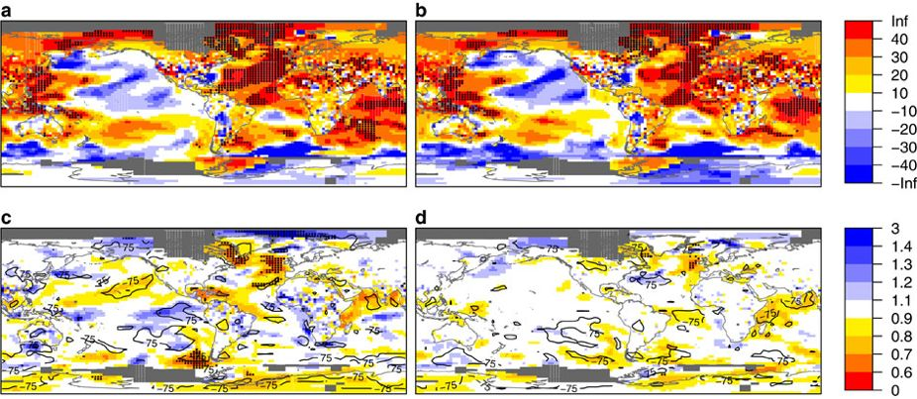
Forecast quality in decadal predictions – added value from initialization?
e.g. near-surface temperature in CMIP5 (RMSSS)
2-5 years 6-9 years
Ini
[Doblas-Reyes et al 2013]
Ini-NoIni
→ Limited predictability from initialisation versus external forcing due to imperfect initialisation?
→ What level of skill may be achievable?
[Interesting scientific question, but also to important to manage expectations!]

Slide 4
Issues with initializing decadal predictions - shocks and drift

Slide 5
Perfect-model prediction experiments
How far can the model predict itself, starting from identical (almost) initial conditions?
CESM1, consistent set-up to decadal hindcasts (just replacing real-world observations with a historical simulation, for both initialisation and evaluation):
decadal simulations started from a historical reference run, 1st Jan each year 1961-2005
5 ensemble members (perturbing air temperature with Gaussian noise order of magnitude 10⁻⁵K)
Historical runs (5 members CMIP5 hist) as un-initialised counterpart
Compare skill for initialised/uninitialised runs, and perfect-model/real-world predictions (real-world hindcasts from CMIP5, Yeager et al 2012)
(focus on near-surface temperature to illustrate the framework)

Slide 6
Perfect-model setup
Perfect model
Perfect model
Perfect initialization
Remaining runs as
prediction ensemble
Perturbation members
as prediction ensemble
Starting point
Perturbations
1 historical run
as reference
1 historical run
as reference
time
time

Slide 7
Skill measures
Forecast accuracy: Mean Squared (error) Skill Score (MSSS)
$MSSS\left(H,\overline{O,} O\right)=r_{HO}^{2}−{\left[r_{HO}−\frac{S_{H}}{S_{O}}\right]}^{2}−{\left[\frac{\overline{H}−\overline{O}}{S_{O}}\right]}^{2}$
$r_{HO}$: sample correlation between the hindcasts and the observations
${S_{H}}^{2};\text{S}\text{O}\text{2}$: the sample variances of the ensemble mean hindcasts and observations,
$\overline{O}=\sum_{j=1}^{n}{O_{j}}:$climatological forecast (where Oj represents the observations, or perfect-model reference respectively, over j = 1,...,n start times), $\overline{H}$ the mean hindcast
Ensemble dispersion: Logarithmic Ensemble Spread Score (LESS)
$LESS=ln\left(\frac{\overline{σ_{\hat{H}}^{2}}}{σ_{R}^{2}}\right)$
in which,
$\overline{σ_{\hat{H}}^{2}}=\frac{1}{n}\sum_{j=1}^{n}{\frac{1}{m−1}}\sum_{i=1}^{m}{{({\hat{H}}_{ij}−{\hat{H}}_{j})}^{2}}$ (average ensemble variance)
$σ_{R}^{2}=\frac{1}{n−2}\sum_{j=1}^{n}{{\left({\hat{H}}_{j}−O_{j}\right)}^{2}}$ (reference mean square error)
LESS <0: the ensemble is under-dispersive (i.e. overconfident)
LESS >0: the ensemble is over-dispersive (i.e. under-confident)

Slide 8
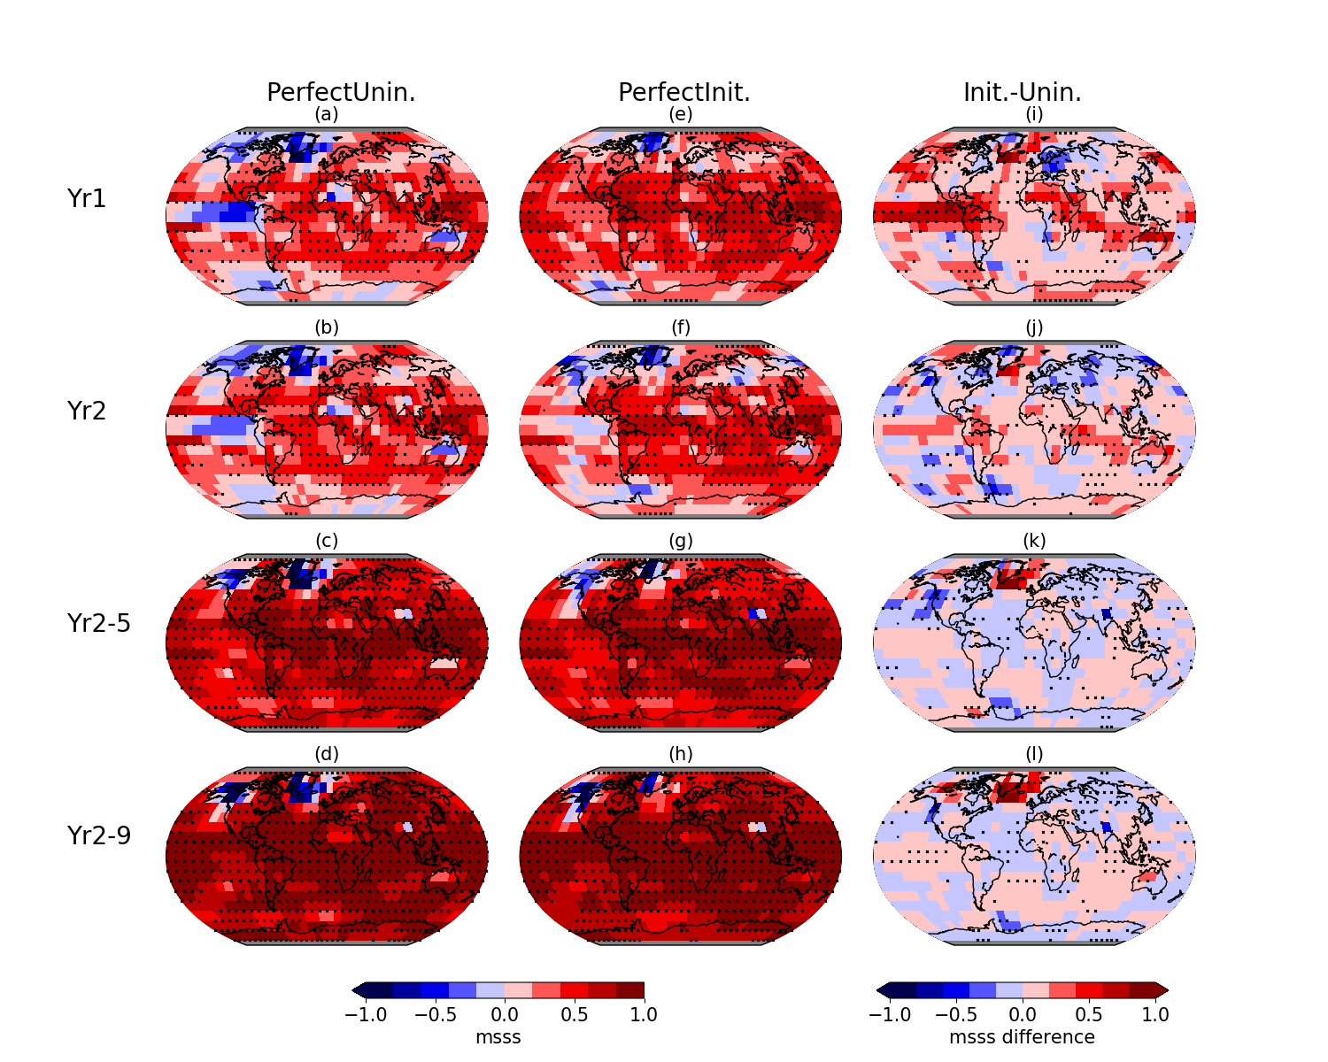
MSSS in initialized and un-initialized perfect-model predictions
[added value from initialization?]

Slide 9
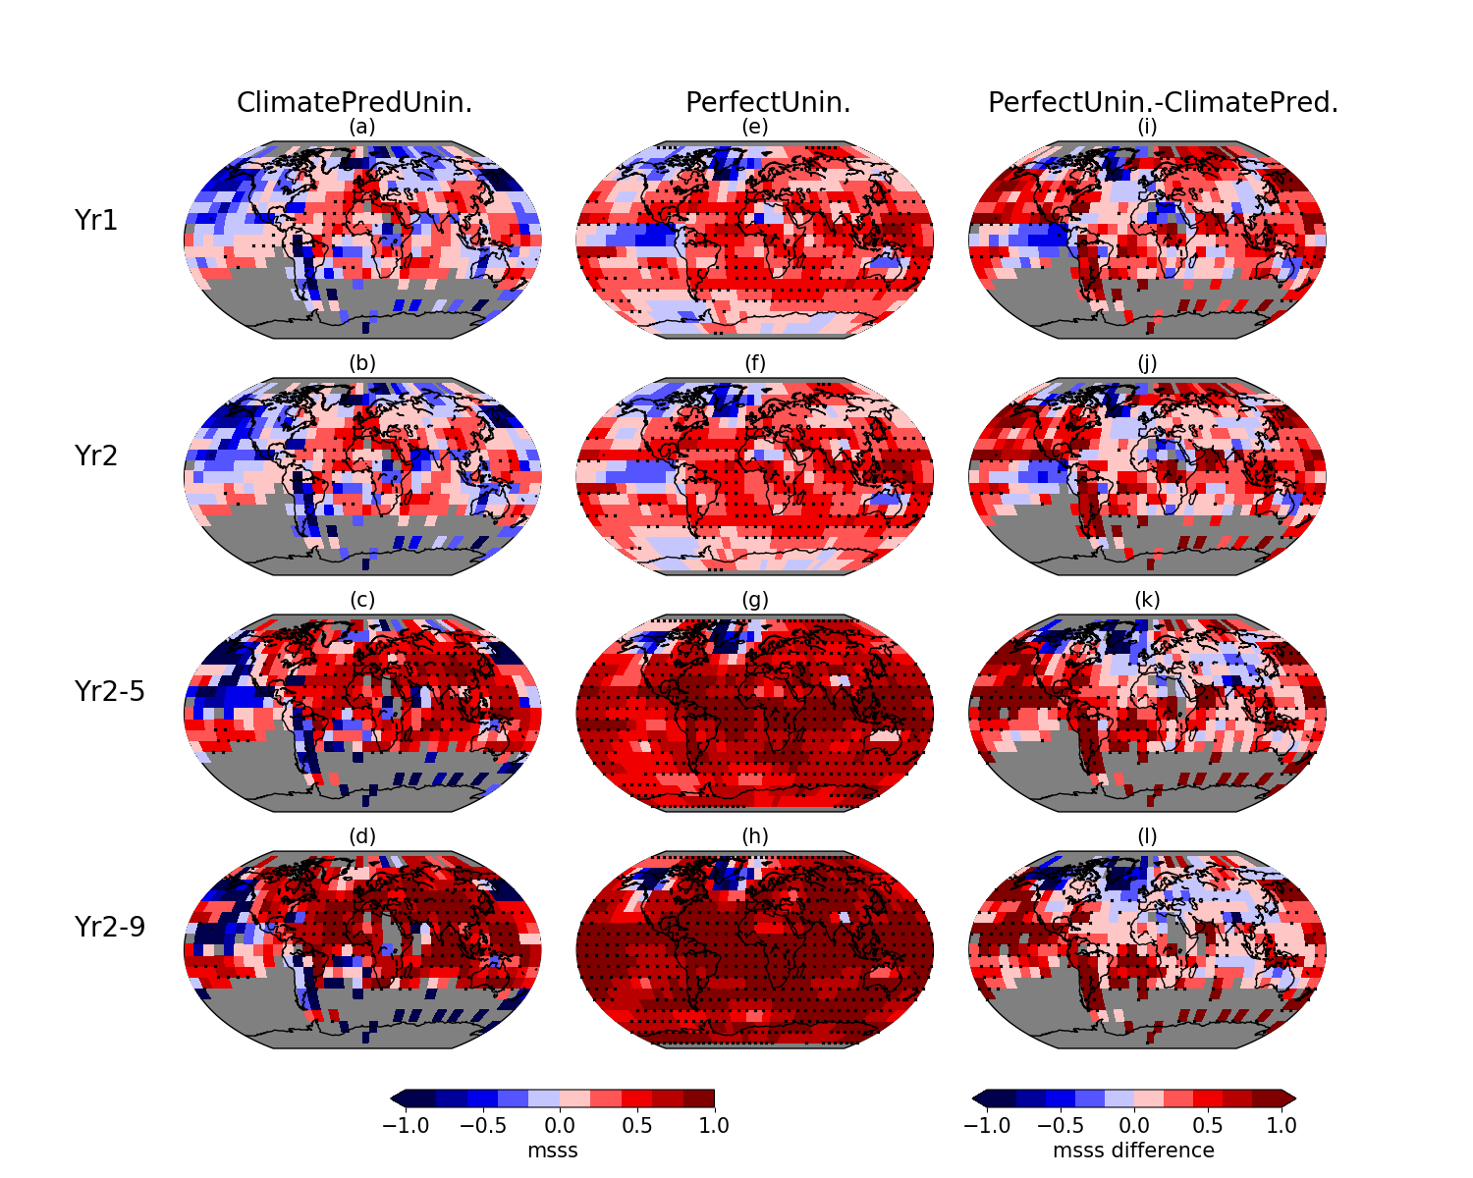
MSSS un-initialized real-world and perfect-model predictions
[inconsistencies model vs. obs?]

Slide 10
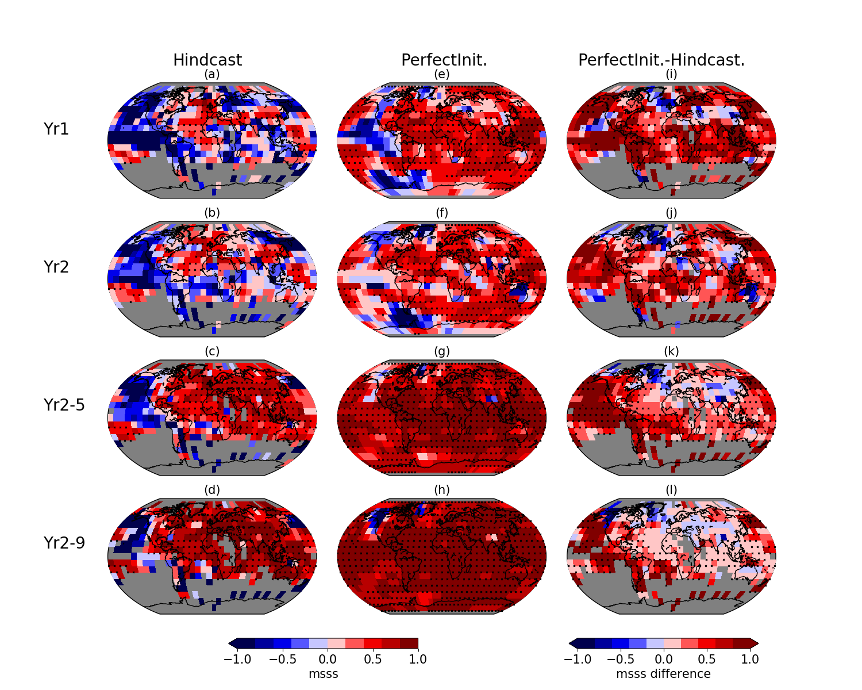
MSSS initialized real-world hindcasts and perfect-model prediction
[total margin of possible improvement?]

Slide 11
Compare areas with increased/decreased skill
 | Lead year | Significant improvement (p<0.1) | Significant negative difference
Initialized perfect model vs ‘uninitialized’ perfect model | 1 | 35% | --
 | 2 | 15% | 5%
 | 2-5 | -- | 12%
 | 2-9 | 13% | 9%
Uninitialized perfect model vs uninitialized climate predictions | 1 | 29% | --
 | 2 | 27% | --
 | 2-5 | 45% | --
 | 2-9 | 44% | 5%
Initialized perfect model vs decadal hindcasts | 1 | 48% | --
 | 2 | 29% | --
 | 2-5 | 61% | --
 | 2-9 | 54% | --
Effect of initialisation

Slide 12
Compare areas with increased/decreased skill
 | Lead year | Significant improvement (p<0.1) | Significant negative difference
Initialized perfect model vs ‘uninitialized’ perfect model | 1 | 35% | --
 | 2 | 15% | 5%
 | 2-5 | -- | 12%
 | 2-9 | 13% | 9%
Uninitialized perfect model vs uninitialized climate predictions | 1 | 29% | --
 | 2 | 27% | --
 | 2-5 | 45% | --
 | 2-9 | 44% | 5%
Initialized perfect model vs decadal hindcasts | 1 | 48% | --
 | 2 | 29% | --
 | 2-5 | 61% | --
 | 2-9 | 54% | --
Inconsistencies
Model - observations

Slide 13
Compare areas with increased/decreased skill
 | Lead year | Significant improvement (p<0.1) | Significant negative difference
Initialized perfect model vs ‘uninitialized’ perfect model | 1 | 35% | --
 | 2 | 15% | 5%
 | 2-5 | -- | 12%
 | 2-9 | 13% | 9%
Uninitialized perfect model vs uninitialized climate predictions | 1 | 29% | --
 | 2 | 27% | --
 | 2-5 | 45% | --
 | 2-9 | 44% | 5%
Initialized perfect model vs decadal hindcasts | 1 | 48% | --
 | 2 | 29% | --
 | 2-5 | 61% | --
 | 2-9 | 54% | --
Overall possible improvement
If perfect-model skill was achievable

Slide 14
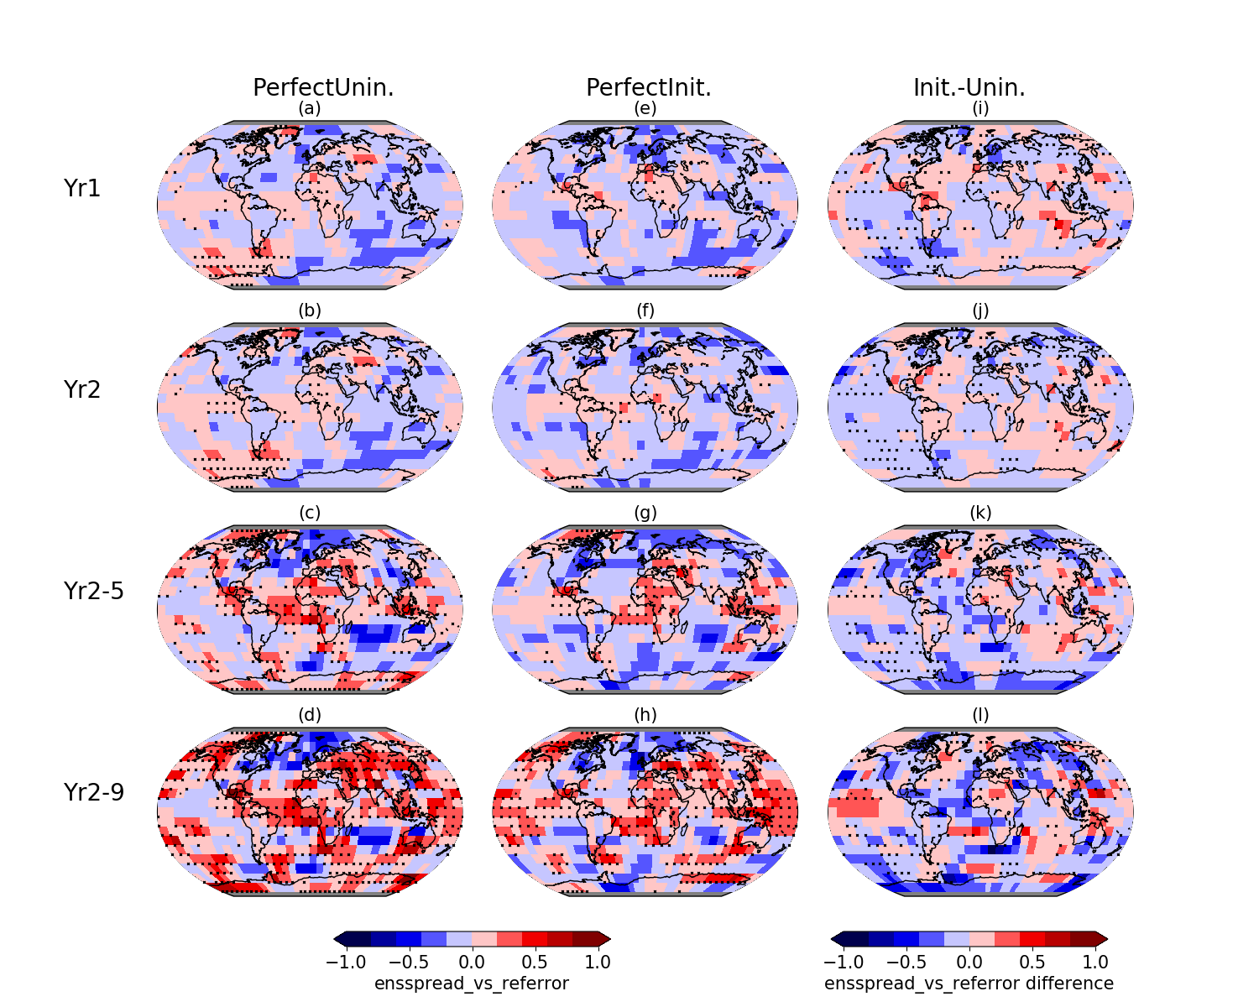
LESS in initialized and un-initialized perfect-model predictions
[no clear effect from initialization!]

Slide 15
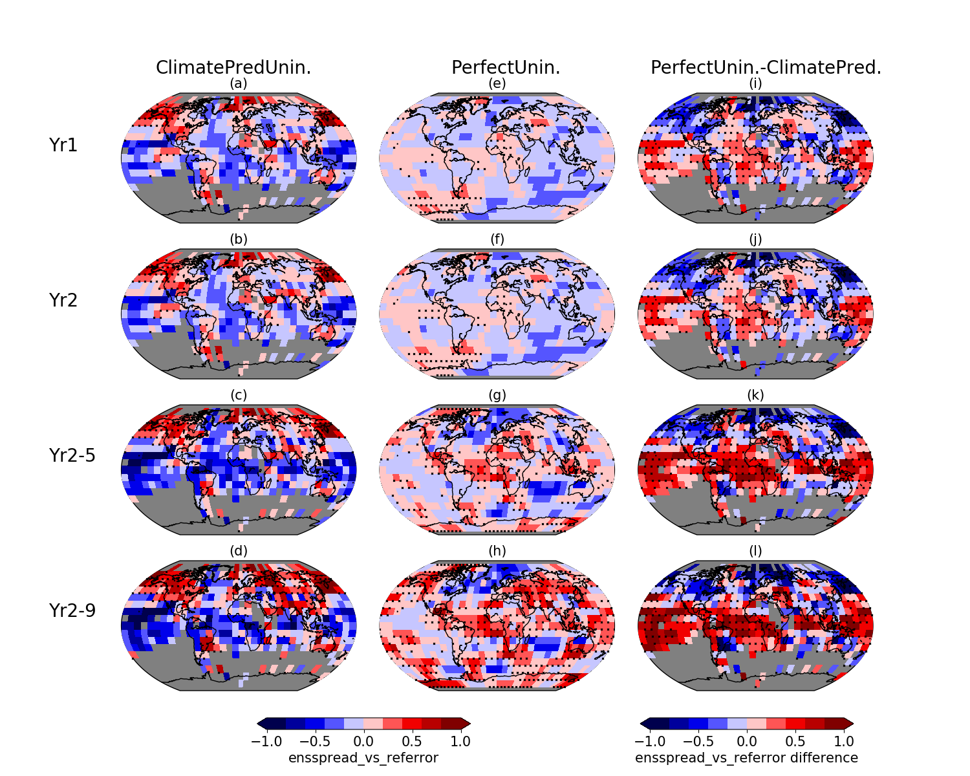
LESS un-initialized real-world and perfect-model predictions
[inconsistencies model vs. obs?]

Slide 16
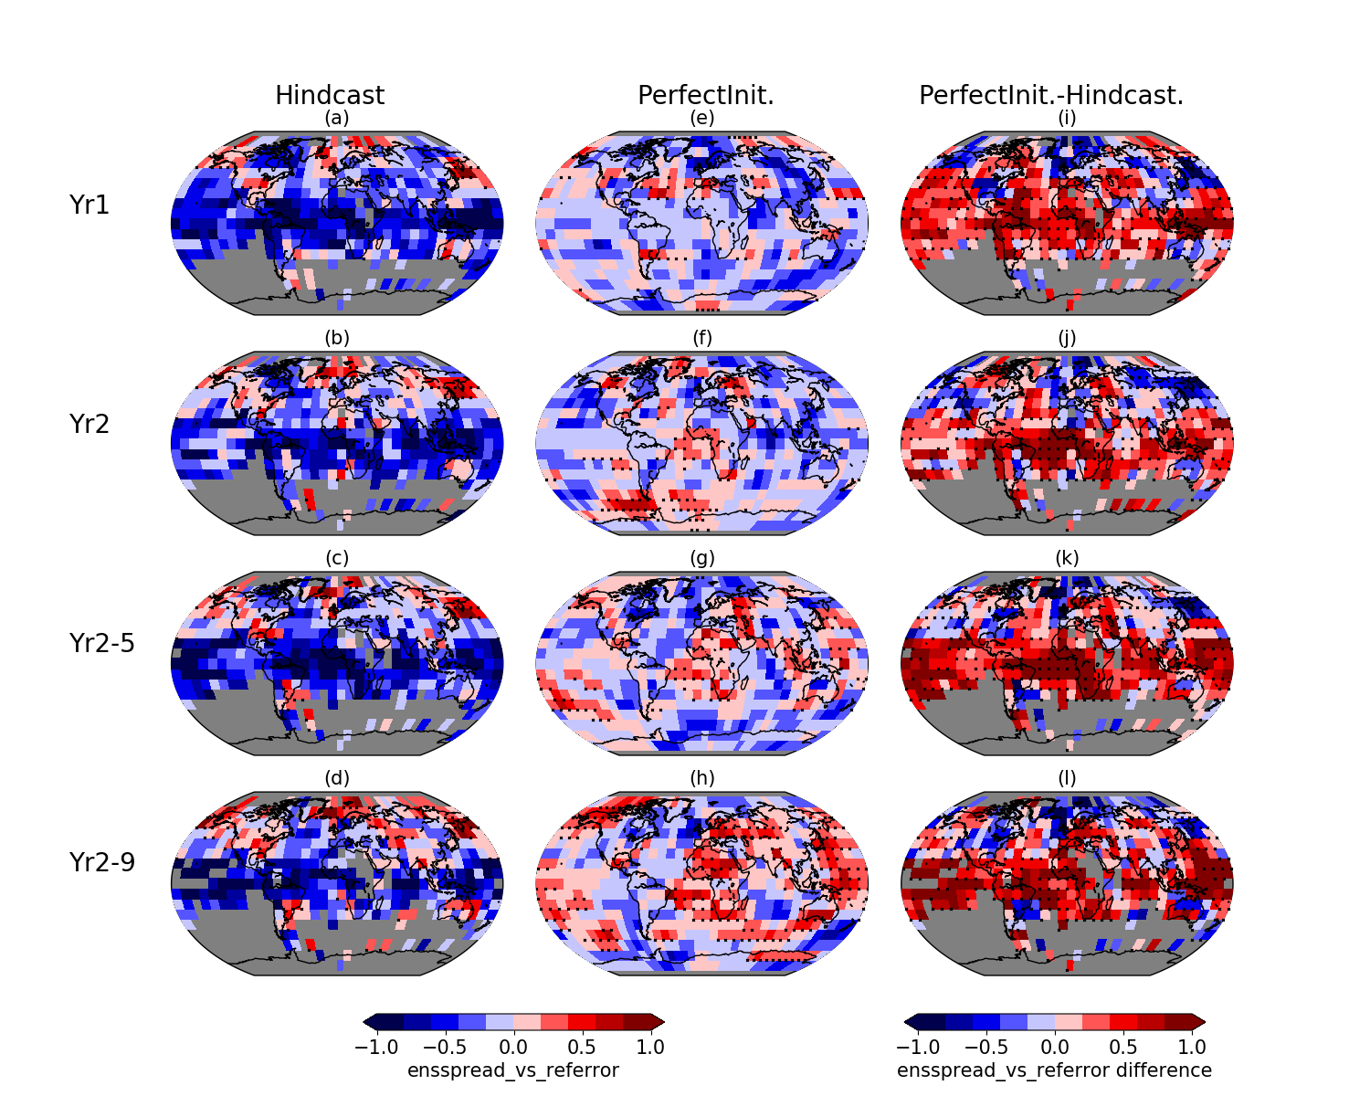
LESS initialized real-world hindcasts and perfect-model prediction
[pattern/differences very similar between initialized/un-initialized]

Slide 17
Summary + Concluding thoughts
perfect-model experiments can be useful to determine the limits of achievable prediction skill (illustrated for tas, but similarly applicable to other variables…)
Added value from initialisation until ~2 years forecast time
(ideal) initialisation does not appear to affect ensemble dispersion
Future work:
Run similar experiments (e.g. complementary to DCPP-A) with other models to understand in how far predictability patterns are model-dependent
Larger ensemble sizes needed to e.g. better estimate robustness of skill differences, reliability, etc.
[Caveat: predictability of real world may be different to predictability within model
missing key processes? Improved models more/less predictable?
→ Perfect-model benchmark informs us what skill is achievable with our existing models (the same used to make predictions!) given ideal initialisation ]

Slide 18
Thank you
Liu, Y., Donat, M. G., Taschetto, A. S., Doblas‐Reyes, F. J., Alexander, L. V., & England, M. H. ( 2019). A framework to determine the limits of achievable skill for interannual to decadal climate predictions. Journal of Geophysical Research: Atmospheres, 124, 2882-2896. https://doi.org/10.1029/2018JD029541
markus.donat@bsc.es

Slide 19
Comparing the different prediction experiments
 | The initialized perfect model predictions | The initialized real-world decadal hindcasts | The uninitialized climate predictions
Near surface temperature observations |  | (iii) | (iv)
Perfect model temperature reference | (i) |  | (ii)

