Slide 1
Assimilating vertical profiles of dust observations with ensemble meteorological initial and boundary conditions
Jeronimo Escribano ⁽¹⁾, Enza Di Tomaso ⁽¹⁾, Carlos Perez Garcia-Pando ⁽¹⁾, Oriol Jorba ⁽¹⁾, Francesca Macchia ⁽¹⁾, Claudia Urbanneck ⁽²⁾, Holger Baars ⁽²⁾, Albert Ansmann ⁽²⁾, and Ulla Wandinger ⁽²⁾
Barcelona Supercomputing Center, Barcelona, Spain
Leibniz Institute for Tropospheric Research, Leipzig, Germany
12/04/2019
EGU 2019
Notes:
Good morning, I will show you our work on assimilating lidar dust extinction profiles in a chemical transport model. First I would like to thank to my collaborators at BSC and TROPOS:
The most usual aerosol data assimilation uses aerosol optical depth as observations, which gives no information about the aerosol vertical structure. Assimilating LIDAR extinction could potentially give information in the vertical, as a dust plume height, for example. We are interesting in the characterization of the uncertainty of the simulation on the vertical dimension, that can be really useful for the profile assimilation. I will show our developments on this by the example of a case of stud
This is a work in progress.

Slide 2
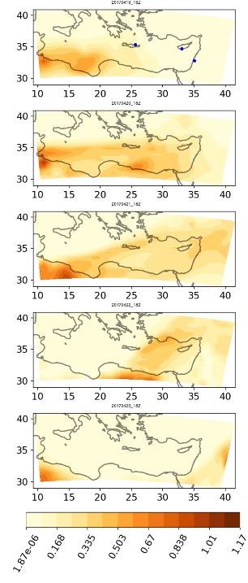
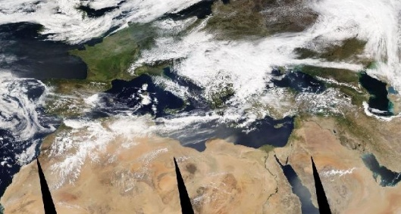
Case of study
19/04/2017
18Z
20/04/2017
18Z
21/04/2017
18Z
22/04/2017
18Z
23/04/2017
18Z
MODIS-Aqua 21/04/2017, NASA
Dust AOD
Notes:
Our case of study is a dust plume over the Eastern mediterranean on april 2017. You can see in the figure the dust plume over the sea. In the right panel, there is a model simulation of this event, that is, the prior of our data assimilation and you can see how the plume moves eastwards, it passes over Crete and Cyprus

Slide 3
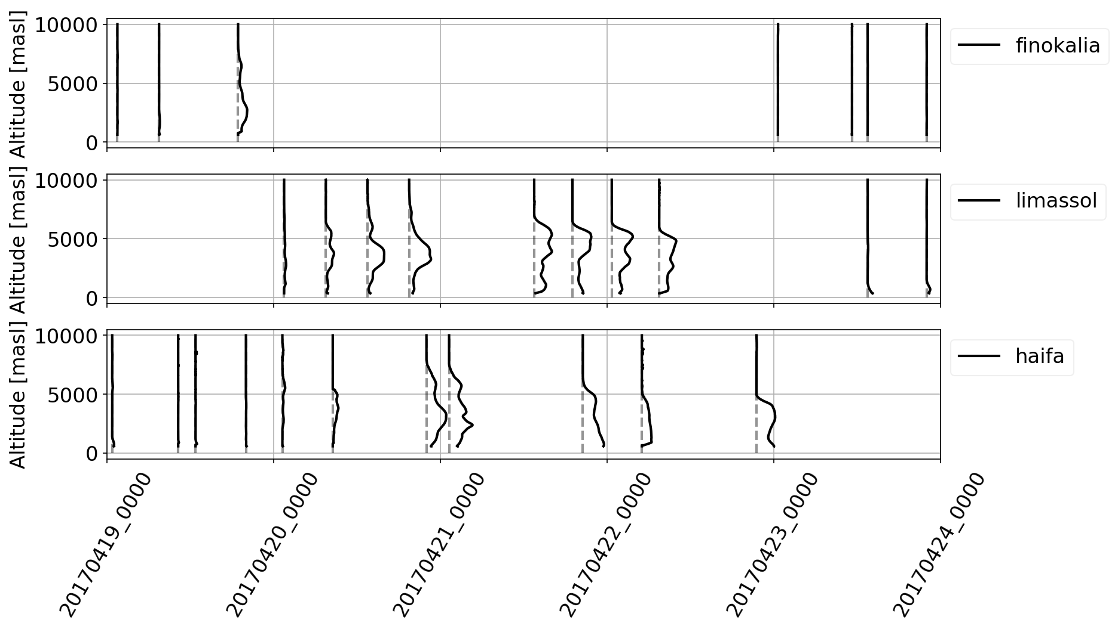
Case of study
19/04/2017
18Z
Event observed by 3 lidar sensors located in Finokalia (Crete), Limassol (Cyprus) and Haifa (Israel) part of the PollyNet (http://polly.tropos.de/) system. Data (with uncertainty estimation) processed by TROPOS.
20/04/2017
18Z
Dust extinction coefficient
21/04/2017
18Z
Finokalia (Crete)
Limassol (Cyprus)
22/04/2017
18Z
Haifa (Israel)
23/04/2017
18Z
Dust AOD
Notes:
The observations we sill use were processed by TROPOS, they are dust exticntion coefficient for 3 lidar sited in Crete (upper), Cyprus(middle) and Israel.(lower) You can how the plume is captured in these 3 lidars as it moves eastward. Tropos provides the values of the exticntions and ther uncertainty.

Slide 4
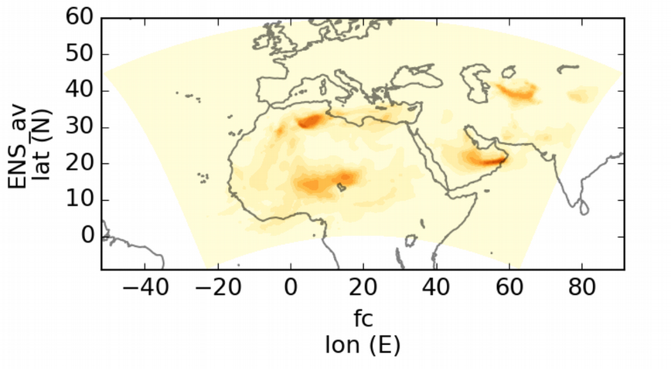
Model and Data Assimilation setup
Model:
NMMB - MONARCH multi-scale chemical weather prediction system model (Janjic et al., 2011, Perez et al., 2011)
Aerosols: only dust configuration
0.66 degrees resolution, 40 vertical levels
Dust emission schemes available
Data assimilation:
Local Ensemble Transform Kalman Filter (LETKF, Hunt et al., 2007; Miyoshi and Yamane, 2007, Schutgens et al., 2010)
24 hours assimilation window
Horizontal localization : 400 km
Vertical localization : 1 model level
Time localization : 4 hours
Dust extinction coefficient observation operator
Ensemble generation:
Perturbation in emission parameters
Perturbation in emission strength
Different dust emission schemes
Different meteorological forcing for the regional model
Can we benefit from an ensemble with different meteorological inputs and emission schemes for aerosol vertical profiles data assimilation?
Mean ensemble forecast for April 20 18Z

Slide 5
Experiments description
4 experiments with different ensembles (20 members):
Experiment | Meteorology boundary and initial conditions | Dust emission
1 meteo, 1 dust scheme | ERA Interim (Dee et al., 2011) | Ginoux et al., 2001
2 meteo, 1 dust scheme | ERA Interim FNL | Ginoux et al., 2001
1 meteo, 2 dust schemes | ERA Interim | Ginoux et al., 2001 Perez et al., 2011
2 meteo, 2 dust schemes | ERA Interim FNL | Ginoux et al., 2001 Perez et al., 2011
+ random perturbations in :
source strength and dust size distribution
dust scheme threshold friction velocity
(Di Tomaso et al., 2017)
Finokalia and Limassol assimilated
Haifa for verification
fr: “free” run (simulations without assimilation)
fc: “forecast” run (start from analysis of previous day)
an: analysis
FNL: NCEP Final Operational Global Analysis

Slide 6
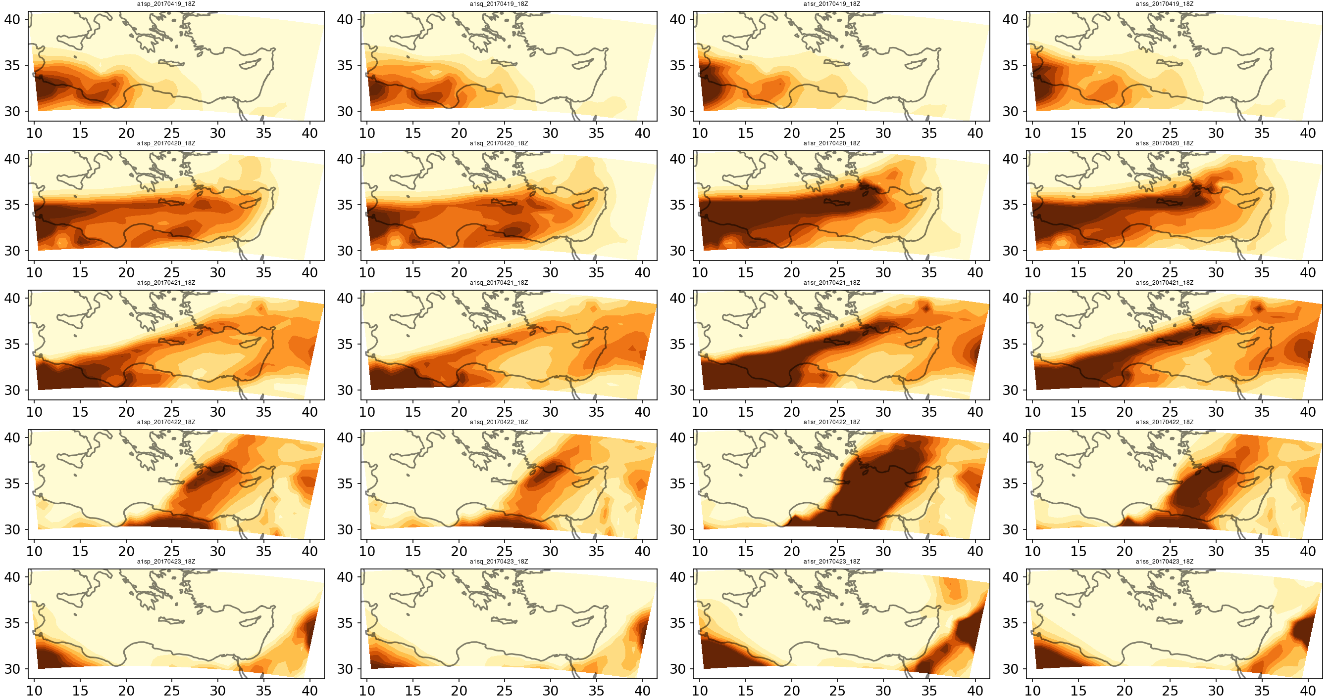
Dust Aerosol Optical Depth 532 nm Analyses
1 meteo, 1 dust scheme
2 meteo, 1 dust scheme
1 meteo, 2 dust schemes
2 meteo, 2 dust schemes
19/04/2017
18Z
20/04/2017
18Z
21/04/2017
18Z
22/04/2017
18Z
23/04/2017
18Z
Dust AOD

Slide 7
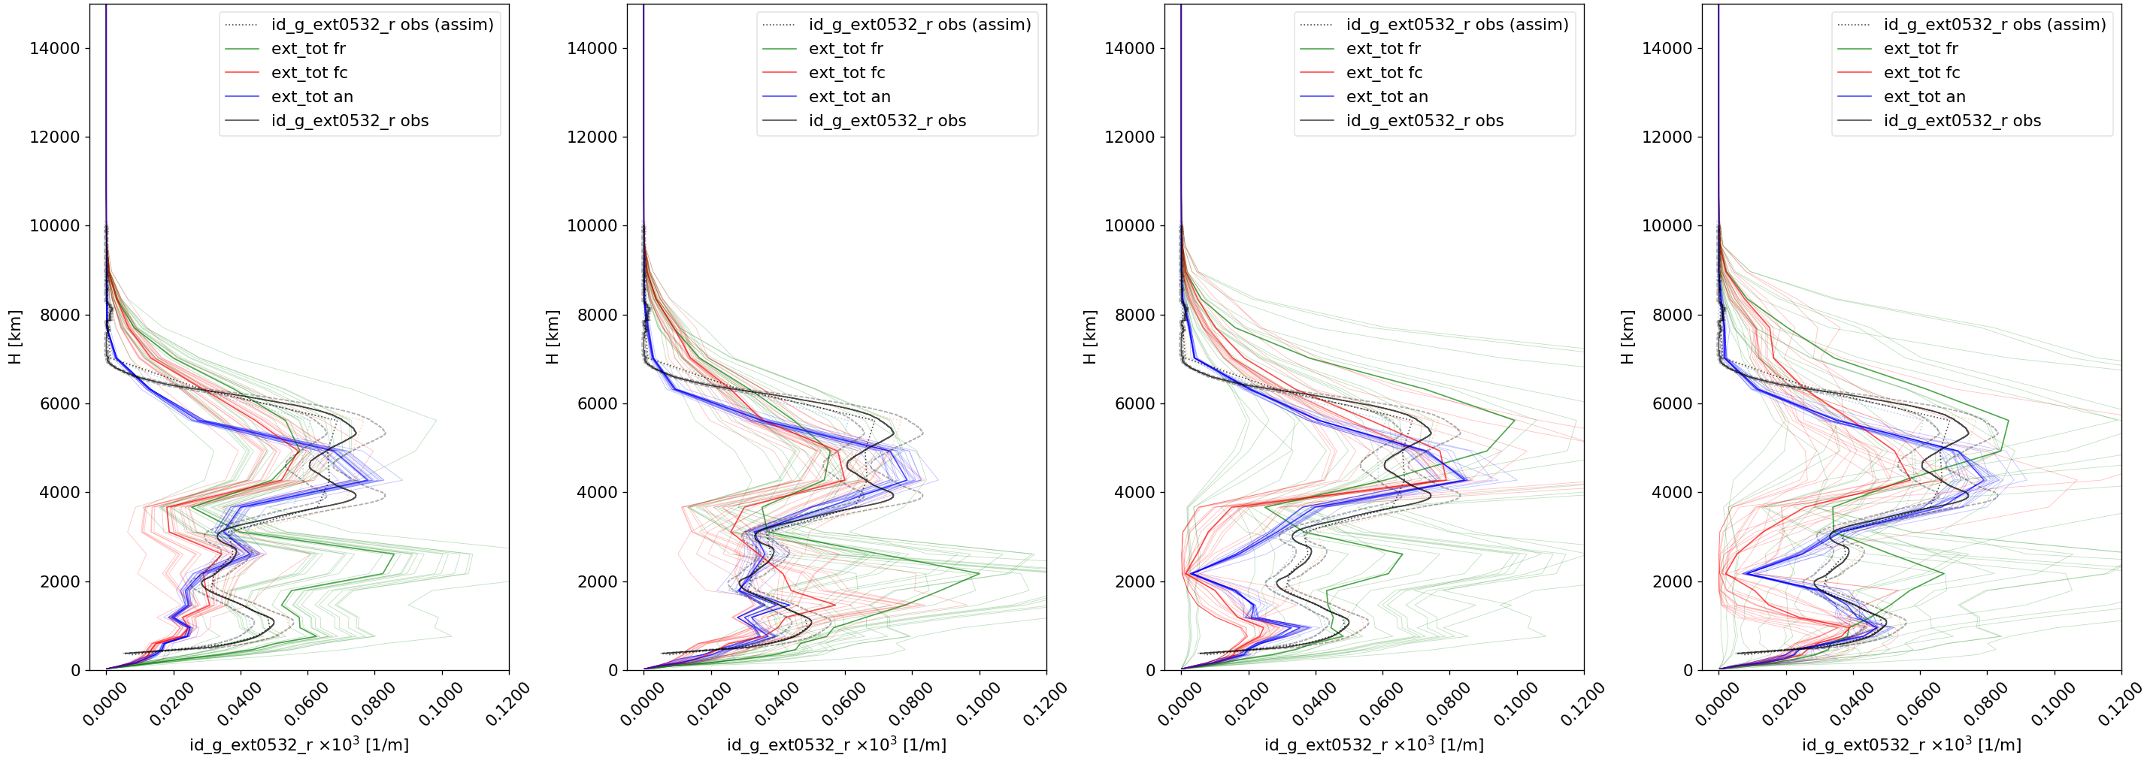
Profiles for the assimilated observations
1 meteo, 1 dust scheme
2 meteo, 1 dust scheme
1 meteo, 2 dust schemes
2 meteo, 2 dust schemes
Extinction coefficient [km⁻¹]
Observation
No assimilation
Forecast run (1 day run from previous analysis)
Analysis
Limassol, 21/04/2017, 13UTC
Notes:
In these 2 examples, meteo pertrubations show….
Below 4km of altitude, the second column shows how the mult meteorology ensemble can is closer to the assimilation observation.
Larger std (down)….

Slide 8
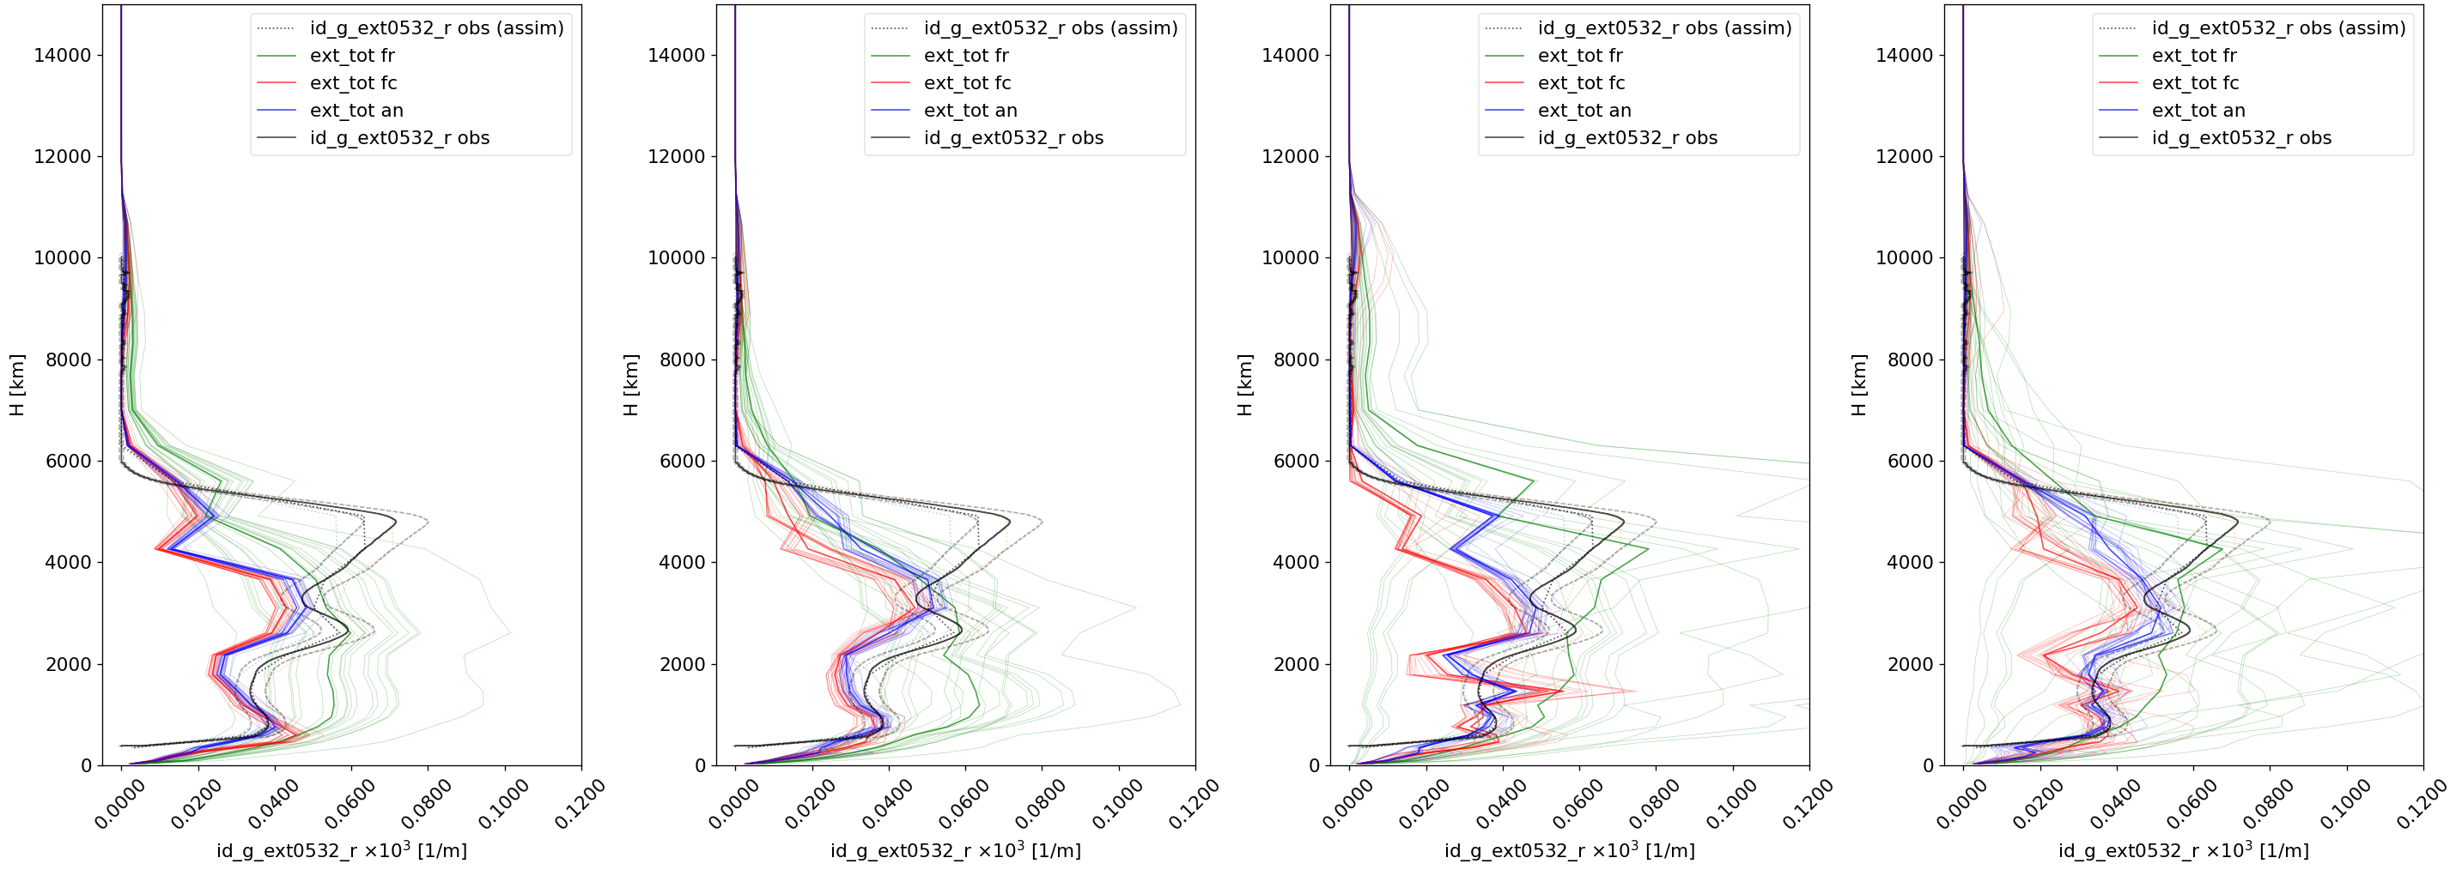
Profiles for the assimilated observations
1 meteo, 1 dust scheme
2 meteo, 1 dust scheme
1 meteo, 2 dust schemes
2 meteo, 2 dust schemes
Extinction coefficient [km⁻¹]
Observation
No assimilation
Forecast run (1 day run from previous analysis)
Analysis
Limassol, 22/04/2017, 07UTC
Notes:
Here is shown how a larger and probably more realistic model spread is given by both cases with mult-meteorological perturbations.
For the multi-scheme pertrubations, it can be seen that :
The fr (green) curve shows the heigh of the plume in the right altitude, wich means that in this case, including a second dust scheme is beneficial and,
The data assimilatio system s able to move, to some extent, th epmaximum of the plume in both multi-sheme cases.
We should note here that the multi-scheme experinmets provides mor valiaribility in the shape of the vertical profile.
Larger std (down)….

Slide 9
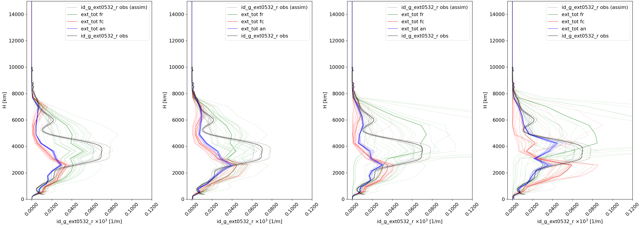
Profiles for the assimilated observations
1 meteo, 1 dust scheme
2 meteo, 1 dust scheme
1 meteo, 2 dust schemes
2 meteo, 2 dust schemes
Extinction coefficient [km⁻¹]
Observation
No assimilation
Forecast run (1 day run from previous analysis)
Analysis
Limassol, 20/04/2017, 13UTC
Notes:
Meteo and schemes alone are not enough for correct the plume (height); but both combined help.
Bottom: none of the experiments are much better tan the others (no difference in multimeteo or multischeme). But it corrects the plume height. 20_13utc

Slide 10
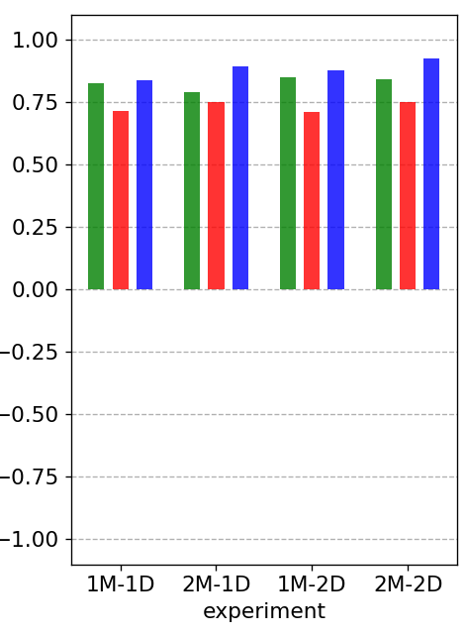
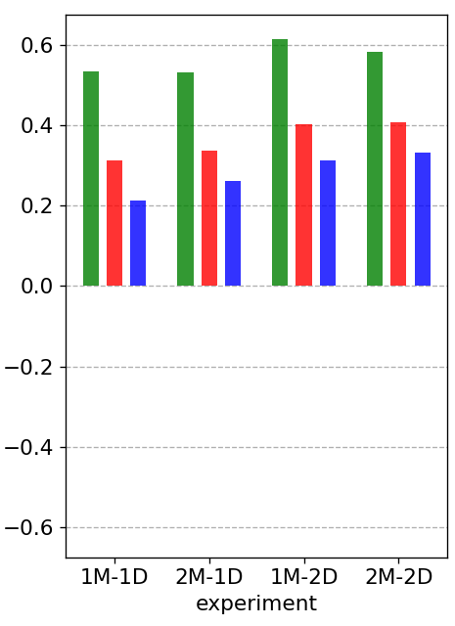
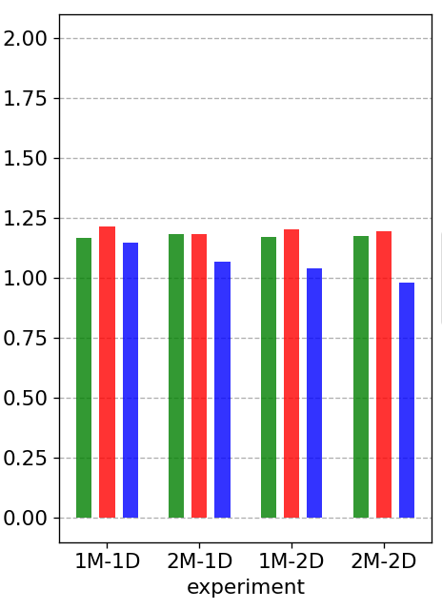
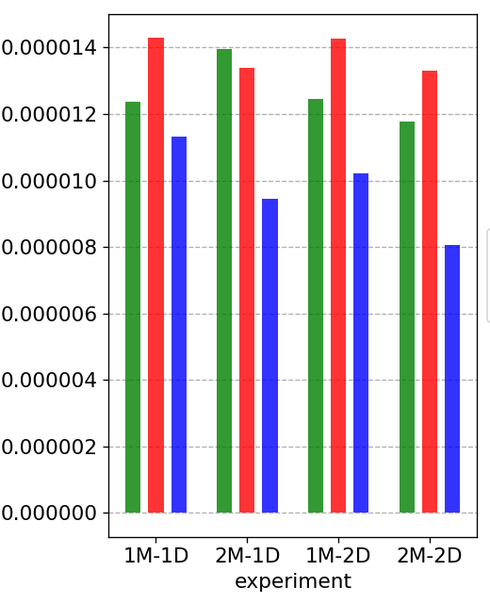
Profiles for the assimilated observations
No assimilation
Forecast run (1 day run from previous analysis)
Analysis
1 meteo, 1 dust scheme
2 meteo, 2 dust schemes
1 meteo, 2 dust schemes
2 meteo, 1 dust scheme
RMSE
Mean Fractional Error
Pearson correlation coefficient
Mean Fractional Bias
N=352

Slide 11
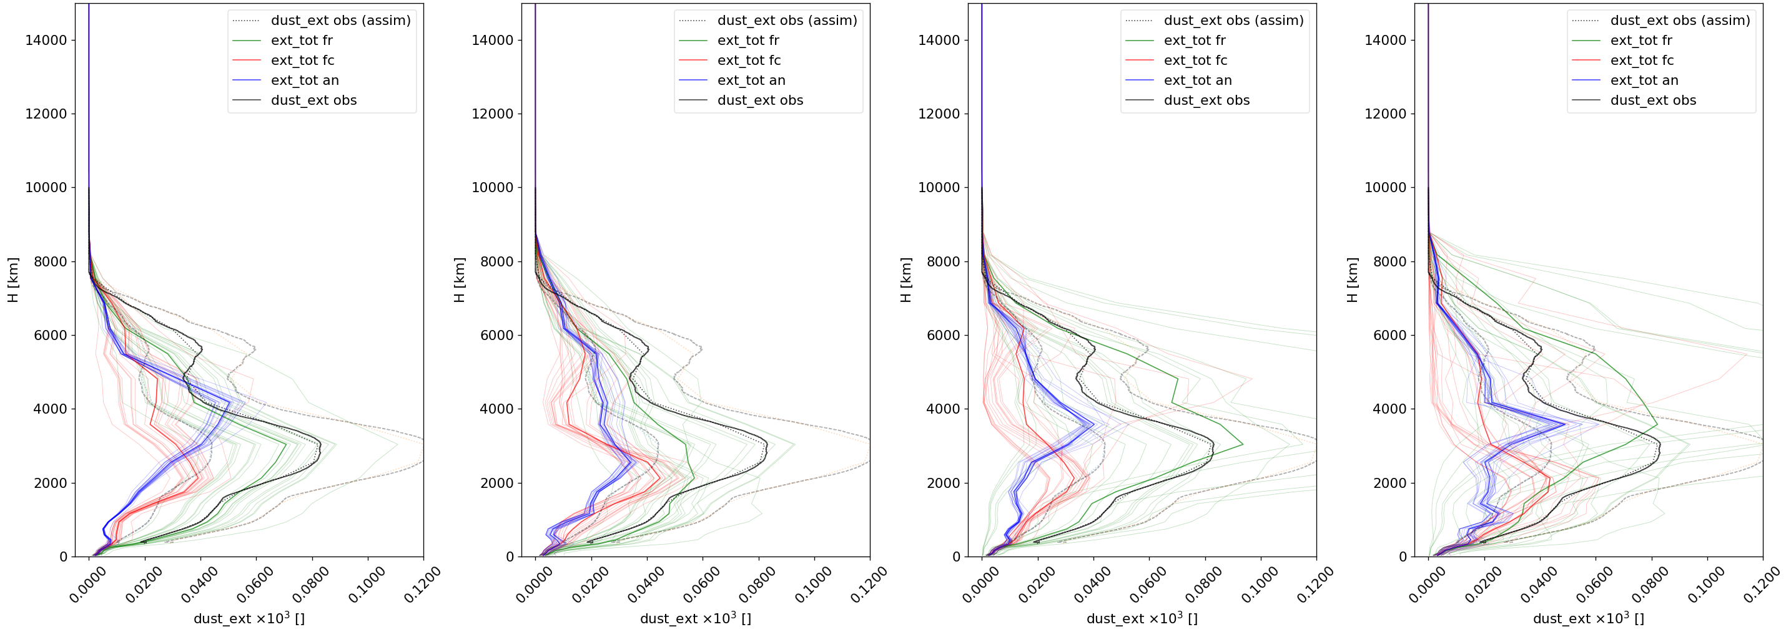
Profiles over Haifa (not assimilated)
1 meteo, 1 dust scheme
2 meteo, 1 dust scheme
1 meteo, 2 dust schemes
2 meteo, 2 dust schemes
Extinction coefficient [km⁻¹]
Observation
No assimilation
Forecast run (1 day run from previous analysis)
Analysis
Haifa, 20/04/2017, 22UTC
Notes:
Top : first part of the plume. 20_2159
No assimilation seems to be better than forecast and analysis.
Altitude of the plume is sligthy better in 2M-1D case
Bottom: last profile, where the plume overpass haifa

Slide 12
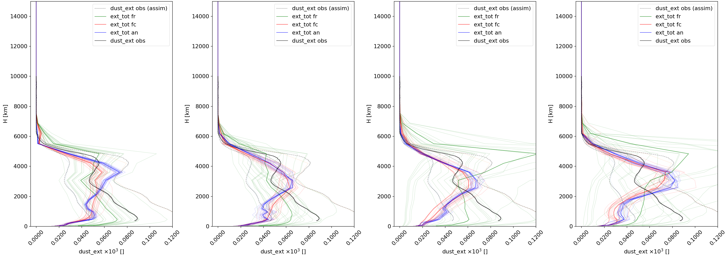
Profiles over Haifa (not assimilated)
1 meteo, 1 dust scheme
2 meteo, 1 dust scheme
1 meteo, 2 dust schemes
2 meteo, 2 dust schemes
Extinction coefficient [km⁻¹]
Observation
No assimilation
Forecast run (1 day run from previous analysis)
Analysis
Haifa, 21/04/2017, 20:30UTC
Notes:
There is a large dust increase in lower levels : emission from lybia that are not observed by the assimilated lidars.
Again, no assimliation run is better than forecast and analysis, for the only-ginoux dust emissions. (two left panels)

Slide 13
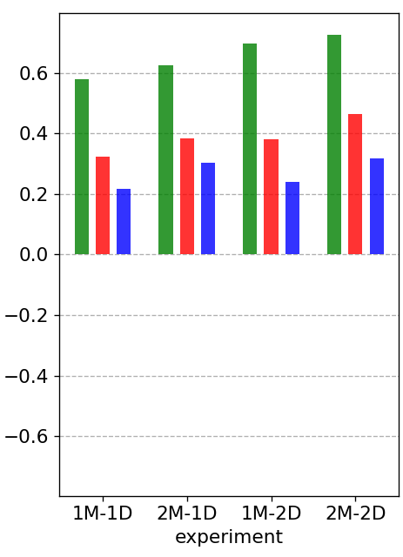
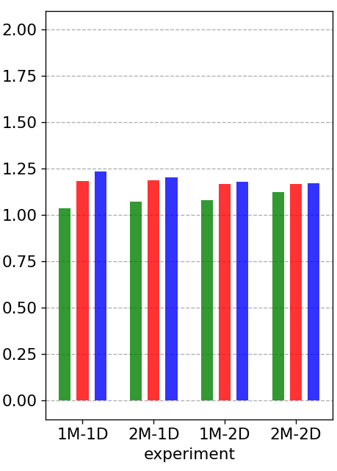
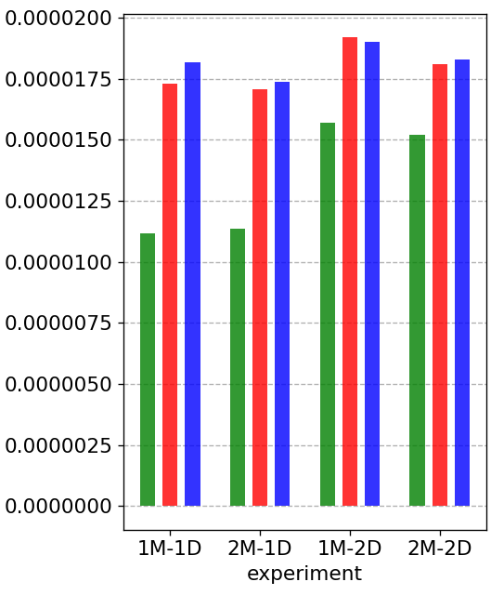
Profiles over Haifa (not assimilated)
No assimilation
Forecast run (1 day run from previous analysis)
Analysis
1 meteo, 1 dust scheme
2 meteo, 2 dust schemes
1 meteo, 2 dust schemes
2 meteo, 1 dust scheme
RMSE
Mean Fractional Error
Pearson correlation coefficient
Mean Fractional Bias
N=220

Slide 14
Summary
Multi-model and multi-emission schemes increase variability in the ensemble profile shape
Better description of profile prior uncertainties
Multi-model and multi-emission schemes increase variability in spatio-temporal dust emissions
Better description of dust plume location and transport uncertainties
Evaluation against a 3rd LIDAR not convincing
More work needed
Quality of ensemble
Observational errors and ensemble inflation (avoid overfitting)
More observations to assimilate and evaluate
Forecast runs performs worse than non-assimilation case: to be investigated

Slide 15
Thank you
This project has received funding from the European Union’s Horizon 2020 research and innovation programme under the Marie Skłodowska-Curie grant agreement H2020-MSCA-COFUND-2016-754433
jeronimo.escribano@bsc.es

Slide 16
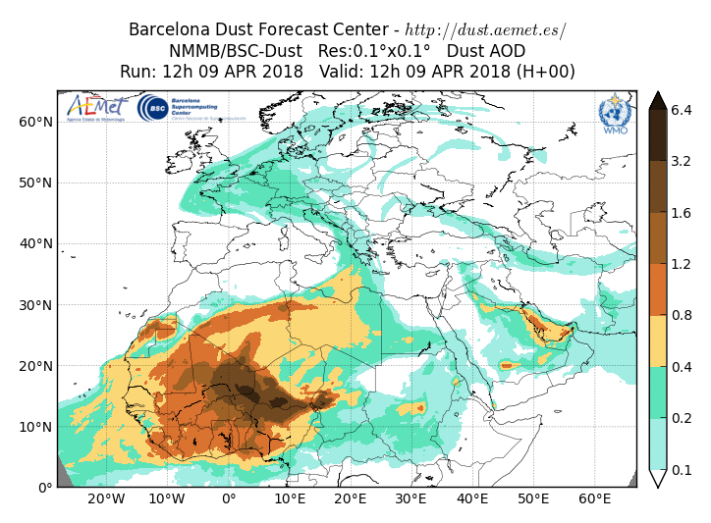
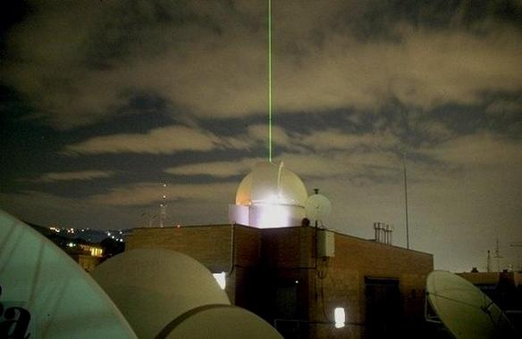
Motivation
Constraining the representation of dust vertical structure
Implication on the radiation’s budget
Implication on dust transport
Constraining an individual aerosol species through data assimilation
Assess the potential benefit of dedicated dust observation products in dust data assimilation
We will present an exploratory case of study
Dust ext. coef. Earlinet 72h, 2012, Granada
Altitude [m]
UPC- RSLAB
Time
Notes:
Operational dust forecast and dust reanalyses are produced in the framework of aerosol data assimilation, where total AOD is used to constrain all the main aerosol species
Assess the potential benefit of dedicated dust observation products in dust data assimilation
Left side of the slide
Satellite observations can used to constrain model simulations in a number of way (improve processes, parameters and initial conditions).
Data assimilation provides us with a sophisticated, and computationally expensive, mathematical framework to do that.
At BSC we use (in research mode) satellite observations to create better initial condition for our dust forecast (Figure with animation).
The Barcelona Dust Forecast Center operates under a WMO initiative and is run jointly by BSC and AEMET.
E.g. we make use of sensors onboard NASA satellites (Figure: NASA Aqua satellite is on the left, it carries the MODIS sensor) and onboard ESA satellites (Figure: ESA Metop satellite is on the right, it carries the IASI sensor).
Right side of the slide
This allows us to improve monitoring and forecast of atmospheric constituents with the production of reanalyses and analyses (for past and current conditions of the atmosphere) and of prediction initialized with improved initial conditions.
This has a positive impact, through air quality services, on key socio-economic sectors such as energy, transport and health.

Slide 17
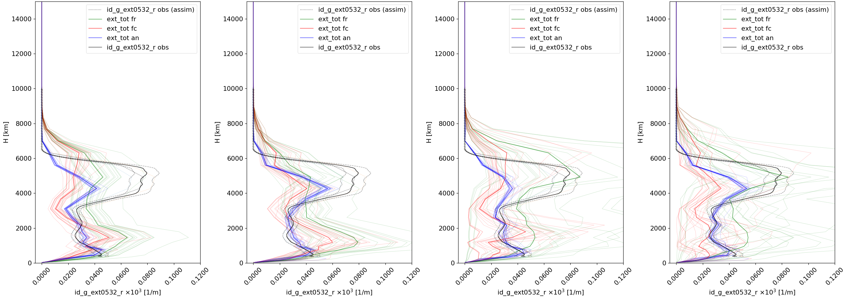
Profiles for the assimilated observations
1 meteo, 1 dust scheme
2 meteo, 1 dust scheme
1 meteo, 2 dust schemes
2 meteo, 2 dust schemes
Extinction coefficient [km⁻¹]
Observation
No assimilation
Forecast run (1 day run from previous analysis)
Analysis
Limassol, 21/04/2017, 19UTC
Notes:
Bottom: none of the experiments are much better tan the others (no difference in multimeteo or multischeme). But it corrects the plume height. 21_19UTC

Slide 18
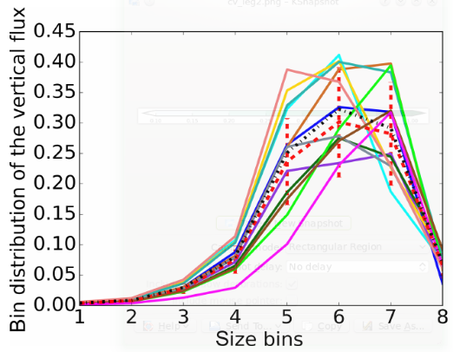
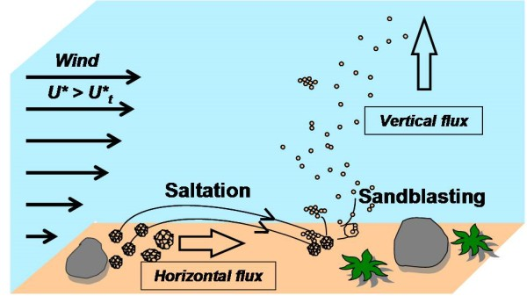
Ensemble-Based Data Assimilation at BSC
The ensemble forecast has been designed considering model uncertainties with respect to:
surface winds,
soil humidity,
vertical flux distribution at sources,
(2)
by perturbing:
(1) the threshold friction velocity which is soil moisture-dependent, and determines the velocity above which the soil particles begin to move in horizontal saltation flux;
(2) the vertical flux of dust in each of the eight dust transport bins imposing some physical constraint (correlated multiplicative noise across the bins; unimodal distribution).
(1)
*N(1,0.4)
(LISA website)
Notes:
The spin-up period for the ensemble ensures that perturbations applied at the sources propagate everywhere in the globe.
(1)
- the threshold friction velocity for dust emission is perturbed extracting a multiplicative random factor from a normal distribution with mean 1 and spread 0.4.
- this considers the uncertainty of the model with respect to both surface winds and soil humidity: at low resolution, model surface winds are typically underestimated
over dust sources. Furthermore, the model uses the scheme of Fécan et al. (1999) to calculate the increase in the threshold friction velocity with soil humidity, which is typically overestimated in arid regions (Haustein et al., 2015)
(2)
- In the case of NMMB-MONARCH one of the components of the uncertainty in the emission term has been identified for example in the vertical flux distribution at sources (Gama et al., 2016).
- NMMB-MONARCH follows a sectional approach for dust, i.e. the size distribution is decomposed into small
size bins
- The perturbations are extracted imposing some physical constraint: correlated noise is used across the bins so that noise correlation decreases with increased difference of the normalized cubic radius among the bins; the noise has mean 1 and standard deviation of 30 % of the unperturbed value in each bin; the final distribution is unimodal

Slide 19
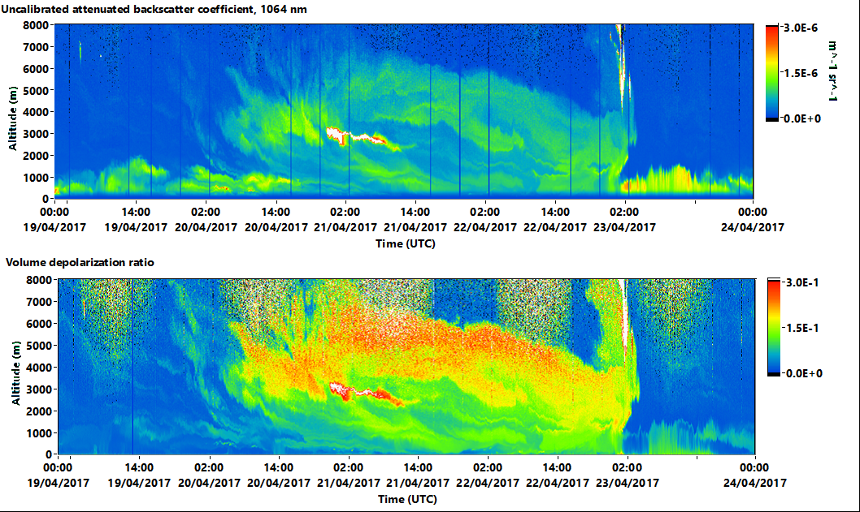
Uncalibrated attenuated backscatter (Limassol)

Slide 20
Summary
Future:
More members to investigate why Haifa comparison (spurious correlations – localization too large?)
Observation uncertainty and inflation: avoid overfitting
Earlinet72h 2012 case: observations in Granada, Potenza and Bucharest: no dust additional sources in the transport of the plume
Observing System Simulation Experiments (OSSEs)
And..
Less sparse observations and a longer period to assimilate and evaluate: CALIOP/LIVAS product?
Add more aerosols to be able to use AERONET or total AOD retrievals.
Look at the joint AOD + LIDAR assimilation problem

Slide 21
Summary
Test localization parameters
Balance error matrices (diagnostics)
Unbias each ensemble (one by one)?
More observations/ long term DA: earlinet? LIVAS product?
Covariance structure: 3Dplots
Vertical localization- level dependent (km?)
Breaks assumptions of gaussianity errors (4 different configurations in the ensemble: 5 members each more or less gaussian)
Combine lidar + AOD: How to deal with the inconsistences? OSSEs to prepare?
Assimilation window length: find optimal value, inflation?
More weight to observations at the end of the assim window.
Remember to do histograms of departures!
Overfitting?: fr worse que fc
Source affecting Haifa that the DA do not see. : ensemble- correlation matrix deficiencies?
Earlinet 72h 2012 case possible.
Localization parameters.

Slide 22
Summary
Skill are improved and profiles are qualitatively improved with respect to the assimilated observations for all the experiments
Multi-meteorology initialization can help in correcting altitude of the plume in some cases
Degradation of skills in all experiments with respect to the no assimilated observations
Limited dataset to assimilate and validate
A good prior is very important

