Slide 1
Berlin, 11th of May 2017
Joint uncertainty assessment of models and observations in verification of climate predictions.
Omar Bellprat
Francois Massonnet, Stefan Siegert, Chloé Prodhomme, Daniel Macias-Gomez, Dirk Notz, Virginie Guemas, Francisco Doblas-Reyes
VERITAS-CCI

Slide 2
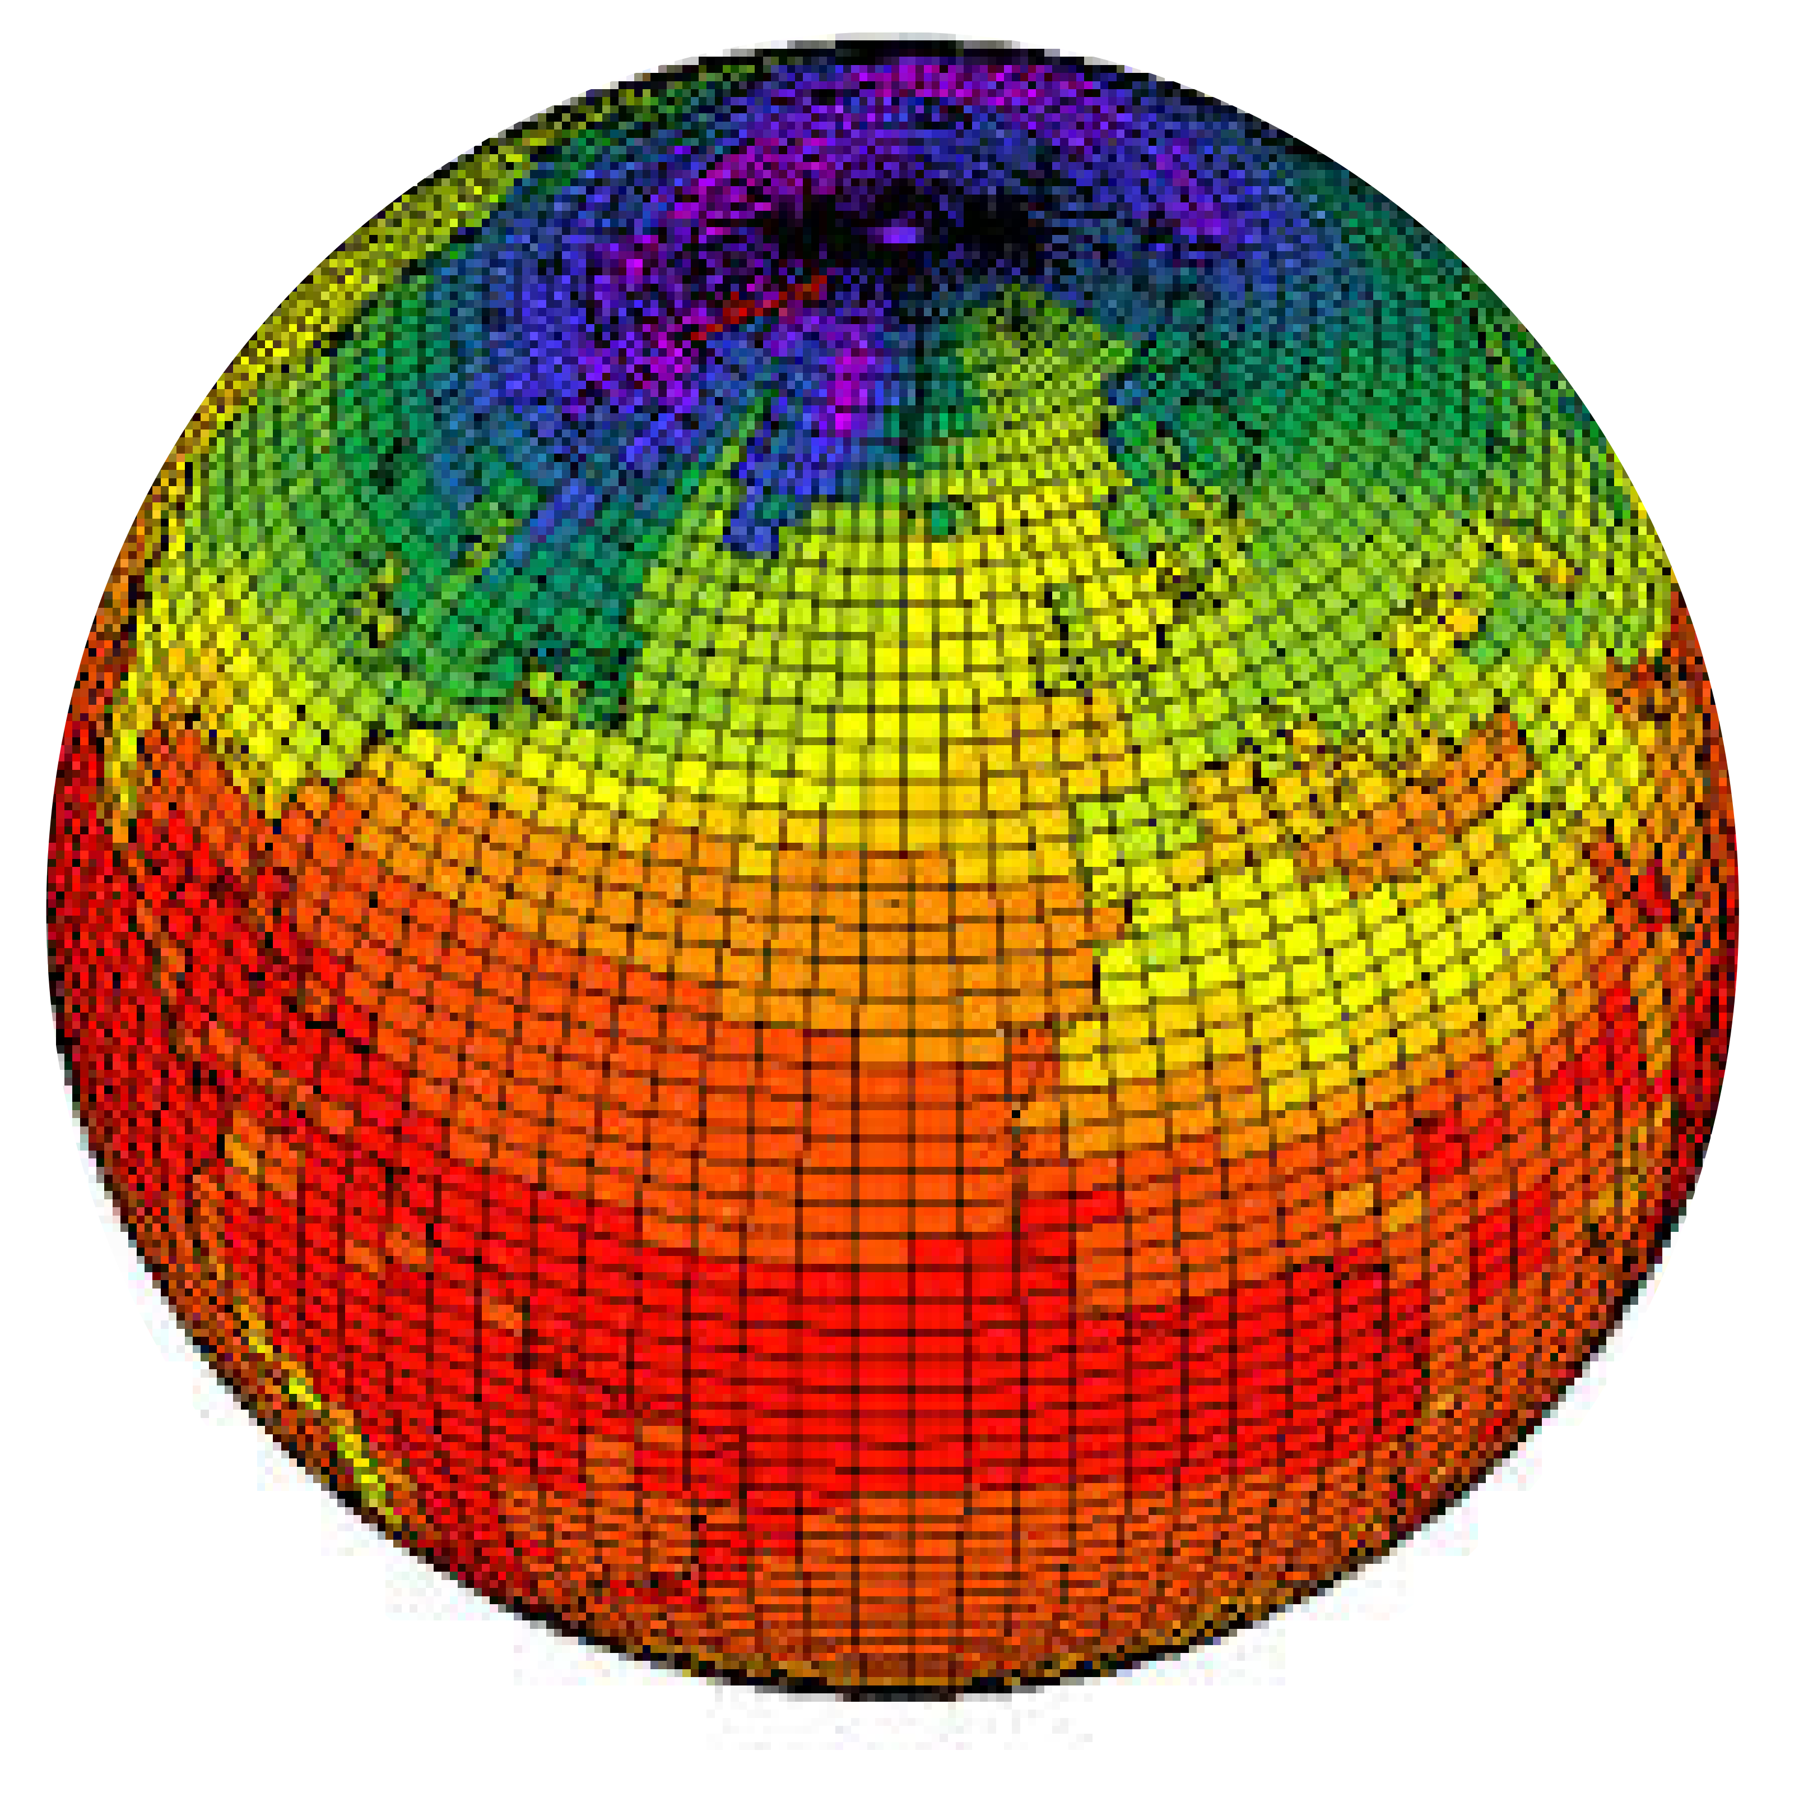
Traditional evaluation perspective
Model
Reality
Observations
Curtosy Dirk Notz

Slide 3
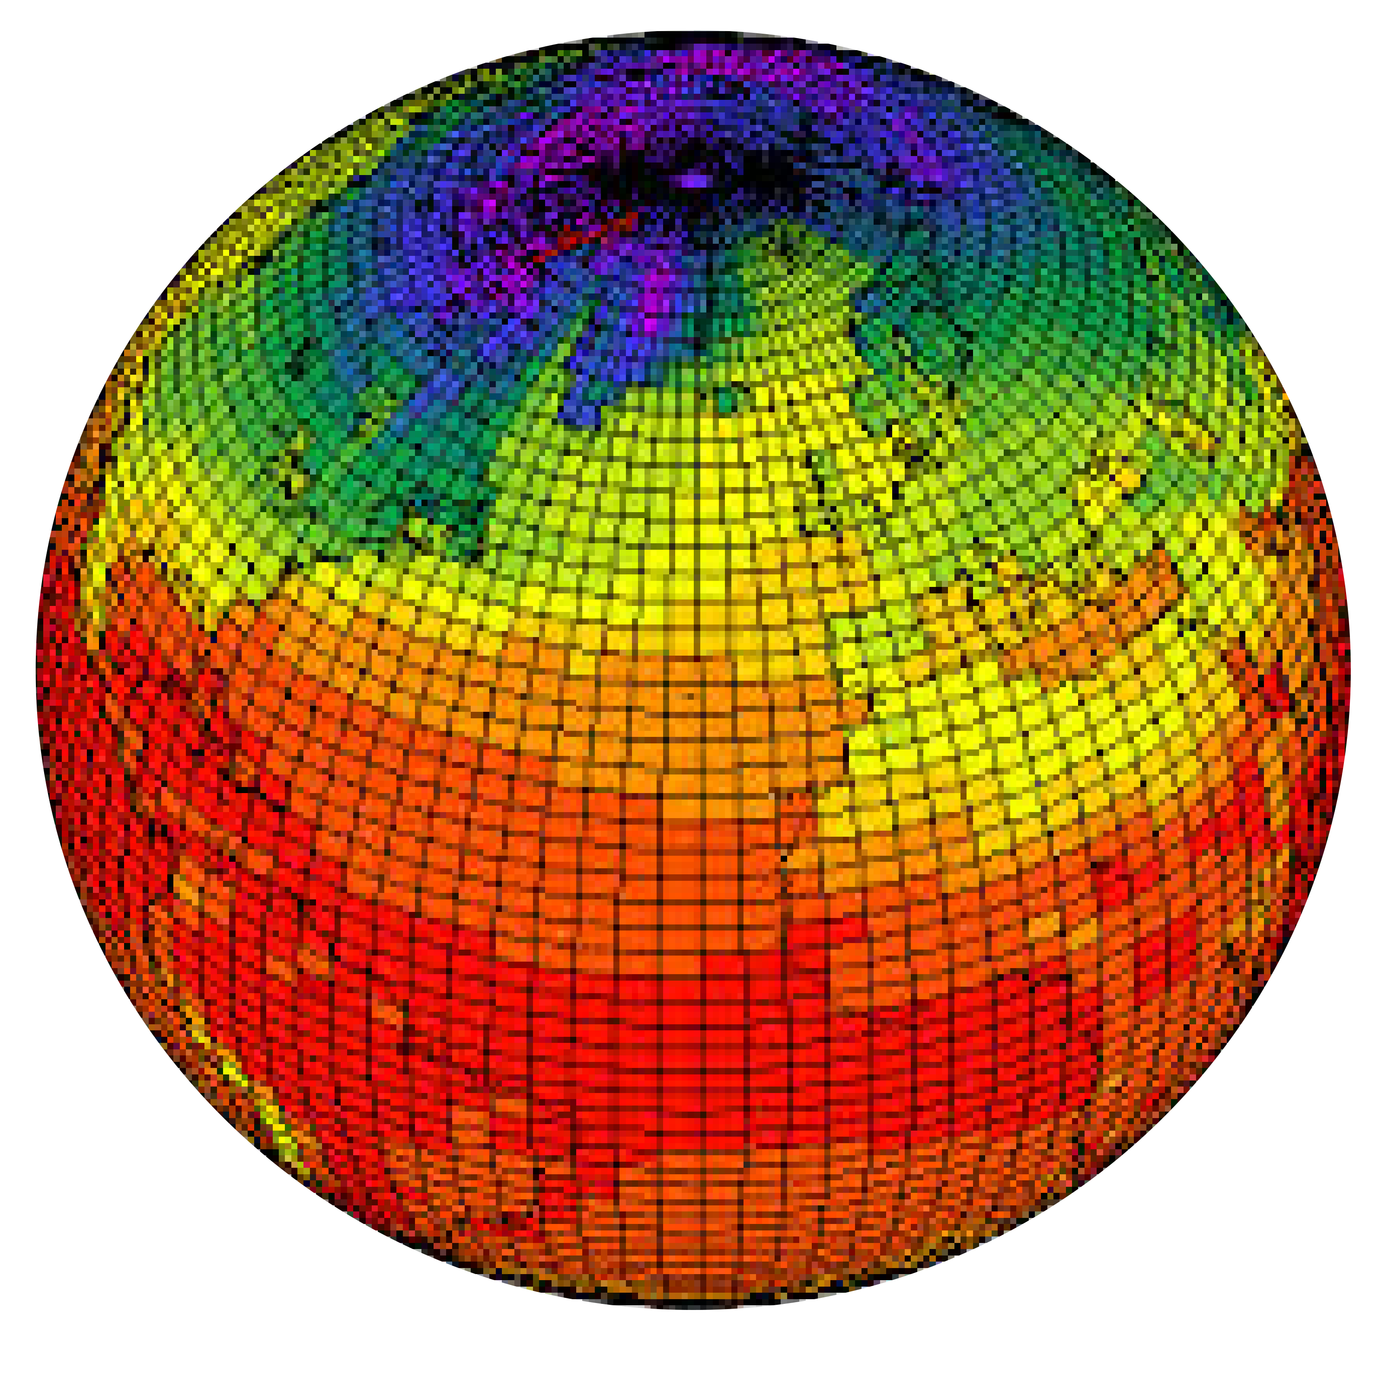
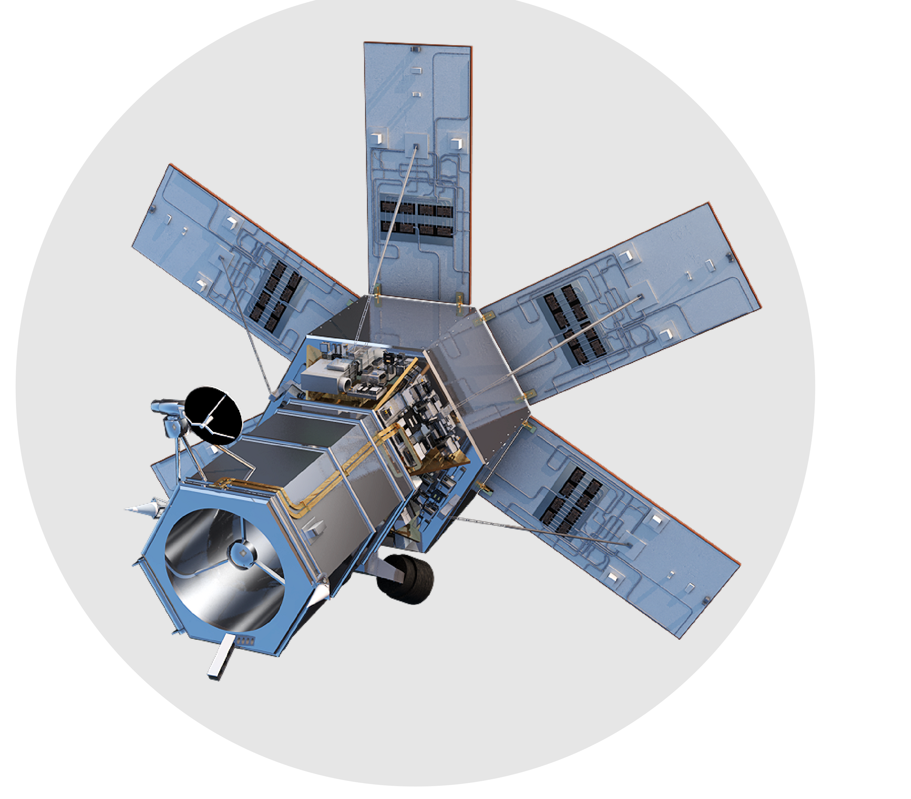
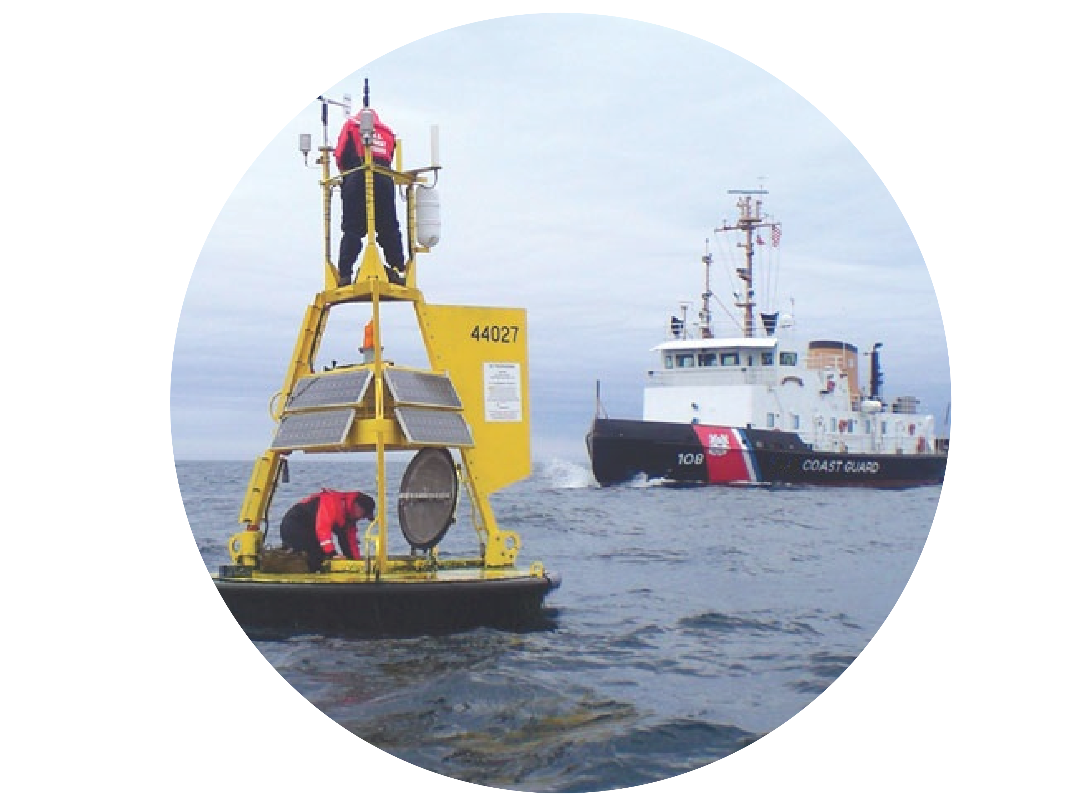
A shift in the paradigm
Reality
Model A
Observation A
Observation B
Curtosy Dirk Notz

Slide 4
A traditional verification question
Is model system B superior to model system A?
A
B
Low horizontal resolution
High horizontal resolution

Slide 5
Comparing climate forecasts
Compare hindcast skill with an observation
A
B
r(AO)
r(BO)
r(BO)
O
Anomaly Correlation
Correlation is symetric: How well correlates O with A or B?

Slide 6
Reversing the question
Which observation is better? A useful question?
A
r(AOB)
r(AOA)
O
O
B
A

Slide 7
Overview this presentation
A
A
B
r(AOB)
r(AOA)
r(BO)
O
O
O
?
A
B
A
O
B
Which observations
has the smallest error
(b) How important is the observational uncertainty

Slide 8
Seasonal forecast skill
Prediction started 1 May 2010
Prediction started 1 May 1991
Prediction started 1 May 1992
… every year …
Prediction started 1 May1992
1992
2010
Observations

Slide 9
Seasonal forecast skill
Target: Global and Niño3.4 SST
Observations: 4 Sea-surface Temperature (SST) observations: ESA-CCI, HadISST, ERSST4, ERA-Interim
Prediction started 1 May 2010
Prediction started 1 May 1991
… every year …
Prediction started 1 May 1992
Prediction started 1 May1992
Compute ensemble-mean to distill climate signal
calculate e.g. anomaly correlation
Models: EC-Earth (3 versions), ECMWF S4, North American Multi-Model Ensemble (NMME, 7 models)
10 – member forecast each

Slide 10
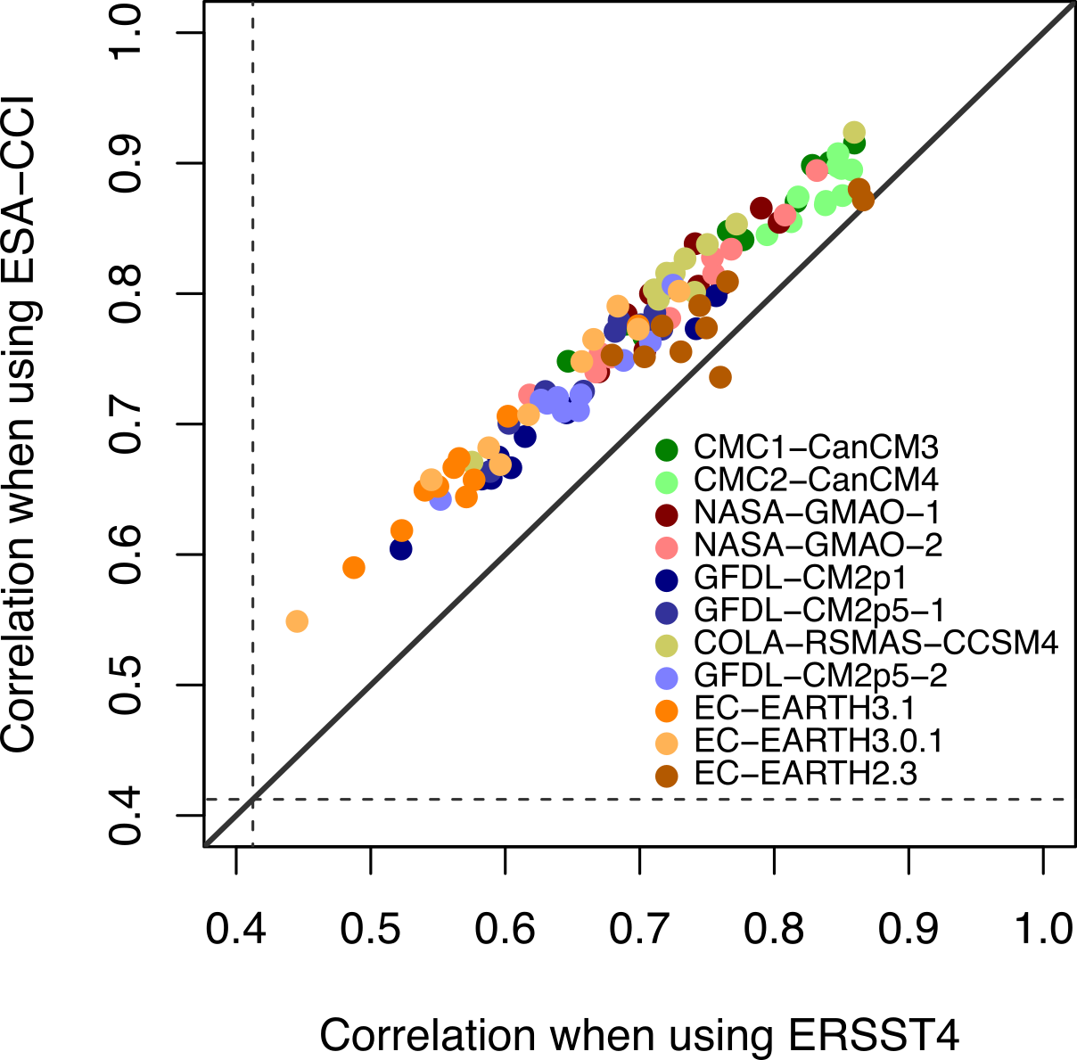
Reversing verification question
CCI SST yields systematic higher correlation skill across many models
Independent from the models
Fully
independent datasets
Massonnet et al. (2016) Science

Slide 11
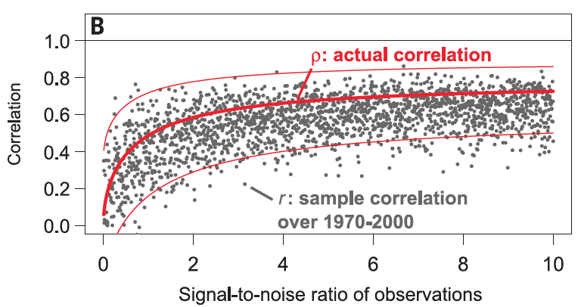
Effect observational uncertainty
Correlation reduces with noise either co-variates: observational uncertainty reduces forecast skill
Massonnet et al. (2016) Science

Slide 12
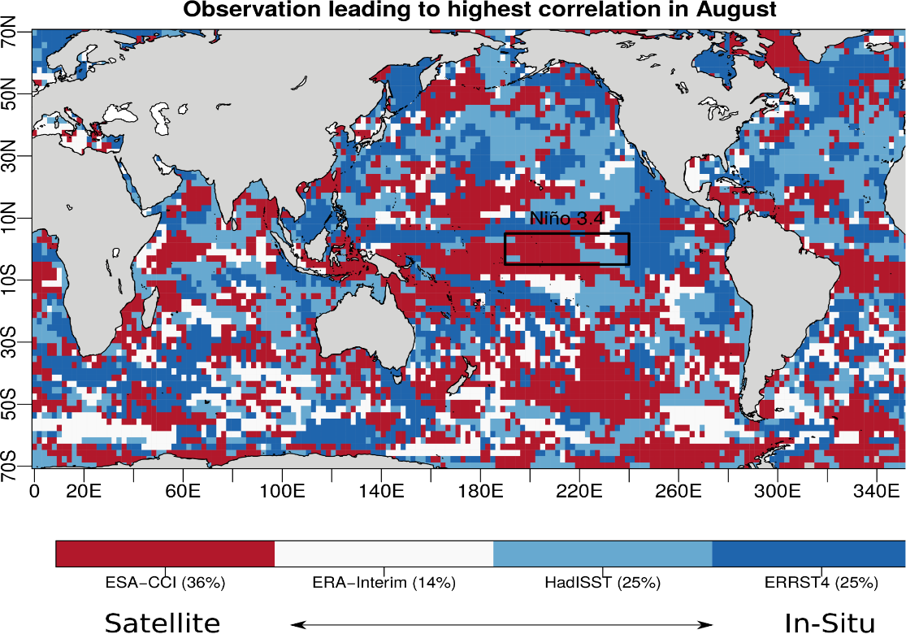
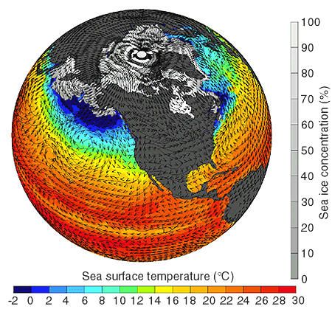
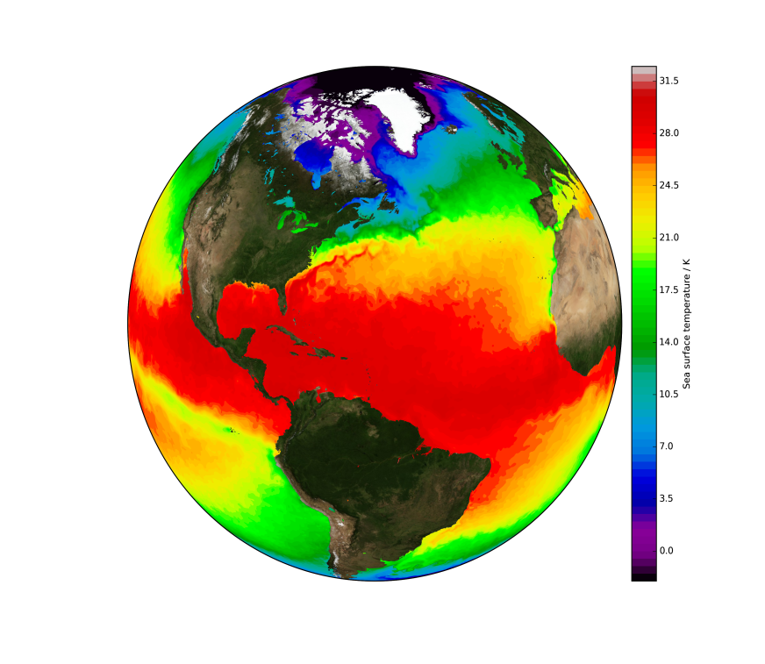
Reversing verification question
Choice of observation may differ on the location, overall CCI best
Shipping routes?
CMUG
CCI SST
Climate model
Climate observation
Massonnet et al. (2016) Science

Slide 13
Observational uncertainty
How important is the observational uncertainty?
A
B
O
?
A
O
B

Slide 14
Acknowledging joint uncertainty
Correlation skill ENSO
Independent from the models
Model uncertainty
Observational uncertainty
How important for individual system?

Slide 15
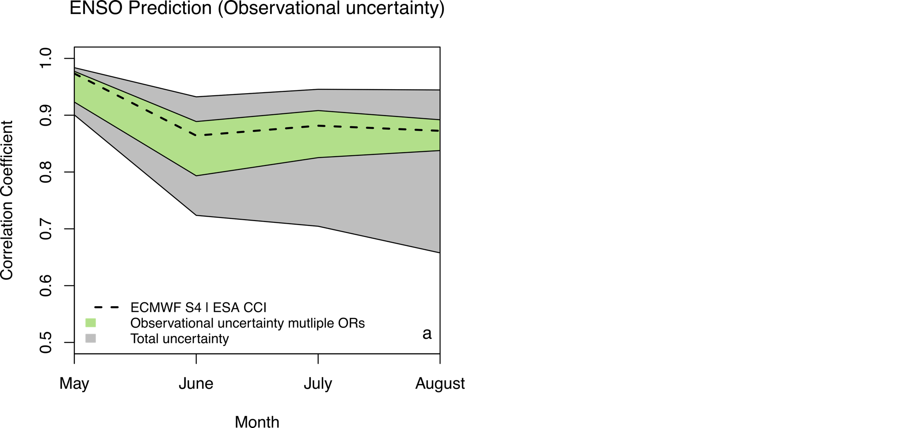
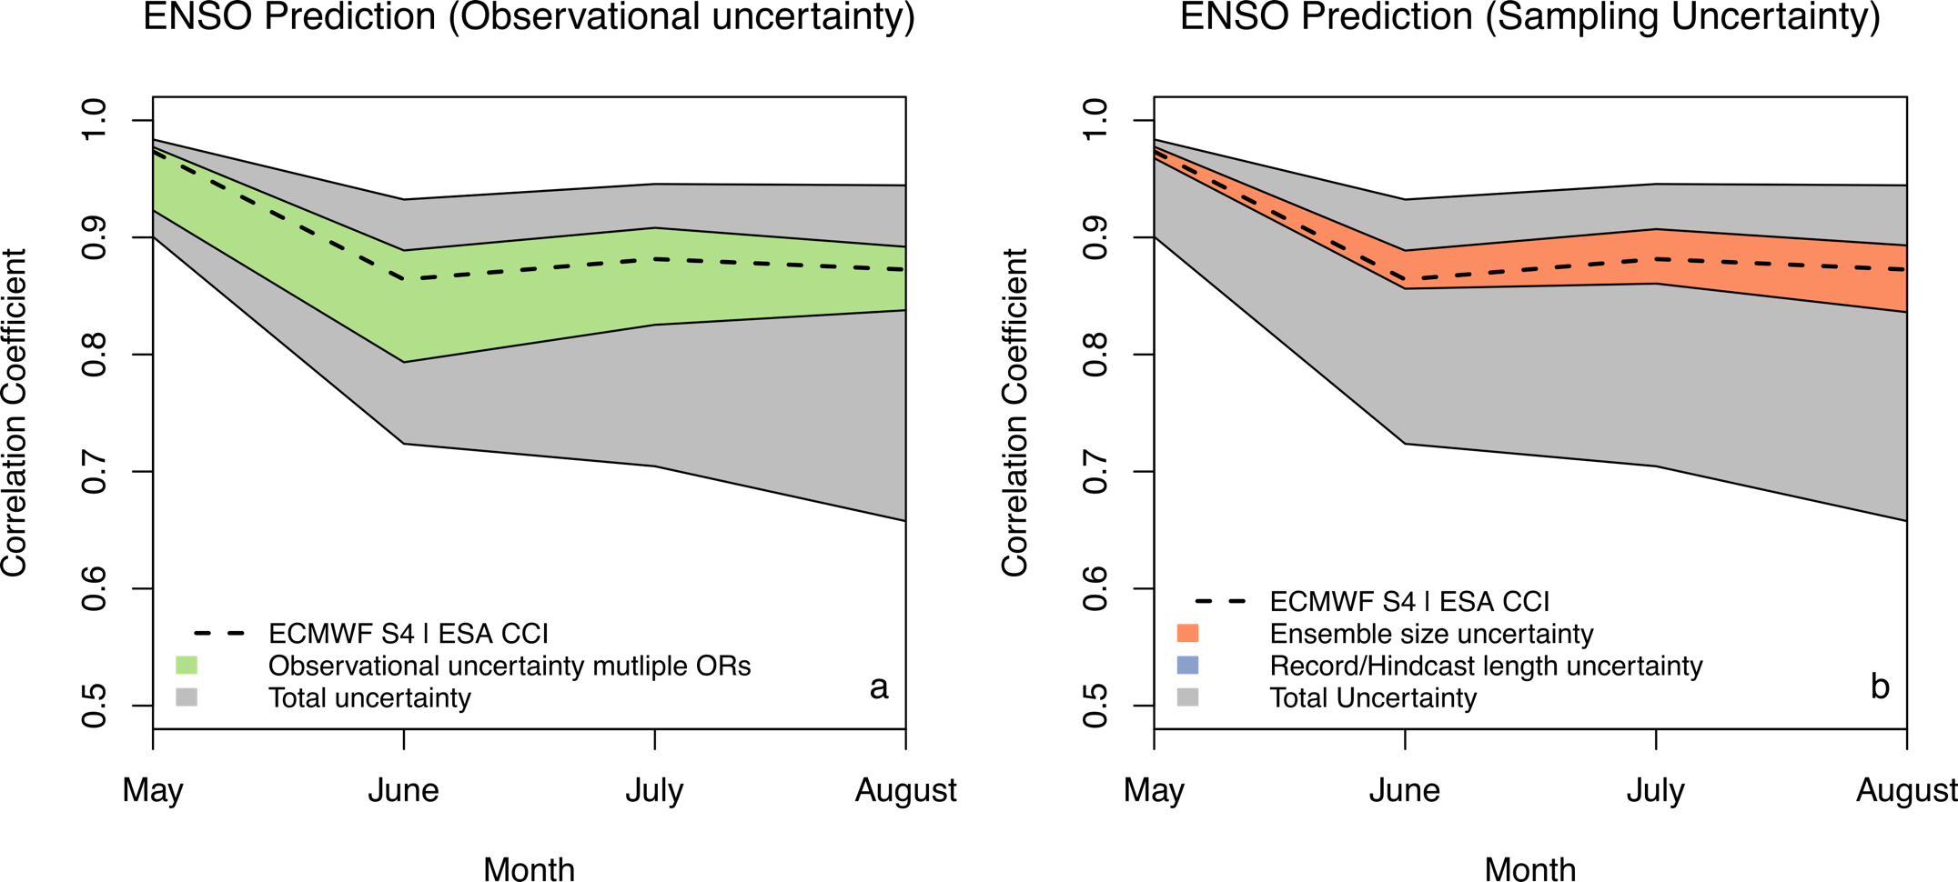
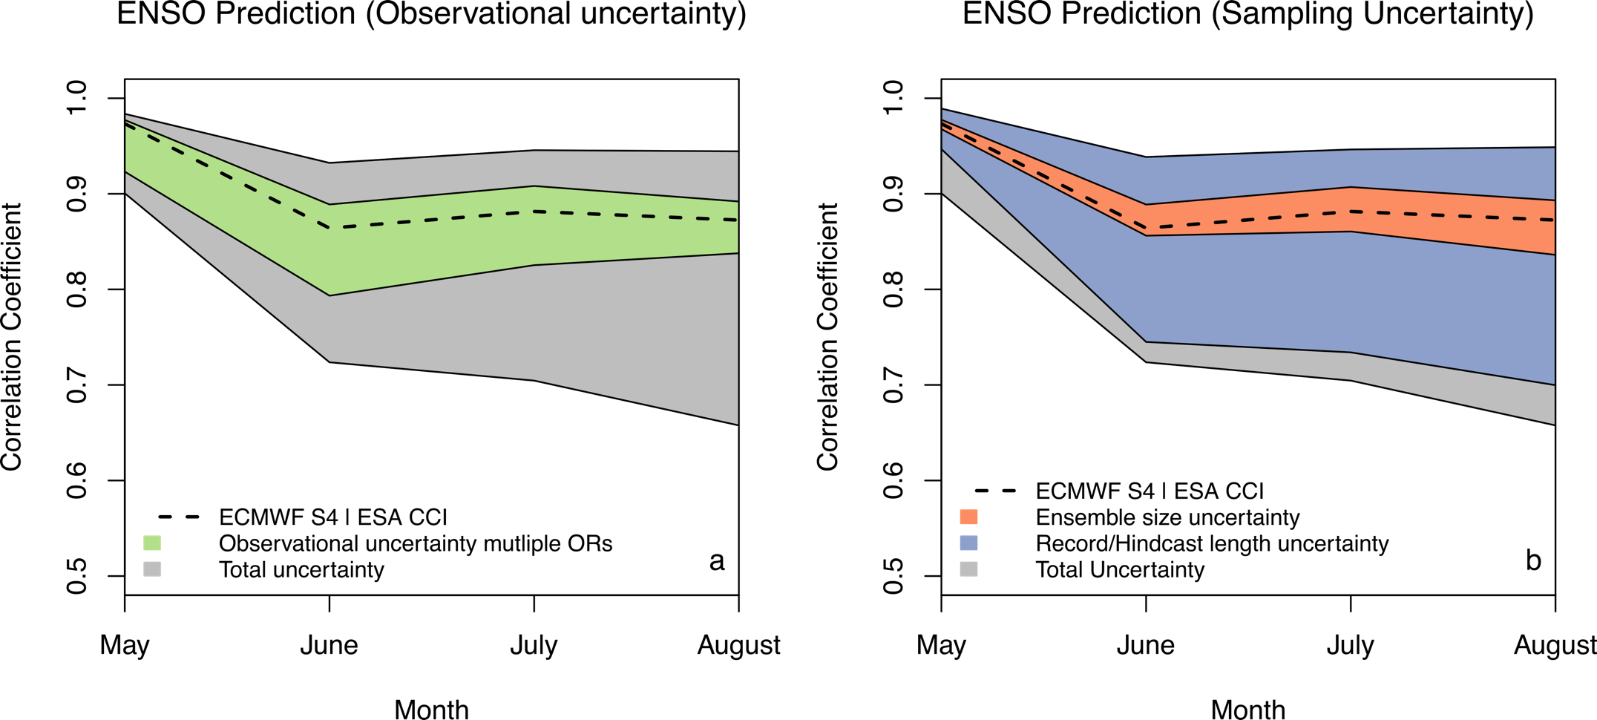
Decomposition of uncertainties
Comparison to sample uncertainties: observational uncertainty is an important source of verification uncertainty for ENSO
60%!
20%
Bellprat et al. (2017) Remote Sensing of the Environment

Slide 16
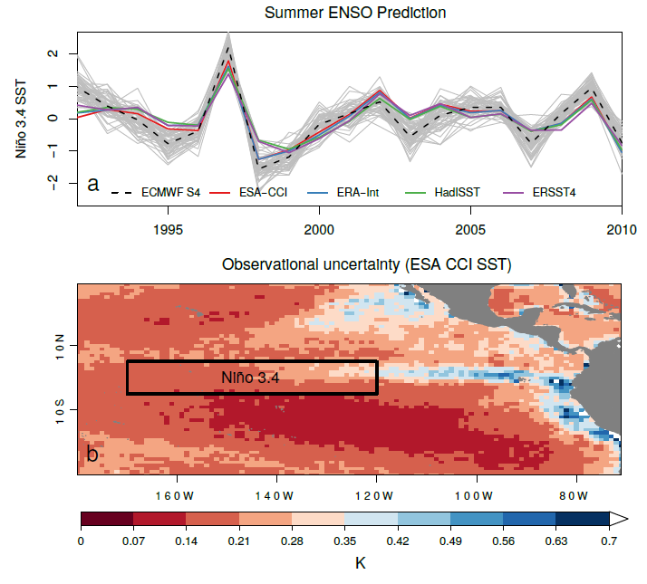
Observational uncertainty CCI
Model evaluation often requires spatial and temporal averaging, requires the consideration of error correlation scales
Monthly Niño3.4
Daily, 4 km
Bellprat et al. (2017) Remote Sensing of the Environment

Slide 17
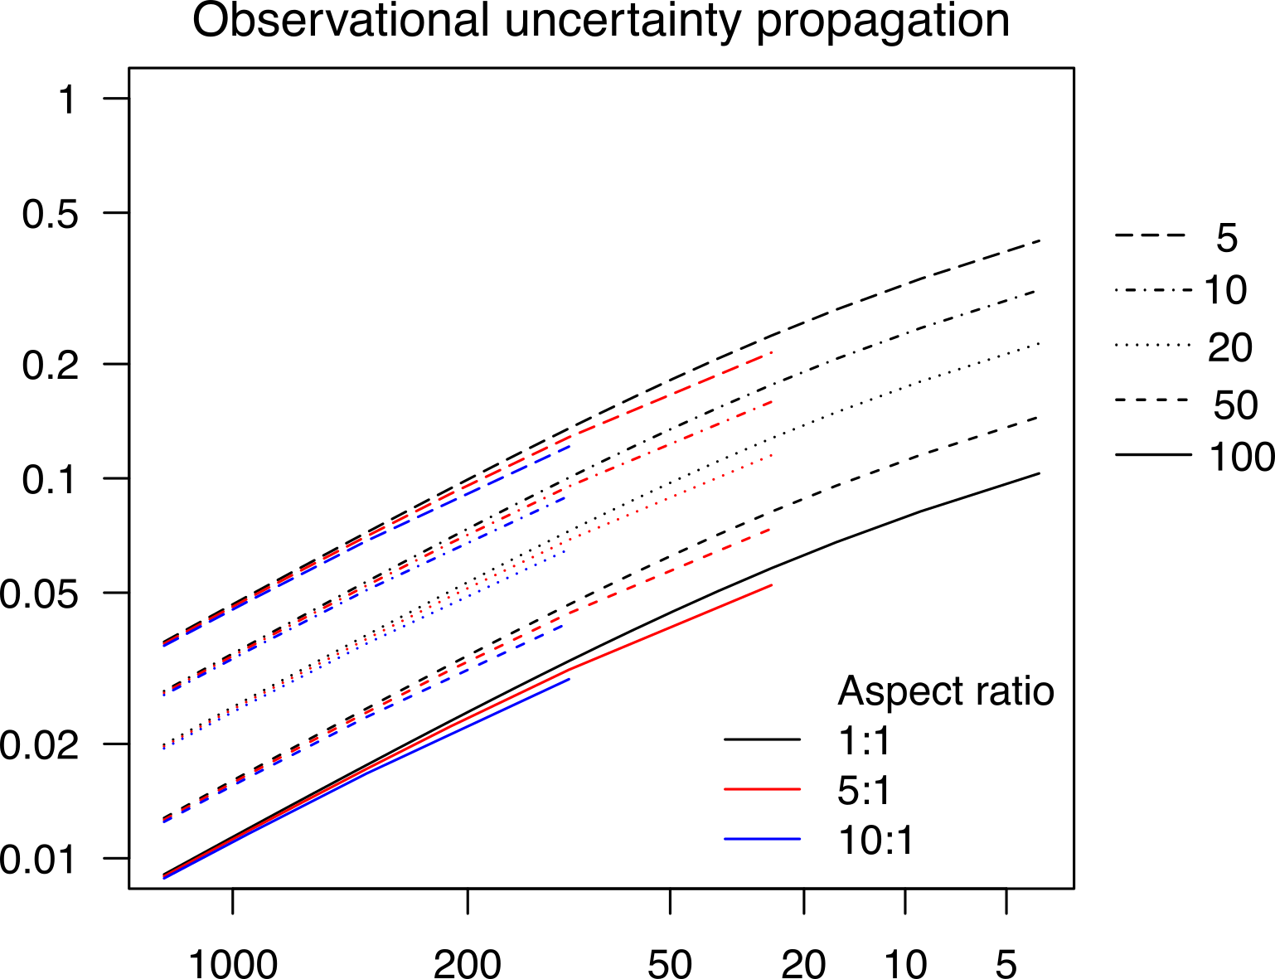
A “look-up” propagation approach
Use of error correlation scales: analytical solution that allows to
look-up propagation factors
Propagation for monthly Niño3.4
Time domain /
correlation length
Reduction of propagated uncertainty
Ex: Synoptic systems
Temporal L=10 days
Spatial L=1000 km
Spatial domain / correlation length
Bellprat et al. (2017) Remote Sensing of the Environment

Slide 18
What is the “true” skill ?
True climate predictions skill is systematically underestimated due
to uncertainties in the observations
True skill?

Slide 19
Underestimation of “true” skill
Seasonal SST forecast skill is underestimated up to 0.2 correlation
Correction for attenuation of correlation coefficients (Spearman, 1904)

Slide 20
A joint uncertainty perspective
Models and observations are both approximations of the truth and uncertainty in both sources can be important.
Models can be valuable in assessing observational quality and thus guide to a more objective dataset selection
Observational uncertainty needs to be propagated for climate model evaluation and metrics that allow to account for uncertainty need to be defined.

Slide 21
Outlook: CMUG3
Climate Modelling User Group (CMUG) is building a new proposal for the next phase of the ESA Climate Change Initiative (CCI+).
Evaluation, Emergent Constraints, Initialization, Re-analysis, Process understanding, Machine Learning, Impacts
WP4: Joint uncertainty assessment of observations and models:
Uncertainty propagation to model scales for CCI (+) variables
Defining deterministic and probabilistic measures that account for observational uncertainties
Systematic comparison between observational and model uncertainties (internal variability, structural uncertainty)

Slide 22
Thank you!
Massonnet, F., Bellprat, O., Guemas, V., Doblas-Reyes, F. J., (2016). Using climate models to estimate the quality of global observational data sets, Science (AAAS)
Bellprat, O., Massonnet, F., Siegert, S., Guemas, V., Doblas-Reyes, F. J. (2017). Uncertainty propagation of observational references to climate model scales, Remote Sensing of the Environment (RSE), accepted

Slide 23
Extra Slides

Slide 24
Detecting statistical differences
Are the differences in performance of models or
observations significant r(CCI) > r(ERSST) ?
Sample correlation
True correlation
r(A)
ρ(A)
A
r(B)
ρ(B)
B

Slide 25
Dependence
Models and observations are statistically dependent!
r(AB)
A
B
r(AO)
r(BO)
r(BO)
O
Fisher-test (common test in community) assumes independence while newer tests (Steiger, 1980, Zou, 2007) don’t.

Slide 26
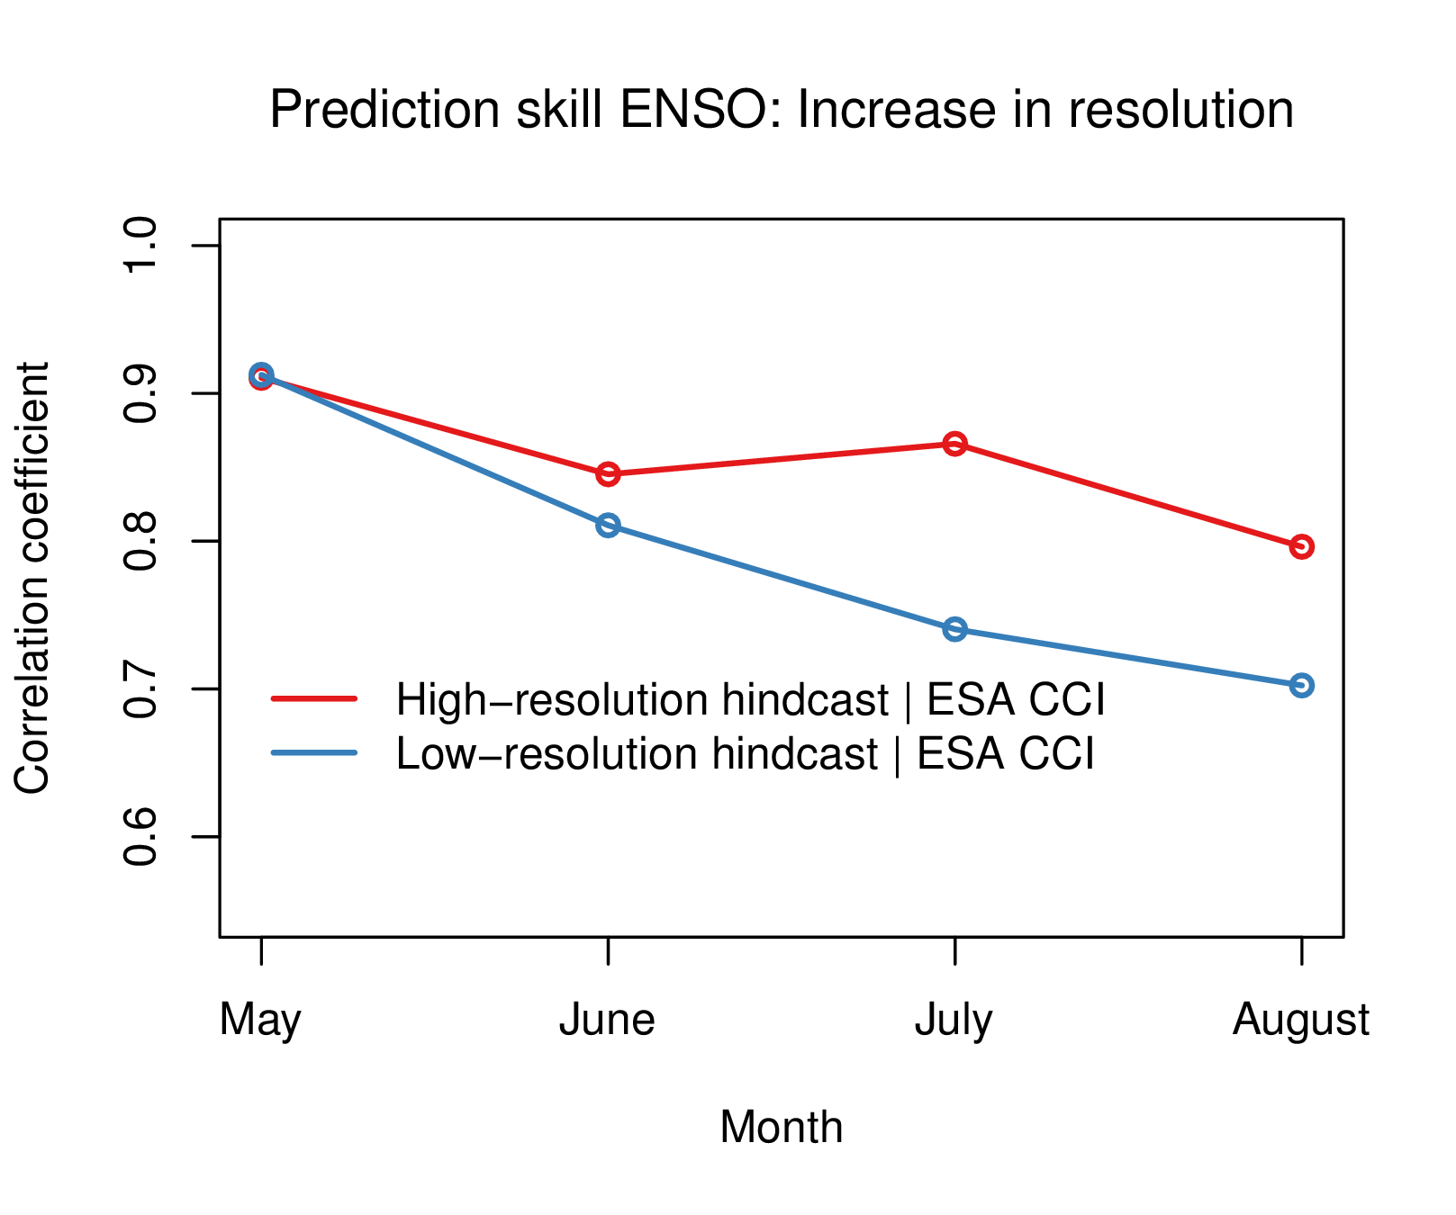
Example ENSO and resolution
High-resolution hindcasts improves El Niño Southern Oscillation (ENSO) predictions, but change not significant at 5% (Fisher-test)
Bellprat et al. (2015) Tech. Rep. BSC 002

Slide 27
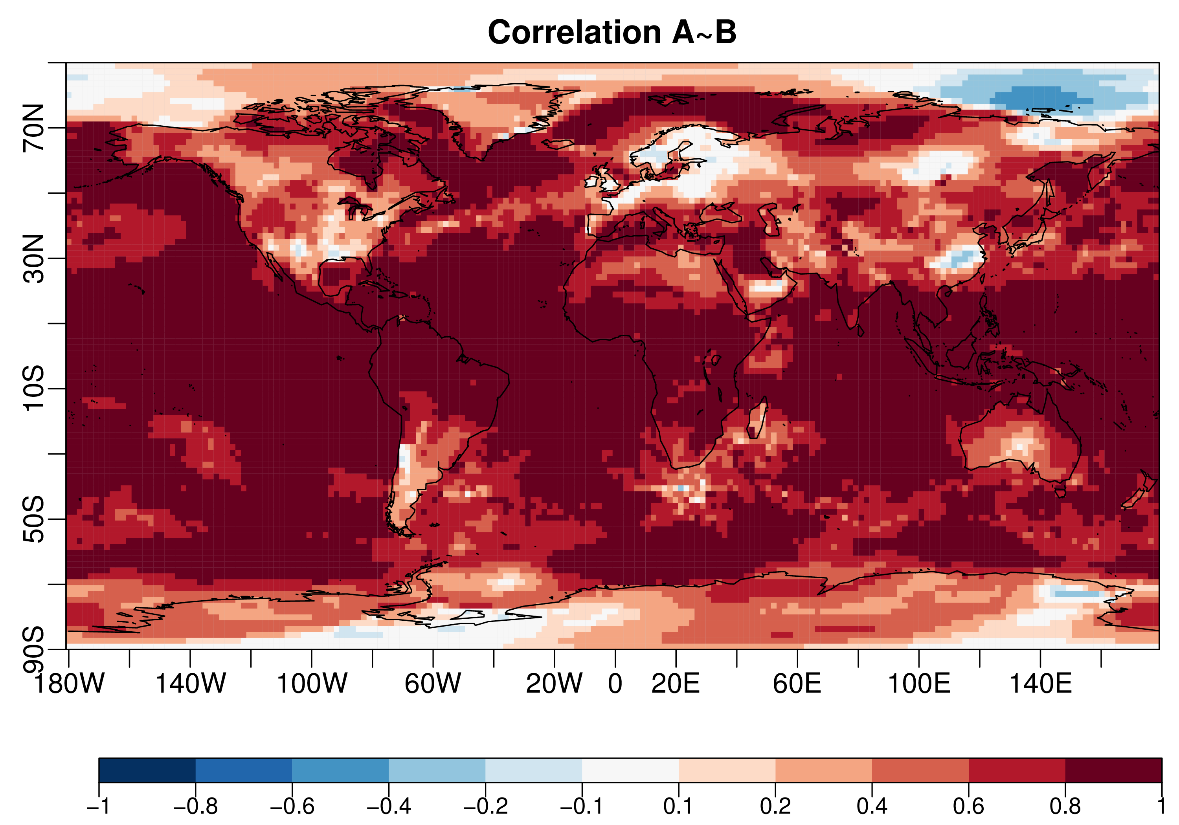
Model dependence
Correlation of Low and High-resolution hindcast

Slide 28
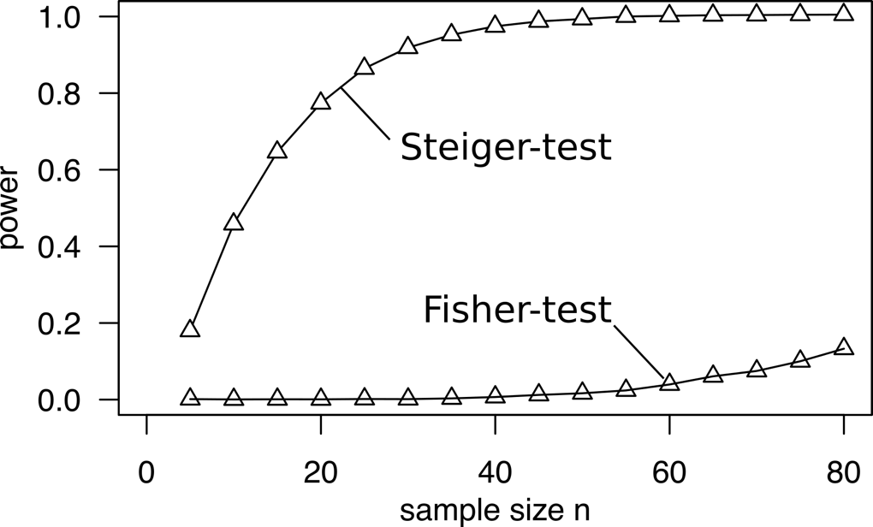
Statistical power dependent tests
Power to detect a difference between increases dramatically. Improvement now statistical significant at 1% level.
Statistical power
In medicinal science only studies with power > 80% are accepted, a guideline for forecasting?
Siegert et al. (2017) Monthly Weather Review

Slide 29
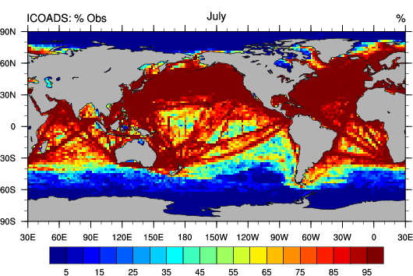

Slide 30
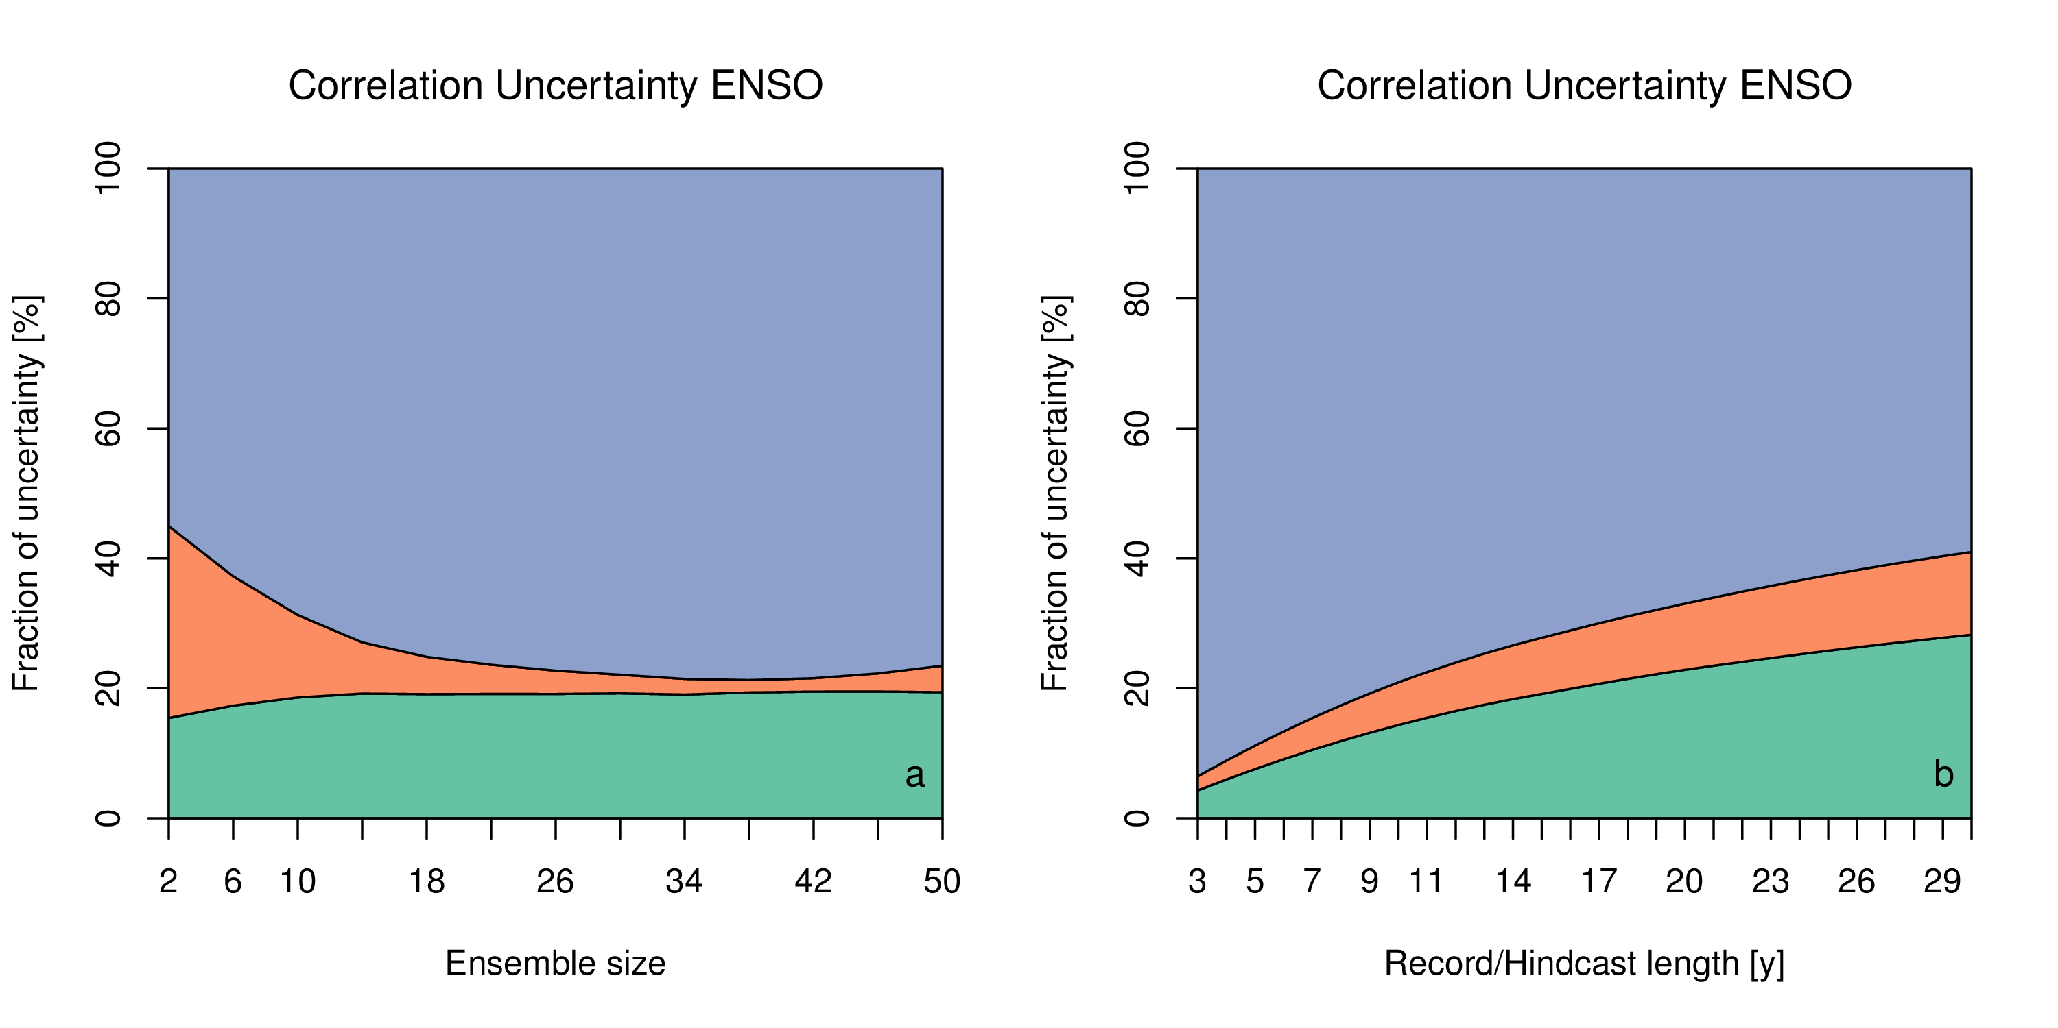
Sensitivity to sample

Slide 31
Effect observational uncertainty
Correlation reduces with noise either co-variates: observational uncertainty reduces forecast skill
Massonnet et al. (2016) Science

Slide 32
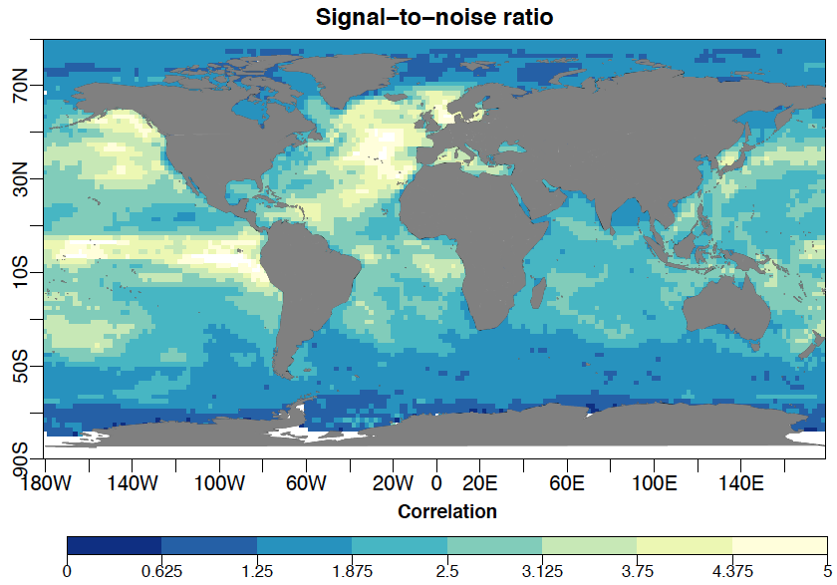
Signal-to-noise ratio SSTs
Signal (inter-annual variability) versus observational uncertainty (noise)

Slide 33
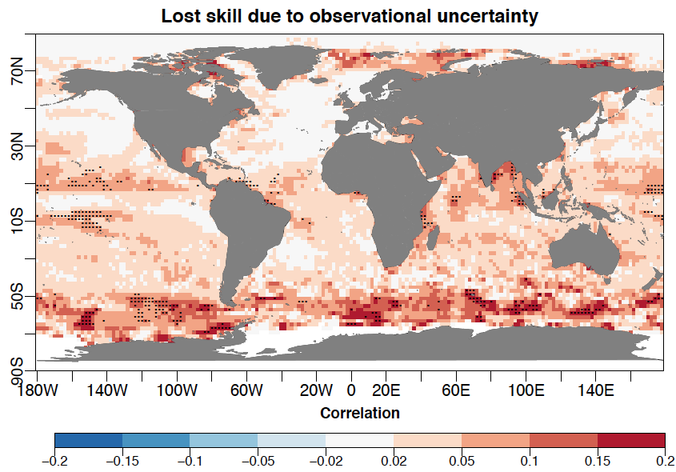
Underestimation of “true” skill
Seasonal SST forecast skill is underestimated up to 0.2 correlation

Slide 34
A “look-up” propagation figure
Use of error correlation scales: analytical solution that allows to
look-up propagation factors
Propagation for monthly Niño3.4
Time domain /
correlation length
Reduction of propagated uncertainty
Ex: Synoptic systems
Temporal L=10 days
Spatial L=1000 km
Spatial domain / correlation length
Bellprat et al. (2017) RSE (in review)

Slide 35
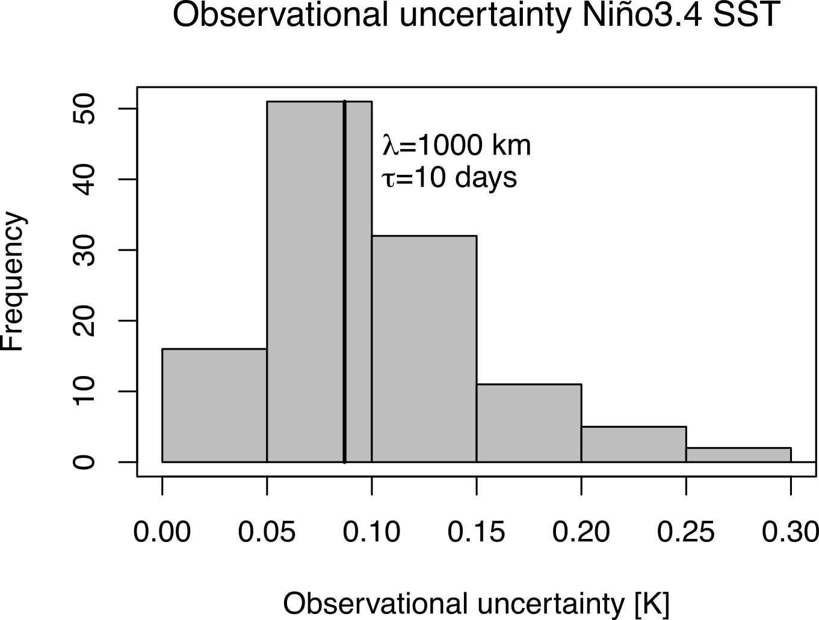
Comparison to multi-observations
Propagation assuming synoptic scales (1000 km, 10 days) of weather systems agrees well with deviations between existing products
Propagated CCI uncertainty
Different products
Assumes all observations are equally “likely”

Slide 36
ESA CCI Uncertainty estimate

Slide 37
Relative contributions

Slide 38
Introduction: Research at BSC
Improving capabilities of seasonal-to-decadal predictions

