Slide 1
Climate services for the Mediterranean food security
Nube González-Reviriego, M. Terrado, R. Marcos, B. Solaraju, A. Manrique, A. Soret and F.J. Doblas-Reyes
19/10/2018
11 Congreso Internacional AEC

Slide 2
Climate services for olive oil, wine and pasta

Slide 3
Co-development of the climate service
Involvement of users as project partners
They should represent the sectorial expertise.
Their feedback will contribute to the co-development of the service.
User engagement in early stages of the service is crucial…
To understand the user chain
To understand the sectorial needs
To co-develop the service

Slide 4
Interaction with users
- Lack of overview of climate info available
- All decision are important
How do we interact with users?
Scoping workshops
Interviews
Not always easy
Focus groups
- Limited trust in climate information
- Lack of a common terminology
Participatory approaches with sectorial experts and/or farmers.

Slide 5
User interaction output (e.g. wine sector)
Weather forecast
Climate predictions
Climate projections
Sub-
seasonal
Seasonal
Decadal
1-15 days
10-60 days
1-15 months
5-10 years
20-100 years
Siting, choice of scion variety and rootstock.
Assessment of water needs
Grow cycle management
Pathogen pressure, abiotic stresses
Crop forcing
Productivity, quality
Wine style
Harvest date and duration
Adapted from: Antonio Graça, SOGRAPE VINHOS SA, 2014
Time

Slide 6
From climate data to climate services
Climate service product
ForEcast quality assessment
The final products from the service provide useful information for specific needs.
05
Several skill scores have been obtained by the comparison of predictions with observations. Positive skill means an added value with respect climatology.
04
RAW Climate predictions
03
Tailored climate predictions
Predictions obtained directly from different climate prediction systems.
02
01
Climate predictions tailored to specific needs for agricultural users: specific agro-climatic indices, higher spatial resolution, …
Bias adjustment
These adjustments have been applied to improve as much as possible reliability of the climate predictions.

Slide 7
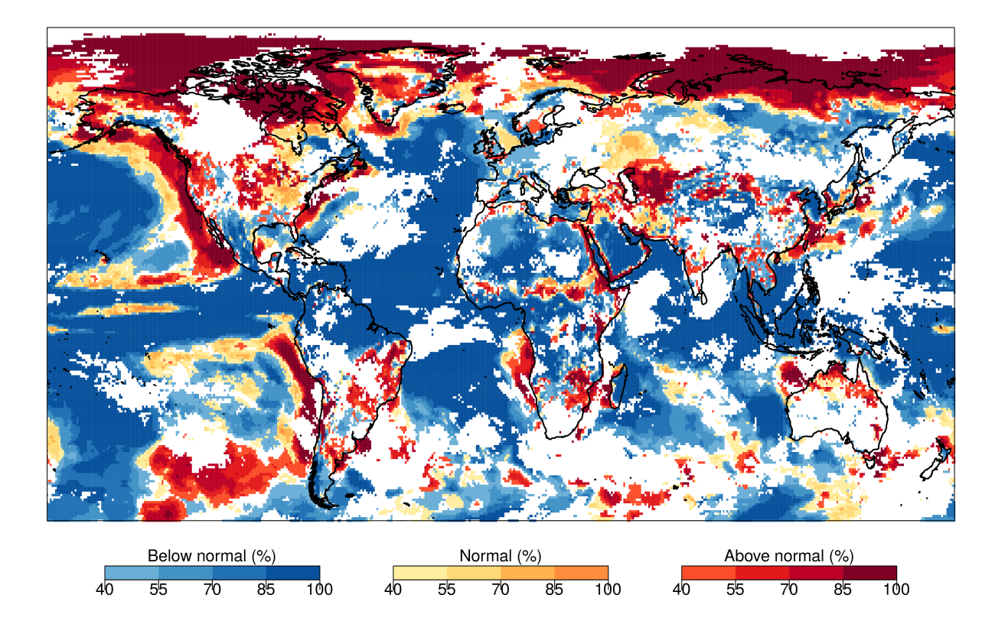
Climate service product: most likely category map
Seasonal prediction of most probable category of temperature for May 2016 with ECMWF S4
How will be the next month/season temperature?
Only areas with positive skill (RPSS) are shown to the users
Summarising information in one map only
➔
✔
✔

Slide 8
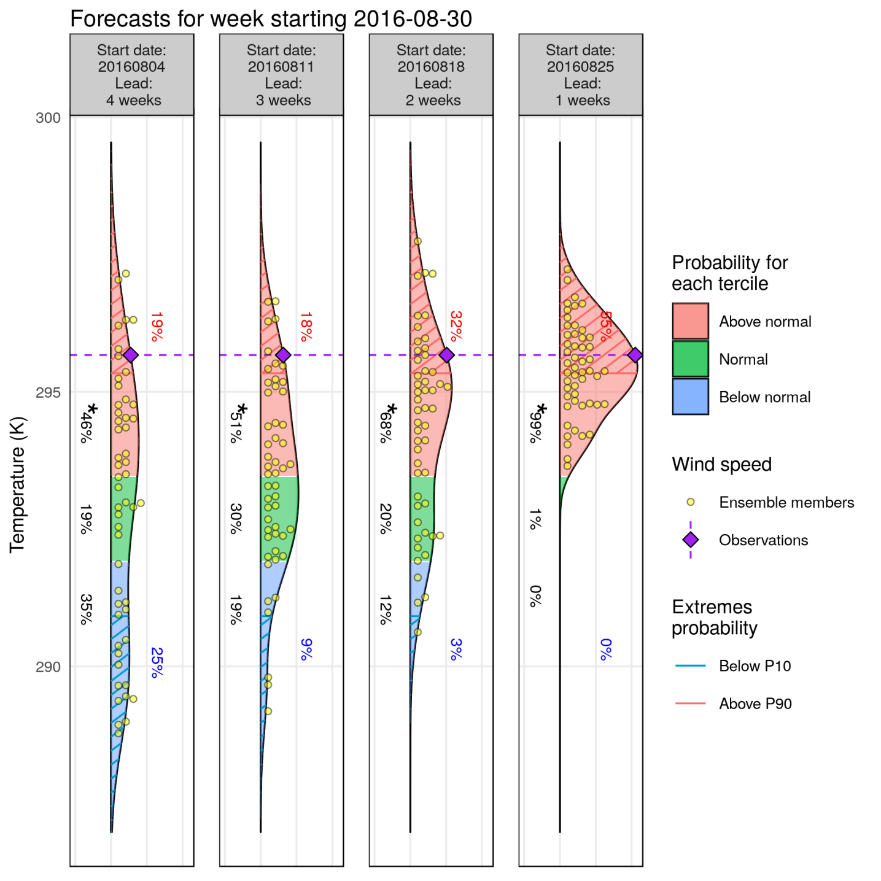
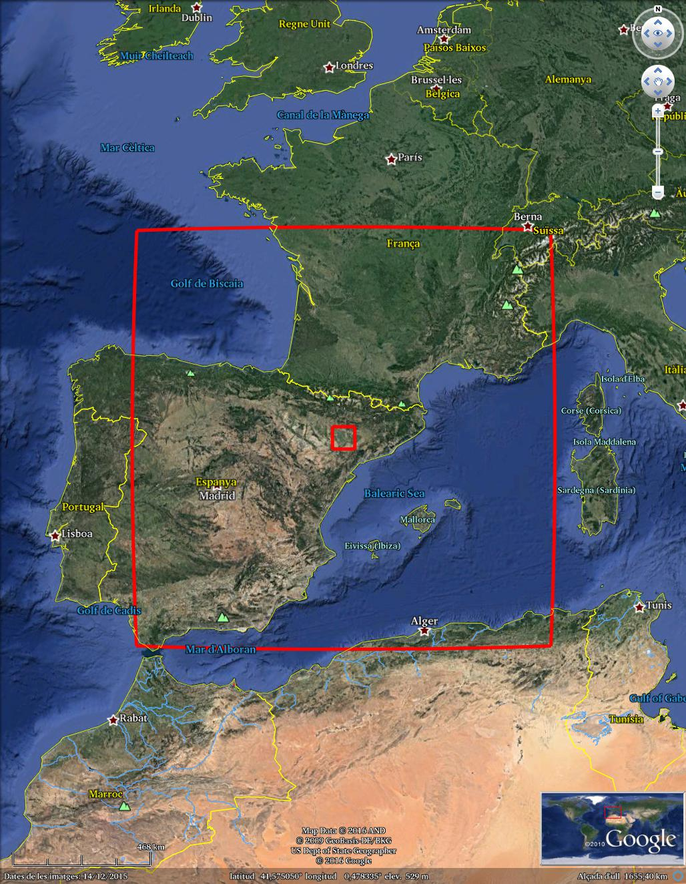
Climate service product: temperature predictions for an specific point
Sub-seasonal predictions of temperature for 1st week of September 2016 with different lead times based on ECMWF monthly prediction system
fairRPSS: 0.05 0.05 0.03 0.42
System: ECMWF monthly prediction system
Reanalysis: ERA-Interim
Bias adjusted –calibrated
Hindcast: 1996-2015
Lat= 40.5 N/Lon = 358.5 E

Slide 9
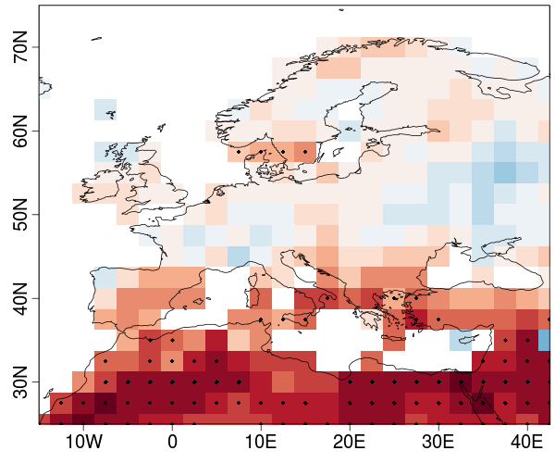
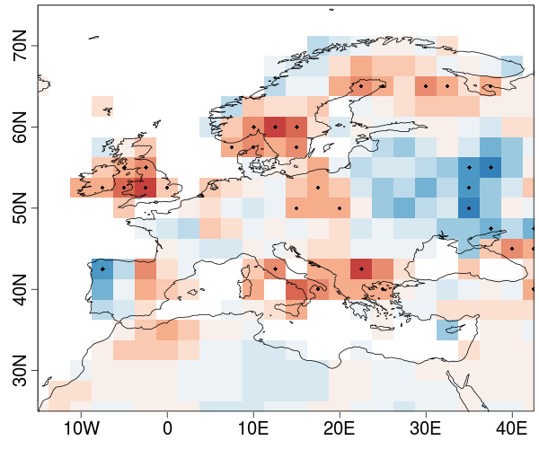
Example of climate service product: drought index (SPEI6)
Correlation between predicted and observed SPEI6 index averaged over 2 to 5 years for the month of August with EC-EARTH decadal predictions
INIT
INIT minus NoINIT
INIT: Initialised decadal predictions
NoINIT: Non-initialised climate simulations

Slide 10
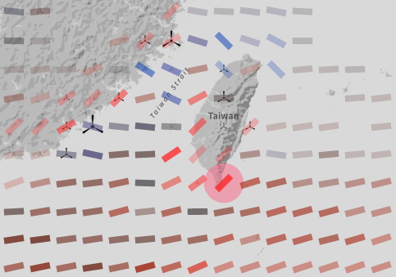
RESILIENCE tool: operational predictions
www.bsc.es/ess/resilience
and more…

Slide 11
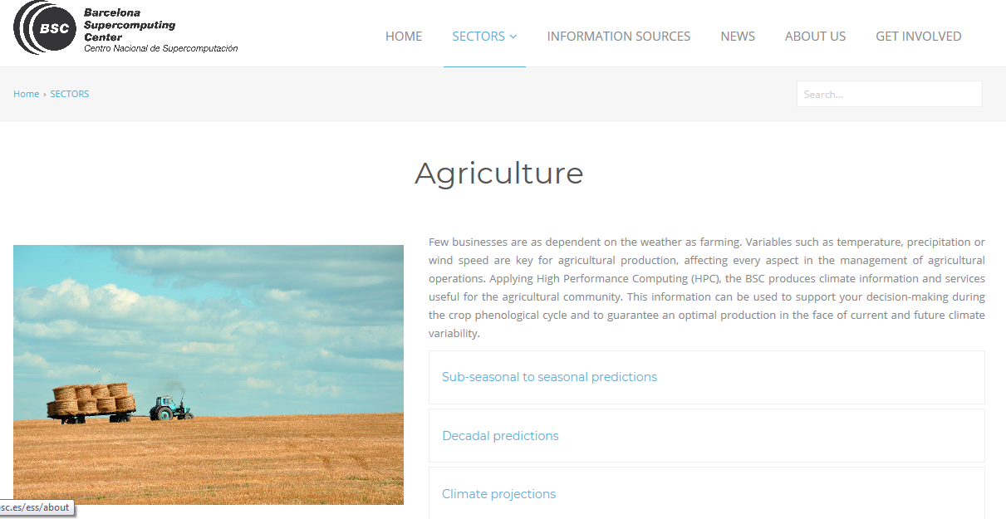
Climate Services developed by ESS
www.bsc.es/ess

Slide 12
Thank you! Questions?
nube.gonzalez@bsc.es
HIATUS
HIATUS

