Slide 1
The NEMO ORCA36 configuration and approaches to increase NEMO4 efficiency
Miguel Castrillo
BSC-ES Performance Team, Computational Earth Sciences
25/05/2020
6th ENES HPC workshop

Slide 2
The Barcelona Supercomputing Center

Slide 3
Barcelona Supercomputing Center Centro Nacional de Supercomputación
BSC-CNS objectives
Supercomputing services
to Spanish and EU researchers
R&D in Computer, Life, Earth and
Engineering Sciences
PhD programme, technology transfer, public engagement
Spanish Government 60%
Catalan Government 30%
Univ. Politècnica de Catalunya (UPC) 10%
BSC-CNS is
a consortium
that includes

Slide 4
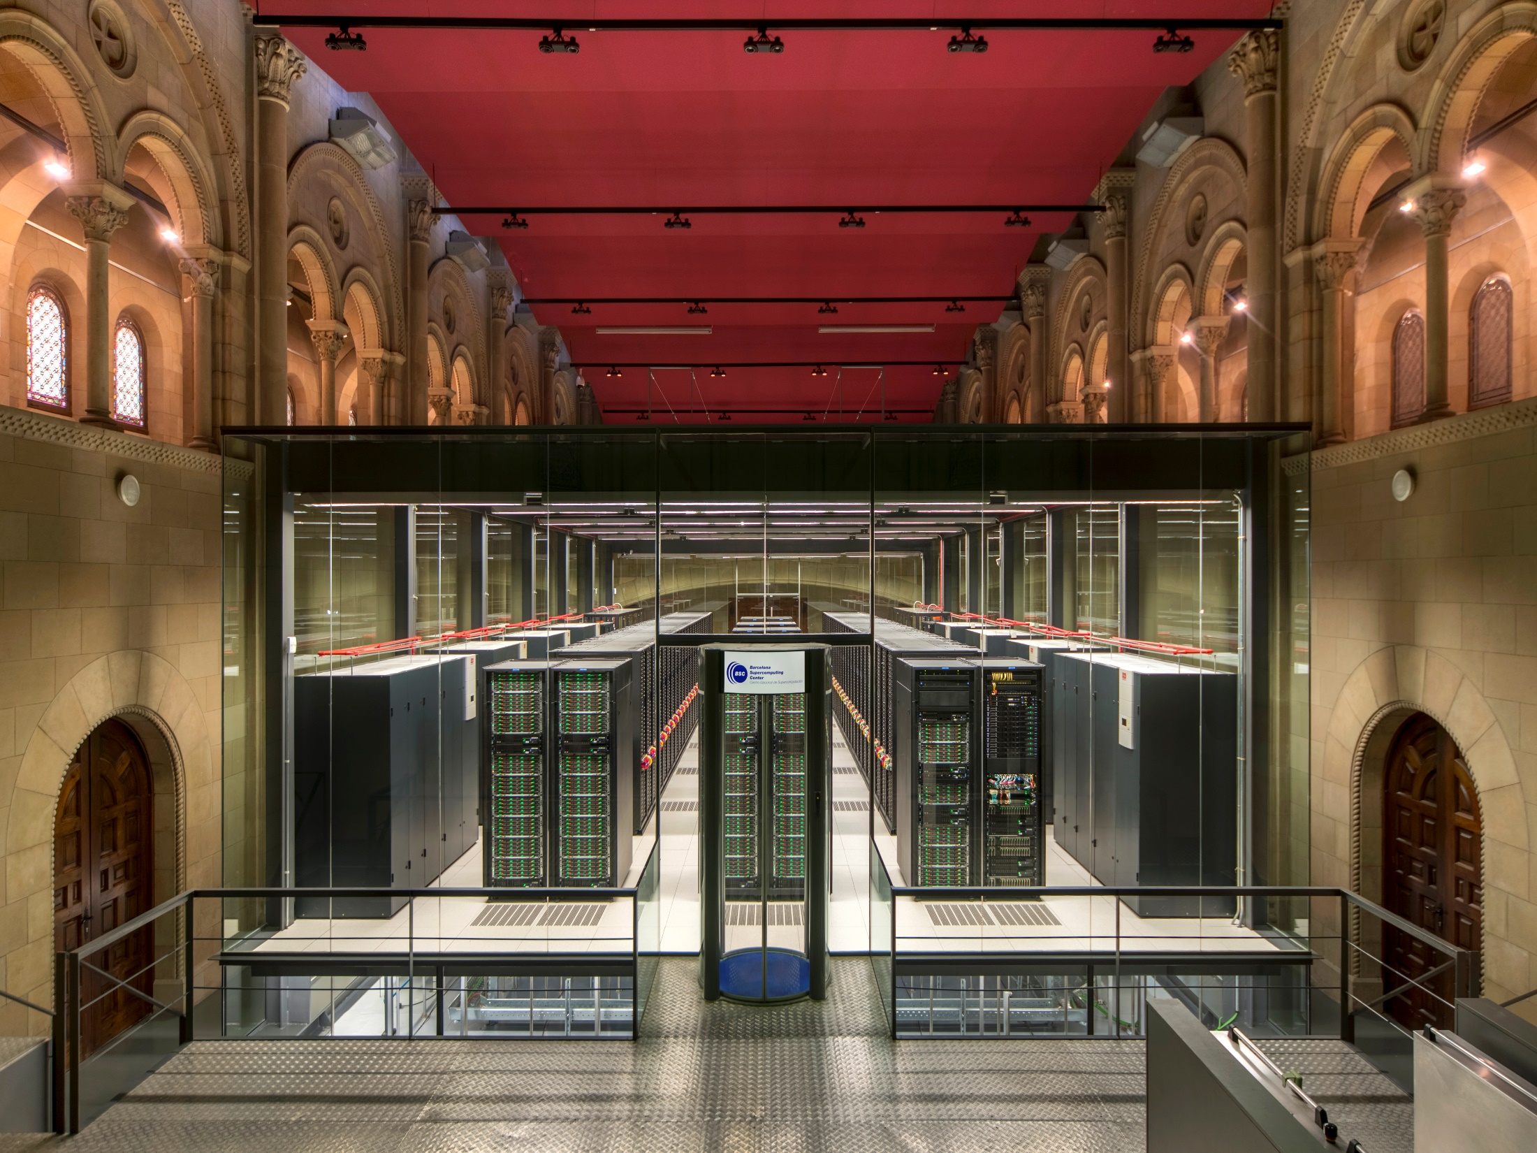
MareNostrum 4
Total peak performance: 13,7 Pflops
General Purpose Cluster: 11.15 Pflops (1.07.2017)
CTE1-P9+Volta: 1.57 Pflops (1.03.2018)
CTE2-AMD: 0.52 Pflops (2020)
CTE3-Arm V8: 0.5 Pflops (2020)
Access: prace-ri.eu/hpc_acces
Access: bsc.es/res-intranet
MareNostrum 1
2004 – 42,3 Tflops
1st Europe / 4th World
New technologies
MareNostrum 2
2006 – 94,2 Tflops
1st Europe / 5th World
New technologies
MareNostrum 3
2012 – 1,1 Pflops
12th Europe / 36th World
MareNostrum 4
2017 – 11,1 Pflops
2nd Europe / 13th World
New technologies

Slide 5
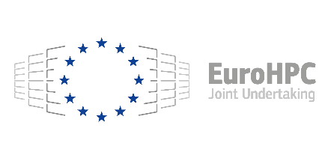
MareNostrum 5. A European pre-exascale supercomputer
Hosting Consortium:
200 Petaflops peak performance (200 x 10¹⁵)
Spain
Portugal
Turkey
Croatia
Experimental platform to create supercomputing technologies “made in Europe”
223 M€ of investment

Slide 6
ESiWACE2 H2020

Slide 7
BSC-ES involvement in ESiWACE2
Task 1.1: Develop infrastructure for production-mode configurations
Introduce XIOS in EC-Earth, NEMO Mixed Precision...
Task 1.2: Develop production-mode configurations
EC-Earth: 16 km (TL1279) atmosphere coupled to a 1/12 degree (~8 km) ocean
Task 1.3: Port models to pre-exascale EuroHPC systems
Port EC-Earth ~10km to MareNostrum5

Slide 8
EC-Earth4
Development of a mixed precision mode for NEMO 4.2. Port EC-Earth3 Ocean configurations.
XIOS integration into OpenIFS 43r3. XIOS benchmarking and computational evaluation to improve I/O efficiency.
Scientific and computational evaluation (in collaboration with other institutions) of EC-Earth4 in MP mode (OpenIFS-SP, NEMO-MP).
Profiling studies to ensure that the eventual main bottlenecks of EC-Earth4 are highlighted and their solution studied.

Slide 9
IMMERSE & IS-ENES3 H2020

Slide 10
BSC-ES involvement in IMMERSE
IS-ENES3 T8.1: Improving Nemo computational performance
Routine level scalability: Communication impact, workload balance, mixed precision analysis
IMMERSE T4.1:​ Efficient exploitation of memory hierarchies and hardware peak performance
Assessment of the performance impact
IMMERSE T4.3: Efficient IOs and diagnostics for operational systems
Offload NEMO model diagnostics to GPUs
IMMERSE T4.4: Load balancing for AGRIF massive multigrid capability
Efficiency assessment for high-resolution configuration

Slide 11
NEMO timeline in BSC-ES performance
TYPE-C
2019
2020
2021
2022
COPERNICUS CMEMS Final report: ORCA036 profiling
IS-ENES3 M8.4: Definition of the optimization strategy
IMMERSE MS25: First setup of online diagnostics
ESiWACE2 D1.2: Model inter-comparison
IMMERSE MS34: Final setup of online diagnostics
ESiWACE2 D1.1: Production mode configurations
ESiWACE2 D1.3: Scalability for pre-exascale systems
IS-ENES3 D8.5: Update NEMO code
IMMERSE D4.1: Activities during 2019
IS-ENES3 D4.3: CPMIP metrics & performance
IMMERSE D4.3: AGRIF performance
IMMERSE D4.4: Node performance
IMMERSE D4.5: Report online diagnostics
NEMO 4.2 beta

Slide 12
From ORCA2 to ORCA36

Slide 13
NEMO 4
New Sea-Ice component (SI3)
AGRIF compatible with sea-ice and z* coordinate
Aerobulk package for atmospheric forcing
Wave coupling to external wave model
Passive tracer module (TOP) re-designed (modular)
MPI communications reduced
Removal of wrk_alloc’s
Automatic land sub-domains removal
Simplification & robustness
Notes:
‹#›

Slide 14
From ORCA2 to ORCA36
ORCA: Curvilinear tripolar grid family without singularity point inside the computational domain. It has two north mesh poles placed on lands.
name | jpiglo | jpjglo | jpk | size (million vertices) | resolution (km)
ORCA2 | 182 | 149 | 31 | 0.84 | 220.19
ORCA1 (SR) | 362 | 292 | 75 | 7.92 | 110.7
ORCA025 (HR) | 1,442 | 1,021 | 75 | 110.42 | 27.79
ORCA12 (VHR) | 4,322 | 3,059 | 75 | 991.57 | 9.27
ORCA36 (VVHR?) | 12,962 | 9,173 | 75 | 8,917.53 | 3.09
x9.4
x14
x10,650
x9
x9
Notes:
‹#›

Slide 15
ORCA36
Configurations
Code | Step | Init T&S | Atmospheric Forcing | ICE | Runoff | Geothermal heating | QSR
O36-I | 90 | F | F | F | F | F | F
O36-II | 90 | F | 512x256 | F | F | F | F
O36_ICE | 90 | F | 512x256 | T | F | F | F
O36_FULL* | 30 | 9,173x12,962 | 512x256 | T | 9,173x12,962 | 360x180 | 9,173x12,962

Slide 16
ORCA36 in MareNostrum4
Resources constraints
Configuration | Minimum resources standard nodes (96GB) | Minimum resources high-mem nodes (384GB)
O36-I | 64 nodes, 6TB memory | 16 nodes, 6TB memory
O36-II | 64 nodes, 6TB memory | 16 nodes, 6TB memory
O36_ICE | 64 nodes, 6TB memory | 16 nodes, 6TB memory
O36_FULL* | - | 16 nodes, 6TB memory

Slide 17
ORCA36 scaling

Slide 18
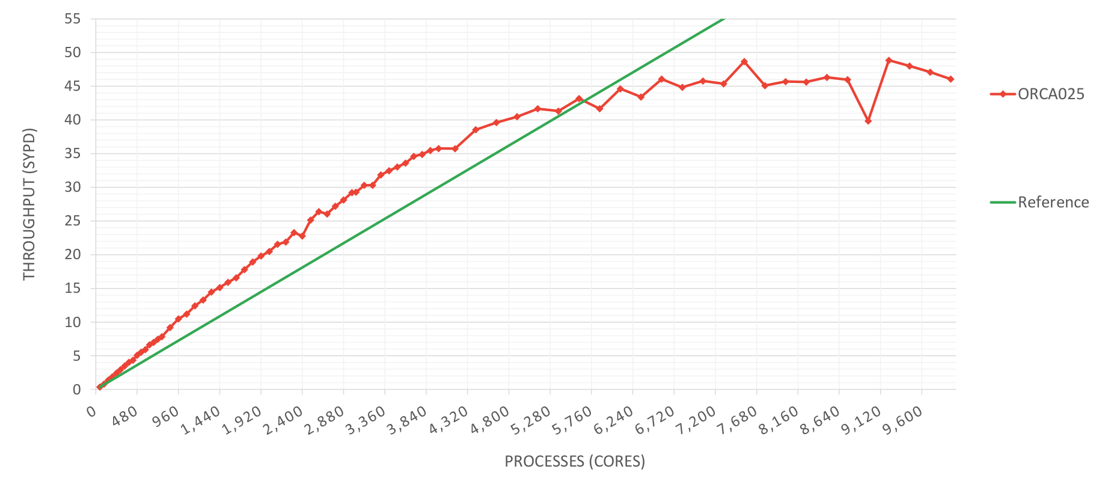
ORCA025 scalability (MN4)
ORCA025 scalability
PROCESSES (CORES)

Slide 19
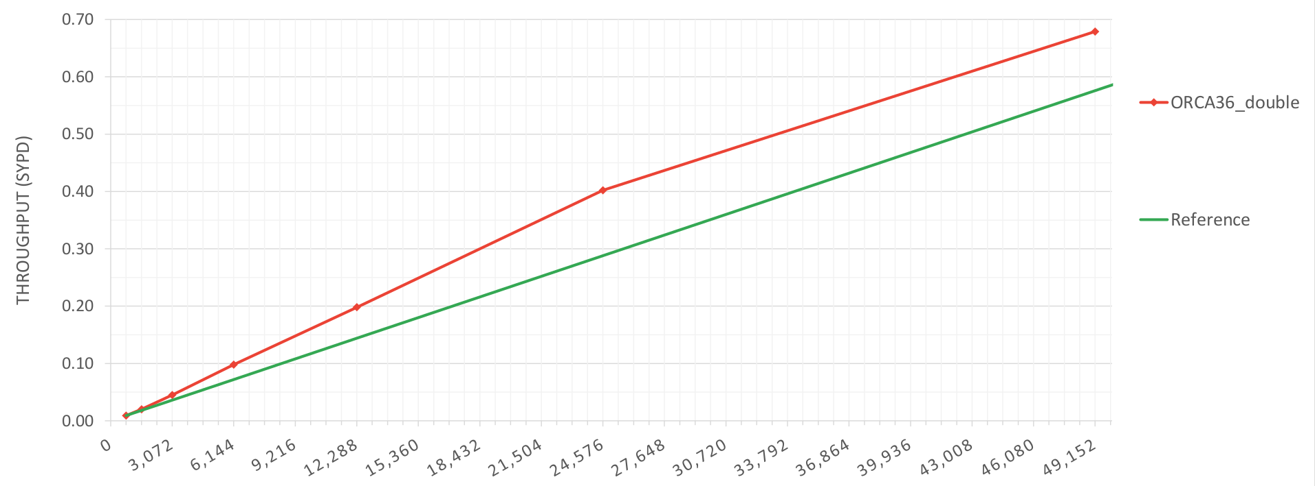
ORCA36 scalability (MN4)
ORCA36 scalability
PROCESSES (CORES)

Slide 20
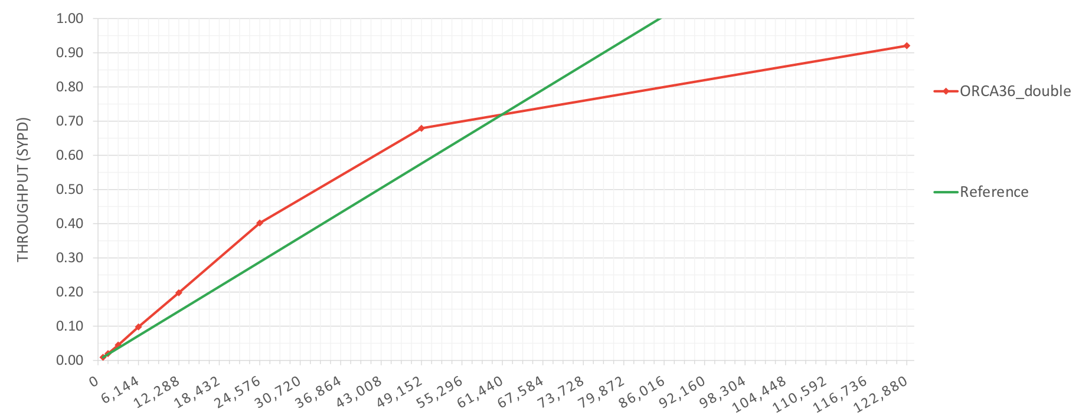
ORCA36 scalability (MN4)
ORCA36 scalability – Grand Challenge
PROCESSES (CORES)

Slide 21
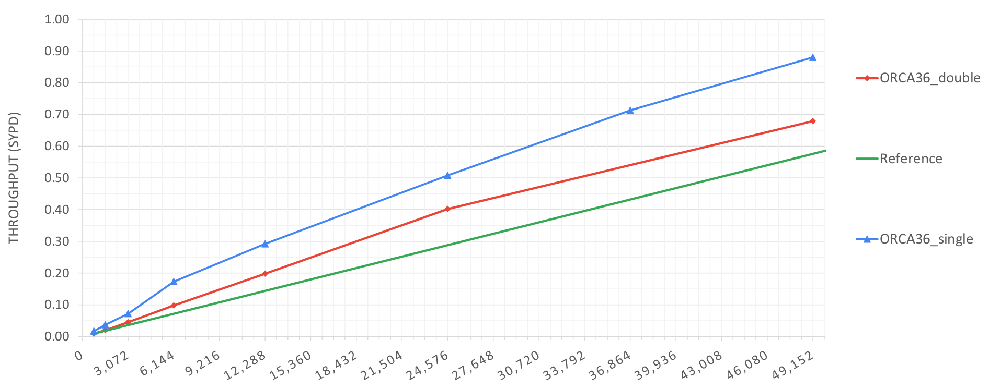
ORCA36 scalability (MN4)
ORCA36 scalability – Double precision vs Single precision
PROCESSES (CORES)

Slide 22
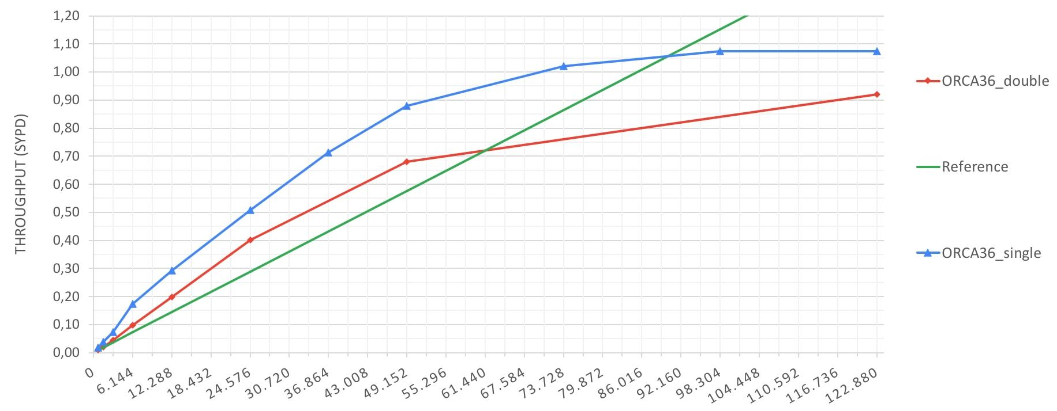
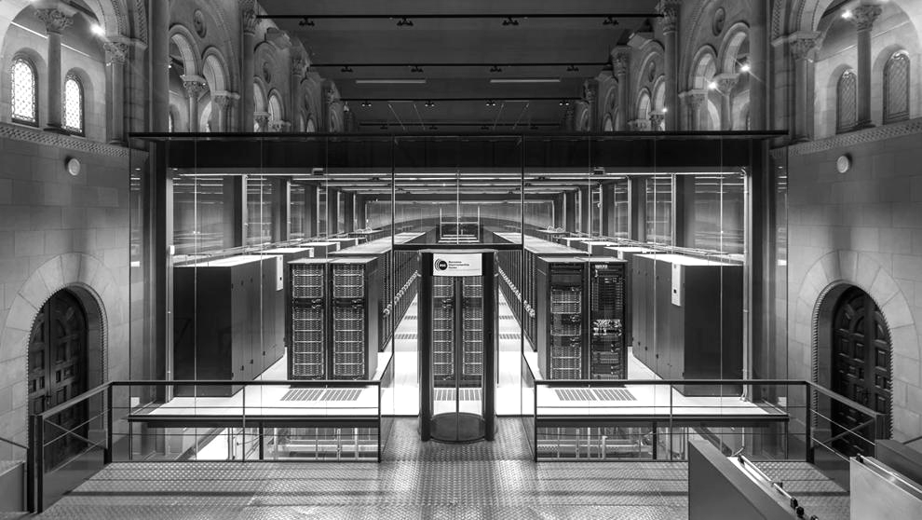
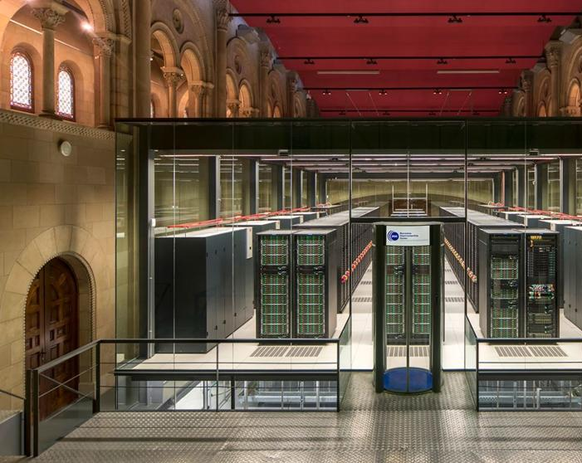
ORCA36 scalability (MN4)
ORCA36 scalability – Double precision vs Single precision – Grand challenge
71% of MN4
PROCESSES (CORES)

Slide 23
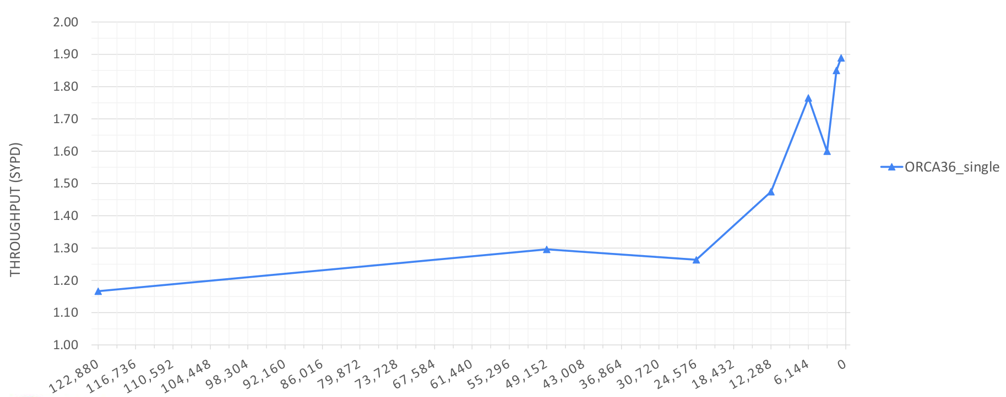
ORCA36 scalability (MN4)
ORCA36 scalability – Double precision vs Single precision
PROCESSES (CORES)

Slide 24
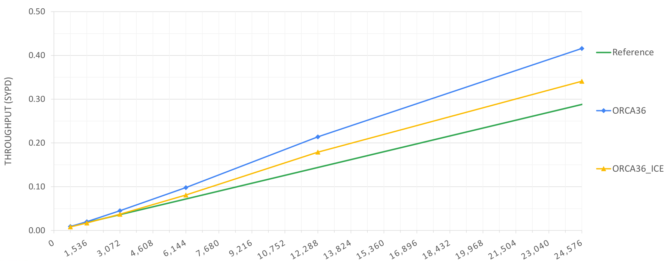
ORCA36 scalability (MN4)
ORCA36 scalability - ICE
PROCESSES (CORES)

Slide 25
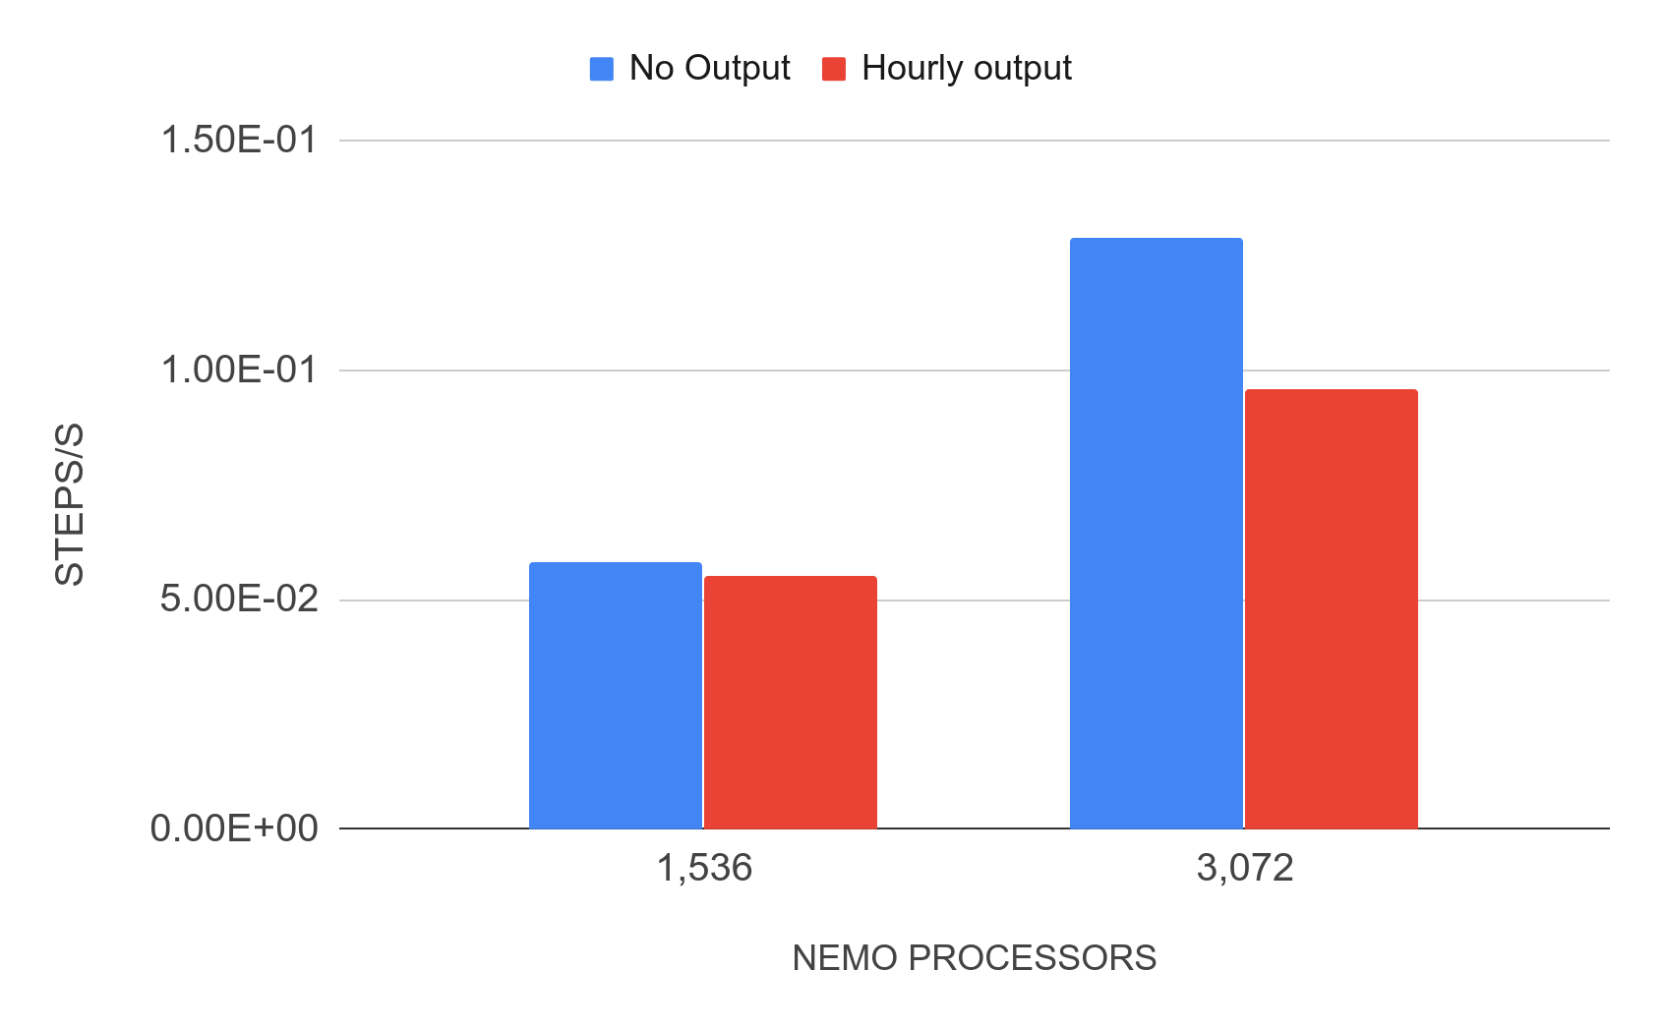
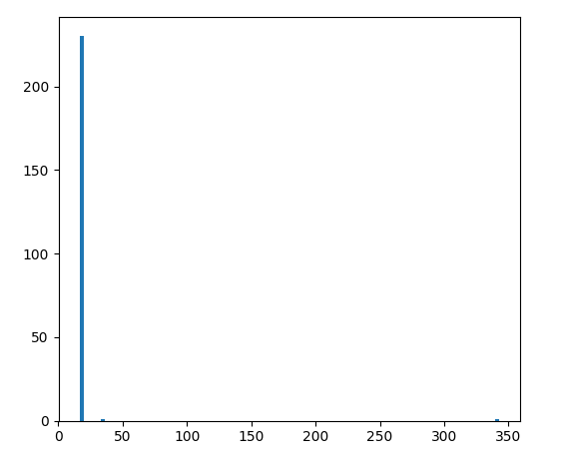
ORCA36 I/O (MN4)
ORCA36 I/O tests with XIOS2.5
Timestep duration hist. 1,536 processors I/O
Timestep (s)
Hourly output runs: 1,536 XIOS servers (32 nodes) in high-memory nodes (8GB/core). One-file mode. 340GB per simulated hour.

Slide 26
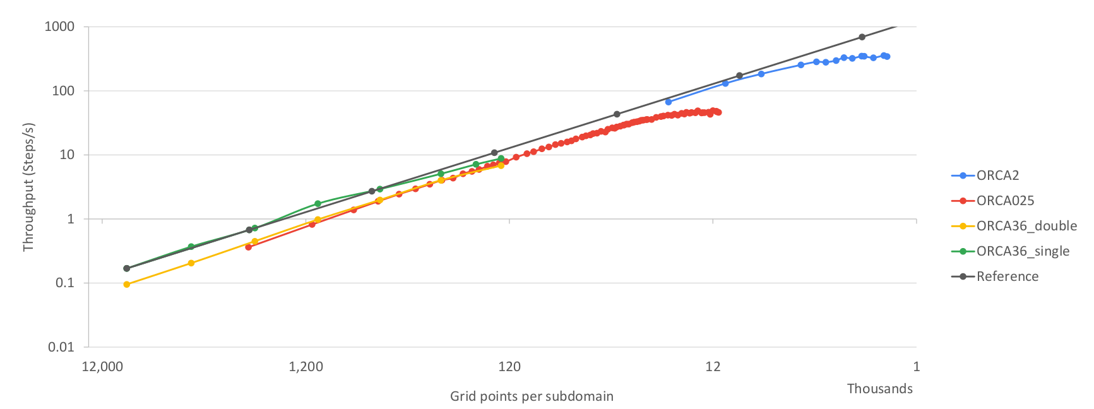
ORCA weak scaling (MN4)
ORCA2, ORCA025 and ORCA36 scalability. Steps per second per subdomain size

Slide 27
ORCA36 Performance analysis

Slide 28
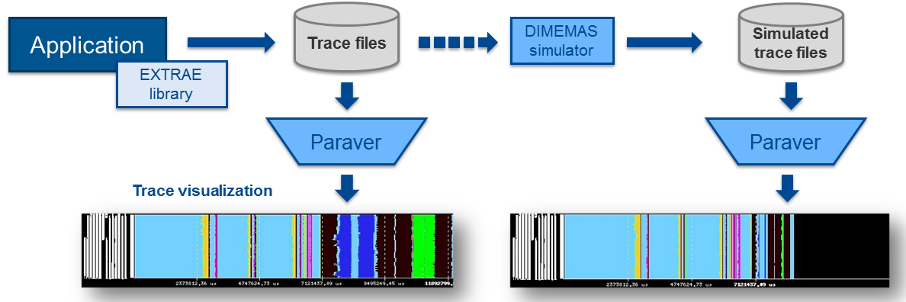
Performance analysis
Since 1991
Based on traces
Open Source: https://tools.bsc.es
Extrae: Package that generates Paraver trace-files for a post-mortem analysis
Paraver: Trace visualization and analysis browser
Dimemas: Message passing simulator

Slide 29
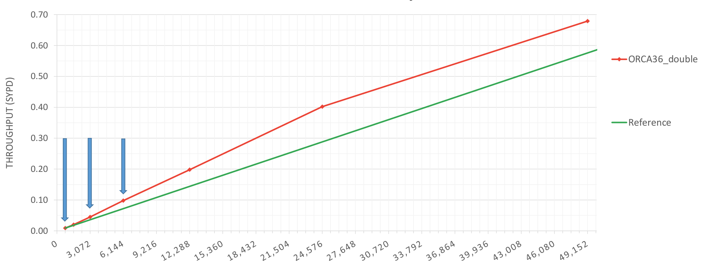
ORCA36 scalability (MN4)
ORCA36 scalability
PROCESSES (CORES)

Slide 30
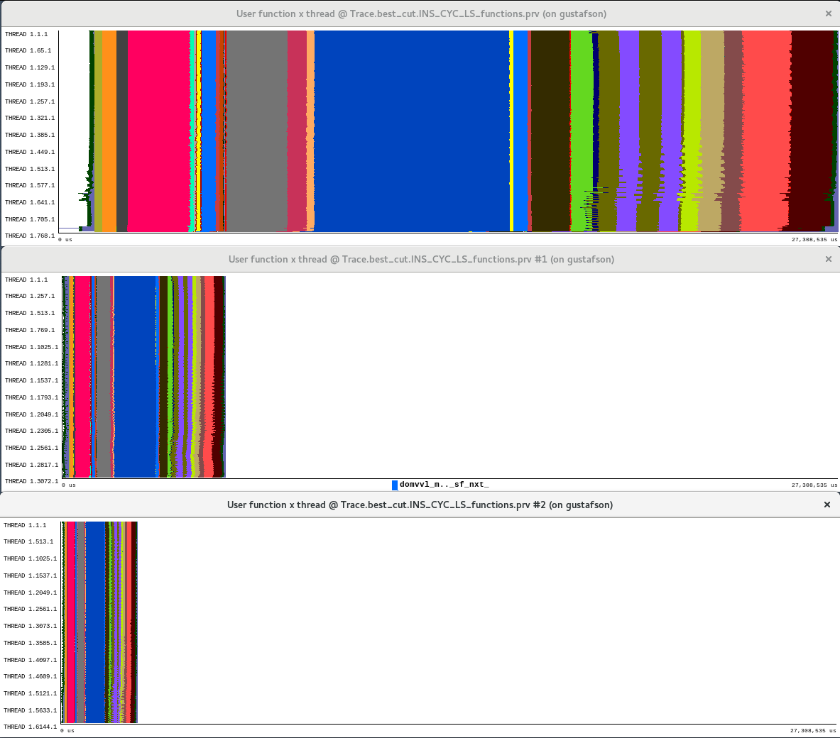
ORCA36 functions view
768
3,072
6,144
t

Slide 31
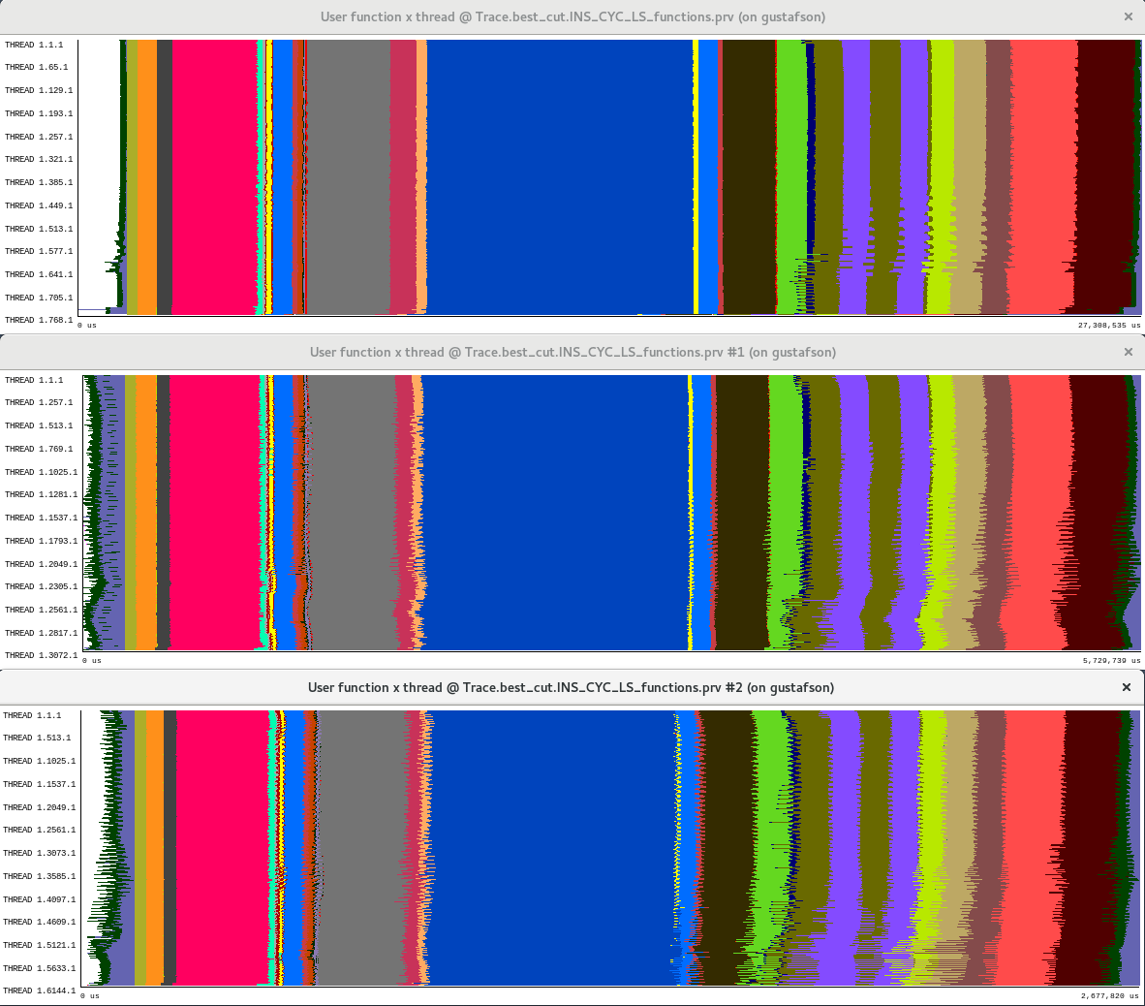
ORCA36 functions view
768
3,072
6,144
t

Slide 32
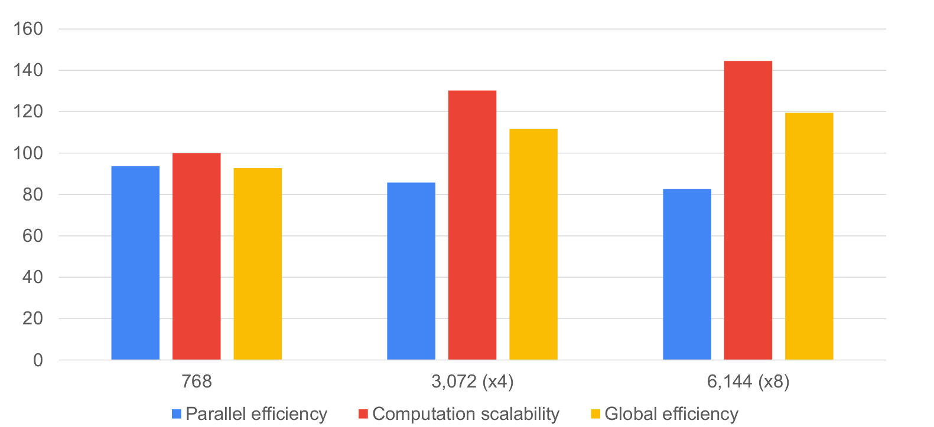
ORCA36 scalability
Model factors explaining scalability on 16, 32 and 64 nodes

Slide 33
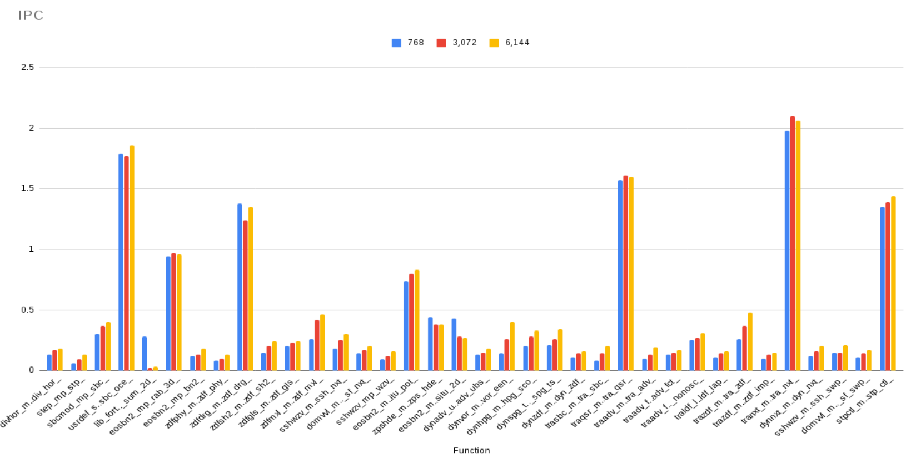
ORCA36 IPC per function

Slide 34
NEMO4 time vs cost

Slide 35
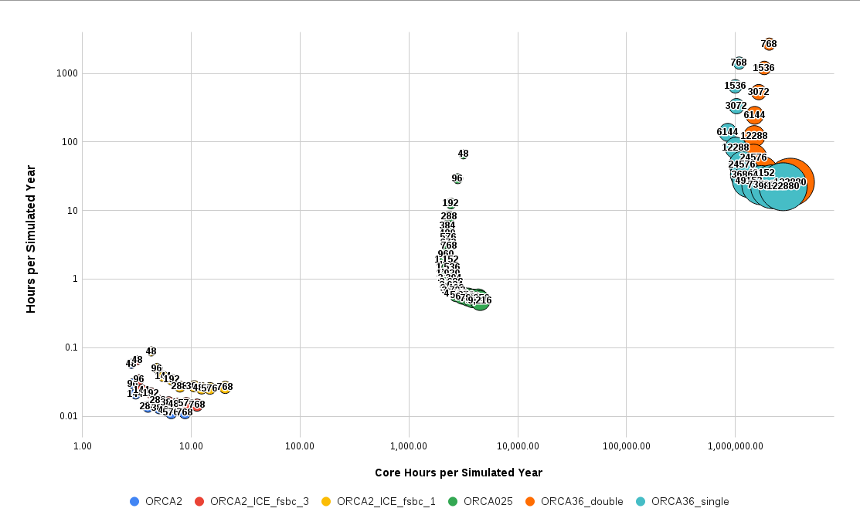
NEMO4 time vs. cost

Slide 36
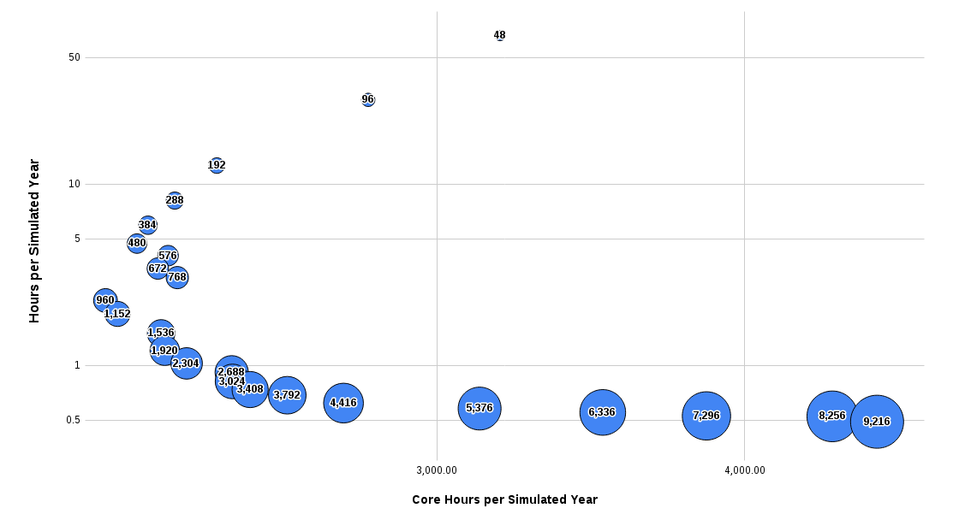
NEMO4 time vs. cost
ORCA 025
Slower
Faster
Cheaper
More expensive

Slide 37
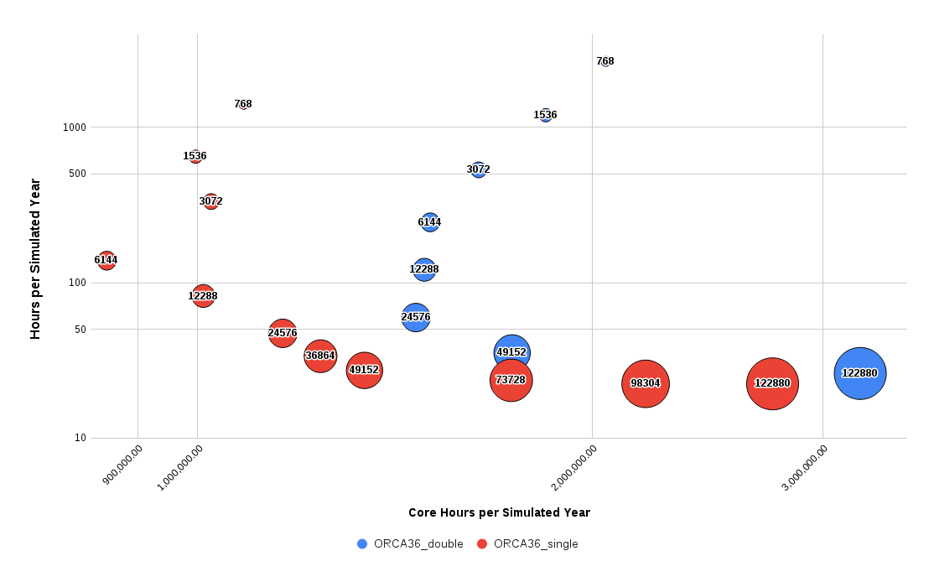
NEMO4 time vs cost
ORCA 36
Slower
Faster
Cheaper
More expensive

Slide 38
Conclusions
NEMO scalability is good when maintaining subdomain size over 15x15. Max. throughput achieved at 10x10. With very large configurations (and many more PE’s) this may not be true.
Using mixed precision in NEMO may allow to achieve 1SYPD with 3km global resolution on current architectures. Up to x1.9 speedup on memory bandwidth bound configurations.
NEMO memory usage is not scaling: online interpolations in ORCA36 make impossible to run the model on standard nodes.
Data is an issue: ~1Tb size restarts, ~360GB per simulation hour.
Production throughput depends on many variables: time step size, I/O frequency, I/O size, diagnostics computation, coupling, namelist parameters…...

Slide 39
Porting NEMO diagnostics to GPUs

Slide 40
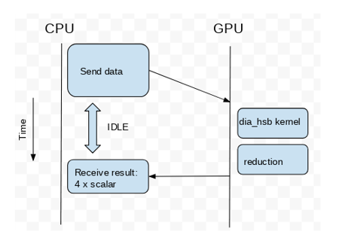
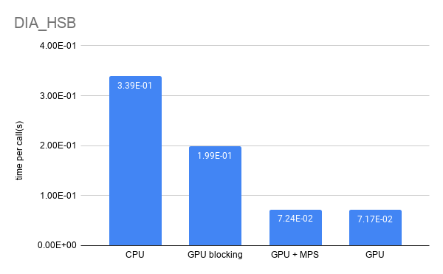
IMMERSE: Porting diagnostics to GPUs
The diagnostics dia_hsb kernel
DIA_HSB diagnostics time, using one Power9 node
Maicon Faria (BSC)

Slide 41
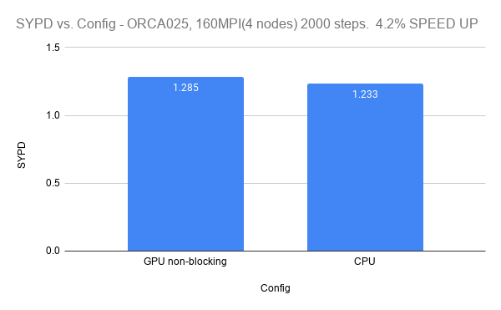
NEMO's GPU Diagnostic Strong Scaling
ORCA 025
Maicon Faria (BSC)
Notes:
Elapsed time for the NEMO’s diagnostic routine for the ORCA025 resolution in a synchronous/blocking implementation (2000 steps). The strong scaling behaviour is represented for one, two, and four CTE-Power nodes, each node equipped with four V100 GPUs.

Slide 42
Thank you
This project has received funding from the European Union’s Horizon 2020 research and innovation programme under grant agreement No 823988.
miguel.castrillo@bsc.es

