Slide 1
Forecast Quality of Climate Extreme Predictions and its Relevance for Climate Services
Francisco Doblas-Reyes
V. Agudetse, C. Delgado-Torres, M.G. Donat, N. González-Reviriego, P. De Luca, N. Milders, A.G. Muñoz, Ll. Palma, N. Pérez-Zanón, J. Ramon, B. Solaraju-Murali, A. Soret and V. Torralba
24 April 2023

Slide 2
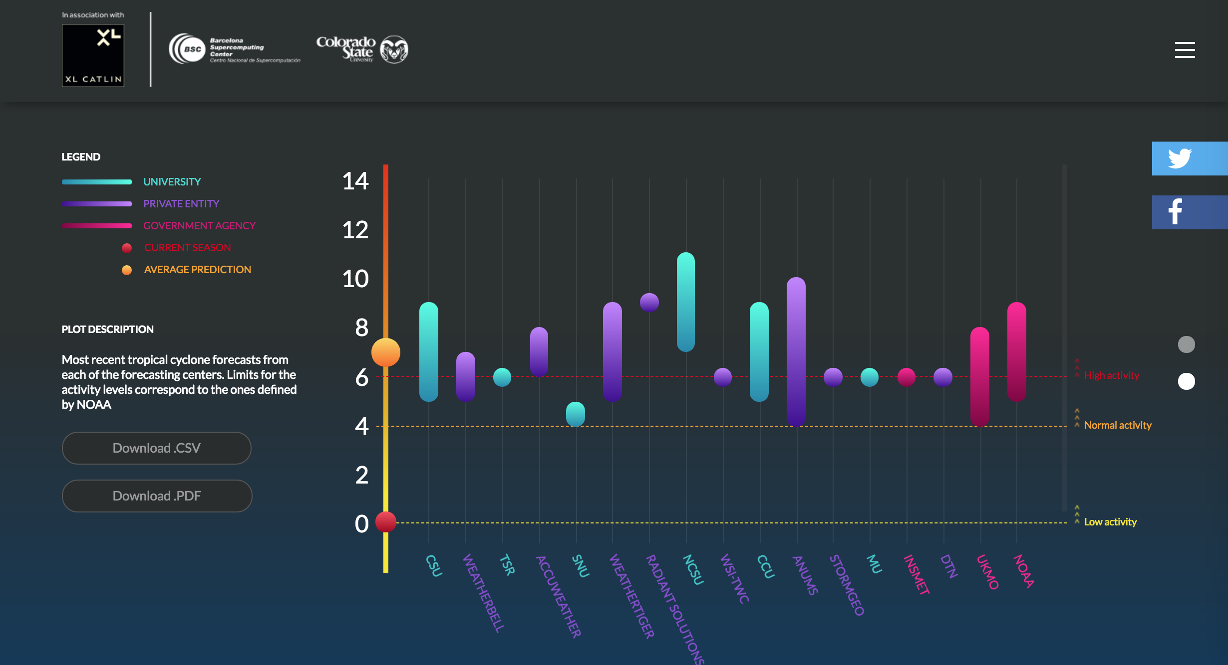
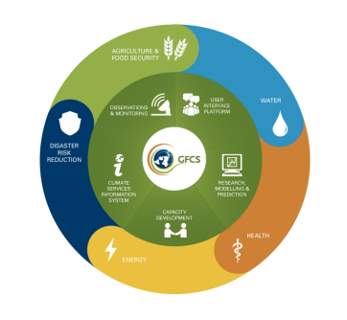
Same definitions
Climate data: numerical values representing ECVs and associated magnitudes; includes metadata
Climate product: the result of processing climate data according to the available climate knowledge
Climate information: climate product put in context and generated in a co-production process with the user
Climate service: ensemble of processes through which both climate data and information are generated

Slide 3
Time scales
Observations, process-based or dynamical forecast systems, empirical models, process understanding, are all key pieces to build climate forecasts.
Dynamical forecast systems are used as the standard, but it is reductionist.
Subseasonal to seasonal forecasts (2 weeks-18 months)
Decadal forecasts (18 months-30 years)
Climate-change projections
Weather forecasts
Time
Initial-value driven
Boundary-condition driven
MJO
ENSO
AMV
Climate change
Adapted from Meehl et al. (2009)

Slide 4
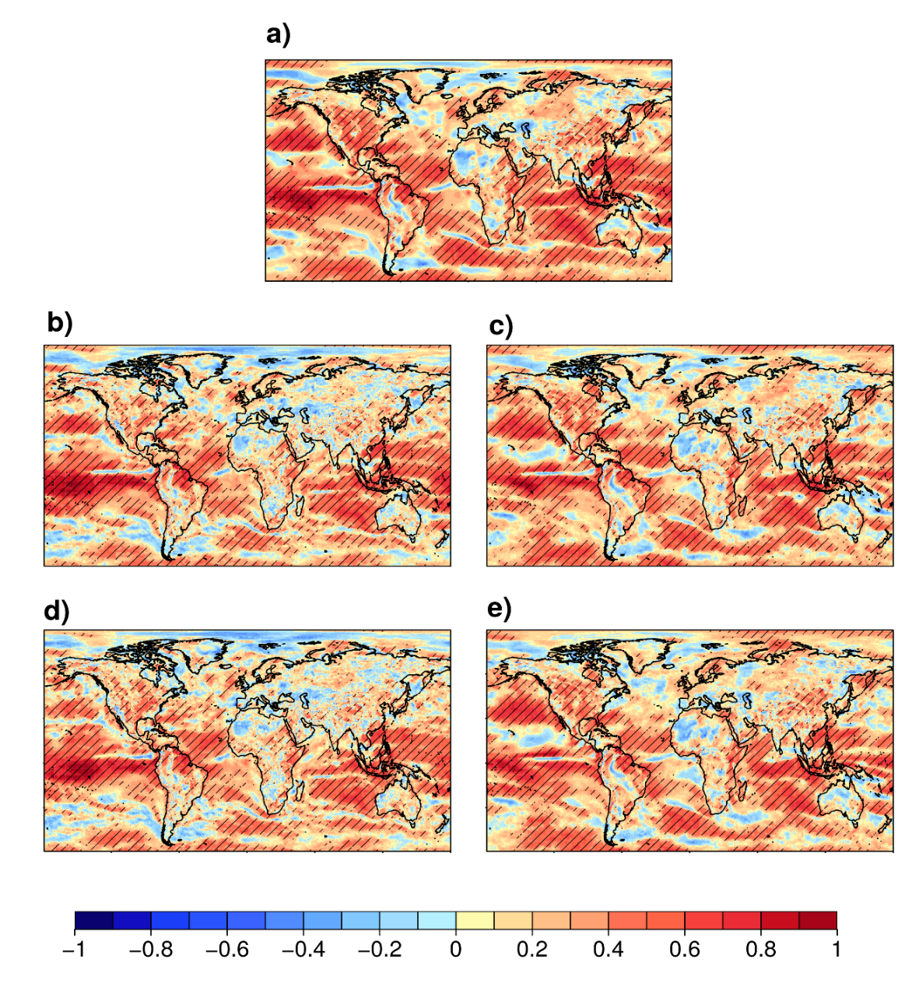
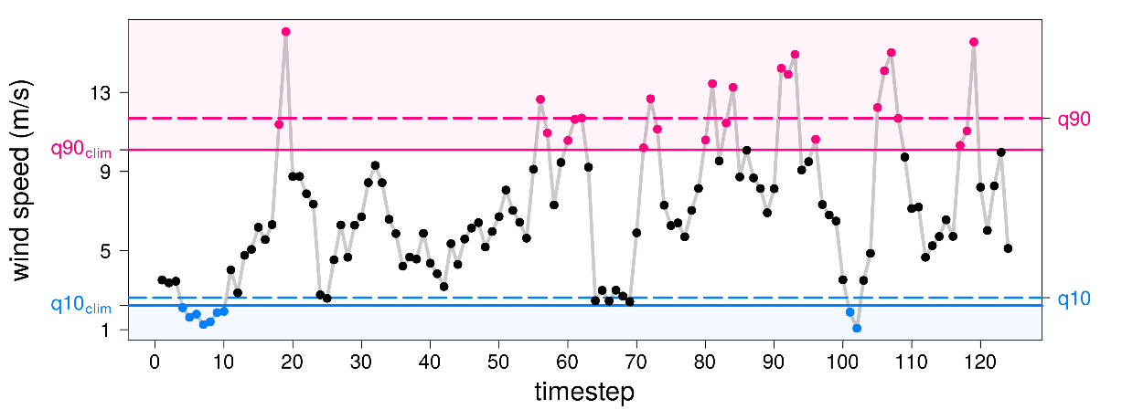
Seasonal climate prediction of extremes
Correlation of seasonal predictions of DJF 10-metre wind speed from ECMWF SEAS4 starting on the first of November over 1993-2016.
q90, q10: seasonal percentiles of each specific year
fbq10, faq90: fraction of time above the climatological
percentile in each year
mean
q10
q90
fbq10_clim
faq90_clim
V. Torralba (BSC)

Slide 5
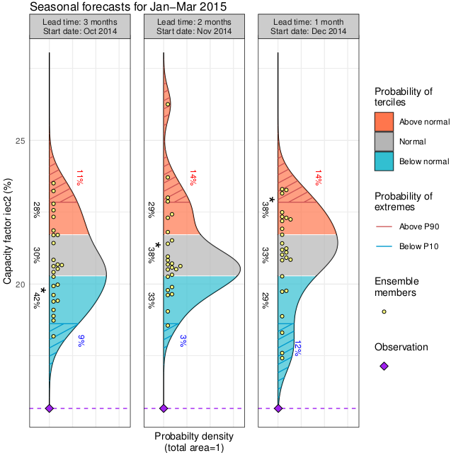
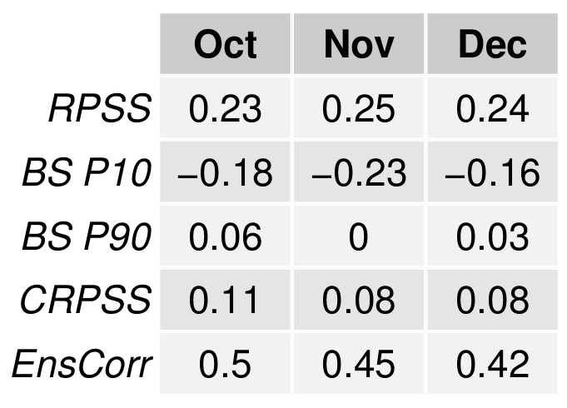
User-oriented forecasts
Co-design implies predicting what the user is interested in.
Seasonal predictions of DJF capacity factor over North America (124-95⁰W, 26-44⁰N) starting on the first of October, November and December for the first season of 2015, ECMWF SEAS5, reanalysis: ERA-Interim, hindcasts over 1993-2016.
Lledó et al. (2019, ERL)

Slide 6
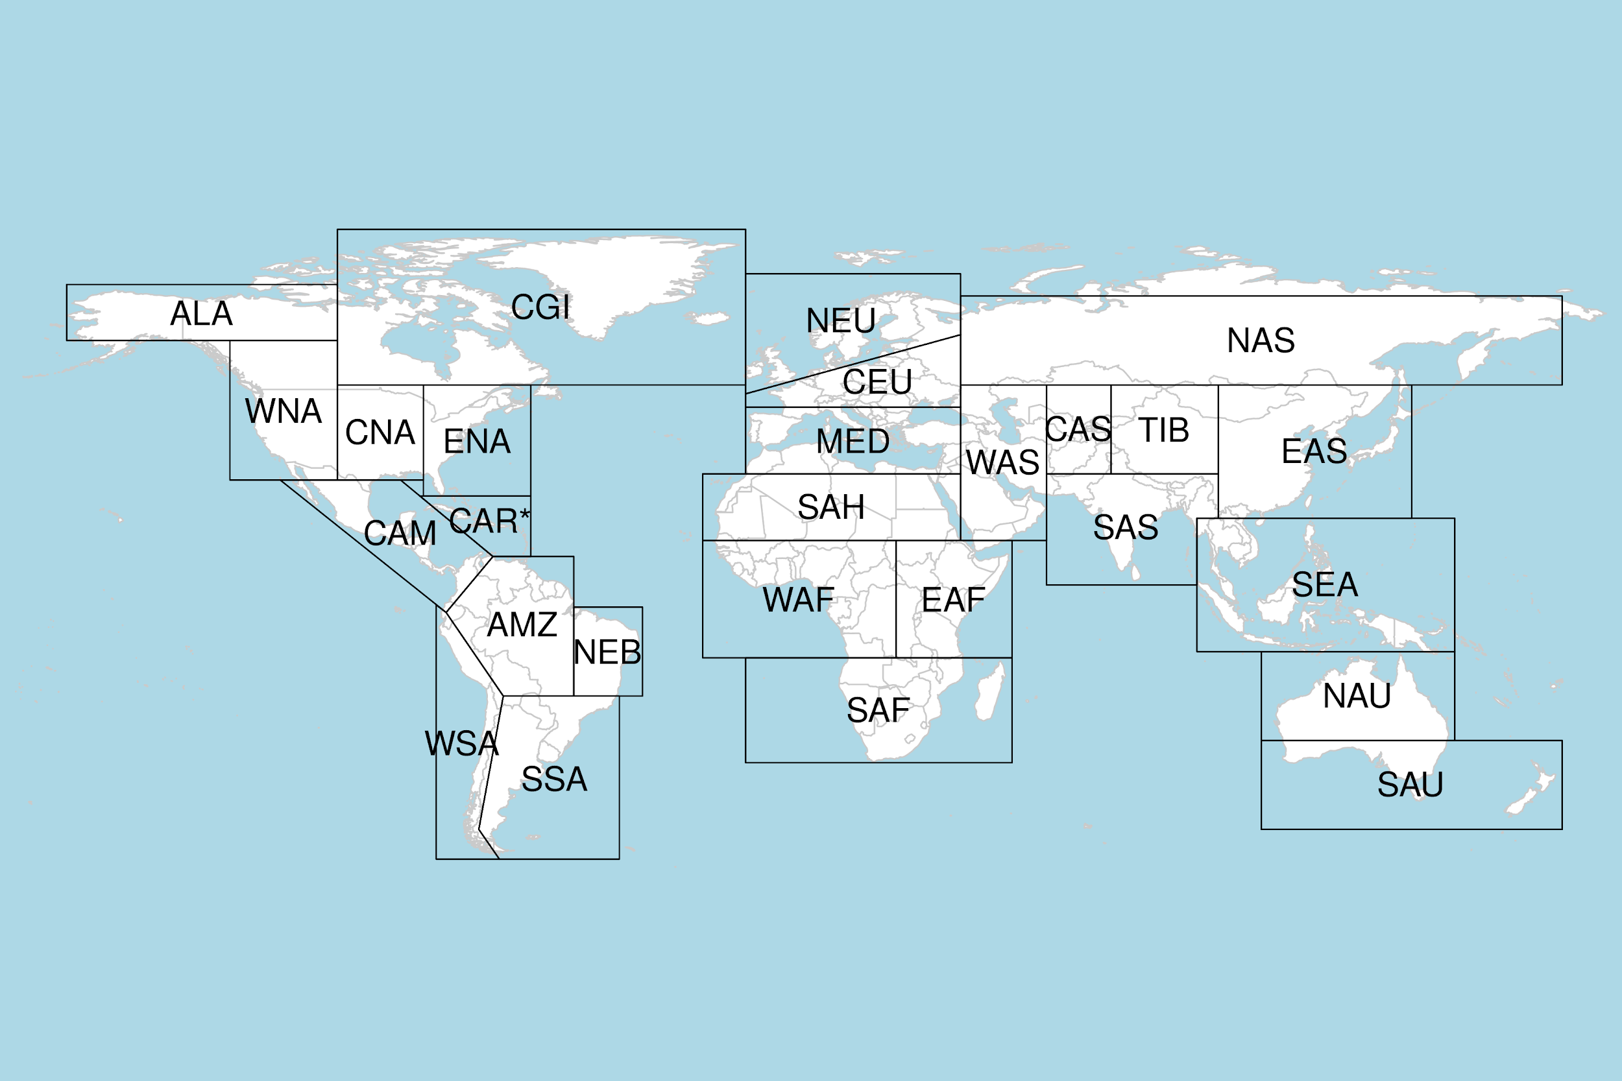
Beware of the observational uncertainty
Verification of 10-metre wind speed with two ground-based observational datasets and three reanalyses. The use of both types of datasets is very informative for wind energy users as they use them for the development of impact models and the long-term resource assessments.
“Failing to account for the effects of observation error when deciding between two forecasting systems could lead to the wrong choice and a high opportunity cost” (Ferro, 2017)
Torralba et al. (in preparation)

Slide 7
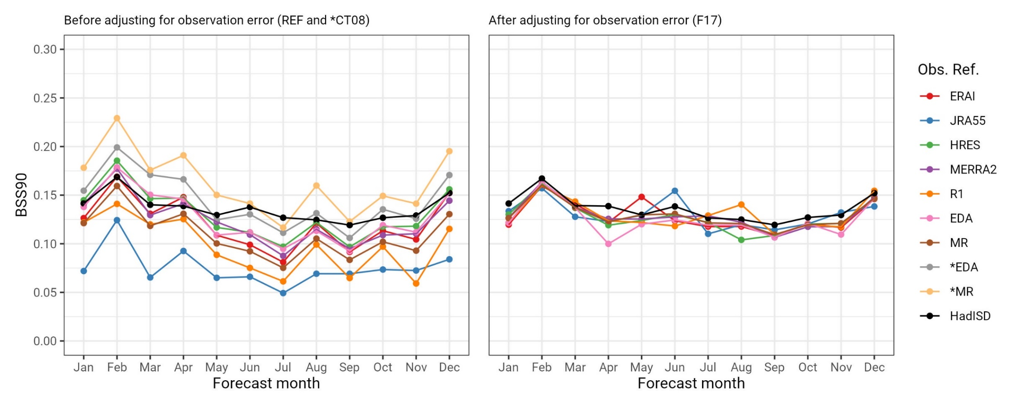
Beware of the observational uncertainty
Verification of 10-metre wind speed with two ground-based observational datasets and three reanalyses. The use of both types of datasets is very informative for wind energy users as they use them for the development of impact models and the long-term resource assessments.
“Failing to account for the effects of observation error when deciding between two forecasting systems could lead to the wrong choice and a high opportunity cost” (Ferro, 2017)
Ramon et al. (in preparation)

Slide 8
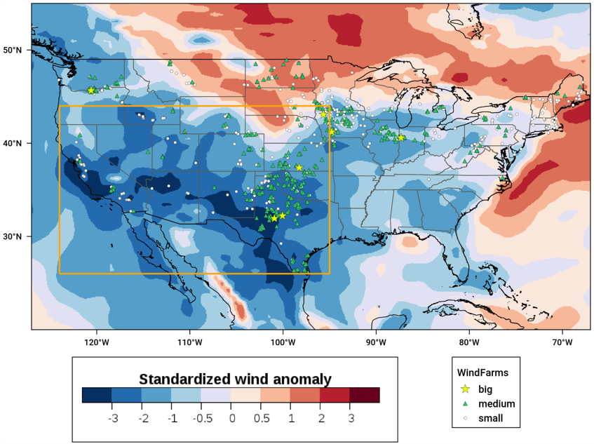
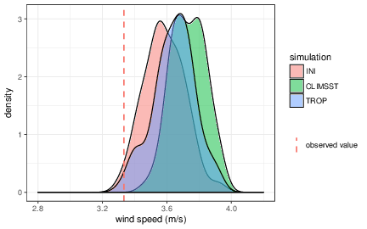
Attribution of climate extreme events from forecasts
During the first quarter of 2015 the United States experienced a widespread and extended episode of low surface wind speeds. Some wind farms did not generate enough cash for their steady payments, decreasing the value of wind farm assets. An attribution study was conducted with EC-Earth to identify the drivers of the anomalous seasonal wind.
Wind speed anomalies reflecting the wind drought over the United States for the first trimester of 2015, where the USA wind-farm fleet is also shown (Lledó et al., JGR 2018)
Lledó et al. (2018, JGR)

Slide 9
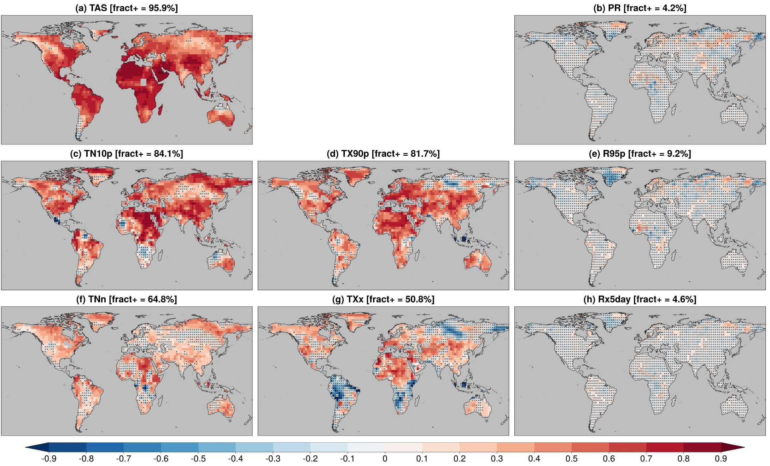
Multi-model decadal prediction
RPSS (3 cat.; BEST-REGEN)
for DCPP, 1-5 forecast years, 169 members, 13 DCPP forecast systems
(significance random walk)
Delgado-Torres et al. (2023, ERL)

Slide 10
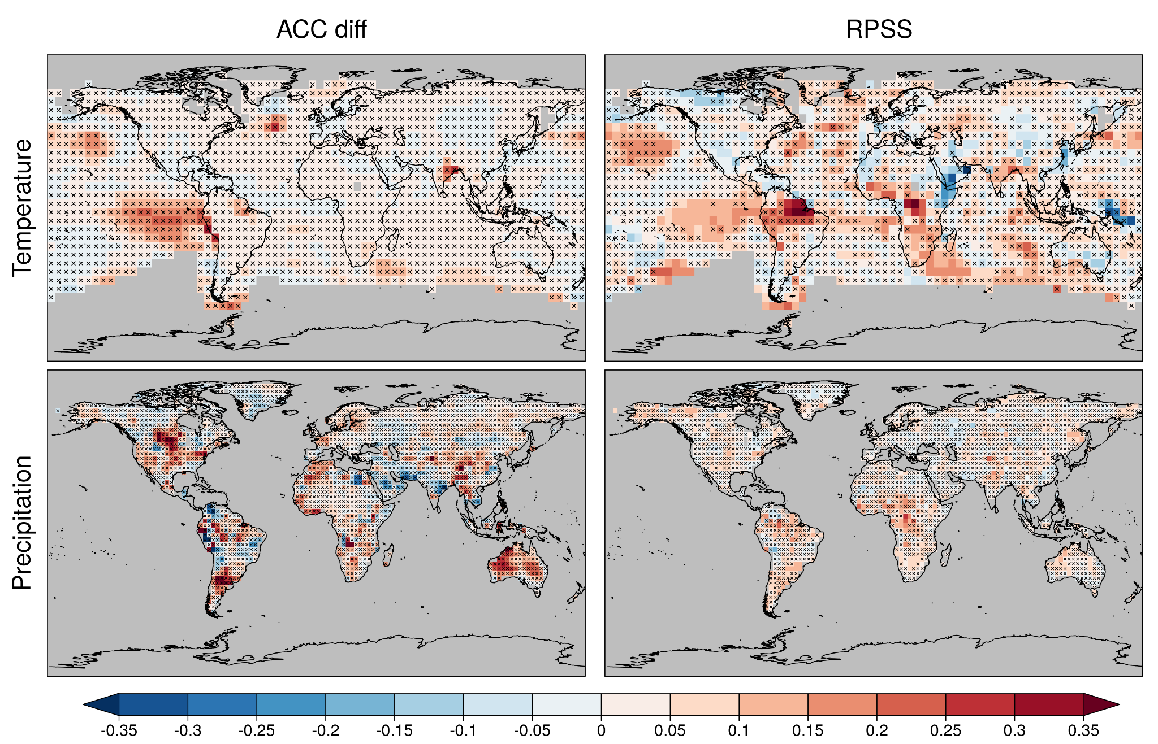
Decadal prediction from research to operations
Systematic assessment of the multi-model decadal prediction forecast quality helps illustrating, among other things, the importance of a large enough operational multi-model.
Comparison between a research (DCPP, 169 members, 13 forecast systems) and an operational (C3S_34c, 40 members, 4 forecast systems, CMCC-CM2-SR5, EC-Earth3-i1, HadGEM3-GC3.1-MM and MPI-ESM1.2-HR).
DCPP worse than C3S_34c multi-model ← | →DCPP better than C3S_34c multi-model
Delgado-Torres et al. (2022, J. Climate)

Slide 11
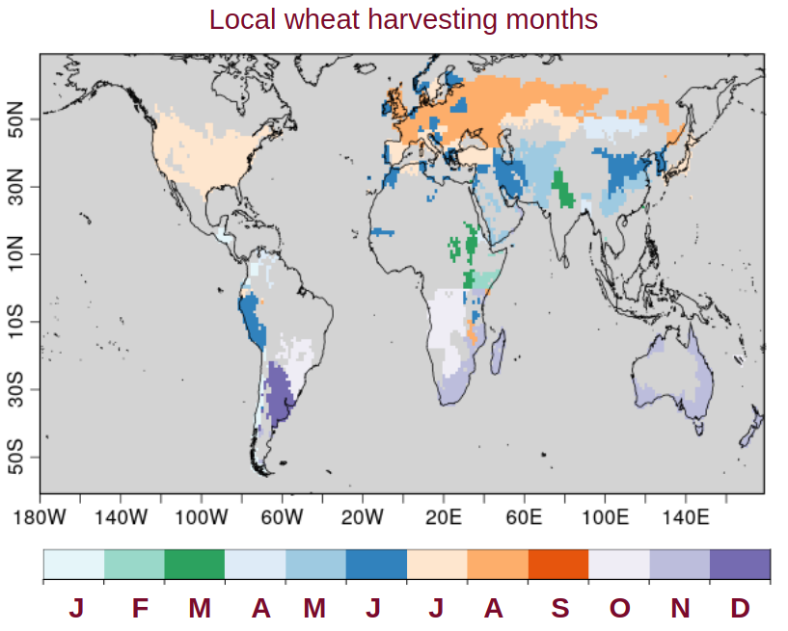
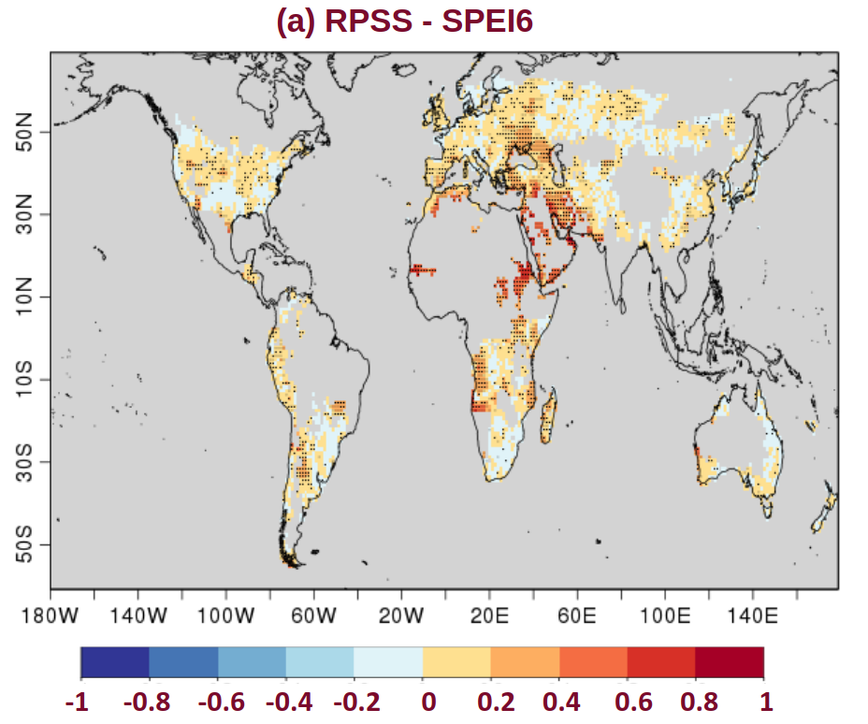
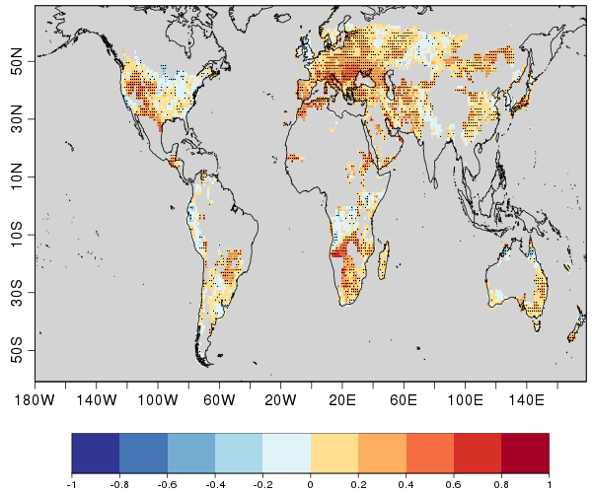
Forecasts for crop yield
Decadal predictions contribute to services in different sectors using indicators based on extreme climate indicators to which they are sensitive.
SPEI6
RPSS (3 categories)
Indicators:
Drought: Standardized Precipitation Evapotranspiration Index (SPEI6)
Heat stress: Heat Magnitude Day Index (HMDI3)
HMDI3
Solaraju-Murali et al. (2021, NPJ Climate)

Slide 12
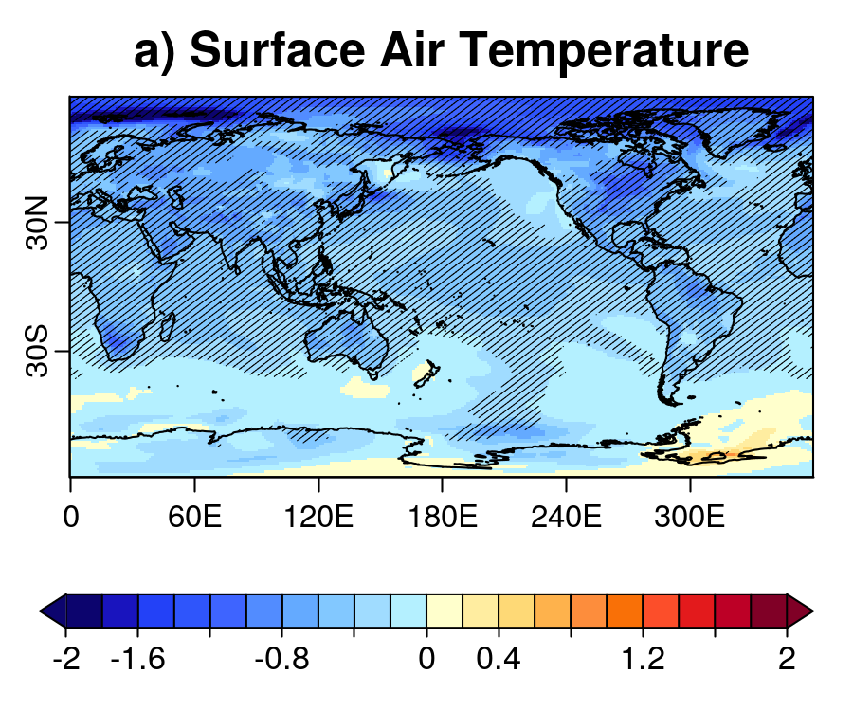
Volcanoes as unavoidable extremes
Explosive volcanoes are not included in the climate-change projections but create signatures that could last from years to decades.
Results from the Decadal Prediction Volcanic Response Readiness Exercise (VolRes-RE).
A 2xEl Chichón eruption is set in April 2022 for the EC-Earth3 decadal forecast started in late 2021 and the difference with respect to DCPP-A made.
TAS YR2-5
ºC
R. Bilbao (BSC)

Slide 13
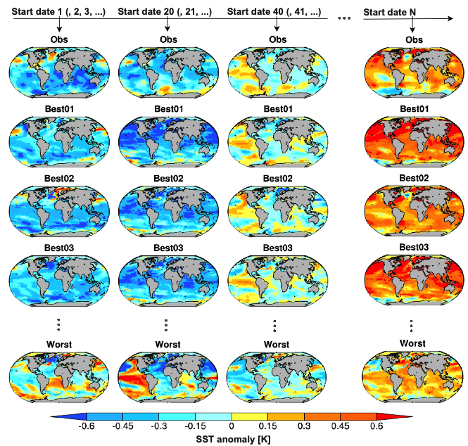
Beyond decadal: Near-term climate information
Projections: 223 members from 35 models
Decadal predictions: 93 members from 9 models
Sub-selecting the 30 projections members in closest agreement with the predictions over common years 1-9 or with the observations over the previous 9 years
Substantial multi-decadal predictability
Constrained projections can be more skillful
initialized prediction
initialized prediction
initialized prediction
initialized prediction
(un-initialized) projections
Mahmood et al. (2021, GRL; 2023, ESD)

Slide 14
Near-term seamless climate information
Skill of 20-year projections using previous observations to select a 30-member ensemble.
Heterogeneous improvements with respect to the full ensemble of historical simulations
Verification of the methods is important to the users
Di Luca et al. (in prep.)

Slide 15
The context for a climate service
Better links, collaboration and knowledge sharing among the increasing, and currently fragmented, community of practice. The current supply-driven approach is more likely to improve climate data, but not necessarily to contribute to better informed decisions. Direct interaction would allow identifying improvement areas and emerging user needs (role for climate services).
Better interaction between providers and users and more effort to build local competences.
Improving usefulness and usability of the products and moving towards demand-driven (instead of demand-relevant):
enhancing credibility with a more transparent approach to the forecast production and quality assurance of the corresponding climate services
enhancing salience by improving the skill, user interface, visualisation and communication
enhancing legitimacy by creating independent quality control and certification systems designed by including the different stakeholders involved in the value chain of climate services
Find a space for those forecast intermediaries (national and sub-national agents) that so far have been using subjective methods, consider a balanced power relation in the transition to fully objective forecasts.
Findlater et al. (2021, NCC), Bojovic et al. (2022, Clim. Change)

Slide 16
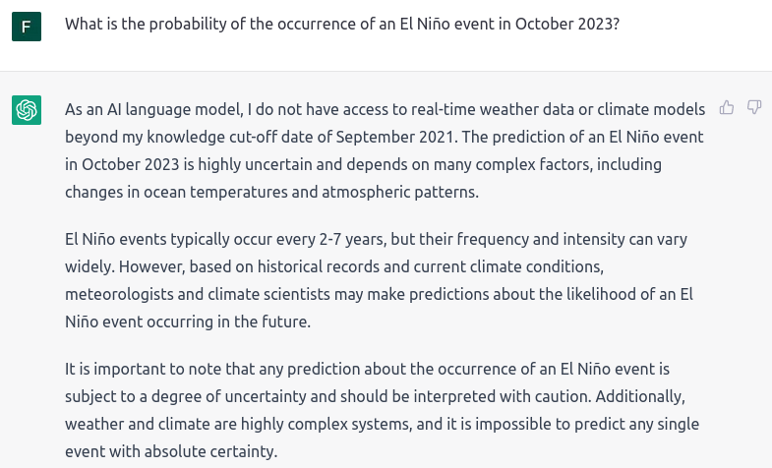
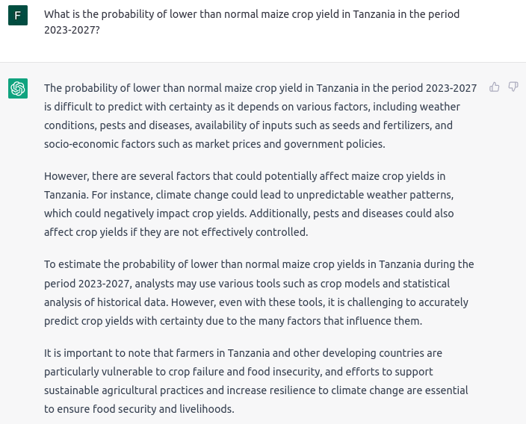
Extreme scaling: User interface to climate information
How long before a generative chatbot will be trained with the latest forecast information?

