Slide 1
The Weather Roulette: assessing the economic value of seasonal wind speed predictions
Isadora Christel (1), Nicola Cortesi (1), Veronica Torralba (1), Albert Soret (1), Nube Gonzalez-Reviriego (1,2), Francisco Doblas-Reyes (1,2,3)
(1) Barcelona Supercomputing Center (BSC), Barcelona, Spain (isadora.jimenez@bsc.es), (2) Catalan Institute of Climate
Sciences (IC3), Barcelona, Spain, (3) Institució Catalana de Recerca i Estudis Avançats (ICREA), Barcelona, Spain
EGU General Assembly 2016 (Wien, Austria, 18-22 April 2016)

Slide 2
Introduction
Let’s Play!
Conclusions
USERS NEED
CLIMATE SERVICE
Wind industry currently uses climatology
for resource assessments
Semi-operational prototype that provides wind speed seasonal predictions
http://project-ukko.net
How do we engage wind industry users to consider using seasonal predictions besides climatology?
Demonstrating the VALUE of probabilistic predictions
in economic terms
METHODOLOGY
LET’S PLAY!
We use the Weather roulette framework to show how climate predictions outperform the climatology in skillful areas
It has been designed as a game that you can play in the interactive screen

Slide 3
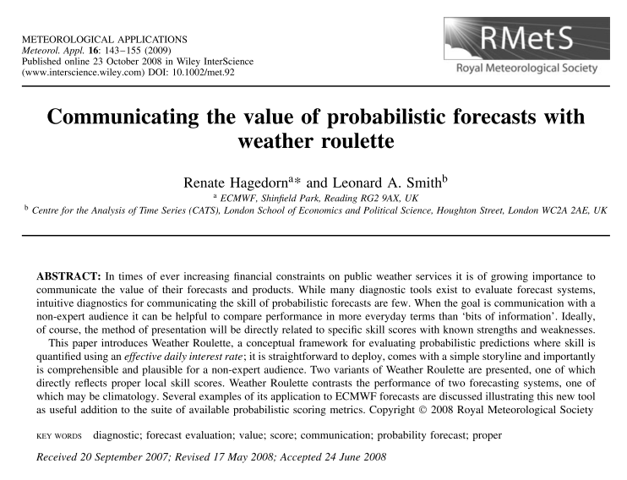
Introduction
Let’s Play!
Conclusions
Introduction
Weather Roulette framework is based on Hagedorn & Smith 2009.
Decision makers are not necessarily familiar with statistical techniques used for the calculation of skill scores in climate predictions, whereas economic and financial knowledge is widespread in the corporate world.
Weather roulette translates skill scores into commonplace concepts as interest ratios or return of investment.
User needs & seasonal pred.
Weather Roulette information
Next

Slide 4
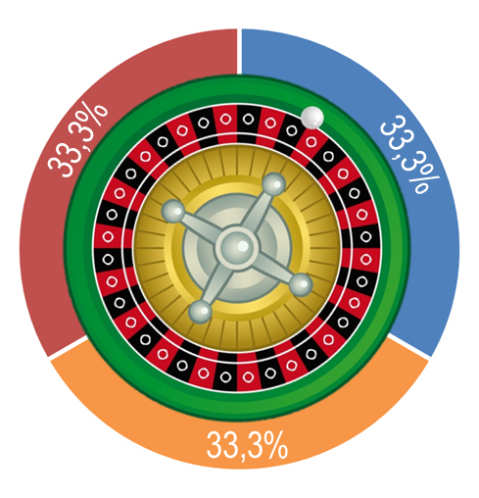
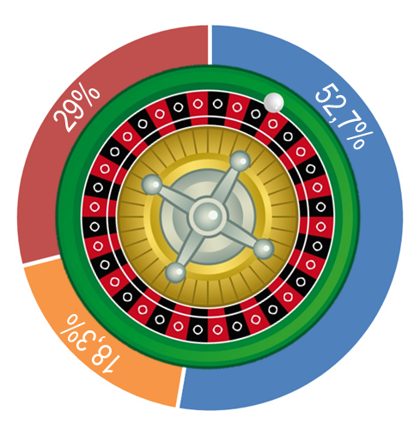
Introduction
Let’s Play!
Conclusions
Introduction
To assess the value of probabilistic prediction for wind energy users, seasonal wind speed predictions play against climatology.
Climatology assumes a fixed probability to each category while climate predictions adjust the category probabilities of the ‘climatology’ forecast.
User needs & seasonal pred.
Weather Roulette information
In the game, the user bets proportionally to the probabilities estimated in the seasonal forecast (e.g. 52% of 10€ to below average winds = 5.2€ invested in the category)
The amount invested in the observed category is multiplied by 3 (i.e. the inverse of the climatology probability)
If the observed category had a larger probability in the forecast than in climatology, then the user earns money (e.g. 5.2€ x 3= 15.6€). Otherwise, the user looses money.
Climatology
RESILIENCE
seasonal predictions
Above average
Expected wind speed:
Average
Below average
Next
Notes:
The money in the other categories is always lost

Slide 5
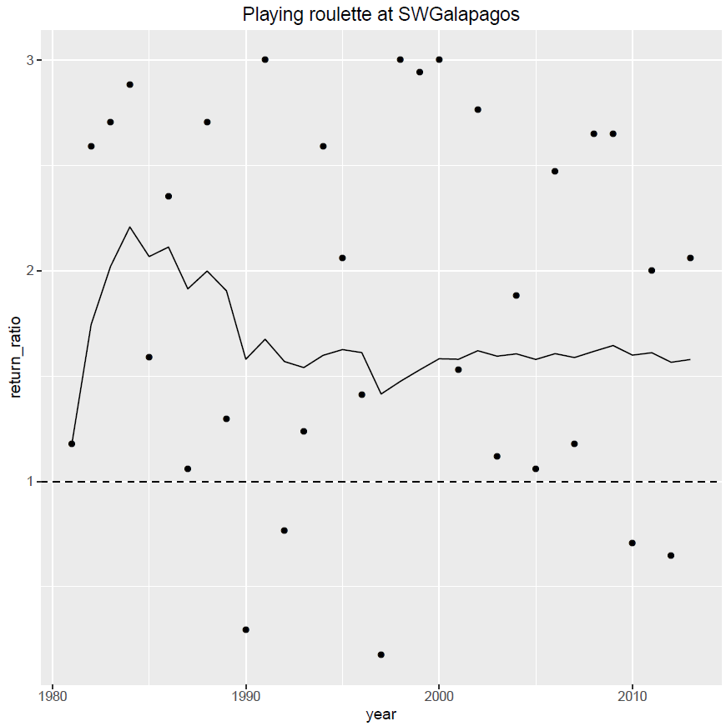
Introduction
Let’s Play!
Conclusions
Initial investment of 10€
Everything earned is reinverted
Introduction
User needs & seasonal pred.
Weather Roulette information
33 runs (from 1981 to 2013)
Always in Winter period (Dec-Jan-Feb)
In each game the skill of the seasonal predictions is provided as RPSS (Ranked Probability Skill Score)
After a sufficient number of runs we calculate the geometric average of return ratios (the line)
That can be indicated as interest rate too
The dots are the performance of the forecast in each run (individual return ratios)
Next

Slide 6
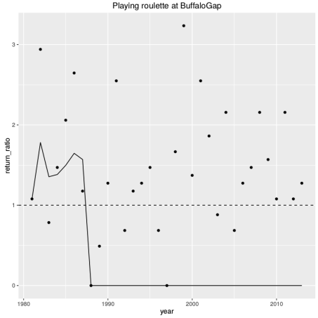
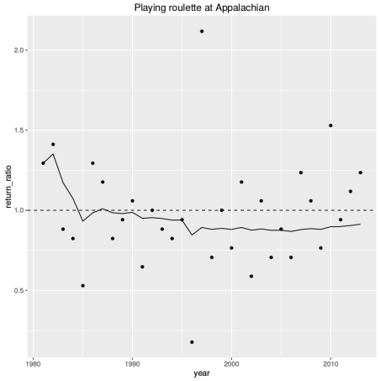
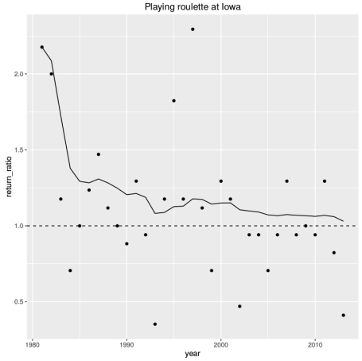
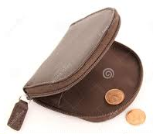
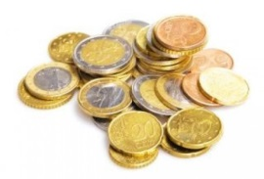
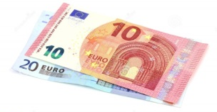
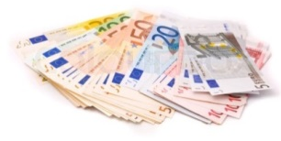
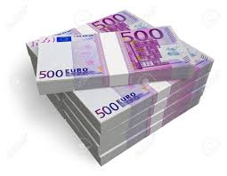
Introduction
Let’s Play!
Conclusions
Introduction
With the return ratio and the amount invested the total amount earned can be calculated
User needs & seasonal pred.
Weather Roulette information
Below 1 (dashed line) climatology is better
Over 1 seasonal predictions are better
Let’s play!

Slide 7
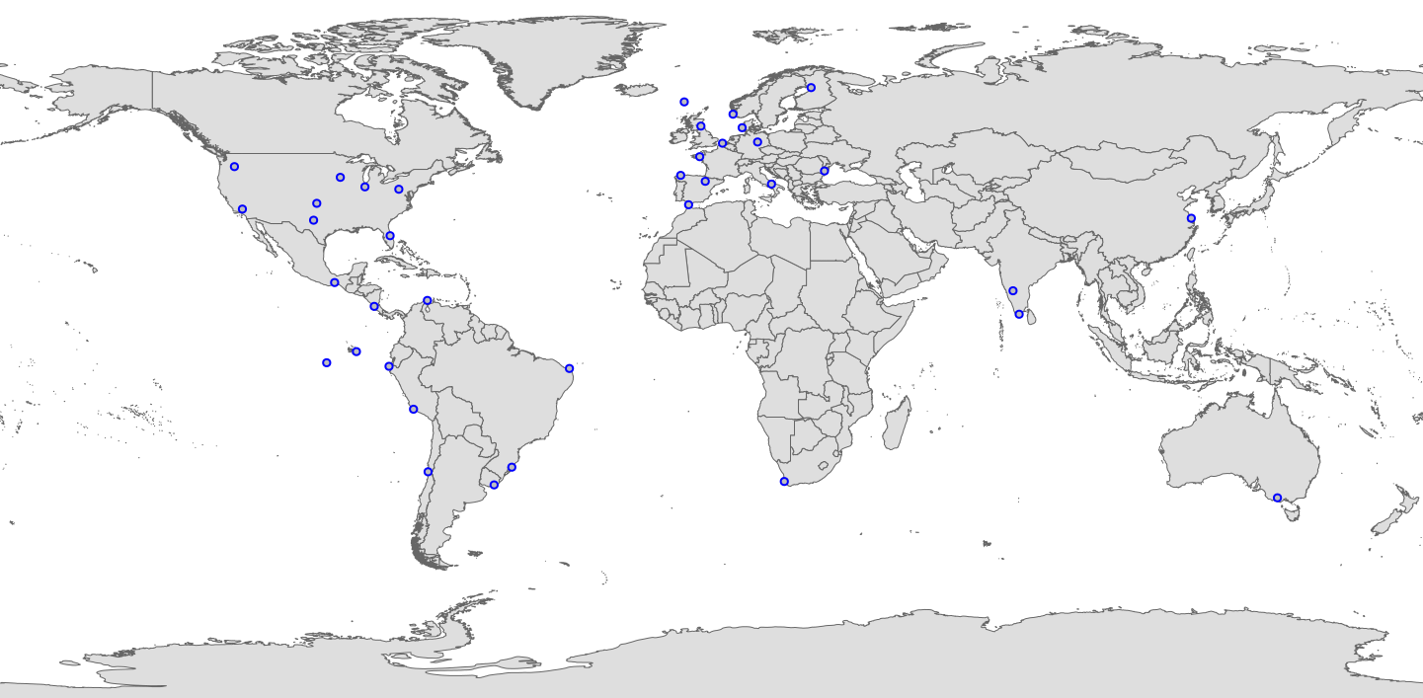
Introduction
Let’s Play!
Conclusions
Wind farms in areas with Skill scores >0
Let’s Play!
Wind farms in areas with Skill scores ≤0
Click in a wind farm in the map
Or choose a windfarm from the list
Have you played enough?
What if we play in a portfolio of 6 wind farms?
After all, large companies own many wind farms…

Slide 8
Introduction
Let’s Play!
Conclusions
Windfarm | RPSS | Windfarm | RPSS
SWGalapagos | 0,55 | Guanacaste | 0,00
Guajira | 0,35 | Shangai | 0,00
Talara | 0,29 | CapeTown | -0,01
Orlando | 0,23 | Fantanele | -0,01
BuffaloGap | 0,22 | Uruguay | -0,01
Indiana | 0,18 | Stavanger | -0,02
RioGrandeNorte | 0,13 | Campania | -0,03
Galapagos | 0,12 | HornRevs | -0,03
Faeroe | 0,08 | Bretagne | -0,04
Marcona | 0,08 | Ebro | -0,05
ShepherdFlats | 0,06 | Magdeburg | -0,05
Oklahoma | 0,06 | Melbourne | -0,06
Iowa | 0,03 | Karnataka | -0,06
Coquimbo | 0,03 | Tarifa | -0,06
Edinburg | 0,02 | Appalachian | -0,07
Oslo | 0,02 | Lugo | -0,08
RioGrandeSur | 0,01 | LaVentosa | -0,09
 |  | TamilNadu | -0,10
 |  | Belgium | -0,10
 |  | TehachapiPass | -0,12
Let’s Play!
Back to the map
See all results in a table
Wind farms in areas with Skill scores >0
Wind farms in areas with Skill scores ≤0

Slide 9
Introduction
Let’s Play!
Conclusions
Let’s Play!
Back to the map
See all results in a table
Skill score (RPSS) = 0.55
Return ratio = 1.578
Interest rate = 57.8%
From 10€ inverted,
34 772 654€ returned after 33 runs

Slide 10
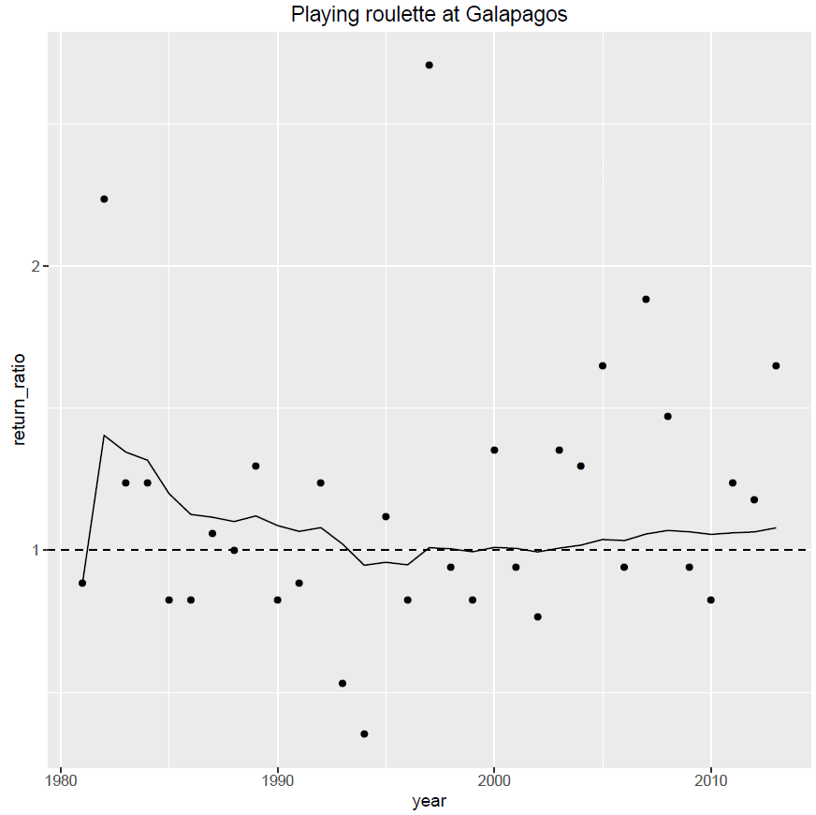
Introduction
Let’s Play!
Conclusions
Let’s Play!
Back to the map
See all results in a table
Skill score (RPSS) = 0.12
Return ratio = 1.079
Interest rate = 7.9%
From 10€ inverted,
123€ returned after 33 runs

Slide 11
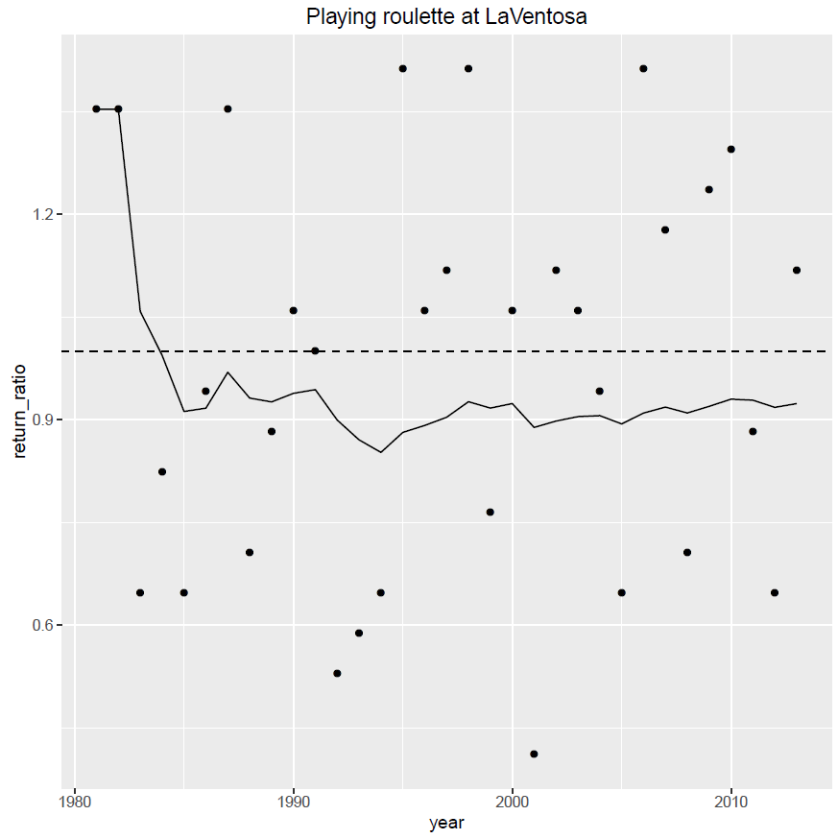
Introduction
Let’s Play!
Conclusions
Let’s Play!
Back to the map
See all results in a table
Skill score (RPSS) = -0.09
Return ratio = 0.924
Interest rate = -7.6%
From 10€ inverted,
70 cents returned after 33 runs

Slide 12
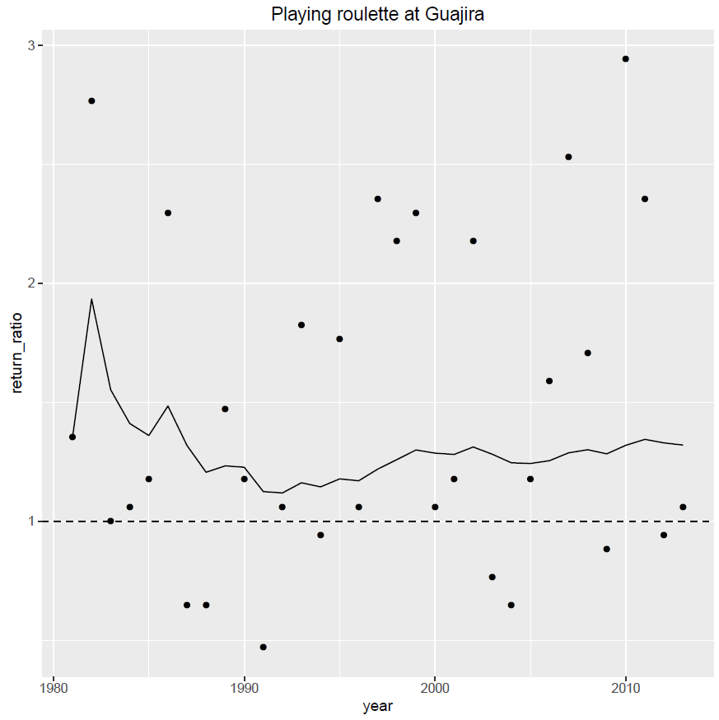
Introduction
Let’s Play!
Conclusions
Let’s Play!
Back to the map
See all results in a table
Skill score (RPSS) = 0.35
Return ratio = 1.32
Interest rate = 32%
From 10€ inverted,
95 667€ returned after 33 runs

Slide 13
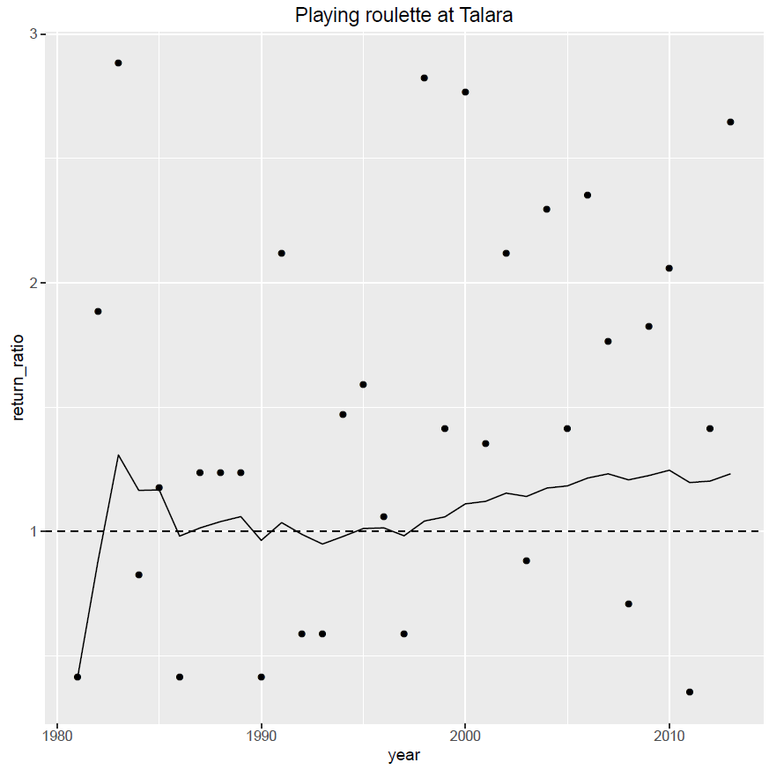
Introduction
Let’s Play!
Conclusions
Let’s Play!
Back to the map
See all results in a table
Skill score (RPSS) = 0.29
Return ratio = 1.232
Interest rate = 23.2%
From 10€ inverted,
9 657€ returned after 33 runs

Slide 14
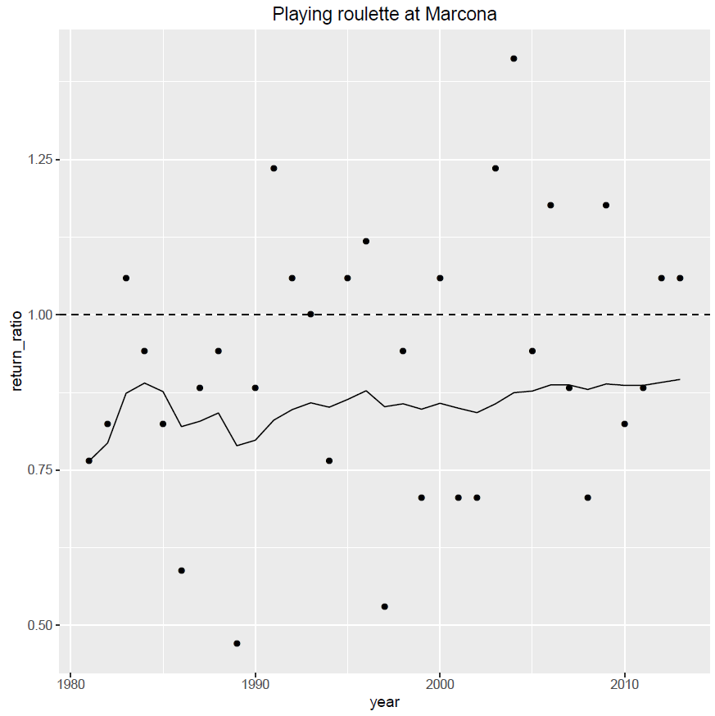
Introduction
Let’s Play!
Conclusions
Let’s Play!
Back to the map
See all results in a table
Skill score (RPSS) = 0.08
Return ratio = 1.024
Interest rate = 2.4%
From 10€ inverted,
22€ returned after 33 runs

Slide 15
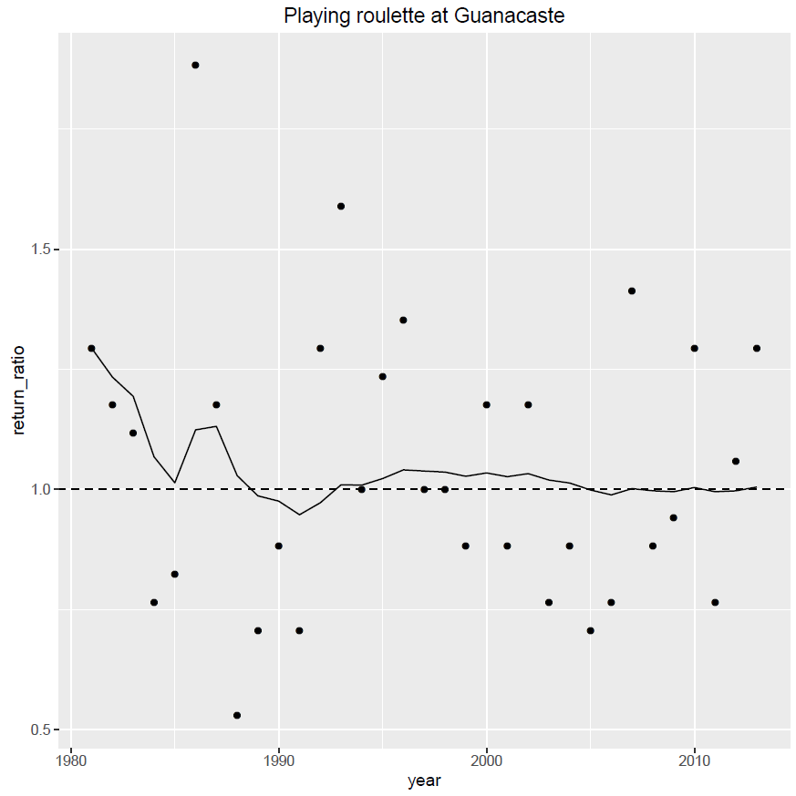
Introduction
Let’s Play!
Conclusions
Let’s Play!
Back to the map
See all results in a table
Skill score (RPSS) = 0
Return ratio = 1.005
Interest rate = 0.5%
From 10€ inverted,
11.8€ returned after 33 runs

Slide 16
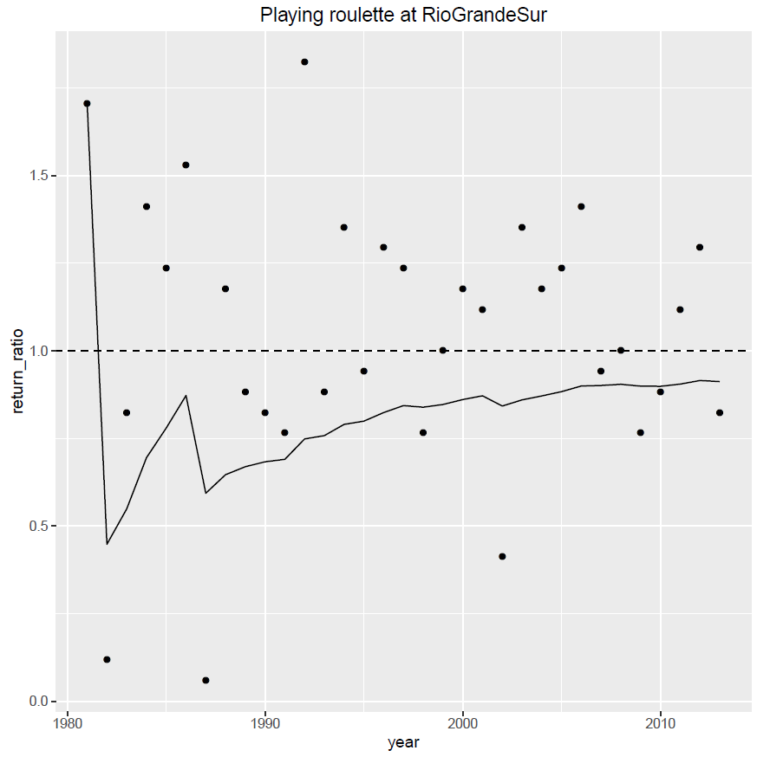
Introduction
Let’s Play!
Conclusions
Let’s Play!
Back to the map
See all results in a table
Skill score (RPSS) = 0.01
Return ratio = 0.912
Interest rate = -8.8%
From 10€ inverted,
50 cent returned after 33 runs

Slide 17
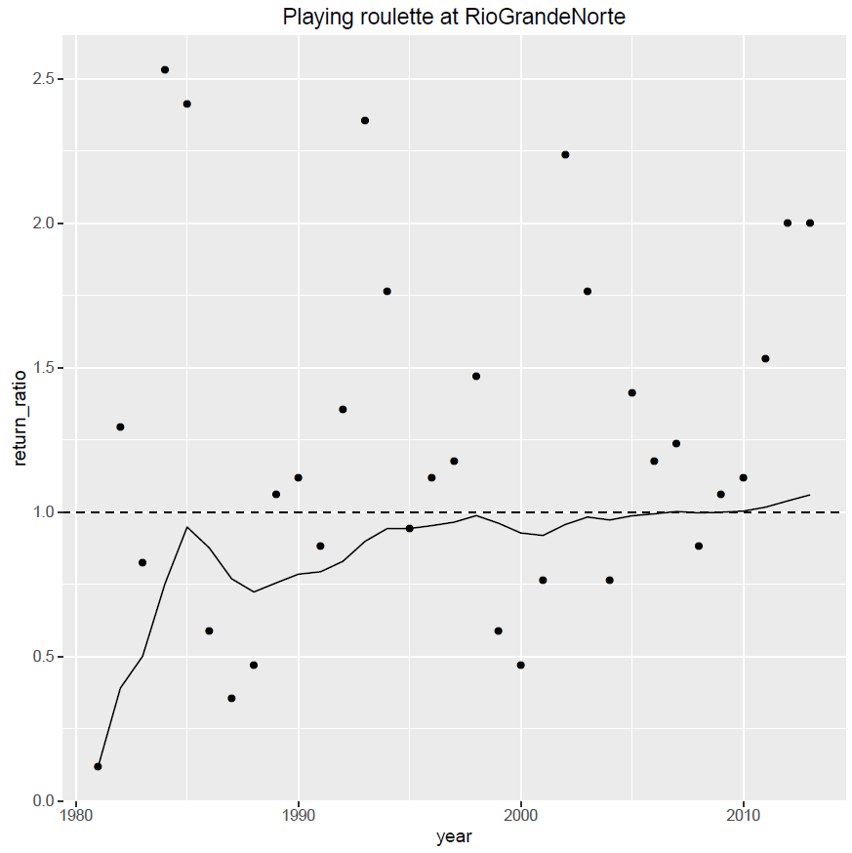
Introduction
Let’s Play!
Conclusions
Let’s Play!
Back to the map
See all results in a table
Skill score (RPSS) = 0.13
Return ratio = 1.059
Interest rate = 5.9%
From 10€ inverted,
66.8€ returned after 33 runs

Slide 18
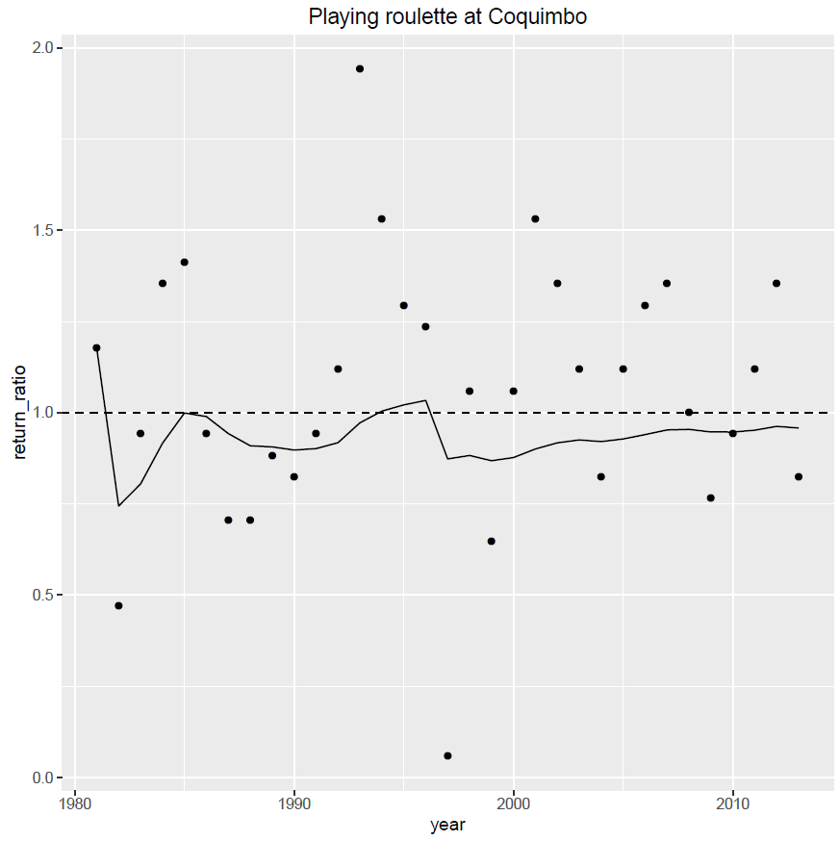
Introduction
Let’s Play!
Conclusions
Let’s Play!
Back to the map
See all results in a table
Skill score (RPSS) = 0.03
Return ratio = 0.958
Interest rate = -4.2%
From 10€ inverted,
2.4€ returned after 33 runs

Slide 19
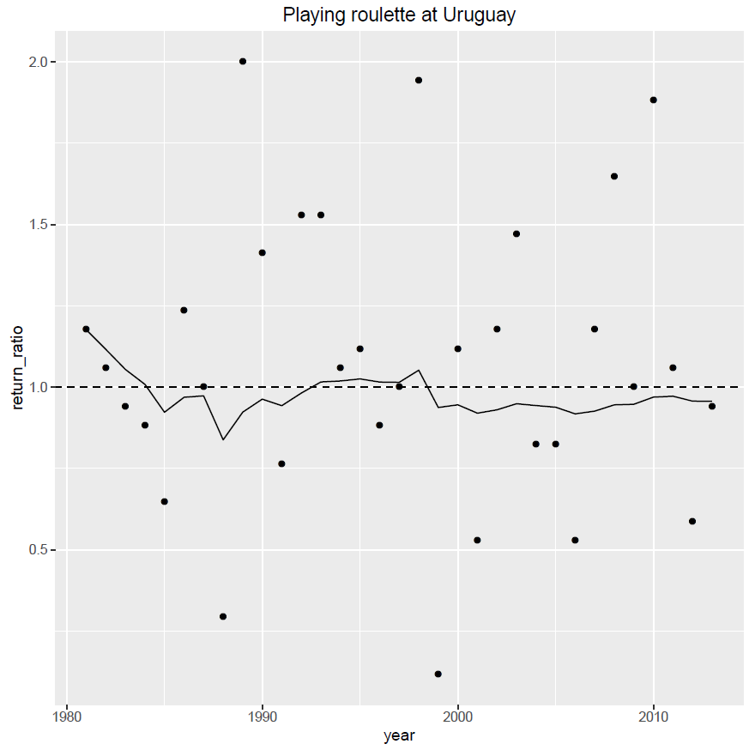
Introduction
Let’s Play!
Conclusions
Let’s Play!
Back to the map
See all results in a table
Skill score (RPSS) = -0.01
Return ratio = 0.956
Interest rate = -4.4%
From 10€ inverted,
2.3€ returned after 33 runs

Slide 20
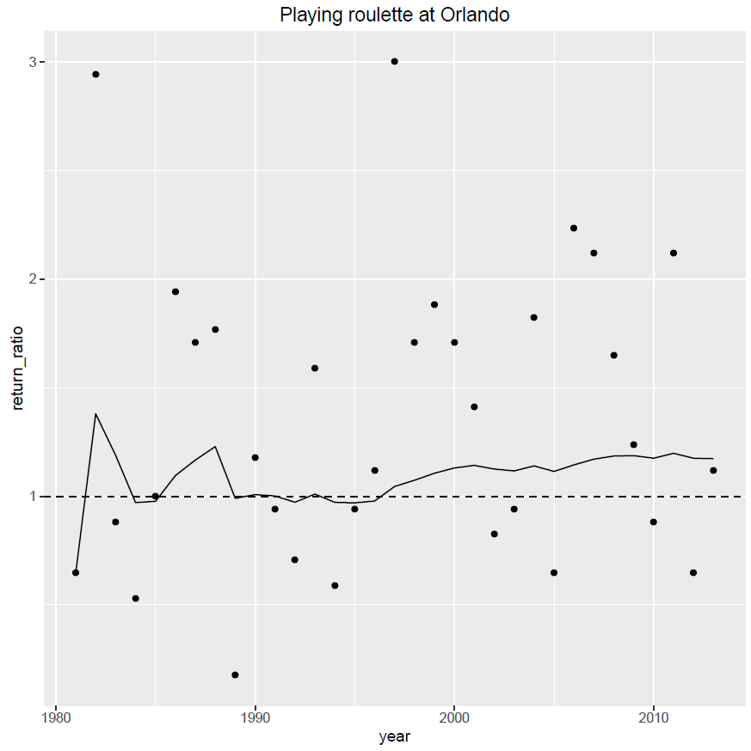
Introduction
Let’s Play!
Conclusions
Let’s Play!
Back to the map
See all results in a table
Skill score (RPSS) = 0.23
Return ratio = 1.173
Interest rate = 17.3%
From 10€ inverted,
1944€ returned after 33 runs

Slide 21
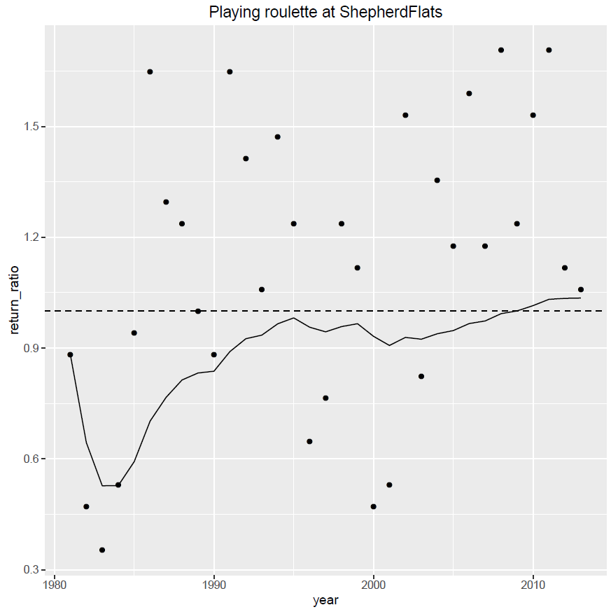
Introduction
Let’s Play!
Conclusions
Let’s Play!
Back to the map
See all results in a table
Skill score (RPSS) = 0.06
Return ratio = 1.035
Interest rate = 3.5%
From 10€ inverted,
31.5€ returned after 33 runs

Slide 22
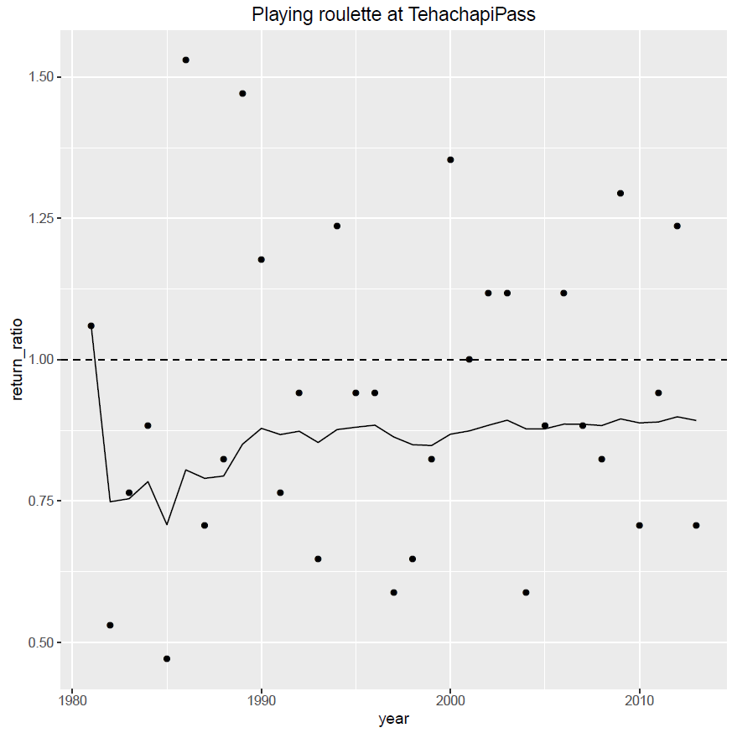
Introduction
Let’s Play!
Conclusions
Let’s Play!
Back to the map
See all results in a table
Skill score (RPSS) = -0.12
Return ratio = 0.892
Interest rate = -10.8%
From 10€ inverted,
20 cents returned after 33 runs

Slide 23
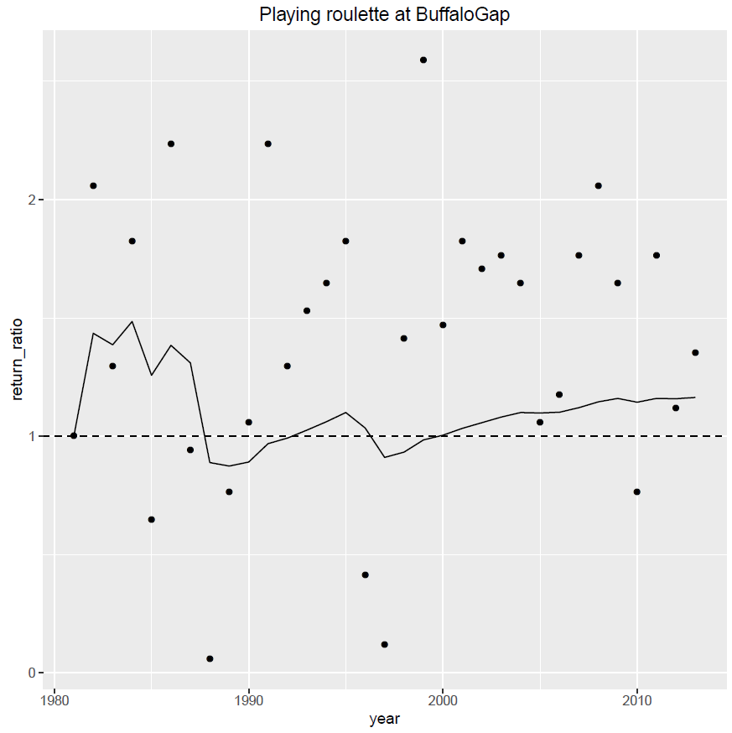
Introduction
Let’s Play!
Conclusions
Let’s Play!
Back to the map
See all results in a table
Skill score (RPSS) = 0.22
Return ratio = 1.164
Interest rate = 16.4%
From 10€ inverted,
1499 € returned after 33 runs

Slide 24
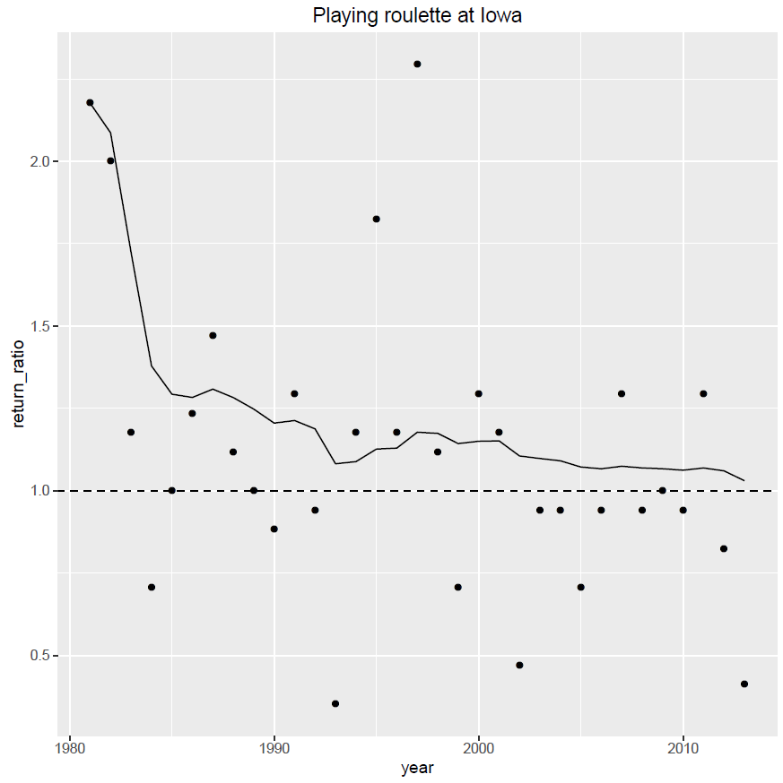
Introduction
Let’s Play!
Conclusions
Let’s Play!
Back to the map
See all results in a table
Skill score (RPSS) = 0.03
Return ratio = 1.031
Interest rate = 3.1%
From 10€ inverted,
27€ returned after 33 runs

Slide 25
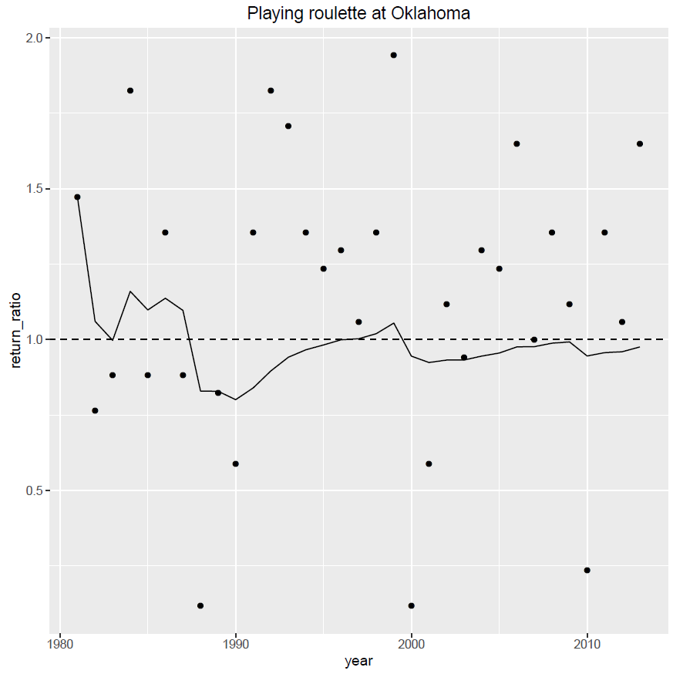
Introduction
Let’s Play!
Conclusions
Let’s Play!
Back to the map
See all results in a table
Skill score (RPSS) = 0.06
Return ratio = 0.976
Interest rate = -2.4%
From 10€ inverted,
4.4€ returned after 33 runs

Slide 26
Introduction
Let’s Play!
Conclusions
Let’s Play!
Back to the map
See all results in a table
Skill score (RPSS) = -0.07
Return ratio = 0.913
Interest rate = -8.7%
From 10€ inverted,
50 cents returned after 33 runs

Slide 27
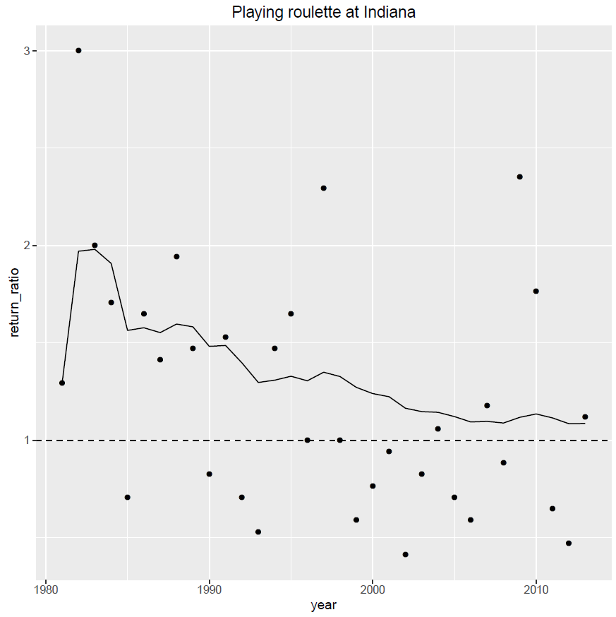
Introduction
Let’s Play!
Conclusions
Let’s Play!
Back to the map
See all results in a table
Skill score (RPSS) = 0.18
Return ratio = 1.086
Interest rate = 8.6%
From 10€ inverted,
150€ returned after 33 runs

Slide 28
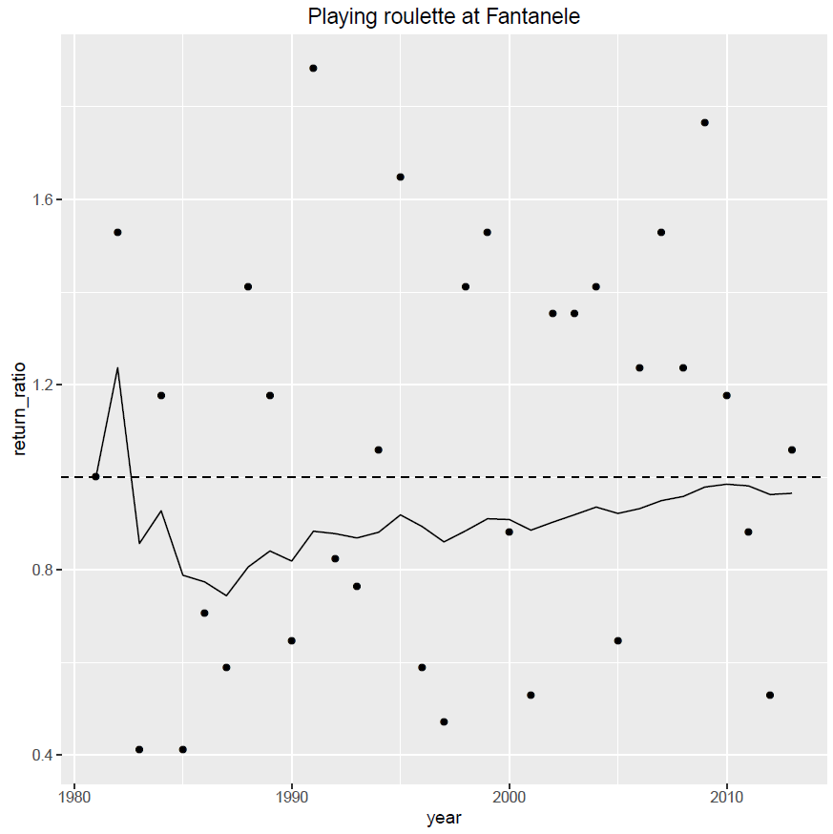
Introduction
Let’s Play!
Conclusions
Let’s Play!
Back to the map
See all results in a table
Skill score (RPSS) = -0.01
Return ratio = 0.966
Interest rate = -3.4%
From 10€ inverted,
3.1€ returned after 33 runs

Slide 29
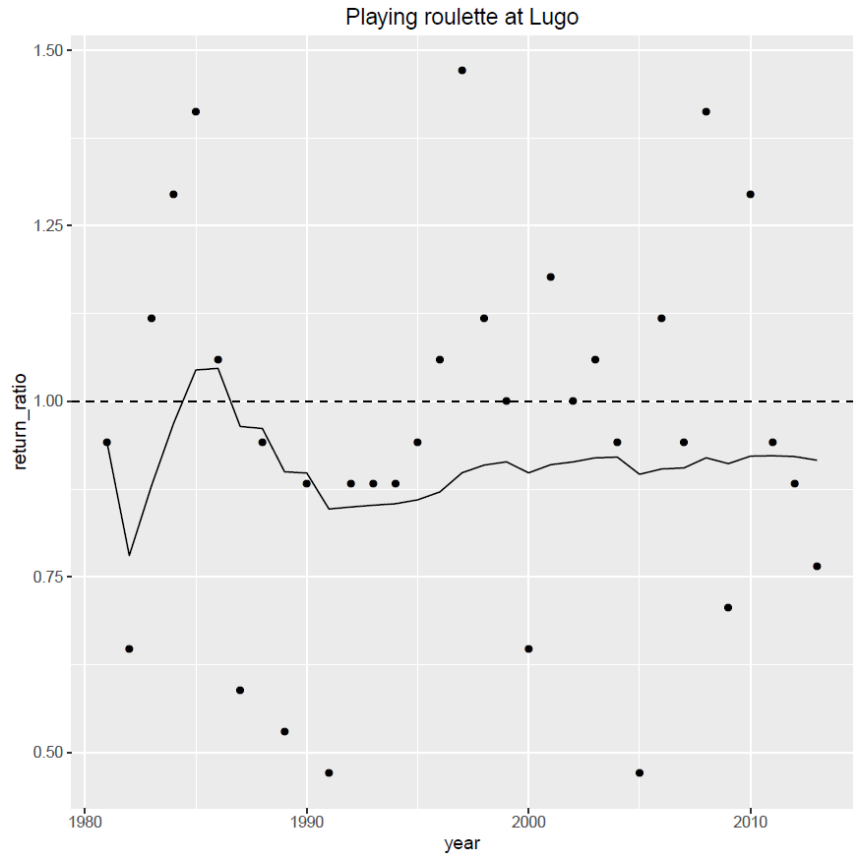
Introduction
Let’s Play!
Conclusions
Let’s Play!
Back to the map
See all results in a table
Skill score (RPSS) = -0.08
Return ratio = 0.916
Interest rate = -8.4%
From 10€ inverted,
60cent returned after 33 runs

Slide 30
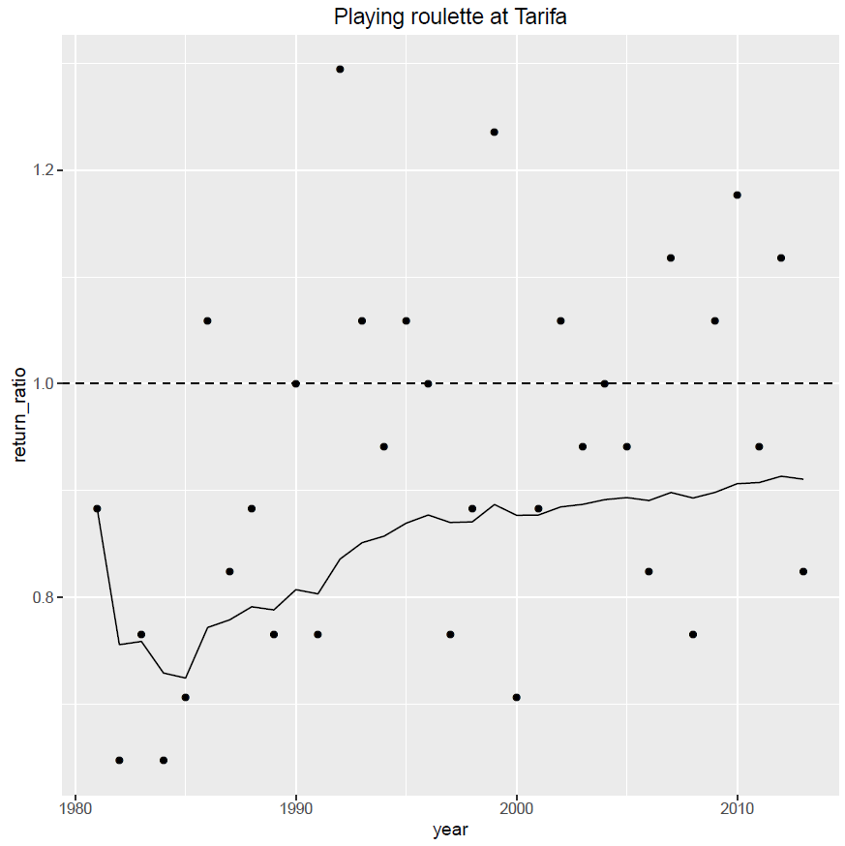
Introduction
Let’s Play!
Conclusions
Let’s Play!
Back to the map
See all results in a table
Skill score (RPSS) = -0.06
Return ratio = 0.910
Interest rate = -9%
From 10€ inverted,
50 cent returned after 33 runs

Slide 31
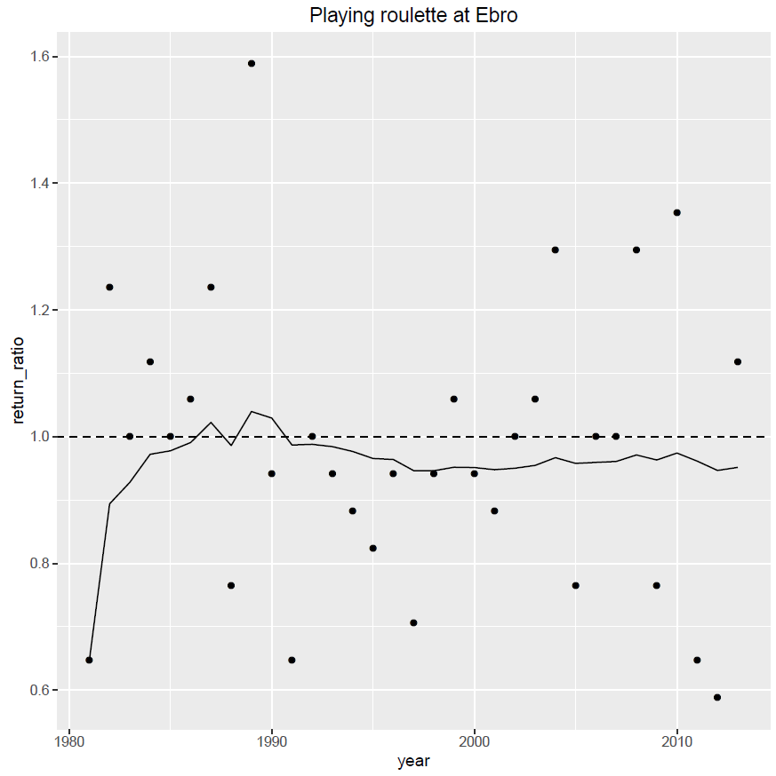
Introduction
Let’s Play!
Conclusions
Let’s Play!
Back to the map
See all results in a table
Skill score (RPSS) = -0.05
Return ratio = 0.952
Interest rate = -4.8%
From 10€ inverted,
1.9€ returned after 33 runs

Slide 32
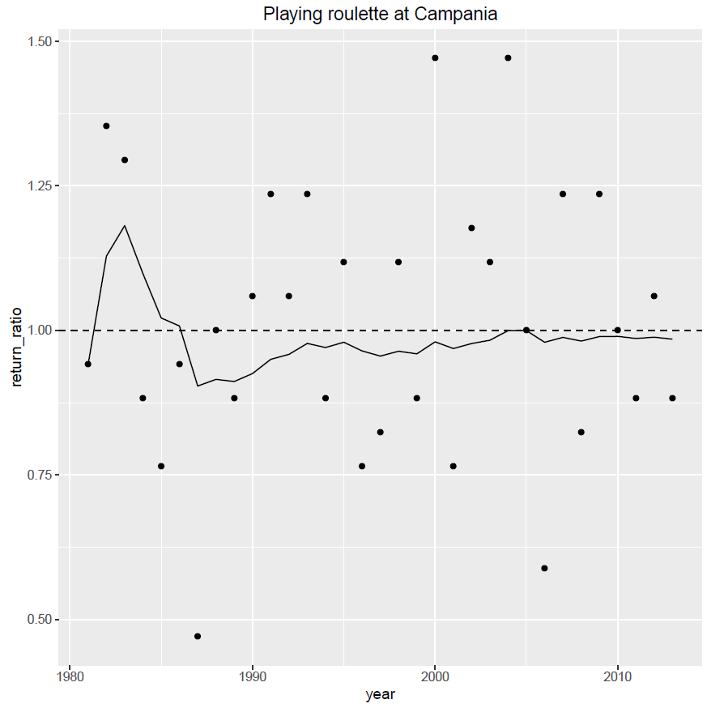
Introduction
Let’s Play!
Conclusions
Let’s Play!
Back to the map
See all results in a table
Skill score (RPSS) = -0.03
Return ratio = 0.985
Interest rate = -1.5%
From 10€ inverted,
6€ returned after 33 runs

Slide 33
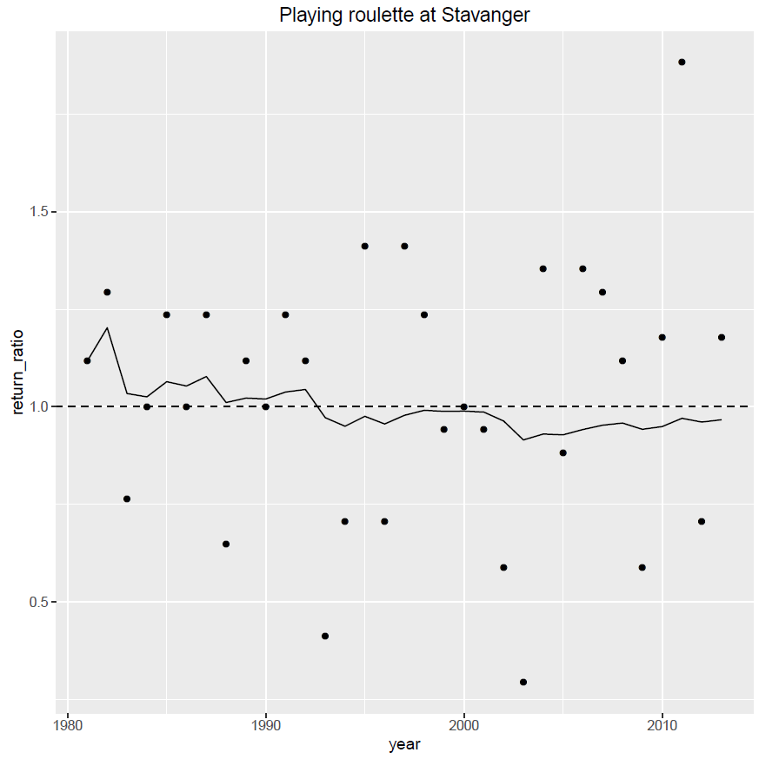
Introduction
Let’s Play!
Conclusions
Let’s Play!
Back to the map
See all results in a table
Skill score (RPSS) = -0.02
Return ratio = 0.967
Interest rate = -3.3%
From 10€ inverted,
3.3€ returned after 33 runs

Slide 34
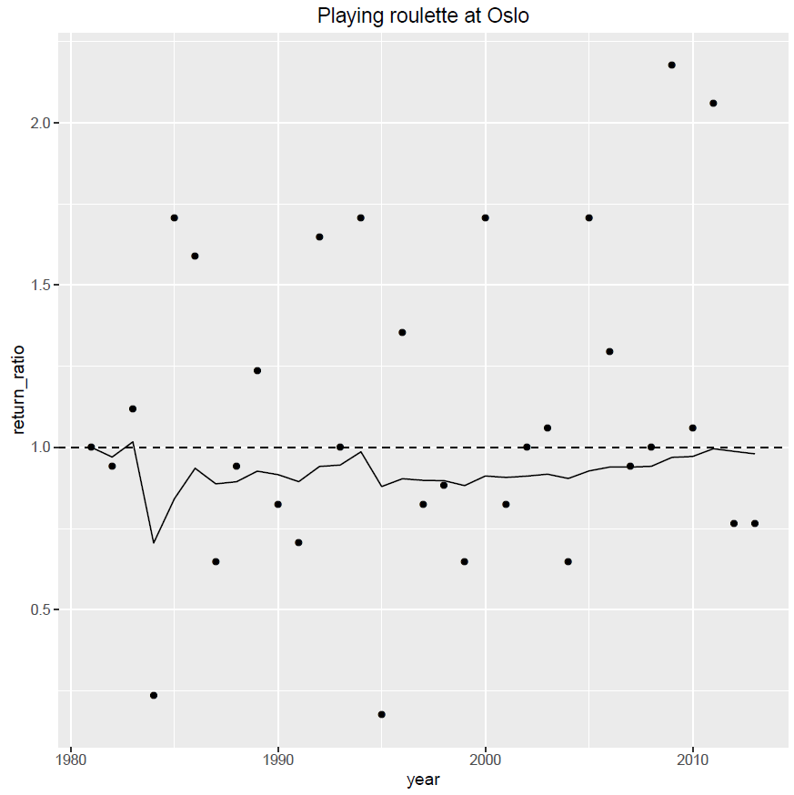
Introduction
Let’s Play!
Conclusions
Let’s Play!
Back to the map
See all results in a table
Skill score (RPSS) = 0.02
Return ratio = 0.98
Interest rate = -2%
From 10€ inverted,
5.1€ returned after 33 runs

Slide 35
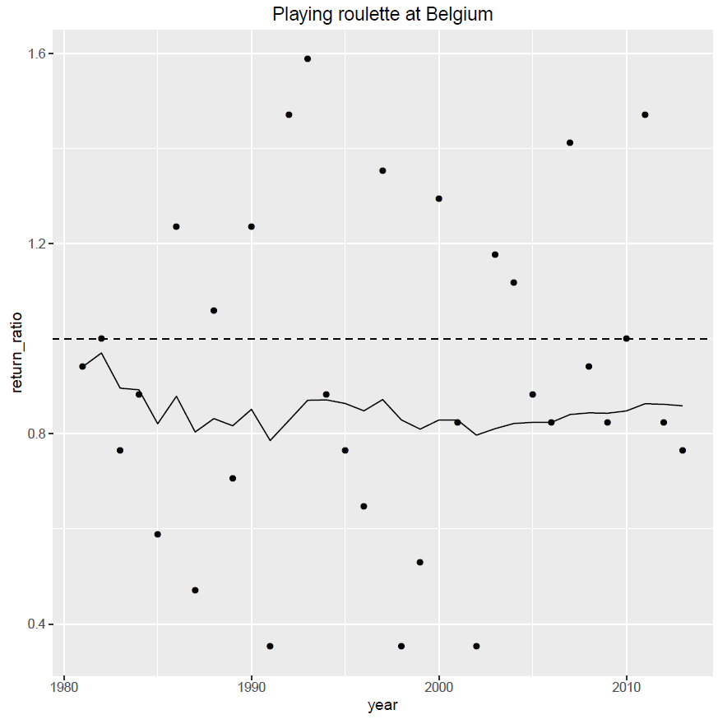
Introduction
Let’s Play!
Conclusions
Let’s Play!
Back to the map
See all results in a table
Skill score (RPSS) = -0.10
Return ratio = 0.859
Interest rate = -14.1%
From 10€ inverted,
10 cent returned after 33 runs

Slide 36
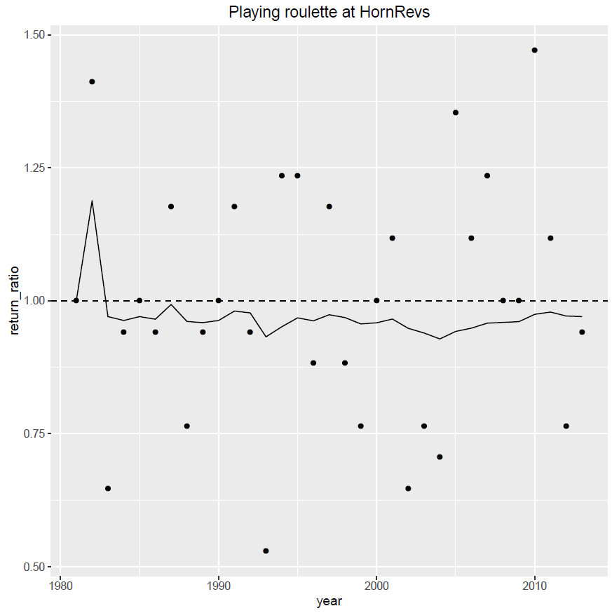
Introduction
Let’s Play!
Conclusions
Let’s Play!
Back to the map
See all results in a table
Skill score (RPSS) = -0.03
Return ratio = 0.970
Interest rate = -3%
From 10€ inverted,
3.7€ returned after 33 runs

Slide 37
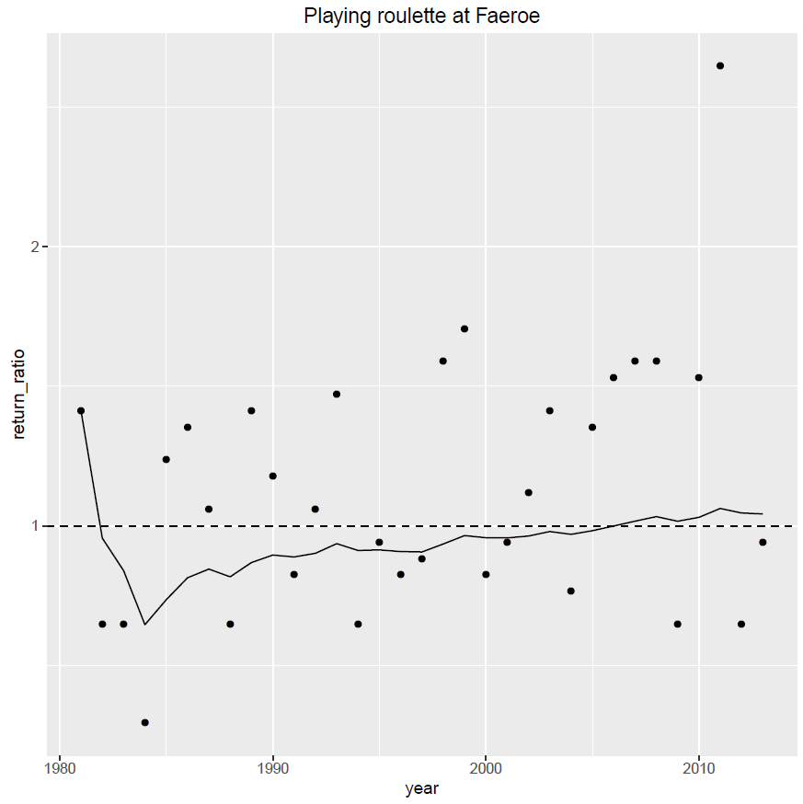
Introduction
Let’s Play!
Conclusions
Let’s Play!
Back to the map
See all results in a table
Skill score (RPSS) = 0.08
Return ratio = 1.043
Interest rate = 4.3%
From 10€ inverted,
39.6€ returned after 33 runs

Slide 38
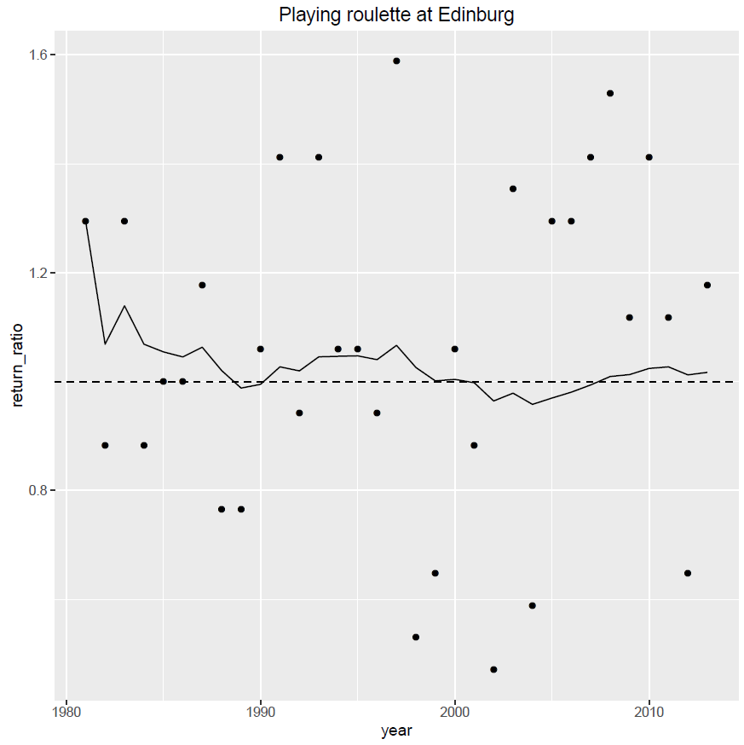
Introduction
Let’s Play!
Conclusions
Let’s Play!
Back to the map
See all results in a table
Skill score (RPSS) = 0.02
Return ratio = 1.017
Interest rate = 1.7%
From 10€ inverted,
17.4€ returned after 33 runs

Slide 39
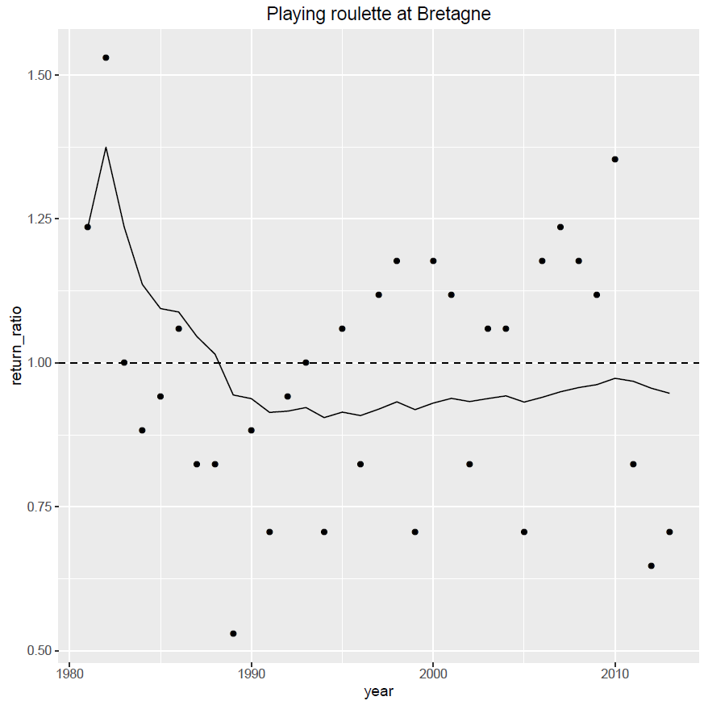
Introduction
Let’s Play!
Conclusions
Let’s Play!
Back to the map
See all results in a table
Skill score (RPSS) = -0.04
Return ratio = 0.947
Interest rate = -5.3%
From 10€ inverted,
1.7€ returned after 33 runs

Slide 40
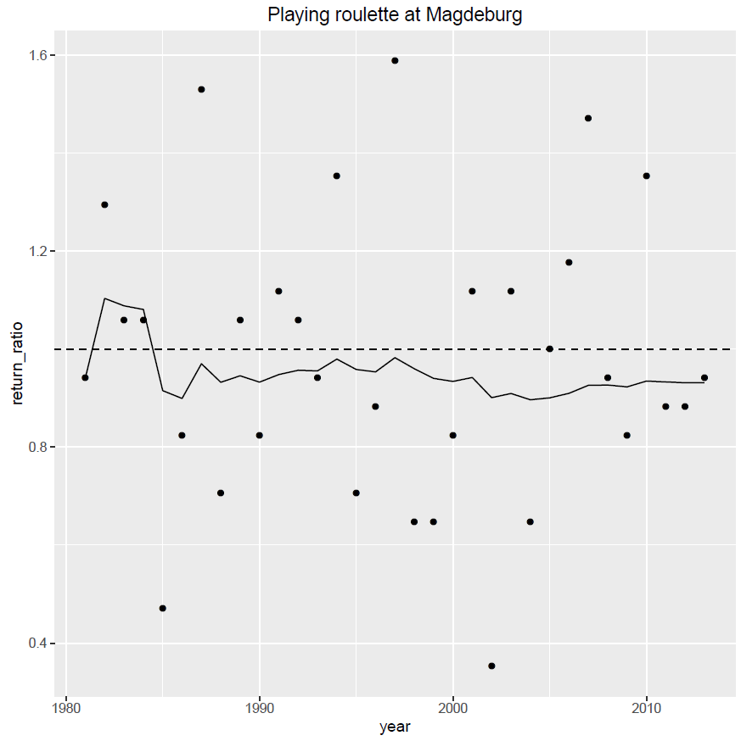
Introduction
Let’s Play!
Conclusions
Let’s Play!
Back to the map
See all results in a table
Skill score (RPSS) = -0.05
Return ratio = 0.932
Interest rate = -6.8%
From 10€ inverted,
1€ returned after 33 runs

Slide 41
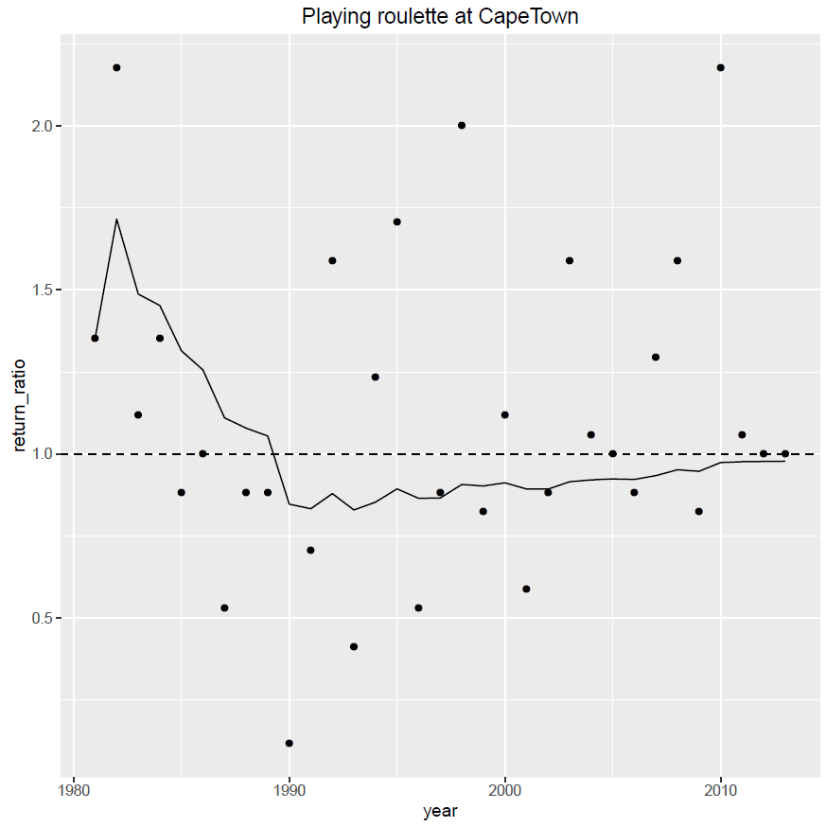
Introduction
Let’s Play!
Conclusions
Let’s Play!
Back to the map
See all results in a table
Skill score (RPSS) = -0.01
Return ratio = 0.978
Interest rate = -2.2%
From 10€ inverted,
4.8€ returned after 33 runs

Slide 42
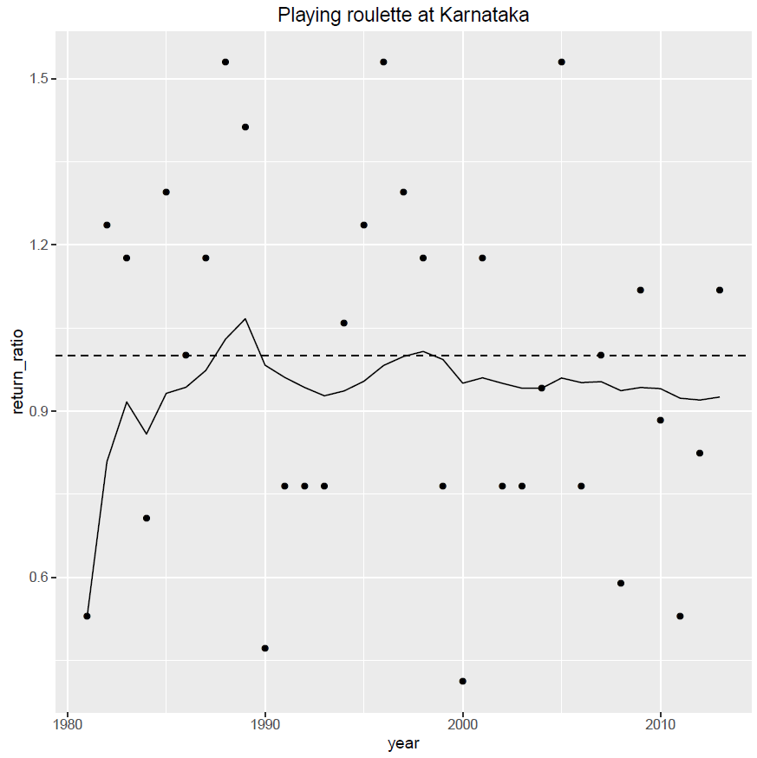
Introduction
Let’s Play!
Conclusions
Let’s Play!
Back to the map
See all results in a table
Skill score (RPSS) = -0.06
Return ratio = 0.925
Interest rate = -7.5%
From 10€ inverted,
80cent returned after 33 runs

Slide 43
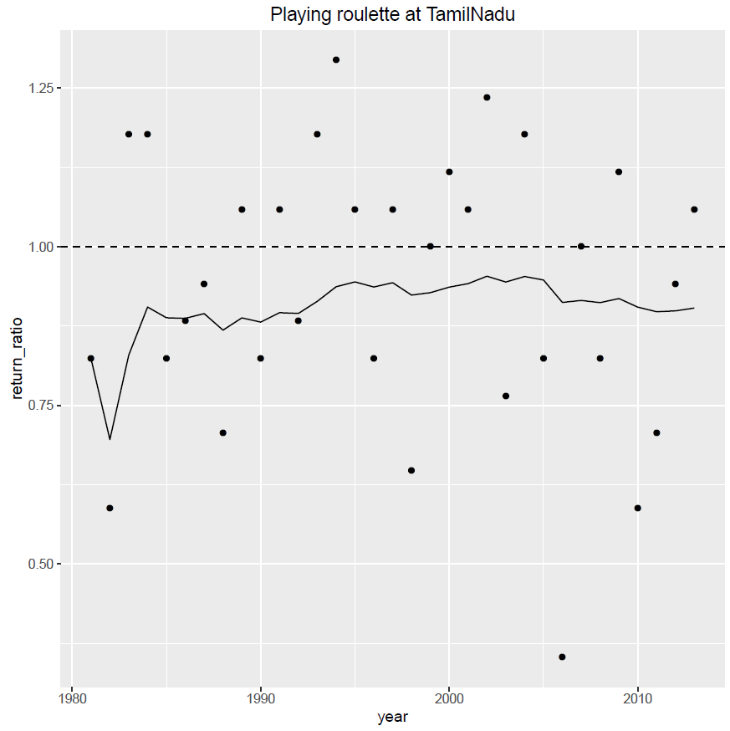
Introduction
Let’s Play!
Conclusions
Let’s Play!
Back to the map
See all results in a table
Skill score (RPSS) = -0.1
Return ratio = 0.903
Interest rate = -9.7%
From 10€ inverted,
30cent returned after 33 runs

Slide 44
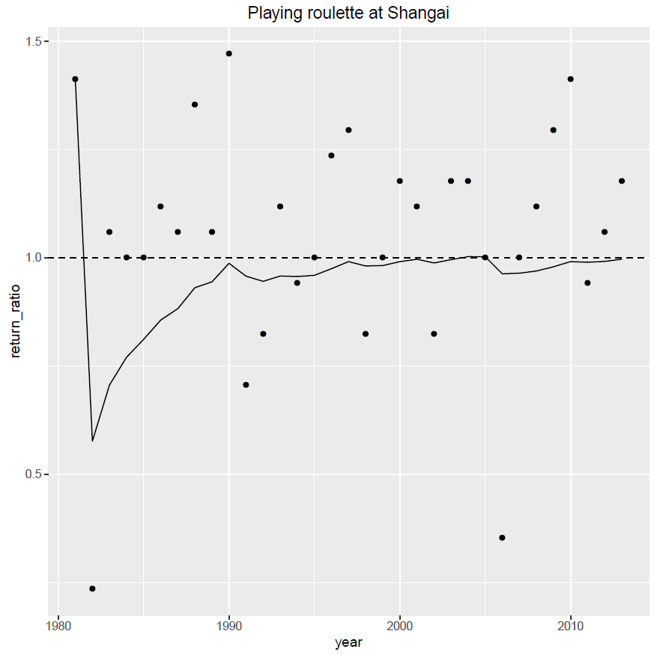
Introduction
Let’s Play!
Conclusions
Let’s Play!
Back to the map
See all results in a table
Skill score (RPSS) = 0
Return ratio = 0.997
Interest rate = -0.3%
From 10€ inverted,
8.9€ returned after 33 runs

Slide 45
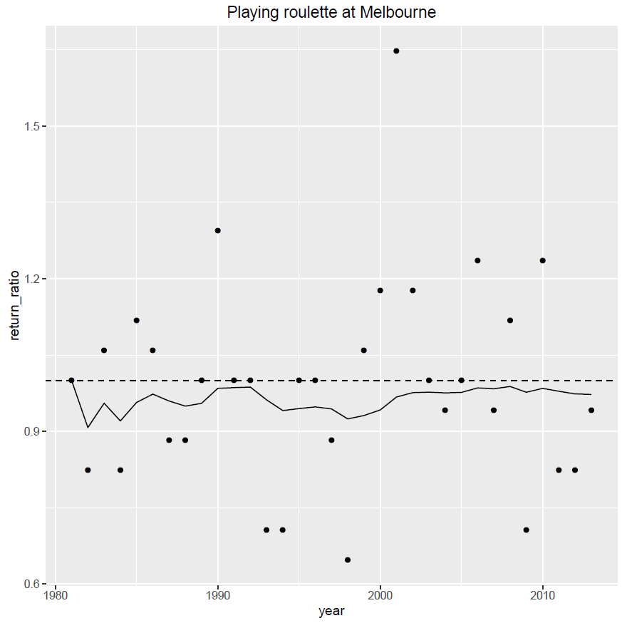
Introduction
Let’s Play!
Conclusions
Let’s Play!
Back to the map
See all results in a table
Skill score (RPSS) = -0.06
Return ratio = 0.973
Interest rate = -2.7%
From 10€ inverted,
4€ returned after 33 runs

Slide 46
Introduction
Let’s Play!
Conclusions
Wind farms in areas with Skill scores >0
Let’s Play!
Back to the map
Name | Country | ISS | RPSS | Return ratio | Interest rate | Capital
SWGalapagos | Niño | 0,41544854 | 0,55 | 1,578 | 57,8% | 34772654,8
Guajira | Colombia | 0,25282698 | 0,35 | 1,320 | 32,0% | 95666,8
Talara | Perú | 0,18957353 | 0,29 | 1,232 | 23,2% | 9656,8
Orlando | USA, Florida | 0,14536596 | 0,23 | 1,173 | 17,3% | 1944,4
BuffaloGap | USA, Texas | 0,13818133 | 0,22 | 1,164 | 16,4% | 1498,5
Indiana | USA, Indiana | 0,07474927 | 0,18 | 1,086 | 8,6% | 150,3
Galapagos | Ecuador | 0,0692019 | 0,12 | 1,079 | 7,9% | 122,9
RioGrandeNorte | Brazil | 0,05236713 | 0,13 | 1,059 | 5,9% | 66,8
Faeroe | Faeroe | 0,03794958 | 0,08 | 1,043 | 4,3% | 39,6
ShepherdFlats | USA, Oregon | 0,0316247 | 0,06 | 1,035 | 3,5% | 31,5
Iowa | USA, Iowa | 0,02736987 | 0,03 | 1,031 | 3,1% | 27,0
Marcona | Perú | 0,0217341 | 0,08 | 1,024 | 2,4% | 22,0
Edinburg | UK | 0,01523402 | 0,02 | 1,017 | 1,7% | 17,4
Next

Slide 47
Introduction
Let’s Play!
Conclusions
Let’s Play!
Wind farms in areas with Skill scores ≤0
Back to the map
Name | Country | ISS | RPSS | Return ratio | Interest rate | Capital
Guanacaste | CostaRica | 0,00465578 | 0,00 | 1,005 | 0,5% | 11,8
Shangai | China | -0,00309463 | 0,00 | 0,997 | -0,3% | 8,9
Campania | Italy | -0,01394017 | -0,03 | 0,985 | -1,5% | 6,0
Oslo | Finland | -0,01839976 | 0,02 | 0,980 | -2,0% | 5,1
CapeTown | SouthAfrica | -0,02031751 | -0,01 | 0,978 | -2,2% | 4,8
Oklahoma | USA, Oklahoma | -0,02249513 | 0,06 | 0,976 | -2,4% | 4,4
Melbourne | Australia | -0,02526114 | -0,06 | 0,973 | -2,7% | 4,0
HornRevs | Denmark | -0,0274035 | -0,03 | 0,970 | -3,0% | 3,7
Stavanger | Norway | -0,03060747 | -0,02 | 0,967 | -3,3% | 3,3
Fantanele | Rumania | -0,03187434 | -0,01 | 0,966 | -3,4% | 3,1
Coquimbo | Chile | -0,03921145 | 0,03 | 0,958 | -4,2% | 2,4
Uruguay | Uruguay | -0,04051668 | -0,01 | 0,956 | -4,4% | 2,3
Ebro | Spain | -0,04524107 | -0,05 | 0,952 | -4,8% | 1,9
Bretagne | France | -0,04945709 | -0,04 | 0,947 | -5,3% | 1,7
Magdeburg | Germany | -0,06432401 | -0,05 | 0,932 | -6,8% | 1,0
Karnataka | India | -0,07067669 | -0,06 | 0,925 | -7,5% | 0,8
LaVentosa | México | -0,07242712 | -0,09 | 0,924 | -7,6% | 0,7
Lugo | Spain | -0,07977718 | -0,08 | 0,916 | -8,4% | 0,6
Appalachian | USA, Pennsilvania | -0,08252204 | -0,07 | 0,913 | -8,7% | 0,5
RioGrandeSur | Brazil | -0,08360425 | 0,01 | 0,912 | -8,8% | 0,5
Tarifa | Spain | -0,08534977 | -0,06 | 0,910 | -9,0% | 0,5
TamilNadu | India | -0,09253552 | -0,10 | 0,903 | -9,7% | 0,3
TehachapiPass | USA, California | -0,1036274 | -0,12 | 0,892 | -10,8% | 0,2
Belgium | Belgium | -0,13830422 | -0,10 | 0,859 | -14,1% | 0,1
Back

Slide 48
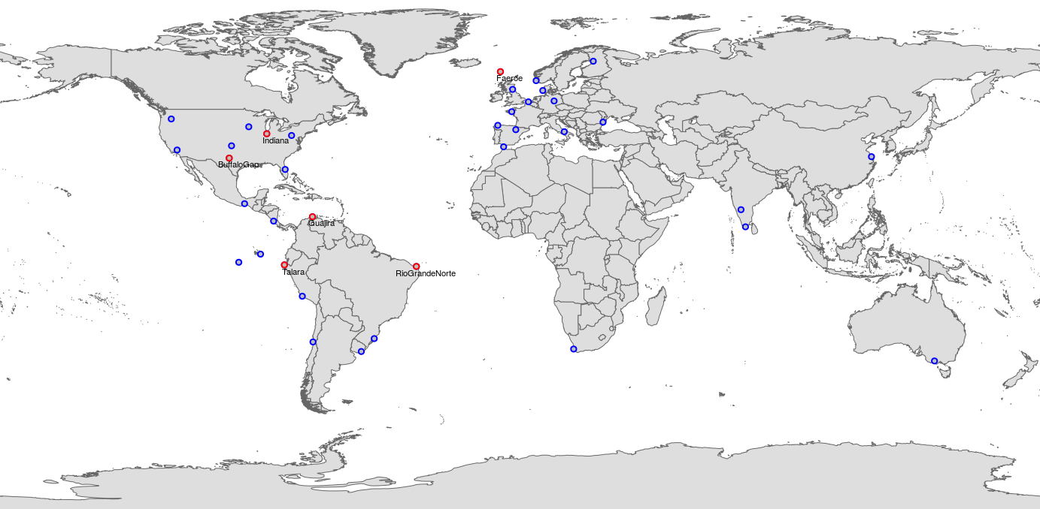
Introduction
Let’s Play!
Conclusions
It is common practice in the energy sector to make assessments in portfolios in order to reduce the variability of individual sites
Let’s Play!
Back to single wind farm game
Let’s play in this portfolio!
From the list of 37 wind farms we have selected a portfolio of 6 wind farms with skill over 0.08
we have bet 10€ in each wind farm
After each run, the benefits are equally reinvested in the 6 wind farms
Let’s play
in this portfolio!

Slide 49
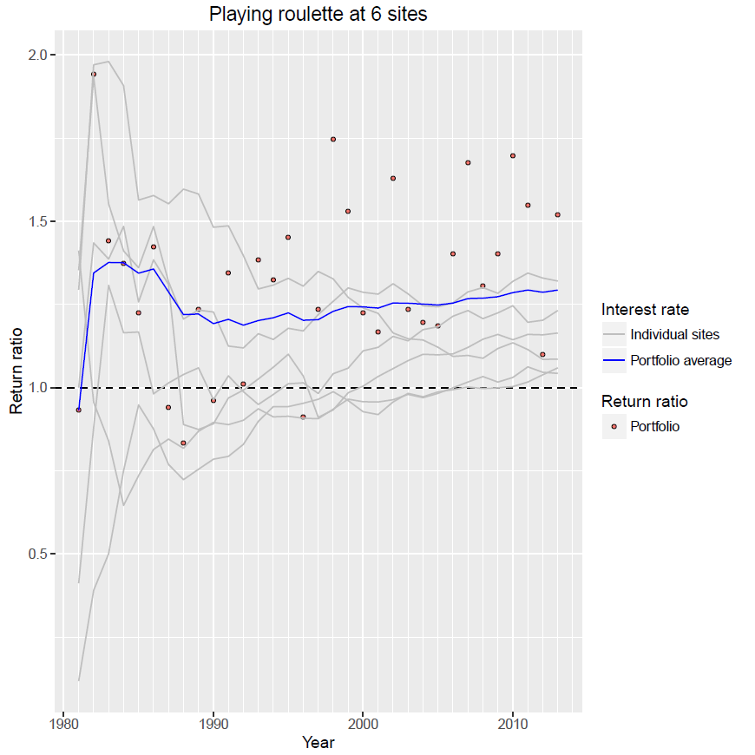
Introduction
Let’s Play!
Conclusions
Let’s Play!
Back to the map
See portfolio result in a table
Skill score (RPSS)
from 0.08 to 0.35
Return ratio = 1.29
Interest rate = 29%
From 60€ inverted,
289 314€ returned after 33 runs
A portfolio assessment usually outperforms individual forecasts when the model errors are uncorrelated. Because this uncorrelation leads to compensation of errors.

Slide 50
Introduction
Let’s Play!
Conclusions
Name | Country | ISS | RPSS | Return ratio | Interest rate | Capital
Guajira | Colombia | 0,252827 | 0,35 | 1,320 | 32,0% | 95667
Talara | Perú | 0,189574 | 0,29 | 1,232 | 23,2% | 9657
BuffaloGap | USA, Texas | 0,138181 | 0,22 | 1,164 | 16,4% | 1499
Indiana | USA, Indiana | 0,074749 | 0,18 | 1,086 | 8,6% | 150
RioGrandeNorte | Brazil | 0,052367 | 0,13 | 1,059 | 5,9% | 67
Faeroe | Faeroe | 0,03795 | 0,08 | 1,043 | 4,3% | 40
 |  |  |  |  | Sum of individual games | 107079
 |  |  |  |  | PORTFOLIO GAME | 289314
A portfolio assessment usually outperforms individual forecasts when the model errors are uncorrelated. This happens uncorrelation leads to compensation of errors.
Back

Slide 51
Introduction
Let’s Play!
Conclusions
One single prediction is not representative of the performance of climate predictions even if it is from an area where the model has skill.
Skill is the scientific approach to assess a model performance, however weather roulette translation in interest rate provides a more familiar way of interpreting probabilistic predictions in terms of economic value.
A portfolio assessment usually outperforms individual forecasts when the model errors are uncorrelated. This leads to compensation of errors.
As long as the user choses areas with skill climate predictions will be better
We encourage energy users to adopt climate predictions in the areas that have skill. In the long run it will help them to increase the benefits.
This work will be further developed into an App within the project EUPORIAS
If you want to have more information contact us at info-services-es@bsc.es
The research leading to these results has received funding from the EU Seventh Framework Programme (FP7) under grant agreement n° 308291 and from the Ministerio de Economía y Competitividad (MINECO) as part of the RESILIENCE project CGL2013-41055-R

Slide 52
Introduction
Let’s Play!
Conclusions
Introduction
Climate predictions can provide new insights in the future variability of climate from sub-seasonal to decadal time scales.
This information can potentially benefit the wind energy sector.
However, current energy practice relies on climatology to estimate what is going to happen in the future. Assuming that future conditions will be similar to the past.
Not taking into account extreme events, limited information of the past, variability in past conditions or climate change.
User needs & seasonal pred.
Weather Roulette information
Next

Slide 53
Introduction
Let’s Play!
Conclusions
Introduction
A CLIMATE SERVICE FOR WIND INDUSTRY
RESILIENCE is a semi-operational prototype that provides seasonal wind speed predictions for the energy sector.
Based on ECMWF S4 data, seasonal predictions are tailored and post-procecessed into a final service (more info in project-ukko.net and resilience.euporias.eu)
However, to foster the adoption of new technology we have to demonstrate the value of the predictions compared to climatology
This is currently done with skill scores but… Is there a better way to present this to users? How can we improve the communication of probabilistic predictions?
User needs & seasonal pred.
Weather Roulette information
Next

Slide 54
Introduction
Let’s Play!
Conclusions
Introduction
Understanding and quantifying wind resources is a key element to multiple user profiles in the wind energy sector both in pre and post-construction.
Site selection
Resource assessment for the windfarm lifetime (ca. 15 years)
Operation & Maintenance
Energy trading
…
User needs & seasonal pred.
Weather Roulette information
WHY is not used? (or at least generate interest?)
There are many factors: Untailored and complex information, difficulties to access data and its interpretation, lack of integration with the decisions making processes, etc.
Need for Climate Services

