Slide 1
High-resolution SDS forecast requirements for the Middle East
Sara Basart (sara.basart@bsc.es)
A. Vukovic, L. Vendrell, C. Pérez García-Pando and O. Jorba
5th International Workshop on SDS, 23-25 October 2017, Istanbul

Slide 2
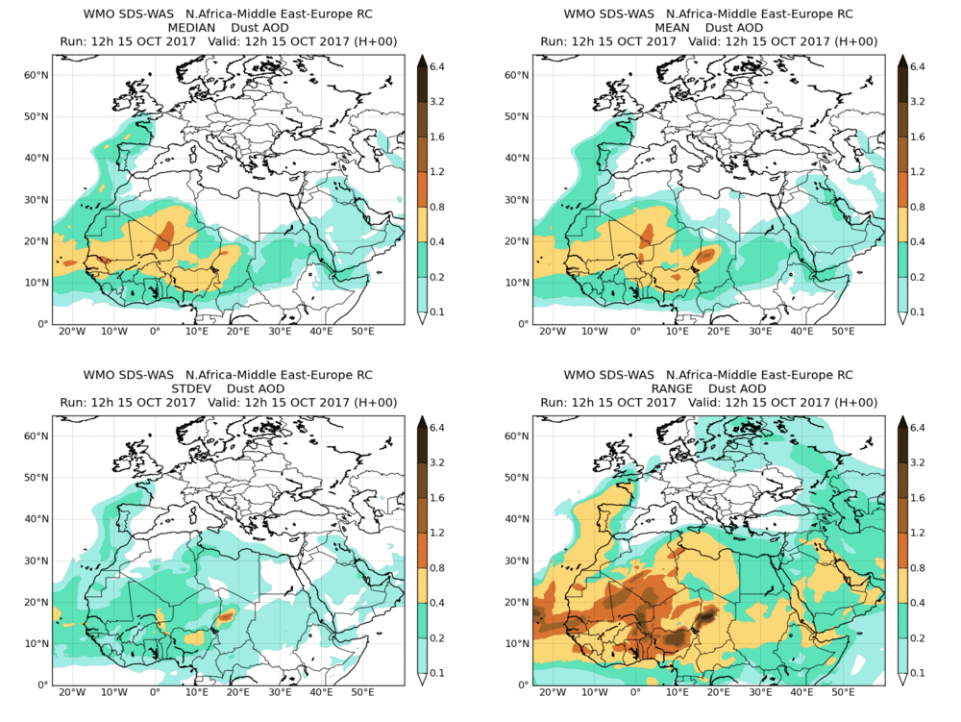
Dust forecasts: SDS-WAS Multi-model
SDS-WAS product
12 Global – Regional models
(from ~ 100 to 10 km)

Slide 3
Dust forecasts: SDS-WAS Multi-model
Dust-filtered AERONET evaluation for 2016
 | NDATA | r | RMSE | MB | MAE
Directsun Version 3 Level 1.5 (dust filter based on AE < 0.75 is DOD and AE > 1.2 DOD = 0)
Sahel/Sahara | 8104 | 0.78 | 0.27 | -0.12 | 0.15
Middle East | 1744 | 0.63 | 0.22 | -0.07 | 0.15
Mediterranean | 10469 | 0.85 | 0.08 | -0.02 | 0.05
All sites | 20795 | 0.84 | 0.19 | -0.06 | 0.10
O’Neill Version 3 Level 1.5 (only coarse fraction)
Sahel/Sahara | 4599 | 0.80 | 0.17 | -0.02 | 0.09
Middle East | 2272 | 0.64 | 0.15 | 0.01 | 0.08
Mediterranean | 13318 | 0.84 | 0.06 | -0.02 | 0.04
All sites | 20189 | 0.83 | 0.11 | -0.02 | 0.06

Slide 4
Dust forecasts: SDS-WAS Multi-model
Kuwait University AERONET site
Meteorolgy
Topography - Complex terrains
Smaller-scales phenomena (i.e. mesoscale convective systems and sea-breezes)
Dust emissions
Identification of dust sources – Land uses databases
IMS-METU-ERDEMLI AERONET site

Slide 5
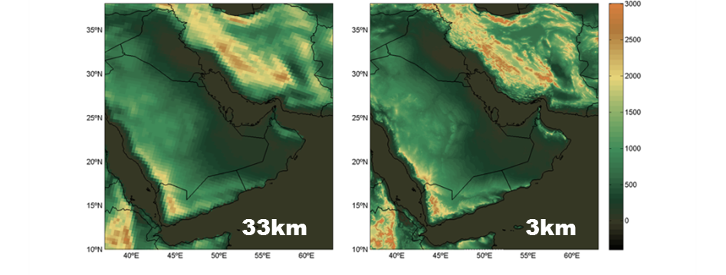
Topographical impacts on dust transport
33km
3km
TIP: Choose domain, resolution and output frequency wisely!
Increase 2X horizontal resolution, computing time increases 8X (on the same number of processors).
→ Double the number of vertical levels is additional 2X.
Two simulations using the NMMB/BSC-Dust model (the mineral dust module of the NMMB-MONARCH model) demonstrates results demonstrate how the dust prediction in the vicinity of complex terrains improves using high-horizontal resolution simulations.
Model configuration: LR (0.33º, ~33km), HR (0.03º, ~3km), 40 levels, FNL as meteo. Initial conditions
Forecast time: 10 – 21 March 2012
(Basart et al., Aeolian Research, 2016)

Slide 6
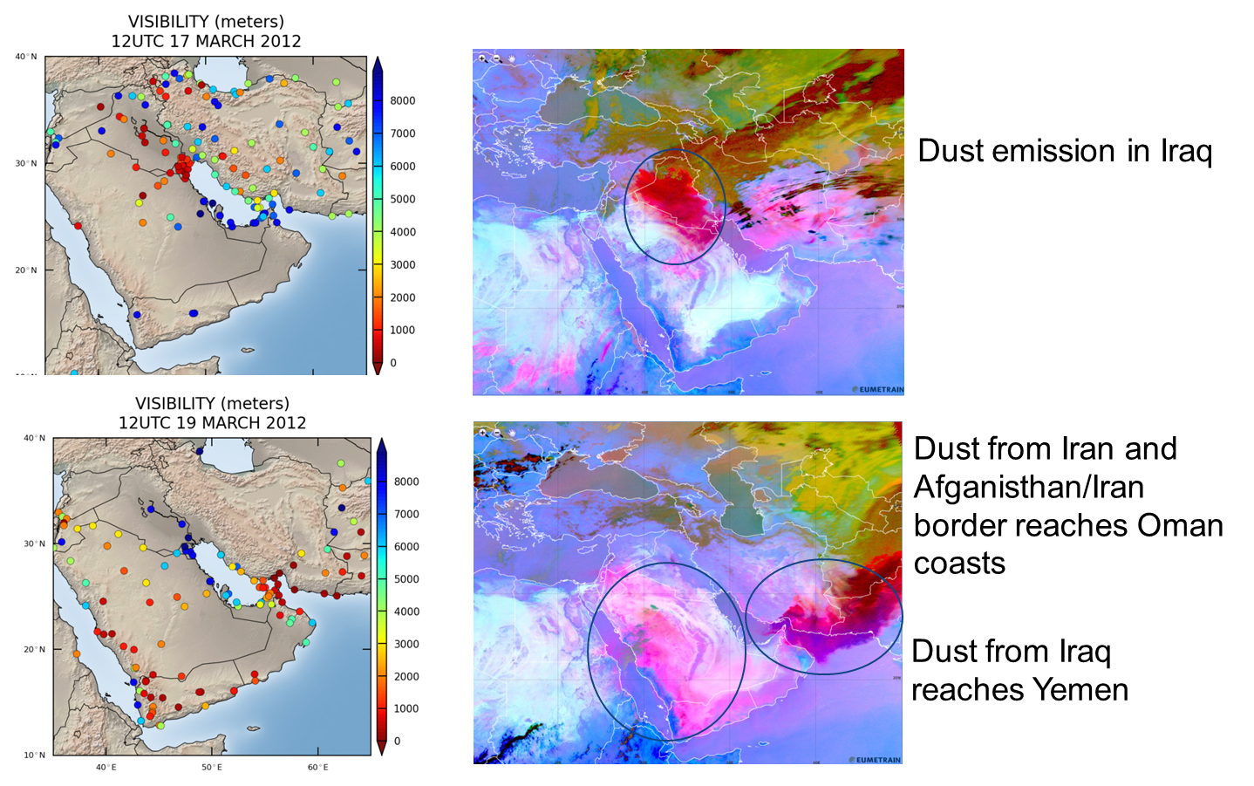
Topographical impacts on transport
Dust event on March 2012
(Basart et al., Aeolian Research, 2016)

Slide 7
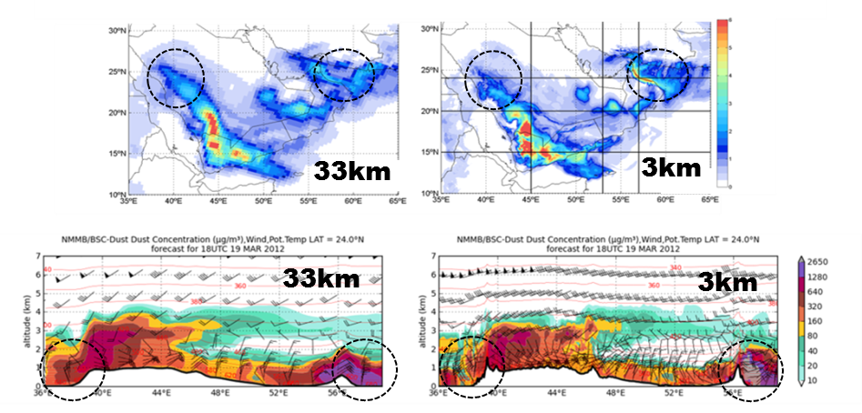
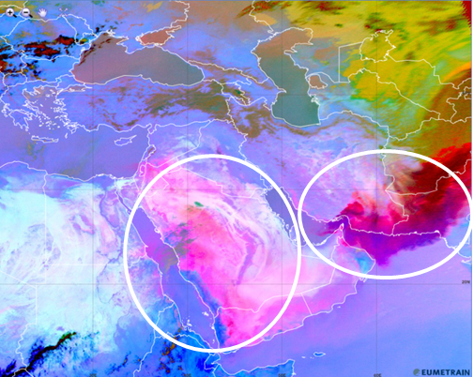
Topographical impacts on dust transport
NMMB/BSC-Dust 19-March-2012 18UTC
33km
3km
MSG RGB 19-March at 12 UTC
(Basart et al., Aeolian Research, 2016)

Slide 8
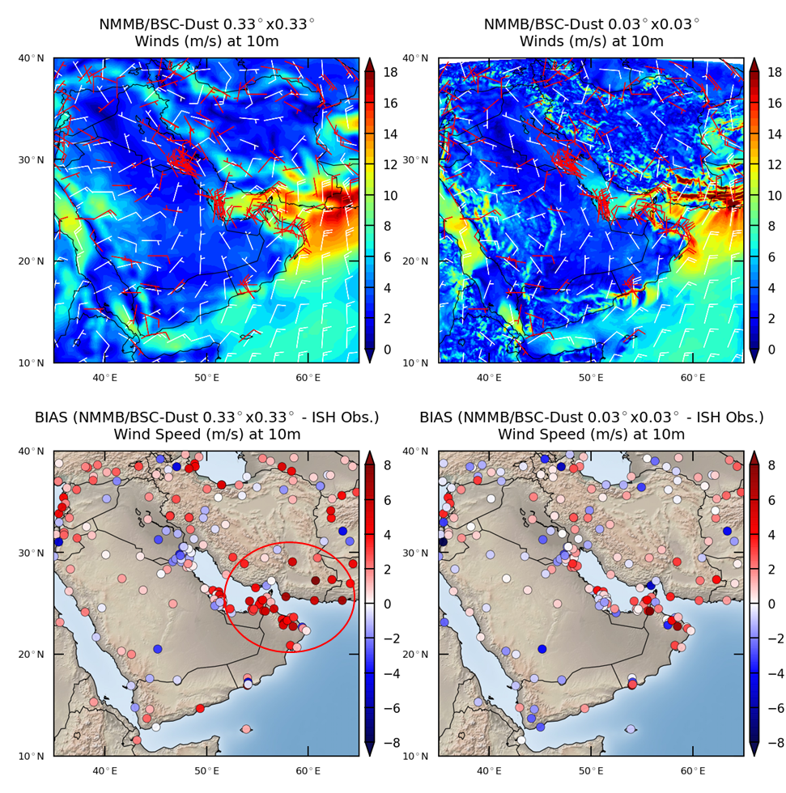
Topographical impacts on dust transport
NMMB/BSC-Dust 19-March-2012 21UTC
(Basart et al., Aeolian Research, 2016)

Slide 9
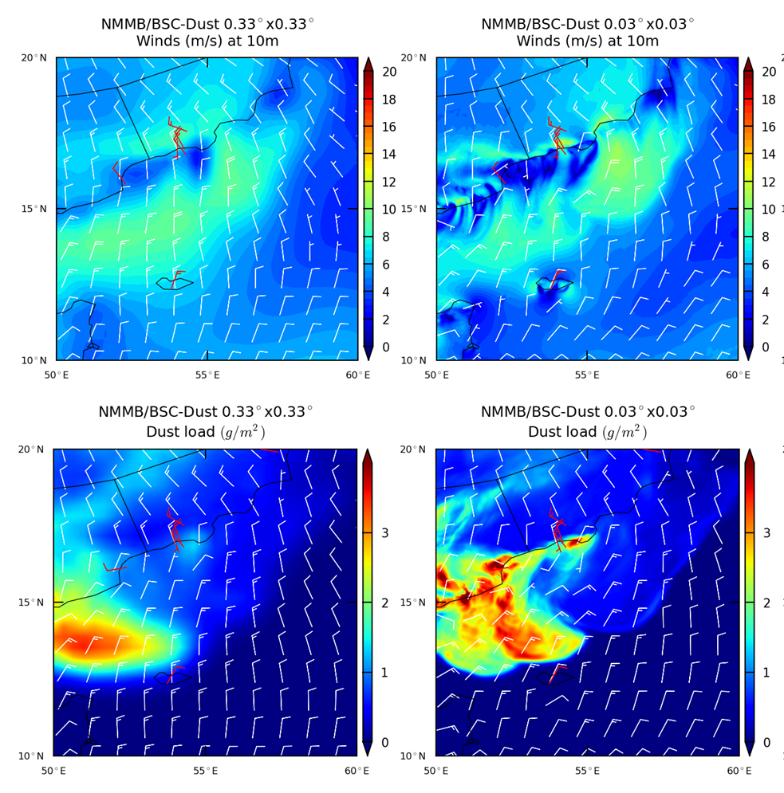
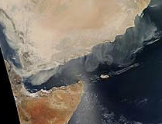
Topographical impacts on dust transport
NMMB/BSC-Dust 20-March-2012 12UTC
MODIS 10:40 UTC
(Basart et al., Aeolian Research, 2016)

Slide 10
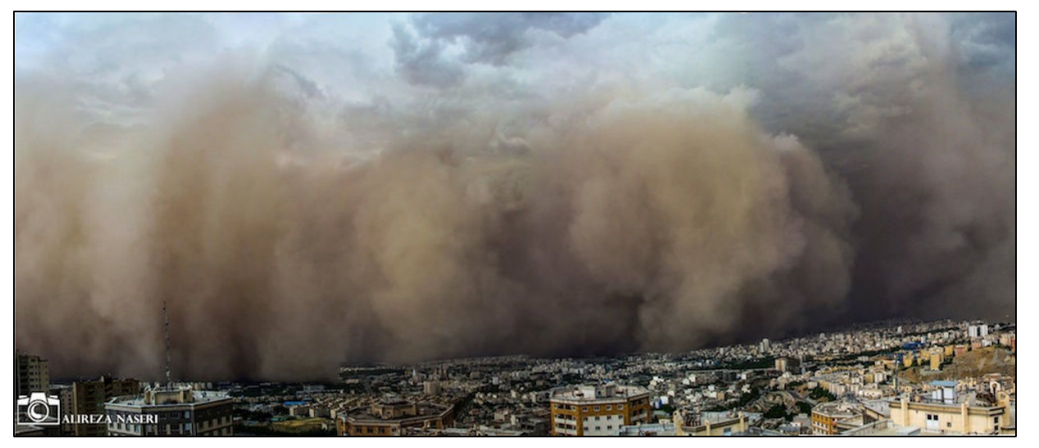
Iranian Haboob: Teheran 2nd June 2014
Ongoing SDS-WAS Study Case
The event was local (several 100km), intense (several 1000μg/m³ PM10) & short lived (few hours) dust storms
(Vukovic et al., in preparation)

Slide 11
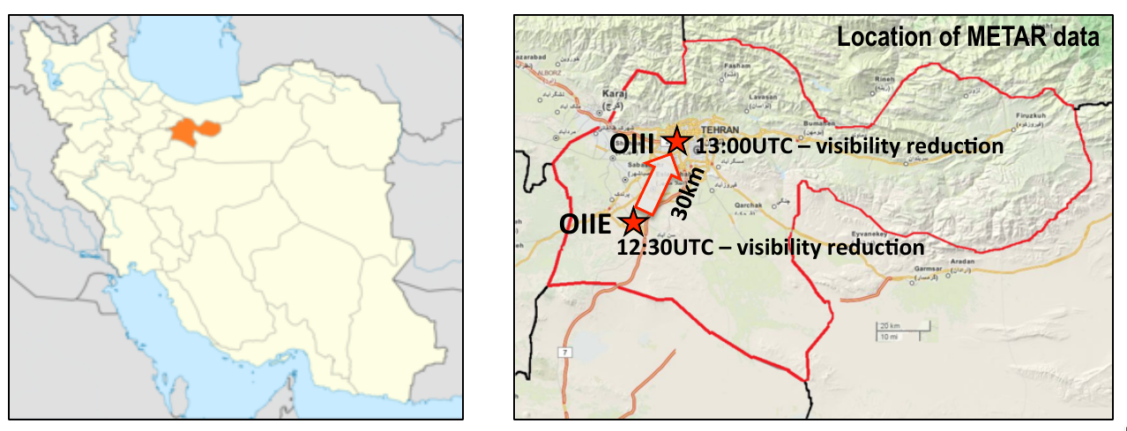
Iranian Haboob: Teheran 2nd June 2014
Information from reports
reached city at 5.30 p.m. local time;
passing of the sand storm over the fixed site lasted about 15min;
storm duration less than 2h;
reduction of visibility to ~10m; wind velocity reached 110 km/h;
temperature dropped from 33 to 18ºC in several min;
at least 5 deaths, 82 injured; multiple vehicle collision;
(Vukovic et al., in preparation)

Slide 12
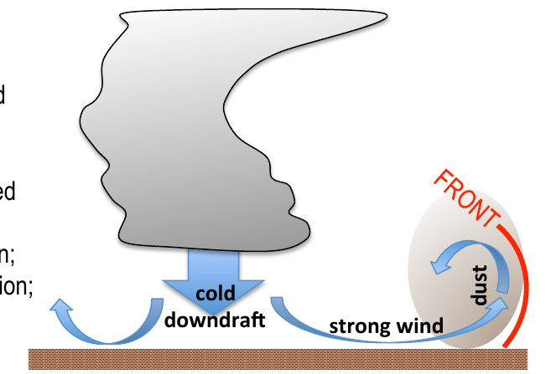
Iranian Haboob: Teheran 2nd June 2014
Intensive cold downbursts from convective cells produced high velocity surface wind, creating cold front which was lifting, mixing and pushing dust towards the city;
Expected: high wind speed, drop in temperature, rise in humidity, rise in pressure, reduction of visibility.
(Vukovic et al., in preparation)

Slide 13
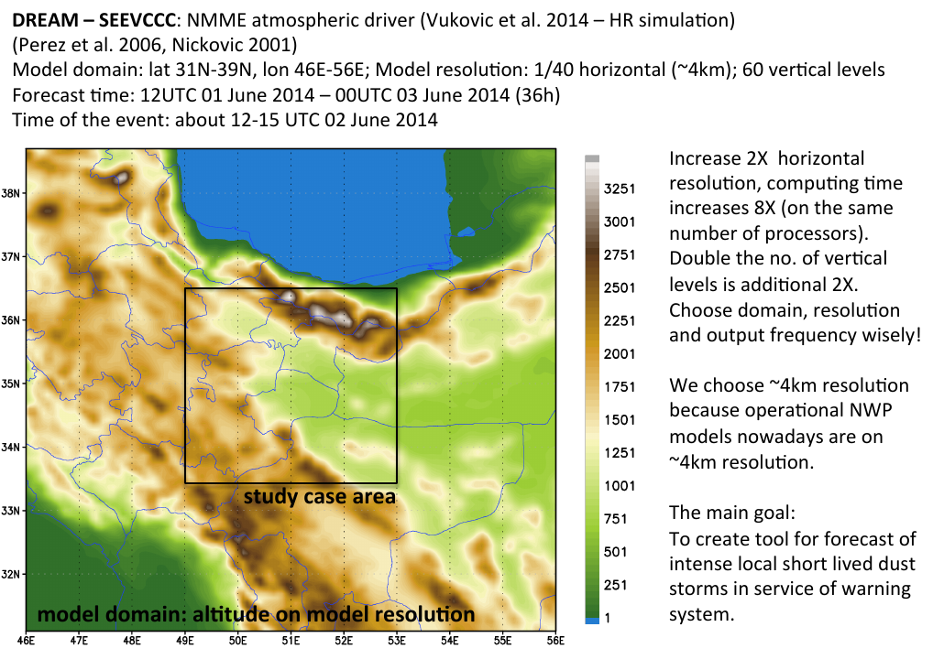
Iranian Haboob: Teheran 2nd June 2014
(Vukovic et al., in preparation)

Slide 14
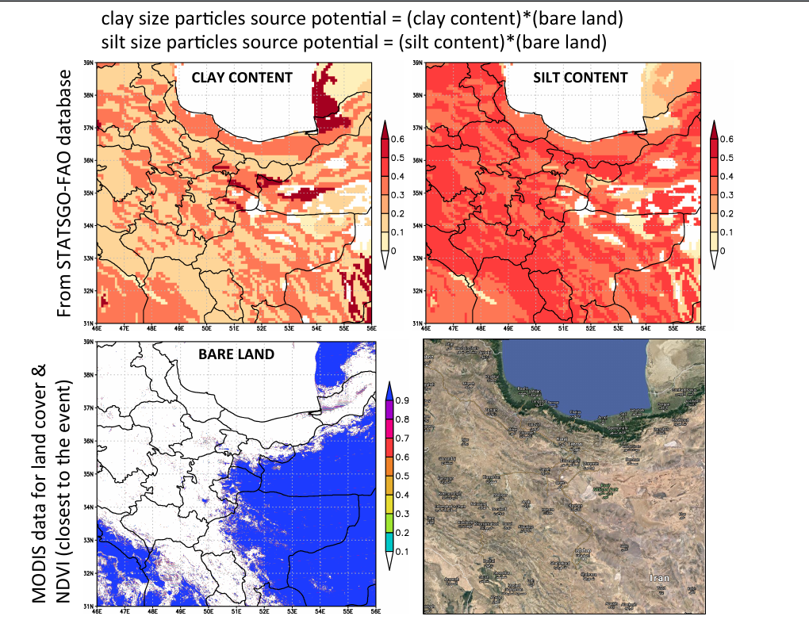
Iranian Haboob: Teheran 2nd June 2014
High-resolution dust modelling ↔ High-resolution updated land databases
(Vukovic et al., in preparation)

Slide 15
Iranian Haboob: Teheran 2nd June 2014
NMME-DREAM (SEEVCCC) simulation results for the period 06-20 UTC 2014
(Vukovic et al., in preparation)

Slide 16
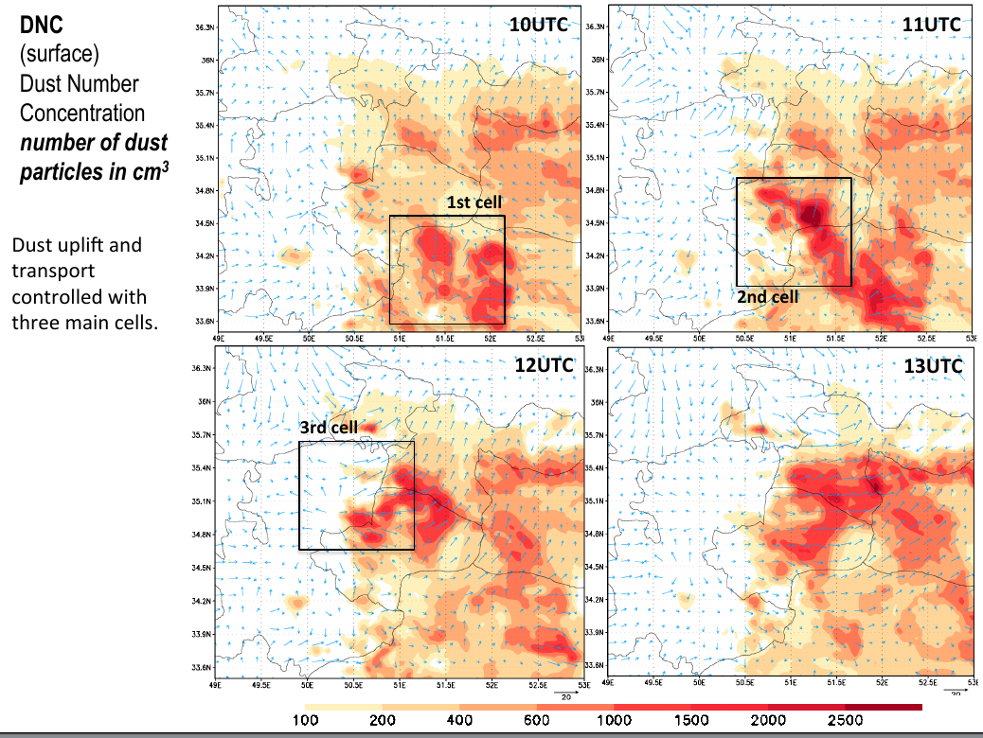
Iranian Haboob: Teheran 2nd June 2014
Explicit convection simulations are highly dependent on the initial conditions and the microphysical scheme
→ Probabilistic dust forecast based on model ensembles
(Vukovic et al., in preparation)

Slide 17
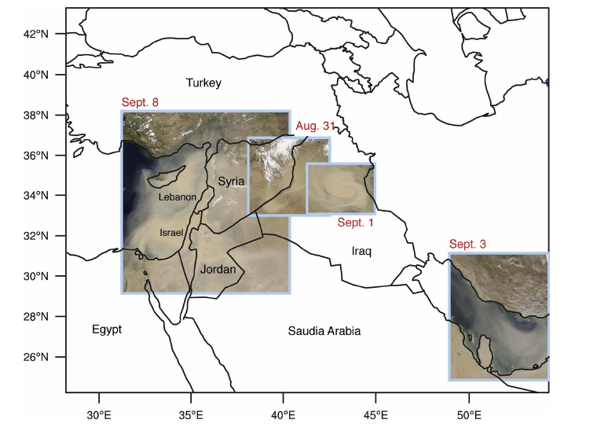
Exceptional dust event on September 2015
Climate Change?
Land use change?
Extracted from (Parolari et al., 2016)

Slide 18
Exceptional dust event on September 2015
Extracted from (Mamouri et al., 2016)

Slide 19
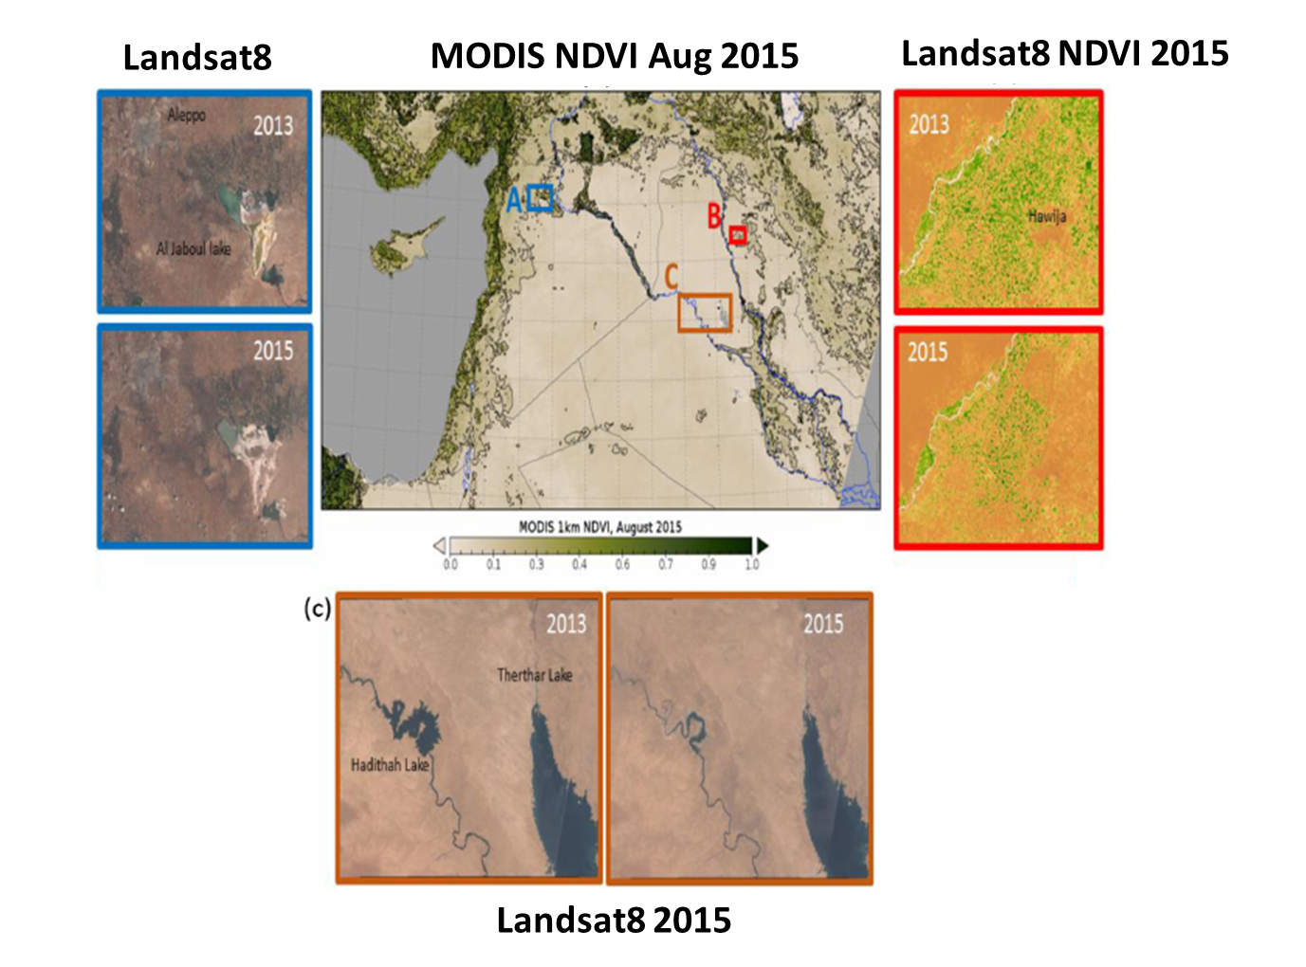
Exceptional dust event on September 2015
It seems these regions were not involved
in the analysed dust outbreak that affected Cyprus
Extracted from (Solomon et al., 2017)
Notes:
Figure 2. MODIS NDVI observations for August 2015 were used to identify regions of bare soil that can be sources of dust aerosols. The contour lines correspond to the major ticks of the colour scale. Large regions of western Syria and Iraq have NDVI values from 0 to 0.1. The three subpanels show examples of land type changes between summer 2013 and summer 2015. (a) Landsat 8 natural colour images of the Aleppo region, Syria, show changes of cultivation patterns and drying of the nearby Al Jaboul lake (e.g. the bright areas of the Al Jaboul Lake, dry parts of the lake, increased from 2013 to 2015); (b) Landsat 8 NDVI images in the region of Hawija, Kirkuk Province, Iraq,
reveal that large areas remained uncultivated in 2015 (e.g. the 2013 map shows many more green spots, agriculturally used areas, than the 2015 map); (c) Landsat 8 natural colour images showing the diminishing area of Haditha Lake on the Euphrates River and the drying up of
the Therthar canal and lake.

Slide 20
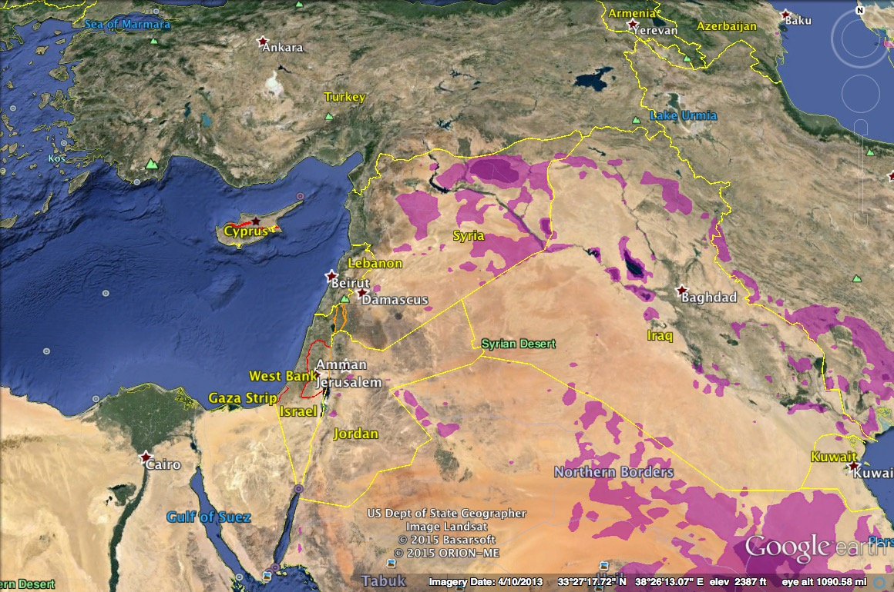
Exceptional dust event on September 2015
Frequency of dust storms over agriculture derived from MODIS Deep Blue (Ginoux et al., Rev Geophys., 2012). Highest frequency where the storm originated.
Extracted from (Ginoux et al., 2012)
Notes:
This dust storm originated from un-irrigated agricultural area between the Euphrates river and Turkey. This type of agriculture is more susceptible to drought, which has now been affecting the Middle East for several years.

Slide 21
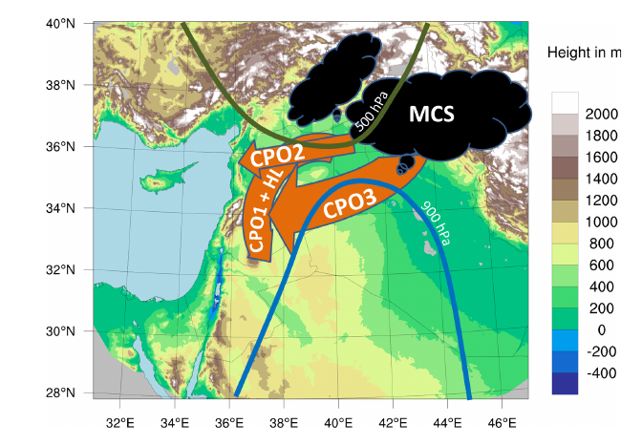
Exceptional dust event on September 2015
First cold-pool outflow, heat low and Eastern Mediterranean sea-breeze
Figure extracted from (Gasch et al., 2017)

Slide 22
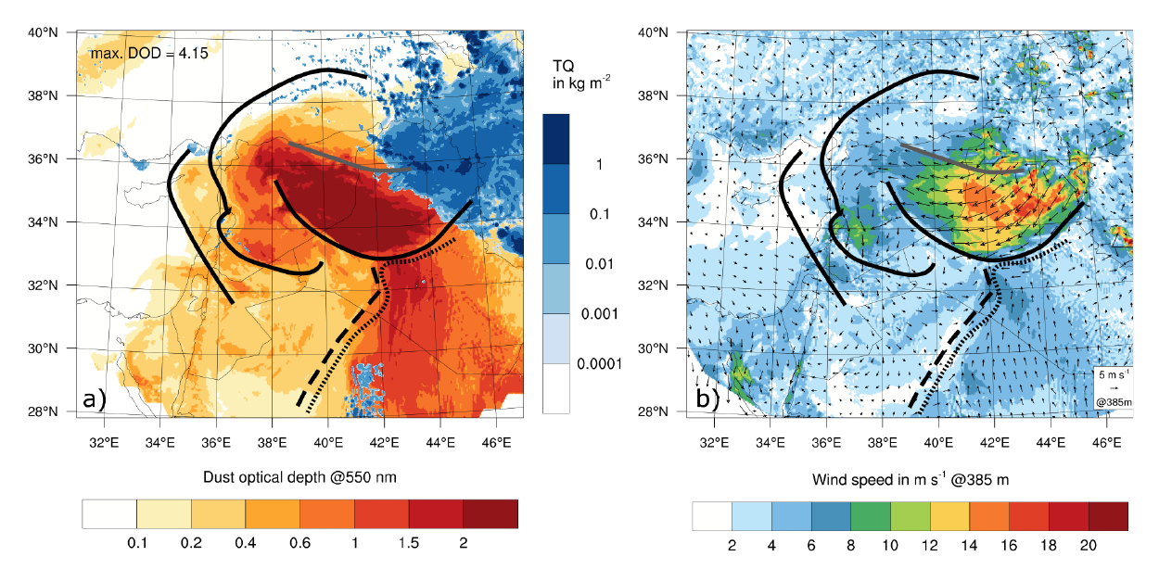
Exceptional dust event on September 2015
ICON-ART at 10UTC 7 September
(global-parent domain usign IFS as initial conditions provides boundaris to 4 nested domains at 2.5km)
MODIS
Extracted from (Gasch et al., 2017)
Notes:
Figure 5. ICON-ART model results at 10 UTC 07 September. Displayed are: a) Dust optical depth at 550 nm overlain with column integrated hydro-meteor content TQ (cloud water, cloud ice and graupel). b) Wind speed at 385 m model height and wind velocity as vectors.
The regional distribution of soil types used for dust emission in ART is taken from the Harmonized World Soil Database (HWSD) dataset with a resolution of 30 arc seconds (Nachtergaele and Batjes, 2012). The fraction of erodible soil is determined assuming that certain land use classes from the GlobCover2000 dataset (Arino et al., 2008) contribute to mineral dust emission whereas others do not, with snow

Slide 23
Summary and conclusions
Why high-resolution dust modelling for the Middle East?
To improve the representation of the topography of the region
This will improve the meteorological and dust forecasts
To better predict smaller scale sand and dust storms
Convective dust storms requires explicity convection ( < 4km)
Towards high-resolution forecasts: Modelling requirements
A non-hydrostactic model capable to run in HPC platforms
High-resolution and update land surface databases
Identification of dust sources
Dust ground-based and satellite observations
Model Evaluation and Data Assimilation
Probabilistic forecasting of smaller scale SDS – Model Ensembles
to constrain the uncertainty associated to the dust forecasts: initial conditions, microphysic scheme, …

Slide 24
Thank you
Acknowlegde to Emilio Cuevas, Slodoban Nickovic, Francesco Benincasa, Enza DiTomaso, Oriol Jorba, Kim Serradell, Enric Terradellas, J. M. Baldasano as well as AERONET, MODIS, U.K. Met Office MSG, MSG Eumetsat and EOSDIS World Viewer principal investigators and scientists for establishing and maintaining data used in the present contribution. Also special thank to all researchers, data providers and collaborators of the WMO SDS-WAS NA-ME-E Regional Node.
sara.basart@bsc.es

