Slide 1
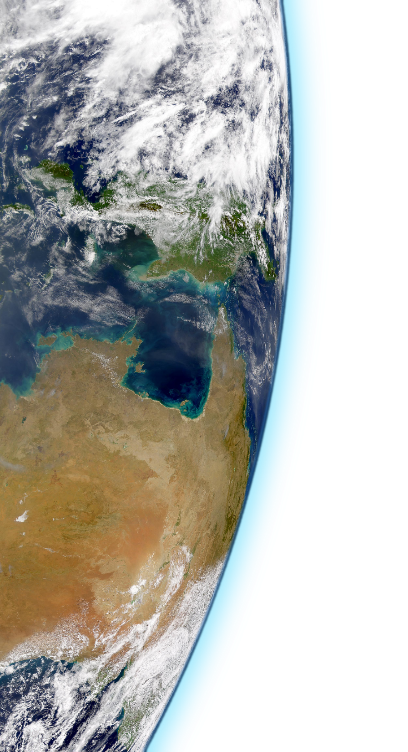
Optimizing numerical precision in NEMO 4
NEMO HPC WG
25/11/2019
Oriol Tintó Prims
BSC- Earth Sciences Department

Slide 2
Optimizing numerical precision in NEMO 4
Precision Analysis
Implementation Roadmap

Slide 3
Optimizing numerical precision in NEMO 4
Precision Analysis
Implementation Roadmap

Slide 4
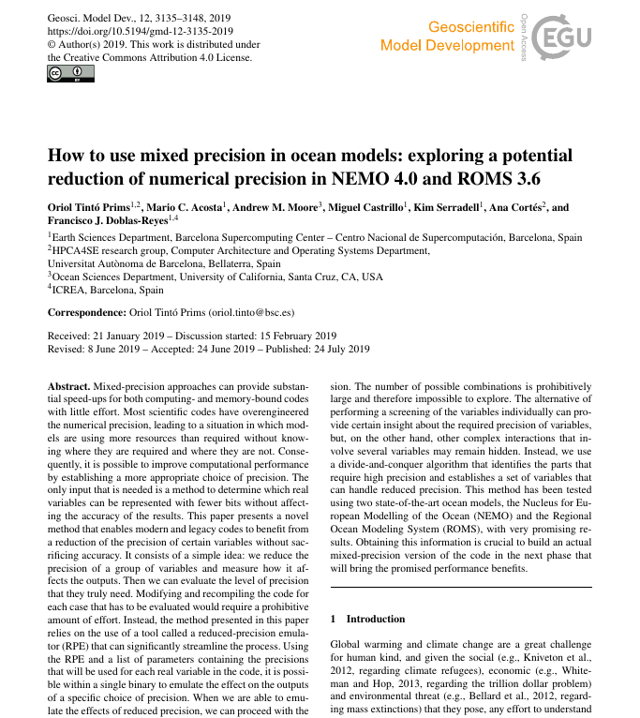
How to use mixed precision in ocean models:
exploring a potential reduction of numerical precision in NEMO 4.0 and ROMS 3.6
Oriol Tintó Prims, Mario Acosta, Andrew M. Moore, Miguel Castrillo, Kim Serradell,
Ana Cortés, Francisco J. Doblas-Reyes,
How to use mixed precision in ocean models:
exploring a potential reduction of numerical precision in NEMO 4.0 and ROMS 3.6
Geoscientific Model Development, 2019, Volume 7, Pages 3135-3148, DOI:10.5194/gmd-12-3135-2019.
,

Slide 5
Introduction

Slide 6
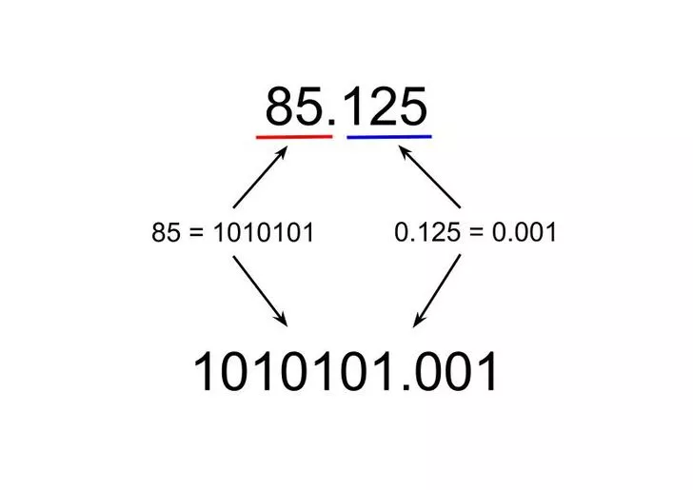
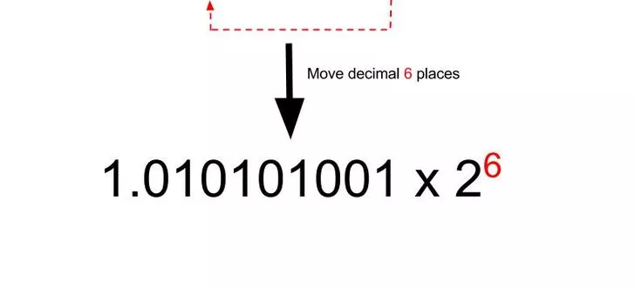
Introduction
-1⁰

Slide 7
Introduction

Slide 8
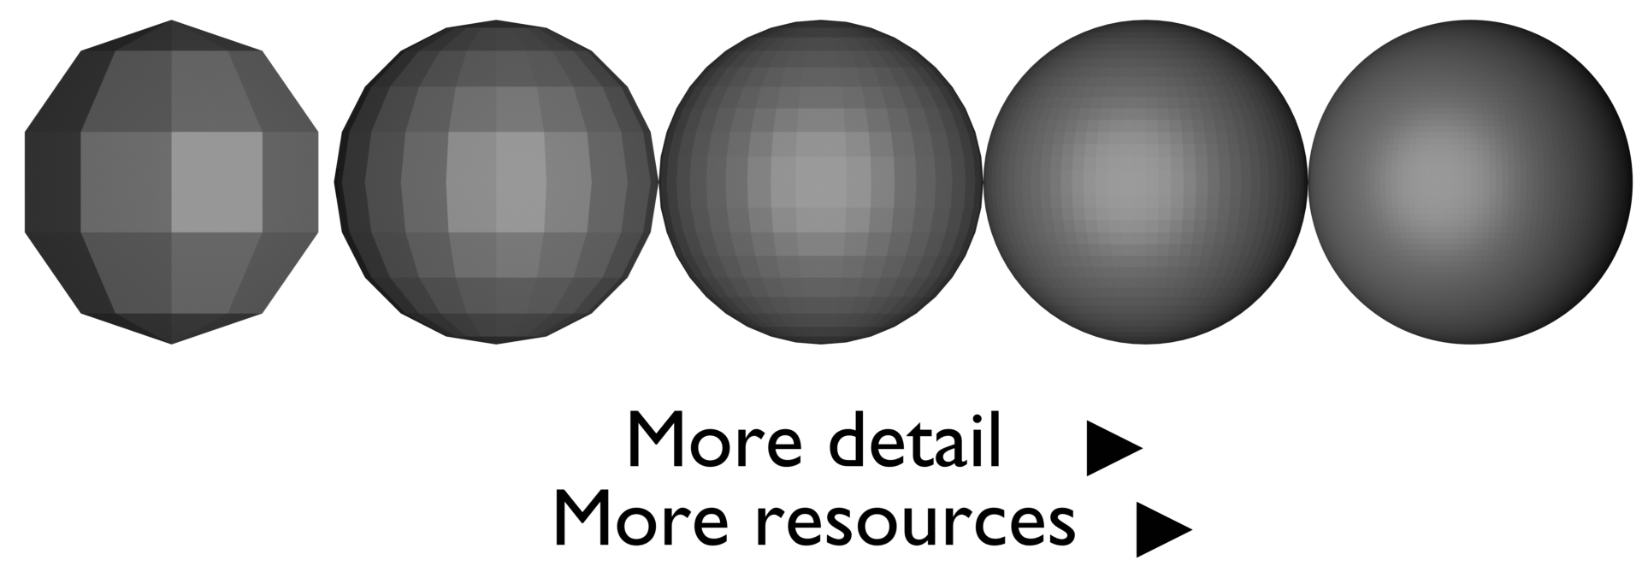
Introduction
Numerical Precision:
Faster
Cheaper
Slower
More expensive

Slide 9
Introduction
Required memory for a 3D variable in ORCA12:
7.4 GBytes
3.7 GBytes

Slide 10
Introduction
Required memory for a 3D variable in ORCA12
7.4 GBytes
3.7 GBytes
double vs single:
For memory-bound regions → 2x speed-up
For compute-bound regions → 2x speed-up

Slide 11
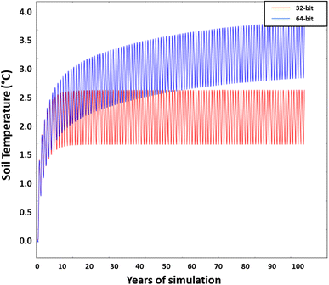
Introduction
Source: “The reliability of single precision computations in the simulation of deep soil heat diffusion in a land surface model“, Harvey, R. & Verseghy, D.L. Clim Dyn (2016) 46: 3865. https://doi.org/10.1007/s00382-015-2809-5

Slide 12
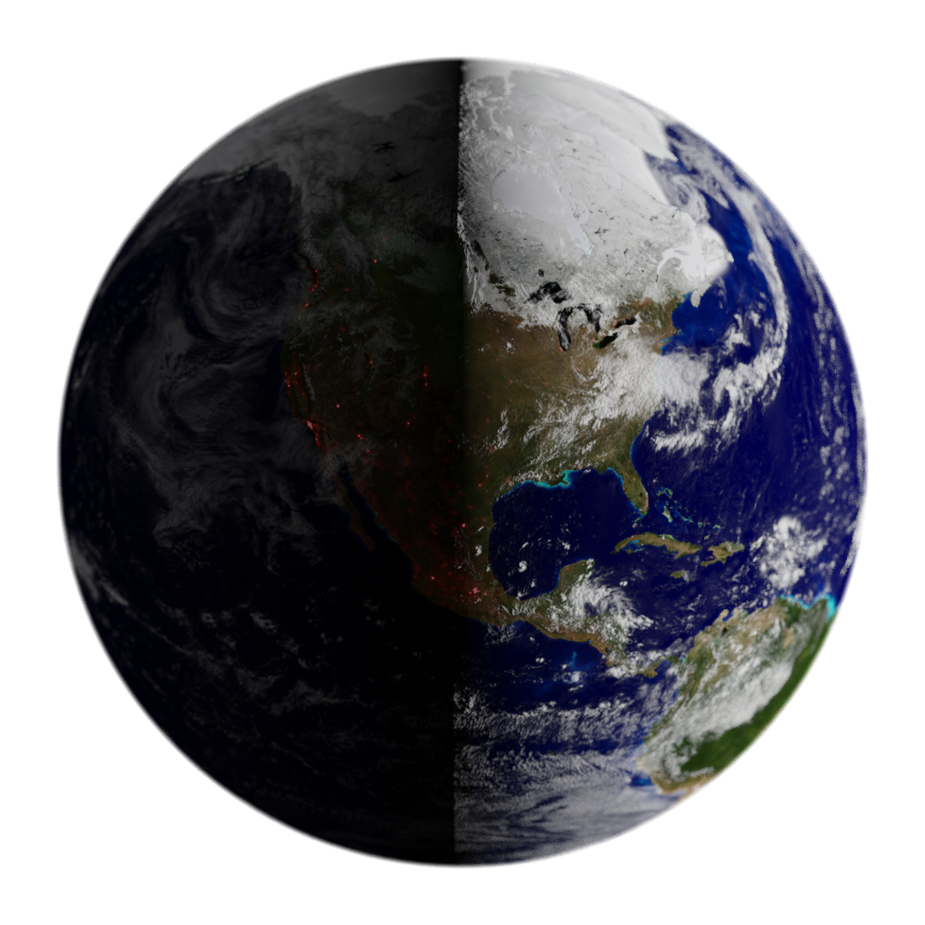
Introduction
Risky
Faster and cheaper

Slide 13
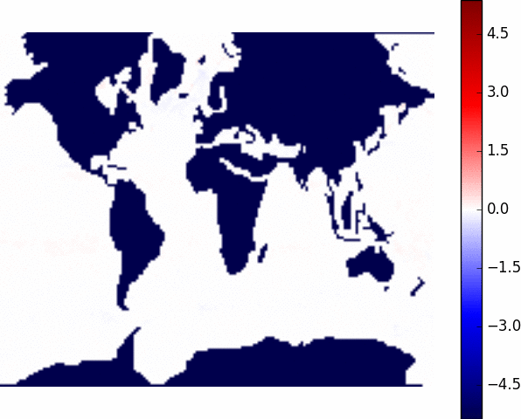
Introduction
Difference between single and double precision in NEMO
ºK

Slide 14
Introduction
We need a way to determine
which is the precision required
in a code.

Slide 15
Introduction
We need a way to determine
which is the precision required for each variable
in a code.

Slide 16
Introduction
We need a way to determine automatically
which is the precision required for each variable
in a code.

Slide 17
Introduction
Faster and cheaper
Risky

Slide 18
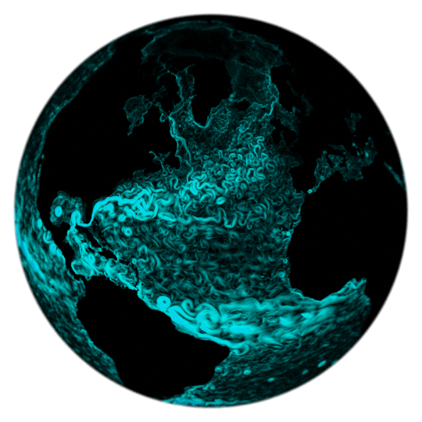
Methodology
Model
Result
Are the results accurate?
Notes:
Make a better introduction about why we need an automatic method.

Slide 19
Methodology
Model
Result
+
Reduced Precision Emulator
Are the results accurate?
Notes:
Make a better introduction about why we need an automatic method.

Slide 20
Methodology
Precision
Model
Result
+
Reduced Precision Emulator
Are the results accurate?
Notes:
Make a better introduction about why we need an automatic method.

Slide 21
Methodology
Precision
Model
Result
Are the results accurate?
Notes:
Make a better introduction about why we need an automatic method.

Slide 22
Methodology
Precision
Input
Are the results accurate?
Output
or
Notes:
Make a better introduction about why we need an automatic method.

Slide 23
Methodology
Precision
Having thousands of variables to analyze, even with this system it was a huge task to draw conclusions from all the variables of a code.
So the next step was to develop an automatic analysis algorithm.
Are the results accurate?
or
Notes:
Make a better introduction about why we need an automatic method.

Slide 24
Methodology
The algorithm
[0 1 2 3 4 5 6 7 8 9]
Variables
Notes:
Make a better introduction about why we need an automatic method.

Slide 25
Methodology
The algorithm
[0 1 2 3 4 5 6 7 8 9]

Slide 26
Methodology
The algorithm
[0 1 2 3 4 5 6 7 8 9]
[0 1 2 3 4]
[5 6 7 8 9]

Slide 27
Methodology
The algorithm
[0 1 2 3 4 5 6 7 8 9]
[0 1 2 3 4]
[5 6 7 8 9]
[0 1 2]
[3 4]

Slide 28
Methodology
The algorithm
[0 1 2 3 4 5 6 7 8 9]
[0 1 2 3 4]
[5 6 7 8 9]
[0 1 2]
[3 4]
[3]
[4]

Slide 29
Methodology
The algorithm
[0 1 2 3 4 5 6 7 8 9]
[0 1 2 3 4]
[5 6 7 8 9]
[0 1 2]
[3 4]
[3]
[4]

Slide 30
Methodology
The algorithm
[0 1 2 3 4 5 6 7 8 9]
[0 1 2 3 4]
[5 6 7 8 9]
[0 1 2]
[3 4]
[3]
[4]

Slide 31
Methodology
The algorithm
[0 1 2 3 4 5 6 7 8 9]
[0 1 2 3 4]
[5 6 7 8 9]
[0 1 2]
[3 4]
[3]
[4]

Slide 32
Methodology
The algorithm
[0 1 2 3 4 5 6 7 8 9]
[0 1 2 3 4]
[5 6 7 8 9]
[0 1 2]
[3 4]
[3]
[4]

Slide 33
Methodology
The algorithm
[0 1 2 3 4 5 6 7 8 9]
[0 1 2 3 4]
[5 6 7 8 9]
[0 1 2]
[3 4]
[3]
[4]

Slide 34
Methodology
The algorithm
[0 1 2 3 4 5 6 7 8 9]
[0 1 2 3 4]
[5 6 7 8 9]
[0 1 2]
[3 4]
[3]
[4]
Keeping variable 4 in double-precision we can reduce the precision of all the other variables.

Slide 35
Results
Using the method with NEMO
A tool to implement the emulator was developed.
A workflow manager was developed to handle the tests.
Marenostrum 4 was used to launch the analysis.
The code has more than 3500 real variable declarations.

Slide 36
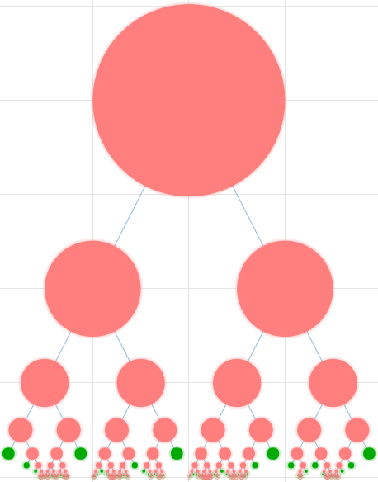
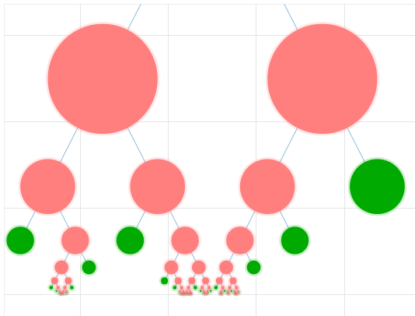
Results

Slide 37
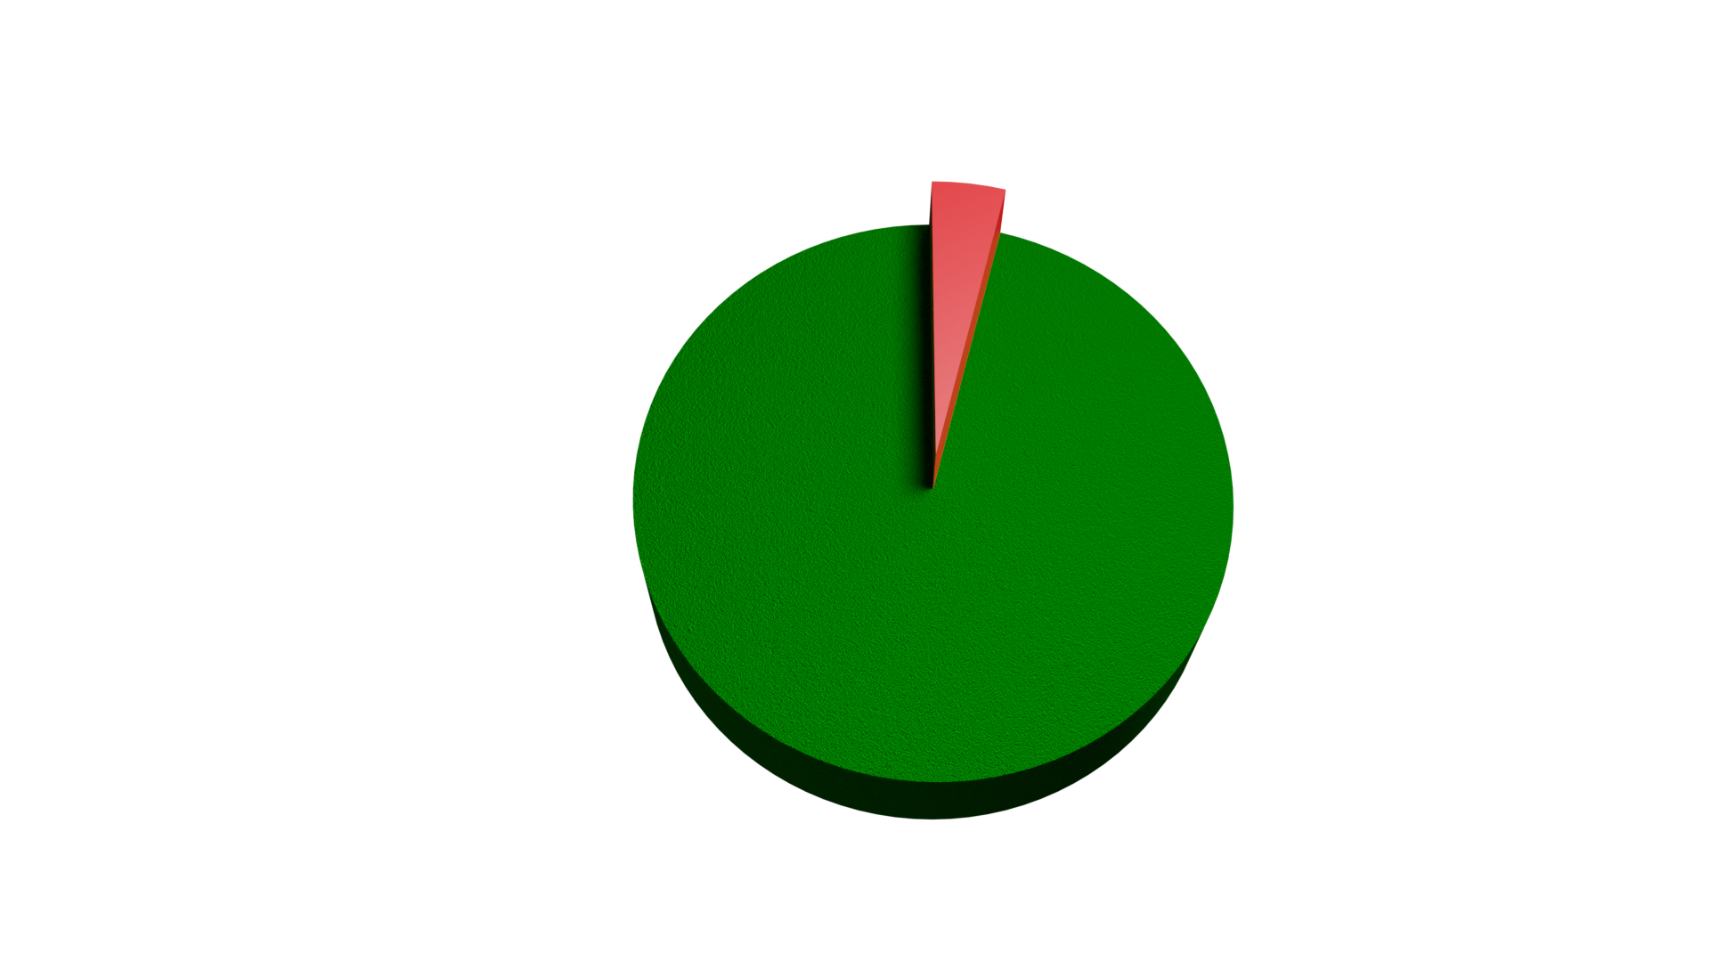
Results
Notes:
Expand with ROMS results.

Slide 38
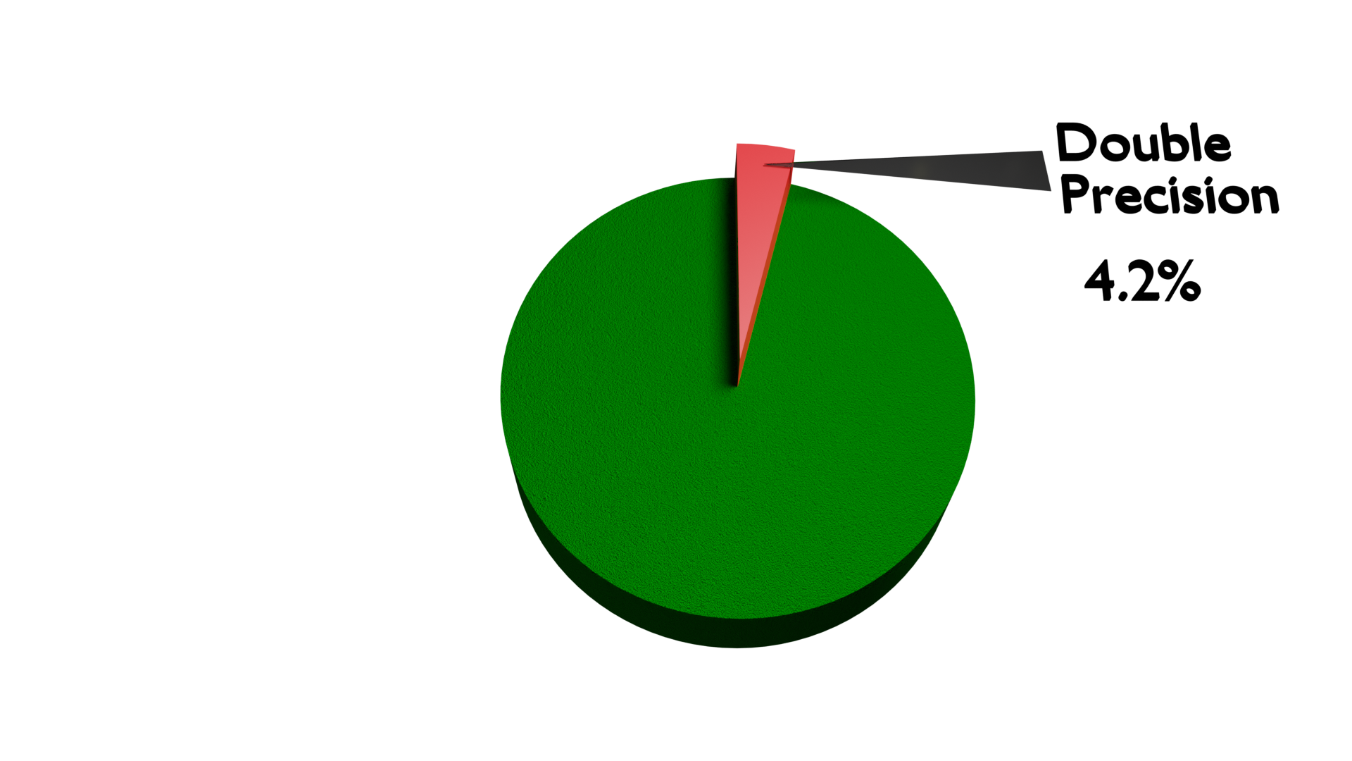
Results
Notes:
Expand with ROMS results.

Slide 39
Results
Notes:
Expand with ROMS results.

Slide 40
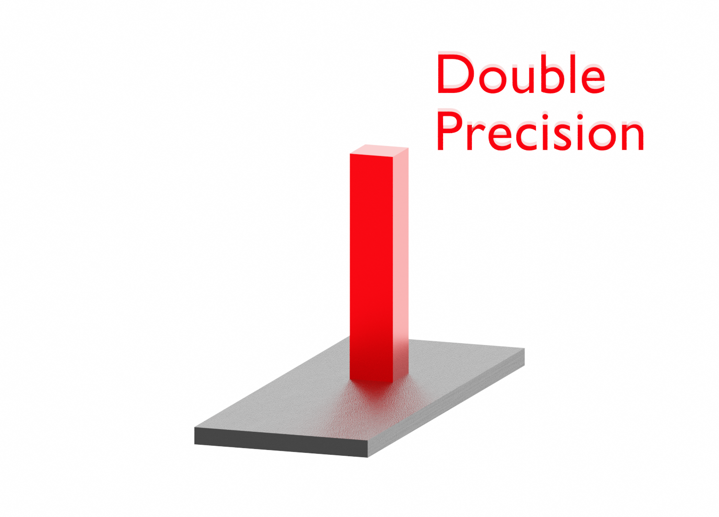
Results
Estimated Impact
Notes:
Expand with ROMS results.

Slide 41
Results
Estimated Impact
Notes:
Expand with ROMS results.

Slide 42
Results
Estimated Impact
Notes:
Expand with ROMS results.

Slide 43
Results
Estimated Impact
Notes:
Expand with ROMS results.

Slide 44
Results
Estimated Impact
Memory usage reduced by a 45%
Notes:
Expand with ROMS results.

Slide 45
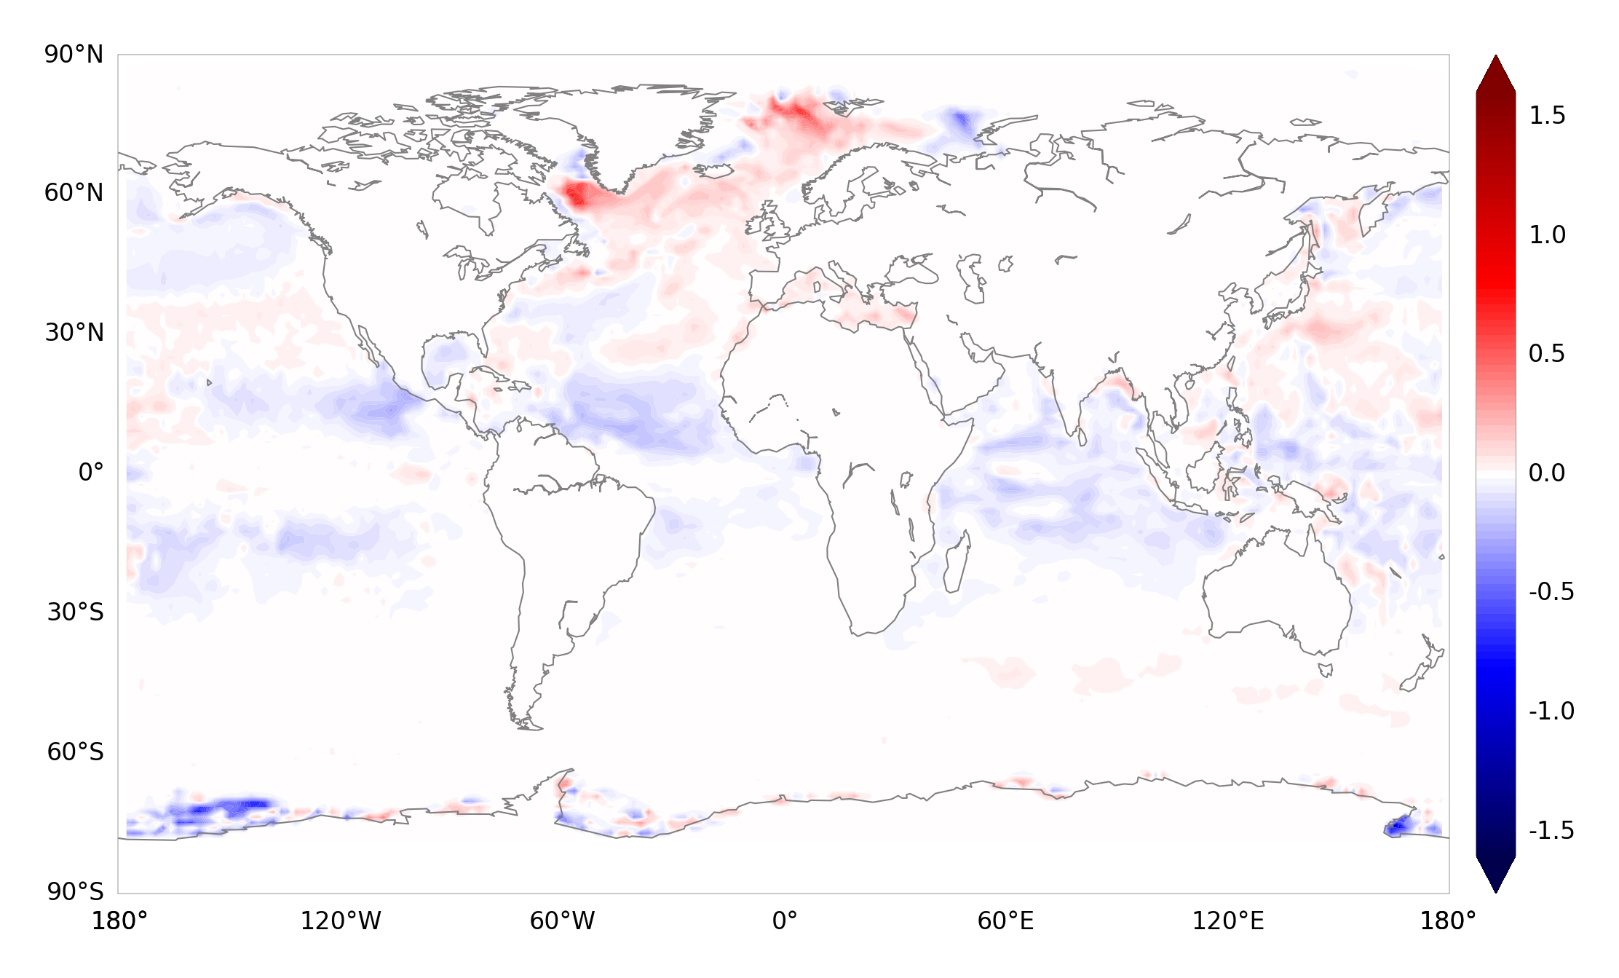
Results
Difference between double and single after one month
ºK
Notes:
Expand with ROMS results.

Slide 46
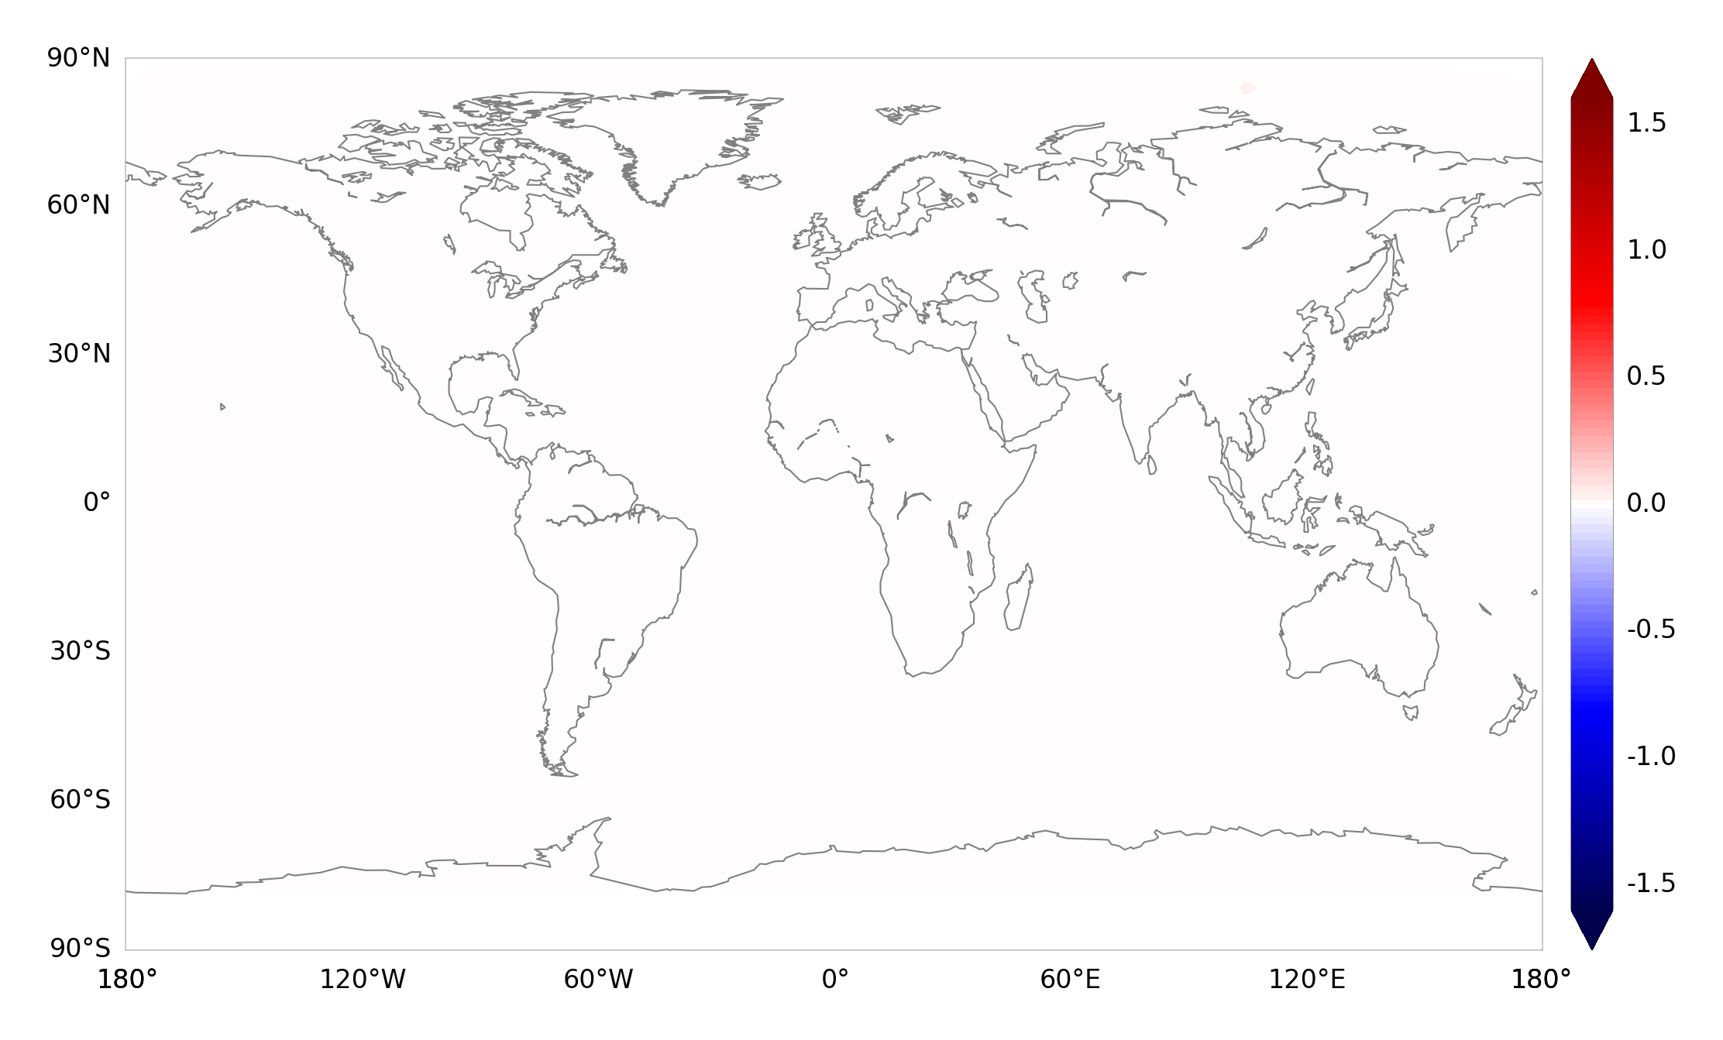
Results
Difference between double and mixed-precision after one month
ºK
Notes:
Expand with ROMS results.

Slide 47
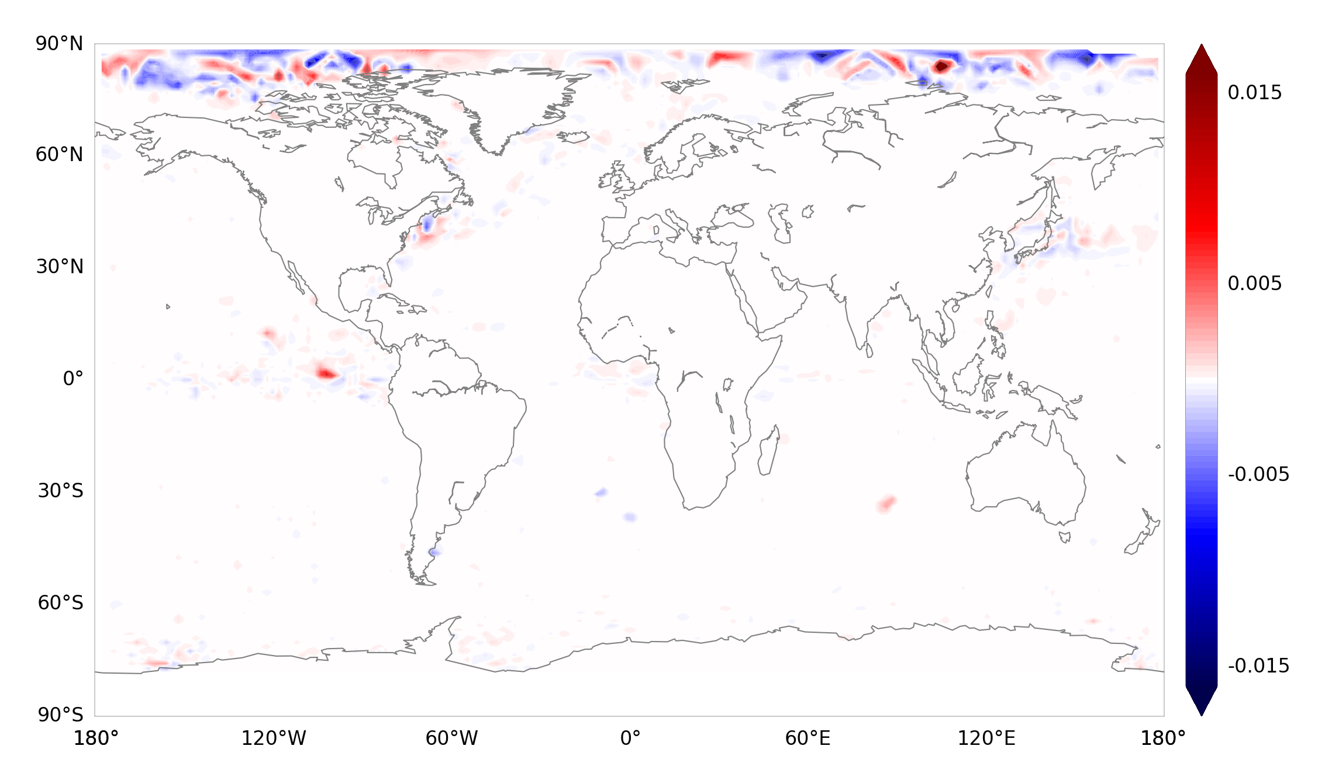
Results
Difference between double and mixed-precision after one month
ºK
Range 100 times smaller!
Notes:
Expand with ROMS results.

Slide 48
Results
Conclusions
The proposed algorithm can satisfactorily determine which variables can use reduced precision satisfying pre-established accuracy requirements.
The method and tools are not specific for NEMO and can be applied to other Earth Science models.
NEMO has huge room for reducing the numerical precision.
For more details:
Oriol Tintó Prims, Mario Acosta, Andrew M. Moore, Miguel Castrillo, Kim Serradell,
Ana Cortés, Francisco J. Doblas-Reyes,
How to use mixed precision in ocean models:
exploring a potential reduction of numerical precision in NEMO 4.0 and ROMS 3.6
Geoscientific Model Development, 2019, Volume 7, Pages 3135-3148, DOI:10.5194/gmd-12-3135-2019.

Slide 49
Optimizing numerical precision in NEMO 4
Precision Analysis
Implementation Roadmap

Slide 50
Integration roadmap
Our idea on how the implementation should be
The changes shouldn’t be invasive so the model is able to compile and run in double precision as usual.
We rely on the current structure using working precision, but now it will be possible to compile and run with wp = sp.
The sensitive variables will be declared using dp, so they will be using double precision regardless of the working precision used.
To do so, few routines will need to be duplicated so they are able to run with single and double precision arguments (communication, I/O, … ). Quite straightforward using the generic template approach.

Slide 51
Integration roadmap
What is already done?
Raw single precision implementation:
Can compile with single or double precision. (key_single)
Several interfaces duplicated (can communicate single and double precision variables,...).
Precision analyses:
Several sensitive variables identified using different tests.

Slide 52
Integration roadmap
a) BSC developing a prototype based on NEMO 4.0.1; Further testing done at ECMWF with this version.
b) Provide demonstrator for NEMO ST (how? => Scientific Publication, Branch in NEMO rep.) (BSC)
c) If it is possible and worth, prepare minimal list of changes for merge party that could enter next NEMO version (BSC+ ECMWF together with feedback from IPSL, within 1 month.)
d) Prepare tools for automation to make sure that all the workflow that goes from identifying sensitive variables to a final implementation can be reapplied to any version of the code. (BSC, April 2020)
e) Provide a mixed-precision branch at the NEMO SVN starting after the merging party. (BSC, April 2020)
f) Provide scientific evaluation and progress idealised test cases motivated by single precision evaluation and beyond (throughout 2020) (ECMWF); (Discussion on intercomparison test cases at Commodore Workshop, January 2020).
g) By end 2020, ECMWF anticipates to have a working version of NEMO + SI3 in mixed precision for DA, medium-range and extended-range ocean prediction in forced and coupled mode. Potential changes will be included into the Mixed-precision branch. (ECMWF+BSC task).

Slide 53
Thank you!
oriol.tinto@bsc.es

