Slide 1
JLESC Research Collaboration:
Monitoring the Arctic Climate
Earth Science Department
Data Assimilation Research Team,
RIKEN Center for Computational Science
V. Guemas, K.Serradell, P. Ortega, M. Castrillo, M. Acosta, J. Acosta,
P. Echevarria, E. Moreno-Chamarro
T. Miyoshi, S. Kotsuki, K. Terasaki

Slide 2
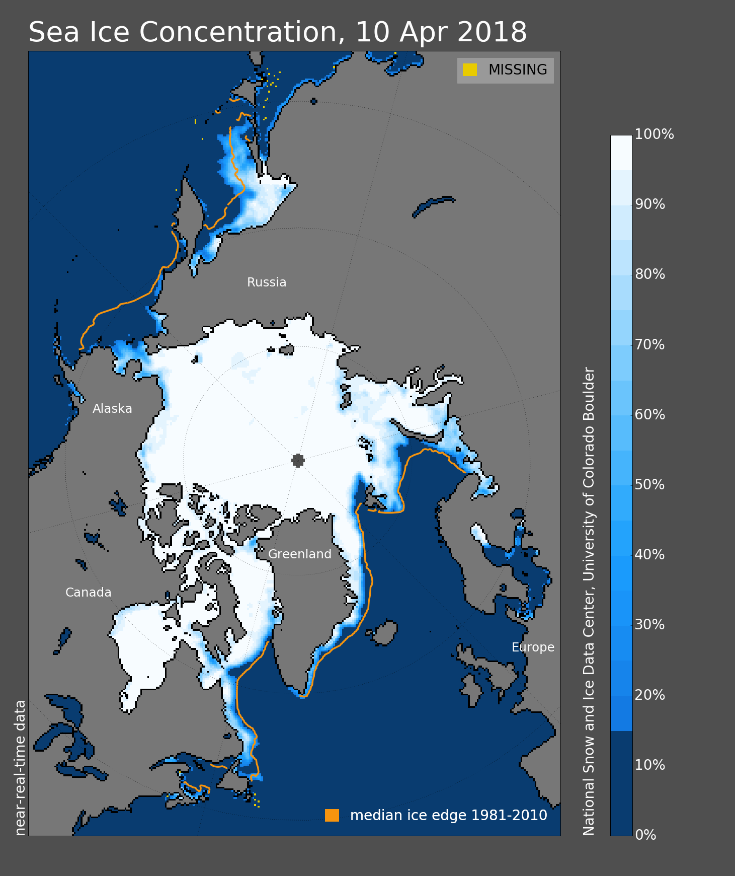
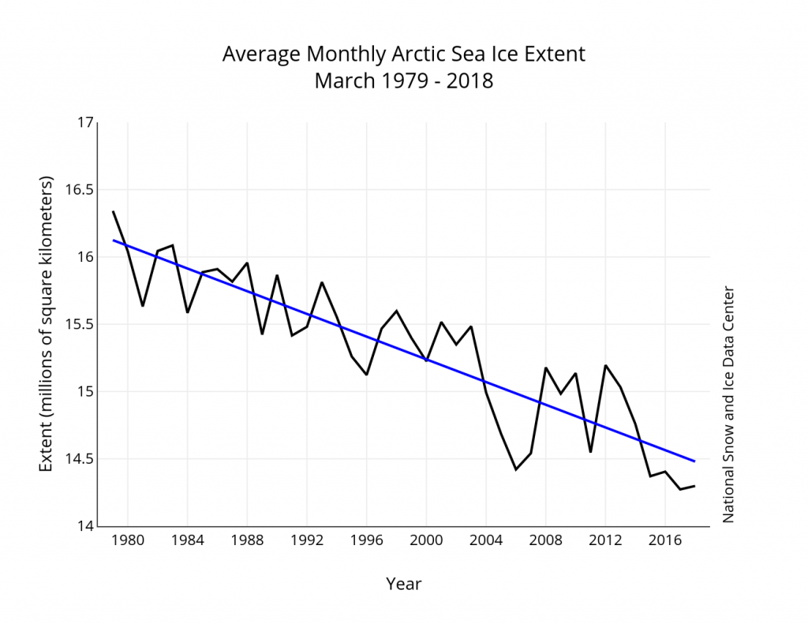
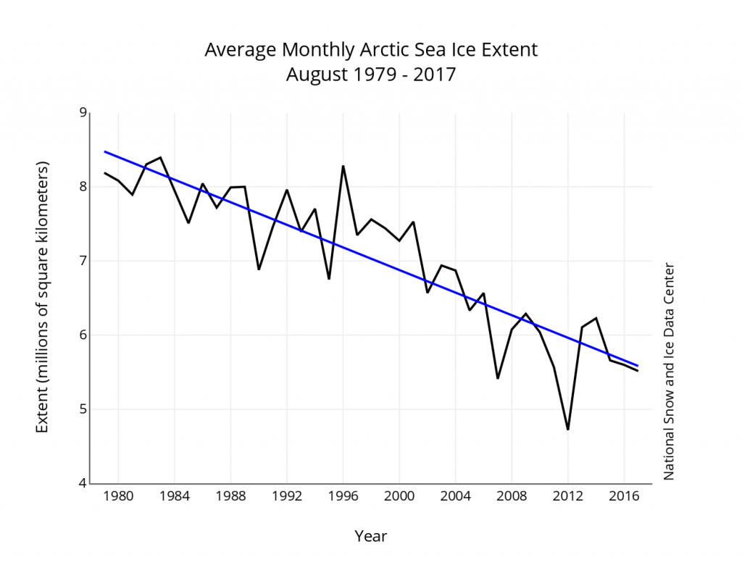
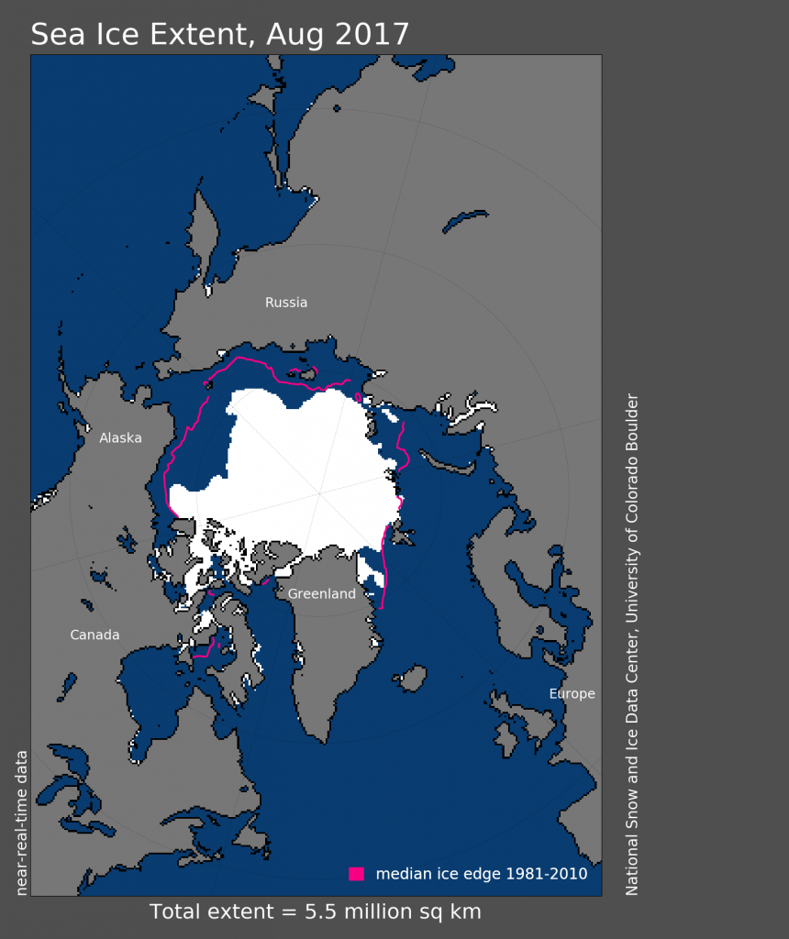
Context: A dramatic decline in Arctic sea ice...
Sea Ice Contentration
March Arctic Sea Ice extent 1979-2018
10 April
2018
10% decline in March
Near-real time satellite observations from NSIDC
August Arctic Sea Ice extent 1979-2017
August
2018
35% decline in August

Slide 3
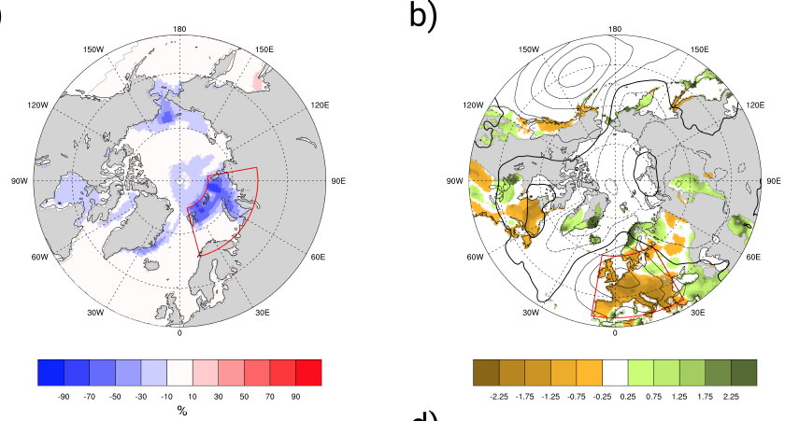
Context: ...with important climatic consequences
Acosta et al (Under review in BAMS)
Record low Sea Ice concentration in Barents-Kara Seas (Nov-Dec 2016)
Record-low Precipitation in Central Europe (Dec 2016)
Frequency of cold NH midlatitude winters (Cohen et al., 2012)
Polar temperature amplification (Manabe and Stouffer 1980
Commercial routes, ecotourism, resources extraction and industrial fishing
Other impacts:

Slide 4
Context: ...with important climatic consequences
Acosta et al (Under review in BAMS)
Record low Sea Ice concentration in Barents-Kara Seas (Nov-Dec 2016)
Record-low Precipitation in Central Europe (Dec 2016)
MOTIVATION:
Understanding climate and sea-ice variability in the Arctic region is therefore crucial for prediction purposes and future adaptation/mitigation strategies
Frequency of cold NH midlatitude winters (Cohen et al., 2012)
Polar temperature amplification (Manabe and Stouffer 1980
Commercial routes, ecotourism, resources extraction and industrial fishing
Other impacts:

Slide 5
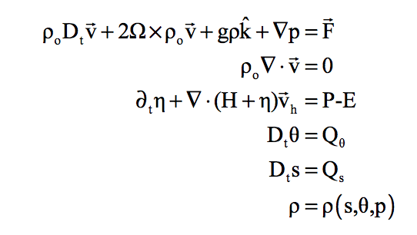
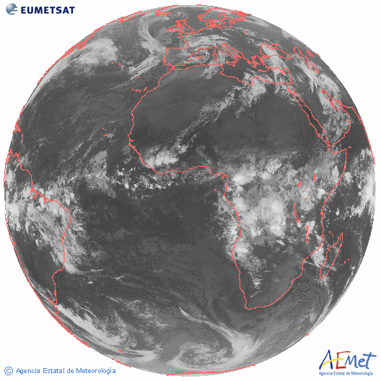
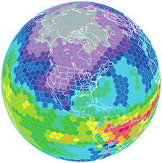
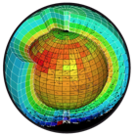
Cornerstones of Numerical Weather Prediction
For a given
atmospheric state
we can solve the Governing equations
To make a weather prediction
within a discretized global climate model
from: https://www.earthsystemcog.org/projects/esmf/

Slide 6
Cornerstones of Numerical Weather Prediction
For a given
atmospheric state
we can solve the Governing equations
To make a weather prediction
within a discretized global climate model
from: https://www.earthsystemcog.org/projects/esmf/
Good predictions rely on a good initialization of the model with observational data

Slide 7
NICAM-LETKF: Global Atmospheric Data Assimilation System
S. Kotsuki, K. Terasaki, T. Miyoshi
Data Assimilation Research Team,
RIKEN Center for Computational Science, Japan

Slide 8
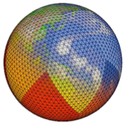
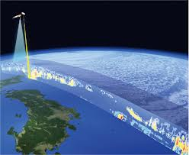
Overview on Data Assimilation
Observations
NICAM
LETKF
(JAXA)
Local Ensemble Transform Kalman Filter (Hunt et al. 2007)
Data assimilation combines simulation and real world, and brings synergy

Slide 9
Numerical Weather Prediction
FCST
FCST
Model
Simulation
DA
DA
OBS
OBS
Init
True Atmosphere（unknown)
time

Slide 10
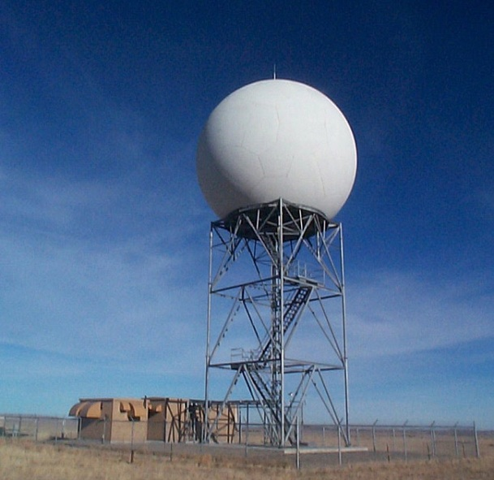
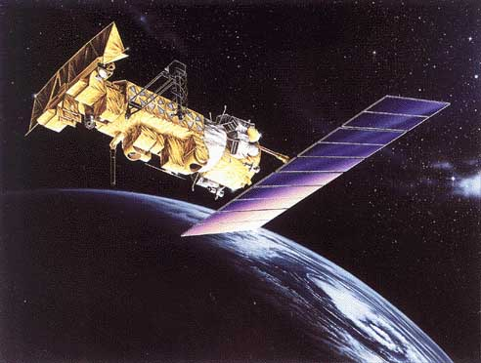
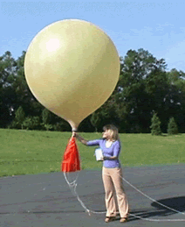
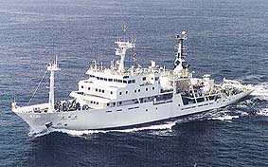
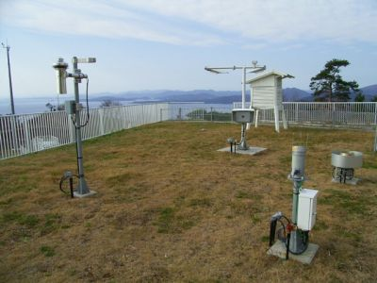
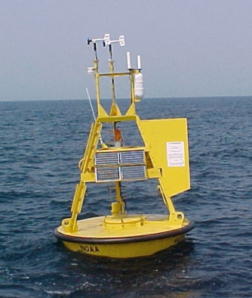
Global Observation System
Radar
Aircraft
Satellite
Weather balloon
Ship
Buoy
Surface station

Slide 11
Observation data (6-h period) (Courtesy of JMA)
NWP has been pioneering “Big Data” science!

Slide 12
Workflow of Data Assimilation
(Best estimate)
Initial State
Boundary
Conditions
Simulation
High-res sea-ice and temperature data from BSC
Simulated State
Sim-to-Obs
conversion
DA
Observations
Sim-minus-Obs
Broad-sense DA

Slide 13
Caveat: Temperature Bias in NICAM-LETKF
Present NICAM-LETKF has
a cold BIAS
near the surface.
vs. ERA Interim

Slide 14
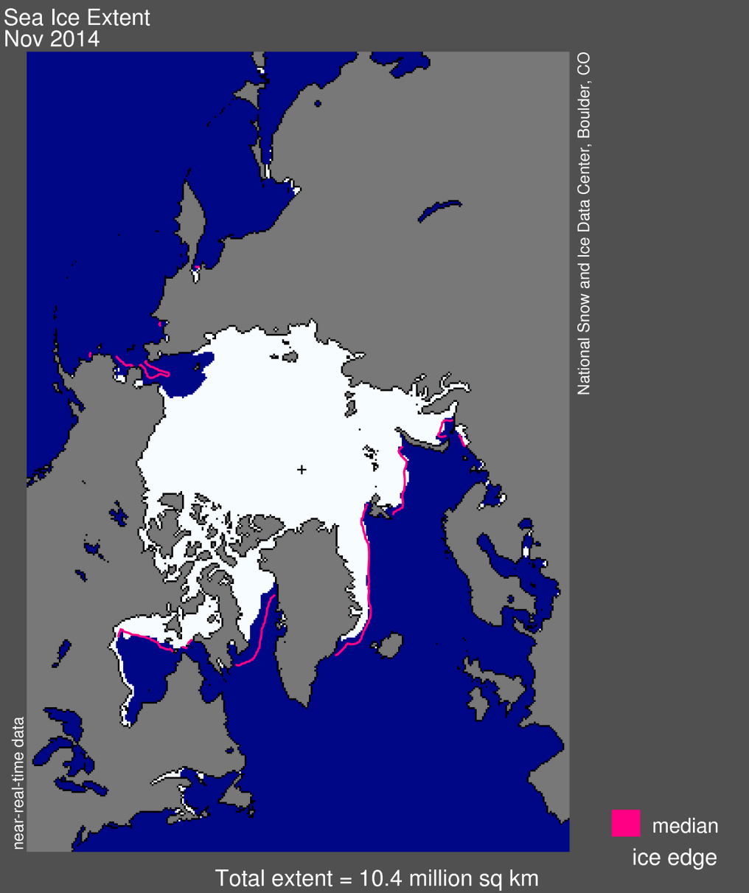
Caveat: Temperature Bias in NICAM-LETKF
NSIDC
Sea ice and temperature data may mitigate this problem!

Slide 15
Arctic research activities at BSC:
From Sea Ice reconstructions to Seasonal-to-decadal (S2D) Prediction
Earth Sciences Department
V. Guemas, K.Serradell, P. Ortega, M. Castrillo, M. Acosta, J. Acosta, P. Echevarria, E. Moreno-Chamarro

Slide 16
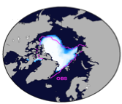
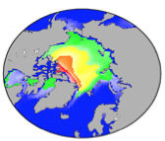
Arctic Research at BSC
ICs for S2D Climate Predictions - Sea Ice Reconstruction:
Provides smoother initialization than observational products
Covers the period 1979-2015
Performed with coupled version of NEMO+LIM in Standard resolution (1°x1°)
Boundary conditions: Atmospheric forcing from DFS5.2
Assimilation of ESA and OSISAF (two european satellite products) Sea Ice concentrations using EnKF
Observed Sea Ice
Concentration Sep 2007
Reconstructed Sea Ice
Thickness Sep 2007

Slide 17
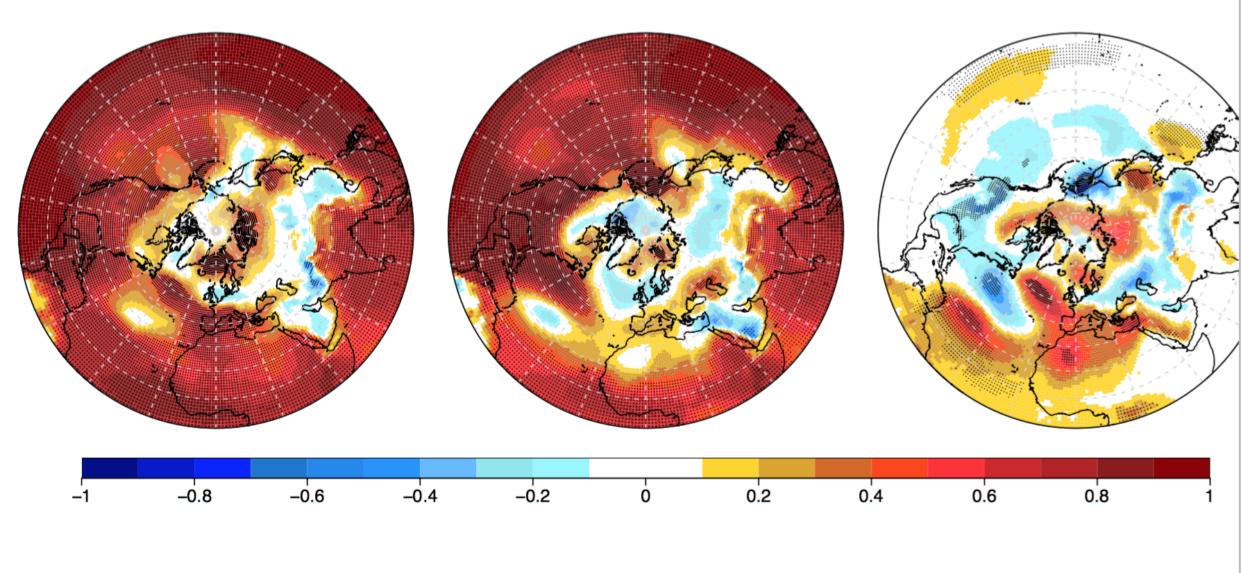
Arctic Research at BSC
Impact of Sea Ice Initialization
in Seasonal Climate Prediction skill
H2020 Project
Skill in DJF SST
Difference
in Skill
Sea Ice Assimilation (EnKF)
Sea Ice Reconstruction
(Ocean nudging)
More sophisticated initialization techniques for sea-ice (EnKF) improve prediction skill in the mediterranean region

Slide 18
Next steps of the Collaboration
Porting the Ec-Earth Model to the K-Computer
Developing and testing a new configuration to assimilate sea-ice with EnKF at high-resolution
Producing a high-resolution sea ice reconstruction
Incorporating the new HR reconstruction in the NICAM-LETKF Assimilation System
Investigating the impact of these improved sea-ice initial conditions on the skill of NWPs

Slide 20
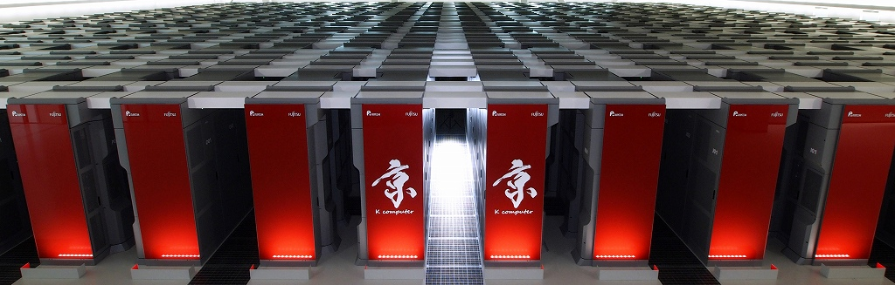
Perspective
“Big Data” ⬄ “Big Simulation”
For the next decade: Exa-scale computing
➔ Revolutionize Weather Prediction
With the Post-K, we aim to run 1000-member global NICAM-LETKF at 3.5-km resolution
in close collaboration with the FLAGSHIP 2020 project

