Slide 1
Climate services for clean energy
Llorenç Lledó⁽¹⁾, Albert Soret⁽¹⁾, Andrea Manrique-Suñén⁽¹⁾, Verónica Torralba⁽¹⁾, Nube González-Reviriego⁽¹⁾, Isadora Christel⁽¹⁾, Francisco J. Doblas-Reyes,^{(1,2)}
(1) Barcelona Supercomputing Center (BSC), Barcelona, Spain
(2) Institució Catalana de Recerca i Estudis Avançats (ICREA), Barcelona, Spain

Slide 2
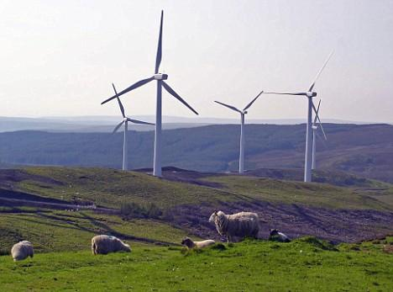
Context and motivation
Renewable energy is growing fast to decarbonize the energy system.
Both energy supply and demand are strongly influenced by atmospheric conditions and its evolution over time in terms of climate variability and climate change.
Notes:
Both energy supply and demand are strongly influenced by weather conditions and their evolution over time in terms of climate variability and climate change. The sensitivity of electricity demand to temperature is significant. While in northern Europe, cold spells during winter represent high-risk periods for the energy security of large areas (Ely et al., 2013), in southern Europe hot spells during summer are the source of high risk to the energy network stability (Pardo et al., 2002).
Despite cost competitive in many settings, renewable energy diffusion remains limited largely due to its variability. This works as a major barrier to renewable energies integration in electricity networks as knowledge of power output and demand forecasting beyond a few days remains poor.
The highest priority for the energy network operators is the balance between electricity demand and supply. Before the introduction of renewable energies, the demand was matched with base-load power plants (coal and nuclear) and generating plants that can be scheduled, usually hydroelectric and fossil-based power plants. This landscape has been changing rapidly with the integration of wind and solar energies into the energy mix over recent years. The increase has been particularly significant in wind energy which had rate of growth of 17% in 2014-2015 (GWEC, 2016), reaching near to 370 GW of installed capacity worldwide in 2014 (WWEA, 2015).This increase of renewable energy resources implies the introduction of new generation capacity that is dependent on a highly variable weather/climate (Spiecker and Weber, 2013).
‹#›

Slide 3
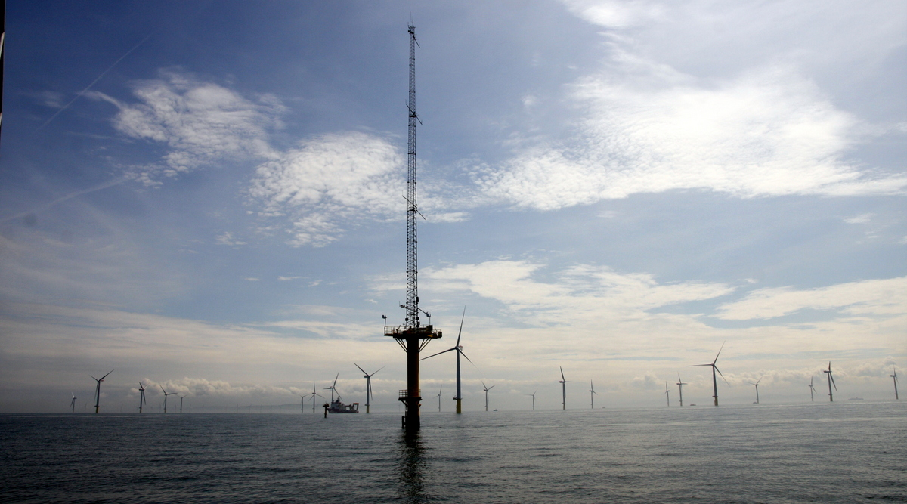
Context and motivation
The energy sector routinely uses weather forecast up to several days.
But beyond this time horizon, past climatological records are used to estimate risks.
Met mast on Gwynt y Môr offshore wind farm (source: solar wheel)
Hours
Days
Weeks
Months
Seasons
Years
Decades
Centuries
METEOROLOGICAL FORECASTS
SUBSEASONAL PREDICTION
SEASONAL PREDICTION
DECADAL
PREDICTION
CLIMATE
PROJECTIONS
Notes:
While the energy sector has routinely been using weather forecasts of up to 15 days (Dubus, 2010), beyond this time horizon, climatological data (typically 30-year averages) are used. A common assumption in this method is that future conditions will be similar to past conditions. This assumption entails two inherent shortcomings. The first one is that past conditions can be highly variable, which can make them of limited use to forecast future ones. The second one is that climatology cannot predict events which have never happened before, e.g. extreme events, which can be particularly harmful and whose prediction is of special interest for stakeholders. Our knowledge of climatology is based on a finite sample of past events. This sample is limited in time, and doesn’t need to be fully representative of what can happen. Moreover, a climatological approach does not take into account changes in atmospheric dynamics, such as those caused by climate change. Climate change may render past conditions useless for predicting future events, as they may no longer be reproduced.
‹#›

Slide 4
S2S4E objective

Slide 5
Objective
Offer an innovative service that improves RE variability management by:
developing new research methods and exploring the frontiers of atmospheric predictions for the upcoming weeks and months.
co-designing a Decision Support Tool (DST) that for the first time integrates sub-seasonal to seasonal (S2S) climate predictions to inform RE generation and electricity demand.
Notes:
‹#›

Slide 6
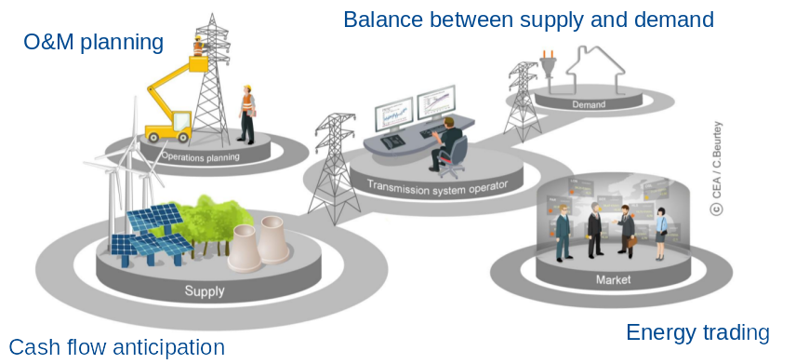
Applications
O&M teams:
plan maintenance tasks
TSO:
guarantee supply and demand balance
Energy traders:
forecast electricity prices
Plant owners:
anticipate revenues and cash flow

Slide 7
Challenges and opportunities

Slide 8
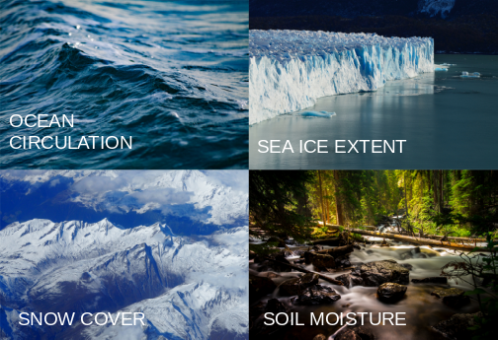
Components of the Earth System
ATMOSPHERE

Slide 9
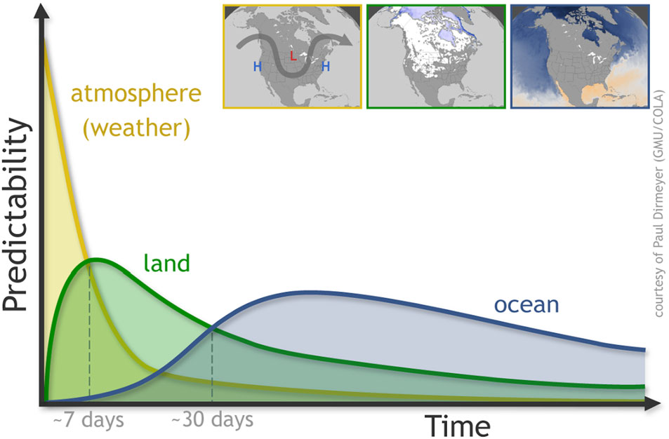
S2S Forecast ranges and skill
Predictability sources:
Skill estimates:
(Source: Mariotti et al. 2018 )
(Source: White et al., 2017 )
Notes:
‹#›

Slide 10
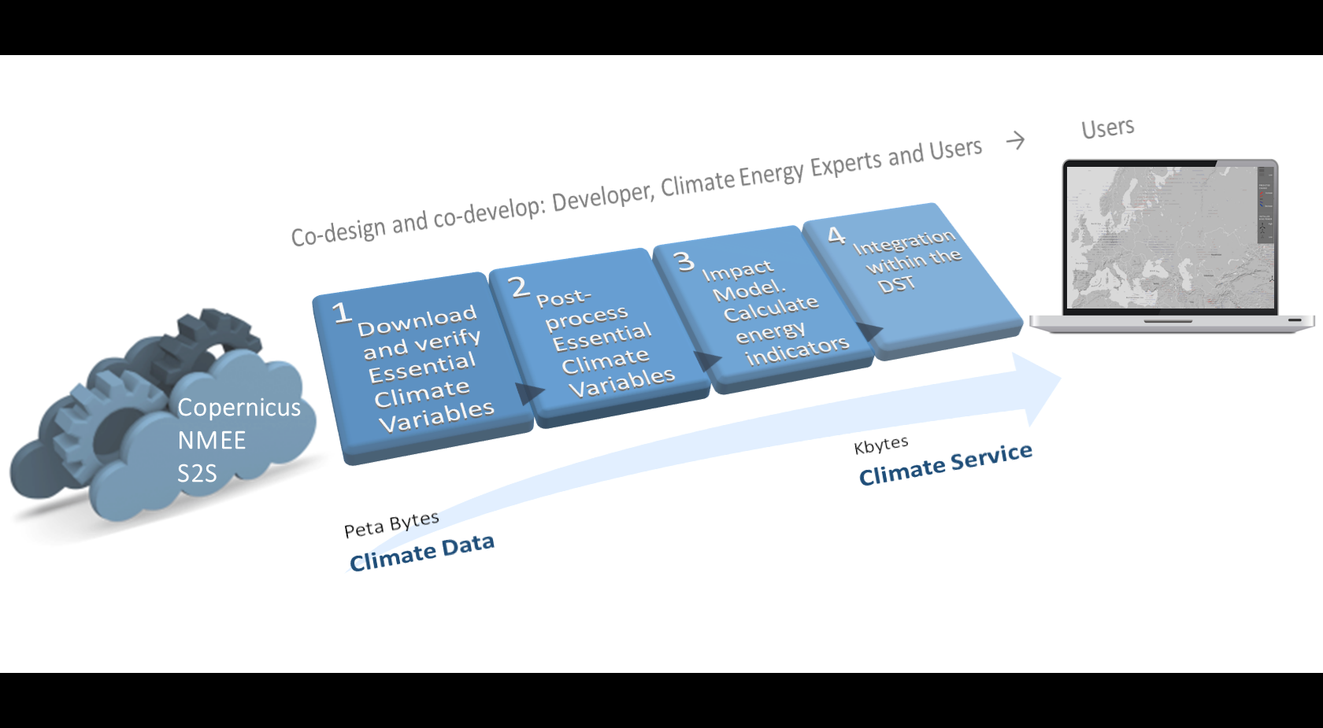
From data to information
and to service
Notes:
‹#›

Slide 11
Climate services
User: How much energy will I produce next month?
Scientist: Bias adjustment, skill assessment, probabilistic information, etc.
Notes:
Climate predictions (Figure 1) including both sub-seasonal (up to one month) and seasonal predictions (for the forthcoming months) have witnessed considerable improvements in the last decade demonstrating that probabilistic forecasting can inform better decision making at some temporal scales and regions (Alessandri et al., 2011, Doblas-Reyes et al., 2013). However, despite this improvement, climate predictions come with a new set of challenges for users: information is often un-tailored and hard to understand or apply in a decision-making context. Further research is needed to broaden our knowledge of the predictability and usability of S2S predictions and the requirements of energy companies and transmission system operators.
‹#›

Slide 12
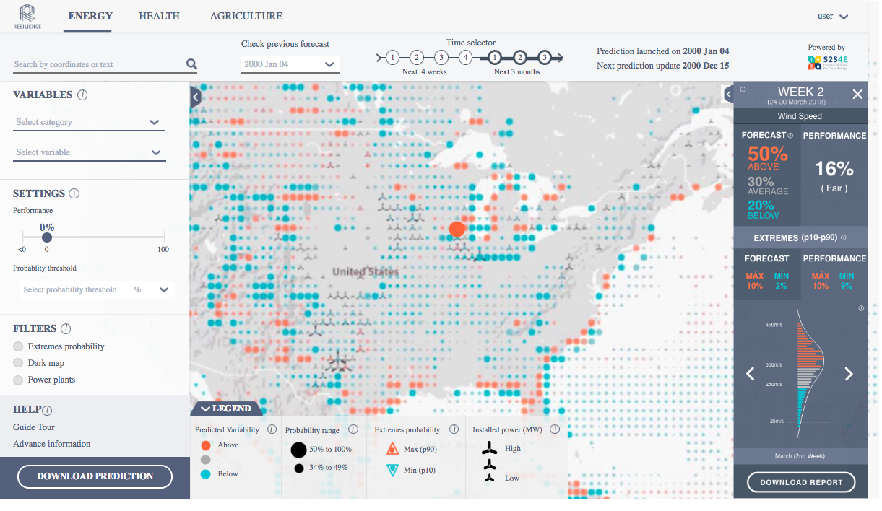
Decision Support Tool
http://www.bsc.es/ess/resilience/map.html
Notes:
‹#›

Slide 13
Methodology and first results

Slide 14
First year results
Evaluation of 5 reanalyses: climatology, trends and interannual variability in 4 ECVs (wind, t2m, precipitation & solar radiation).
Impact of climate variability on RE generation and demand (see poster PA11D-0819)
8 case studies

Slide 15
Case study 6
US wind drought - JFM 2015
Seasonal forecasts

Slide 16
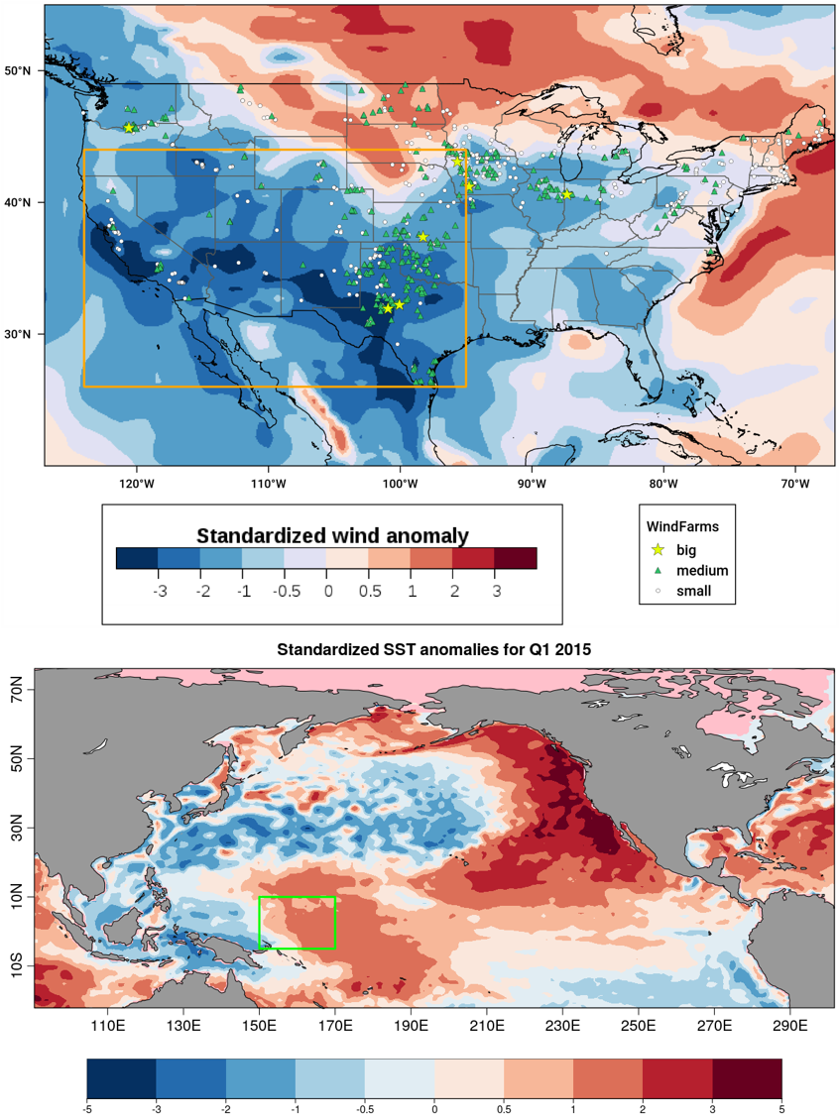
Wind anomaly Q1 2015

Slide 17
Event impacts
“US clean energy suffers from lack of wind”
Financial Times, September 2015.
“El Niño Buffers U.S. Wind Power Dreams”
Wall Street Daily, September 2015.
“El Niño blowing down wind projections in US”
Fierce Energy, July 2015.
“We never anticipated a drop-off in the wind resource as we have witnessed over the past six months”
David Crane, RNG, September 2015.

Slide 18
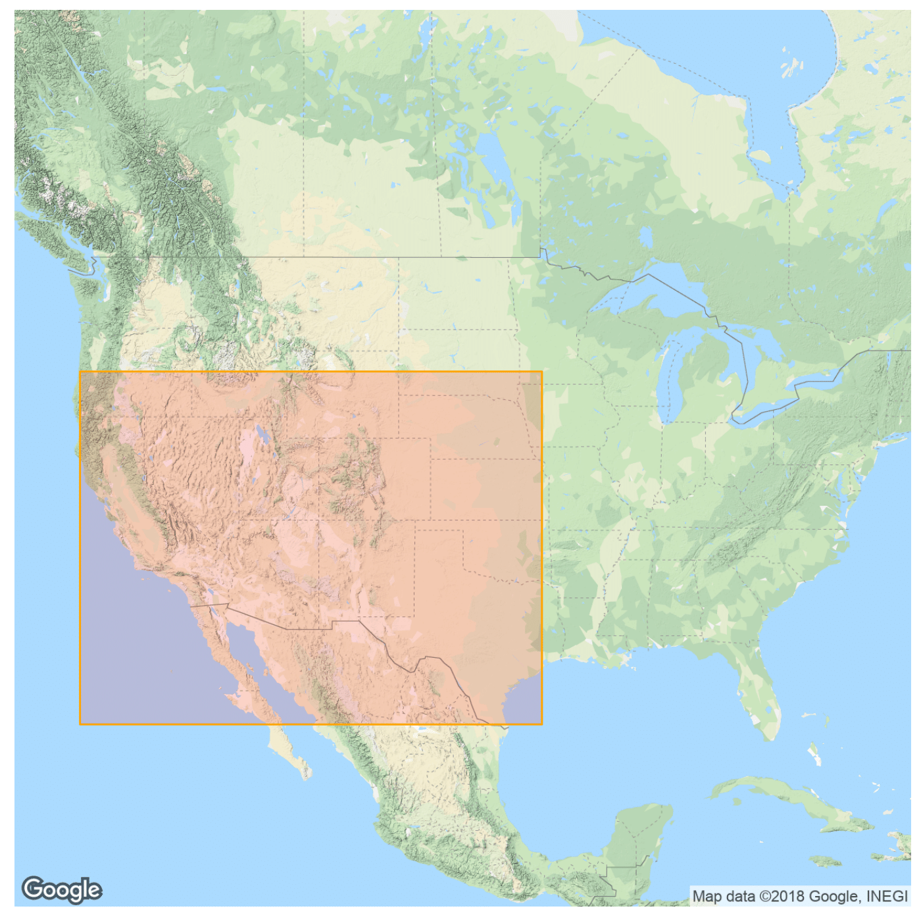
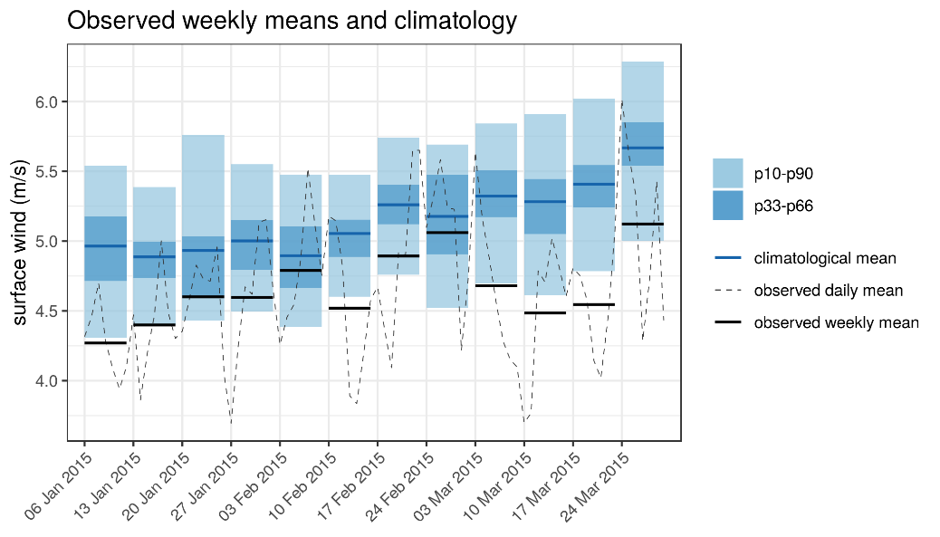
Widespread and extended in time

Slide 19
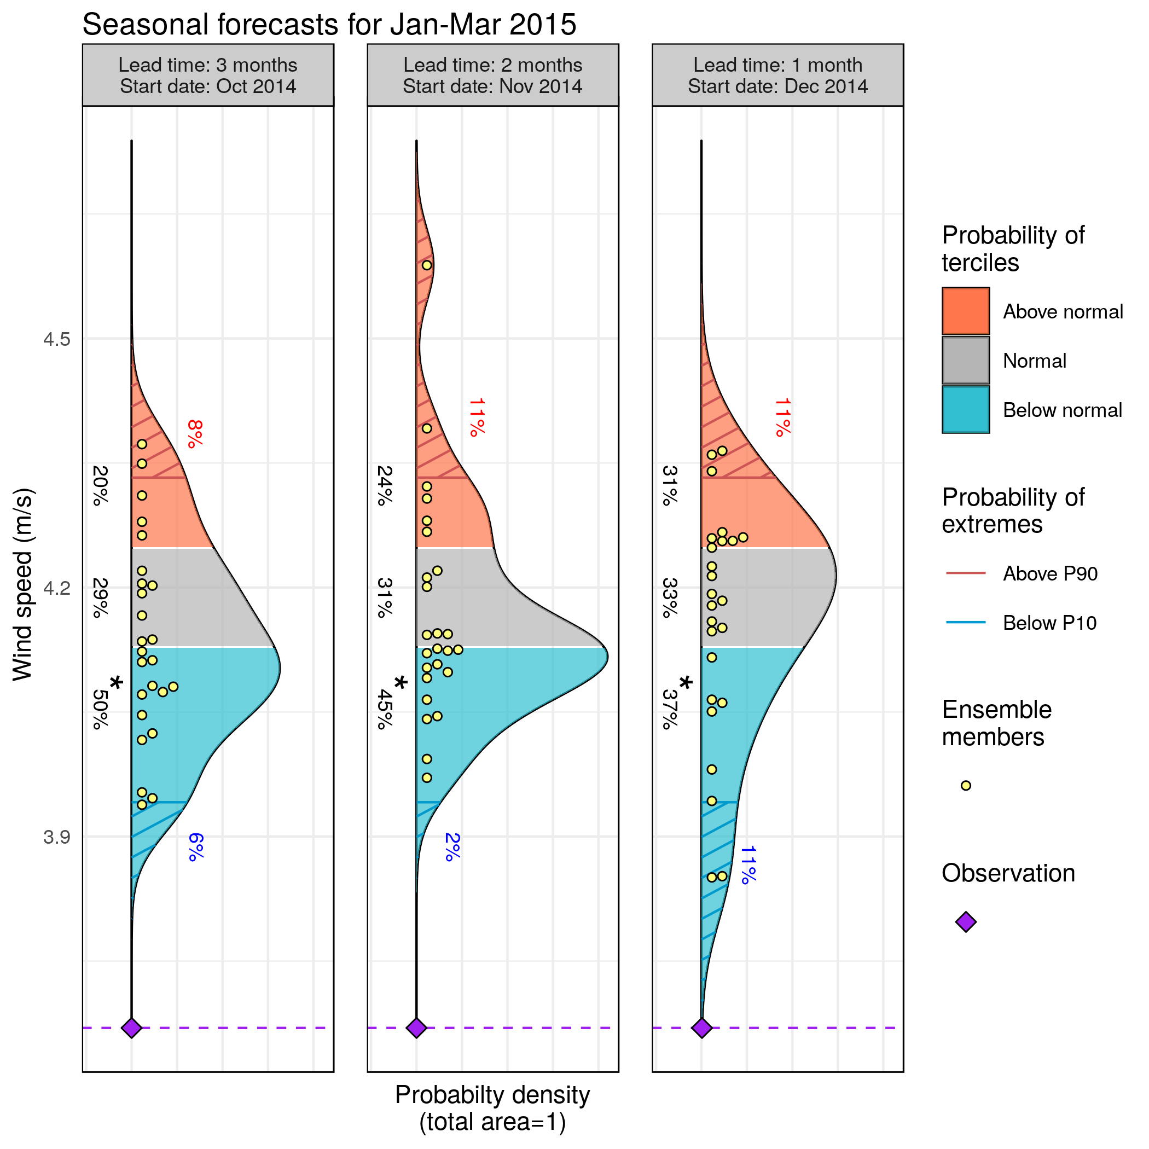
Fcsts available 3 to 1 months ahead
Associated Skill Scores
 | Start Date
 | Oct | Nov | Dec
RPSS | 0.35 | 0.39 | 0.35
BS P10 | −0.07 | −0.27 | −0.16
BS P90 | 0.1 | 0.04 | 0.07
CRPSS | 0.14 | 0.11 | 0.14
EnsCorr | 0.55 | 0.54 | 0.51
Which decisions would you make in view of those forecasts?
System: ECMWF SEAS5
Reanalysis: ERA-Interim
Bias adjustment: calibration
Hindcast: 1993-2015

Slide 20
Why this happened?

Slide 21
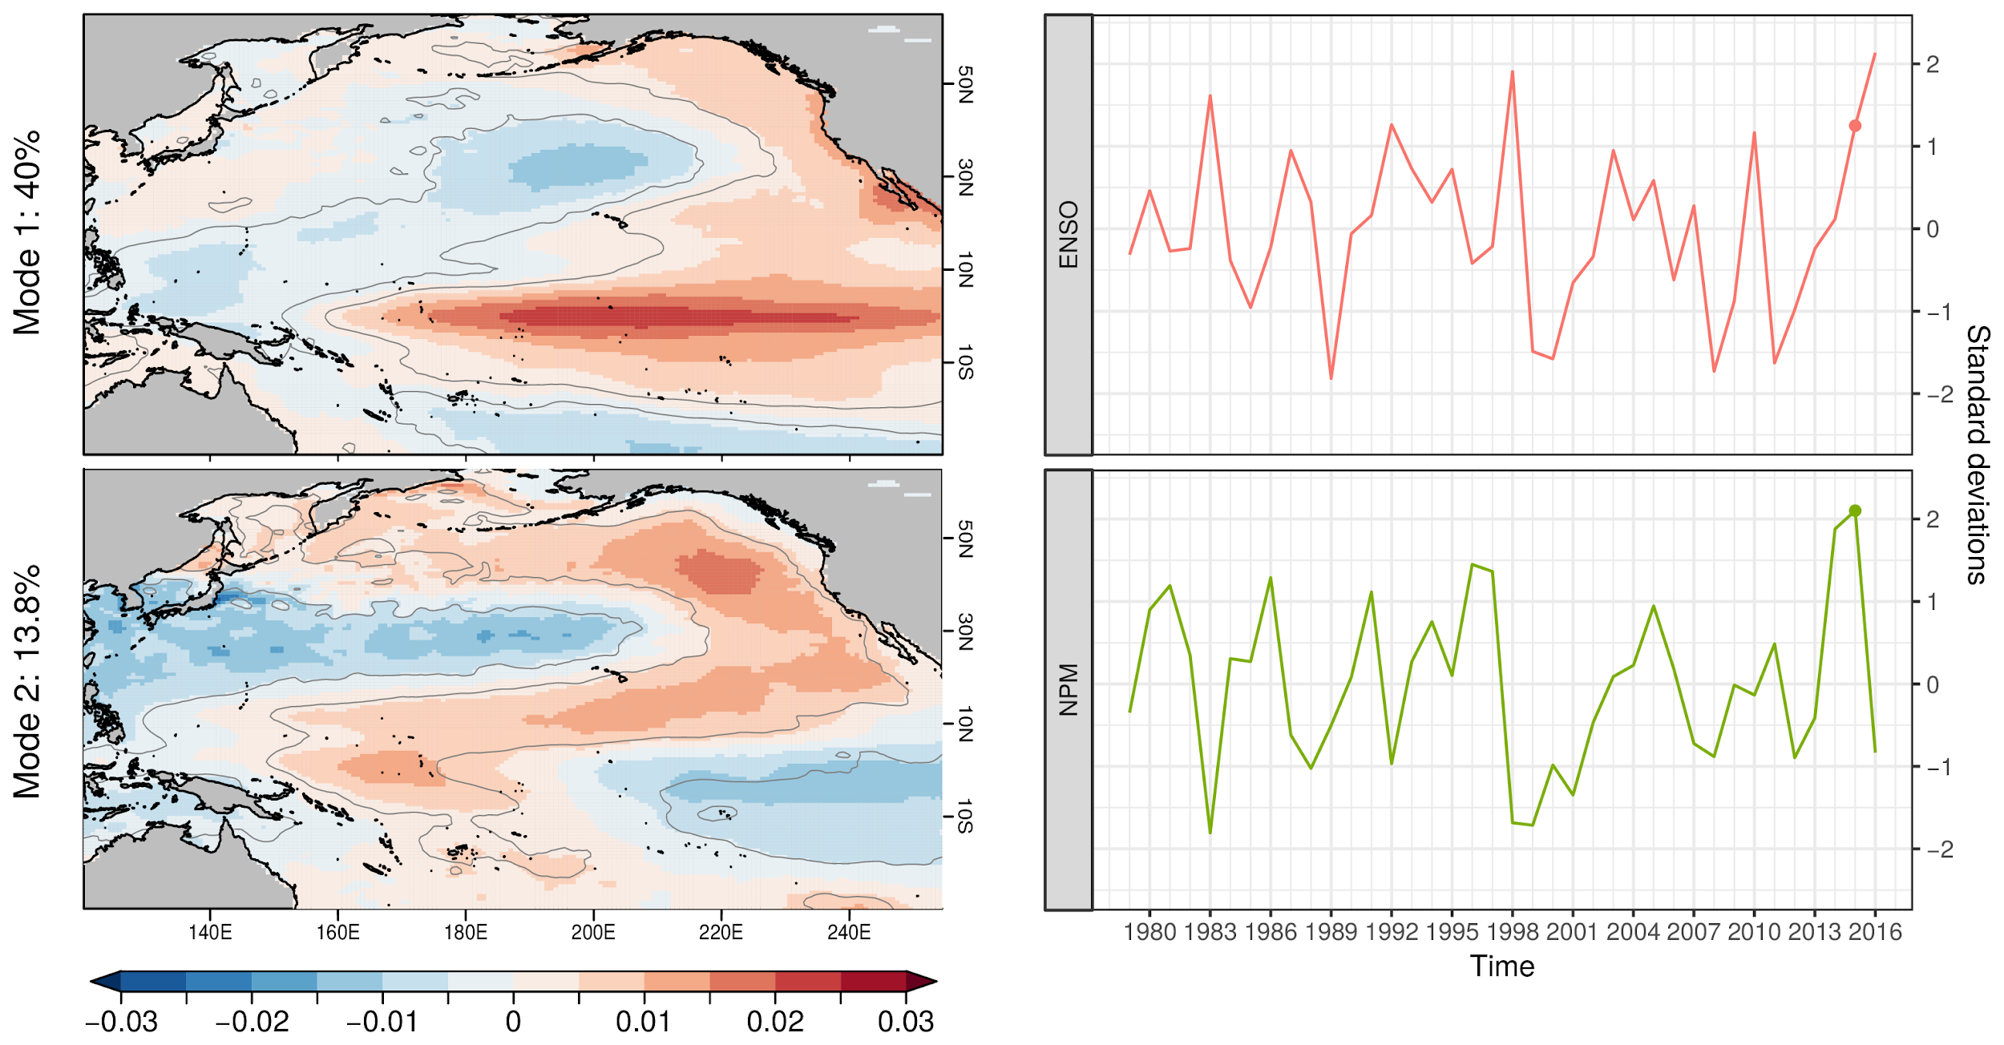
ENSO and NPM state
Lledó et al., 2018: Investigating the effects of Pacific sea surface temperatures on the wind drought of 2015 over the United States.

Slide 22
Case study 3
Heat wave and wind drought in Spain - Sep 2016
Subseasonal forecasts

Slide 23
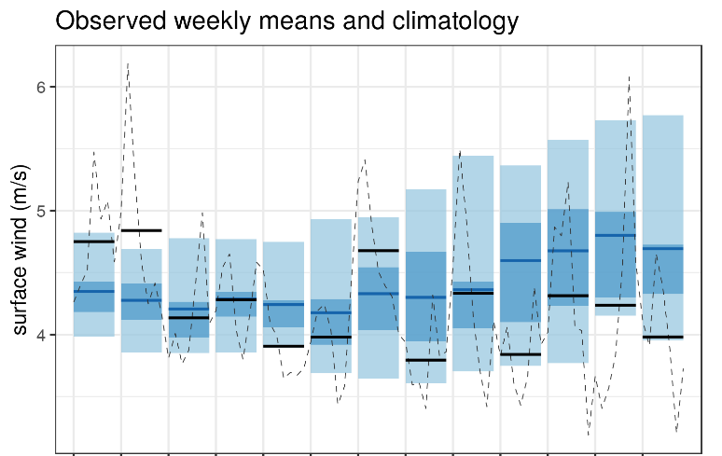
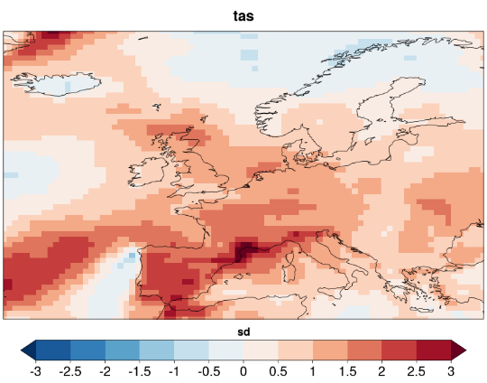
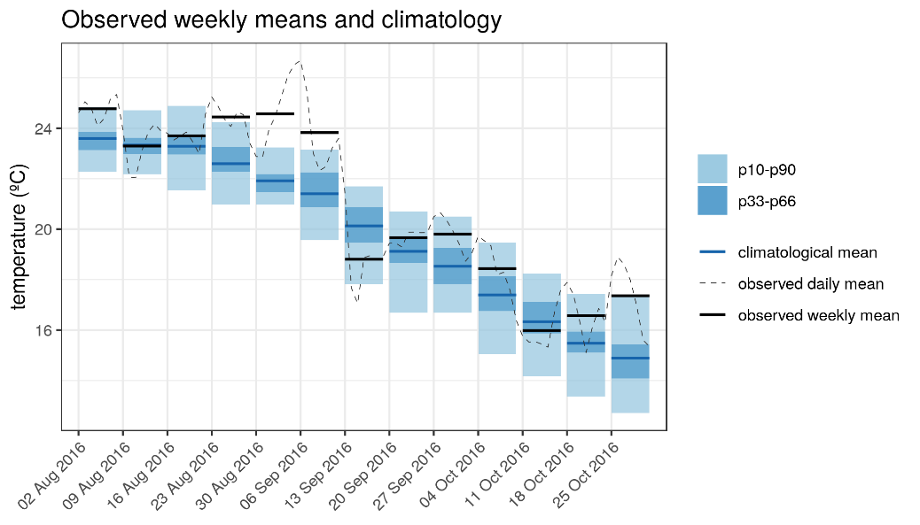
Heat wave and wind drought in Spain. Sep 2016
A hot spell over Europe created a combination of:
large increase in electricity demand
lower than usual hydro and wind power generation
Surface wind and temperature anomalies for the week 30/08/2016-5/09/2016. ERA-Interim with respect to climatology (1981-2017)
Notes:
‹#›

Slide 24
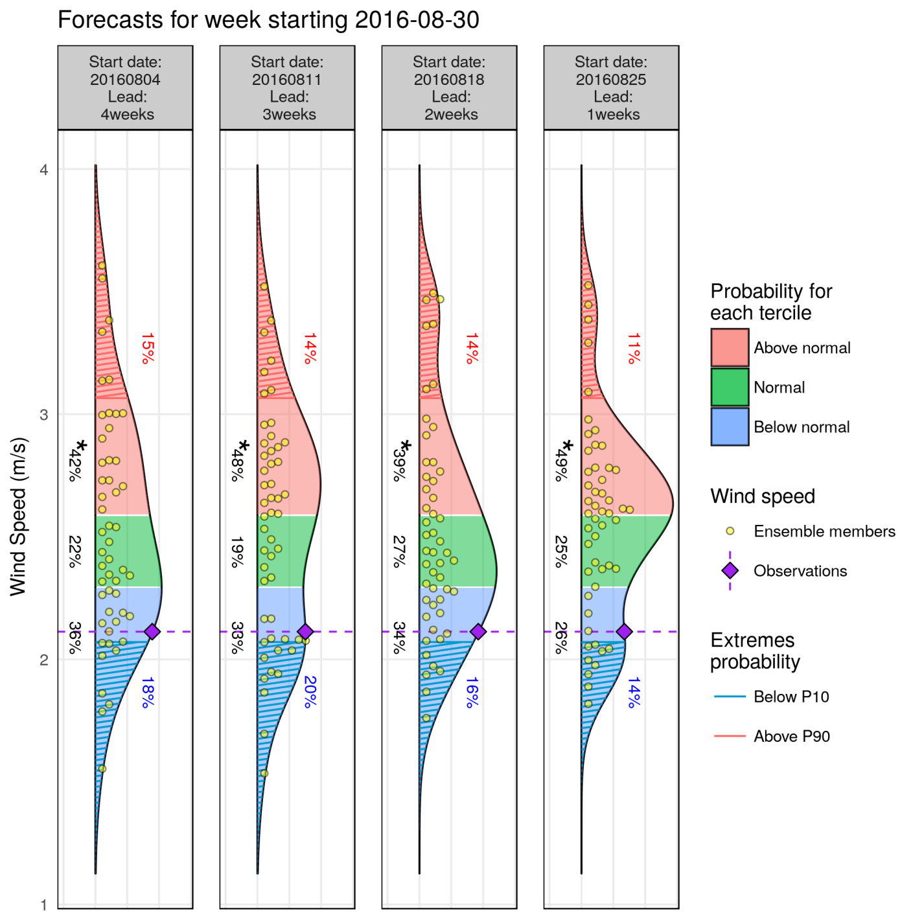
Wind speed forecasts
fairRPSS: -0.01 -0.02 0.02 0.09
System: ECMWF monthly prediction system
Reanalysis: ERA-Interim
Bias adjusted –calibrated
Hindcast: 1996-2015
Lat= 40.5 N/Lon = 358.5 E
Notes:
‹#›

Slide 25
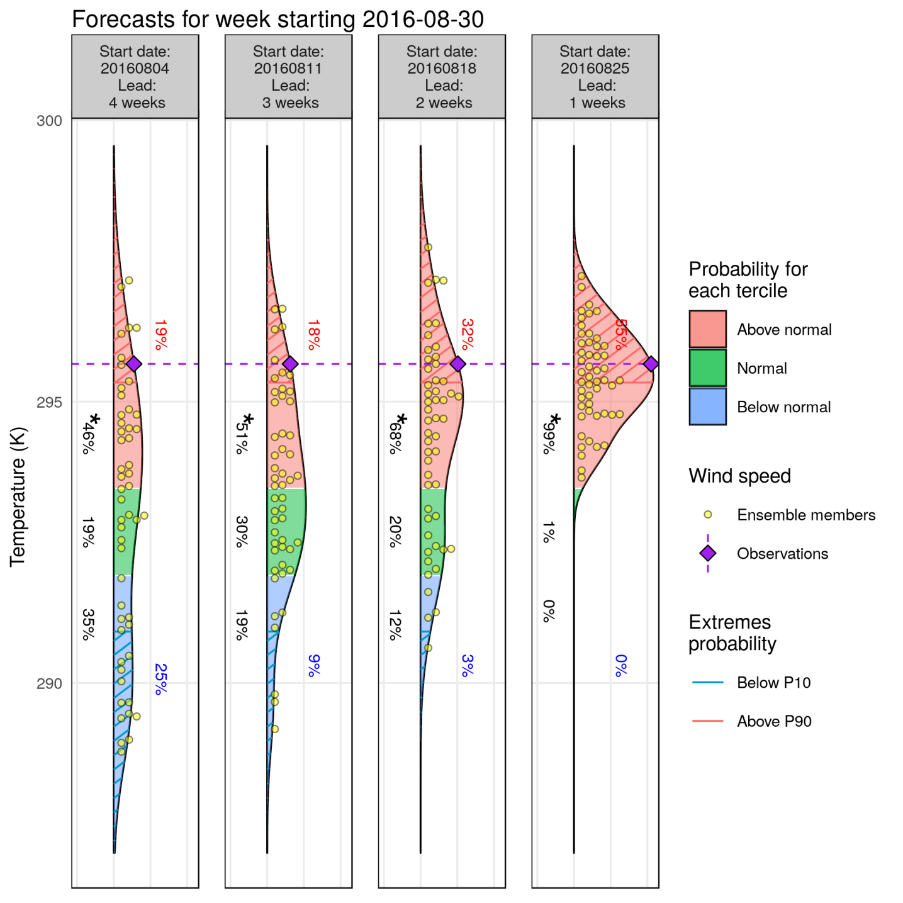
Temperature forecasts:
fairRPSS: 0.05 0.05 0.03 0.42
System: ECMWF monthly prediction system
Reanalysis: ERA-Interim
Bias adjusted –calibrated
Hindcast: 1996-2015
Lat= 40.5 N/Lon = 358.5 E
Notes:
‹#›

Slide 26
Final remarks
Climate prediction systems have improved in the last decade. Lets promote their usage for specific applications!
There is a long way between climate data and services
Case studies help scientists and users close the gap
Future work
Improve skill through multi-model ensembles
Improve skill through large-scale teleconnection patterns and weather regimes
Notes:
‹#›

Slide 27
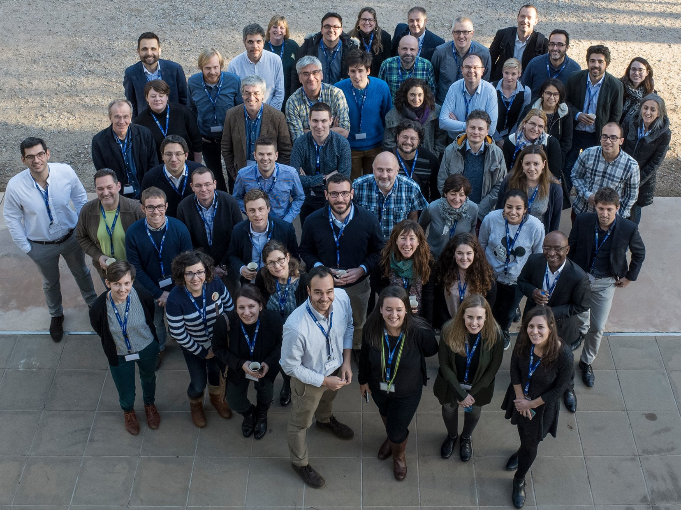
Llorenç Lledó: llledo@bsc.es www.s2s4e.eu
Notes:
‹#›

