Slide 1
Aerosol-sensitive Ice Nucleation Parameterizations in the EC-Earth3: evaluation and climate impacts
BSC: Montserrat Costa Surós, Maria Gonçalves Ageitos, Luka Ilić, Gilbert Montané Pintó, Carlos Pérez-García Pando,
EPFL/CSTACC: Paraskevi Georgakaki, Athanasios Nenes
Univ. of Crete/CSTACC: Maria Kanakidou, Marios Chatziparaschos,
NOA/CSTACC: Stelios Myriokefalitakis
KNMI: Twan Van Noije, Philippe Le Sager
25/05/2023
and No 821205”

Slide 2
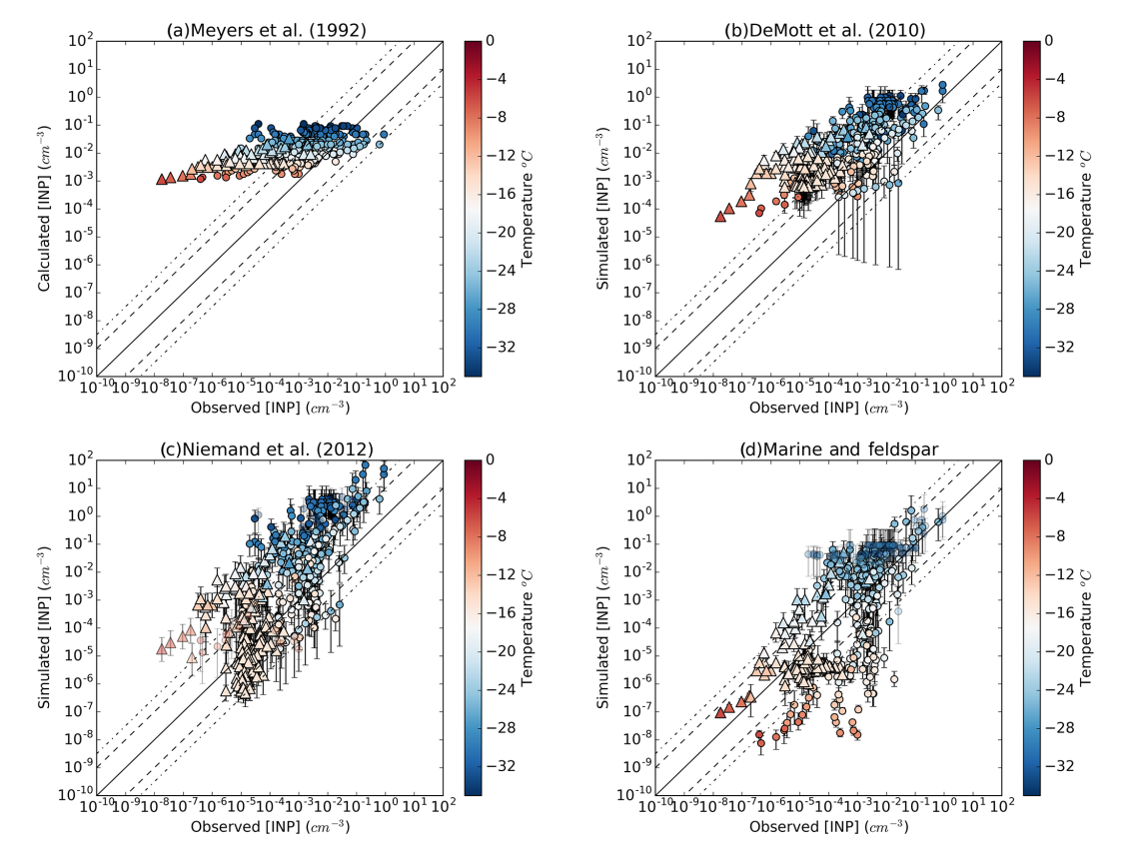
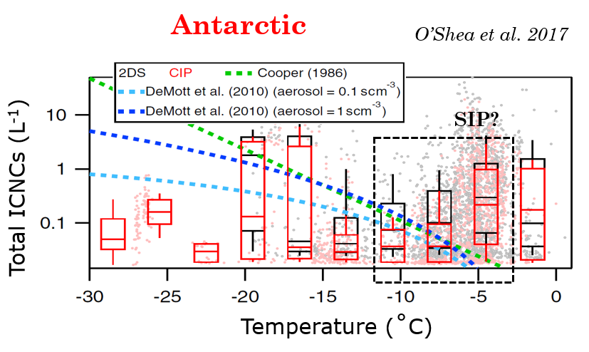
Motivation
Improve the representation of clouds in the CMIP6 ESM EC-Earth3-AerChem by updating the heterogeneous ice nucleation representation. The commonly used ice nucleation scheme based only on temperature is replaced with a state-of-the-art scheme sensitive to both aerosol and temperature and a secondary ice production parameterization based on a random forest model.
Vergara-Temprado et al., 2017
1
Why we believe that the new parameterizations will improve the modeled clouds? Because there is eveidence that mineralogy-dependent parameterizations compare better with INP observations. So if we can better reproduce the INP we will most probably better reproduce the MPC.
And regarding the SIP, we have included them because it has been found to be a large source of icnc at warm temperatures that the models don’t capture when compared with observations.
Investigate the effect of modeled dust mineralogy upon heterogeneous ice nucleation in mixed-phase clouds by implementing new ice nucleation parameterizations in EC-Earth3-AerChem dependent of aerosols, and the effect of the secondary ice production (SIP) in a global model by implementing a new SIP parameterization based on a Random Forest regressor (RaFSIP) in the EC-Earth3-AerChem.

Slide 3
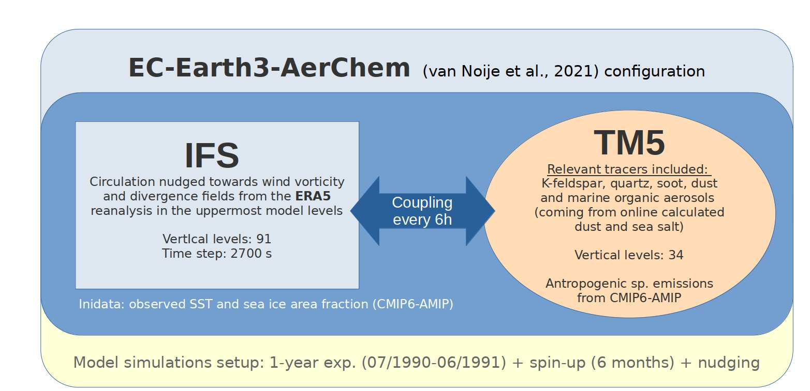
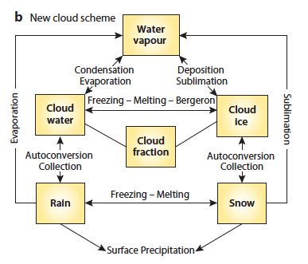
ECE3 with interactive aerosol mineralogy
Forbes et al., 2011
1
Collaboration with S. Myriokefalitakis (NOA), who implemented the mineral tracers in the TM5, I implemented the coupling to be used as an input to IFS.
Technical requirements prior tests
1. Prepare IFS module for printing new output variable: icnc, etc. (done with the PEXTRA functionality) and its cmorization
2. To implement aerosol mineralogy from TM5 interactively with IFS I needed to couple the individual mineral tracers (insoluble Quartz and Feldspar in accumulation and coarse modes) from TM5 to IFS (through OASIS)
3. Include these new tracers to the IFS output to be able to check the consistency of the coupling → we detected that it actually makes a level assignation not an interpolation
6-months spin-up allow for a good spread / homogeneization of the dust regardless of the initial conditions
Atmospheric
Chemistry
TM5
Atmospheric
Dynamics
IFS
Horizontal resolution:
IFS: ~80km (T255L91, 0.7x07º, 256x512)
TM5: 2x3º (34 vertical lev)
Feldspar
Quartz
Marine organic
[...]

Slide 4
PRIMARY ICE
PRODUCTION
New heterogeneous ice nucleation parameterization
ICNC estimation
Temperature-sensitive ice nucleation parameterization
Aerosol-sensitive ice nucleation parameterization
SECONDARY ICE PROCESSES
Meyers et al. (1992): deposition-condensation freezing
Immersion freezing
Wilson et al. (2015): of marine organic aerosols
Atkinson et al. (2013): K-fedlspar
or
Ullrich et al. (2017): soot and dust
or
Harrison et al. (2019): K-feldspar and quartz
N_{i}: ice crystal number concentration
e_{sl}: saturation vapor pressure with respect to liquid water
e_{si}: saturation vapor pressure with respect to ice
Collision fragmentation,
Hallett-Mossop or rime-splinetring
Droplet shattering
Sublimation fragmentation
Georgakaki et al. (in prep.): RaFSIP, which considers:
- Hallet-Mossop process
- Droplet shattering during freezing
- Fragmentation due to collisional break-up
Secondary ice production
Lohmann et al., 2016
Ice crystal growth by vapor deposition
Depositional growth parameterization
Following Pruppacher and Klett (1997) and Rotstayn et al. (2000)
1
Four 1-year-long simulations (July 1990 – June 1991) with different ice nucleation parameterizations were run with the EC-Earth3-AerChem ESM with the configuration as in Fig. 1 and the ice nucleation and growth scheme as in Fig.2:
The Meyers et al. (1992) parameterization used in the original ECMWF IFS model.
Aerosol-sensitive (A-s) ice nucleation parameterization as a combination of the following primary ice production (PIP) processes: Harrison et al. (2019), Ullrich et al. (2017), and Wilson et al. (2015).
Aerosol-sensitive ice nucleation parameterization (as in “2”) in combination with a Random Forest regressor, RaFSIPv1, where the secondary ice production (SIP) processes are estimated from ice enhancement factors (Georgakaki et al., in prep.).
Same as in “3” but in combination with RaFSIPv2, where the SIP is directly estimated from the random forest parameterization
The modeled ice nucleating particles (INPs) were evaluated in the previous version of the transport model (TM4), which uses the same principles as TM5, against observations from "Impact of Biogenic versus Anthropogenic emissions on Clouds and Climate: towards a Holistic UnderStanding" (BACCHUS) (http://www.bacchus-env.eu/in/index.php) and Wex et al. (2019) in Chatziparaschos et al. (2023).

Slide 5
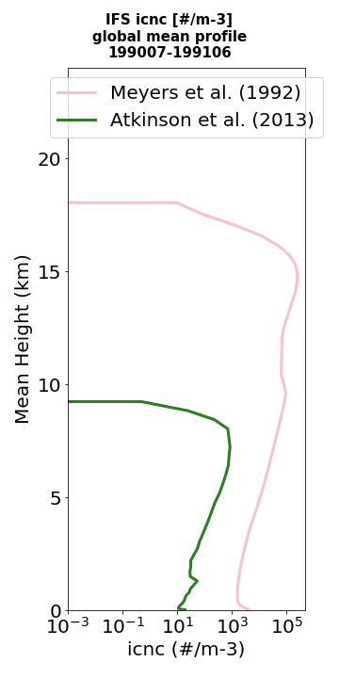
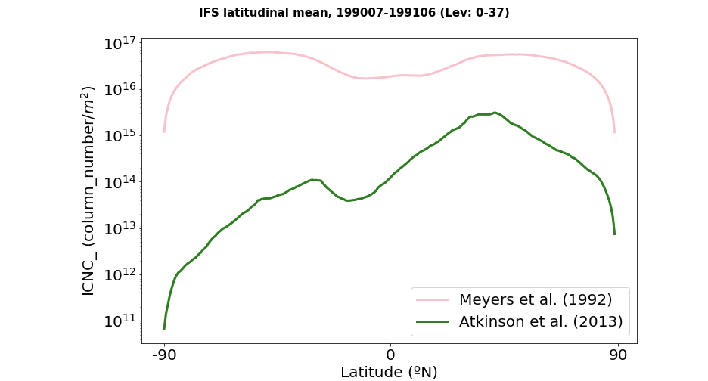
Meyers: a5yk
Atkinson: a5y6
Heterogeneous ice nucleation immersion freezing parameterizations
Atkinson et al. (2013):
- K-feldspar mass (acc. and coarse insoluble modes)
- [-25.15, -5.15] ºC
- External mixing assumption
1-year nudged simulations ICNC_MPC results
ICNC_MPC
(<~10 km)
1

Slide 6
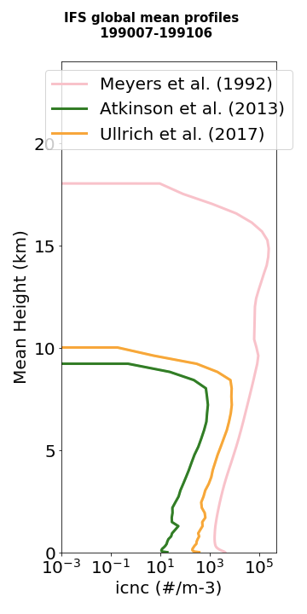
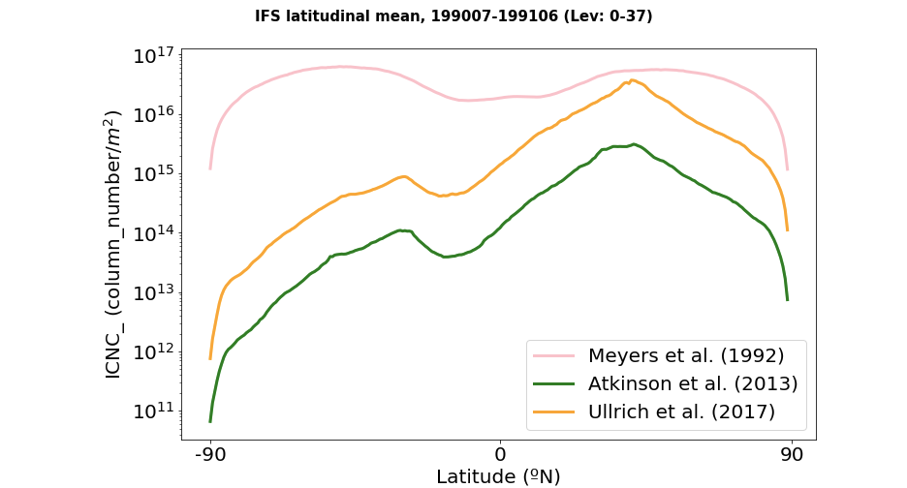
Meyers: a5yk
Ainson: a5y6
Ullrich: a5y8
Heterogeneous ice nucleation immersion freezing parameterizations
Ullrich et al. (2017):
- Dust (accum. and coarse soluble and insoluble), and soot mass (accum. and coarse soluble modes)
- Dust: [-30, -14] ºC, and soot: [-34.15, -18.15] ºC
- External mixing (for insoluble) and internal mixing (for soluble).
1-year nudged simulations ICNC_MPC results
ICNC_MPC
(<~10 km)
1

Slide 7
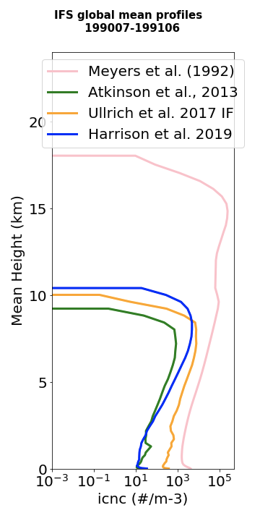
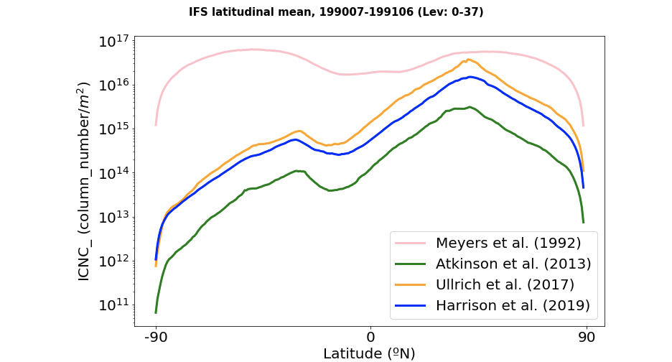
Meyers: a5yk
Atkinson: a5y6
Ullrich: a5y8
Harrison: a5y4
Heterogeneous ice nucleation immersion freezing parameterizations
Harrison et al. (2019):
- K-feldspar and quartz mass (acc. and coarse insoluble modes).
- K-f: [-37.51, -3.5] ºC, quartz: [-37.51, -10.5ºC]
- External mixing assumption
1-year nudged simulations ICNC_MPC results
ICNC_MPC
(<~10 km)
1

Slide 8
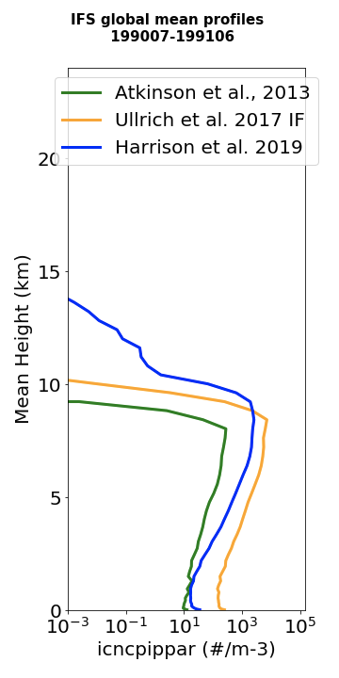
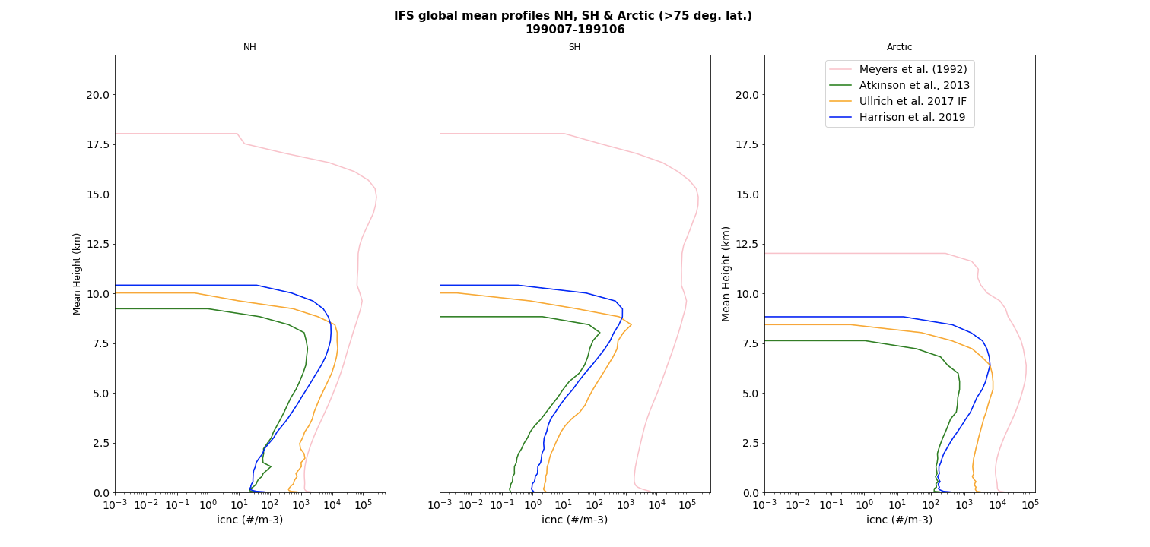
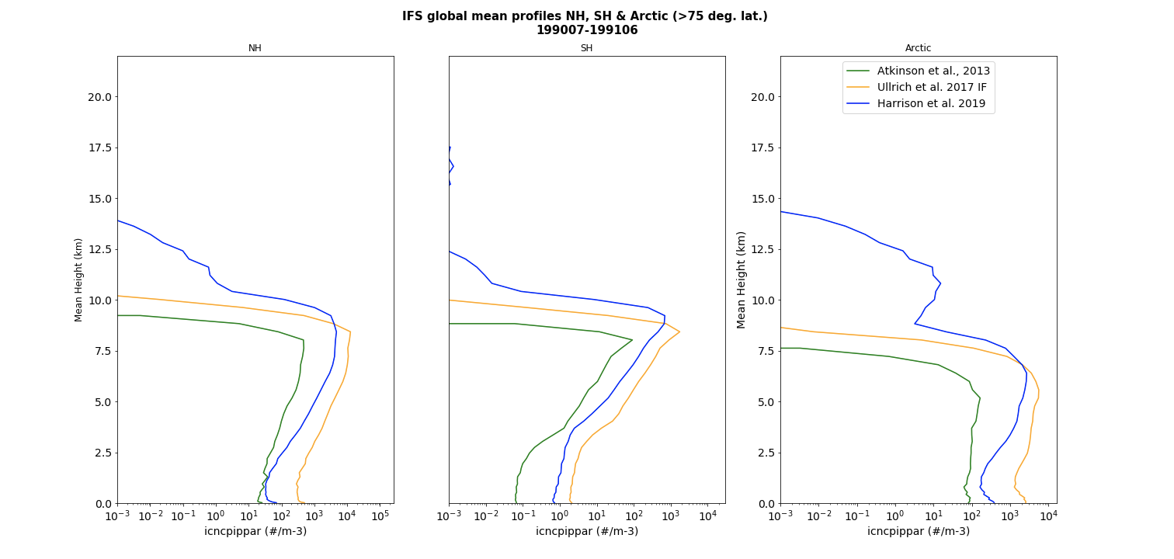
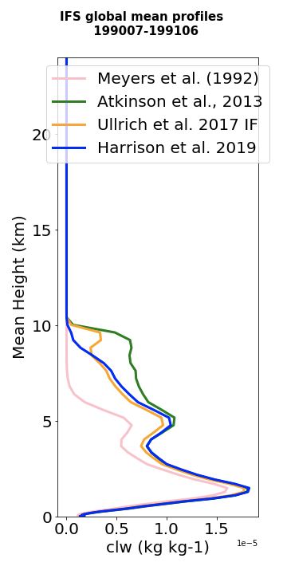
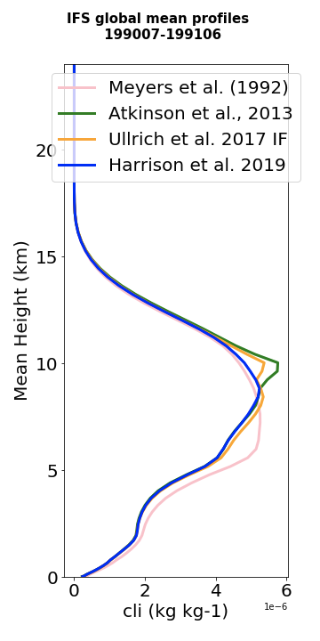
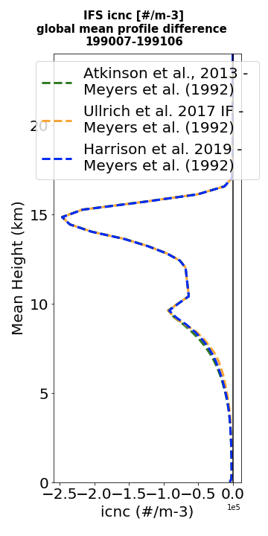
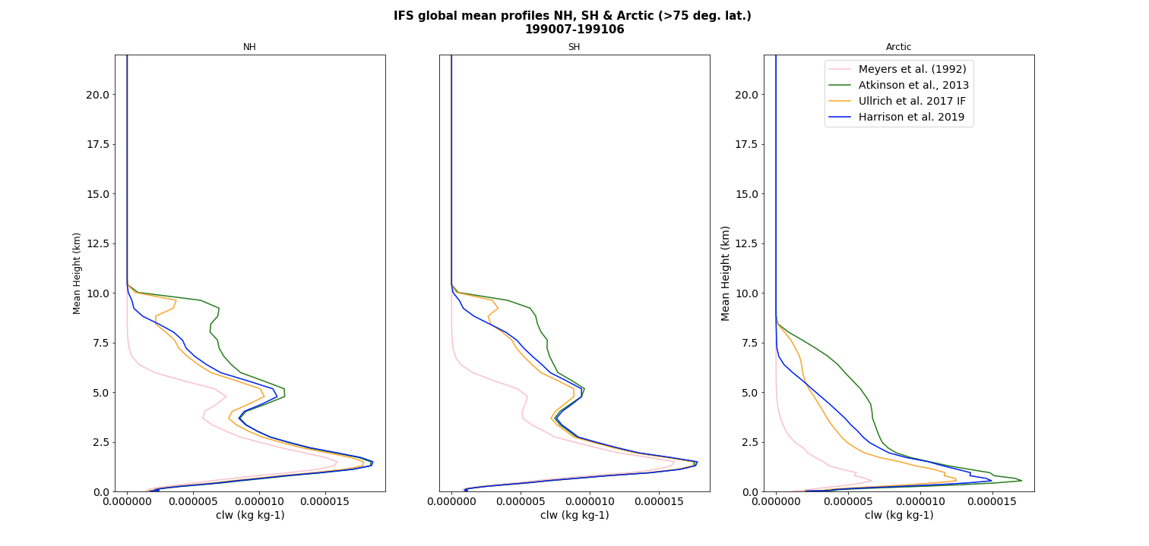
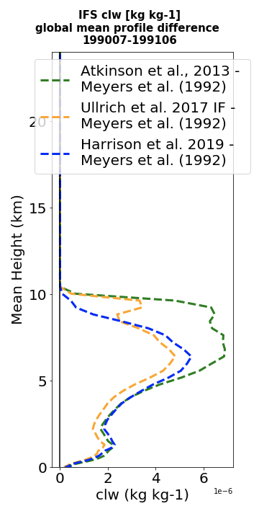
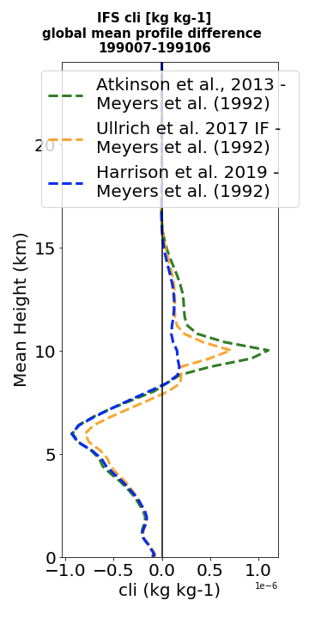
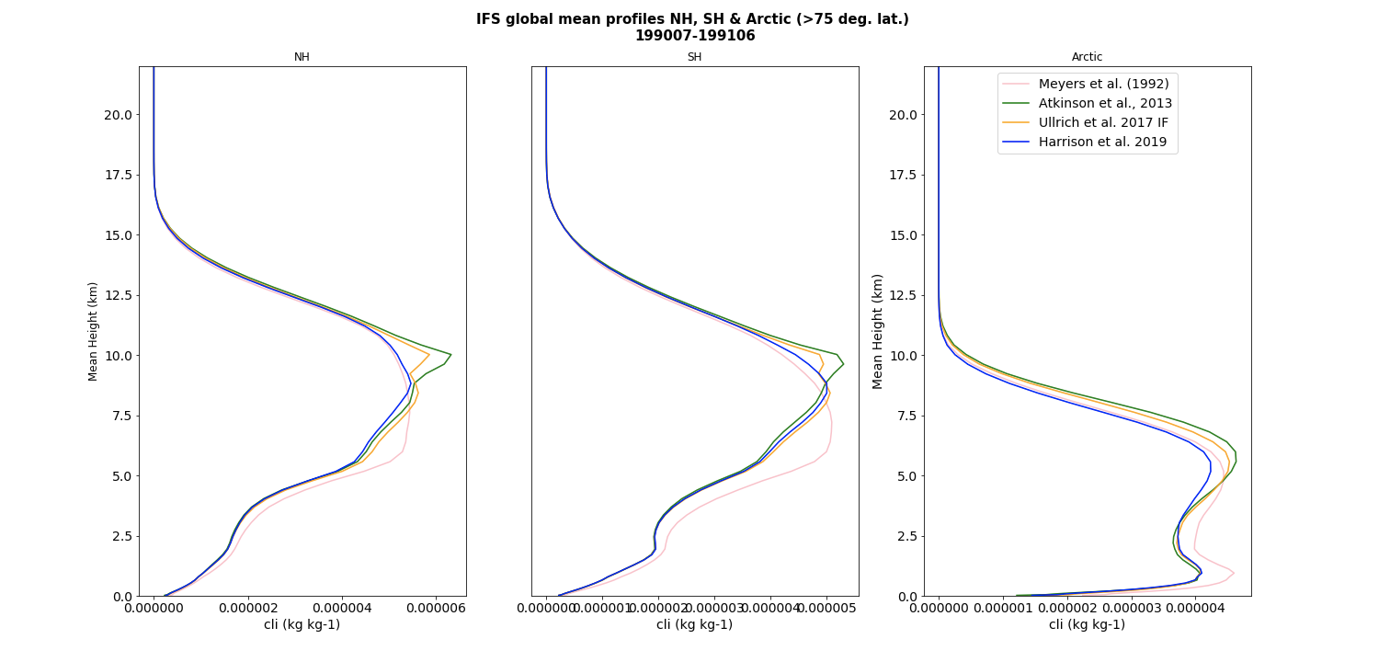
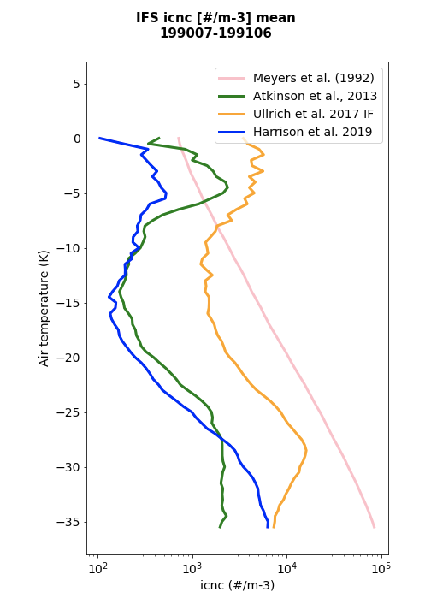
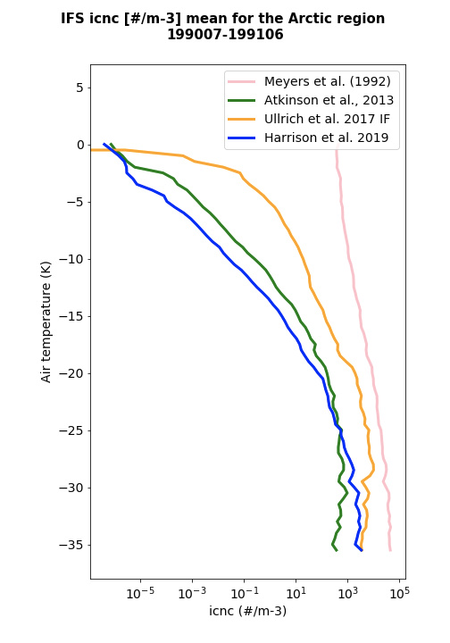
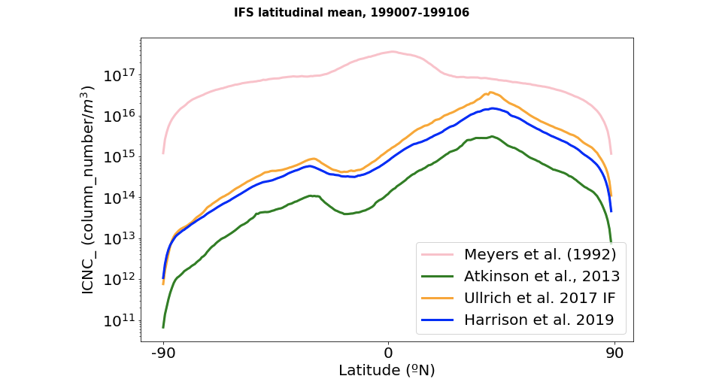
a5yk Meyers
a5y6 Atkinson
a5y8 Ullrich
a5y4 Harrison
Impact of the aerosol-sensitive parameterizations in the clouds
ICNC_MPC
LWC
IWC
We chose Harrison et al. 2019 bc:
- most updated reference (based in two dust mineral components)
- reaches higher altitudes (do it with pressure levels too)
- don’t overpass Meyers (check temp. figure how it’s done)
ICNC in the mixed-phase cloud regime used for the calculation of ice mass by depositional growth
Homogeneous
freezing
Homogeneous
freezing
Above ~ 10-11km homogeneous freezing dominates
(Meyers ICNC > 10-11km are not effective for heterogeneous ice production)
1

Slide 9
a5yk Meyers
a5y6 Atkinson
a5y8 Ullrich
a5y4 Harrison
ICNC in MPC regime: results of 1-year nudged simulations
ICNC in the mixed-phase cloud regime used for the calculation of ice mass by depositional growth
Need to take into account other processes and aerosols:
Include parameterization depending on immersion freezing of marine organic aerosols
Secondary ice production
Less ICNC_MPC from aerosol-sensitive ice nucelation parameterizations than from Meyers, especially at the SH.
ICNC_MPC
(<~10 km)
1

Slide 10
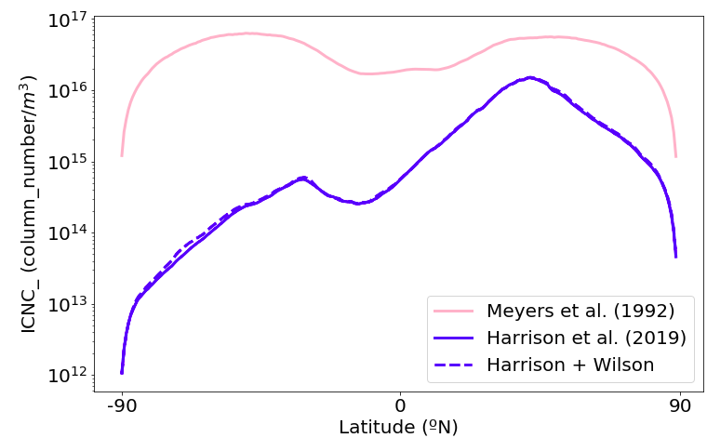
MPOA emission parameterization:
- Internally mixed with sea-salt (online calculation Gong et al., 2003)
- based on oceanic chlorophyll-a content (MODIS), Vignati et al., 2010
Meyers: a5yk
Harrison: a5y4 and H+W: a5yn
Heterogeneous ice nucleation immersion freezing parameterizations
Wilson et al. (2015):
- Marine organic aerosol particles (acc. soluble)
- [-28, -6.5] ºC
ICNC_MPC increase (%):
(Harrison + Wilson) - Harrison (+3.6%)
ICNC_MPC
(<~10 km)
Including a parameterization depending on immersion freezing of marine organic aerosols increasess lower levels ice formation in the oceanic regions
1

Slide 11
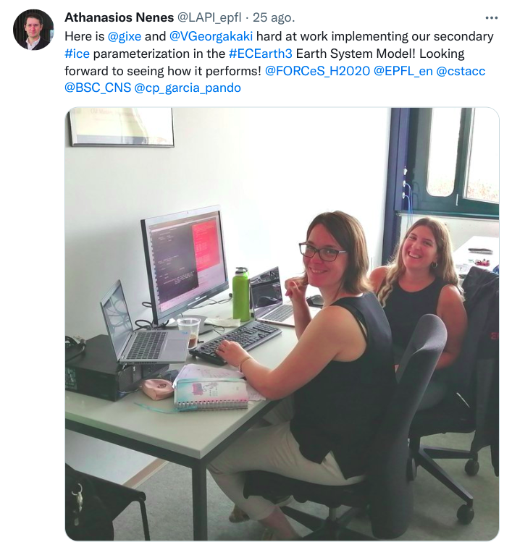
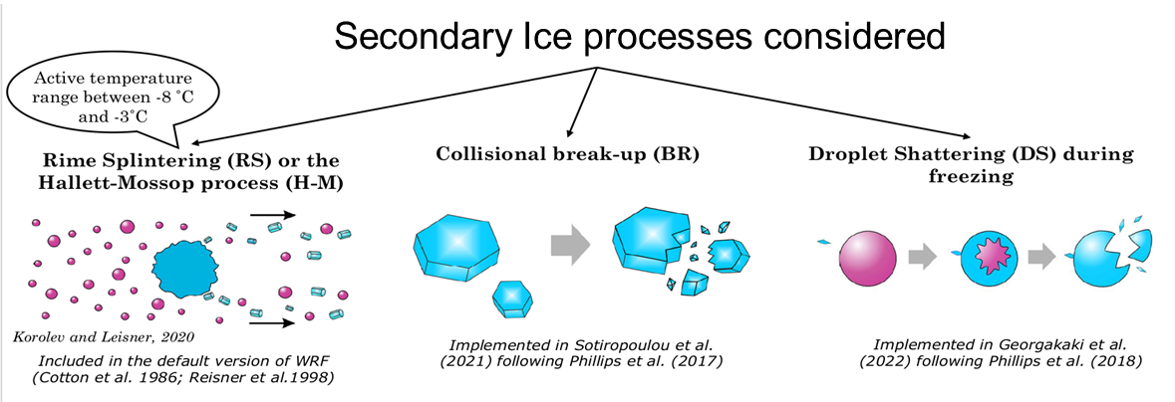
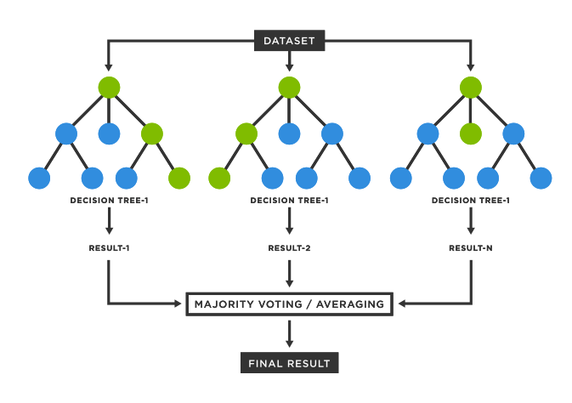
Secondary ice production parameterization
Georgakaki et al. (in prep.):
Parameterization developed from 2 years of simulation data with WRF that includes secondary ice microphysics:
Between -25
and -3 ºC
Between -25
and -3 ºC
The methodology has been tested in the NorESM, ECE3-AerChem, ECHAM-HAM, and Polar-WRF models and now implemented in the ICON.
Two approaches available:
RaFSIPv1: multiply the primary ice in each grid cell for each time step with an Ice Enhancement Factor (IEF) that accounts for SIP effects (not shown)
RaFSIPv2: the SIP is directly estimated from the random forest parameterization
11
11
Random Forest Regressor (RadSIP) used to express IEF as a factor of: IWC, LWC, Temperature, RHI, Raindrop mass mixing ratio, Cloud droplet riming (RIMC) and Raindrop riming (RIMR) (RIMC and RIMR explicitly calculated by RF reg.)

Slide 12
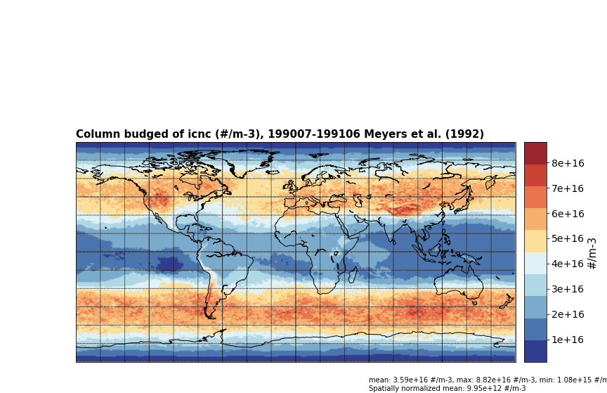
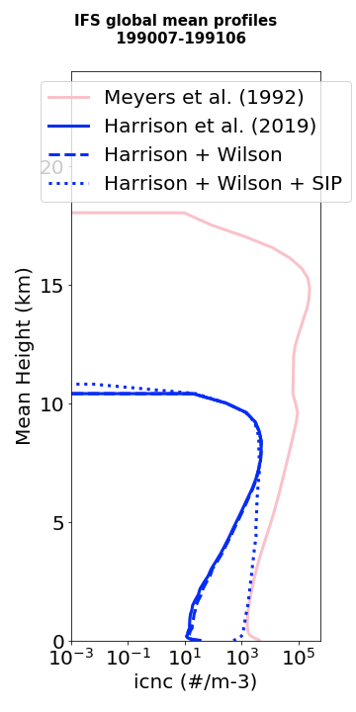
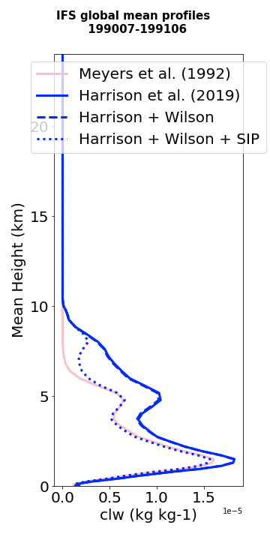
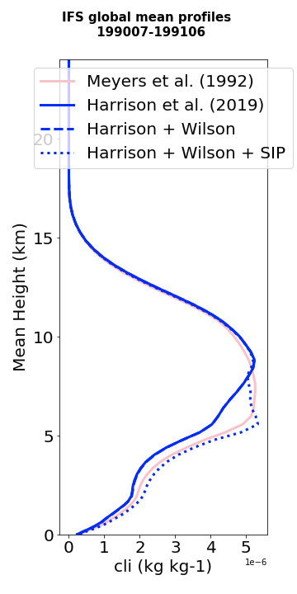
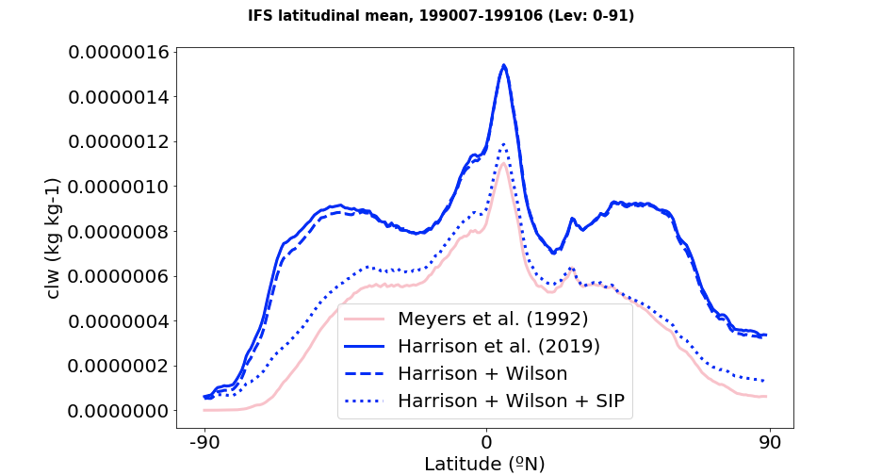
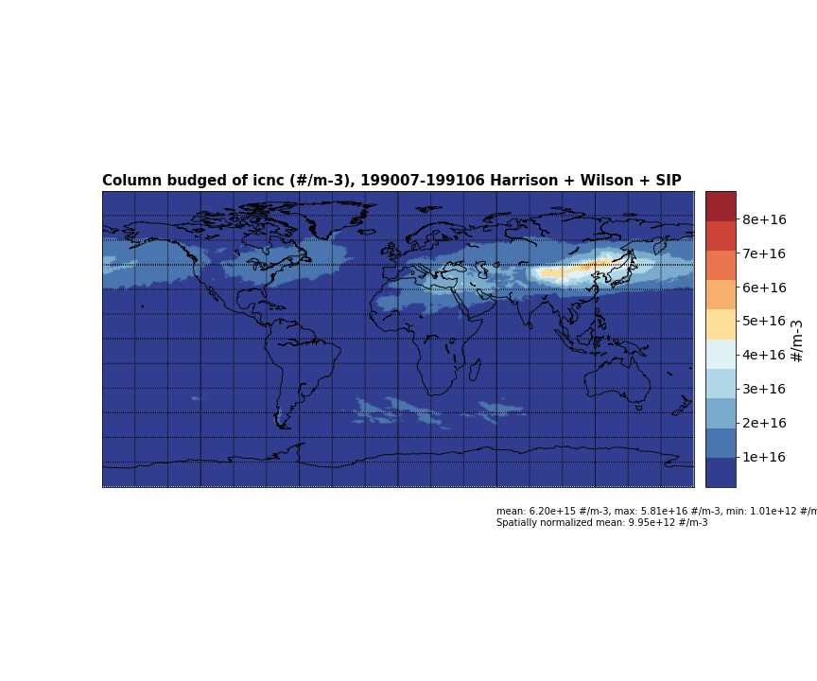
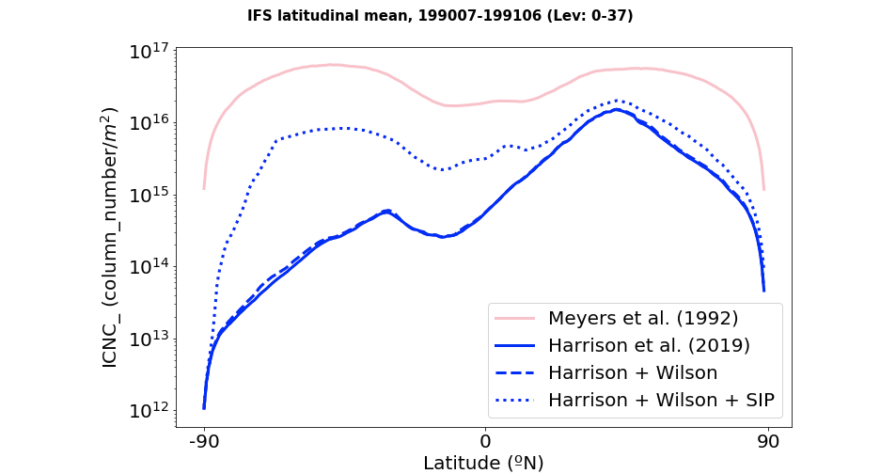
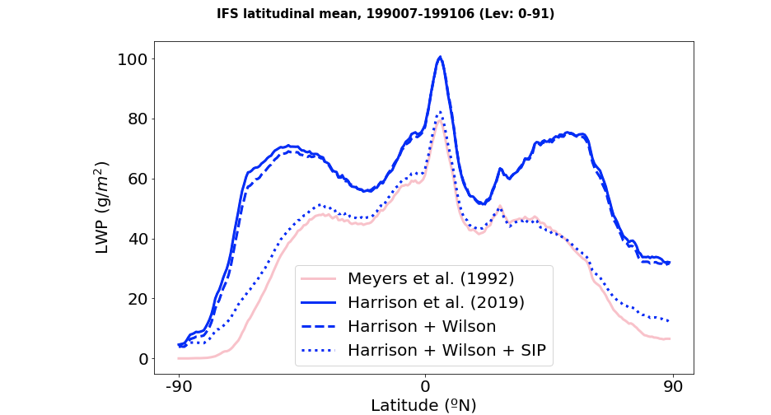
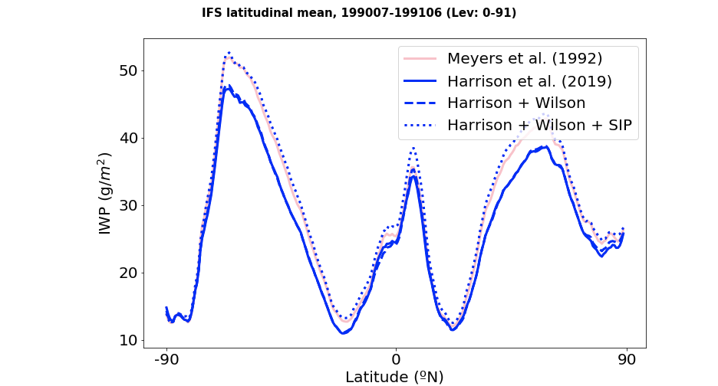
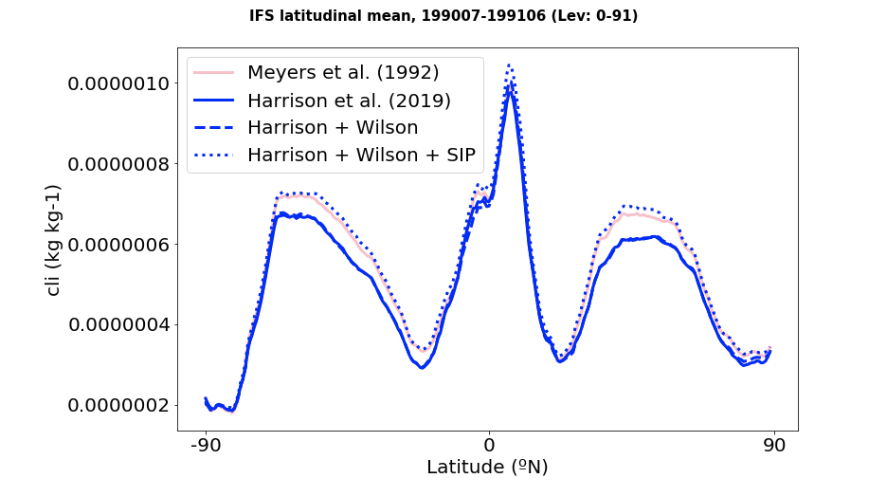
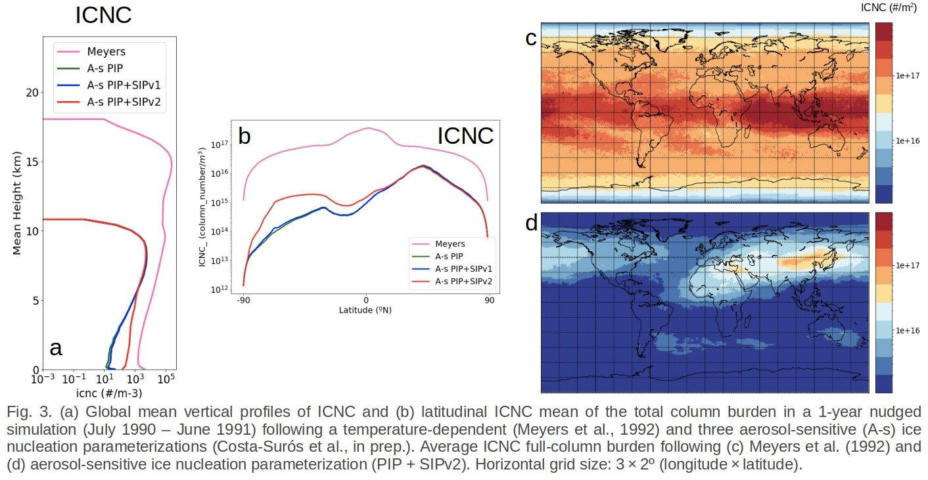
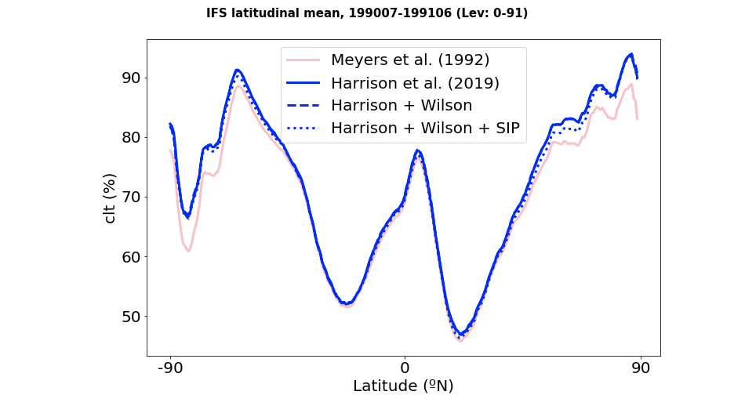
a5yk Meyers
a5y4 Harrison
a5yn Harrison + W
a5xy Harrison + W + SIP
Secondary ice production parameterization (RaFSIPv2)
ICNC_MPC
ICNC_MPC (column burden <~10Km)
LWC
IWC
#/m³
Homogeneous
freezing
Homogeneous
freezing
Homogeneous
freezing
Meyers
Harrison + Wilson + RaFSIPv2
LWP
IWP
More realistic distribution since it depicts a clear association of the simulated ICNC with the mineral-dust emission sources and transported areas.
ICNC_MPC
(<~10 km)
12
12
Parameterization’s impact to ICNC in 1-year average ICNC_MPC full-column burden:
Reduction in MPC ICNC with the new aerosol-dependent ice nucleation parameterization in comparison to Meyers et al.; however, the distribution seems more realistic since it depicts a clear association of the simulated ICNC with the mineral-dust emission sources and transported areas.

Slide 13
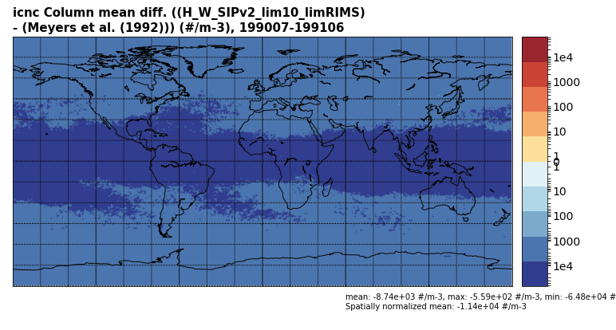
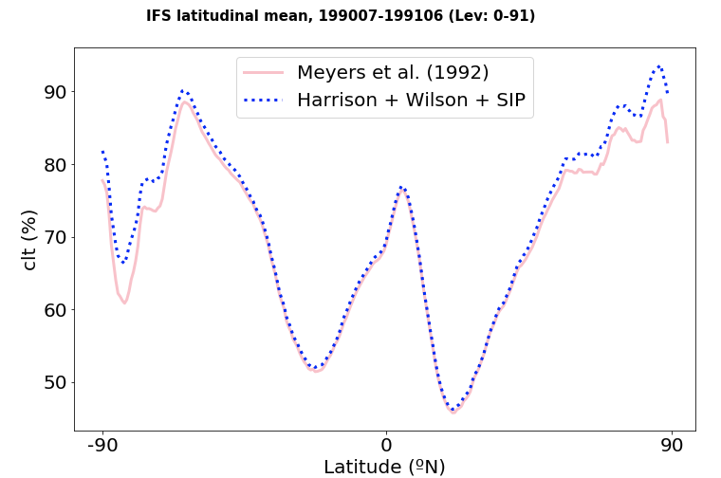
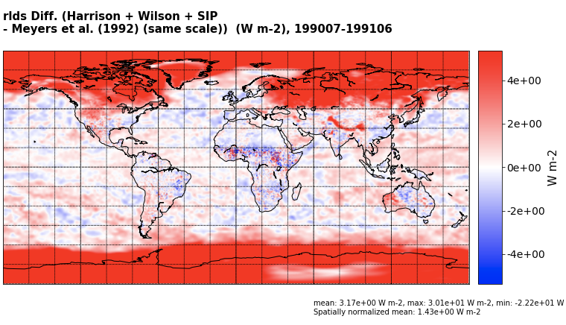
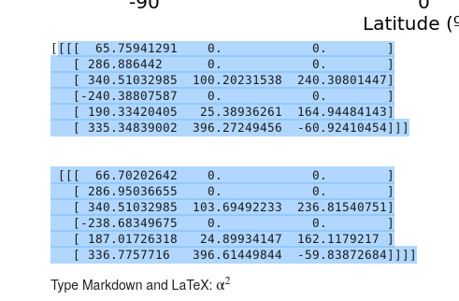
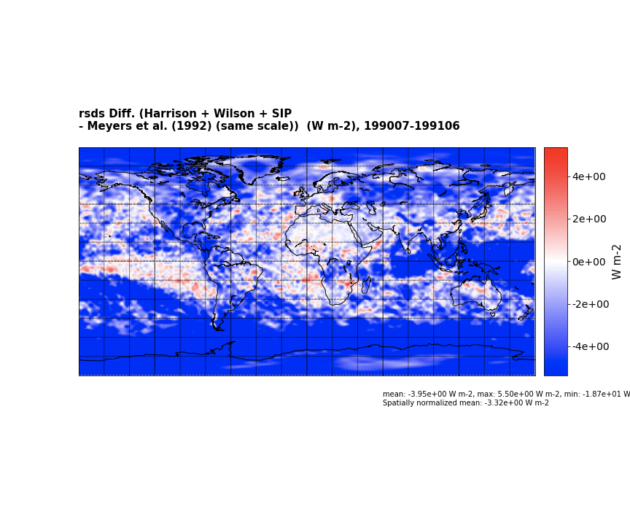
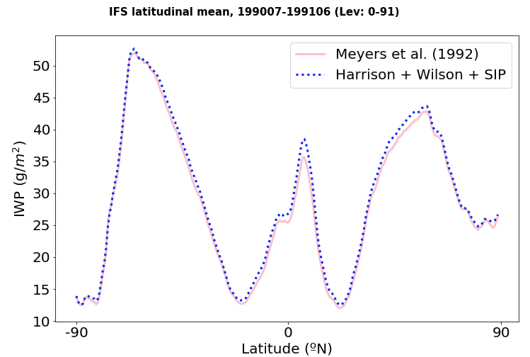
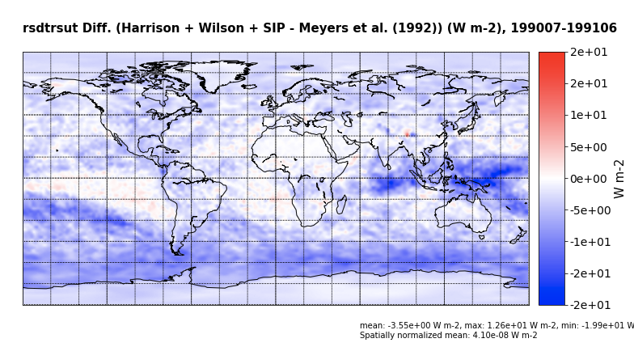
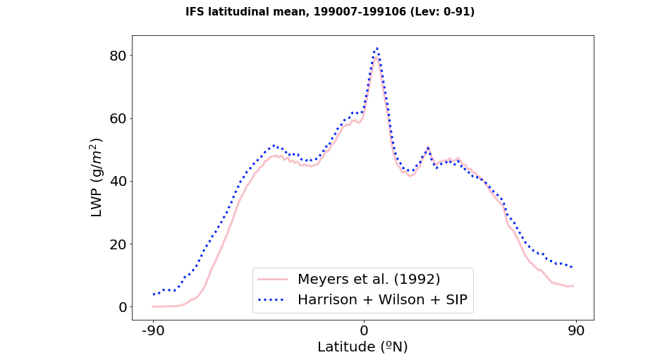
a5yk Meyers
a5xy Harrison + W + SIP
Climate impacts
Difference between aerosol-sensitive param. (Harrison et al. (2019) + Wilson et al. (2015) + RaFSIPv2) and Meyers et al. (1992)
(1-year nudged simulations)
Cloud cover (+0.9%)
LWP (+32.5%)
IWP (+0.05%)
TOA out. SW rad. (+3.5W/m2)
TOA out. LW rad. (-1.7W/m2)
Near-Surf. air temp. (+0.06K)
12
12
Globally, there is, on average, an increase in cloud cover with the new ice nucleation parameterization (PIP+SIPv2), in comparison to the Meyers et al. (1992) simulation, due to increase of liquid water path (Fig. 4). The global near-surface temperature increases on average by 0.05 K, while regionally, the temperature change ranges from -2.4 to 3.6 K (Fig. 4b). Radiative fluxes changes at the top of the atmosphere (TOA) are consistent with the cloud cover differences. There is a clear increase in the short-wavelength (SW) radiation flux at the TOA returning to space and a global decrease of the long-wavelength (LW) counterpart (Fig. 4d,f).
In comparison to Meyers et al. (1992) parameterization, with the A-s param. there is more cloud cover (mainly more liq. Cluds) which:
- increases the SWup_TOA (global average: 100.2 vs 103.7W/m2)
- decreases the LWup_TOA (global average:
Therefore, more thermal energy is kept in the system and makes the temperature rise (gl. Ave: +0.06K, ranging from 0.2 to -3.6K)
WIP: still working on the parametrizations, final results may change
Why LWP and IWP increase: bc less precip? yes

Slide 14
Key findings
The novel aerosol-sensitive ice nucleation parameterization, including primary ice nucelation and secondary ice processes, provides a comprehensive new parameterization that can substitute the deposition-condensation-freezing temperature-dependent parameterization by Meyers et al. (1992).
The new ICNC distribution seems more realistic since it depicts a clear association of the simulated ICNC with the mineral-dust emission sources and transported areas.
Large model sensitivity to ICNC is found: globally increased cloud cover (+0.9%), LWP (+33%), SW (+3.5 W/m²) and LW (-1.7 W/m²) upwards radiation flux at TOA, and near-surface temperature (+0.06 K, regionally ranges from -0.2 to 3.6 K).
1
2
3
12

Slide 15
Conclusions
The results suggest that substituting the temperature-dependent ice nucleation parameterization with an aerosol-sensitive parameterization, could partially reduce the known EC-Earth3 biases (Döscher et al., 2022) because it may simulate the global ice formation more realistically.
The simulations with the dust-sensitive IN param. tend to warm the high-latitude regions compared to the temperature-dependent parameterization. This corrects part of the cold bias over large parts of the NH land regions and the Arctic.
For Antarctica, the new aerosol-sensitive parameterization tends to warm on top of the warm bias. Since it has been attributed to biases in shortwave cloud radiative effects, it is probable that modifications in the cloud scheme from later IFS cycles will reduce them.
The aerosol-sensitive ice nucleation parameterization has been integrated with other developments from the EU FORCeS project to help improve the representation of aerosols and their interactions with warm and cold clouds.
Döscher et al. (2022) EC-Earth3 ensemble mean TAS biases compared to ERA5 (1980 – 2010)
1
2
TAS Difference between aerosol-sensitive param. and temperature-dependent
3
12
Specifically, the simulations with the dust-sensitive ice nucleation parameterization tend to warm the high-latitude regions compared to the temperature-dependent parameterization. This corrects part of the cold bias found in previous studies over large parts of the NH land regions and the Arctic (Döscher et al., 2022). However, for Antarctica, the new aerosol-sensitive parameterization tends to warm on top of the warm bias already found by Döscher et al. (2022). Since the warm bias of EC-Earth3 for the Southern Ocean and Antarctica has been attributed to biases in shortwave cloud radiative effects, it is probable that modifications in the cloud scheme from later IFS cycles will reduce them.
The aerosol-dependent implementation will be integrated into the EC-Earth3-FORCeS version together with other groups' developments to improve the aerosol forcing representation.

Slide 16
Future plans
Better representation of the ice formation processes by including other INPs as precursors of ice crystals (e.g. pollen).
Consider other immersion freezing parameterizations (e.g. McCluskey et al., 2018).
The SIP parameterization will be further tested in the FOR-ICE intercomparison project.
The simulation period will be extended to climatological scales to assess the variability of the results over longer periods.
12
The following further improvements and refinements of the aerosol-dependent parameterization are planned:
Model simulations for the dust intrusion event occurred in March 2022 (nudging towards ERA5).

Slide 17
Special acknowledgements: Atmospheric Composition EC-Earth3 Working Group
montserrat.costa@bsc.es
Aknowlegdments:
This project has received funding from the European Union's Horizon 2020 research and innovation programme under the Marie Sklodowska-Curie grant agreement No. 754433 from the call H2020-MSCA-COFUND-2016 (STARS), No. 821205 (H2020-LC-CLA-2018-2, FORCeS project), No. 773051 (ERC-2017-COG, FRAGMENT project), No. 726165 (ERC-2016-COG, PyroTRACH project), and from the AXA Research Fund.
and No 821205”

