Slide 1
Kuwait, February 2017
Modeling and predicting
the dust cycle at BSC
From R&D to operational forecast
Carlos Pérez García-Pando (carlos.perez@bsc.es)

Slide 2
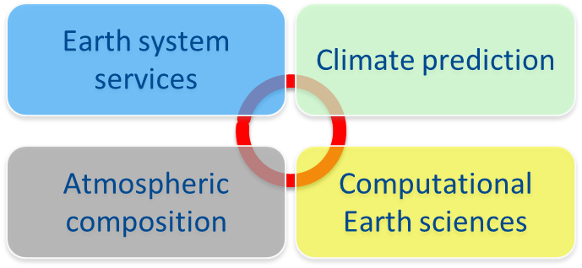
Barcelona Supercomputing Center
Spanish National HPC facility
Created in 2005: 450 employees
Our mission
to provide infrastructure and supercomputing services to European scientists, and
to generate scientific knowledge and technology to transfer to business and society.
Earth Sciences Dpt.
Industry

Slide 3
BSC Dust Services

Slide 4
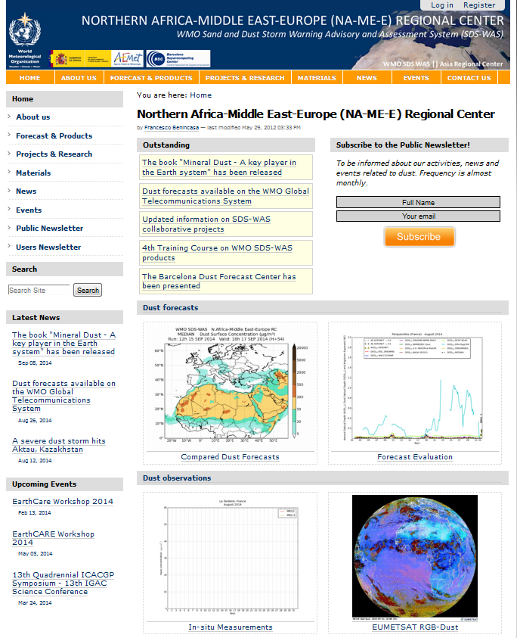
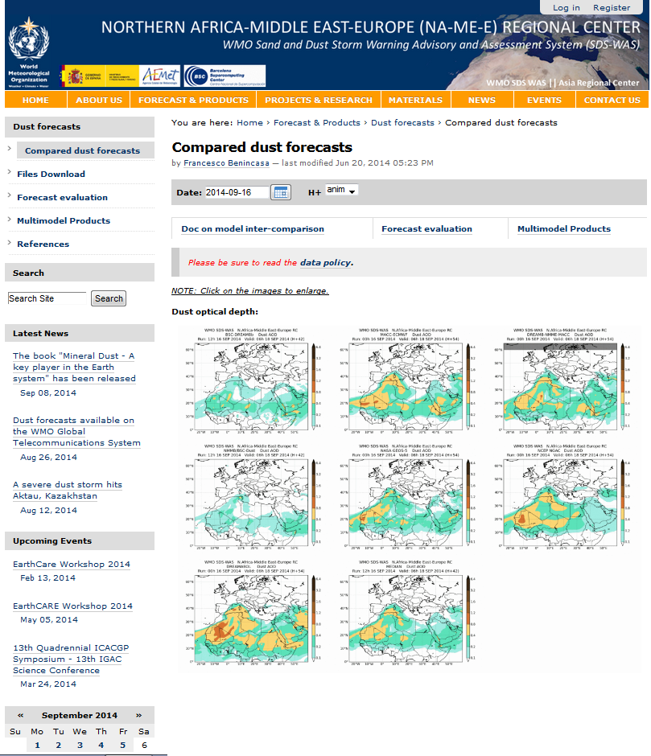
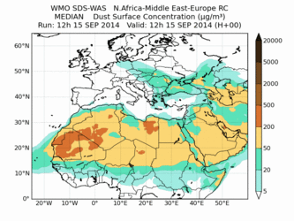
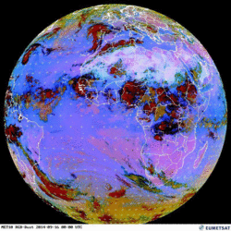
WMO SDS-WAS programme
Dust impacts have motivated the creation (in 2007) of WMO Sand and Dust Storm Warming Advisory and Assessment System (SDS-WAS) programme.
The objective of this programme is to improve the understanding of dust processes and dust prediction capabilities.
WMO SDS-WAS programme has 2 regional nodes, which are managed in 2 regional centers (RC):
NAMEE RC: AEMET-BSC, Barcelona
ASIA/Central Pacific RC: China Meteorological Agency, Beijing
WMO SDS-WAS NAMEE RC:
8 dust models (e.g. NMMB/BSC-DUST, BSC-DREAM8b) → Dust forecast (DOD, Surf. Conc.)
NRT evaluation (e.g. AERONET sun-photometers, MODIS)
http://sds-was.aemet.es/

Slide 5
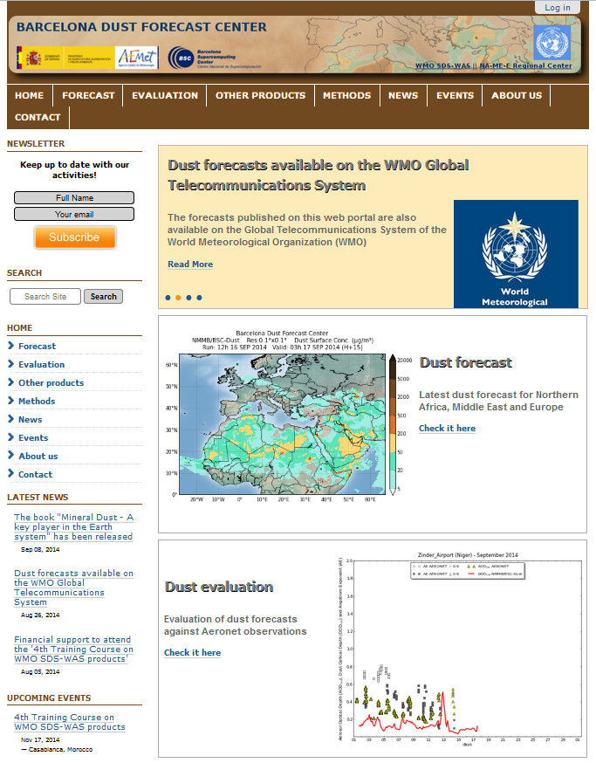
WMO Barcelona Dust Forecast Center
WMO Barcelona Dust Forecast center (BDFC):
It is the first specialized center for mineral dust prediction of the WMO
NMMB/BSC-Dust model has been selected by WMO as dust model of reference for the dust forecast of this center
Dust forecast (NMMB/BSC-Dust):
0.1ºx0.1º
72h (daily updated)
Various variables (e.g. DOD, Dust surf. Con.)
North Africa, Middle East, and Europe
NRT, monthly, and seasonal evaluation:
AERONET sun-photometers (e.g. AOD, AE)
http://dust.aemet.es/

Slide 6
NMMB/BSC-Dust
Nonhydrostatic Multiscale Model on the B-grid (NMMB)
meteo variables/parameters
→ Janjic and Gall (NCAR/TN 2012)
→ Janjic and Vasic (EGU2012)
→ Janjic et al. (MWR 2011)
→ (...)
NMMB/BSC-CTM
→ Pérez et al. (ACP 2011)
→ Haustein et al. (ACP 2012)
AEROSOLS
→ Spada et al. (ACP 2013)
→ Spada et al. (AE 2014)
BSC Chemical
Transport Model
(gas/aerosol variables:
mass mixing ratios)
→ Spada et al. (GMD 2016 in prep)
VOLCANIC ASH
→ Martí et al. (2017)
GAS-PHASE
CHEMISTRY
→ Jorba et al. (JGR 2012)
→ Badia and Jorba (AE 2014)
→ Badia et al. (GMDD 2016)

Slide 7
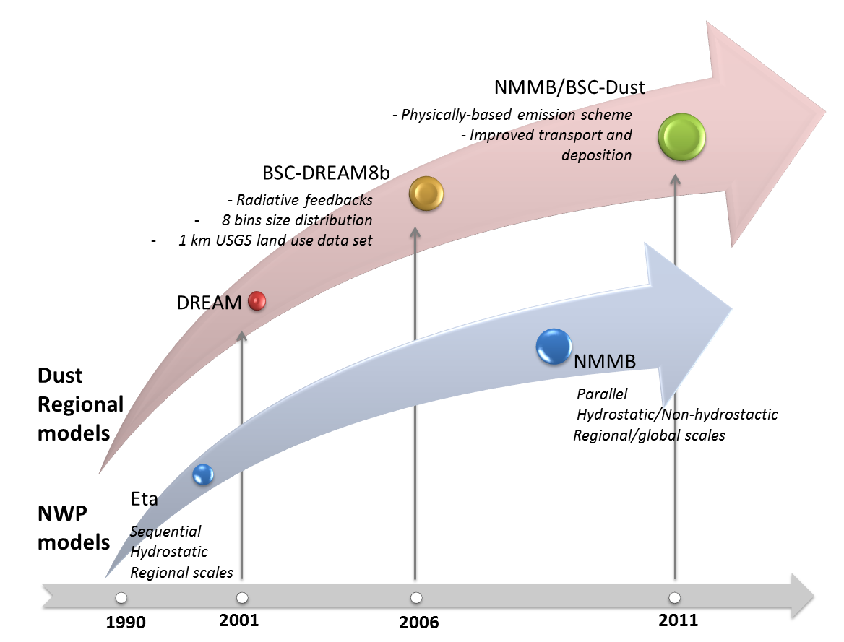
NMMB/BSC-Dust model operational at BSC since 2012
26

Slide 8
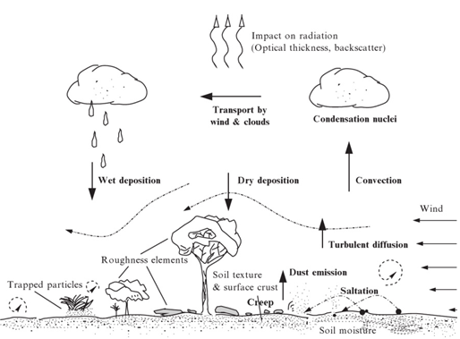
$$\frac{∂C_{k}}{∂t}=$$
$$−u\frac{∂C_{k}}{∂x}−v\frac{∂C_{k}}{∂y}−w\frac{∂C_{k}}{∂z}−∇\left(K_{H}∇C_{k}\right)−\frac{∂}{∂z}\left(K_{Z}\frac{∂C_{k}}{∂x}\right)+\left(\frac{∂C_{k}}{∂t}\right)−\left(\frac{∂C_{k}}{∂t}\right)$$
Horizontal
advection
Vertical
advection
Horizontal
turbulent
mixing
Vertical
turbulent
mixing
Emission
Deposition
Dry deposition: aerodynamic and surface resistance (Zhang et al., 2001)
Gravitational settling: Stokes approximation, Cunningham correction factor. Both implicit and explicit upwind schemes available.
In-cloud and below cloud scavenging from grid-scale (Ferrier Microphys.) and sub-grid scale (BMJ) clouds
Below cloud scavenging (directional interception, inertial impaction and Brownian diffusion)
Vertical convective mixing follows the BMJ adjustment scheme (instead of a mass flux scheme)
Radiation: RRTM SW/LW aerosol radiative feedback

Slide 9
Dust emission scheme:
Horizontal flux (H) (White, 1979) ($u^{∗}>u_{ths,i}^{∗}$):
$$H=δ\frac{ρ_{air}}{g}u^{∗3}\sum_{i=1}^{4}{\left(1−\frac{u_{ths,i}^{∗}}{u^{∗}}\right)\left(1−\frac{u_{ths,i}^{∗2}}{u^{∗2}}\right)}s_{i}$$
Threshold friction velocity ($u_{ths}^{∗}$) (Iversen and White, 1982; Marticorena and Bergametti, 1995; Fécan et al., 1999):
$$u_{ths}^{∗}=u_{tsd}^{∗}\left(D_{s}\right){·f}_{h}$$
Vertical flux ($F_{k}$) (Shao et al., 1993; Marticonera and Bergametti, 1995; Tegen et al, 2002):
$$F_{k}∝C·α·H$$
${ f}_{h}=Mositure correction$
${ u}_{tsd}^{∗}\left(D_{s}\right)=u_{ths}^{∗} in dry and smooth surfaces$
C $=Calibration factor$
$α=$ The horizontal to vertical flux ratio (for each soil population)

Slide 10
Source function
USGS landuse dataset [0-1]
1km dataset with 27 landuse categories
NESDIS vegetation fraction [0-1]
0.144 degree monthly 5-yr climatology
USGS Preferential sources [0-1]
(Ginoux et al., 2001)
Source function δ [0-1]

Slide 11
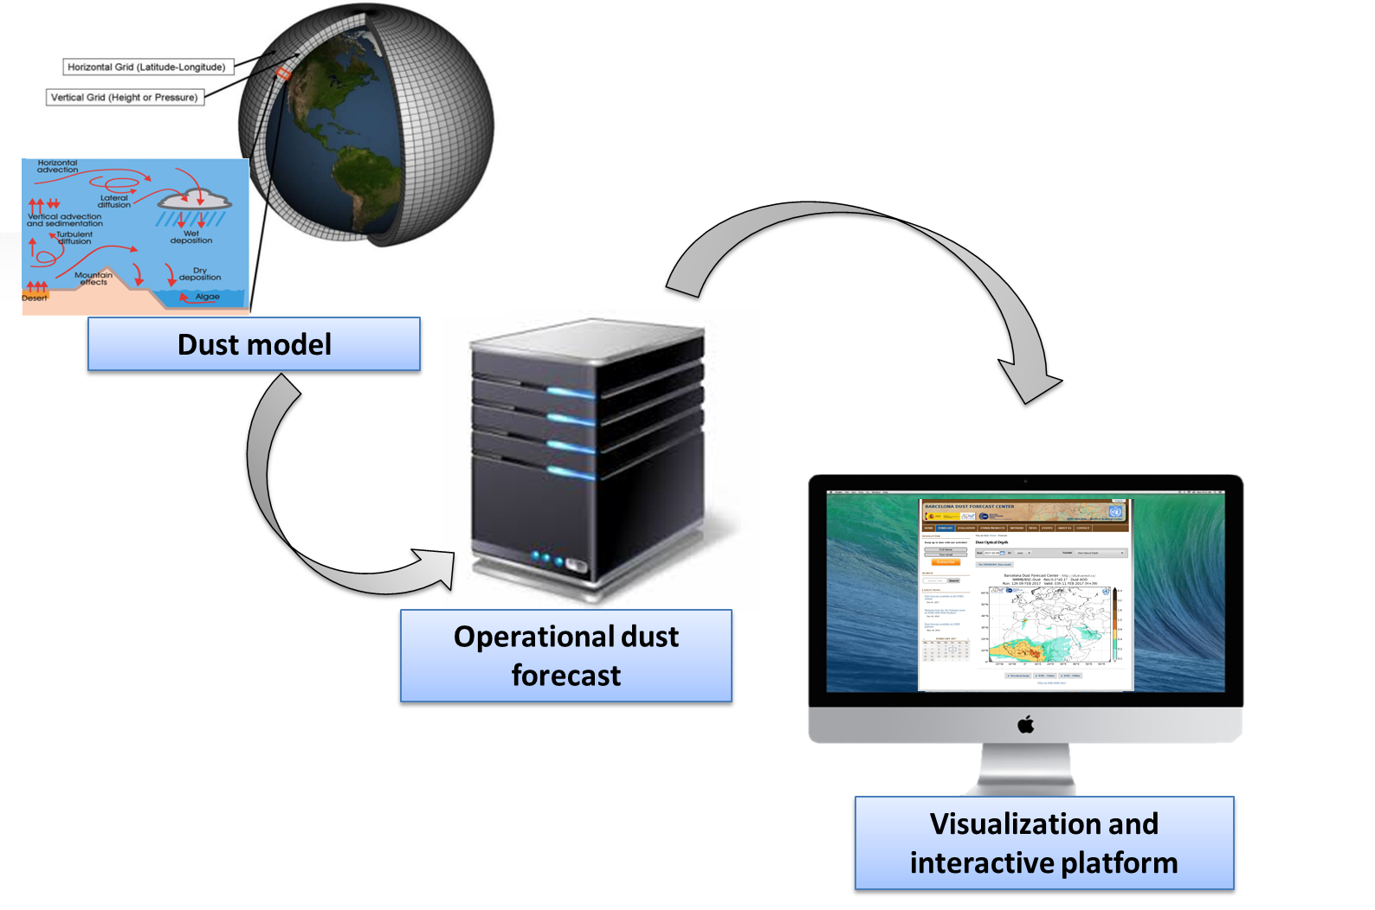
K-Dust project
OBJECTIVE: Development and implementation of a state-of-the-art dust forecasting system for Kuwait.

Slide 12
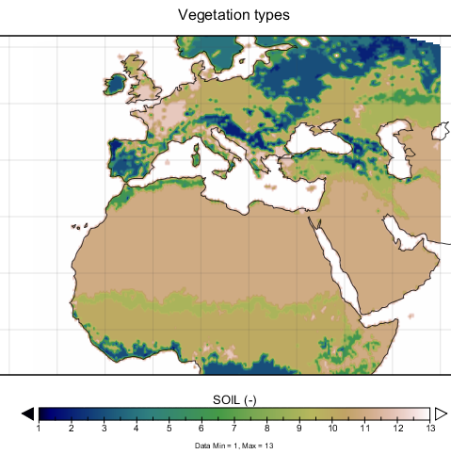
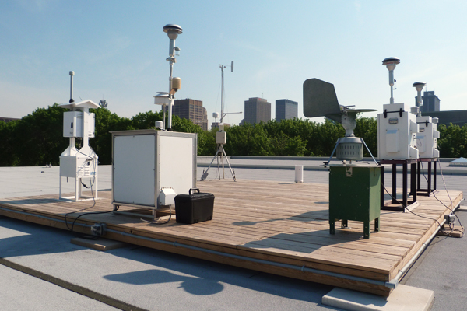
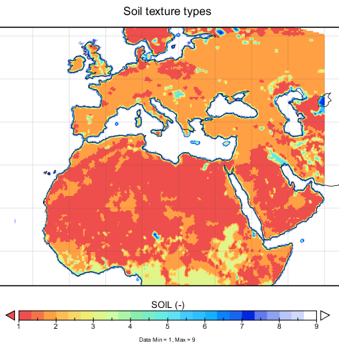
K-Dust project: WP1
WP1 SDS characterization over Kuwait
Task 1.1. Compilation of available dust information for the study region.
Task 1.2. Aerosol characterization and identification of the desert dust sources.
Observations
Aerosols and dust sources
Land databases
Notes:
WP1 Sand and dust storm characterization over Kuwait
This activity will focus on the compilation of available dust (ground-based and satellite) observations over Kuwait to perform the characterization of dust storms over Kuwait and the refinement of the dust sources implemented in the modelling system that affect Kuwait.
Task 1.1. Compilation of available dust information for the study region. In-situ and ground-based remote sensing observations of aerosols and dust will permit characterization of both natural and anthropogenic aerosols over Kuwait. This information will essential for the Task 1.2, and to implement the near-real-time evaluation included in the operational dust forecasting system (WP2). This task considers the participation of KISR to provide and get access to national and local databases.
Task 1.2. Aerosol characterization and identification of the desert dust sources. Using the results of Task 1.2, an aerosol characterization over Kuwait based on long-term ground-based and satellite aerosol observations will be described. This aerosol characterization will include a climatology of SDS over Kuwait. This climatology will consider seasonal patterns, frequency, intensity of dust storm events (annual, seasonal and diurnal), interannual variability of dust storms, climatological trends of dust outbreaks that contributes to identify the frequency and intensity of dust production events in the region of study. These results will be used for the improvement of the model through the refinement of the localisation of the dust sources over the study domain (Task 2.2) and the implementation of the near-real-time evaluation considered in the operational forecasting system (Task 2.6). All the tests to obtain the optimal desert dust source mask for our region of interest that will be implemented in the operational system (WP2) can be run at the HPC supercomputer hosted by BSC.
Deliverables
D1.1. Report on SDS over Kuwait including the available observations that it can be used for the operational near-real-time evaluation.
D1.2. Improved desert dust source map for dust modelling of the Middle East.
Milestones
M1.1. Compilation of available ground-based and satellite observations over the Middle East.

Slide 13
K-Dust project: WP2
WP2 Implementation of the dust forecasting-modelling system
Task 2.1 HPC resource requirements.
Task 2.2 Model configuration.
Task 2.3 Model compilation and testing.
Task 2.4 Improvement of the model performance.
Task 2.5 Operational Implementation.
Task 2.6 Data Management.
Task 2.7 Visualization interface.
Notes:
WP2 Implementation of the dust forecasting-modelling system
The main objective of this task is the implementation of a mineral dust forecasting system using the NMMB/BSC-Dust model in order to perform a daily mineral dust forecast (72 hours) at high spatial resolution over Kuwait. The forecast simulations will be evaluated in near-real-time with available data from ground based stations. A comprehensive analysis will be performed. The model input data and emission parameterizations will be further adapted to the specific domain and improved.
The NMMB/BSC-Dust model (Perez et al, 2011; Haustein et al. 2012) has been selected to forecast the atmospheric cycle of mineral dust in Kuwait. The model is comprised of an atmospheric model (the Non-Hydrostatic Multi-scale Model, NMMB) developed at NOAA/NCEP (Janjic, 2005; Janjic and Black, 2007; Janjic et al., 2011; Janjic and Gall, 2012) and a dust module developed by the Atmospheric Composition Group of the BSC in close collaboration with NOAA/NCEP and other partners, including the NASA Goddard Institute for Space Studies (NASA GISS) and the University of California, Irvine (UCI) (Pérez et al., 2011; Haustein et al., 2012; Jorba et al., 2012; Spada et al., 2013; Badia and Jorba, 2014). This state-of-the-art model is designed to be efficient, flexible, and extendible. It contains advanced physics, chemistry and aerosol packages, and has the unique ability to be configured as a global model or as a very high-resolution regional model. Physical processes include dry deposition, grav­itational settling, wet deposition (including rainout and washout in and below the clouds), and radiative interaction allowing feedbacks between dust and the atmosphere. The model produces forecasts at the SDS-WAS Regional Center for a regional domain comprising Northern Africa, Middle East and Europe, where it is combined with other dust model forecasts from collaborating institutions and evaluated in near-real time. The model also runs operationally (7 days a week, 365 days a year) at the Barcelona Dust Forecast Center (BDFC; http://dust.aemet.es/) with a horizontal resolution of 10 km for the same region. At the global scale, the model contributes to the International Cooperative for Aerosol Prediction (ICAP) Multi Model Ensemble (Sessions et al., 2014), A detailed description of the model is presented in Section 6.2.
Task 2.1 HPC resource requirements. The modelling system needs an HPC facility to be executed. This includes a computing cluster with several nodes and a filesystem tuned to run parallel simulations. The parallel programming model implemented in NMMB/BSC-Dust is Message Passage Interface (MPI) and can be compiled with a wide range of compilers. A general-purpose architecture is required. A group of HPC experts from BSC will visit Kuwait to analyse the current capacity of the KISR cluster. The BSC can performance HPC analyses using performance tools based on hardware counters to improve the performance of the model. This information will be considered for the definition of the model configuration (Task 2.2).
Task 2.2 Model configuration. The model configuration (which includes the definition of the domain, resolution and the input databases for the model run) will be achieved using the results of the WP1 (the definition of the source mask) and the available HPC resources at KISR (computational and storage resources) resulting from Task 2.1.
Task 2.3 Model compilation and testing. To build the NMMB/BSC-Dust model in the KISR’s cluster, BSC will need to install additional software applications (i.e. libraries and tools) for the model compilation and execution. Once the model configuration is defined (Task 2.2) and the necessary software installed, a general compilation and execution of system is required. The model outputs will be used to verify that the model has been correctly built in the KISR cluster.
Task 2.4 Improvement of the model performance. The performance of the dust forecast system will be analysed using BSC performance tools. To perform this analysis some software (i.e. Extrae) will be installed Trace analysis of an execution in the KISR cluster will be analysed with the methodology developed by the BSC. The communication pattern of the model, the input/output of the system, the coupling of the meteorology with the chemistry and aerosols, among others will be studied. Any improvement on the model performance will have an important effect on the overall forecast time of the forecasting system. Recommendations to tune the hardware or execution parameters could be transmitted to system administrators of the cluster.
Task 2.5 Operational Implementation. The dust operational system consists in three main modules: pre-processing, model run and post-processing. The pre-processing includes a download and degrib of the meteorological input data from the global meteorological model (typically, ECMWF or NCEP). The post-processing includes the generation of the output files (in NetCDF format) and the map generation (using a programming language as Python, GrADS or R).
Task 2.6 Data Management. Output files from the dust prediction model and observational data from the air quality monitoring stations and will be gathered together with other products (RGB product from Meteosat Second Generation, MSG,… ) resulting from Task 1.1 and organized through a database in order to facilitate the generation of products suitable for operational monitoring and forecast . For the data storage, it would be needed a volume of approximately 1 TB per year. The storage server(s), if separated from the front-end (web interface) should be connected to this with a gigabit or (better) low latency network to make the communication between storage and visualization layer easier and not create overhead. KISR will be in charge to provide the necessary storage server and BSC will build storage infrastructure in the machine.
Task 2.7 Visualization interface. The information resulting from the operational dust forecasting system will be presented to users through a web-based application based on the current web-interface from the Barcelona Dust Forecast Center (http://dust.aemet.es), which will provide:
Three-hourly charts of the main parameters predicted by the model (dust surface concentration, dust load, dust optical depth, dry and wet deposition, …) up to a lead time of 72 hours.
Daily and monthly plots of model data interpolated to specific sites (e. g. air quality stations, airports, main cities) updated after every model run including the available observations.
To host the web-interface, it would be needed a server with this minimum technical requirements:
8 cores 3.2GHz, 64 bit architecture
16 GB main memory
hard disk size minimum 0.5TB + data volume (if hosted in the same server)
It will be necessary to install all software packages to run the web server, mail server and data processing and visualization libraries. KISR will be in charge to provide the web-server and BSC will install all the necessary software and libraries and build the web-interface.
Deliverables
D2.1. Report on the available HPC resources on KISR to build the dust forecasting system.
D2.2. User Guide of the dust forecasting system.
D2.3. Report on the model performance.
D2.4. Data catalogue (model and observations).
D2.5. Web interface based on the BDFC configuration.
Milestones
M2.1. HPC visit to KISR-Kuwait.
M2.2. Model configuration.
M2.3. Compiled code.
M2.4. Implementation of the operational download of the necessary input data.
M2.5. Implementation of the storage database (modelled and observational products).

Slide 14
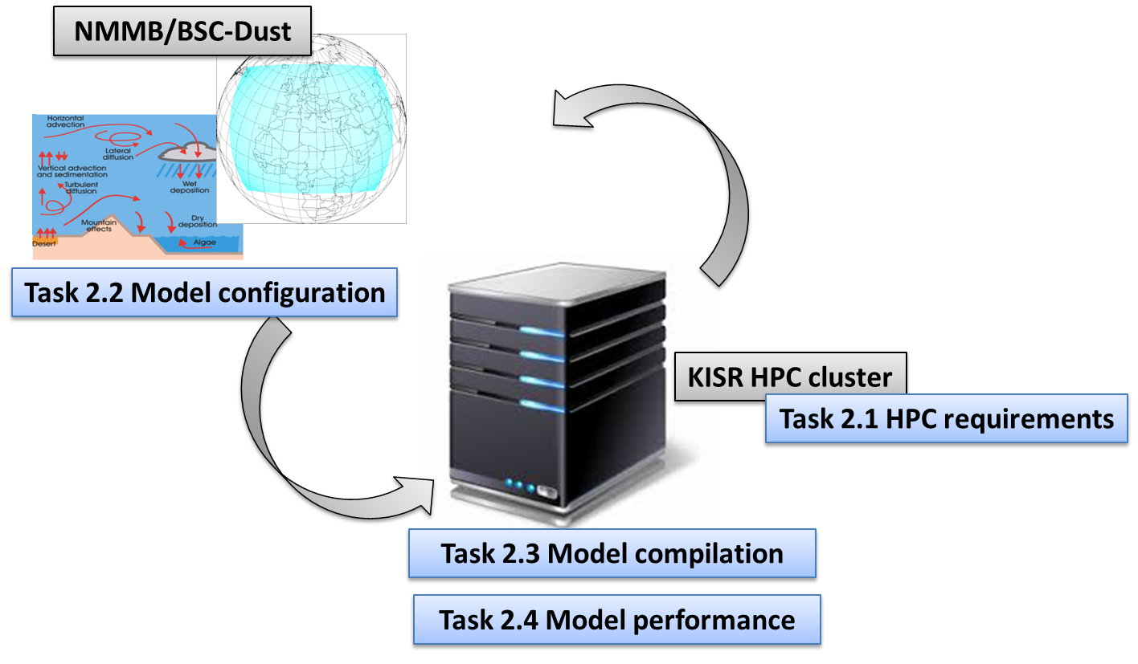
K-Dust project: WP2

Slide 15
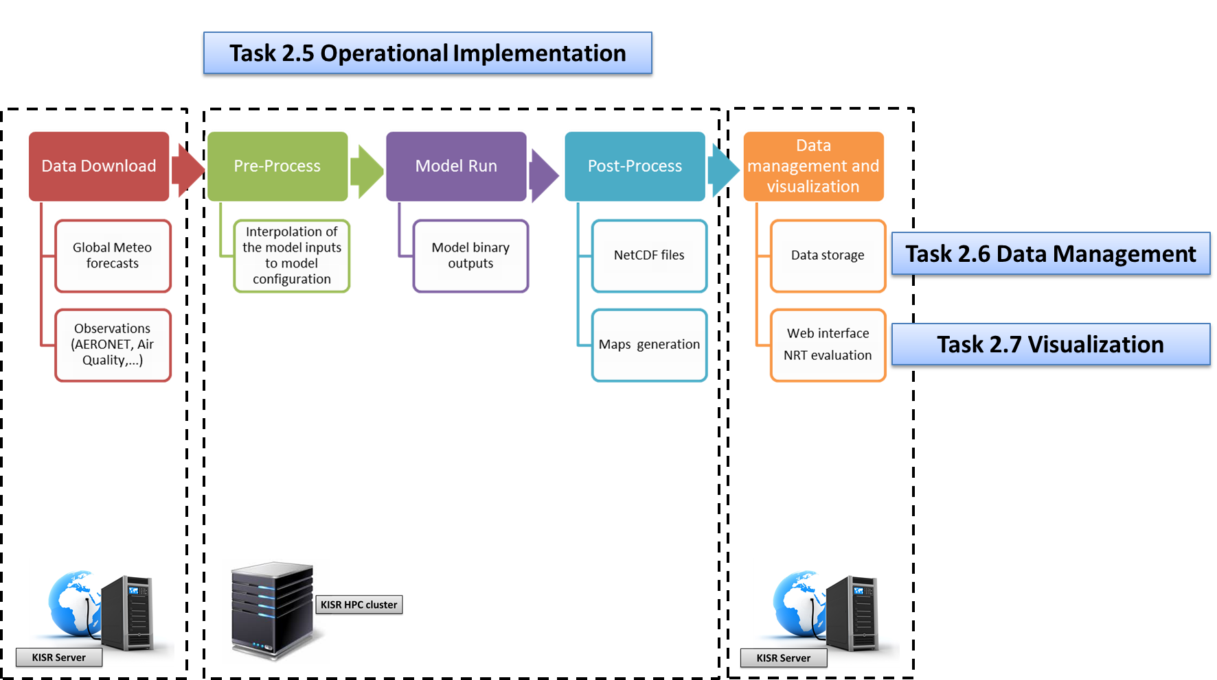
K-Dust project: WP2

Slide 16
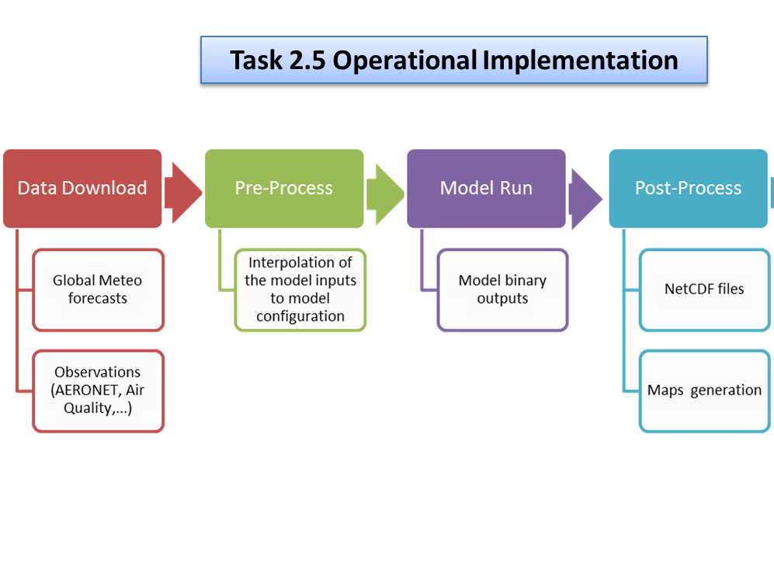
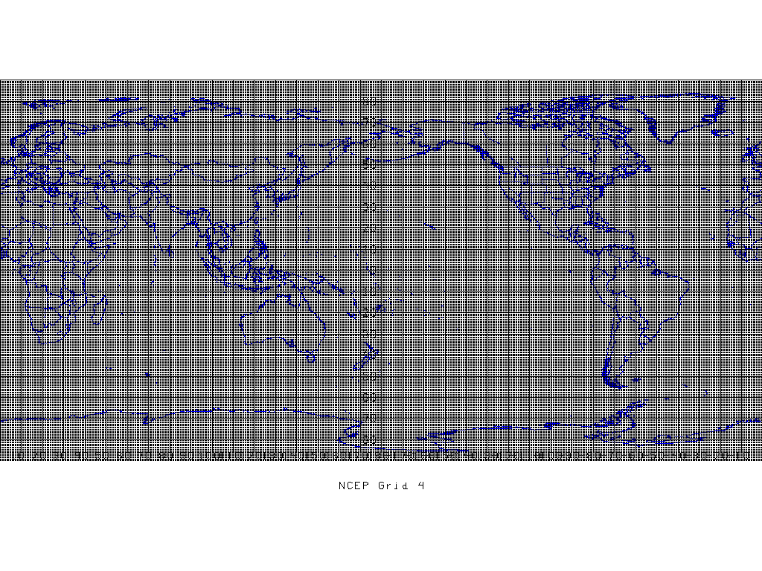
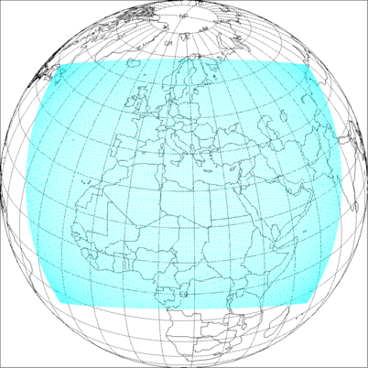
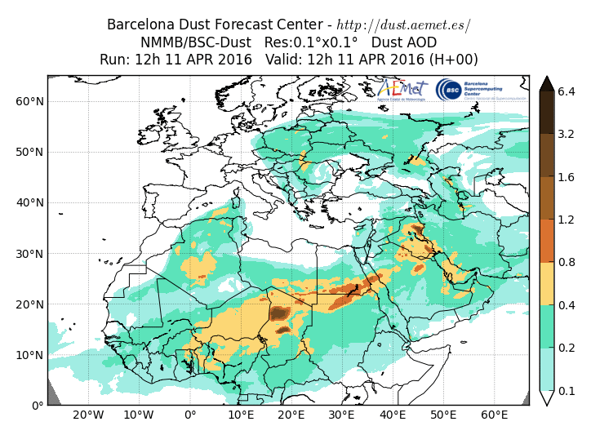
K-Dust project: WP2
NCEP GFS Glob. Meteo grid
NMMB/BSC-Dust Regional grid

Slide 17
K-Dust project: WP2

Slide 18
K-Dust project: WP2

Slide 19
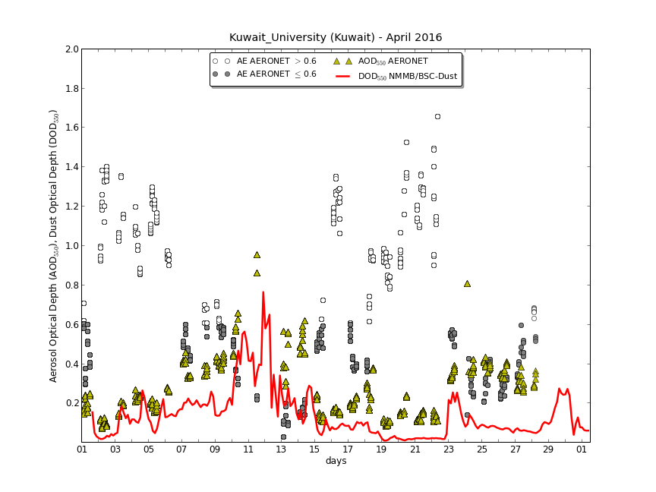
K-Dust project: 11 April 2016
AERONET

Slide 20
K-Dust project: WP3
WP3 Capacity building and training
Task 3.1. Dust forecasting skills and analysis of dust from observations.
Dust observations and forecasting models.
Manipulation of scientific formats
Task 3.2. Implementation and maintenance of a dust forecasting system.
Compilation of the NMMB/BSC-Dust model.
Operational system: download input data, pre-processing, model execution and post-processing.
The NMMB/BSC-Dust model: parameterizations and main routines of the model code.
Data management (storage/archive) and web-interface.
Notes:
WP3 Capacity building and training
The main objective of this task is to work on the transfer of knowledge and skills on dust forecasting providing guidelines on dust products and to build capacity of the KISR staff to maintain the model.
Task 3.1. Dust forecasting skills and analysis of dust from observations. This first task will focus to provide the necessary background to the KISR staff on dust forecast. This task searches to provide fundamental concepts about dust forecasting models and training on the manipulation of the most common scientific formats. BSC will provide access to the forecasts products of the Barcelona Dust Forecast Center (that are based on the NMMB/BSC-Dust model) to KISR. These operational dust products will be used to provide real cases to the attendants of the courses.
Task 3.2. Implementation and maintenance of a dust forecasting system. The set of courses included in this task are oriented to prepare the KISR staff to build and maintain the dust operational system. The courses will focus on the structure of the operational system from WP2 as well as the basic concepts to configure one forecast domain and to maintain and enhance the web-server interface.
Deliverables
D3.1. Training course 1 (20h): Dust observations and forecasting models.
D3.2. Training course 2 (20h): Manipulation (read/write and visualization using programming languages as GrADs, Python, R, ...) of scientific formats (NetCDF, Grib, ASCII, ...).
D3.3. Training course 3 (20h): Compilation of the NMMB/BSC-Dust model.
D3.4. Training course 4 (20h): Operational system: download input data, preprocessing, model execution and postprocessing.
D3.5. Training course 5 (20h): The NMMB/BSC-Dust model - parameterizations and main routines of the model code.
D3.6. Training course 6 (20h): Data management (storage/archive) and web-interface.
Milestones
M3.1. Announcement of the training course 1.
M3.2. Announcement of the training course 2.
M3.3. Announcement of the training course 3.
M3.4. Announcement of the training course 4.
M3.5. Announcement of the training course 5.

Slide 21
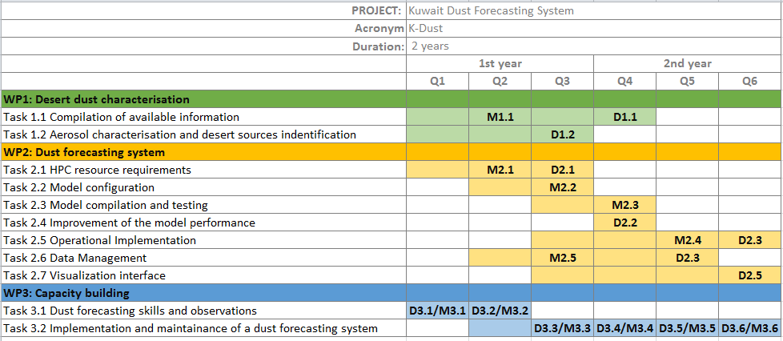
K-Dust project

Slide 22
Thank you! Thanks to NASA AERONET, NASA MODIS, U.K. Met Office MSG, MSG EUMETSAT and EOSDIS World Viewer principal investigators and scientists for establishing and maintaining data used.
For further information please contact
carlos.perez@bsc.es

