Slide 1
The different developments and uses of
NEMO surface restoring (sbcssr.F90) at BSC
Yohan Ruprich-Robert
Valentina Sicardi, Xavier Levine, Thomas Arsouze, Roberto Bilbao, Mario Acosta, Miguel Castrillo
Nemo meeting, October 11th 2018
INADEC

Slide 2
Decadal Climate Prediction Panel of CMIP6
DCPP Component C: Predictability, mechanisms and case studies (Boer et al. 2016)
Experiments to understand coupled climate model decadal variability
Attribution of observed decadal climate variability to Atlantic / Pacific SST variations
In particular: Idealized Atlantic Multidecadal Variability (AMV) experiments
North Atlantic SST time series (Ting et al. 2009)
AMV pattern
Externally forced variability
AMV
(dataset: Ersst_v4)
1
1

Slide 3
Decadal Climate Prediction Panel of CMIP6
Coupled model daily North Atlantic SST Climatology +/- AMV pattern
Restoring of SST through non-solar surface surface fluxes (cf. sbcssr.F90):
$$Q_{k}=Q_{k}^{o} + ɣ\left({SST}_{k}^{o}− {SST}_{AMV}\right)$$
Restoring coefficient of ɣ = -40W/m²/K over North Atlantic (Eq-70ºN)
Free ocean-ice-land-atmosphere interactions outside of North Atlantic
North Atlantic SST time series (Ting et al. 2009)
AMV pattern
Externally forced variability
AMV
(dataset: Ersst_v4)
1

Slide 4
Sbcssr.F90 namelist
sn_sst / sn_sss: information on sst/sss restoring files to use
nn_sstr / nn_sssr: activation keys for sst/sss restoring
rn_dqdt / rn_deds: strenght of the restoring coefficent
rn_dqdt = ɣ = -40W/m²/K
$$Q_{k}=Q_{k}^{o} + ɣ\left({SST}_{k}^{o}− {SST}_{AMV}\right)$$
2

Slide 5
Decadal Climate Prediction Panel of CMIP6
Question 1: what to do over region where model simulates too much sea-ice?
3

Slide 6
Decadal Climate Prediction Panel of CMIP6
Question 1: what to do over region where model simulates too much sea-ice?
Model sea-ice border
3

Slide 7
Decadal Climate Prediction Panel of CMIP6
Question 1: what to do over region where model simulates too much sea-ice?
Clim:
TS = -15ºC
TS = -1.7ºC
Sea ice
SST = -1.8ºC
SST = -1.7ºC
AMV+:
Sea ice
TS = SST
Model sea-ice border
AMV-:
TS $≠$ SST
Sea ice
Conclusion: No restoring over sea-iced regions
➔ Introduction of a key in the namelist: nn_icedmp
ΔTS = 15ºC
introduction of spurious anomalies!!
3

Slide 8
Sbcssr.F90 namelist
sn_sst / sn_sss: information on sst/sss restoring files to use
nn_sstr / nn_sssr: activation keys for sst/sss restoring
rn_dqdt / rn_deds: strenght of the restoring coefficent
nn_icedmp: activation key for surface restoring under ice
3

Slide 9
Decadal Climate Prediction Panel of CMIP6
Question 2: Do I need to change the restoring files to change the region of restoring?
Masking the data will do the trick
Introduction of a mask file:
sn_msk
4

Slide 10
Sbcssr.F90 namelist
sn_sst / sn_sss: information on sst/sss restoring files to use
nn_sstr / nn_sssr: activation keys for sst/sss restoring
rn_dqdt / rn_deds: strenght of the restoring coefficent
nn_icedmp: activation key for surface restoring under ice
nn_msk/sn_msk: activation key for and information on restoring mask
4

Slide 11
Decadal Climate Prediction Panel of CMIP6
Question 3: SST not constrained the same way over all grid points, what can we do about it?
JJAS
DJFM
JJAS:
shallow mixed layer
DJFM:
deep mixed layer
DJFM - mld
T
T
z
z
5

Slide 12
Decadal Climate Prediction Panel of CMIP6
Question 3: SST not constrained the same way over all grid points, what can we do about it?
JJAS
DJFM
JJAS:
shallow mixed layer
DJFM:
deep mixed layer
DJFM - mld
T
T
Same amount of heat
z
z
5

Slide 13
Decadal Climate Prediction Panel of CMIP6
Question 3: SST not constrained the same way over all grid points, what can we do about it?
JJAS
DJFM
$$Q_{k}=Q_{k}^{o} + ɣ\left({SST}_{k}^{o}− {SST}_{AMV}\right)$$
ɣ fixed to -40W/m²/K
ɣ function of mixed layer depth
$$ɣ\left(t\right)=ɣ_{ref}×\frac{mld\left(t\right)}{{mld}_{ref}}$$
http://forge.ipsl.jussieu.fr/decennal/wiki/vargamma
5

Slide 14
Decadal Climate Prediction Panel of CMIP6
Question 3: SST not constrained the same way over all grid points, what can we do about it?
JJAS
DJFM
$$Q_{k}=Q_{k}^{o} + ɣ\left({SST}_{k}^{o}− {SST}_{AMV}\right)$$
ɣ fixed to -40W/m²/K
ɣ function of mixed layer depth
$$ɣ\left(t\right)=ɣ_{ref}×\frac{mld\left(t\right)}{{mld}_{ref}}$$
http://forge.ipsl.jussieu.fr/decennal/wiki/vargamma
Not fully satisfying: further test ongoing
5

Slide 15
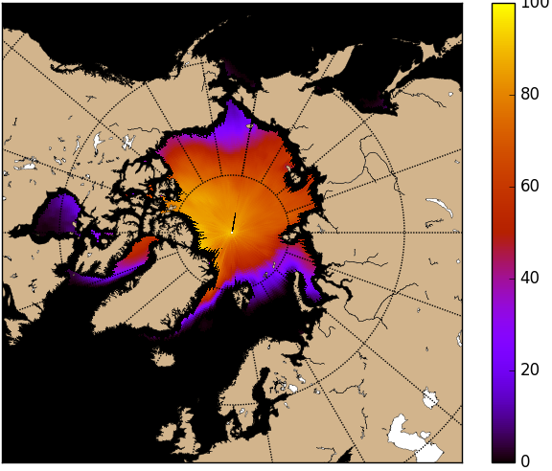
APPLICATE
APPLICATE WP5: isolate climate impacts of sea-ice reduction due to global warming
Impose projected sea-ice in present climate state simulations
Projected sea-ice OND
Straightforward approach:
Remove sea-ice in sea-ice model
somebody knows LIM3?
Player approach:
There is ice only if SST cold enough
surface restoring!!
Sea-ice concentration (%)
Model sea-ice OND
Restored simulation
Sea surface temperature restoring ponderated by sea-ice differences:
(projected - model)
xavier.levine@bsc.es
6

Slide 16
Climate Prediction: Shock and drift characterization
Reconstruction I
SSS and SST surface restoring
3D nudging
1958
2018
Reconstruction II 1958-2018
SST surface restoring
3D nudging
1958
2018
Reconstruction III 1958-2018
SSS and SST surface restoring
1958
2018
7

Slide 17
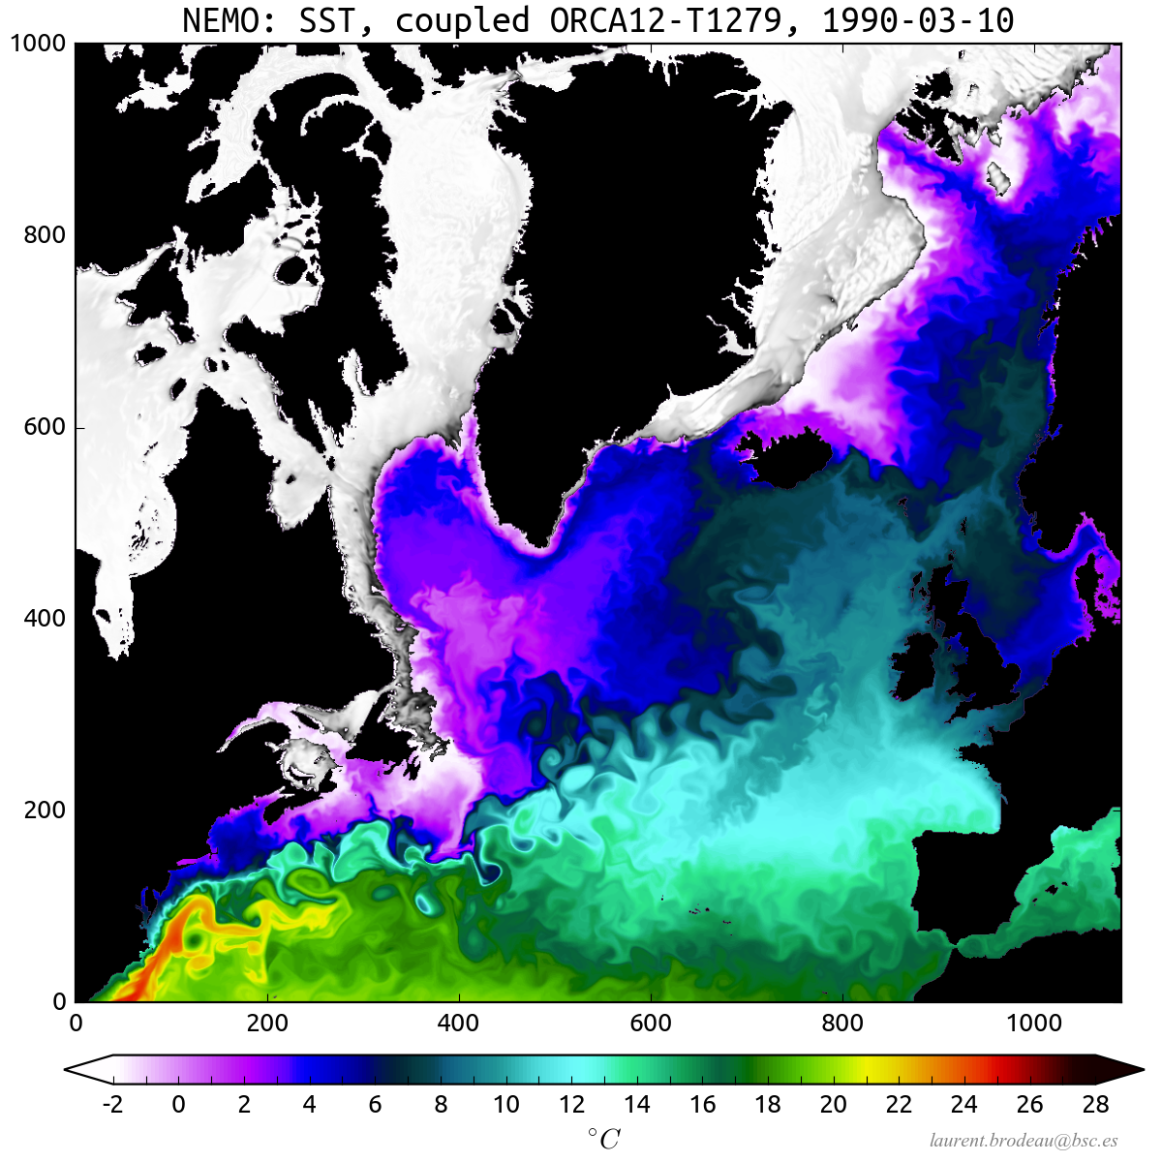
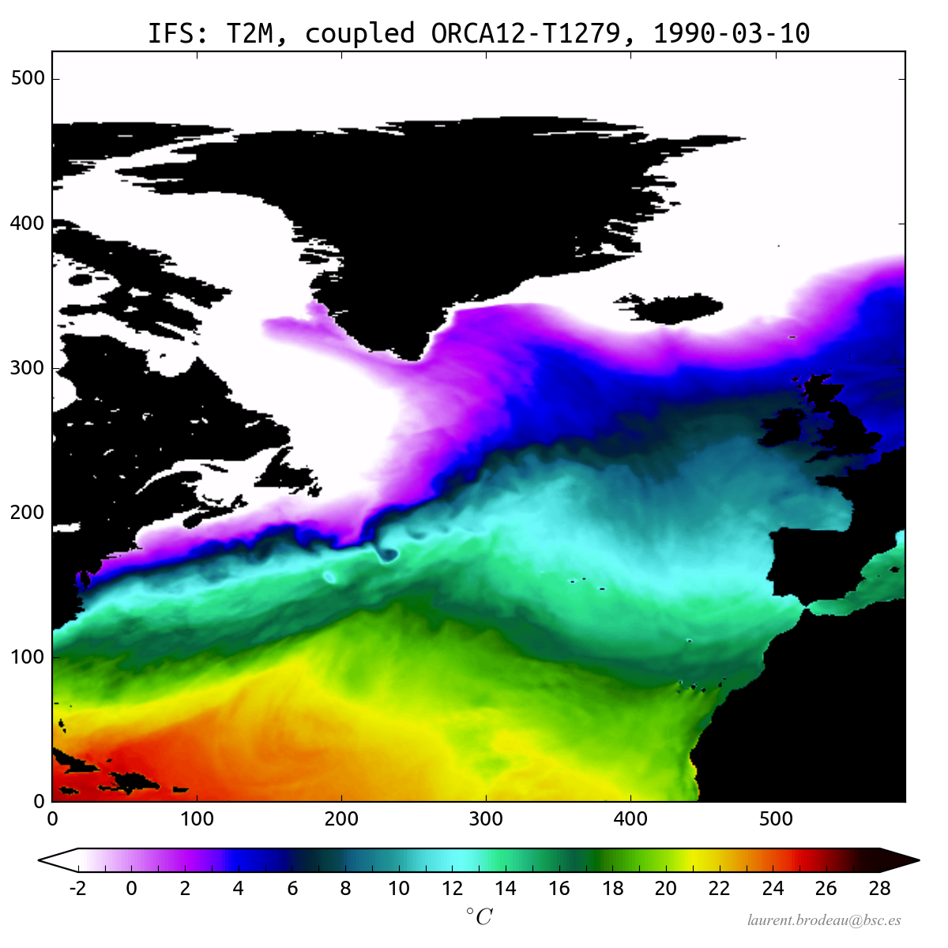
Global 12km resolution coupled simulation
NEMO ORCA12
IFS T1279
thomas.arsouze@bsc.es
HighResMIP protocol
(7yr of spinup done,
SDPY: 0.45/0.33)
7

Slide 18
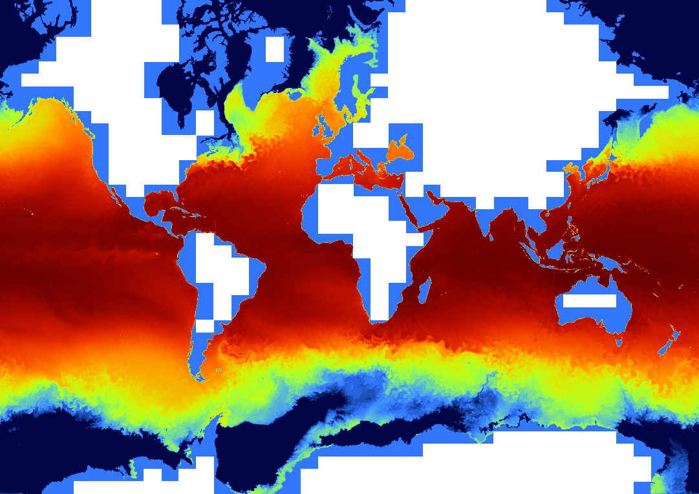
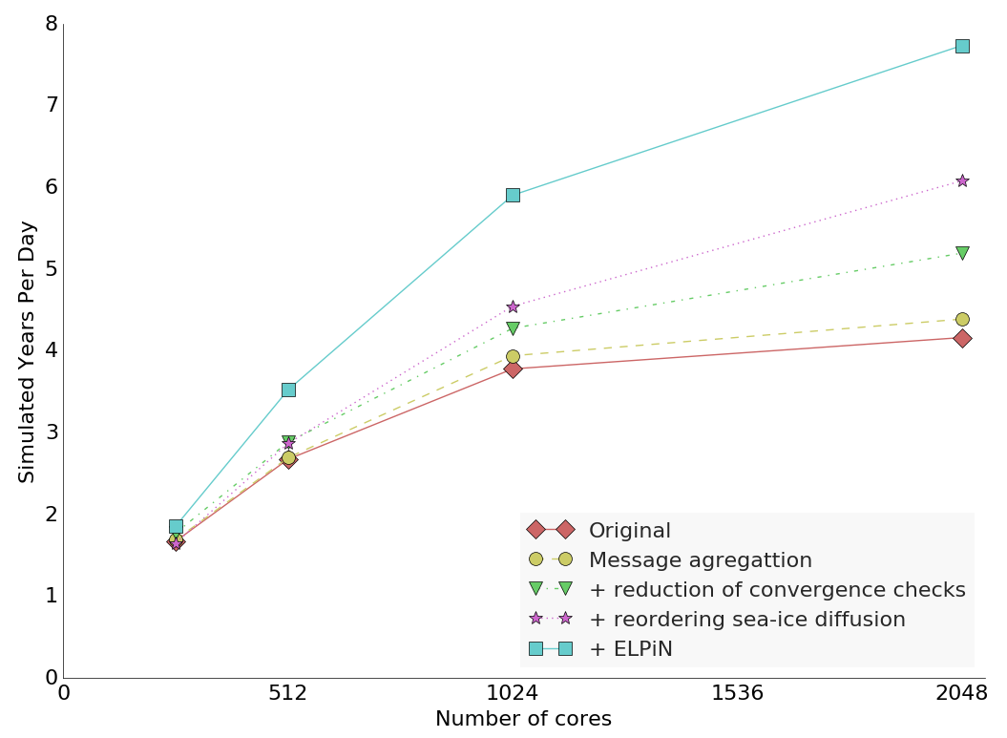
ELPiN
Exclude Land Processes in
NEMO
Performance of ORCA025-T511
oriol.tinto@bsc.es
8

Slide 19
H2020-MSCA-800154

Slide 20
Climate Prediction
1

