Slide 1
Madrid, 13 June 2016
Alta disponibilidad de los servicios del SDS-WAS y BDFC
Francisco J. Doblas-Reyes, Sara Basart, Francesco Benincasa, Kim Serradell
BSC Earth Sciences Department
Enric Terradellas
AEMET

Slide 2
NMMB/BSC-Chemical Transport Model
The main system is build on the meteorological driver NMMB
Multiscale: global to regional scales allowed (nesting capabilities)
Nonhydrostatic dynamical core: single digit kilometre resolution
On-line coupling: weather-chemistry feedback processes allowed
Enhancement with a data assimilation system
NMMB/BSC-CTM
NMMB
BSC-CTM
CHEM
DUST
SEA SALT
BC/OM/SULFATE
http://www.bsc.es/earth-sciences/nmmbbsc-project

Slide 3
Barcelona Dust Forecast Center
BDFC: First Specialized Centre for Mineral Dust Prediction of WMO
NMMB/BSC-Dust selected to provide operational forecasts at high resolution (~10km) for the NAMEE region

Slide 4
BDFC: Dust forecast products
Dust products:
Dust Optical Depth at 550nm
Dust Dry Deposition
Dust Load
Dust Surface Concentration
Dust Surface Extinction at 550nm
Dust Wet Deposition

Slide 5
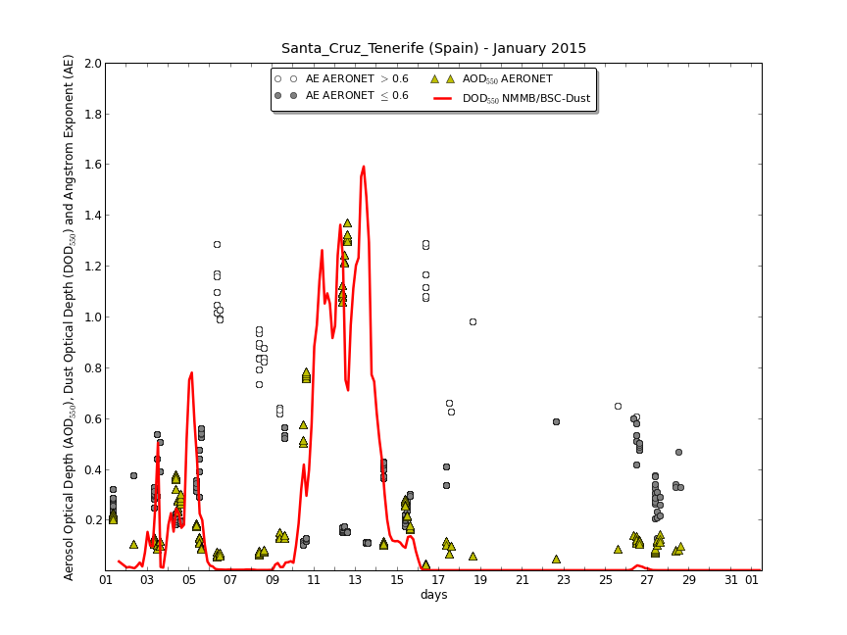
BDFC: NRT evaluation using AERONET
Model evaluation metrics (bias, correlation, RMSE and FGE)
By regions: NA-ME-E, Sahel/Sahara, Middle East and Mediterranean
By time periods: monthly, seasonal and annual

Slide 6
BDFC: Operational suite
MODEL
EXCUTION
72h forecasts (3-hourly res.)
Operational MN3
(0.1º res. fcst)
Backup
(0.33º res. fcst)
STORAGE
MAIN SERVER
PROXY
PRODUCT DISSEMINATION
WMO/AEMET GTS
INTERNET
DOWNLOAD INPUTS
NCEP
(meteo)

Slide 7
SDS/BDFC: Web server replication
Goal: create a mirror of the portal http://dust.aemet.es
Features required
Web content management system
Data download
Product generation (plots, statistics, …)
Product dissemination (mail notices/newsletters, AEMET/WMO GTS, EumetCAST, …)
Internet
If BSC connection is not available
BSC
AEMET
Web
Web
Storage
Products
Products
Storage
Nightly synchronization

Slide 8
SDS/BDFC: Web server replication
Status
Issues to be solved
VPN issues at AEMET (still not completely solved)
Web server installation | done
Mail server installation | done
Products software installation | done
Dissemination system | done
Synchronization system | end June
Full test period | mid July
Publication | end July

Slide 9
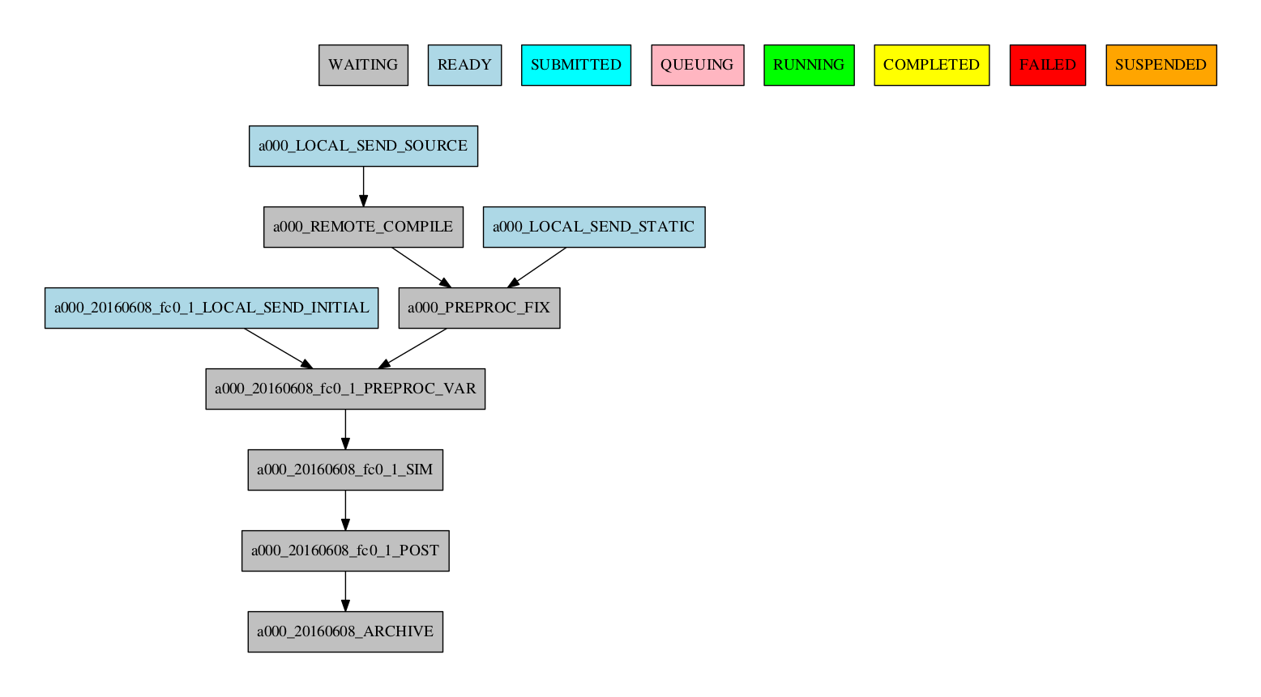
BDFC: Workflow manager
Autosubmit is the BSC-ES workflow manager and has been adapted to run operational forecasts
These tasks are only run the first time
These are the daily operational tasks

Slide 10
BDFC: Computational resources
Marenostrum3 (BSC)
49m in 256 cores
25m sequential
234 cpu/hours per run
909 MB of output (72 hour forecast with 3-hourly frequency)
CCA (ECMWF)
6875 SBUs per run

Slide 11
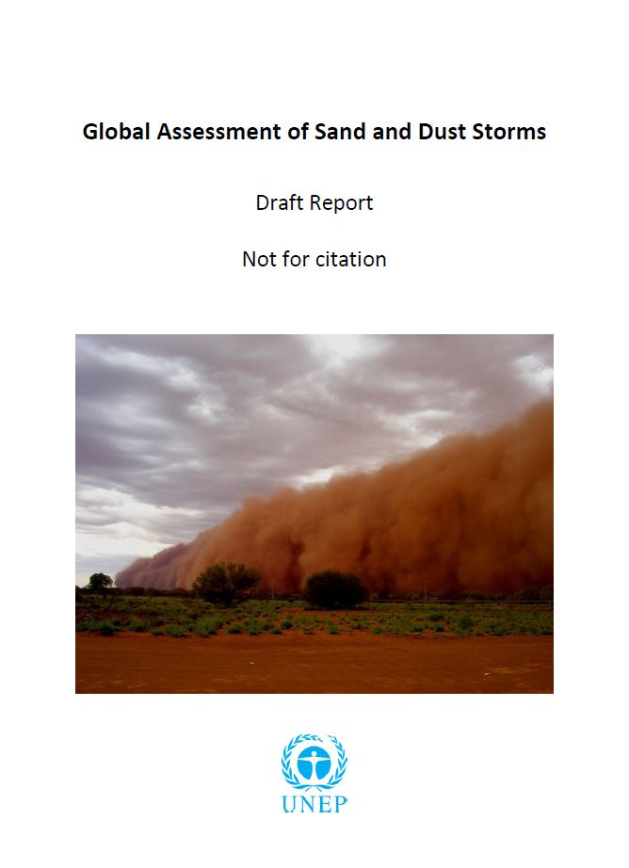
SDS-WAS: Cooperation with UNEP
UNEP distributes products generated by SDS-WAS and BDFC through its platform (UNEPLive). An approach that gives maximum visibility to both centres is being developed.
UNEP, WMO and UNCCD have been working together in a “Global Assessment of Sand and Dust Storms” that will be released shortly. A draft version is already available. SDS-WAS had an active role in writing the document.

