Slide 1
Seasonal forecasting and crop modelling application: A case study of small-scale farming systems in the Eastern Cape Province, South Africa
L. Zhou
21 September, 2017- UPC Spain

Slide 3
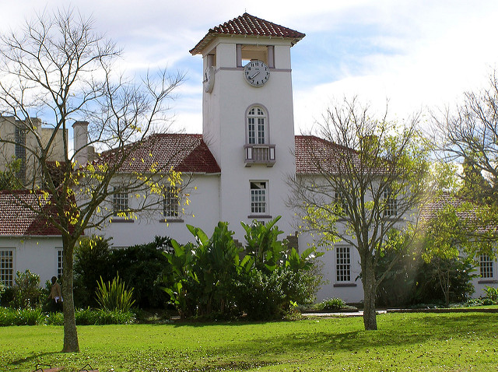
Three campuses : Alice

Slide 4
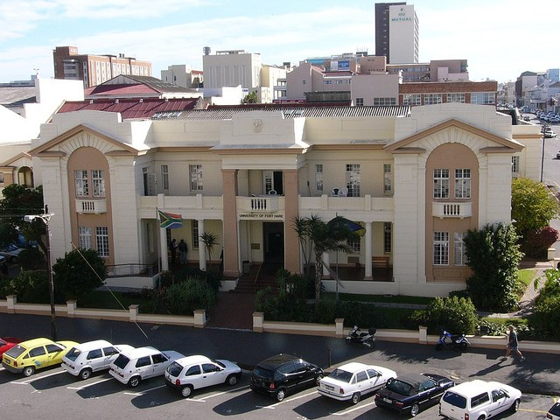
East London

Slide 5
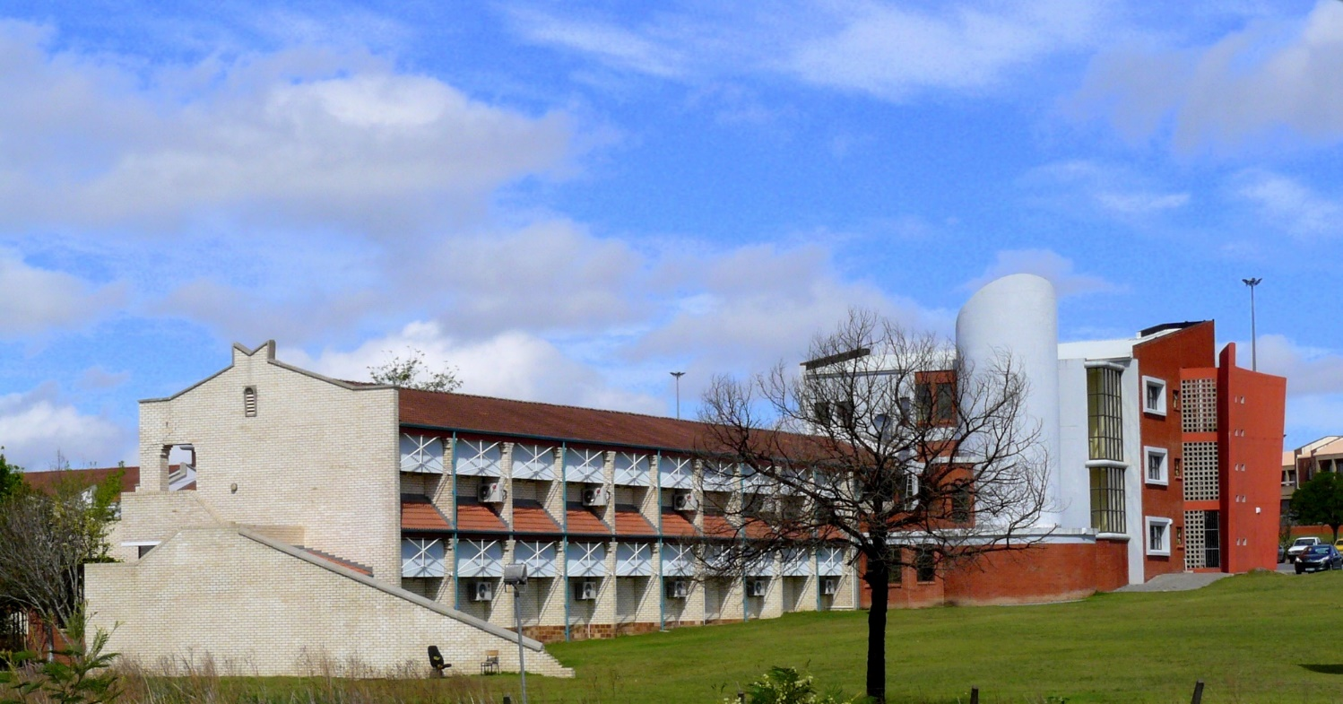
Bhisho campus

Slide 6
Faculties
Management & Commerce
Social Sciences & Humanities
Law
Science & Agriculture
Education
Health Sciences

Slide 7
Faculty of Management & Commerce
Departments
Accounting
Business Management
Development Studies
Economics
Industrial Psychology
Information Systems
Public Administration
Notes:
Projects running: Develop IT software for detecting crime in communities registered IP for this project. Business partners also involved in this project

Slide 8
Faculty of Social Sciences & Humanities
Departments
African Languages
Afrikaans
Communication
Criminology
English
Fine Art
History

Slide 9
Faculty of Social Sciences & Humanities (cont’d)
Library and Information Science
Music
Philosophy
Political Science and International Relations
Psychology
Social Work & Social Development
Sociology & Anthropology
Theology
Notes:
Psychology – In process of developing battery of psychology test. Social Work – NCFAS scales

Slide 10
Faculty of Education
Campuses
Alice (School of Further and Continuing Education)
East London (School of General and Continuing Education)
Nelson Mandela Institute for Education & Rural Development launched by Madiba in 2007
Establishment of a transdisciplinary Early Childhood Development Centre of Excellence
Fields of research
Early Childhood Development
Early Childhood Education

Slide 11
Faculty of Health Sciences
Officially opened on 22 April 2016
Previously School of Health Sciences - only had the Department of Nursing Sciences
Human Movement Science
Current fields of research
Rural Sport Development Initiative
The impact of Long Term Athlete Development and Gross Motor Skill Development programs on social and sport development in rural areas.
Psychological strategies of coaching in competitive sports

Slide 12
Faculty of Science & Agriculture
Classification into three schools:
School of Agriculture & Agribusiness
School Of Biological & Environmental Science
School Of Physical & Computational Science

Slide 13
Faculty of Science & Agriculture (cont’d)
School of Agriculture & Agribusiness
Agricultural Economics and Extension
Agronomy
Livestock and Pasture Science
Agricultural and Rural Development Research Institute (ARDRI)
Research Farm
Traction Centre
Agri-park
Notes:
Agronomy – Developed draught resistant seed for maize
Livestock – Gadget to test quality of meat
Traction Centre – Hand held planter wheel for small farmers

Slide 14
Faculty of Science & Agriculture (cont’d)
School of Biological & Environmental Science
Biochemistry and Microbiology
Botany
Geography & Environmental Science
Geographic Information Systems
Zoology and Entomology
Central Analytical Laboratory (CAL)
Science Workshop

Slide 15
Faculty of Science & Agriculture (cont’d)
School of Physical & Computational Science
Computer Science
Geology
Pure and Applied Mathematics
Pure and Applied Chemistry
Physics
Statistics
Notes:
Working with Solar and Wind Energy – developed type of gear mechanism inside turbine to optimize the wind energy

Slide 16
Faculty of Science & Agriculture (cont’d)
Centres & Institutes
Agricultural and Rural Development Research Institute
Applied and Environmental Microbiology Research Group
Electron Microscopy Unit
Fort Hare Institute of Technology
FOSST Discovery Centre
Plant Stress Group
Risk & Vulnerability Science Centre
Telkom Centre of Excellence in ICT for Development
Traction Centre
Notes:
Working with scientists in physics.

Slide 17
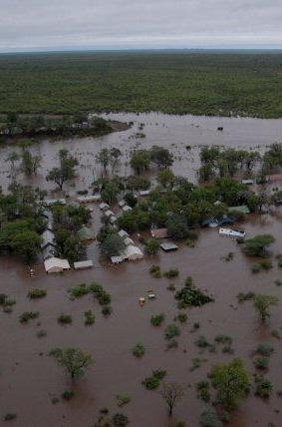
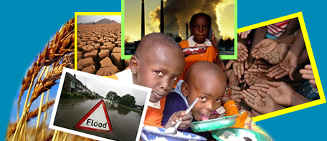
RISK AND VULNERABILITY SCIENCE CENTRES (RVSC) Studying Global Change, Tackling local Impacts
HOSTED AT:
FUNDED BY:

Slide 18
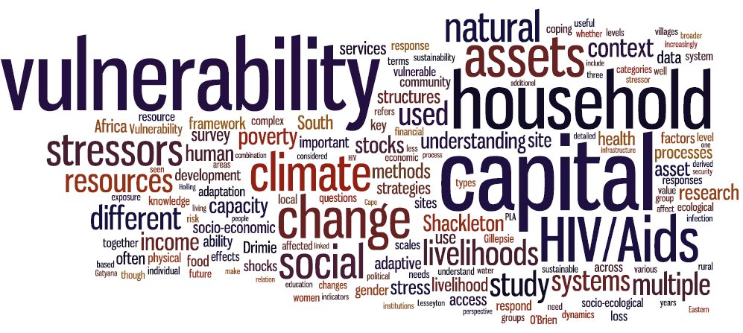
Risk & Vulnerability Science Centres (RVSCs) Studying Global Change, Tackling local Impacts
10-Year innovation plan of Department of Science & Technology on Global Change Grand Challenges (Global Change Research Programme (GCRP).
HOSTED AT:
FUNDED BY:

Slide 19
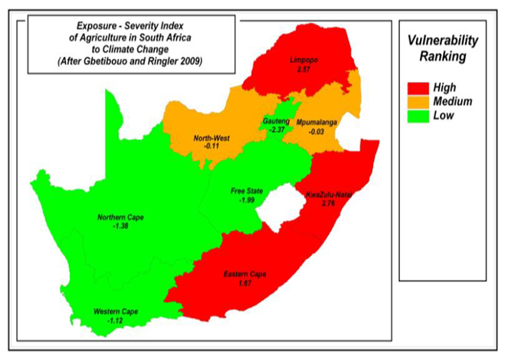
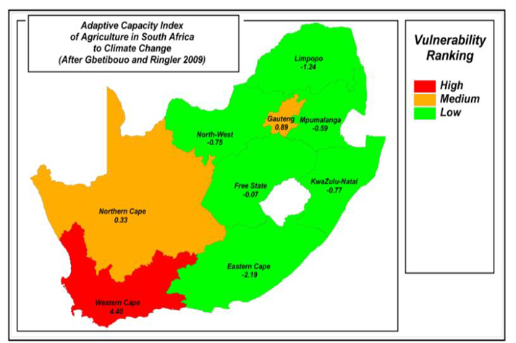
Vulnerability rankings

Slide 20
Map showing most vulnerable Province
Though rural setting, there is absence of agricultural activities and income generation projects

Slide 21
Risk and Vulnerability Science Centres: Mandate
Generate and disseminate knowledge on risk and vulnerability on global change challenges to:
Improve scientific understanding of global changes
Develop technologies and innovations to respond to global changes
Strengthen science-policy-practice interface
How?
Capacity building
Knowledge generation / research
Data storage, utilisation and accessibility
Community engagement

Slide 22
GLOBAL CHANGE: CHALLENGES AND RESEARCH THEMES
A Understanding a Changing Planet | B Reducing the human footprint | C Adapting the way we live | D Innovation for sustainability
1. Observation, monitoring & adaptive management | 1. Waste minimisation methods & technologies | Preparing for rapid change & extreme events | 1. Dynamics of transition at different scales-mechanisms of innovation & learning
2. Dynamics of the oceans around southern Africa | 2. Conserving biodiversity & ecosystem system services | 2. Planning for sustainable development in a Southern African context | 2. Resilience and capability
3. Dynamics of the complex internal earth systems | 3. Institutional integration to manage ecosystems & ecosystem services | 3. Water security for South Africa | 3. Options for greening the development state
4. Linking the land, air & sea | 4. Doing more with less | 4. Food & fibre security of South Africa | 4. Technological innovation for sustainable social-ecological systems
5. Improving model prediction different scales |  |  | 5. Social Learning for sustainability, adaptation, innovation and resilience.

Slide 23
Research projects
Project Title: The Impact of Climate Change on Food Security among Coastal Communities of Hamburg in the Eastern Cape, South Africa The project was meant to be the catalyst to initiate a longer-term definitive programme on adaptation to climate change among coastal communities.
Project Title: Household vulnerability to disasters in the Eastern Cape: An application of the household vulnerability index (HVI). The objective was to assess the extent of household vulnerability to climate change related disasters using the Household Vulnerability Index (HVI tool) in the Eastern Cape Province & Limpopo

Slide 24
Research Project Cont…
Exploring the Evidence of Water-Energy-Food Nexus Linkages to Sustainable Local Livelihoods and Wellbeing in South Africa.
-Water-Energy- Food (WEF) Nexus research has so far remained weak in identifying how the Nexus is interlinked with livelihoods (Biggs et al, 2014).
- This proposed project aims to fill the knowledge gap, exploring ways in which integrating WEF thinking into development planning, implementation and management can support more equitable sustainable development outcomes at the household level.
How and why a Nexus approach on WEF could deliver more equitable development outcomes at household level?

Slide 25
Research Projects Cont...
Integrated use of seasonal forecast for community preparedness to climate variability.
-The project would offer the opportunity to assess how communities respond the forecasts that may be associated with different levels of skill and consequently further improve the definition of needs and expectation at local scales, at a time scale that is requested by smallholder farming communities.

Slide 26
PhD
Title :Communicating seasonal forecasting information and crop modelling: A case study of small-scale farming systems, Raymond Mhlaba Local Municipality, Eastern Cape Province, South Africa
To identify effective approaches, methods and tools to communicate the use of seasonal forecasting information and crop models in making crop management decisions among the rural small-scale farmers
To demonstrate the use of seasonal forecasting information and crop models to rural small-scale farmers in the Eastern Cape Province
To examine challenges and opportunities of communicating seasonal forecasting information and crop models to rural small -scale farmers in the Eastern Cape province
To develop a framework for communicating information to rural small -scale farmers

Slide 27
Masters student
Title: Integrating Indigenous Knowledge with Scientific Seasonal Forecasts for Climate Risk Management in Nkonkobe local Municipality, Eastern Cape
Document existing indigenous knowledge indicators that are used to predict weather and climate
Understand farmers perceptions on climate change and variability and link it to empirical evidence
To link IK indicators with Scientific Seasonal Forecasts.
Rural farmers also have traditional ways of coping and adapting to climate change effects (Mkuhlani et al., 2017).
T

Slide 28
Challenges faced by the farmers
Finance
Inputs e.g. fertilisers; seeds
Climate e.g. droughts; El Ninos; dry spells
Knowledge
Infrastructure e.g. roads, storage
Markets
Infertile soils
Information e.g. new technology

Slide 29
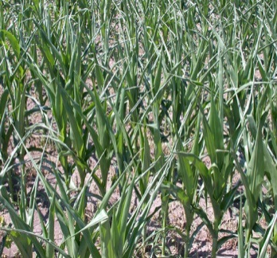
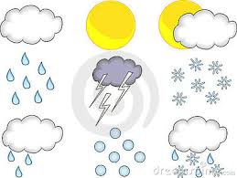
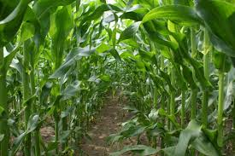
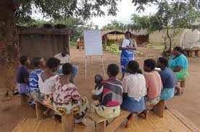
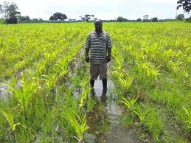
Application
Low rainfall
Seasonal forecast
Farmer strategies
Crop models
ISmall scale farm
High rainfall

Slide 30
Seasonal forecasting & Crop modeling application
Climate change and variability is considered to be the principal source of fluctuations in global food production, particularly in the semi-arid tropics (Cline 2007).
There is need to improve the understanding and interpretation of the climate forecast information to minimise the risk on crop production.
Empirical studies among African farmers show that seasonal forecasts information and crop modelling can help farmers reduce their vulnerability to climate extremes, and to allowing them to maximize opportunities when favourable rainfall conditions are predicted (Patt et al., 2005, Phillips et al., 2001 and Roncoli et al., 2009).

Slide 31
Seasonal forecasting...
Less progress has been made in assessments of the extent and impact of forecast and crop model use, particularly among vulnerable populations, such as rural small-scale farmers in Africa (Meza et al., 2008)
To contribute towards a better understanding and in catalysing further action to empower rural communities (smallholder farmers) a participatory approach was conducted with rural small-scale farmers in the Eastern Cape, South Africa
To improve the uptake of seasonal forecast & crop modeling information among smallholder farmers

Slide 32
Importance of seasonal forecasts
Seasonal forecasts can be used to make farm management decisions especially forecasts land preparation, sowing time, crop types and varieties, irrigation, livestock stocking rates and borrowing money.
Sources of forecast information are DAFF, SAWS, TV, radio and Internet.
.

Slide 33
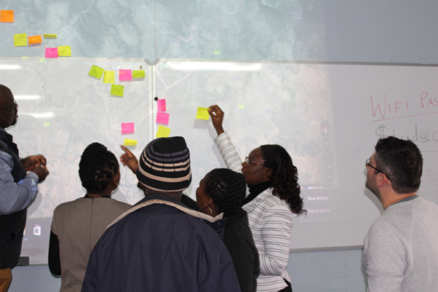
Mapping activity reflecting locations and farming activities of the farmers. This was to enable the participants to understand the spatial distribution of the farmers in attendance in a pictorial form.

Slide 34
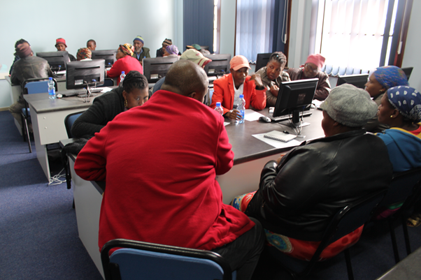
Group exercises
‘?
Questions: Perception and strategies in response to climate risks & awareness on seasonal forecast information

Slide 35
Lessons learnt
Seasonal forecasts and crop models are too scientific and not easily accessible and understandable
On the other hand, indigenous knowledge is not well documented and faces extinction as a result of being concentrated amongst few knowledge holders and the disappearance of specific indicators
Considerable effort is needed to improve the understanding and interpretation of the climate forecast information
Need for better communication methods Communication barriers (discussed by Moser & Dilling, 2007) sit at the nexus of social and resource barriers as they are inﬂuenced by the perceptions, norms and discourses that individuals and

Slide 36
South Africa Adaptation Think Tank Network
In May 2017 the Department of Environmental Science at Rhodes University in partnership with the Adaptation Network hosted a multi-stakeholder ‘Think Tank’
Aim: To further the conversation regarding how to better link CCA and DRR in policy, practice and research. The Think Tank comprised a diverse set of participants, including representatives from the National and Provincial Department of Environmental Affairs, the National Disaster Management Centre, GIZ, District and Local Municipalities, tertiary education institutions, SANBI, NGOs, community members, students and the private sector.
Outcome- Developed a research agenda for the Eastern Cape Province

