Slide 1
Impact of ocean resolution and
initialisation in climate seasonal predictions
Eleftheria Exarchou
(on behalf of F. J. Doblas Reyes)
BSC, Climate Prediction Group, Earth Sciences Department, Barcelona, Spain
Leon, 21st September 2016
Notes:
<number>

Slide 2
BSC Earth Sciences Department
What
Environmental modelling and forecasting
Why
Our strength …
… research …
… operations …
… services …
… high resolution …
How
Develop a capability to model air quality processes from urban to global and the impacts on weather, health and ecosystems
Implement climate prediction system for subseasonal-to-decadal climate prediction
Develop user-oriented services that favour both technology transfer and adaptation
Use cutting-edge HPC and Big Data technologies for the efficiency and user-friendliness of Earth system models
Earth system services
Climate prediction
Atmospheric composition
Computational Earth sciences

Slide 3
Climate prediction time scales
Between initial-value problems (weather forecasting) and multi-decadal to century projections as a forced boundary condition problem.
Subseasonal to seasonal forecasts (2 weeks-18 months)
Decadal forecasts (18 months-30 years)
Climate-change projections
Weather forecasts
Time
Initial-value driven
Boundary-condition driven
Adapted from Meehl et al. (2009)
Notes:
<number>

Slide 4
Climate predictability
Memory on interannual to centennial timescales in the ocean
Memory on seasonal to interannual timescales in the sea ice and land surface
External radiative forcings (solar activity, greenhouse gases, aerosols)

Slide 5
Climate prediction hindcasts
Prediction started 1 May1990
1990
2005
Observations

Slide 6
Climate prediction hindcasts
Prediction started 1 May 1991
Prediction started 1 May1990
1990
2005
Observations

Slide 7
Climate prediction hindcasts
Prediction started 1 May 2005
Prediction started 1 May 1992
… every year …
Prediction started 1 May 1991
Prediction started 1 May1990
Focus on statistics over forecast periods (e.g. months 2-4 for seasonal)
1990
2005
Observations

Slide 8
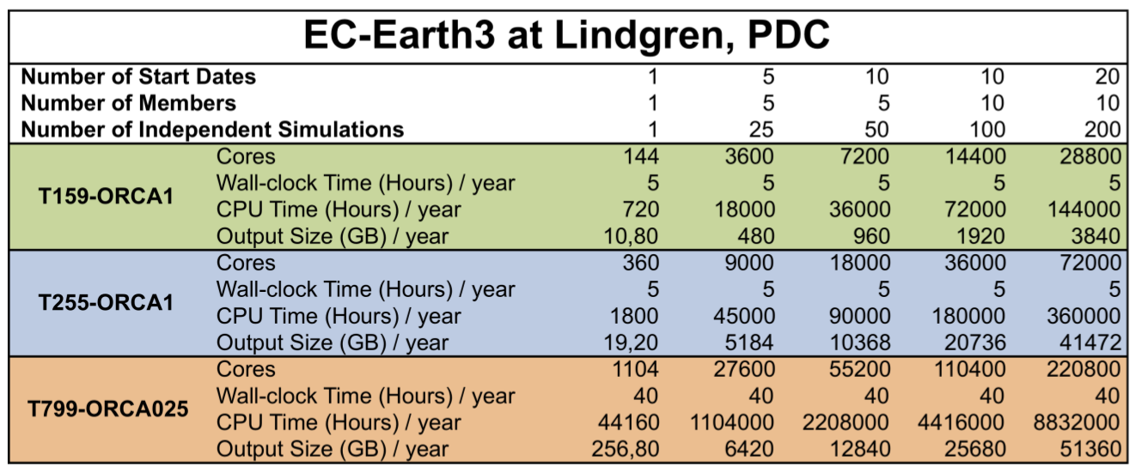
Running climate predictions
Climate prediction allows running jobs independently and simultaneously by wrapping together ensemble members for different start dates.
A workflow manager is required.
CMIP6 DCPP
5,500 simulated years -> 1.4 PB
Notes:
<number>

Slide 9
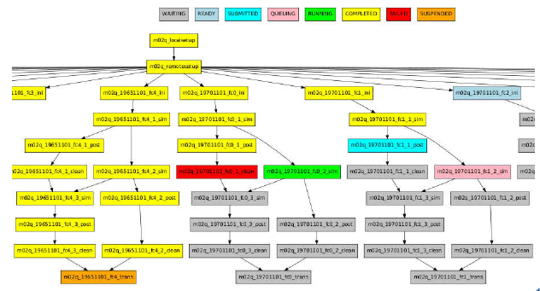
Workflow management - Autosubmit
What is Autosubmit: a python-based tool to create, manage and monitor experiments. It has support for experiments running in more than one HPC and for different workflow configurations
Why Autosubmit is needed:
Automatisation: No user intervention is needed in submission to machines and dependencies between jobs.
Data provenance: Assigns unique identifiers for each experiment, model version, experiment configuration etc.
Failure tolerance: Automatic retrials in case of corrupted or missing data.
Versatility: Runs different models in different HPC platforms
Workflow of an experiment monitored with Autosubmit:
Yellow = completed
Red = failed
Green = running
Blue = submitted
…
Domingo Manubens, Javier Vegas (BSC)

Slide 10
Modelling framework
Standard resolution T255ORCA1
~ 80 km atmosphere
~ 100 km ocean
High-resolution T511ORCA0.25
~ 40 km atmosphere
~ 25 km ocean
Now testing T1279ORCA0.12
~ 16 km atmosphere
~ 12 km ocean

Slide 11
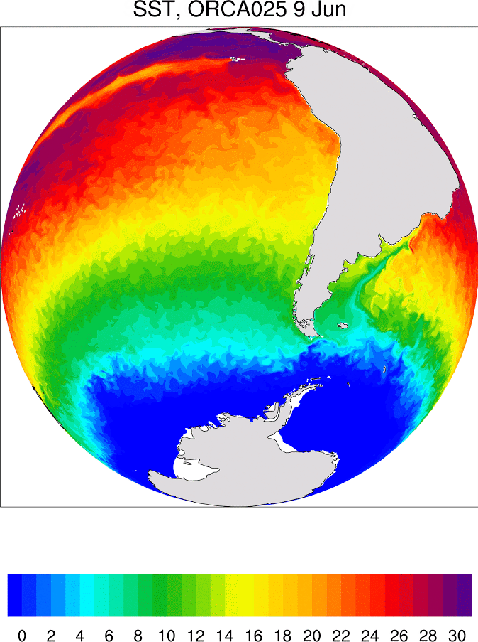
High-resolution forecasting
In high resolution more ocean dynamics are resolved
Sea surface temperature field in a high resolution run
E. Exarchou (BSC)

Slide 12
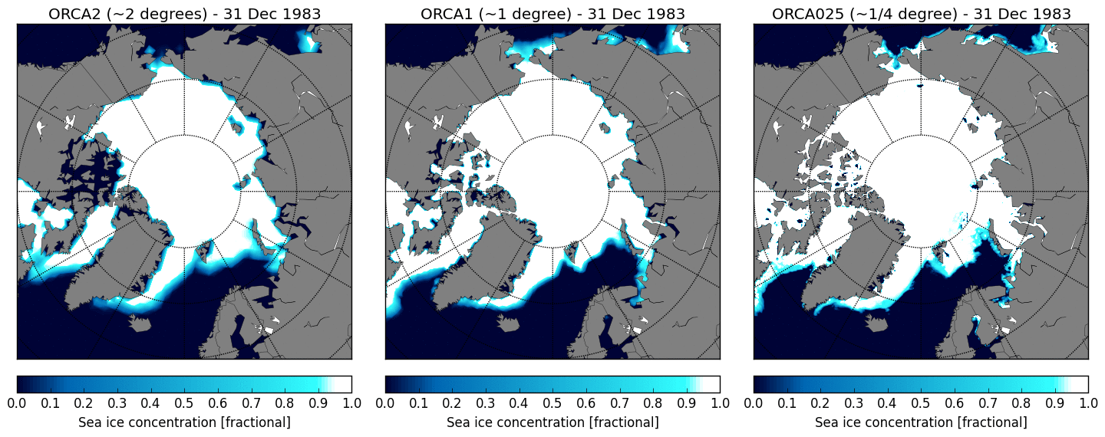
High-resolution forecasting
In high resolution smaller-scale processes in sea ice edges and in marginal seas are better represented
December sea ice concentration (fractional) for three different horizontal resolutions
F. Massonet (BSC)

Slide 13
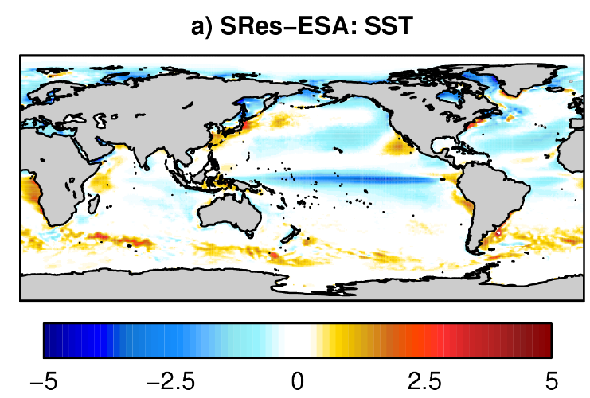
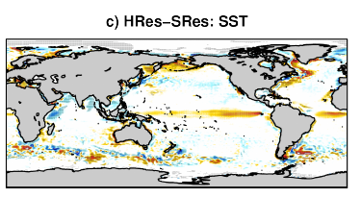
High-resolution forecasting
In high resolution model biases in sea surface temperature are reduced
Mean model biases in sea surface temperatures in June-July- August with respect to ESA in the standard resolution experiment (top). Differences in high resolution minus standard resolution temperatures (bottom).
C. Prodhomme (BSC)

Slide 14
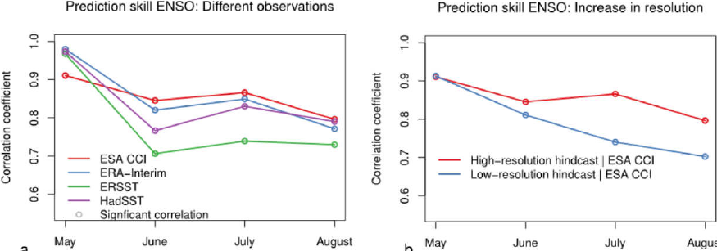
High-resolution forecasting
High horizontal resolution improves ENSO predictions.
Observational uncertainty similar magnitude as improvements.
O. Bellprat (BSC)

Slide 15
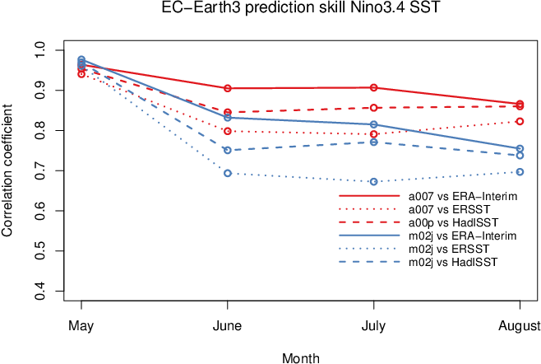
Impact of ocean initialization
Initialization from different observational estimates impacts ENSO prediction
E. Exarchou (BSC)

Slide 16
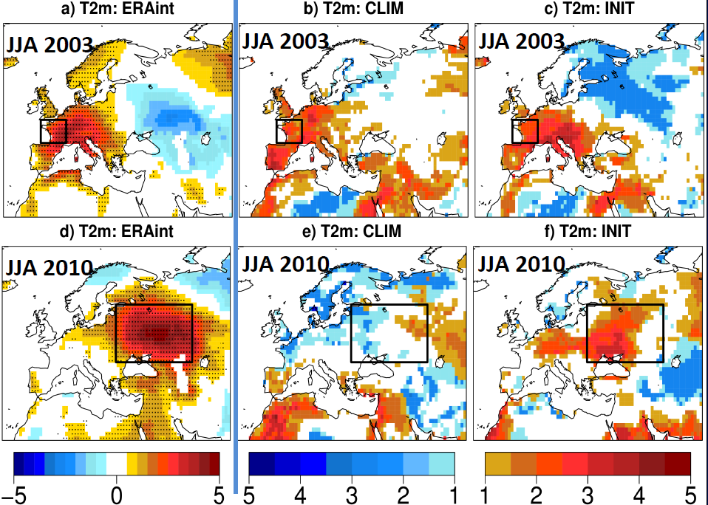
Impact of land initialization
Seasonal prediction of Russian heat wave initializing observed land-surface (INIT) conditions and climatological (CLIM) conditions. Land-surface initialisation matters.
Observed CLIM INIT
C. Prodhomme (BSC)

Slide 17
Summary
Improve our forecast systems with better process representation: new parameterizations, higher resolution, better land use estimates, better use of the existing observations, better knowledge of the physical processes, etc
Increasing model resolution allows for better representation for smaller scale processes, and better resolving of dynamics. It improves model quality and reduces model errors
Even if more technically challenging and computationally demanding, increasing resolution is essential in future model development
Increasing resolution is not panacea: other aspects (i.e.better ocean/land-surface initialization) also important for improving forecast quality
Notes:
<number>

