Slide 1
The S2S4E Decision Support Tool
Operational sub-seasonal and seasonal forecasts for Renewable Energy
Martí Badal^{(1),} Andrea Manrique-Suñén⁽¹⁾, Isadora Christel⁽¹⁾, Luz Calvo⁽¹⁾, Fernando Cucchietti⁽¹⁾,Sebastien Nouvellon⁽²⁾, Pierre-Antoine Bretonnière⁽¹⁾, Lluis Palma⁽¹⁾, Francisco Doblas-Reyes^{(1,3)} and Albert Soret⁽¹⁾
Barcelona Supercomputing Center (BSC), Barcelona, Spain,
Capgemini, Toulouse, France,
Institució Catalana deRecerca i Estudis Avançats (ICREA), Barcelona, Spain
Next slide
GENERAL INFORMATION
DST
Forecast selection
Variables and settings
Map visualisation
Detailed panel
Advanced panel
OFFICIAL LAUNCH

Slide 2
This project has received funding from the Horizon 2020 programme under grant agreement n°776787.
The content of this presentation reflects only the author’s view. The European Commission is not responsible for any use that may be made of the information it contains.
Weather Forecast
Climate Predictions
Multidecadal and Projections
Present-15d
10 d-1 month
1 month–2 years
2-30 years
20-100 years
●
●
●
●
●
S2S4E project
Next slide
GENERAL INFORMATION
DST
Forecast selection
Variables and settings
Map visualisation
Detailed panel
Advanced panel
OFFICIAL LAUNCH

Slide 3
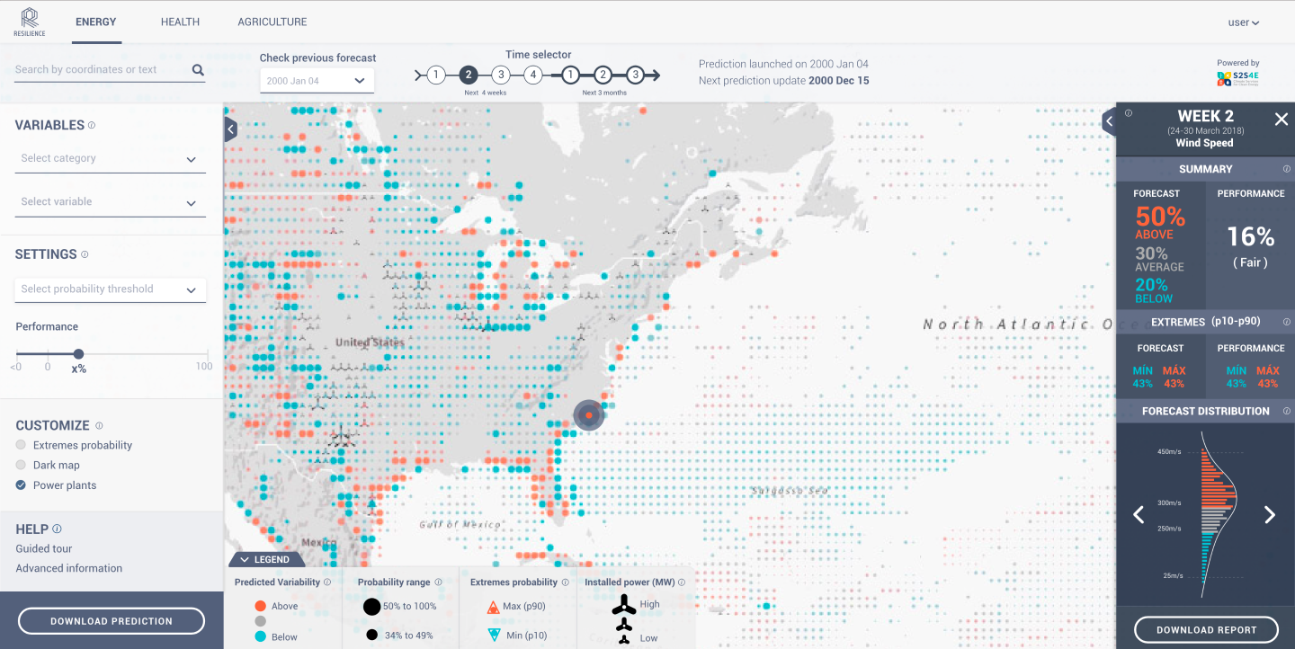
Check out the DST mock up in your own device:
https://bit.ly/2OQWV4i
Next slide
GENERAL INFORMATION
DST
Forecast selection
Variables and settings
Map visualisation
Detailed panel
Advanced panel
OFFICIAL LAUNCH

Slide 4
S2S4E GENERAL INFORMATION
S2S4E is a 3-year project funded by the European Union H2020 Framework Programme for Research and Innovation.
The main objective of S2S4E is to make the European energy sector more resilient to climate variability and high impact events. This objective will be achieved through the investigation of the frontiers and the potential of S2S predictions, which will be turned into a novel decision support tool (DST). This DST has been developed based on S2S climate predictions and tailored to users’ needs - mainly energy companies - following a user-centred approach.
CONSORTIUM The project is led by the Barcelona Supercomputing Center (Spain) and brings together 5 European research centres, 3 energy companies, 3 SMEs and a large consultancy firm.
From climate data to climate Service
Meet the partners
GENERAL INFORMATION
DST
Forecast selection
Variables and settings
Map visualisation
Detailed panel
Advanced panel
OFFICIAL LAUNCH

Slide 5
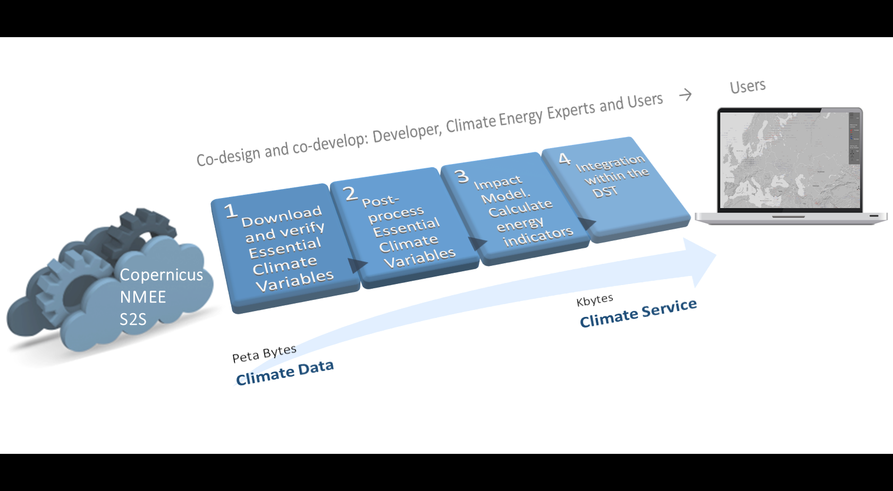
Next slide
GENERAL INFORMATION
DST
Forecast selection
Variables and settings
Map visualisation
Detailed panel
Advanced panel
OFFICIAL LAUNCH

Slide 6
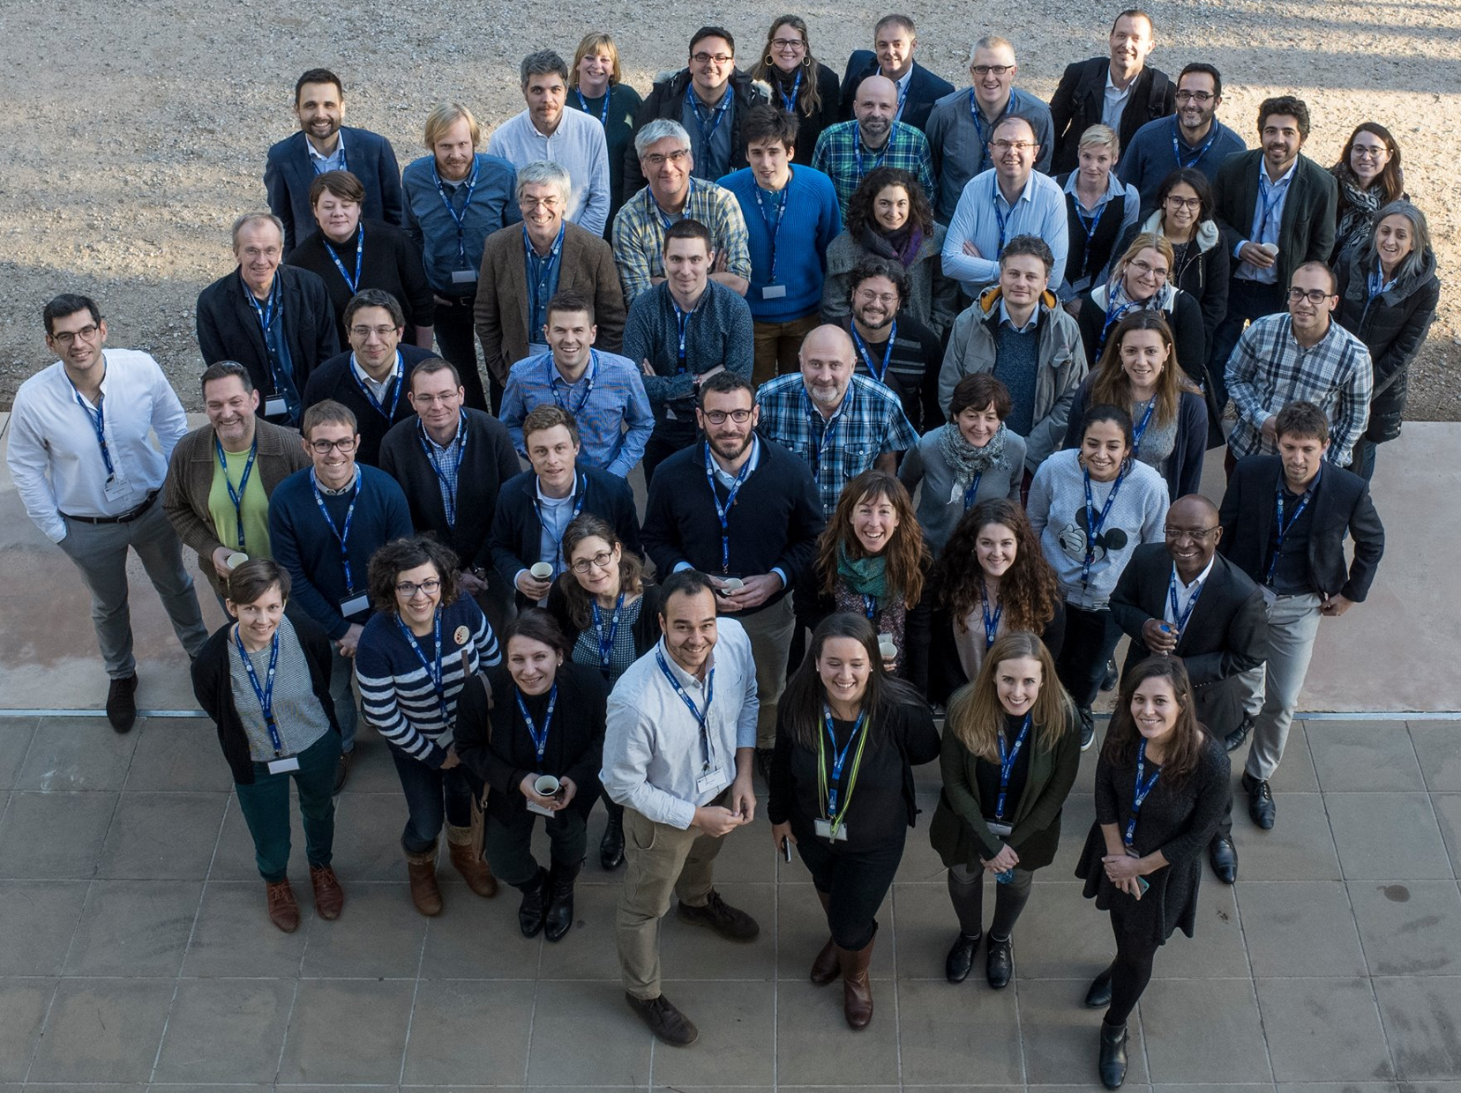
S2S4E CONSORTIUM
The project is led by the Barcelona Supercomputing Center (Spain) and brings together 5 European research centres, 3 energy companies, 3 SMEs and a large consultancy firm. an research centres, 3 energy companies, 3 SMEs and a large consultancy firm.
Next slide
GENERAL INFORMATION
DST
Forecast selection
Variables and settings
Map visualisation
Detailed panel
Advanced panel
OFFICIAL LAUNCH

Slide 7
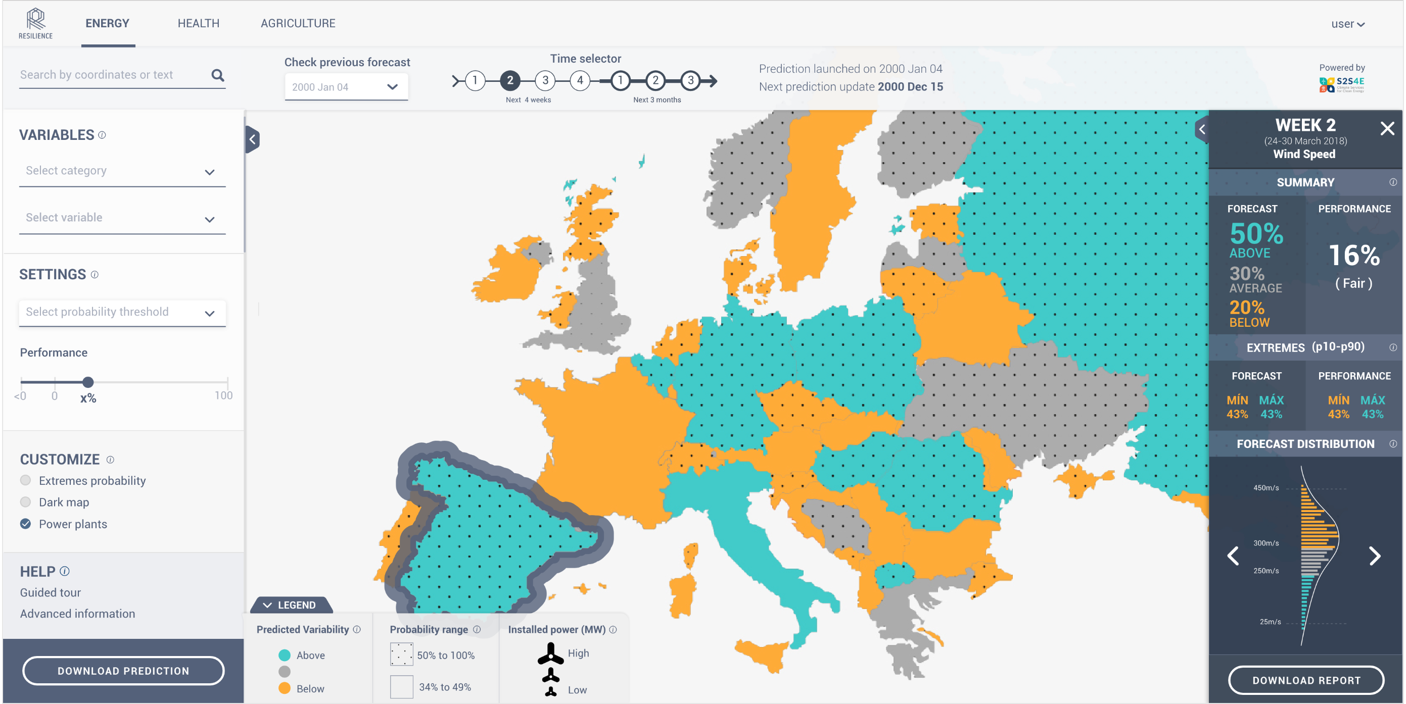
The main interface can show gridded or aggregated climate variables and energy indicators
Gridded variables
Aggregated variables
GENERAL INFORMATION
DST
Forecast selection
Variables and settings
Map visualisation
Detailed panel
Advanced panel
OFFICIAL LAUNCH

Slide 8
Gridded
variables
interface
▼
▼ Learn about the DST ▼
GENERAL INFORMATION
DST
Forecast selection
Variables and settings
Map visualisation
Detailed panel
Advanced panel
OFFICIAL LAUNCH

Slide 9
Aggregated
variables
interface
▼
▼ Learn about the DST ▼
GENERAL INFORMATION
DST
Forecast selection
Variables and settings
Map visualisation
Detailed panel
Advanced panel
OFFICIAL LAUNCH

Slide 10
▼
▼
▼
Selection of region of interest
Selection of current or past forecasts
Seamless selection of sub-seasonal forecasts (1 to 4 weeks ahead) and seasonal forecasts (1 to three months ahead)
GENERAL INFORMATION
DST
Forecast selection
Variables and settings
Map visualisation
Detailed panel
Advanced panel
OFFICIAL LAUNCH

Slide 11
CATEGORIES
▼
Selection of variables category
Essential Climate Variables
Wind energy
Solar energy
Hydro power
Energy balance
▼
Selection of variables and energy indicators within the category
TYPES OF VARIABLES
Essential Climate Variables
Wind speed
Temperature, Tmax, Tmin
Precipitation
Solar radiation
Sea level pressure
Energy indicators
Wind capacity factors
Solar capacity factor
Change in inflow
Annual snow max. anomaly
Energy demand
Wind energy production
Solar energy production
Energy balance
GENERAL INFORMATION
DST
Forecast selection
Variables and settings
Map visualisation
Detailed panel
Advanced panel
OFFICIAL LAUNCH

Slide 12
▼
Select a probability threshold. Only locations with a probability above the threshold in the most likely tercile are shown with big ball
▼
Hide forecast visualisation according to selected RPSS skill score value
▼
Highlight locations with more than 25% predicted probability above p90 or below p10.
GENERAL INFORMATION
DST
Forecast selection
Variables and settings
Map visualisation
Detailed panel
Advanced panel
OFFICIAL LAUNCH

Slide 13
Forecast period information and selected variable
▼
Most likely tercile forecasted and its probability
▼
RPSS skill score of the forecast and translation into qualitative scale
▼
Predicted probability below the p10 percentile and above the p90 percentile
▼
BSS skill scores for the >p90 and <p10 forecasts
▼
Ensemble members distribution and probability function
▼
Option to download detailed reports of the forecast of the selected location
▼
GENERAL INFORMATION
DST
Forecast selection
Variables and settings
Map visualisation
Detailed panel
Advanced panel
OFFICIAL LAUNCH

Slide 14
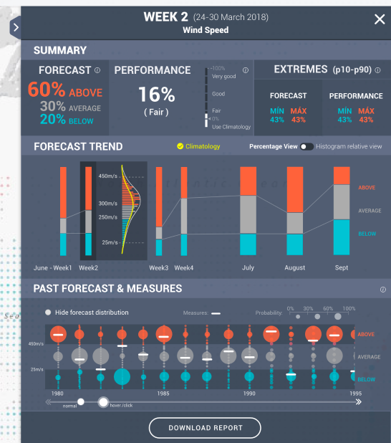
Click in the tab expands the detailed panel into the advanced panel
▼
Summary information is the same as in the detailed panel
▼
Forecast trend shows the forecasted probabilities for all the time windows at sub-seasonal and seasonal time scales
▼
The past forecasts are shown together with reanalysis values
▼
GENERAL INFORMATION
DST
Forecast selection
Variables and settings
Map visualisation
Detailed panel
Advanced panel
OFFICIAL LAUNCH

Slide 15
Official EUSEW 2019 Side Event
DST LAUNCH EVENT
Thursday, June 20th, 14:00h
at
Norway House, Brussels
5 minutes walk from the Berlaymont
If you want to attend, please write to S2S4E@bsc.es
GENERAL INFORMATION
DST
Forecast selection
Variables and settings
Map visualisation
Detailed panel
Advanced panel
OFFICIAL LAUNCH

