Slide 1
Towards exa-scale ocean simulation
Oriol Tintó Prims
Advisors:
Anna Cortés
Mario C. Acosta
Francisco J. Doblas-Reyes
26/04/2019
Universitat Autònoma de Barcelona

Slide 2
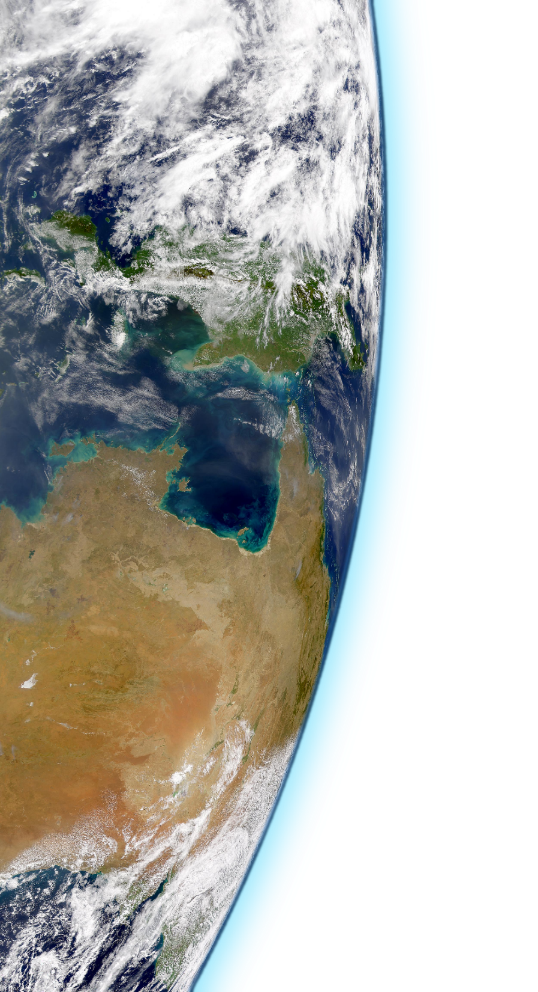
Outline
Introduction
Challenges
Work done
Future Plans

Slide 3
Motivation
Source: @ed_hawkins
Notes:
Script:
What mainly motivates our work is the fact that the world is experiencing a global warming, the climate is changing and the consequences can be severe for the planet and the human-kind.
What can we do against it? Given the situation and our position as a scientists, we can have an impact by producing information that can be a game-changer. Reliable projections (what if?), analysis of impact (where it will hit harder), and anything useful to help adapt the climate change can be a driver for policy-making in the right direction. Only the computational models have the potential to produce geographically and physically consistent estimates. However, the models still have room for improvement and it is necessary to keep reducing the uncertainties.
(What a computational model tries to do is to resolve numerically the mathematical model associated to a physical reality. In the case of the ocean, we do have a mathematical model that describes how the water behaves (Navier-Stokes). However, although the model describes quite well how a fluid behaves, it is not straightforward to use them to describe the whole ocean. The equations have to be discretized and after that, a domain has to be described. In the ocean, there are flow features of different sizes, from large scale eddies that can reach thousands of kilometers to small scale turbulence. The smallest features that are relevant enough to be represented are of the order of 10⁻³ m and timescales of about 1 second. To represent the full ocean with a domain that could resolve these features, we would need to use 1.3 · 10²⁷ cells, more or less the same amount of atoms of a 2 year kid. Since it is (and will be for a long time) impossible, the modelers had to resort on parametrizations. The parametizations try to account for sub-grid scale effects using only grid-scale information and currently are one of the major sources of uncertainty. Increasing the resolution of the models, there are more phenomena that can be simulated explicitly and less parametrizations are required, potentially reducing the uncertainty of the models. Improving how the models use the computational resources, we will allow experiments that nowadays are impossible helping to push forward our knowledge about the ocean and about earth’s climate.)
During my thesis, I helped to improve the performance of the model in many different ways trying to approach the performance issues from different fronts. At 2016 we learned about the work done at ECMWF regarding the use of single precision for IFS simulations and it was clear that a similar approach for NEMO had a lot of potential.
After some experiments blindly-moving all model variables to single precision, we saw that sadly the trivial path was degrading the quality of the simulations beyond what is acceptable.
We decided then that we should find a way to exploit mixed-precision safely.
To do so, we developed a method to identify which variables can effectively use reduced precision and which ones need to keep the double-precision.
The method relies on a tool called reduced precision emulator that (with significant work) allows us to simulate the effect of reducing the precision.
Basically, the method consists in three steps:
Define an accuracy test: Is this simulation accurate?
Implement the emulator into the code: automatize it or it won’t happen.
Scan the variables: algorithm to find an optimal set.
Accuracy test: ?
Implementing the emulator: we want a version of the code where we can specify the precision of each variable through a namelist.
Doing so, we can directly compare the obtained results and determine if a specific set breaks the model or not.
Scan algorithm: ~O(3) variables that are not completely independent between them. Divide and conquer approach, with downscaling and multi-evaluation.
Results: Using the method in NEMO the results are awesome.
Conclusions: The method works and the potential is great for other ocean-models and precisions too.

Slide 4
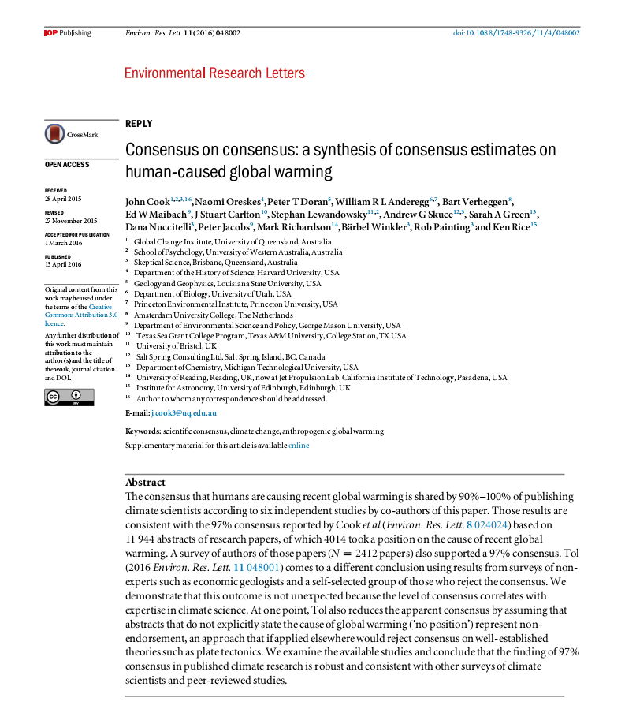
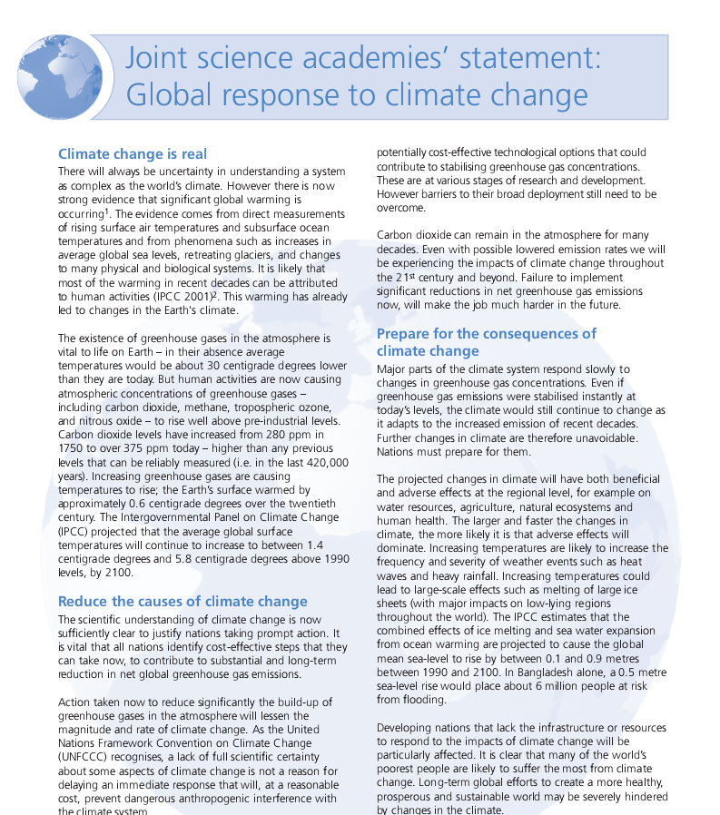
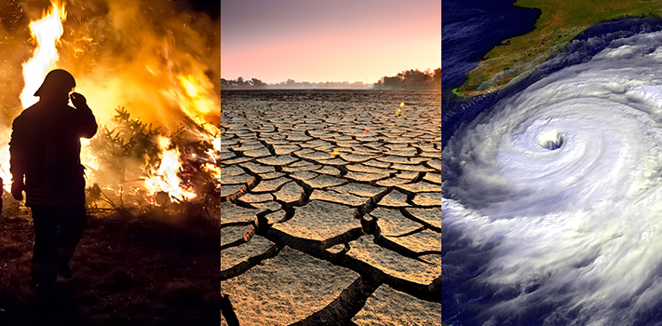
Motivation
Climate is changing.
The potential impact of that change is huge.
This would lead to catastrophic consequences for humankind.

Slide 5
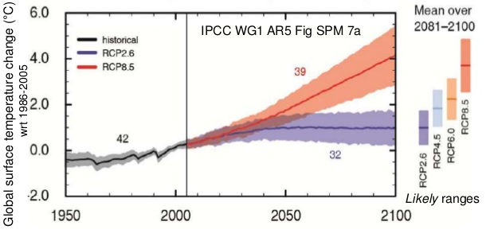
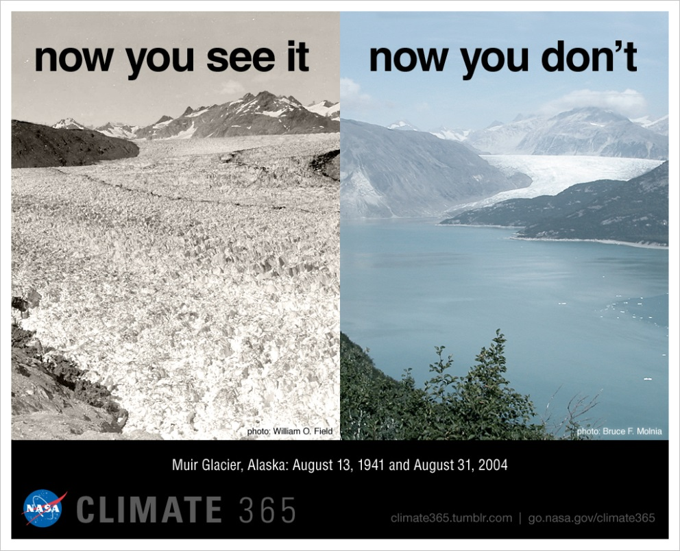
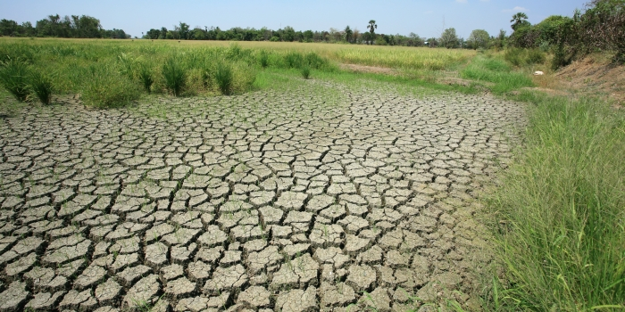
Motivation
Projections
Impact analysis
Adaptation to climate change.
Currently, only computational models have the potential to provide geographically and physically consistent estimates.

Slide 6
Motivation
The same models are used for both weather and climate.
Weather models have a huge value for society.
Improving the computational performance of these models pays back in several ways:
Saving resources.
Allowing new experiments:
Improving climate knowledge
Improving weather predictions

Slide 7
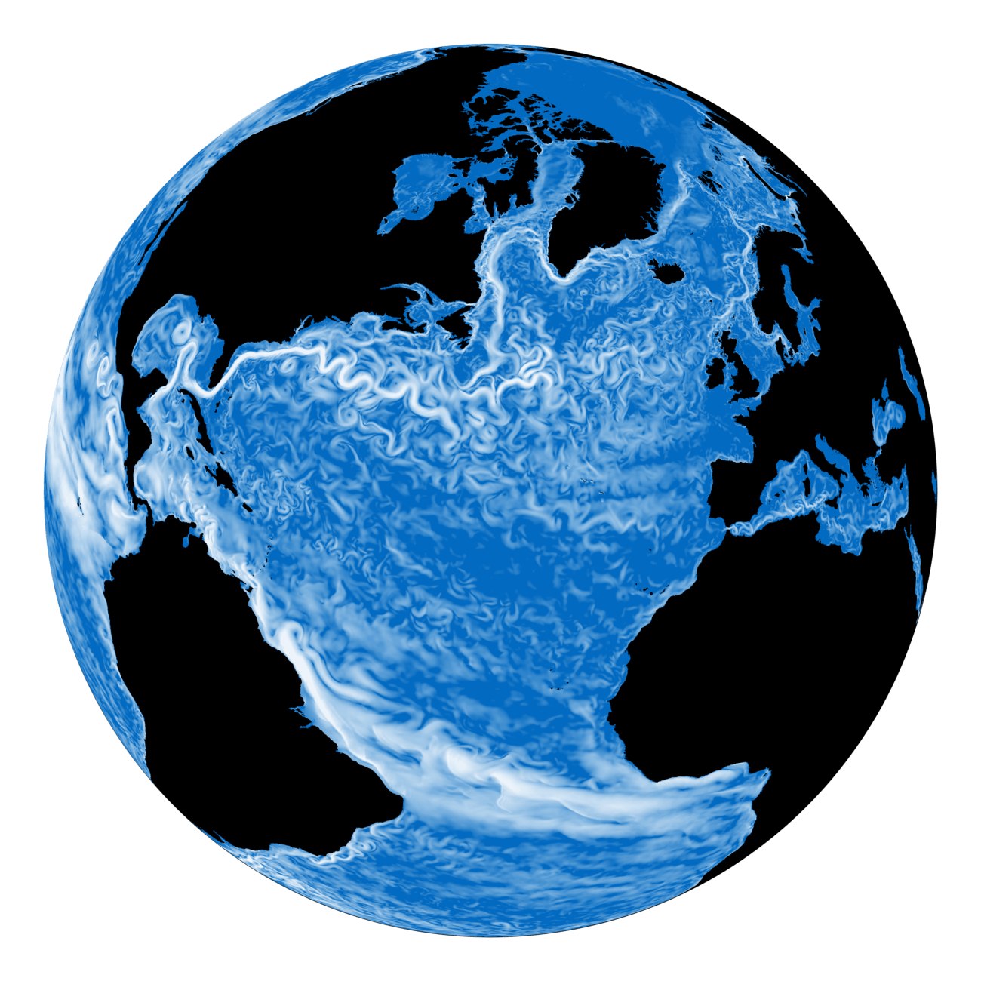
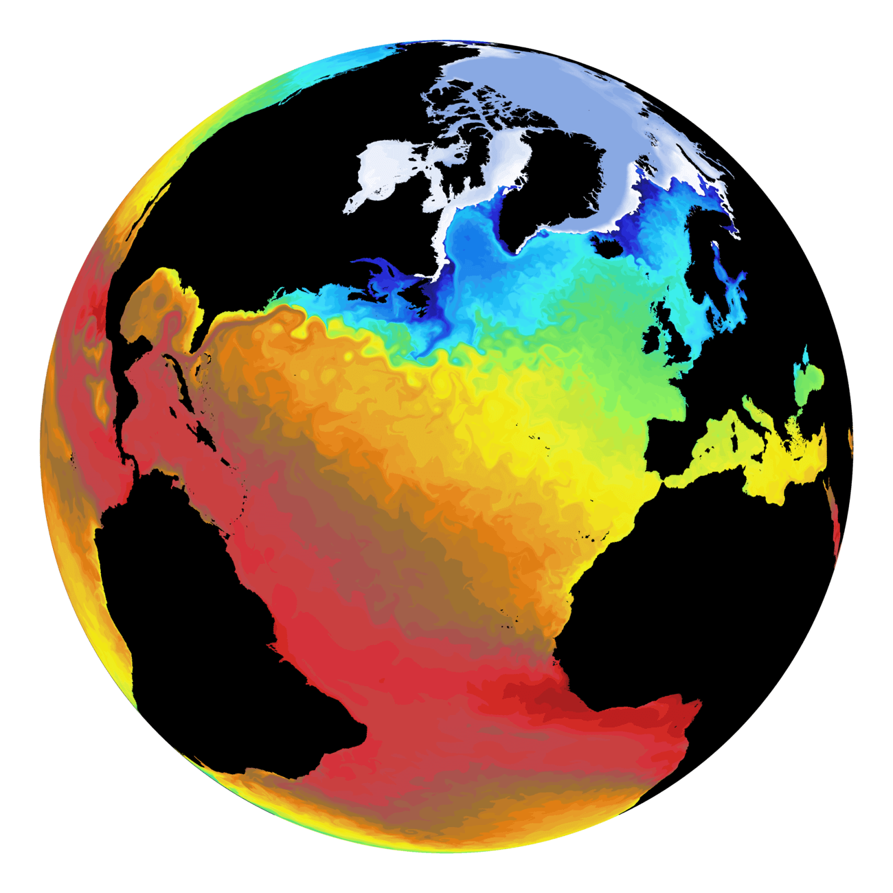
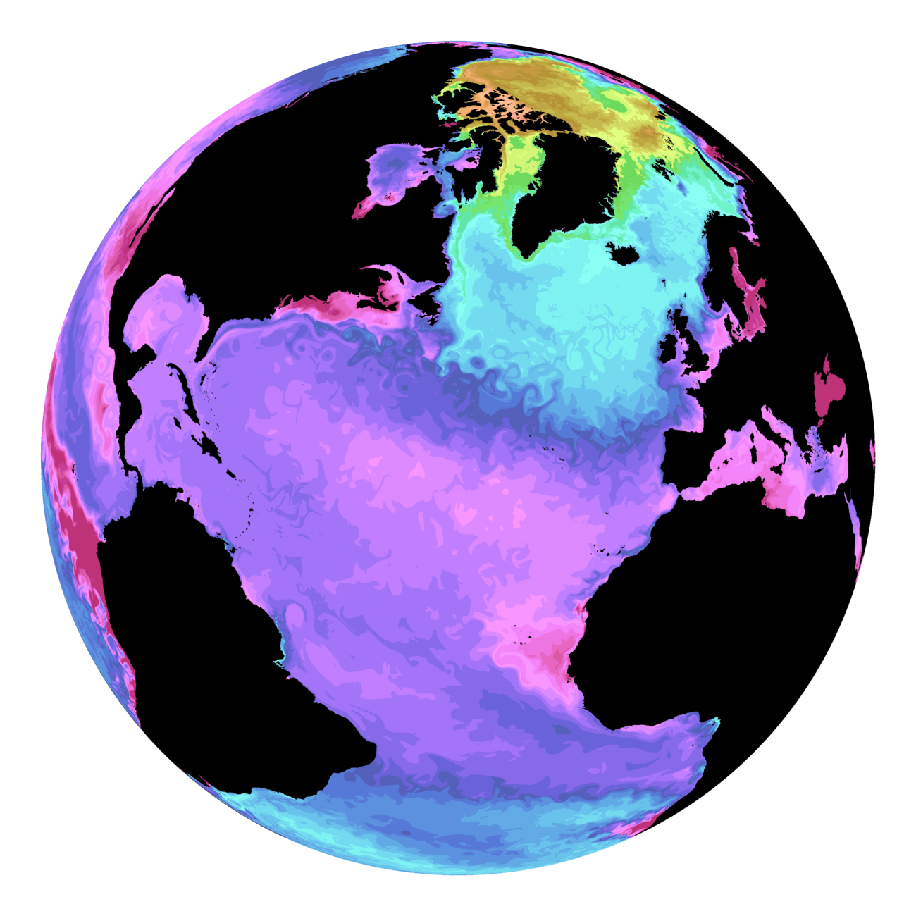
Nucleus for European Modeling of the Ocean (NEMO) is a state-of-the-art global ocean model
It is used in oceanographic research, operational oceanography, seasonal forecast and climate studies
Includes several sub-models. Many of them can work in standalone version , many others need to be coupled
Chlorophyll
Sea Surface Temperature
PH
Current Velocity

Slide 8
A climate modeling Timeline
Inclusion of new components
From the 4th National Climate Assessment (US), Volume I
Allowed the representation of new climate and biogeochemical processes
Improved the ESMs ability to represent the real world
Provides a new framework to investigate the interactions between the different components

Slide 9
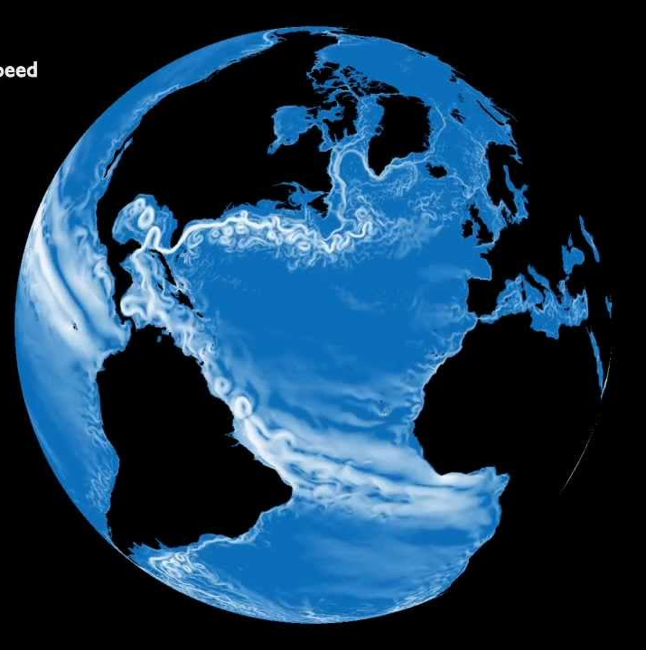
A climate modeling Timeline
Increase in spatial resolution: Ocean
Standard
Resolution (1°)
High Resolution (0.25°) Eddy-permitting
“Ultra-High” resolution:
Eddy-resolving
Today
The improvements in ocean resolution translate in a better representation of eddies and ocean currents, which are key to describe realistically decadal variability in the ocean

Slide 10
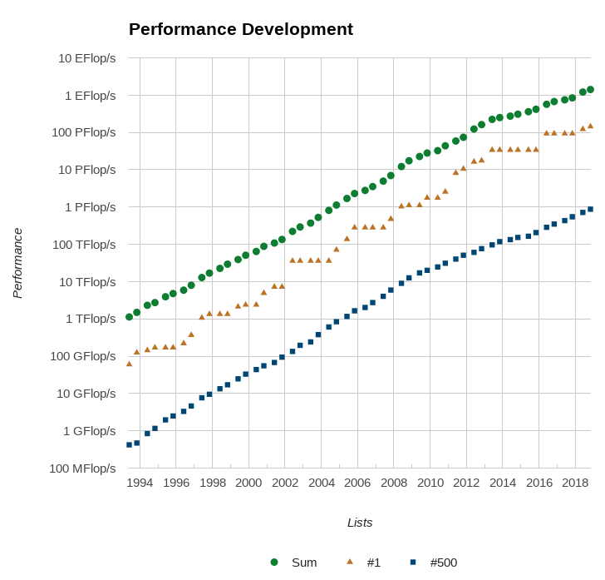
Challenges
TOP500 Ranking of most powerful supercomputers
Notes:
Back in nineteen-nintythree when the top500 of fastest supercomputers started the fastests machine was able to perform 100 Gflop per second, a single node in the current MN3 can achieve 300 Gflop per second, and the fastest machine can reach 33 Pflops , more than 5 orders of magnitude increase.

Slide 11
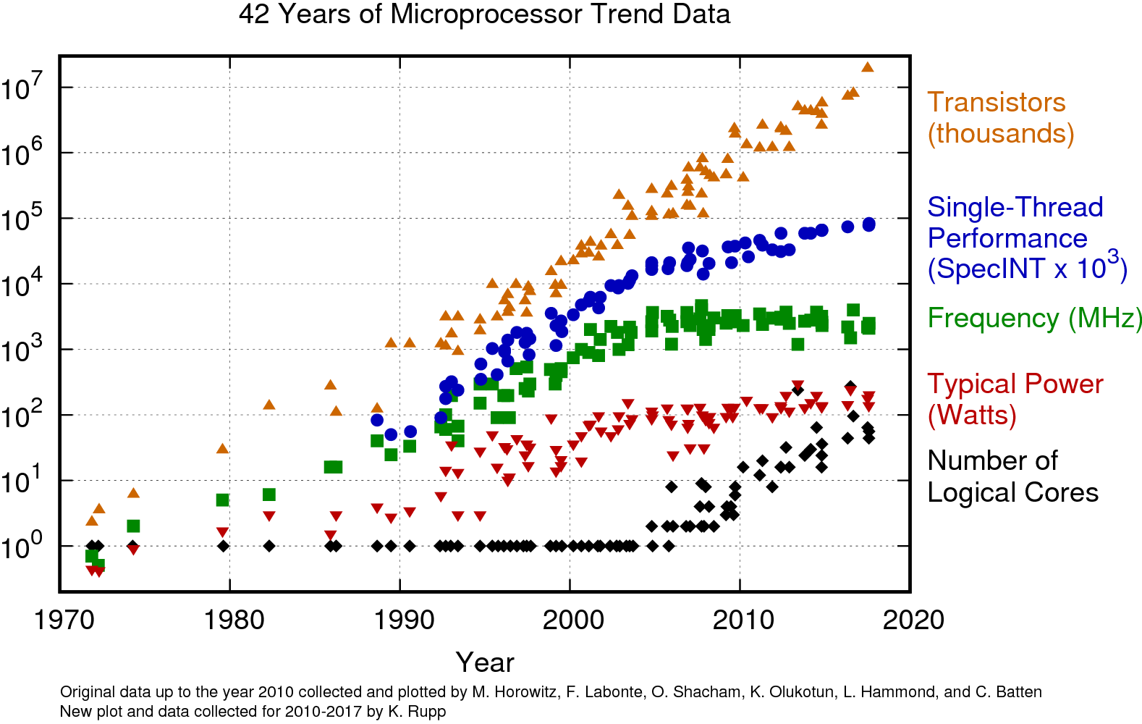
Challenges
Notes:
But let me point that during these time, a very important part of these increase came from the increment of the clock frequency, but back in 2005 it was clear that keep increasing this was impossible due to power-dissimpation limitations. Since then, to keep increasing the computing power of supercomputers, instead of going faster, it was necessary to increase the number of processor cores. While when the performance improvements came from the increment of processor speed the developers could have performance benefits just moving to new machines, now to being able to use more computing power, develoers must adapt their applications to the new paradigm.

Slide 12
Challenges
How to exploit exascale systems:
Synchronization-reducing algorithms.
Communication reducing algorithms.
Mixed Precision methods.
Autotuning.
Fault resilient algorithms.
Reproducibility.

Slide 13
Challenges
Start from scratch to use better the resources?
Development cost of a climate model is estimated to be between 500-1000 person year.
Most of models are community models and communities are reluctant to deep changes.
Adapt the existing state-of-the-art models seems wiser choice!
Notes:
So, its clear that to be able to use the computing power of modern supercomputers, applications must exploit parallelism.

Slide 14
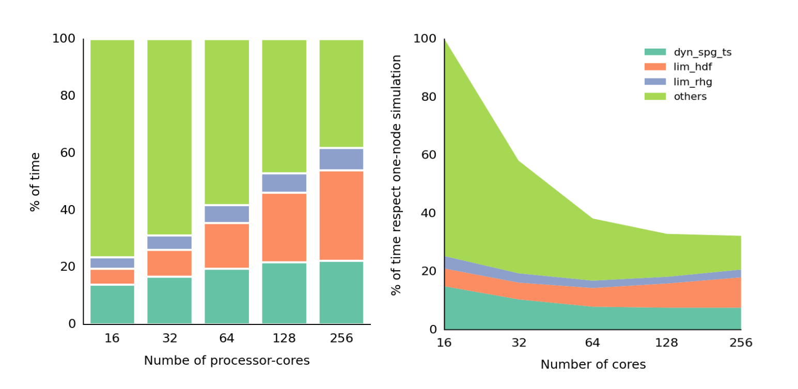
Stress Test
Notes:
Doing a stress test, trying to push the model unti it does not go any faster, we could see that not all the parts of the model behave the same way, and in fact we saw that are mainly three routines of the model that are not scaling well and therefore limiting the model.

Slide 15
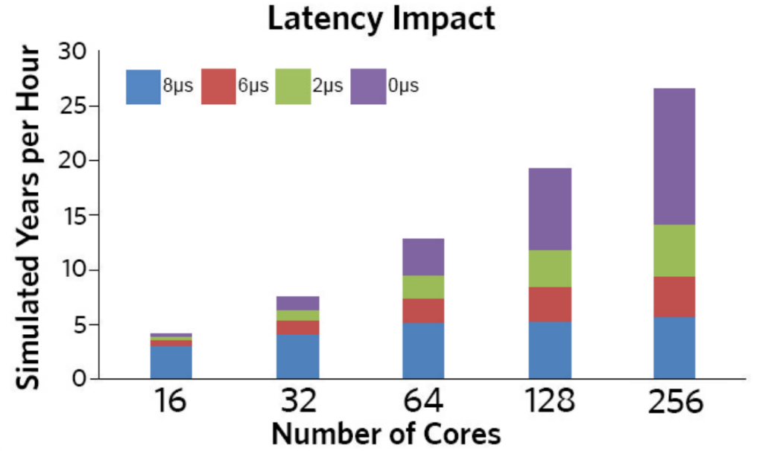
Impact of Communication
Notes:
We could se that the problem was related with the communication, and for instance in this plot you can see the impact of the network latency (the time that takes a message of 0 kb to be sent) in the model. We see that while in the ideal network with 0 latency the model keeps increasing the speed, in slower latencies the model does not scale using more than 64 cores.
This is usually related with a large number of small messages.

Slide 16
Optimizations
Reduction of communication:
Message aggregation
Removing unnecessary collective communication

Slide 17
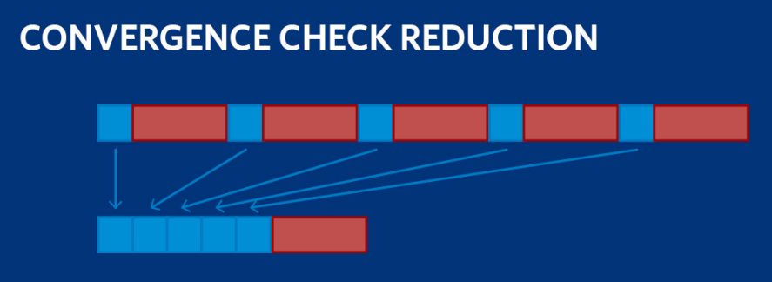
Optimizations

Slide 18
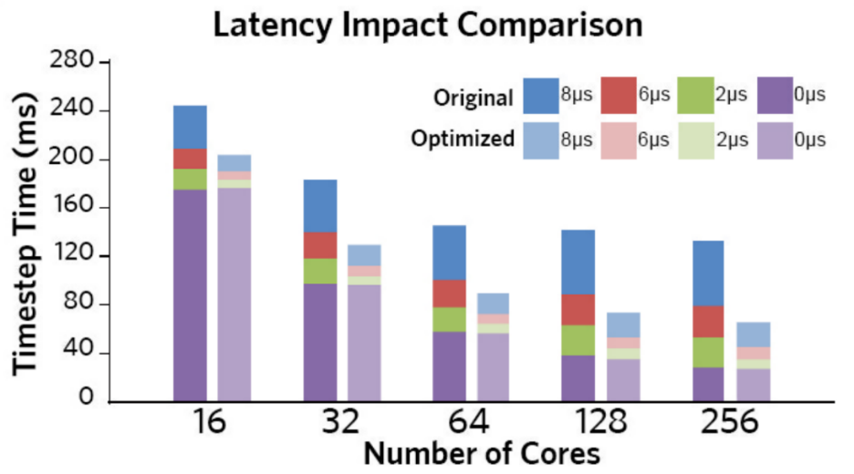
Optimization Impact

Slide 19
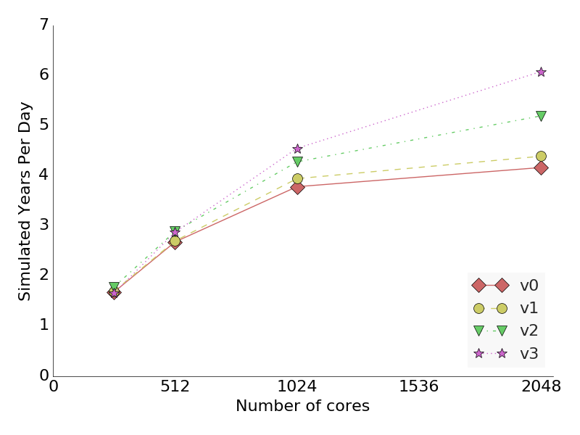
Optimization Impact on ORCA025 simulations

Slide 20
Impact of our work
Our optimizations have been included and used from NEMO 3.6 . Hundreds of users around the world take profit of it and millions of computer hours are saved.
Publication:
Finding, analysing and solving MPI communication bottlenecks in Earth System models - Journal of computational Science
( https://doi.org/10.1016/j.jocs.2018.04.015 )

Slide 21
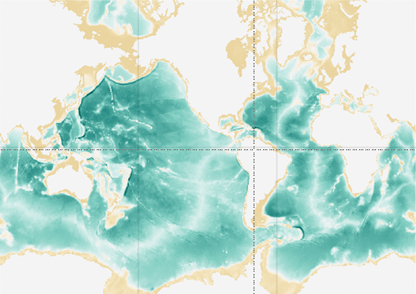
ELPiN
Removing the land-only processes in the smart way.

Slide 22
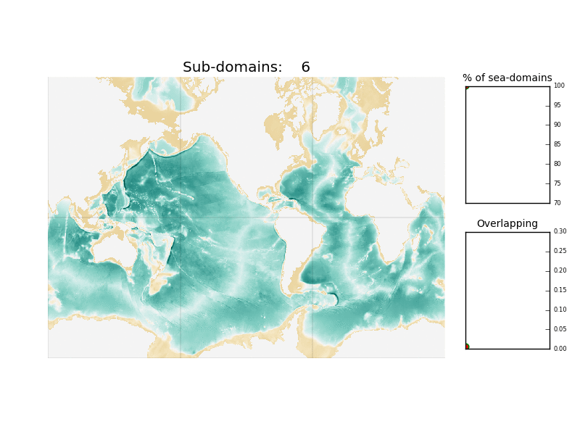
ELPiN
Removing the land-only processes in the smart way.

Slide 23
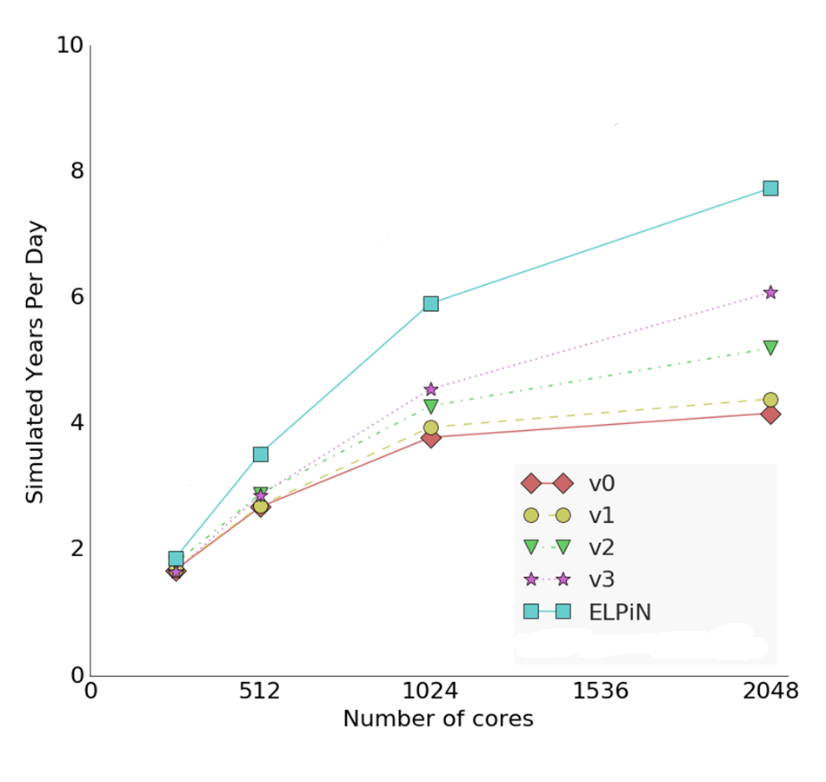
ELPiN
Impact on ORCA025 simulations

Slide 24
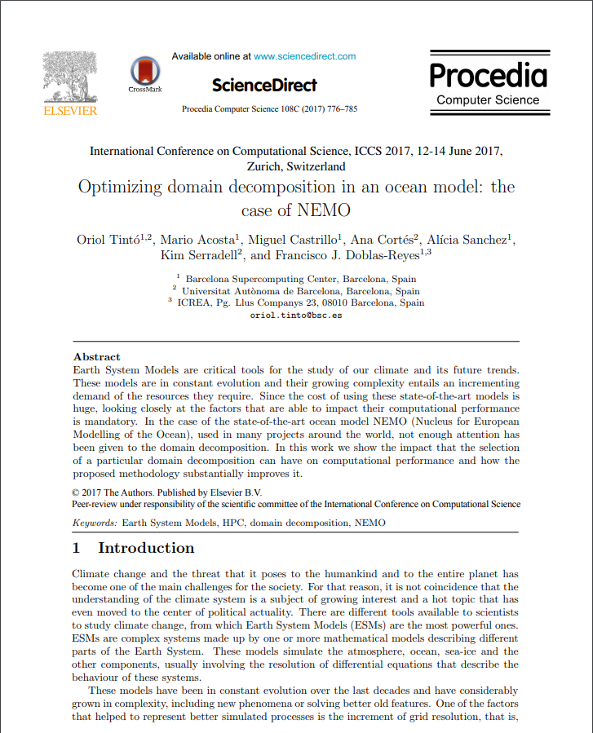
Impact of our work
This tool has been implemented in the EC-Earth production workflow. CMIP-6 simulations with EC-Earth will be using it and therefore saving millions of computing hours.
Presented and published in proceedings of the ICCS 2017 @ Zurich

Slide 25
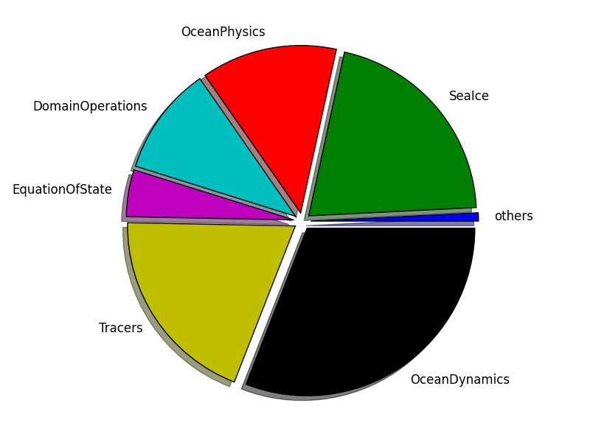
How to keep improving the model?

Slide 26
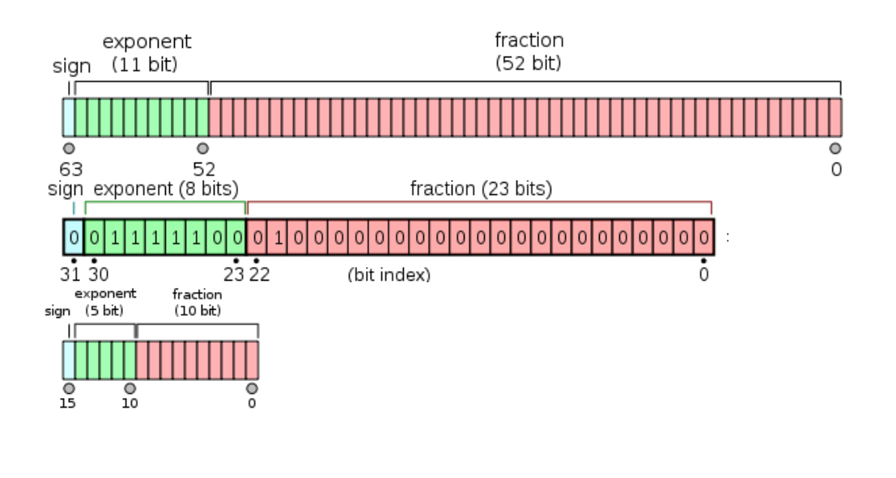
Exploring the use of mixed Precision
~10⁻¹⁶
Exponent
~10⁻⁷
1.2345
= 12345 x 10⁻⁴
~10⁻³
Significand
Base
Which precision is needed for the data that we want to represent?
Satellites can measure sea surface temperature with an uncertainty of 0.3 ºC and surface wind with an uncertainty of 1 m/s.
- Remote Sensing of European Seas - V.Barale, M.Gad
~10⁻¹
To represent data with this level of uncertainty, using half-precision (16-bit) should be enough. Instead, double precision (64-bit) is the standard.

Slide 27
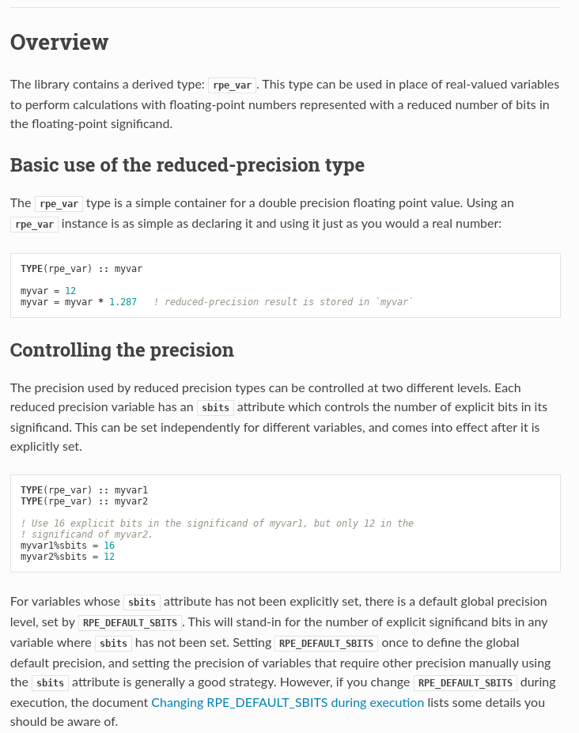
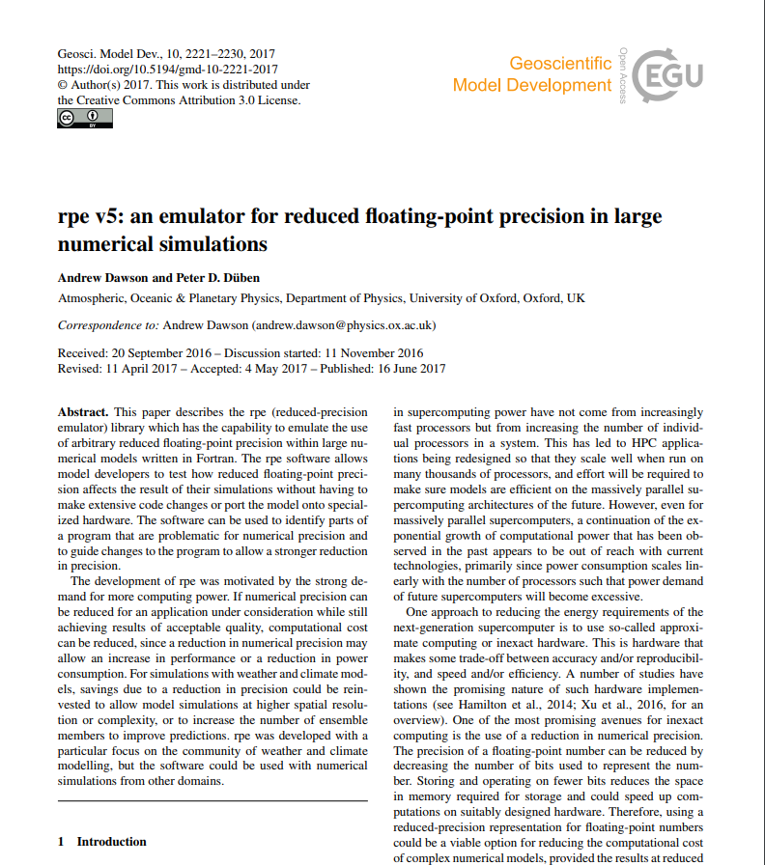
Reduced Precision Emulator
Fortran Library developed by the Atmospheric, Oceanic & Planetary Physics group, within the University of Oxford Department of Physics

Slide 28
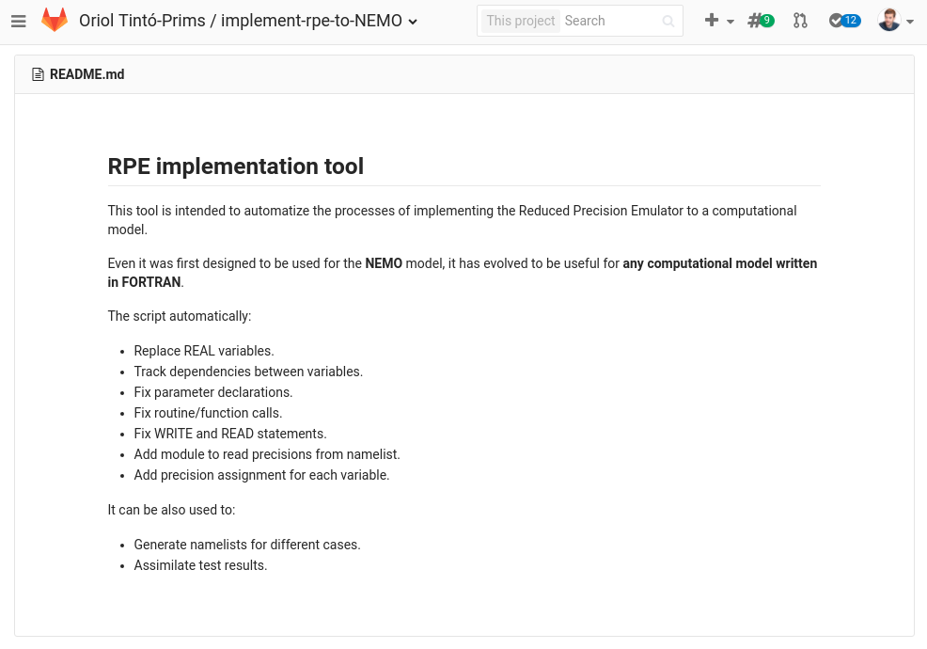
Implementing the emulator
After some months lost manually implementing the emulator…
a Python tool to automate the process was created.

Slide 29
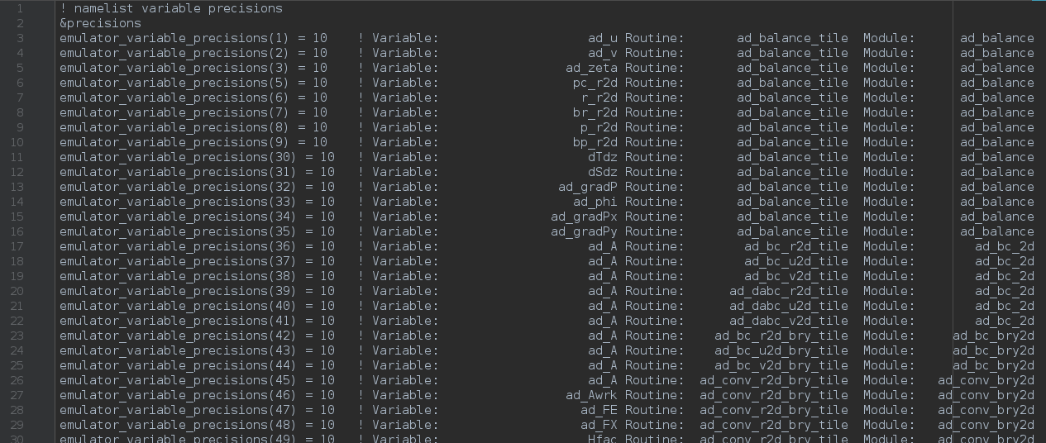
RPE in NEMO:
What we can do with it?
With a single binary, we can specify the number of significant bits used for each real variable declaration within the code through a namelist.

Slide 30
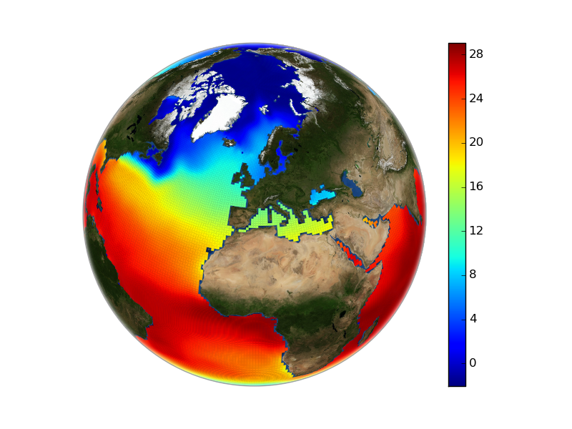
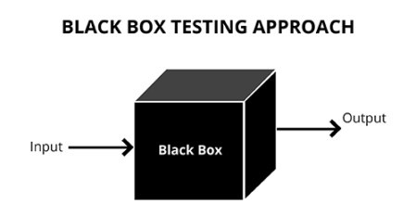
RPE in NEMO:
What we can do with it?
With a single binary, we can specify the number of significant bits used for each real variable declaration within the code through a namelist.
Precision namelist
Model outputs

Slide 31
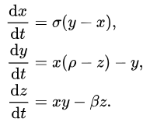
Verifying a non-linear model
a simple example
A simple example:
Lorenz system

Slide 32
Verifying a non-linear model
a simple example

Slide 33
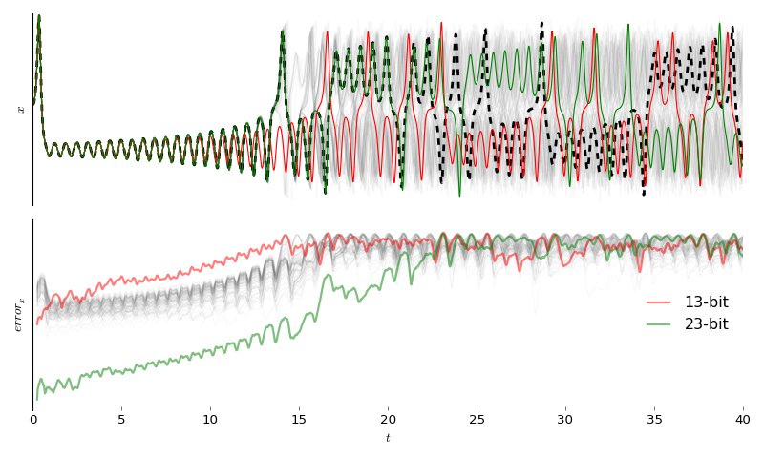
Verifying a non-linear model
a simple example

Slide 34
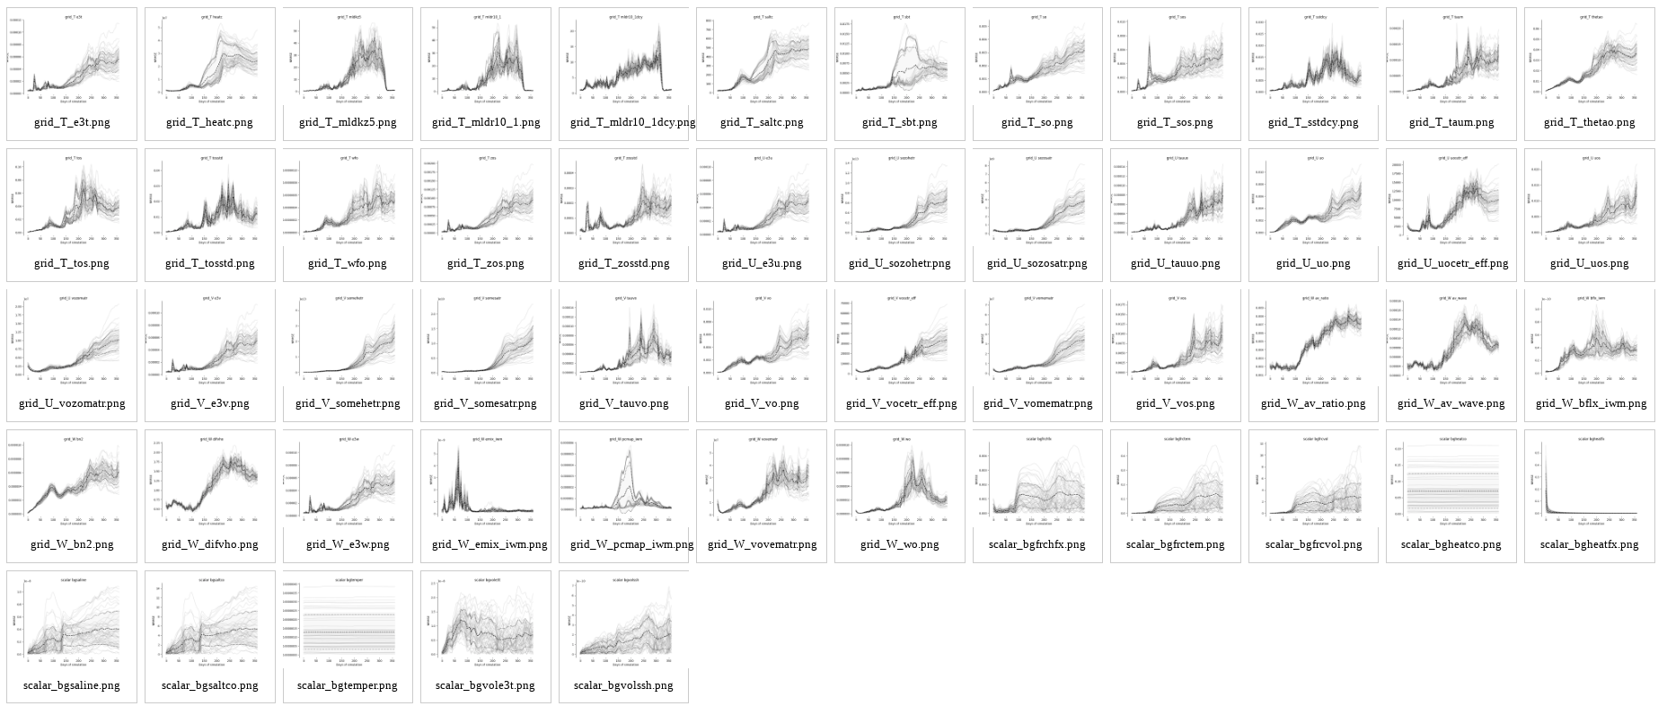
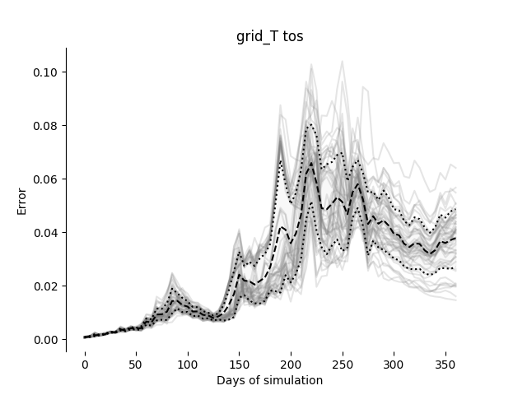
Verifying NEMO
Initial conditions perturbed with white noise in the 3D temperature field.
Evaluating 53 output variables.

Slide 35
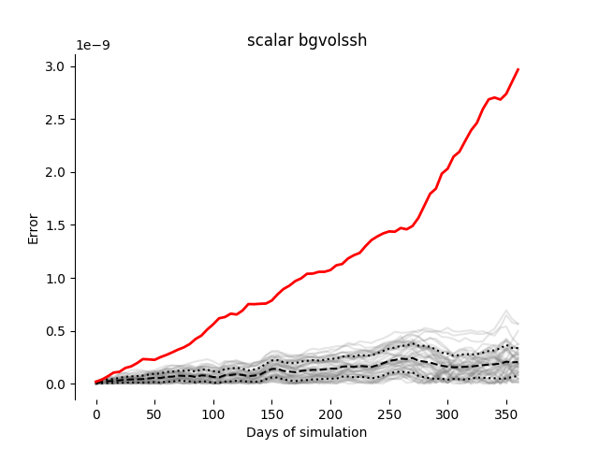
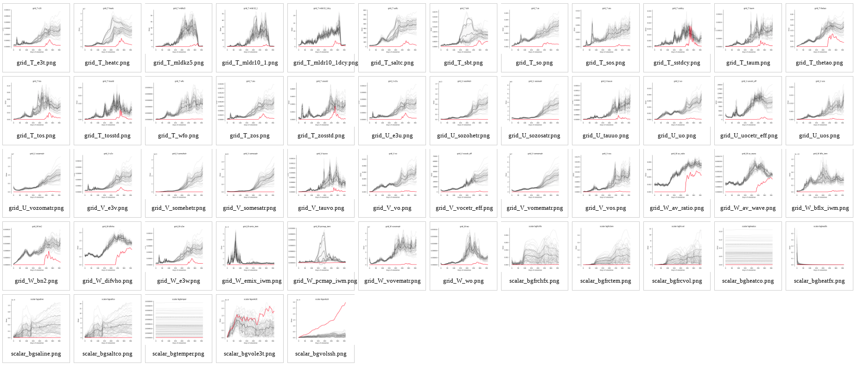
Verifying NEMO
Example: Compiling with –xCORE-avx512

Slide 36
Analysis Algorithm
[0 1 2 3 4 5 6 7 8 9]

Slide 37
Analysis Algorithm
[0 1 2 3 4 5 6 7 8 9]
[0 1 2 3 4]
[5 6 7 8 9]

Slide 38
Analysis Algorithm
[0 1 2 3 4 5 6 7 8 9]
[0 1 2 3 4]
[5 6 7 8 9]
[0 1 2]
[3 4]

Slide 39
Analysis Algorithm
[0 1 2 3 4 5 6 7 8 9]
[0 1 2 3 4]
[5 6 7 8 9]
[0 1 2]
[3 4]
[3]
[4]

Slide 40
Analysis Algorithm
[0 1 2 3 4 5 6 7 8 9]
[0 1 2 3 4]
[5 6 7 8 9]
[0 1 2]
[3 4]
[3]
[4]

Slide 41
Analysis Algorithm
[0 1 2 3 4 5 6 7 8 9]
[0 1 2 3 4]
[5 6 7 8 9]
[0 1 2]
[3 4]
[3]
[4]

Slide 42
Analysis Algorithm
[0 1 2 3 4 5 6 7 8 9]
[0 1 2 3 4]
[5 6 7 8 9]
[0 1 2]
[3 4]
[3]
[4]

Slide 43
Analysis Algorithm
[0 1 2 3 4 5 6 7 8 9]
[0 1 2 3 4]
[5 6 7 8 9]
[0 1 2]
[3 4]
[3]
[4]

Slide 44
Analysis Algorithm
[0 1 2 3 4 5 6 7 8 9]
[0 1 2 3 4]
[5 6 7 8 9]
[0 1 2]
[3 4]
[3]
[4]

Slide 45
Analysis Algorithm
[0 1 2 3 4 5 6 7 8 9]
[0 1 2 3 4]
[5 6 7 8 9]
[0 1 2]
[3 4]
[3]
[4]
Variable 4 must be kept in double-precision.
More info: How to use mixed precision in ocean models. https://www.geosci-model-dev-discuss.net/gmd-2019-20/

Slide 46
Analysis algorithm:
How is it implemented?
Implementation done in Python:
class Job( variable_set):
Submit job to remote machine.
Check job status.
Evaluate success.
Expand subgroups.
Check subgroups.
[0 1 2 3 4 5 6 7 8 9]
[0 1 2 3 4] [ 5 6 7 8 9]
PENDING
RUNNING
SUSPENDED
SUCCESS
FAIL

Slide 47
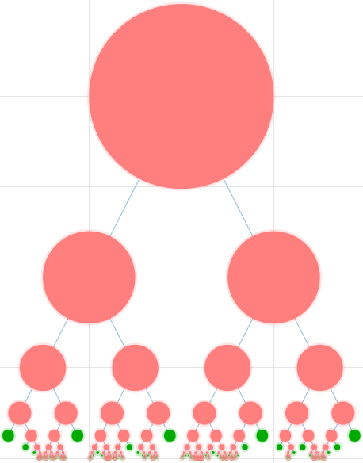
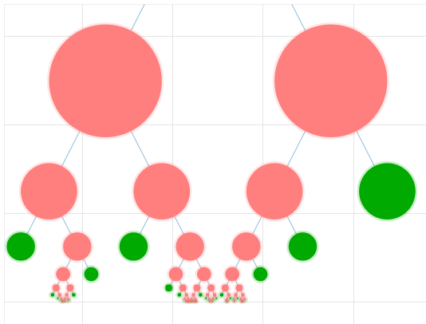
Precision Analysis

Slide 48
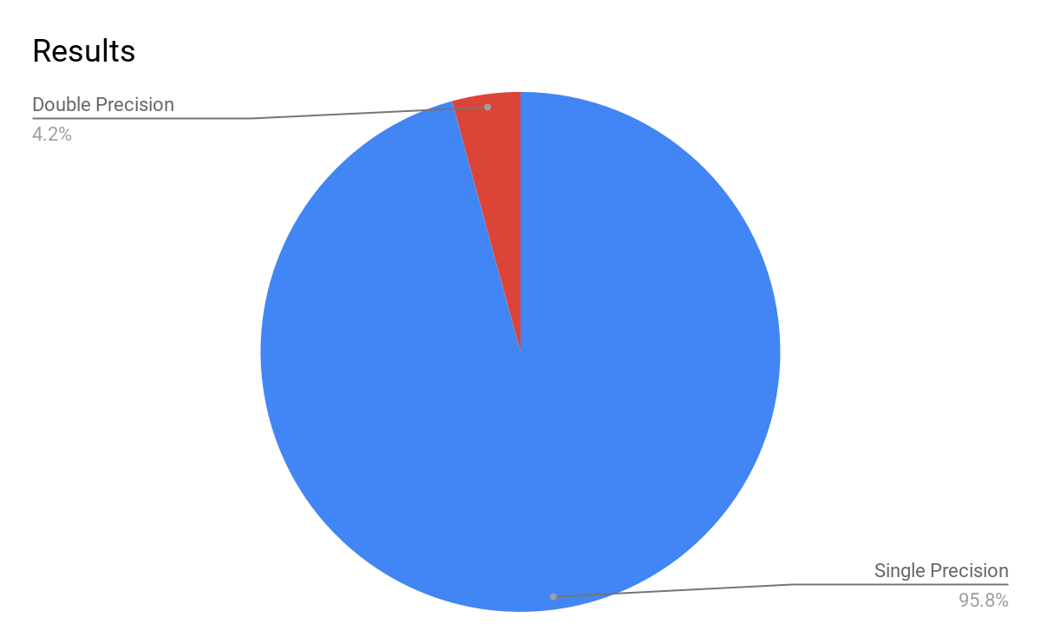
Results

Slide 49
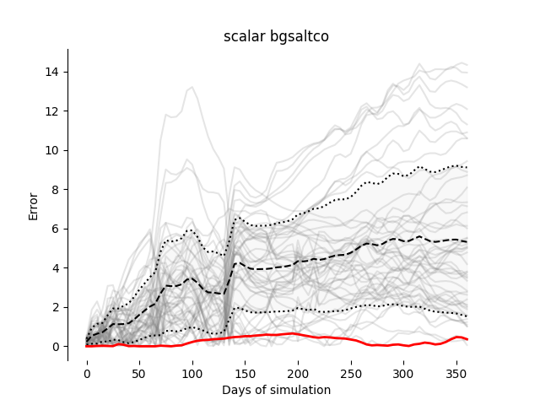
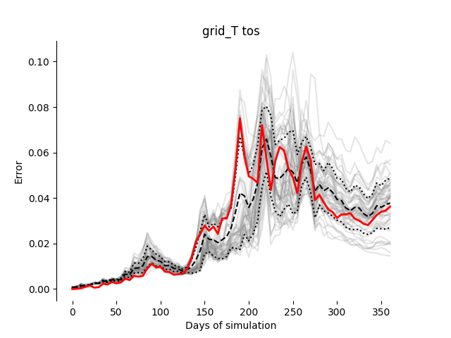
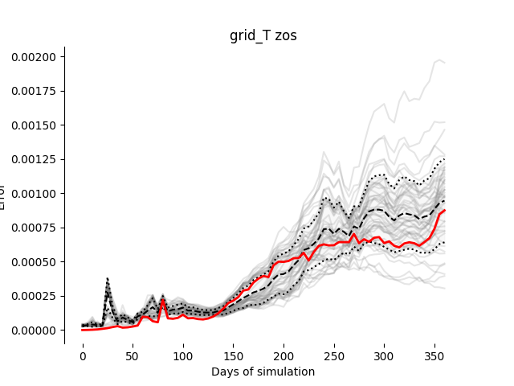
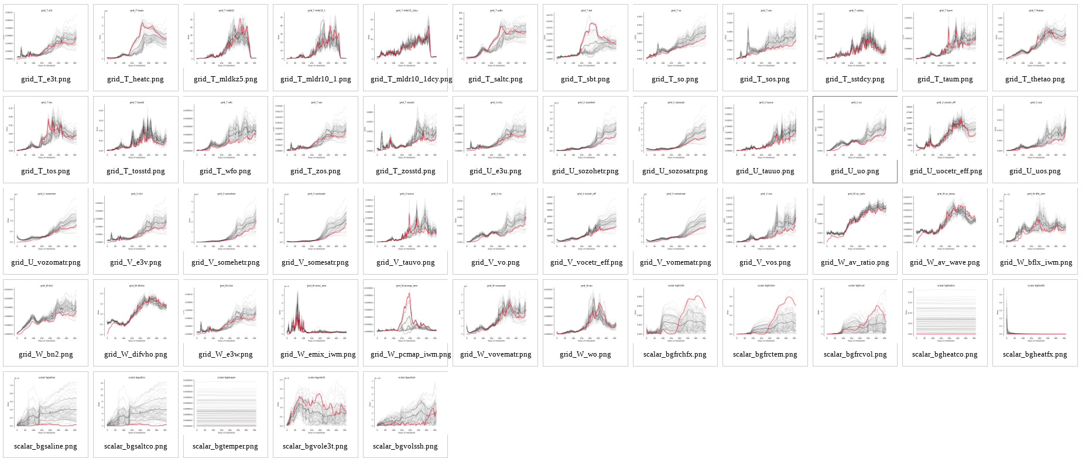
Results
Verifying results.

Slide 50
Contributions
Performance analysis and optimization
Detecting, analyzing and optimizing MPI communication bottlenecks in Earth System models - Published at Journal of Computational Sciences
Domain decomposition optimization
Optimizing domain decomposition in an ocean model: the case of NEMO - Presented at ICCS 2017, published at the proceedings.
Verifying non-linear models
Discriminating accurate results in nonlinear models. - Submitted to WCES @ HPCS 2019
Numerical precision analysis for Earth Science models
How to use mixed precision in Ocean Models - Final stages of revision at Geoscientific Model Development

Slide 51
Future Plans
Finish the thesis during this academic year.

Slide 52
Thank you
oriol.tinto@bsc.es

