Slide 1
Climate services for the retail sector: Filomena’s case
Albert Martinez Boti^{1,3}, Lluís Palma^{1,3}, Francesc Roura¹, Andrea Manrique-Suñén¹, Nube Gonzáles-Reviriego¹, Raül Marcos^{1,3}, Sergio González², Antonio López² and Albert Soret¹
¹Barcelona Supercomputing Center, Earth Sciences, Barcelona, 08034, Spain
²Decathlon España, San Sebastian de los Reyes, Madrid, 28702, Spain
³Universitat de Barcelona, Barcelona, 08007, Spain
04/2021
Earth System Services Group

Slide 2
The Filomena event

Slide 3
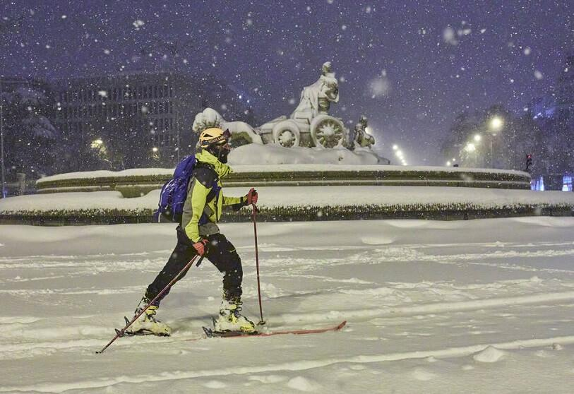
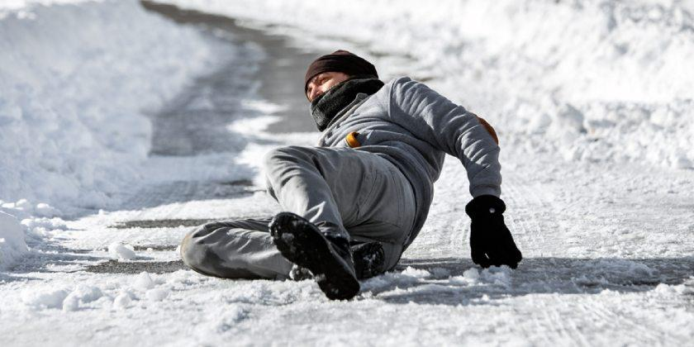
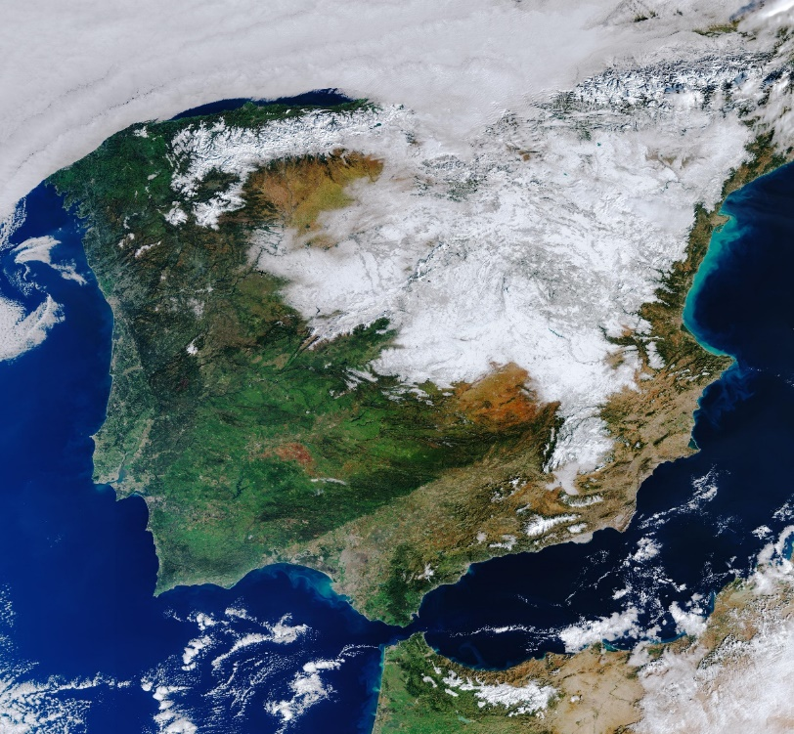
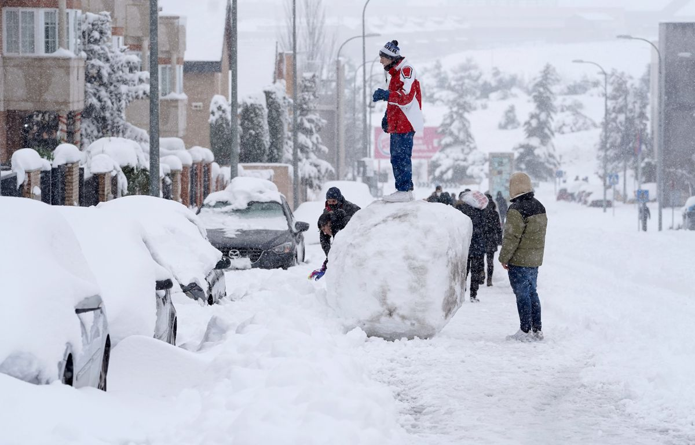
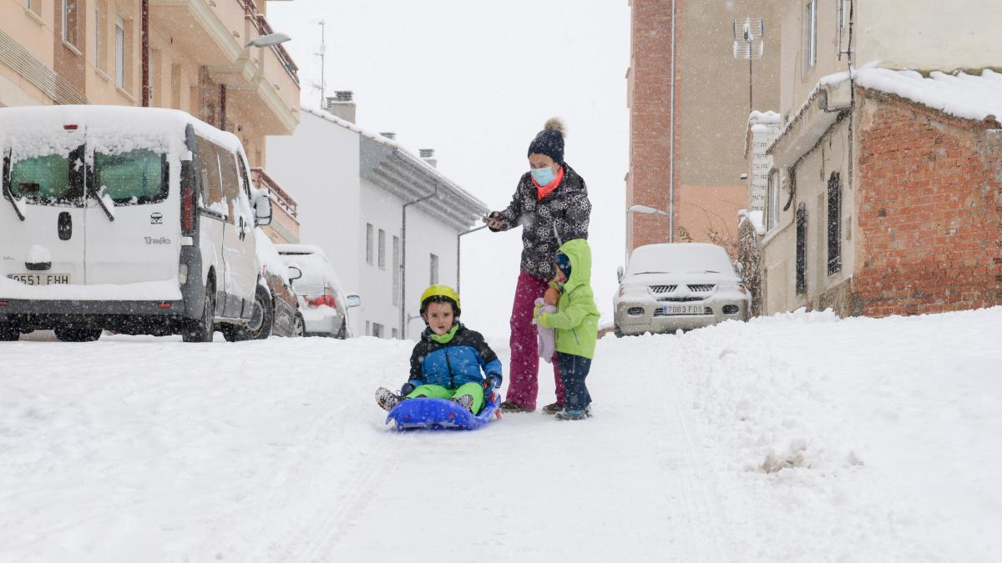
Filomena event in images
Image source: https://atalayar.com/content/sat%C3%A9lites-metop-y-msg-clave-en-la-alerta-ante-la-gran-nevada-ca%C3%ADda-en-buena-parte-de-espa%C3%B1a PHOTO/Europa Press
Image source: cuidateplus.marca.com/bienestar/2021/01/12/como-prevenir-actuar-caidas-hielo-176335.htmlhttps://
Image source: https://www.elplural.com/el-telescopio/tech/espana-filomena-espacio_257533102 Photo: ESA
Image source: https://www.elperiodico.com/es/economia/20210111/efectos-filomena-cubiertos-seguros-11448387
Image source: https://www.heraldo.es/noticias/aragon/2021/01/09/temporal-filomena-la-nieve-tiene-un-efecto-psicologico-positivo-1413878.html

Slide 4
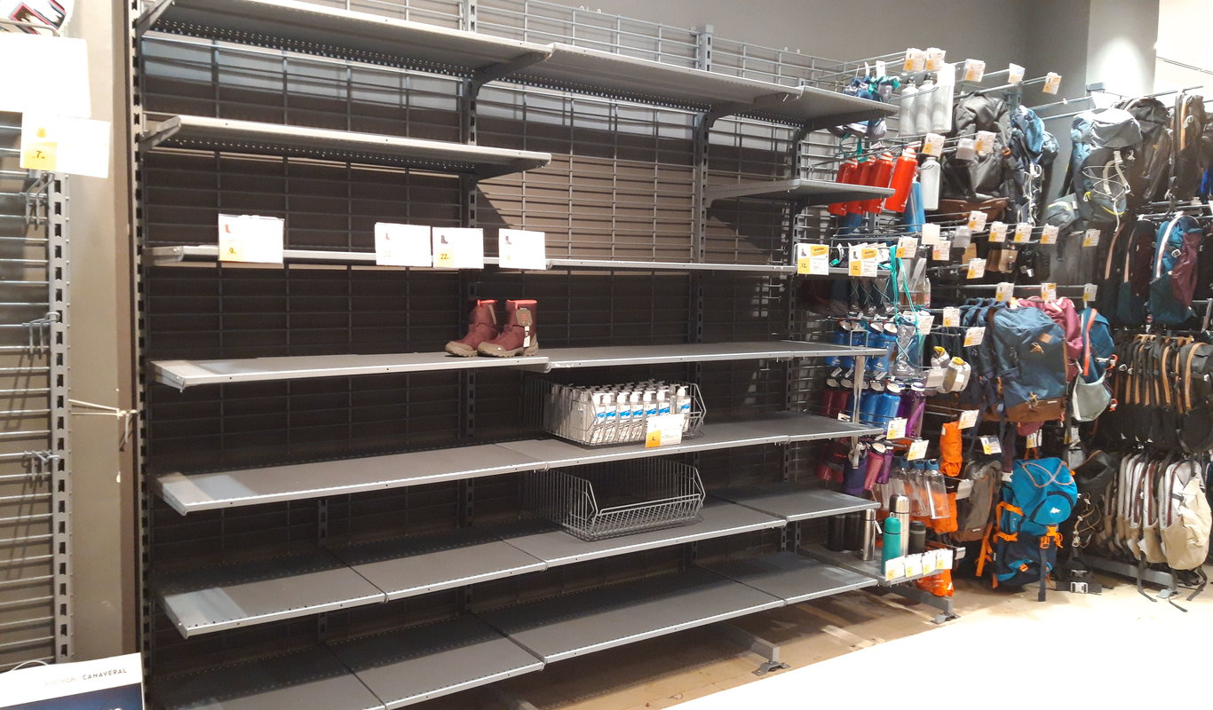
Climate influence on sporting goods sales: Filomena’s proof
“PEOPLE FROM MADRID FINISH ALL HIKING BOOTS UNITS OF DECATHLON”
Source: https://autonomico.elconfidencialdigital.com/articulo/muy_confidencial/madrilenos-arrasan-todas-botas-montana-decathlon/20210118185349068531.html

Slide 5
How can climate services be seized by the retail sector?

Slide 6
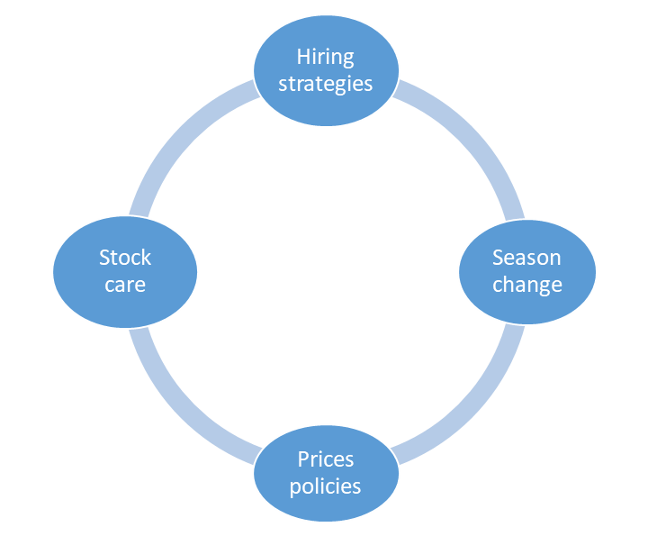
From climate data to climate services
End-users world
Climate world
CLIMATE SERVICES
Co-development
scientists/end-users
Climate-sensitive
decisions
Climate-informed decision-making

Slide 7
Co-development of climate products: The example of our project with Decathlon
Regular meetings
Meetings and workshops to get to know each other’s field
Creation of climate-specific products as an iterative process that involves both Decathlon and BSC. The final climate products are tailored to Decathlon needs.
Support in decision-making: climate-informed decision making
Testing of co-designed climate services products to assess the added value to Decathlon
Image source:
https://www.pinclipart.com/maxpin/Tiwibi/

Slide 8
Benefits of specific co-developed climate products for the retail sector
COMPANY BENEFITS
Avoiding running out of products
Avoiding producing too much
Avoiding the extra-cost of keeping what is not sold
Knowledge acquisition
Optimising the hiring
ENVIRONMENTAL BENEFITS
Produced just what is necessary
The stock transport is optimised (less carbon when transporting)
Image sources:
https://rincondelemprendedor.es/como-invertir-con-exito-los-beneficios-de-nuestra-empresa/
https://www.nueva-iso-14001.com/2020/06/como-integro-la-sostenibilidad-en-los-ambitos-de-mi-empresa/

Slide 9
An example to illustrate the potential of climate services products:
Filomena’s case study

Slide 10
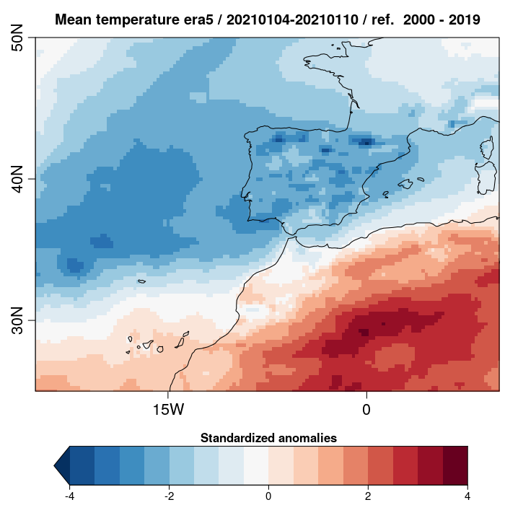
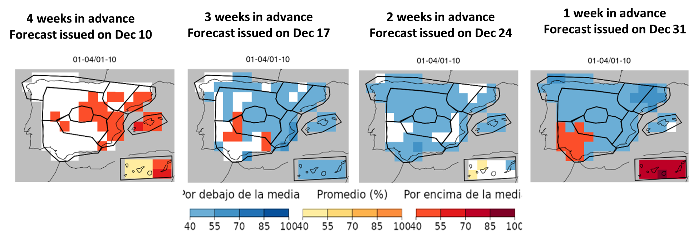
Filomena’s case study
ANOMALY MAP
OBSERVATIONS
vs
PREDICTED TERCILE CATEGORY FOR SURFACE TEMPERATURE DIFFERENT WEEKS IN ADVANCE
WELL-PREDICTED 3 WEEKS
IN ADVANCE!

Slide 11
Which was Filomena impact on Decathlon?
A quick analysis of climate influence with Decathlon data

Slide 12
Data, period and sale variables used for the analysis
Data
Weekly data of regional aggregations of Decathlon’s stores (excluding Canarias and Melilla) and clicks on Decathlon’s website https://www.decathlon.es/
Period
The analysis is conducted for Filomena’s week (from 2021-01-04 to 2021-01-10) and the surrounding ones
Winter and mountain sports: sporting goods and accessories related to the different winter and mountain sports
Turnover: Earnings related to sales.
Glossary
Turnover progression: Percentage increase in sales relative to the same week of the previous year
Clicks progression: Percentage increase in clicks relative to the same week of the previous year
Percentage share: Percentage of winter and mountain sports (for sales or clicks) to the total (for sales or clicks)
Clicks: clicks in Decathlon’s website https://www.decathlon.es/ (total clicks) or its winter and mountain sports sections (winter and mountain sports clicks)
Sale variables
analysed

Slide 13
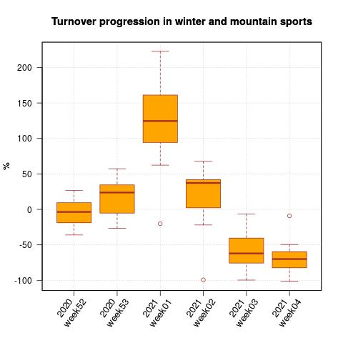
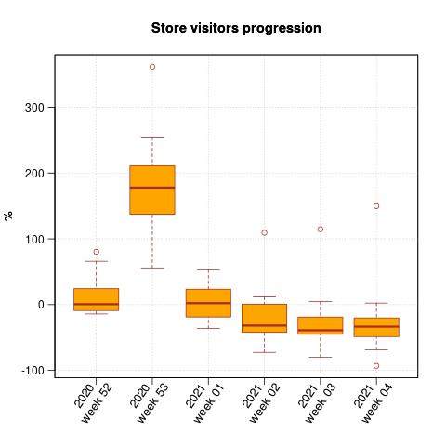
Turnover progression in winter and mountain sports vs store visitors progression
NO SIGNIFICANT OR GENERALISED INCREASE IN DECATHLON’S STORES VISITORS
LARGE INCREASE IN WINTER AND MOUNTAIN SPORTING GOODS SALES
FILOMENA’S WEEK (from 2021-01-04 to 2021-01-10)

Slide 14
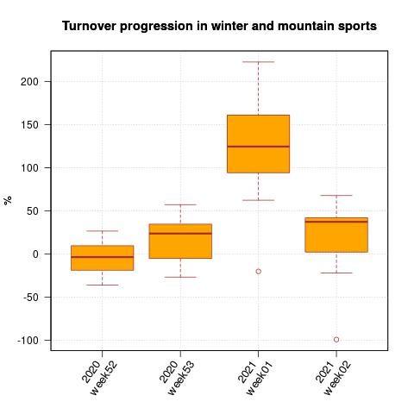
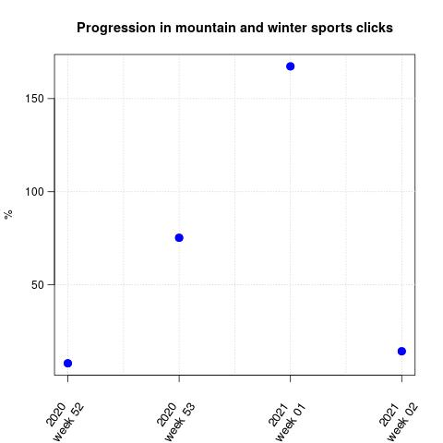
Turnover progression in winter and mountain sports vs progression in winter and mountain sports clicks
HUGE INCREASE IN CLICKS REGARDING THE MOUNTAIN AND WINTER SPORTS SECTIONS ON DECATHLON’S WEBSITE
LARGE INCREASE IN WINTER AND MOUNTAIN SPORTING GOODS SALES
FILOMENA’S WEEK (from 2021-01-04 to 2021-01-10)

Slide 15
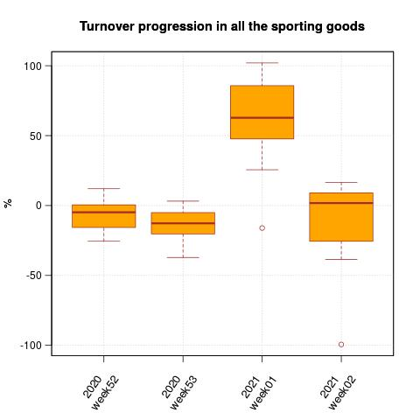
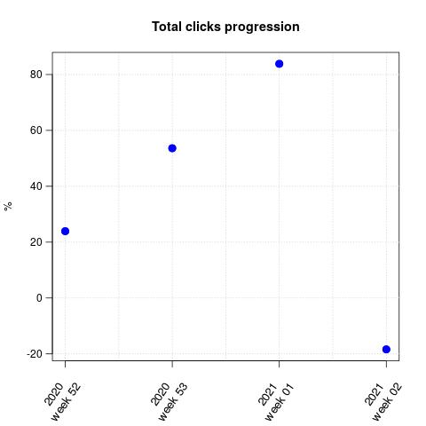
Turnover progression in total sales vs progression in total clicks
LARGE INCREASE IN TOTAL CLICKS ON DECATHLON’S WEBSITE
GREAT INCREASE IN TOTAL SALES
FILOMENA’S WEEK (from 2021-01-04 to 2021-01-10)

Slide 16
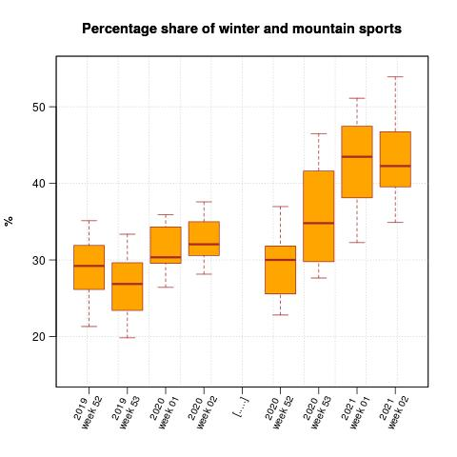
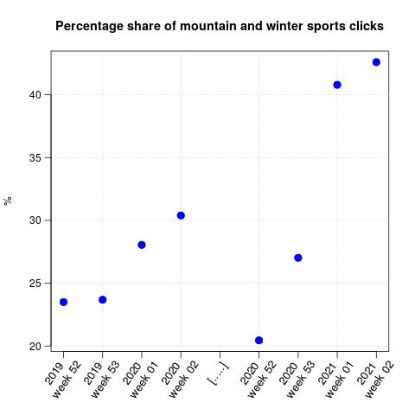
Percentage share of winter and mountain sports vs percentage share of mountain and winter clicks
SALES SHIFTED TOWARDS THE WINTER AND MOUNTAIN SPORTS
CLICKS SHIFTED TOWARDS THE WINTER AND MOUNTAIN SPORTS SECTIONS
FILOMENA’S WEEK AND THE NEXT ONE (from 2021-01-04 to 2021-01-17)

Slide 17
How could climate services products have helped Decathlon to manage the Filomena event?
Designing weeks in advance strategies that may include:
Salt provisioning
Reduction of the stores’ schedules: electricity and heating saving
Warnings to the stores to let them design their strategies
Avoiding unnecessary risks to Decathlon’s visitors
Regional stock movements

Slide 18
Conclusions and discussion

Slide 19
Climate products co-developed with end-users are able to offer added value for decision-making thanks to the implementation of climate-informed decisions.
Climate services are an opportunity to optimise decision-making at multiple prediction time scales, such as subseasonal or seasonal. Ex: optimising stock transport or reducing CO2 emissions (future studies to quantify this effect are planned).
Filomena’s case study is an illustration of the potential value of subseasonal forecast as a climate service tool. We have quantified the influence of climate in the retail through an analysis of some sale variables using Decathlon data for Filomena’s week and the surrounding ones. All the variables point towards an increase in the activity and sales in mountain and winter equipment during Filomena’s event.
Future more detailed studies to quantify patterns between different sale variables and climate variables will be conducted.

Slide 20
Thank you
albert.martinez@bsc.es

