Slide 1
AQWATCH preparation: First insights of NO2 pollution over Mexico City with TROPOMI
PETETIN Hervé
AC group meeting
25/02/2020

Slide 2
AQ-WATCH

Slide 3
AQ-WATCH
Started in January 2020
Coordinated by MPI (Hamburg), involving 12 partners
General objective of AQ-WATCH : Develop a supply chain leading to the generation of several innovative downstream AQ products and services
[WP2, task 2.5]
Objective : estimate surface pollutant concentrations and derive AQ indices using machine learning algorithms, satellite observations (e.g. TROPOMI) among other dataset (e.g. Copernicus, ECMWF)
Application to NO2 and aerosols.
https://earth.bsc.es/wiki/doku.php?id=projects:aqwatch

Slide 4
General information on TROPOMI

Slide 5
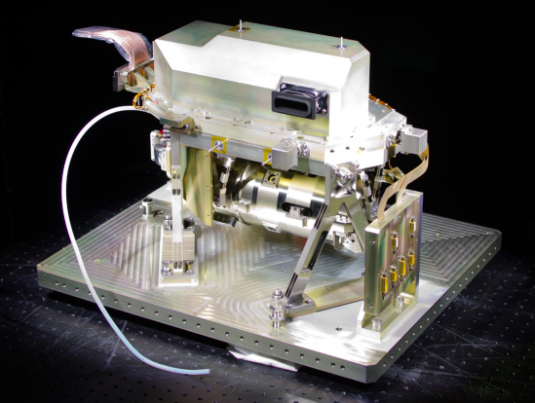
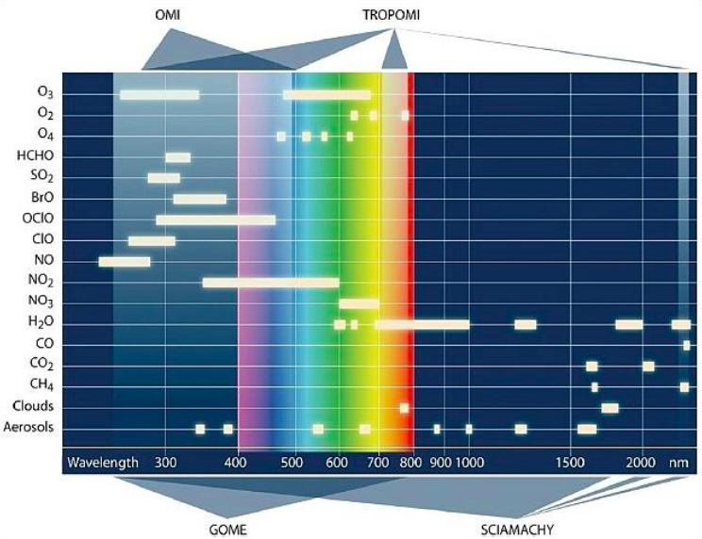
TROPOMI
Sentinel-5 Precursor (LEO) : fill the gap between the current records from OMI (NASA EOS Aura) and SCIAMACHY (ESA Envisat) and the operational Sentinel-4/5 missions
Notes:
(which cannot be donne by GOME-2 and IASI instruments on MetOp because of limited spatial resolution and lack of CH4 and CO measurements with good sensitivity down to the Earth’s surface)

Slide 6
TROPOMI versus OMI
TROPOMI combines the strengths of SCIMACHY, OMI and state of the art technologies
Major improvement of spatial/temporal resolution, spectral resolution, sensitivity
OMI
Optical chanel | Spectral range (um) | Nadir pixel size (km2) | Max S/N ratio
UV | 270-314 | 36x48 | 750
UVIS | 306-500 | 13x24 | 1000
TROPOMI
Optical chanel | Spectral range (um) | Nadir pixel size (km2) | Max S/N ratio
UV | 267-332 | 7x28 | 1000
UVIS | 303-499 | 7x3.5 | 1500
NIR | 675-775 | 7x3.5 | 500
SWIR | 2305-2385 | 7x7 | 100
Global daily coverage at 13h30 LST
Statistics on (lon-lat) spatial resolution calculated over one orbit :
Mean : 6.1±2.7 x 5.6±0.1 km2 (area = 34 km2)
Min : 3.6 x 5.2 km2 (20 km2)
Max : 15.1 x 5.6 km2 (84 km2)
p50 : 5.0 x 5.6 km2 (28 km2)

Slide 7
TROPOMI NO2 at Mexico City

Slide 8
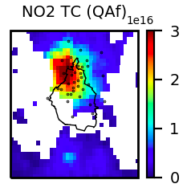
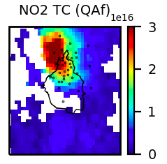
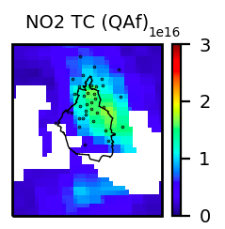
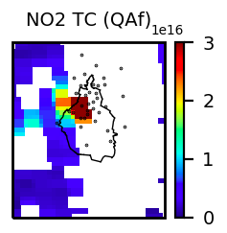
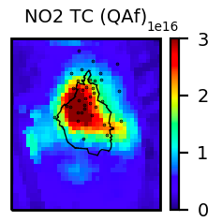
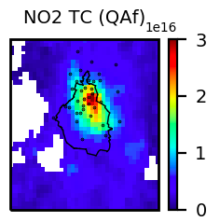
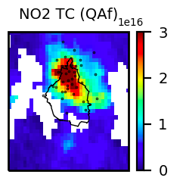
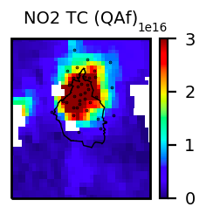
Day-to-day variability
TROPOMI L2 products merged and regridded at 3 km resolution, here for several days in january :

Slide 9
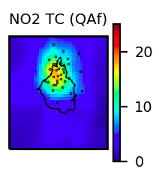
Annual average in 2019
Many cells within Mexico City and generally only one surface station per cell ➔ Strong potential for investigation intra-urban variability in large megacities like Mexico City

Slide 10
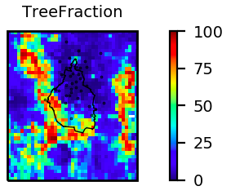
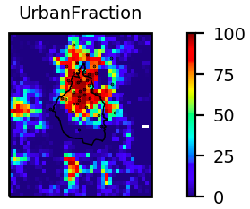
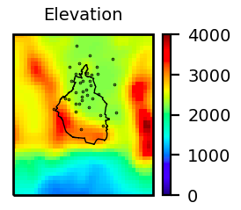
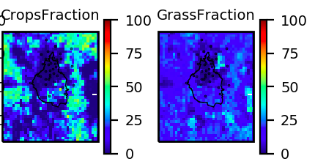
Orography and land cover
Complex orography with mountains at west/south and volcano at east (Popocatépetl)
Crops represents 50% of the land cover in many areas around the cities (and moutains)
(from Copernicus Land Monitoring Service )

Slide 11
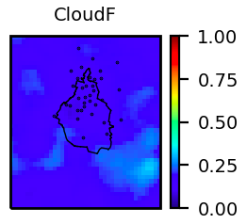
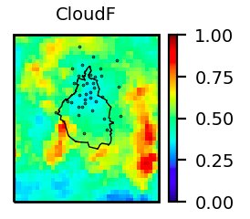
Cloud fraction
Relatively mean low cloud radiance fraction (CRF) in Mexico City area. Highest value of CRF close to Popocatépetl (not only cloud but also eruption plumes?)
(mean)
(p95)

Slide 12
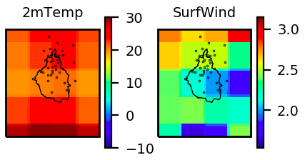
Meteorology
ERA5 meteorology quite coarse (about 30 km) at the megacity scale
Maybe poor quality in an area of such complex orography

Slide 13
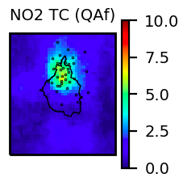
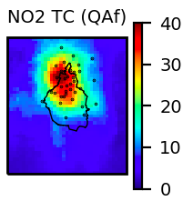
Mean versus extreme values
Around the city center of Mexico City :
Mean NO2 tropospheric column of about : 18e15 molec/cm2
5th percentile : 5e15 molec/cm2
95th percentile : 40e15 molec/cm2
(p05)
(mean)
(p95)

Slide 14
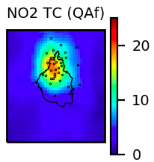
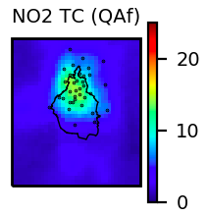
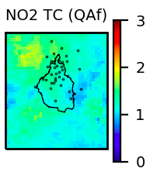
Weekdays and weekends
NO2 tropospheric columns about 1.3 higher during weekdays than during weekends
Surprisingly, highest ratio (about 1.9) is in north-west of Mexico City
(weekdays)
(weekends)
(ratio)

Slide 15
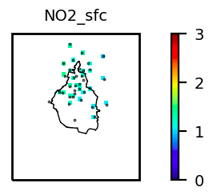
Weekdays and weekends
Weekdays-over-weekend ratio quite consistent with surface observations (colocated in time with TROPOMI)

Slide 16
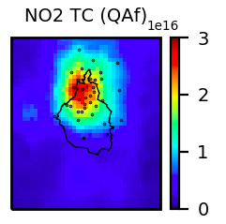
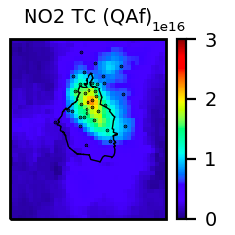
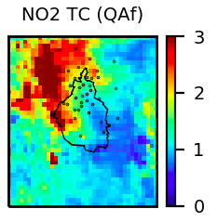
Weekdays and weekends
Focusing on shorter periods, the spatial pattern of the ratio can be strongly accentuated
Here for January : much higher ratio in north-west part (but less days taken into account, so representativeness maybe deteriorated...)
(weekdays)
(weekends)
(ratio)

Slide 17
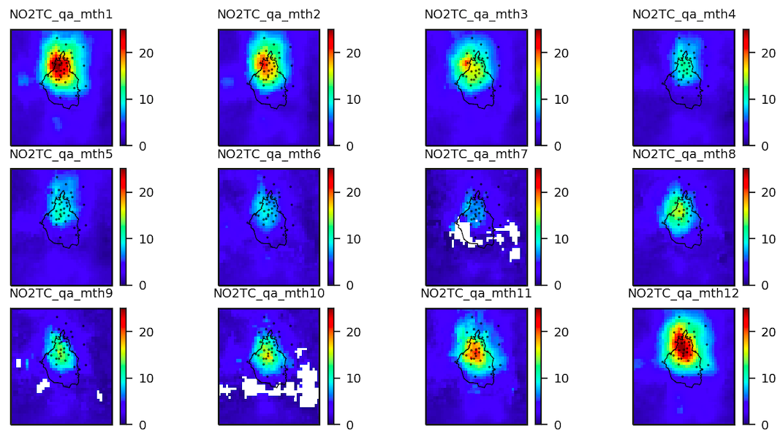
Monthly variability
Very strong seasonal variability
(NB : data gaps maybe partly to TROPOMI netcdf still missing on esarchive)

Slide 18
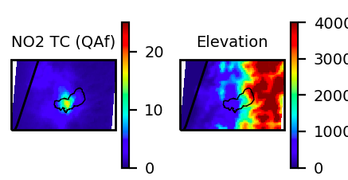
Mexico versus Santiago de Chile
Mean annual NO2 tropospheric columns in 2019 are comparable in the city center of both cities

Slide 19
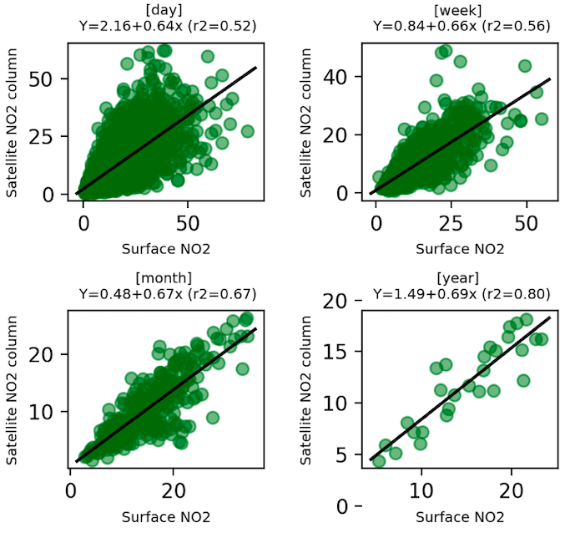
Surface versus columns at Mexico City
Surface NO2 concentrations are quite well correlated with NO2 columns observed from space, especially when considering larger temporal scales

Slide 20
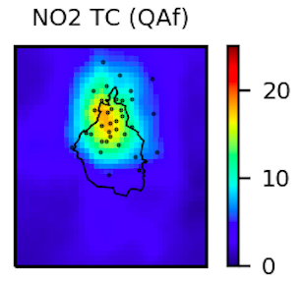
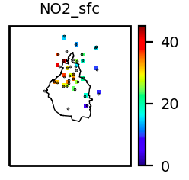
Inference of surface NO2 concentrations
Features
Target :
Machine learning
Predictions with surface concentrations

