Slide 1
Chapel Hill, 25 October 2017
CALIOPE-urban:​ coupling​​ R-LINE​ with​ ​ CMAQ​ for​​ urban​ ​air​ quality​​ forecasts​​ over
Barcelona
Jaime Benavides¹, Michelle Snyder², Marc Guevara¹, Carlos Pérez García-Pando¹, Albert Soret¹, Oriol Jorba¹, Fulvio Amato³ and Xavier Querol³
1.Earth Sciences Department, Barcelona Supercomputing Center, BSC-CNS, Barcelona, Spain
2.Institute for the Environment, The University of North Carolina, Chapel Hill, NC, USA
3.Institute of Environmental Assessment and Water Research, IDAEA-CSIC, Barcelona, Spain
Jaime developed part of this work as research visitor at the Institute for the Environment at UNC in collaboration with Michelle Snyder.
Notes:
‹#›
‹#›

Slide 2
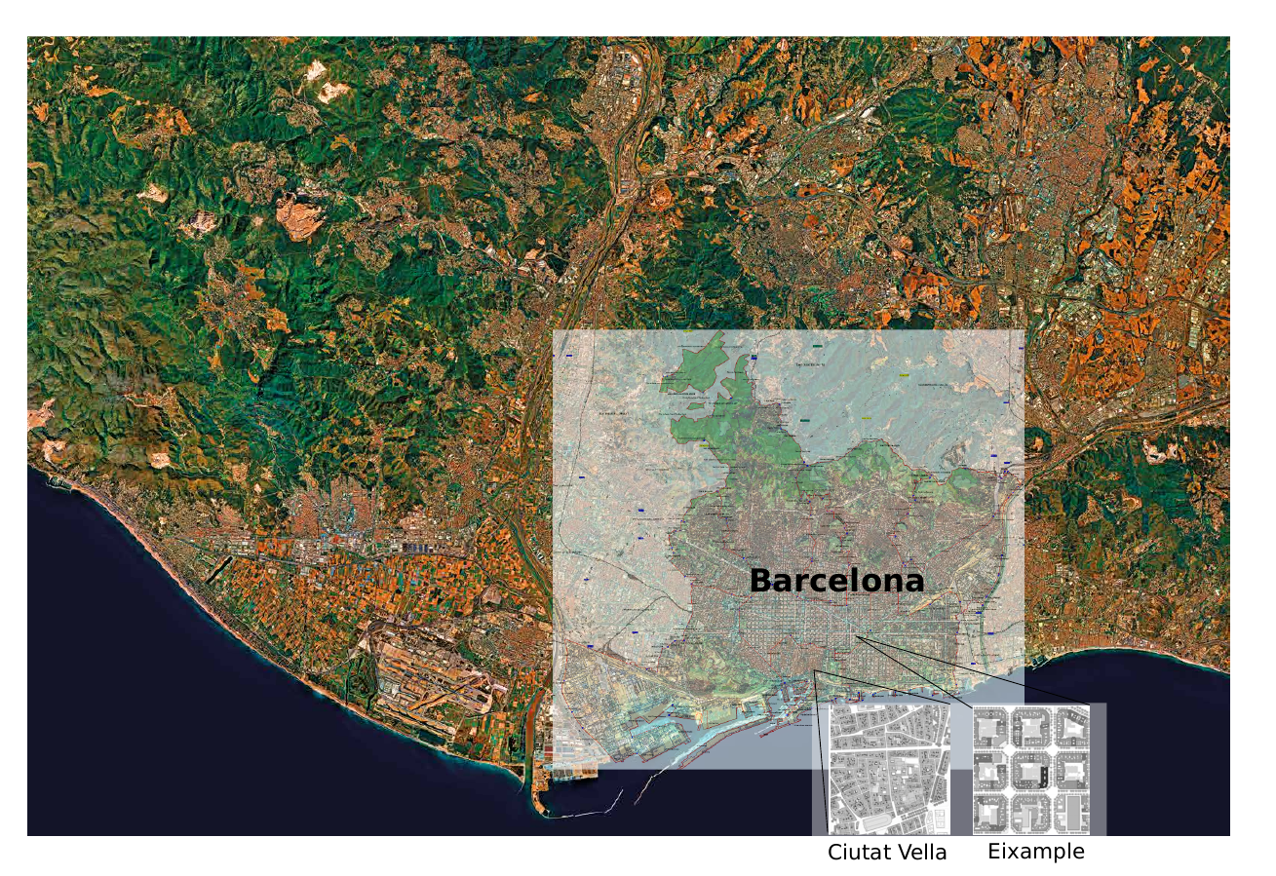
Introduction
Area of study: Barcelona
1.6 million inhabitants
5500 passenger cars/km²
64% of passenger cars are diesel
Traffic sites annual
mean NO₂ 50 μg/m³

Slide 3
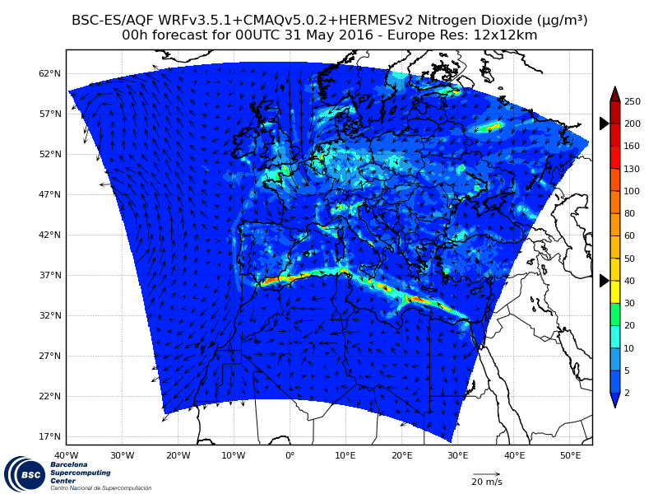
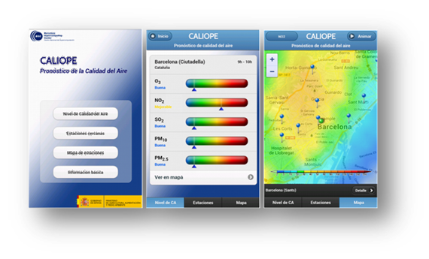
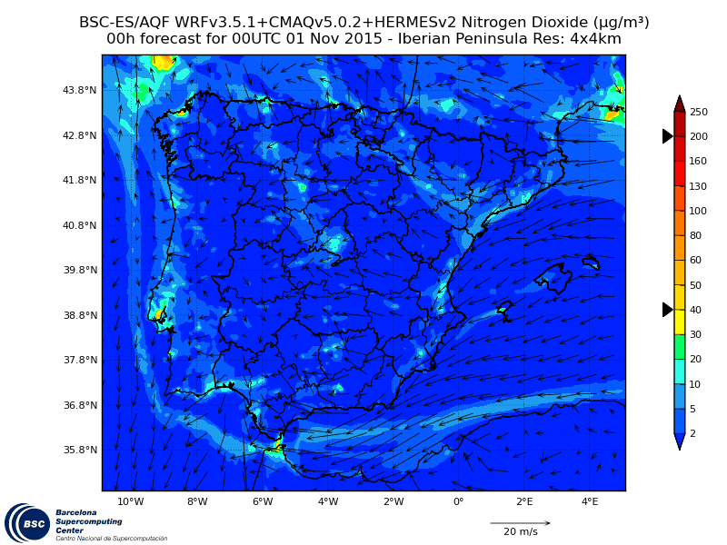
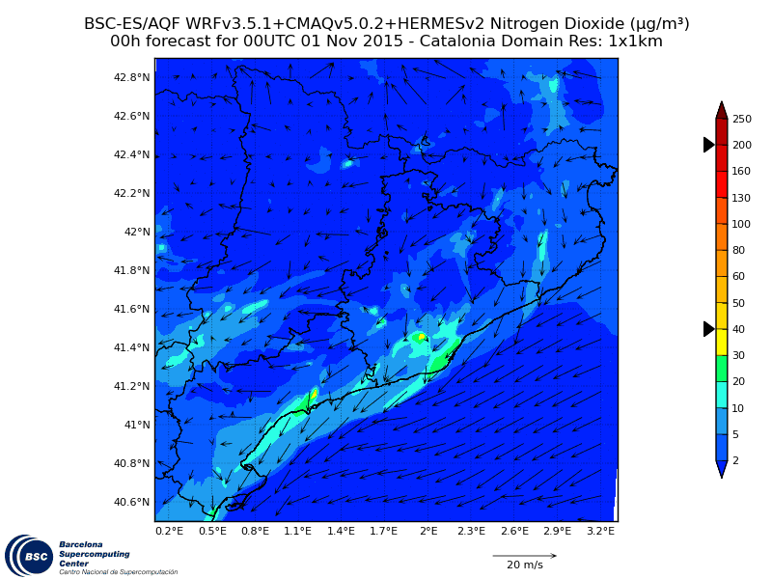
CALIOPE: Air Quality Forecasting System
Provides air quality related information for the coming days and for the application of short term action plans for air quality managers.
Information is delivered using both online or custom applications:
www.bsc.es/caliope

Slide 4
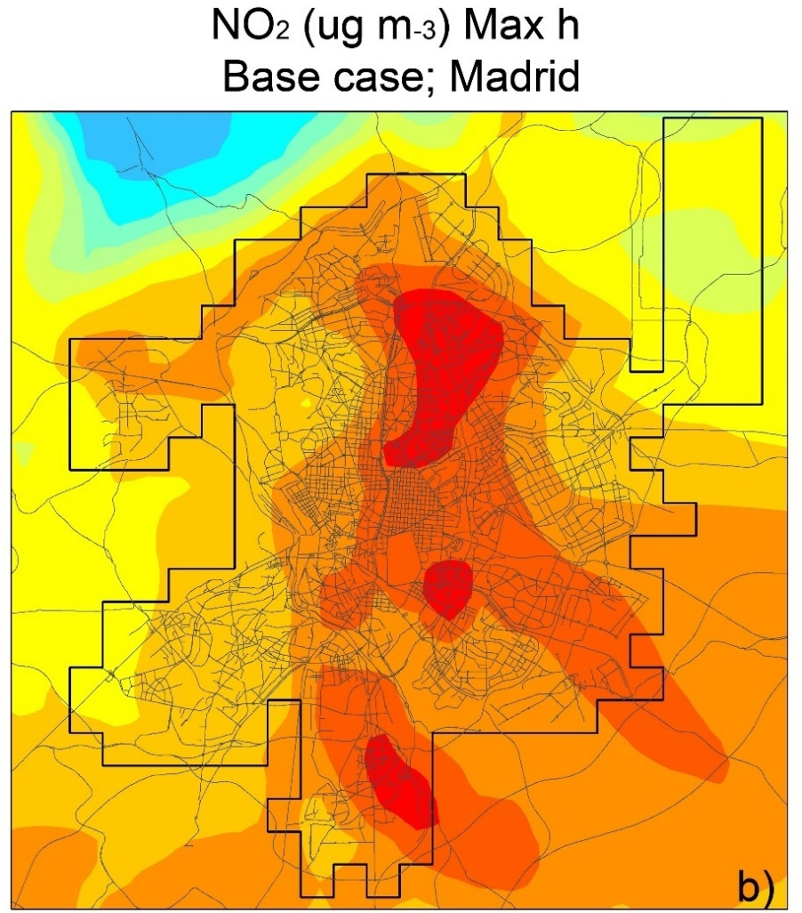
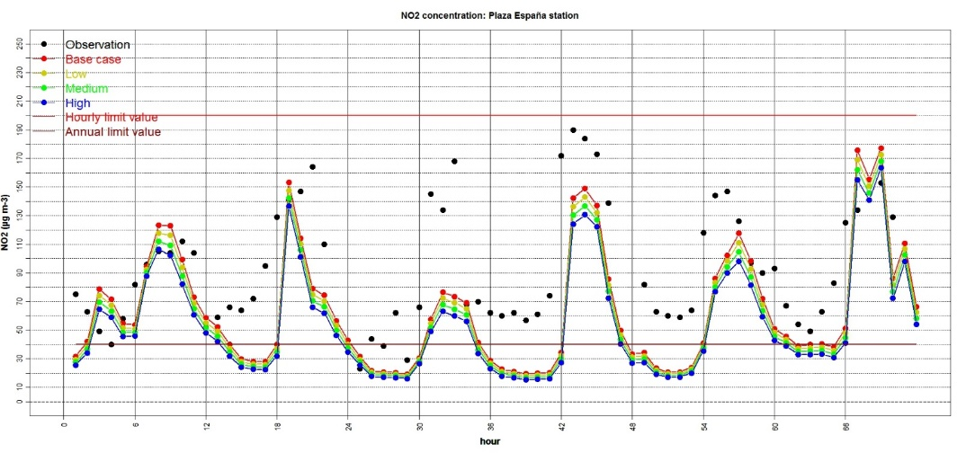
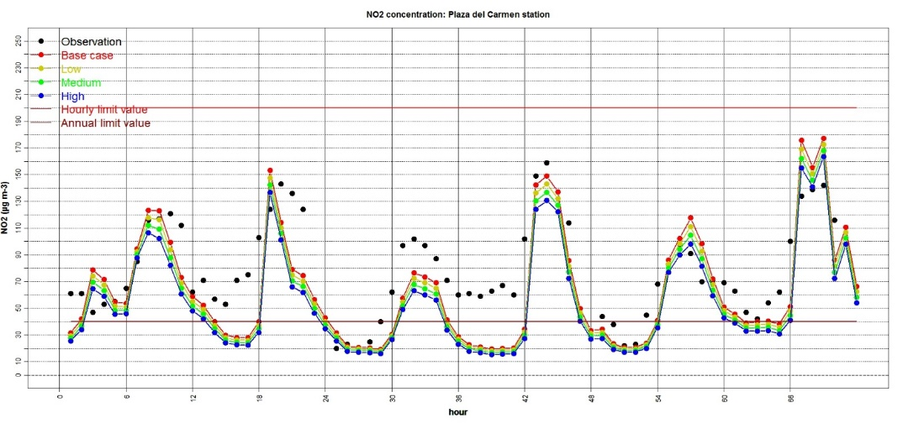
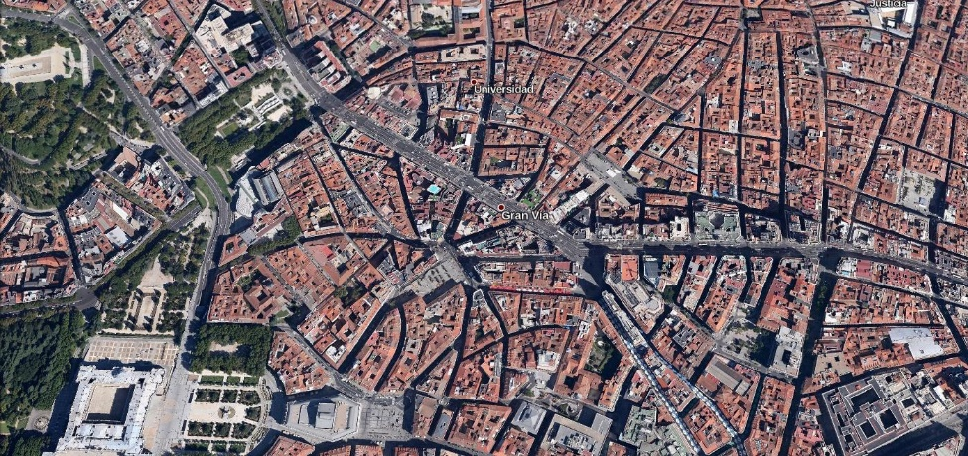
Introduction
Problem definition
NO₂ hourly concentration. Plaza de España station (traffic)
NO₂ hourly concentration. Plaza del Carmen station (background)
Soret et al. (2014)
Notes:
‹#›
‹#›

Slide 5
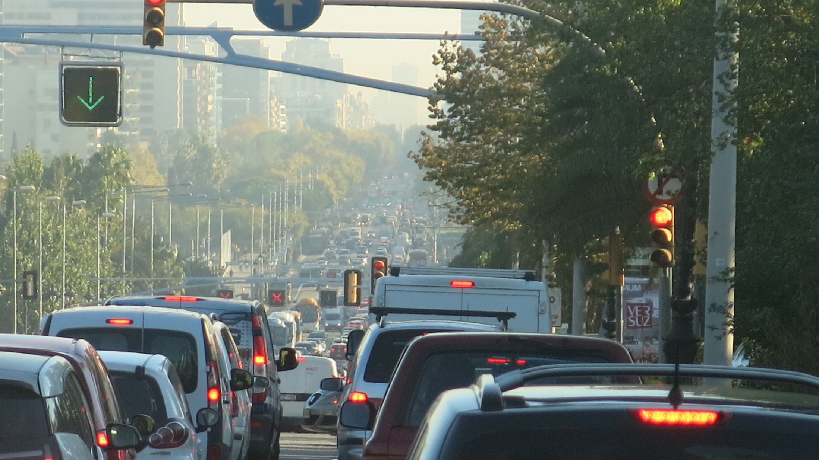
Methodologies
Source: Carlos Orti (2015)

Slide 6
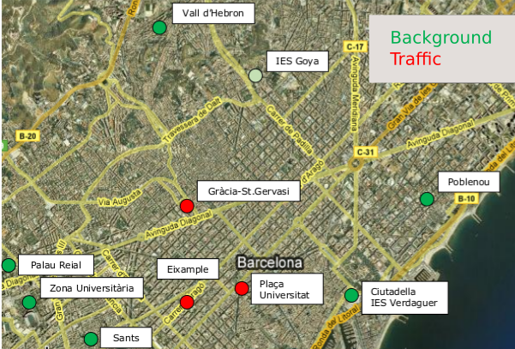
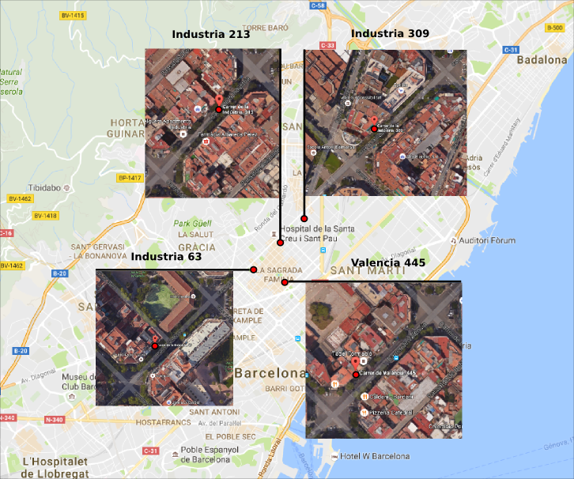
Methodologies
Observational data for calibration and evaluation
Meteorological and air quality measures. Amato et al. (2014)
April 2013 presents a 7-day air pollution episode
Notes:
‹#›
‹#›
‹#›

Slide 7
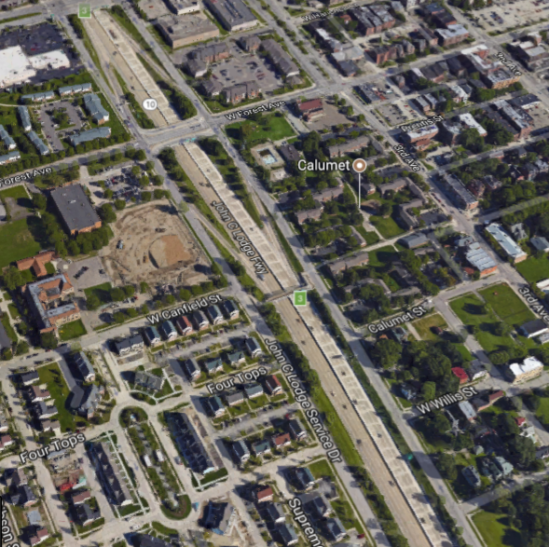
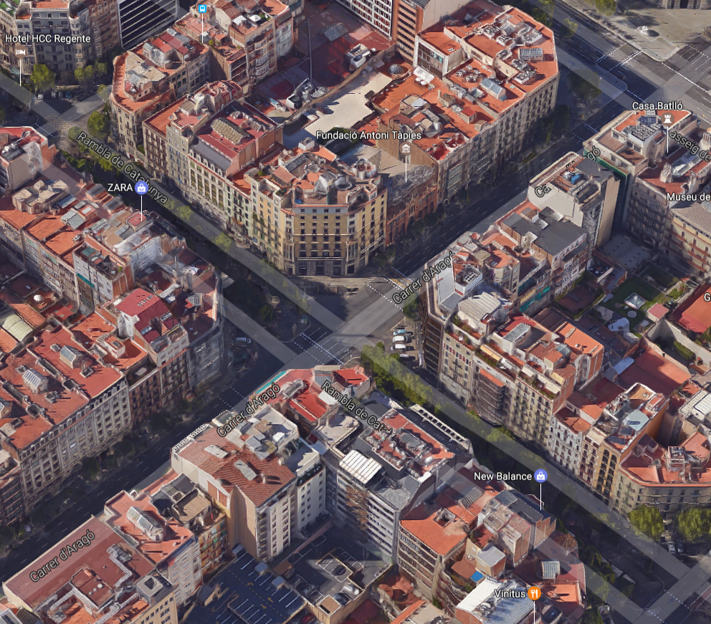
Methodologies
Meteorology: ​Adaptation of​ ​R-LINE​ ​to​ ​Barcelona​
R-LINE world view
open terrain, one meteorological input
Barcelona reality
complex terrain, each street specific meteorological patterns

Slide 8
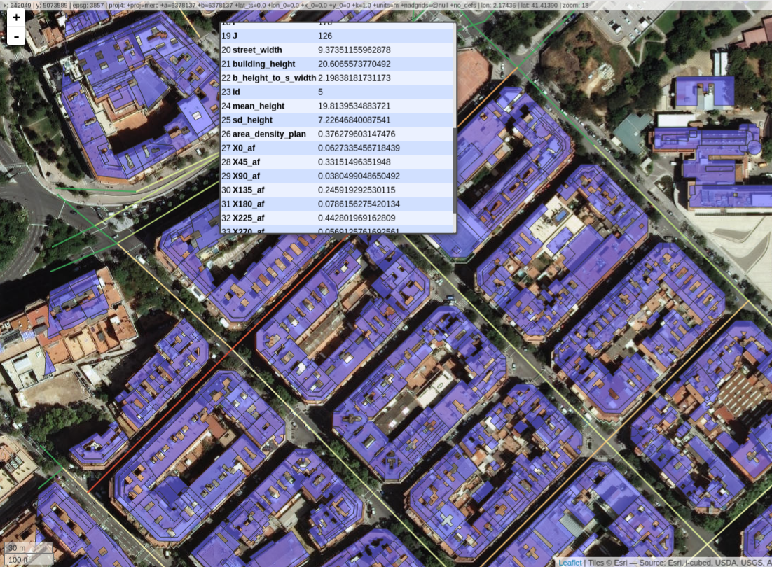
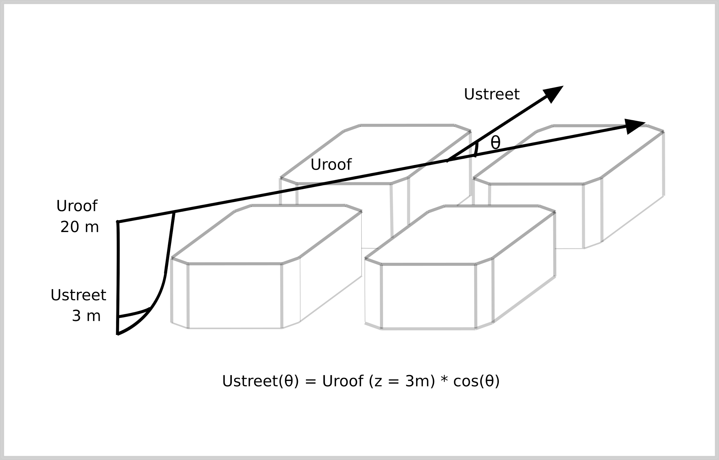
Methodologies
Adapting ​R-LINE​ meteorology ​to​ ​Barcelona​
z0 and dh
using geometry
2. Ustar and Monin-Obukhov length
3. Adjust
meteorology
Spatially averaged velocity over street is function of cos(θ). Soulhac et al. (2008)

Slide 9
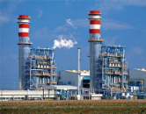
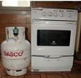
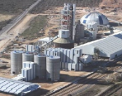
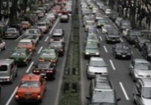
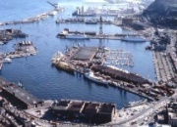
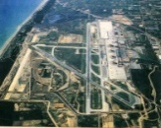
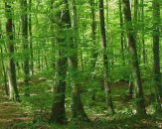
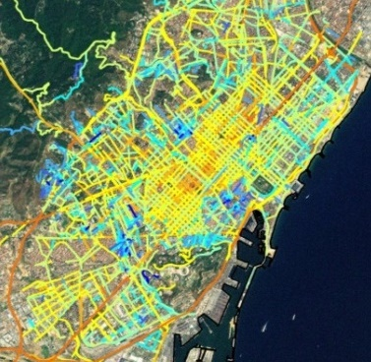
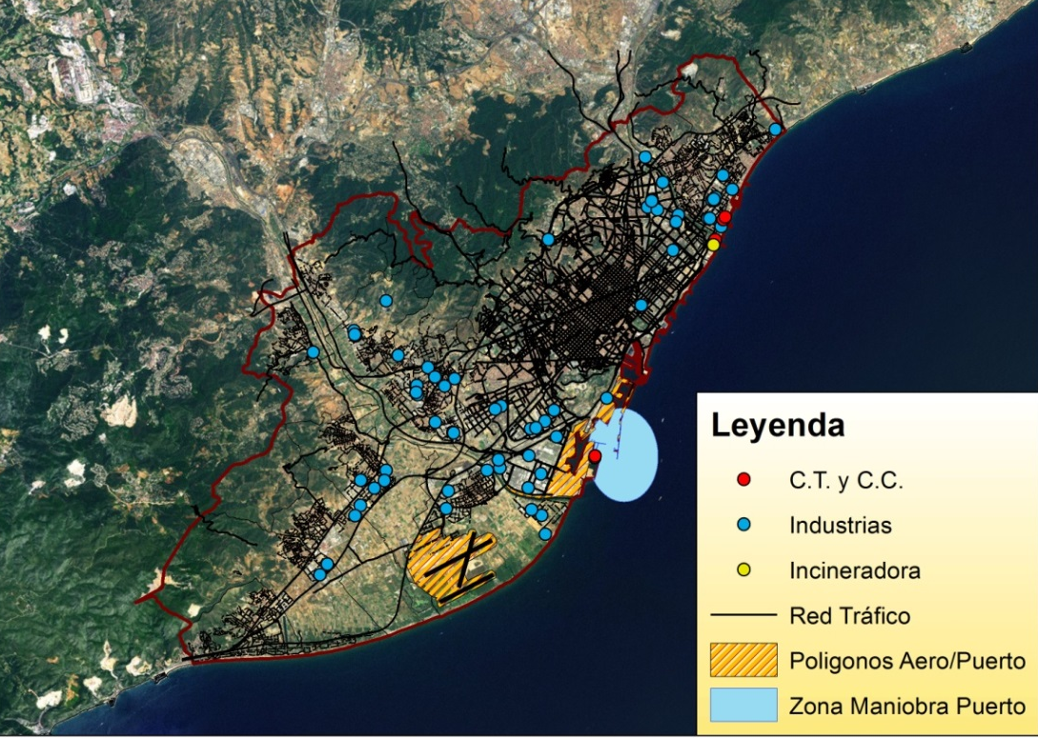
Methodologies
Emissions: HERMES model
Bottom-up emission model for Spain (resolution: 1x1 km² x1h)
Baldasano et al. (2008); Guevara et al. (2013)
Road transport, emission estimation:
COPERT IV → Exhaust emissions (hot&cold), evaporative emissions, tyre/break/road wear
Resuspension (Pay et al., 2010)
Updated for years 2011, 2012, 2013 and 2014
Energy plants (C.C. Besós and
Port de Barcelona)
Incineration RSU (Besós)
Industries
Port
Airport
Road transport

Slide 10
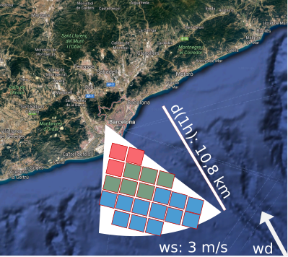
Methodologies
Upwind urban background scheme
Select concentrations from CMAQ depending on the wind speed and direction provided by WRF. Based on Berkowicz (2000)
High spatial (1x1 km²) and
temporal resolution (1h)
over Barcelona
Results on poster “Influence of NO₂ - O₃ urban background on nitrogen dioxide concentration near roadway sources in Barcelona city (Spain)”

Slide 11
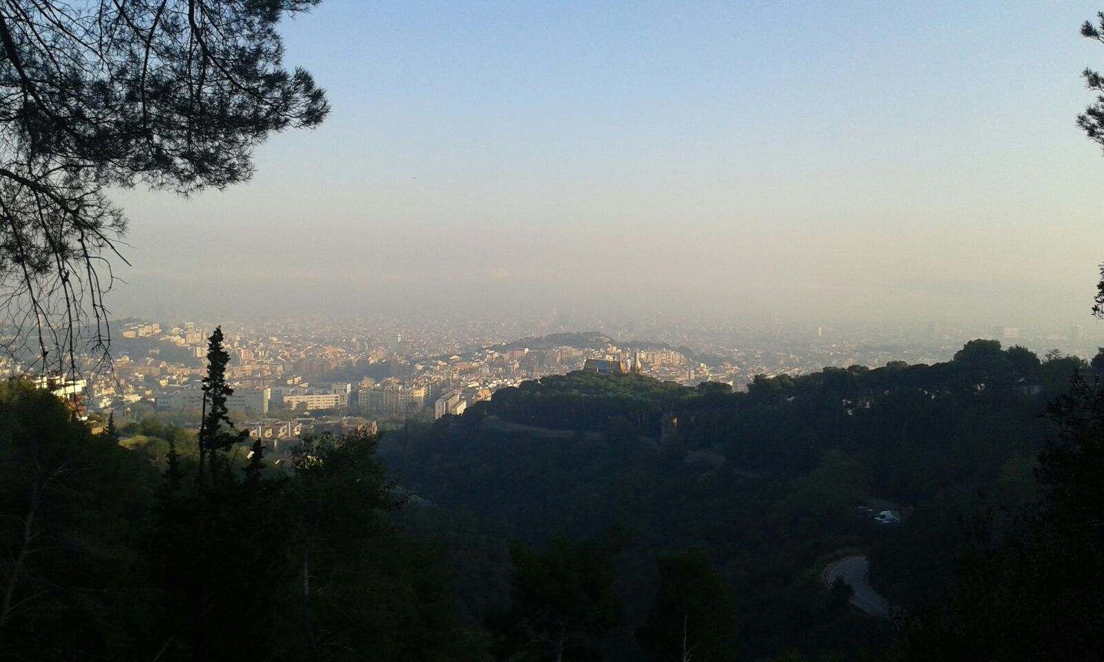
Results
Source: Carlos Orti (2015)

Slide 12
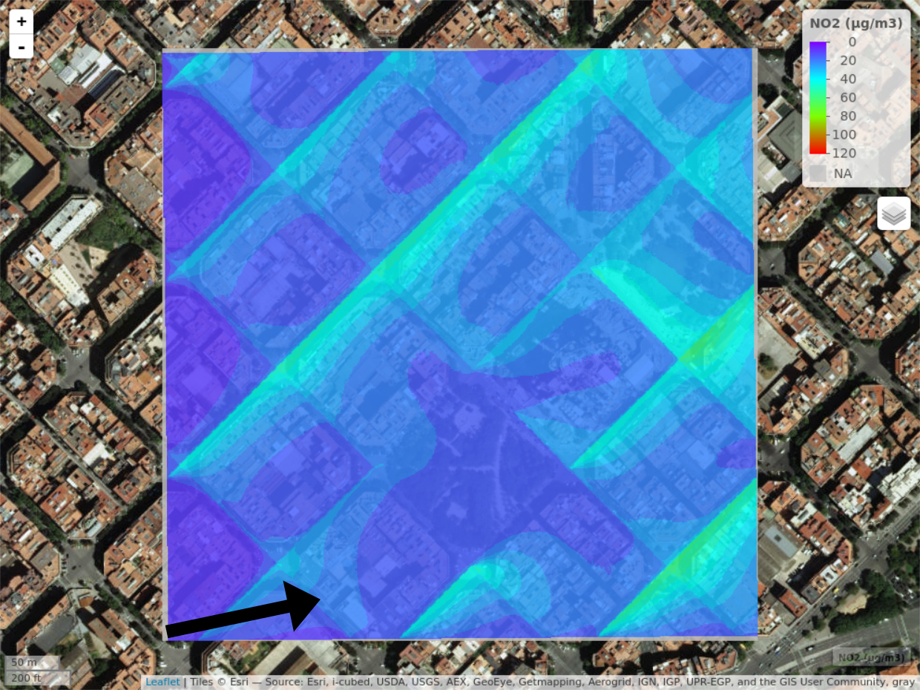
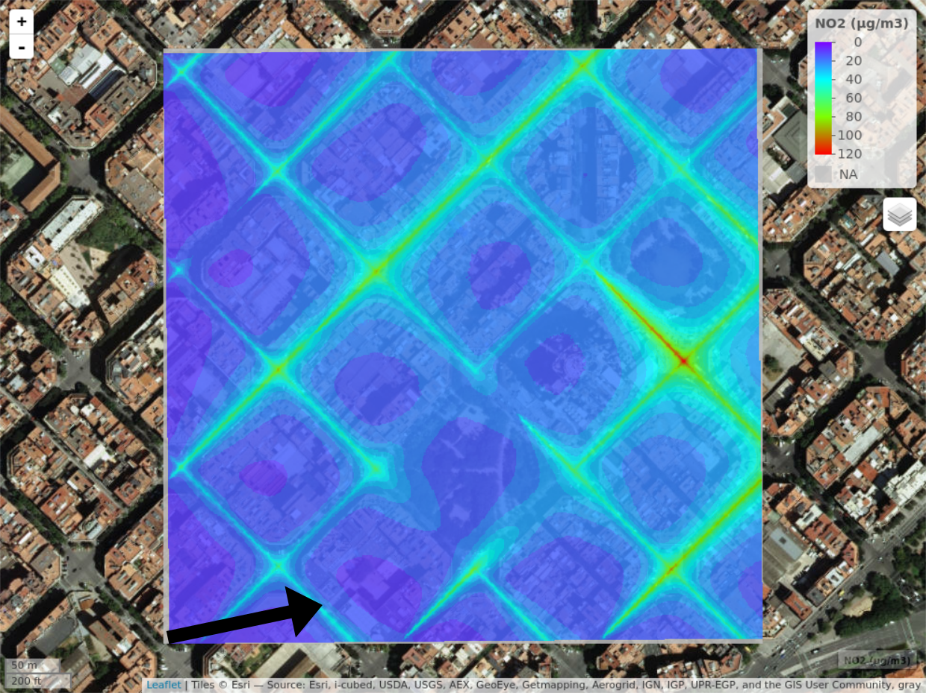
Results
Meteorology
Open terrain
R-LINE (Snyder et al. 2013)
Channelled winds
R-LINE Local
WRF wd
Additional results presented by Michelle Snyder poster on “Adaptation of meteorology and R-LINE to street canyon micro-climates: Application in Barcelona city (Spain)”
Notes:
‹#›
‹#›
‹#›

Slide 13
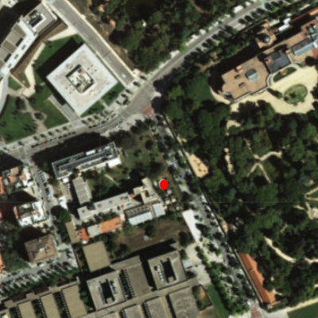
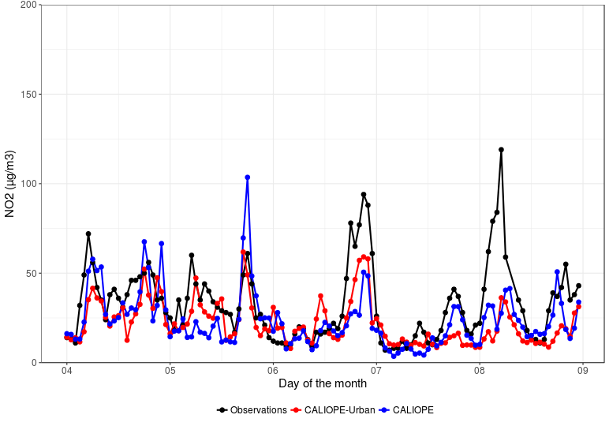
Results
Palau Reial: Urban background

Slide 14
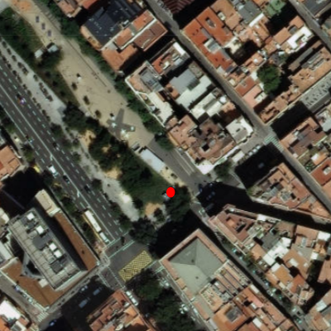
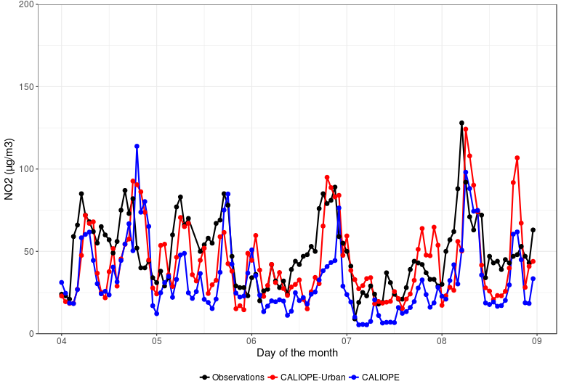
Results
Gracia: Traffic

Slide 15
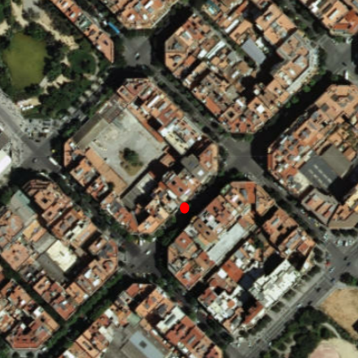
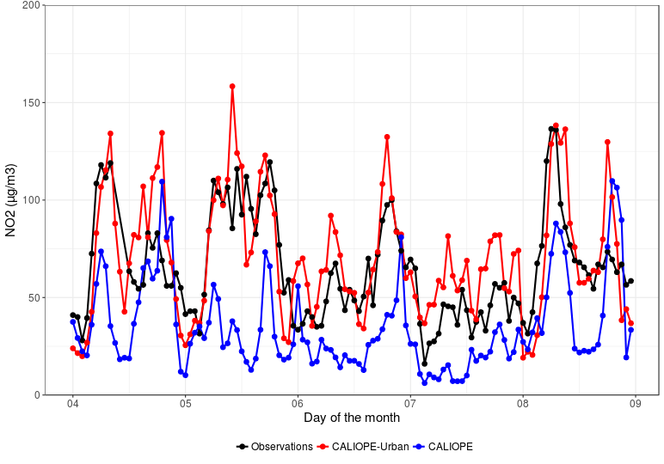
Results
Valencia Street: High traffic

Slide 16
Results
NO₂ summary statistics from 3 to 24 April 2013
FAC2 | MB | RMSE | r
CALIOPE | 0.70 | -4.08 | 27.86 | 0.55
CALIOPE-Urban | 0.66 | -8.26 | 27.72 | 0.47
CALIOPE | 0.58 | -13.97 | 34.33 | 0.50
CALIOPE-Urban | 0.73 | -3.36 | 33.85 | 0.42
CALIOPE | 0.55 | -20.99 | 37.81 | 0.53
CALIOPE-Urban | 0.91 | 5.02 | 28.93 | 0.57

Slide 17
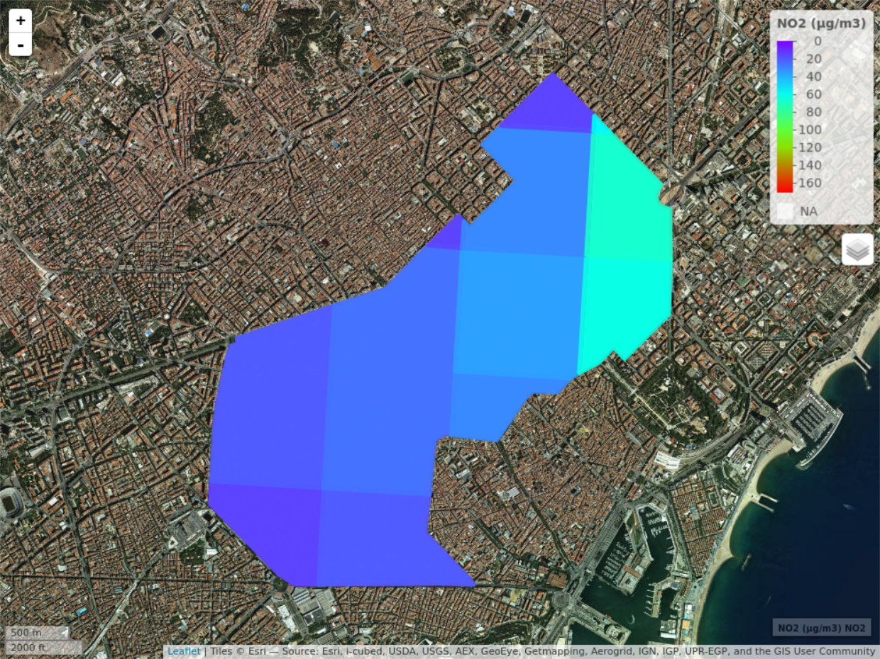
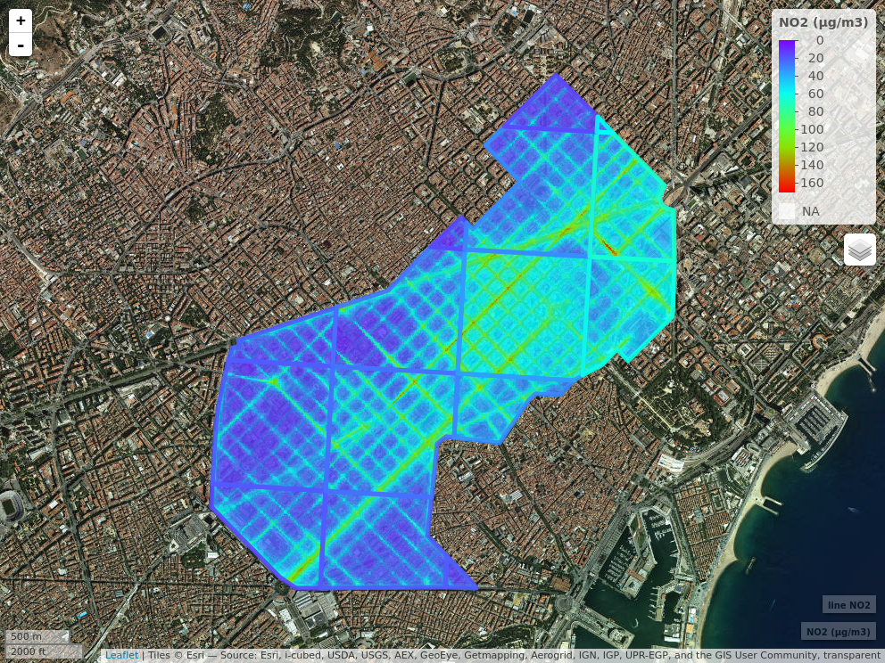
CALIOPE
CALIOPE-Urban

Slide 18
Conclusions and open questions
Urban NO₂: Street scale system results are similar to mesoscale system in background sites and better than mesoscale in traffic sites but street system correlation to observations is lower in sites where urban NO₂ is highly influenced by background NO₂. How to improve system performance under these conditions?
Meteorology: R-LINE meteorology channels dispersion within streets
providing more realistic spatial detail but wind speed is overestimated.
How to improve wind speed without reducing overall efficacy?
Background: Upwind urban scheme couples CMAQ with R-LINE, avoiding double-counting emissions and using directly CMAQ outputs as input without re-executing CMAQ but urban NO₂ estimated with R-LINE using observations as background gives better results. How to reduce differences between observed background and scheme results?
System evaluation: CALIOPE-Urban works well for April 2013 in traffic sites but it has not been evaluated during a longer period over the entire city. What is its performance for a year over the entire city?
Notes:
‹#›
‹#›
‹#›

Slide 19
Thank you Michelle for your collaboration
jaime.benavides@bsc.es
BSC researchers acknowledge the grants CGL2013-46736-R, CGL2016-75725-R and COMRDI15-1-0011-04 of the Spanish Government. J. Benavides PhD work is funded with the grant BES-2014-070637 from the FPI Programme and the mobility grant EEBB-I-17-12296 both by the Spanish Ministry of the Economy and Competitiveness. Jaime developed part of this work as research visitor at the Institute for the Environment at UNC. IDAEA-CSIC acknowledges the Barcelona City Council for the support to the experimental campaign.

